Slide 1

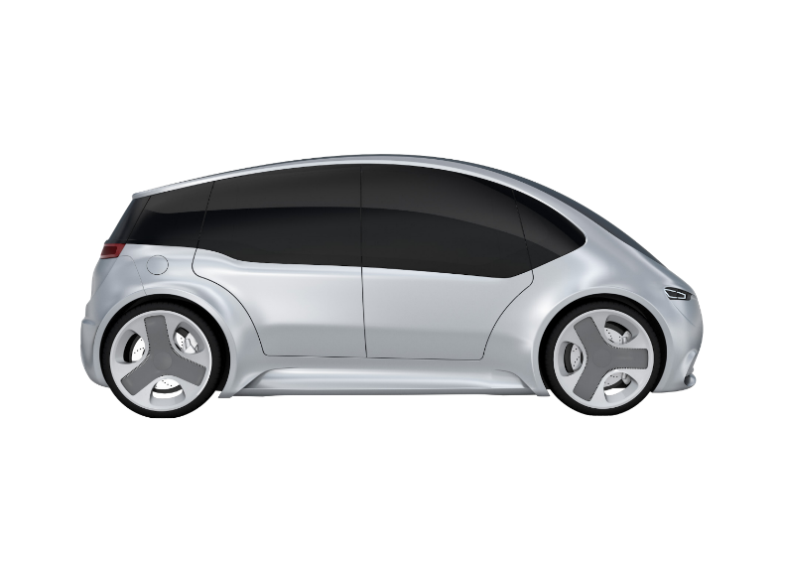
Future business opportunities Eco-System Architecture – Big Picture
Third party cloud
Vehicle
Connectivity
Tier 1 Cloud
Software & Services
Edge Compute
OEM cloud
Mobility Cloud
Domain Services
Platform services
Powertrain services
DA/AD services
Body services
Vehicle services
3rd party services
Data analytics and management
Powertrain
Chassis
DA&AD
Body
Interior & Infotainment
Steering
Electric Actuators
Connectivity- Software
Dev
services
Steering services
Interior services
Other services
Aftersales services
Digital twin Framework
Common runtime
Vehicle Runtime and API’s
API gateway
Market place
Vehicle Computer
Embedded
ECU’s
Self-service portal
Developer portal
Integration portal
Core services
Sensors and Actuators
.
.
.
.
.
.
Data business
Service Business Engine
There is a fundamental shift in the system context: from vehicle to eco-system - including SW function and data

Slide 2
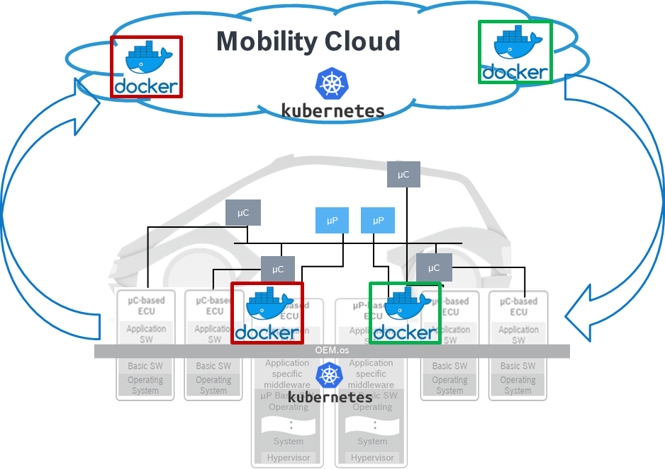
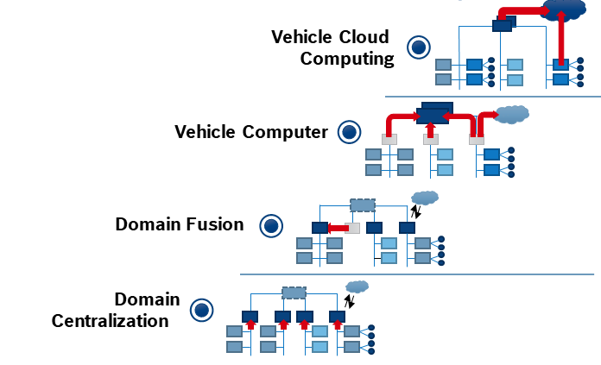


Future business opportunities SW@Bosch - SW Defined Car
From…
To…
“Vehicle E/E architecture with cloud extension”
“Integrated cloud and edge technologies”
E/E evolution
SW revolution
Technology path
Source: M/NE
Common continuous development and deployment framework for cloud and edge
Publish/subscribe mechanism within and from vehicle to cloud
Most technologies are open source and attractive for developers
Managing the complexity of distributed systems
Evolution in E/E architecture: From decentral embedded control units to centralized vehicle compute platforms
= “State of the art” container technology
= “State of the art” container orchestration
Next generation E/E architectures drive the availability of integrated cloud technologies in vehicles.

Slide 3
Continuous development and deployment framework
fast & automated
Plan
Design
Code
Integration
Validation
Release
Deploy
Operate
Monitor
Continuous Integration System
CI : Continuous Delivery
fast & automated
Plan
Design
Code
Integration
Validation
Release
Deploy
Operate
Monitor
Continuous Testing / Delivery System
CD : Continuous Delivery
fast & automated
Plan
Design
Code
Integration
Validation
Release
Deploy
Operate
Monitor
CD : Continuous Deployment

Slide 4

Validating “Fast & Automated” Status in projects/products
Accurate & Complete
75%
80%
Backlog
Design
Code
Test
80%
Processing Time/
Waiting time
30 days
1 day
10 days
2 days
1 day
2 days
60%
80%
100%
Integration
System Testing
Release
5 days
1 day
5 days
5 days
10 days
1 day
Observations:
Too many manual steps
Available tiny Automation solutions doesn’t cover Value Chain
Release cycles are not in sync
Continuous Testing is hurdle
Overall Analysis:
Accurate & Complete : 23%
Processing Time : 12 days
Lead Time : 73 days
+reword days : xxx

Slide 5




Autonomous 1.o - Canvas
 | 2019 |  | 2020 |  |  |  | 2021
 | Q3 | Q4 | Q1 | Q2 | Q3 | Q4 | Q1 | Q2 | Q3 | Q4
Collaboration with Other Initiatives
Light House Projects |  | 2 Product lines |  |  |  |  |  | 2 Product lines
Solution Landscape
Vision
Live Data Dashboard
TOP’99
#FFF project
RB-CoC - IA
TOP’98
Implement Solutions
Implement Solutions
Nomination & Screening
Maturity Evaluation
Measure
Maturity Evaluation
Measure
Automation & AI Solutions – Automating CI, CT, CD
Criteria’s
Collection & Evaluation of solutions
Solution Repository
Hosting it on TOP’98
Assessing the Gaps – Integrating, Harmonizing solutions
Alignment with GBs & Steering members
Tool
Strategic Vision
How?
Maturity Model
Pilot
As of Today
Working On
Achieved

Slide 6
Autonomous 1.o - Canvas
 | 2019 |  | 2020 |  |  |  | 2021
 | Q3 | Q4 | Q1 | Q2 | Q3 | Q4 | Q1 | Q2 | Q3 | Q4
Collaboration with Other Initiatives
Light House Projects |  | 2 Product lines |  |  |  |  |  | 2 Product lines
Solution Landscape
Vision
Live Data Dashboard
TOP’99
#FFF project
RB-CoC - IA
TOP’98
Implement Solutions
Implement Solutions
Nomination & Screening
Maturity Evaluation
Measure
Maturity Evaluation
Measure
Automation & AI Solutions – Automating CI, CT, CD
Criteria’s
Collection & Evaluation of solutions
Solution Repository
Hosting it on TOP’98
Assessing the Gaps – Integrating, Harmonizing solutions
Alignment with GBs & Steering members
Tool
Strategic Vision
How?
Maturity Model
Pilot
As of Today
Working On
Achieved

Slide 7
Strategic Vision’2025 : Autonomous 1.0
FOUNDATION
ROBOTIC
INTEGRATED ANALYTICS
Autonomous
High human interaction & Low Degree of AI
Low human interaction & High degree of AI
Pipeline
Build
Test
Report
Pipeline
Build
Unit Test
SW/SW Test
SW/HW Test
System Test
Report
Pipeline
Build
Unit Test
Smoke Test
Static Code Analysis
Architecture Check
Critical Resources Measurement
Subset Functional Tests
Open Source Code Scanning
SIL
vHIL
HIL
Test Bench
Certification Documents
Fast & Automated : Fast Feedback with frequent CI & Automated Testing

Slide 8
Automation Maturity Model
D
T
R
C
This is a maturity model to measure the current status of Automation in Continuous Deployment – including the levels of continuous Integration and Continuous Delivery
B
It consists of a questionnaire to check the level.
The questions are clustered in 5 categories which are
Build (B)
Testing (T)
Culture (C)
Deployment (D)
Release (R)
and separated in three levels of the continuous lifecycle
Continuous Integration
Continuous Delivery
Continuous Deployment
Continuous Integration
Continuous Delivery
Continuous Deployment
D
D
T
T
R
R
C
C
B
B
Notes:
Assessment in the three stages Continuous Integration, Continuous Delivery and Continuous Deployment • Each stage consists of categories like Build (B), Testing (T), Culture (C), Deployment (D) and Release (R) • In each category there are questions mapped to maturity levels 1 to 5. You only advance to the next level, if all questions from the previous level are checked • The total questionnaire consists of 144 questions • Levels: 1 - Initial 2 - Managed 3 - Defined 4 - Quantitatively managed 5 - Optimizing

Slide 9
Autonomous 1.o - Canvas
 | 2019 |  | 2020 |  |  |  | 2021
 | Q3 | Q4 | Q1 | Q2 | Q3 | Q4 | Q1 | Q2 | Q3 | Q4
Collaboration with Other Initiatives
Light House Projects |  | 2 Product lines |  |  |  |  |  | 2 Product lines
Solution Landscape
Vision
Live Data Dashboard
TOP’99
#FFF project
RB-CoC - IA
TOP’98
Implement Solutions
Implement Solutions
Nomination & Screening
Maturity Evaluation
Measure
Maturity Evaluation
Measure
Automation & AI Solutions – New Implementation, Proof of Scaling, Integrated Solutions
Criteria’s
Collection & Evaluation of solutions
Solution Repository
Hosting it on TOP’98
Assessing the Gaps – Integrating, Harmonizing solutions
Alignment with GBs & Steering members
Tool
Strategic Vision
How?
Maturity Model
Pilot
As of Today
Working On
Achieved

Slide 10



Pockets of Opportunities
System Requirement Development
System-Release Test
40+
300+
System
System Architecture and Design
System -Integration & -Test
Continuous X
HW/SW Integration and Test
35+
Model Based Development
12+
Software Architecture
SW-Integration
and -Test
Component
Requirements
and Design
Subsystem and
Components
85+
65+
New Solutions
Integrated Solutions
Proof of Scaling
Outside-In perspective (Make Vs Buy)
Software
Implementation
SW Unit & Component Test
220+
50+
Solutions

Slide 11
Automation & AI Solutions
AI augmented Defect Prediction
Defect Management
Defect Localization
Defect Prediction
Defect Prioritization
Defect Similarity
Defect Severity
SW Requirements
Bug/Log Reports
Source Code
Defect Descriptions
Configuration Files
Test Cases
ML Based Representation
Static & Semantic Feature Extraction
Code Knowledge Graph
Knowledge Graph
Statistical Technique
Localized Defect in Source Code
Predicted Defective Source Code
CICD Test Metric Features
Software Code Change Commits
File Level Source Code Features
Method Level Source Code Features
Test Prioritization

Slide 12
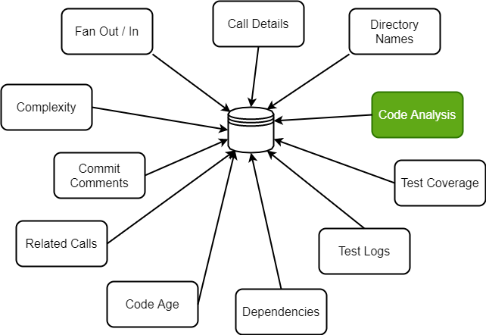
Automation & AI Solutions
Machine based Reviews & Analysis
Daily Changes
Identify Daily Source Changes in GIT using Clang parser
Deepcode.AI
Daily Changes
NLP Technique
Encoder and Decoder Model using LSTM will generate tags for APIs and Test Cases
NLP Technique
Artifacts
Artifacts
With the generated Tags python Scripts to identify Test cases with its Test case IDs as Artifacts
Jenkins Test Automation
Generated Artifacts will be tested in appropriate Jenkin Slave Machines
Jenkins Automation

Slide 13

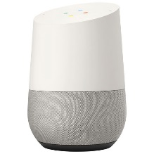



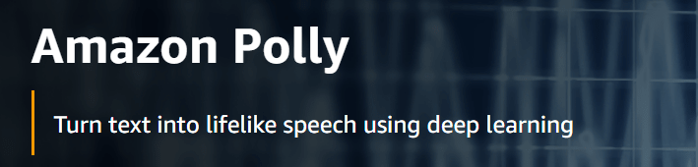
Automation & AI Solutions
Integration via Virtual Nodes
Hardware
Unit under Test
Touch Arm 2
Skill API's End Point
Transform Text to Speech
Touch Interface
Touch Arm 1
WIN
CCB2
Skill Directives
Virtual Device
(Alexa or Google Home)
GTS
Frame grabber / Camera
HMI Console
MQTT Read
Frame grabber / Camera
Mobile
Virtual Devices
Discover Response
Output Validation
Speech to Text
Selenium/Robot Interface
Actual Cloud / Debug server

Slide 14

Technical Approach – Software Defect Prediction
Automation & AI Solutions
Defect Prediction
Feature Selection based on Correlation analysis, Voting Selector & K-best Features
Scalar transformation & removing duplicate and inconsistent data samples
Addressing Class Imbalance using SMOTE, ADASYN & ROS , GAN
Tuning weight parameters for minority class
Other Classifiers: MLP, SGD, Auto-Encoders
Binary Class Prediction
Source Code
Source Metrics
Feature Extraction
AST Feature Extraction
Combined Code Features
Supervised learning algorithms
Statistical Techniques Logistic Regression
Ensemble Based Random Forest, Adaboost, XGBoost, ANN
Kernel Based SVM, SVM-Lite
Perceptron Based LSTM, CNN
Predicted Class (Majority Voting)

Slide 15
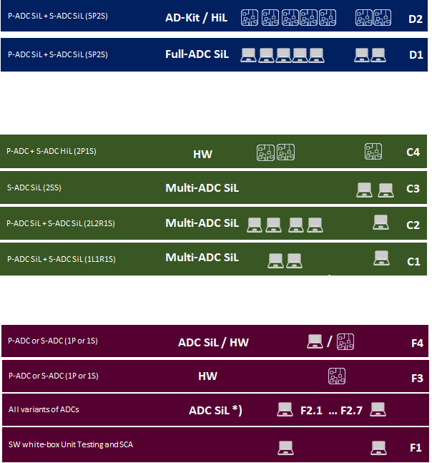


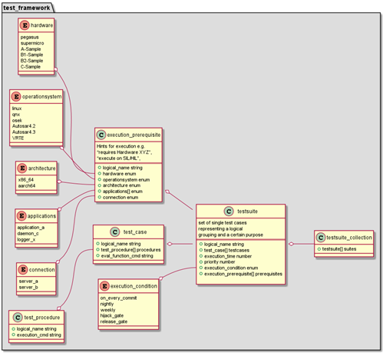
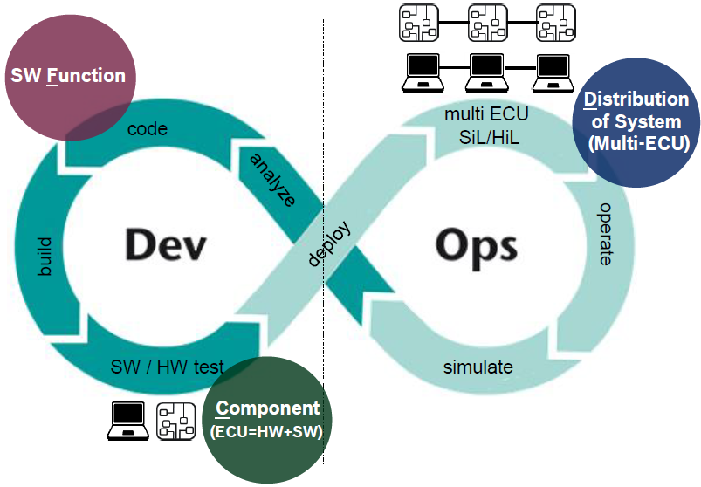
Staged Testing Concept
BSW Framework
Integrated into CI/CT process
Standardized way of describing Test Cases
One common BSW Test Framework for execution
collect all TestSuite Metadata Files and execute - on desired SW/HW environment - at the desired time schedule - with desired priority
CANoe Scripts
TestSuite Metadata
TestSuite Metadata
CANoe Scripts
TestSuite Metadata
BSW Chaos Monkey
ADC SiL
ADC SiL
Testcase Repository
TestSuite Metadata
BSW
Test Framework
TestRunner /
Test Scheduler
TestSuite Metadata
RobotFramework
TestSuite Metadata
XCP TestFramework
Cantata
GoogleTest

Slide 16






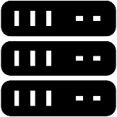




Development | Host environment
Reviews and checks | Version Control
Requirements Change Requests
Design Decisions
Data
Tool
Regulation
Process/Method
….
Maintainers
Update Dev Env
Code
Unit Test
Component Test
Code-self-check
Code review
Check-in / Pull-Request
Developers
Local build
System Testers
Pre-production
Test server
Build server
Qualification
System Test
Subsystem Test
Integration Test
Baseline
Exit Criteria | KPI
Build
Entry criteria
Merge
Pipeline dev. | Maintainers
SQA
SQA
Developers
SW Testers
SQA
Production
Release
End users
Dashboards
Client | Host Env.
Test environment
SQA
Developers
Server Env.
Manual process
KPI1
KPI2
…
Architects
Maintainers
Target HW
Automated process
Duration / Freq.
Cloud Computing
Field Data / Shadow Mode / A-B Testing, ….
Project Mgmt.
SW Testers
Management

Slide 17
Autonomous 1.o - Canvas
 | 2019 |  | 2020 |  |  |  | 2021
 | Q3 | Q4 | Q1 | Q2 | Q3 | Q4 | Q1 | Q2 | Q3 | Q4
Collaboration with Other Initiatives
Light House Projects |  | 2 Product lines |  |  |  |  |  | 2 Product lines
Solution Landscape
Vision
Live Data Dashboard
TOP’99
#FFF project
RB-CoC - IA
TOP’98
Implement Solutions
Implement Solutions
Nomination & Screening
Maturity Evaluation
Measure
Maturity Evaluation
Measure
Automation & AI Solutions – New Implementation, Proof of Scaling, Integrated Solutions
Criteria’s
Collection & Evaluation of solutions
Solution Repository
Hosting it on TOP’98
Assessing the Gaps – Integrating, Harmonizing solutions
Alignment with GBs & Steering members
Tool
Strategic Vision
How?
Maturity Model
Pilot
As of Today
Working On
Achieved

Slide 18


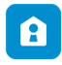

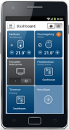

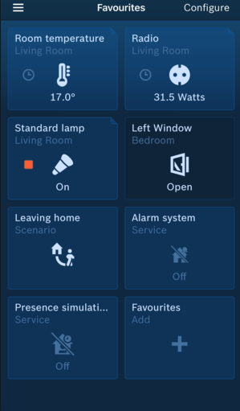













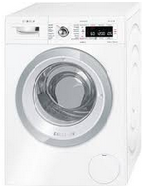






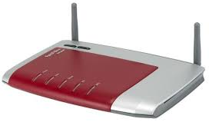










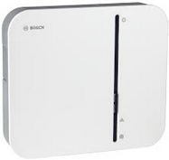


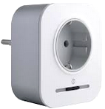



Light House projects
Automation In BSH’s CX Pipeline
Interfaces
USECASE 1
E2E integration w/o appliance
Bosch CIAM
Service
Internet
Backend
USECASE 1
Approximate efficiency resulting in Fast product release:
Using MQTT Simulation & Device Simulators : 35%
Huge Demand of BSH products – Enabled Fast Go-To Market
Cloud Services
HOME API Gateway
Bosch Cloud-based Services
HOME Eco System
Smart Home
Camera Solutions
USECASE 2
Voice Integration Validation
Wi-Fi Router
1st analysis for Lead time reduction -
73 days to 30 days
Support
HOME SSD
HOME Log file Server
Smart Home Controller
Push Notifications
System Devices
USECASE 2
Additional Coverage:
Automation of Voice enabled devices – Google Home, Alexa
HOME Push Proxy

Slide 19









Light House projects
Automation In BBM CX Pipeline
LOCAL MACHINE
Develop
Compiler
warnings
Dataflow &
Coding Rules
Unit
Tests
USECASE 1
Quick “Online” Feedback for SW Developer on Local Computer
Check
out
build
SCA
SUT
Commit
INFRASTRUCTURE
Feature Branches
Pull
Request
Report
USECASE 2
Fast release cycles & Simulation
Continuously on commit
+
Integration
build
SCA
SUT, SIT
TC
SST
USECASE 3
Corner Test Cases
& Target Tests (HIL)
Develop Branch
Pull
Request
+
Pull
Request
Static Code Analysis
S/W Unit Tests, S/W Integration Tests
Test Coverage Evaluation
S/W Simulation Smoke Test
Complete S/W Test
On-target Tests, HIL Tests
Cyclically (e.g. nightly)
RELEASE
build
SCA
SUT,
SIT
TC
CST
HIL
Master/Delivery Branch
USECASE 1
Approximate effort Saving:
Developer’s effort saving 10000 * 40% = 4000 hrs
Extrapolation to entire year = 24 PYO’s
Benefits would be realized year on year continuously
USECASE 3
Approximate Cost Saving:
a) Creating test designs out of textual requirements : 1.4 million Euro

Slide 20
E2E Connectivity - BSH
Accurate & Complete
Backlog
Design
Code
Test
Integration
System Testing
Release

Slide 21
Collaboration
Co-Creation
Competency
Helped engineer domain agnostic cutting edge solutions
Enabled Proof of Scaling
Voluntary contribution helped in X-skilling & controlled spends
Talent development in Intelligent Automation
Education programs in association with HR team.
Motivated driven by hands-on contribution.
Multi-function team (Dev, Test, Integration, Quality)
Cutting across Divisions (CC, PS, TT, BSH, AE)
Partnering to champion SW Practices across

Slide 22
Challenges
People Management
Leading a group of dotted line reports
Alignment of Priorities & Timelines
Constantly driving Interest & Motivation
Divisional Alignment
Scattered Vs. Centralised
Socialising the ‘Standardisation’
Delivery commitment & Management
Budget Control & Funding Sources
Change Management
Handling ways of working
Deploying the change

Slide 23
Benefits to Org
Amalgamation of Best Practices across Divisions
Quality improvement due to fast & automated feedback loops
Reduced Process cycle
Improved Go-to market time
Consolidation of Resources
Central Pool for cross-Divisional usage
Reduction in Costs
Maintenance Cost of ‘current’ redundant Apps
Development Cost of ‘impending’ avoidable Apps

Slide 24


Envisioning future…….
Indicates low maturity
Indicates high CX maturity
Integrated product 1
Integrated product 2
Integrated product 3
Team1
Team1
Team1
Team1
Team4
Projects split in E2E feature teams - Reduction of handovers of workpackages
Clear definition of done on the whole V
Competence for the left and right part of the V
Loosely coupled architecture
Handover
Handover
Handover
Team2
Team2
Team2
Team2
Team3
Team3
Team3
Team3
Handover
Step 1
Step 2
Step 3
Tayloristic approach
Split responsibilities for one feature at different teams.
Full stack SW Team
End to End responsibility (complete V in one team) for one feature by one team.
Notes:
Each handover from one team to another however is error prone. For example, specifications might be incomplete or an important aspect might have been neglected in the design. Unambiguous communication between two teams (sometimes across countries/time zones) is very challenging.
a SW architect derives SW-requirements and/or a SW-design/specifications. Based on those specifications, an implementation team writes the actual code and then passes the work package on to the SW Test team, etc
The term "full stack SW developer" is used to describe an individual, "jack of all trades" IT professional, who is able to cover a wide spectrum of development activities

Slide 25




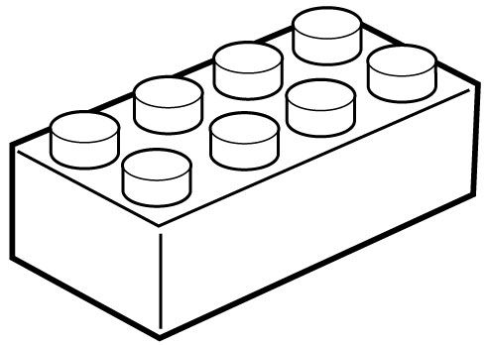

Envisioning Automation Suite……..
Workflow based solutions
User Menu
Components
Community based development
Promote Re-use
Integrated solutions
Connectors

Slide 26
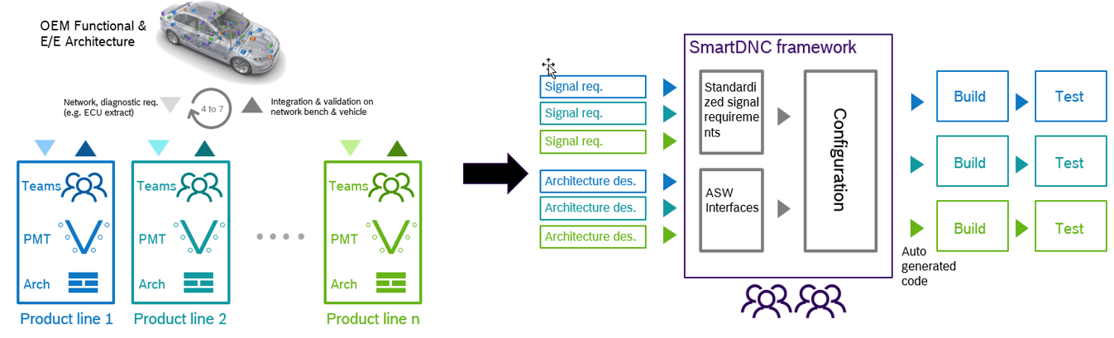

Slide 27

SmartDNC High Level View
Intelligent Automation Workshop
Requirement Phase
Development Phase
Testing Phase
Model Gen
Format Converter
Format Comparator
BU Specific Model Gen
DCM Stack Generator
DCM Specific Code Generator
Test Case Generator
Test Case Library
DOORS
Adapter
BU Specific Generator
Com Stack Generator
RTE Specific Model Gen
ECU Test
SIL / HIL Environment
Application Interface DB
Application Interface Mapping Generator
UI Editor /
Excel
Vector Tool Connector
Automap AI Logic
Hex Creation / FMU / Soft ECU connector
SW
Report Generator
Mapping Sheet Merger
Req Artefact
PMT Tool
Doors Tool
Change Management tool
Vector Tool
CI-CT Connector
SCM Tool
 | SmartDNC Components
 | Integration Components (Adaptors/Connectors)
 | Physical Tools/ PMT Tools

Slide 28
Success factors in NRCS2: Empowered Full Stack Teams
Success Factors for Cx in CC-DA (2020) : general info & full stack teams info
Empowered Teams
Increasing
complexity
SW Team
Domain specific knowledge
(e.g. specific algorithm)
Typically in focus
Enabler for CI & CT
Coding Skills
SW-Design
mastered by
Enabler for Autonomy & Cooperation
Test*
Integration*
Autonomy
Reduction of handovers of work packages
Cooperation
(instead of coordination)
Architecture*
Req. Handling*
Security/Safety*
Full Stack SW Team
*sufficient level of expertise for autonomous, process compliant development
Notes:
Proposition 1: The working style of a Full Stack SW Team is considerably more efficient compared to a classic (tayloristic) collabo-ration model.*
(resulting from a reduction of handovers of work-packages across teams)
Proposition 2: The development efficiency is highly determined by team composition & competence. (because of scaling effects and highly non-linear relation between effort and value contribution)
Team : bessere Performance, ca. 3 times better w.r.t. LOC & Pull Request; Größenordnung besser bzgl. Qualität
Along V-Model*: Req. Engineering, architecture and design, implementation, SW- & Sys-integration tests, support for system tests and validation
Significant counseling and hands-on support for other teams with less SW development experience
Delivery of content/functionality for all customers
Delivery of content/functionality for all variants (= “Produktlinien”), i.e. different products with differing sensor sets
This setup ensures that cross-customer and cross-variant synergies are identified and exploited.
Team “take” components based on priority.

Slide 29
Split responsibility vs. End to End responsibility for the V
Indicates low CX maturity
Indicates high CX maturity
Projects split in E2E feature teams indicate high maturity
Teams work with a clear definition of done on the whole V
Competence for the left and right part of the V in the team becomes important
Loosely coupled architecture is an important enabler for CX
The organization has to facilitate a loosely coupled architecture and the work of the E2E teams
Integrated product 1
Integrated product 2
Integrated product 3
Team1
Team1
Team1
Team1
Team4
Handover
Handover
Handover
Team2
Team2
Team2
Team2
Team3
Team3
Team3
Team3
Handover
Step 1
Step 2
Step 3
e.g. Practiced by HSW, ASF, ETAS (Ascet), NRCS2, Perfectly Keyless
Split responsibilities for one feature at different teams at different locations.
End to End responsibility (complete V in one team) for one feature by one team. One is finished before the next V is addressed.

Slide 30
