Slide 1
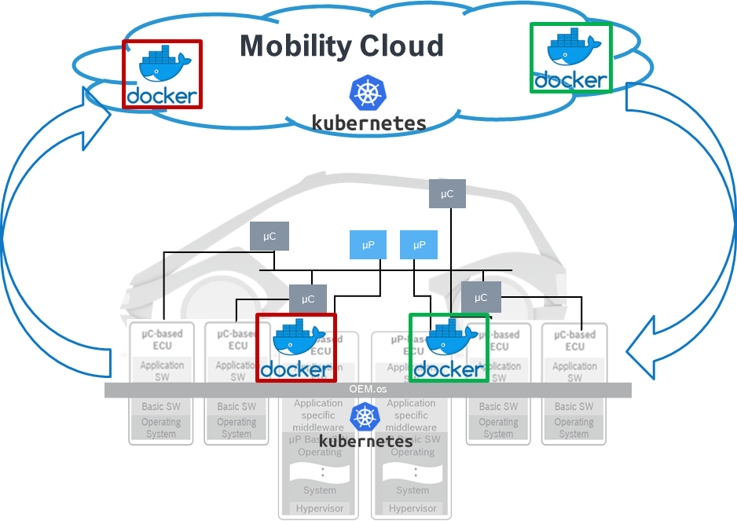
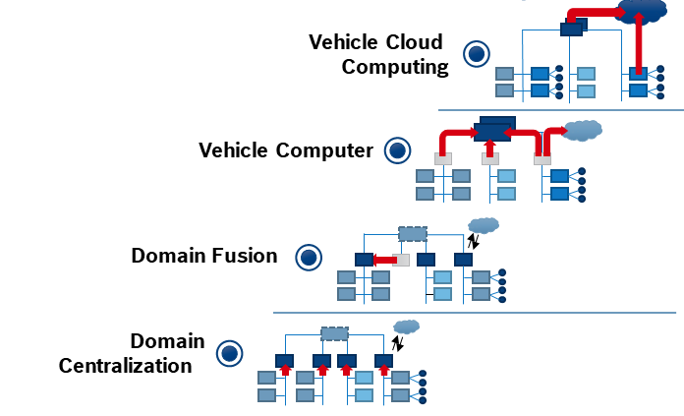


Future business opportunities SW@Bosch - SW Defined Car
From…
To…
“Vehicle E/E architecture with cloud extension”
“Integrated cloud and edge technologies”
E/E evolution
SW revolution
Technology path
Source: M/NE
Evolution in E/E architecture: From decentral embedded control units to centralized vehicle compute platforms
Common continuous development and deployment framework for cloud and edge
Managing the complexity of distributed systems
= “State of the art” container technology
= “State of the art” container orchestration
Next generation E/E architectures drive the availability of integrated cloud technologies in vehicles.

Slide 2


Slide 3

Autonomous 1.0 : SW Defined Car
Functional Complexity is constantly increasing
Market growth is towards SW intensive systems
SaaP and data based services capturing significant turnover
Virtual Platform
Backend Infrastructure
Physical World
code
plan
release
deploy
Development cycle times further reduced
Frequent SW Updates required
build
test
monitor
operate
Digital Twins
Model
Data Lake
Apps, Services
Focus on
CICTCD Integration & Automation

Slide 4
Autonomous 1.0 : SW Defined Car
Functional Complexity is constantly increasing
SaaP and data based services capturing significant turnover
Market growth is towards SW intensive systems
Virtual Platform
Backend Infrastructure
Physical World
code
plan
release
deploy
Development cycle times further reduced
Focus on
CICTCD Integration & Automation
Frequent SW Updates required
test
Digital Twins
Model
Data Lake
Apps, Services
build
monitor
operate

Slide 5

Autonomous 1.0 : Previous State
Fast & Automated
Plan
Design
Code
Integration
Validation
Release
Deploy
Operate
Monitor
Accurate & Complete
75%
80%
Backlog
Design
Code
Test
80%
Processing Time/
Waiting time
30 days
1 day
10 days
2 days
1 day
2 days
Observations:
High Lead Time ~70+ days.
Too many many manual steps
Release cycles are not in sync
Late Feedback - Error prone deliverables
60%
80%
100%
Integration
System Testing
Release
5 days
1 day
5 days
3 days
10 days
1 day
Notes:
Overall Analysis:
Accurate & Complete : 23%
Processing Time : 12 days
Lead Time : 73 days

Slide 6




Autonomous 1.0 : CANVAS
 | 2019 |  |  | 2020 |  |  |  | 2021
 | Q2 | Q3 | Q4 | Q1 | Q2 | Q3 | Q4 | Q1 | Q2 | Q3 | Q4
Collaboration with Other Initiatives
Light House Projects |  |  | 2 Product lines |  |  |  |  | 2 Product lines
Solution Landscape
Vision
Live Data Dashboard
TOP’99
#FFF project
RB-CoC - IA
TOP’98
Implement Solutions
Implement Solutions
Nomination & Screening
Maturity Evaluation
Measure
Maturity Evaluation
Measure
Automation & AI Solutions – Automating CI, CT, CD
Criteria’s
Collection & Evaluation of solutions
Solution Repository
Hosting it on TOP’98
Assessing the Gaps – Integrating, Harmonizing solutions
Alignment with GBs & Steering members
Tool
Strategic Vision
How?
Maturity Model
Pilot
As of Today
Working On
Achieved

Slide 7
Autonomous 1.0 : CANVAS
 | 2019 |  |  | 2020 |  |  |  | 2021
 | Q2 | Q3 | Q4 | Q1 | Q2 | Q3 | Q4 | Q1 | Q2 | Q3 | Q4
Collaboration with Other Initiatives
Light House Projects |  |  | 2 Product lines |  |  |  |  | 2 Product lines
Solution Landscape
Vision
Live Data Dashboard
TOP’99
#FFF project
RB-CoC - IA
TOP’98
Implement Solutions
Implement Solutions
Nomination & Screening
Maturity Evaluation
Measure
Maturity Evaluation
Measure
Automation & AI Solutions – Automating CI, CT, CD
Criteria’s
Collection & Evaluation of solutions
Solution Repository
Hosting it on TOP’98
Assessing the Gaps – Integrating, Harmonizing solutions
Alignment with GBs & Steering members
Tool
Strategic Vision
How?
Maturity Model
Pilot
As of Today
Working On
Achieved

Slide 8
Autonomous 1.0 : Strategic Vision’2025
FOUNDATION
ROBOTIC
INTEGRATED ANALYTICS
Autonomous
High human interaction & Low Degree of AI
Low human interaction & High degree of AI
D
D
Autonomous 1.0 : Maturity Model
Automation Maturity in Continuous lifecycle.
T
T
R
R
Questionnaire clustered in 5 categories :
Build (B)
Testing (T)
Culture (C)
Deployment (D)
Release (R)
Separated in three levels of the continuous lifecycle
Continuous Integration
Continuous Delivery
Continuous Deployment
C
C
B
B
Continuous Integration
Continuous Delivery
Continuous Deployment
Fast Feedback
Build
Unit Test
Smoke Test
Static Code Analysis
Architecture Check
Critical Resources Measurement
Subset Functional Tests
Open Source Code Scanning
SIL
vHIL
HIL
Test Bench
Certification Documents

Slide 9
Autonomous 1.0 : CANVAS
 | 2019 |  |  | 2020 |  |  |  | 2021
 | Q2 | Q3 | Q4 | Q1 | Q2 | Q3 | Q4 | Q1 | Q2 | Q3 | Q4
Collaboration with Other Initiatives
Light House Projects |  |  | 2 Product lines |  |  |  |  | 2 Product lines
Solution Landscape
Vision
Live Data Dashboard
TOP’99
#FFF project
RB-CoC - IA
TOP’98
Implement Solutions
Implement Solutions
Nomination & Screening
Maturity Evaluation
Measure
Maturity Evaluation
Measure
Automation & AI Solutions – Automating CI, CT, CD
Criteria’s
Collection & Evaluation of solutions
Solution Repository
Hosting it on TOP’98
Assessing the Gaps – Integrating, Harmonizing solutions
Alignment with GBs & Steering members
Tool
Strategic Vision
How?
Maturity Model
Pilot
As of Today
Working On
Achieved

Slide 10
Autonomous 1.0
AI augmented Defect Prediction
Defect Management
Defect Localization
Defect Prediction
Defect Prioritization
Defect Similarity
Defect Severity
SW Requirements
Bug/Log Reports
Source Code
Defect Descriptions
Configuration Files
Test Cases
ML Based Representation
Static & Semantic Feature Extraction
Code Knowledge Graph
Knowledge Graph
Statistical Technique
Localized Defect in Source Code
Predicted Defective Source Code
CICD Test Metric Features
Software Code Change Commits
File Level Source Code Features
Method Level Source Code Features
Test Prioritization

Slide 11
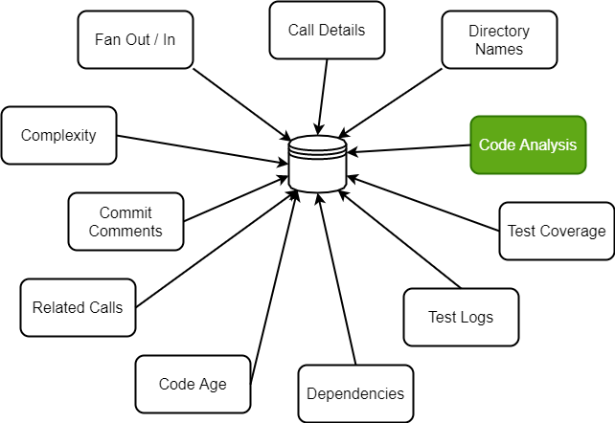
Autonomous 1.0
Machine based Reviews & Analysis
Daily Changes
Identify Daily Source Changes in GIT using Clang parser
Deepcode.AI
Daily Changes
NLP Technique
Encoder and Decoder Model using LSTM will generate tags for APIs and Test Cases
NLP Technique
Artifacts
Artifacts
With the generated Tags python Scripts to identify Test cases with its Test case IDs as Artifacts
Jenkins Test Automation
Generated Artifacts will be tested in appropriate Jenkin Slave Machines
Jenkins Automation

Slide 12





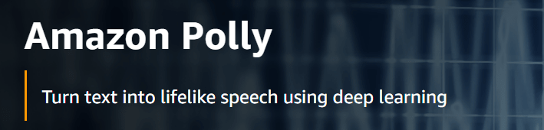
Autonomous 1.0
Integration via Virtual Nodes
Hardware
Unit under Test
Touch Arm 2
Skill API's End Point
Transform Text to Speech
Touch Interface
Touch Arm 1
WIN
CCB2
Skill Directives
Virtual Device
(Alexa or Google Home)
GTS
Frame grabber / Camera
HMI Console
MQTT Read
Frame grabber / Camera
Mobile
Virtual Devices
Discover Response
Output Validation
Speech to Text
Selenium/Robot Interface
Actual Cloud / Debug server

Slide 13
Autonomous 1.0 : Challenges
People Management
Leading a group of dotted line reports
Alignment of Priorities & Timelines
Constantly driving Interest & Motivation
Divisional Alignment
Scattered Vs. Centralised
Socialising the ‘Standardisation’
Delivery commitment & Management
Change Management
Handling ways of working
Deploying the change
Budget Control & Funding Sources

Slide 14
Autonomous 1.0 : CANVAS
 | 2019 |  |  | 2020 |  |  |  | 2021
 | Q2 | Q3 | Q4 | Q1 | Q2 | Q3 | Q4 | Q1 | Q2 | Q3 | Q4
Collaboration with Other Initiatives
Light House Projects |  |  | 2 Product lines |  |  |  |  | 2 Product lines
Solution Landscape
Vision
Live Data Dashboard
TOP’99
#FFF project
RB-CoC - IA
TOP’98
Implement Solutions
Implement Solutions
Nomination & Screening
Maturity Evaluation
Measure
Maturity Evaluation
Measure
Automation & AI Solutions – Automating CI, CT, CD
Criteria’s
Collection & Evaluation of solutions
Solution Repository
Hosting it on TOP’98
Assessing the Gaps – Integrating, Harmonizing solutions
Alignment with GBs & Steering members
Tool
Strategic Vision
How?
Maturity Model
Pilot
As of Today
Working On
Achieved

Slide 15


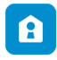

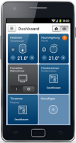

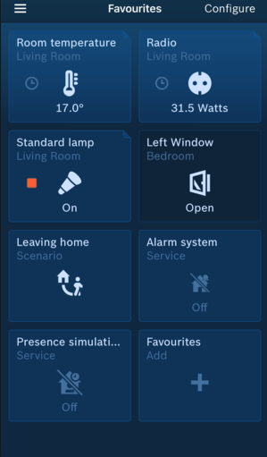













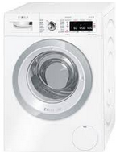






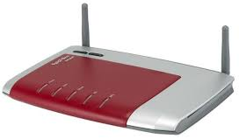










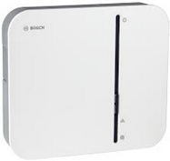






Autonomous 1.0 : Light House Project
USECASE 2
Delay in releasing Third party interfaces – Alexa, GH
USECASE 3
Support tickets increasing drastically.
USECASE 4
Delayed Feedback for SW Developer
USECASE 1
Long Release cycles
BSH’s CX Pipeline
Interfaces
Internet
Bosch CIAM
Service
Backend
USECASE 1
Lead time reduced to 28 days from 73 days in Phase 1
Efficiency enhancement using MQTT Simulation – 18%
Cloud Services
USECASE 2
Automation of Voice enabled devices implemented.
Reduced delay in feature release.
HOME API Gateway
Bosch Cloud-based Services
HOME Eco System
Smart Home
Camera Solutions
Wi-Fi Router
USECASE 3
Defect Prediction : Input data from Market Study, Crowd Data, Support Tickets.
Support
HOME SSD
HOME Log file Server
USECASE 4
Code Impact analysis & Code reviews.
Developer’s effort saving : 24 PYO (4000 hrs – extrapolating to year)
Smart Home Controller
Push Notifications
System Devices
HOME Push Proxy
Enabled Fast Go-To Market : Huge Market demand

Slide 16
Autonomous 1.0 : 3C Model
Collaboration
Co-Creation
Competency
Multi-function team (Dev, Test, Integration, Quality)
Cutting across Divisions (CC, PS, TT, BSH, AE)
Joint hands with similar initiatives with Win-Win approach
Helped engineer domain agnostic cutting edge solutions
Enabled Proof of Scaling
Voluntary contribution helped in X-skilling & controlled spends
Talent development in Intelligent Automation
Education programs in association with HR team.
Motivated driven by hands-on contribution.

Slide 17
Autonomous 1.0 : Realized Benefits
Optimized Process Cycle
Improved Quality
Reduction in Cost
Enhanced Competency
Imporved Go-To-Market
Sspeeding up the entire value chain
Reducing waste time.
Built-in quality using Automatic Solutions.
Fast feedback loop established.
Maintenance Cost of ‘current’ redundant Solutions
Development Cost of ‘impending’ avoidable Solutions
Bringing cutting-edge technology
Enabled platform to collaborate & co-create own problem statements
Amalgamation of best practices across divisions.

Slide 18

Autonomous 1.0 : Envisioning Full Stack Team Structure
Indicates low maturity
Indicates high maturity
Integrated product 1
Integrated product 2
Integrated product 3
Team1
Team1
Team1
Team1
Team4
Projects split in E2E feature teams - Reduction of handovers of workpackages
Clear definition of done on the whole V
Competence for the left and right part of the V
Handover
Handover
Handover
Team2
Team2
Team2
Team2
Team3
Team3
Team3
Team3
Handover
Tayloristic approach
Split responsibilities for one feature at different teams.
Full stack SW Team
End to End responsibility (complete V in one team) for one feature by one team.
Notes:
Each handover from one team to another however is error prone. For example, specifications might be incomplete or an important aspect might have been neglected in the design. Unambiguous communication between two teams (sometimes across countries/time zones) is very challenging.
a SW architect derives SW-requirements and/or a SW-design/specifications. Based on those specifications, an implementation team writes the actual code and then passes the work package on to the SW Test team, etc
The term "full stack SW developer" is used to describe an individual, "jack of all trades" IT professional, who is able to cover a wide spectrum of development activities

Slide 19




Autonomous 1.0 : Envisioning Automation App Store
App Store
A platform to consolidate all available and new Automation solutions.
Solutions can be used in silo mode or integrated using plug-ins.
Community Based Development
Promoting Re-usability & Social coding.
Co-engineering on unique solutions
Central Maintenance of tools
Necessary support to stakeholder to embrace the platform
Plug-in utilities
Silo Solutions

Slide 20



Pockets of Opportunities
System Requirement Development
System-Release Test
40+
300+
System
System Architecture and Design
System -Integration & -Test
Continuous X
HW/SW Integration and Test
35+
Model Based Development
12+
Software Architecture
SW-Integration
and -Test
Component
Requirements
and Design
Subsystem and
Components
85+
65+
New Solutions
Integrated Solutions
Proof of Scaling
Outside-In perspective (Make Vs Buy)
Software
Implementation
SW Unit & Component Test
220+
50+
Solutions

Slide 21

Technical Approach – Software Defect Prediction
Automation & AI Solutions
Defect Prediction
Feature Selection based on Correlation analysis, Voting Selector & K-best Features
Scalar transformation & removing duplicate and inconsistent data samples
Addressing Class Imbalance using SMOTE, ADASYN & ROS , GAN
Tuning weight parameters for minority class
Other Classifiers: MLP, SGD, Auto-Encoders
Binary Class Prediction
Source Code
Source Metrics
Feature Extraction
AST Feature Extraction
Combined Code Features
Supervised learning algorithms
Statistical Techniques Logistic Regression
Ensemble Based Random Forest, Adaboost, XGBoost, ANN
Kernel Based SVM, SVM-Lite
Perceptron Based LSTM, CNN
Predicted Class (Majority Voting)

Slide 22
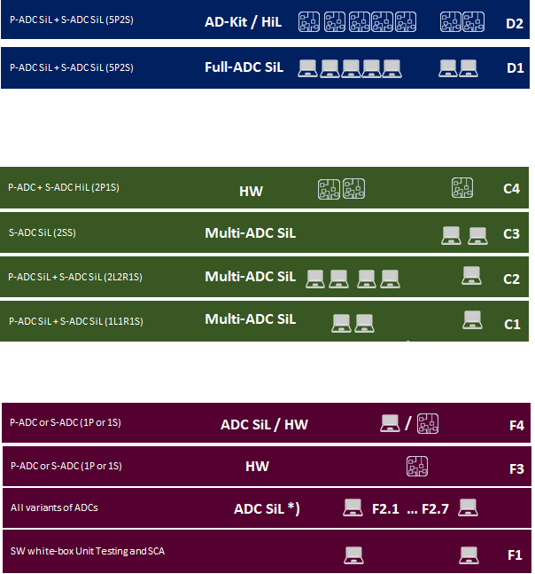


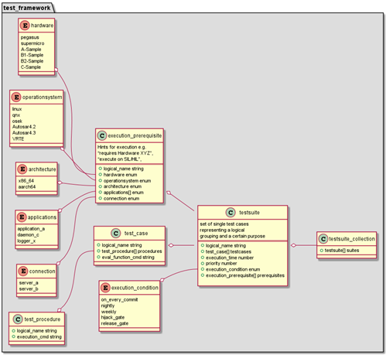
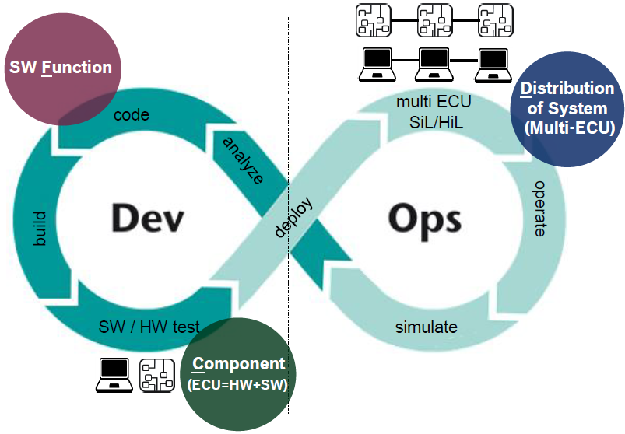
Staged Testing Concept
BSW Framework
Integrated into CI/CT process
Standardized way of describing Test Cases
One common BSW Test Framework for execution
collect all TestSuite Metadata Files and execute - on desired SW/HW environment - at the desired time schedule - with desired priority
CANoe Scripts
TestSuite Metadata
TestSuite Metadata
CANoe Scripts
TestSuite Metadata
BSW Chaos Monkey
ADC SiL
ADC SiL
Testcase Repository
TestSuite Metadata
BSW
Test Framework
TestRunner /
Test Scheduler
TestSuite Metadata
RobotFramework
TestSuite Metadata
XCP TestFramework
Cantata
GoogleTest

Slide 23











Development | Host environment
Reviews and checks | Version Control
Requirements Change Requests
Design Decisions
Data
Tool
Regulation
Process/Method
….
Maintainers
Update Dev Env
Code
Unit Test
Component Test
Code-self-check
Code review
Check-in / Pull-Request
Developers
Local build
System Testers
Pre-production
Test server
Build server
Qualification
System Test
Subsystem Test
Integration Test
Baseline
Exit Criteria | KPI
Build
Entry criteria
Merge
Pipeline dev. | Maintainers
SQA
SQA
Developers
SW Testers
SQA
Production
Release
End users
Dashboards
Client | Host Env.
Test environment
SQA
Developers
Server Env.
Manual process
KPI1
KPI2
…
Architects
Maintainers
Target HW
Automated process
Duration / Freq.
Cloud Computing
Field Data / Shadow Mode / A-B Testing, ….
Project Mgmt.
SW Testers
Management

Slide 24









Light House projects
Automation In BBM CX Pipeline
LOCAL MACHINE
Develop
Compiler
warnings
Dataflow &
Coding Rules
Unit
Tests
USECASE 1
Quick “Online” Feedback for SW Developer on Local Computer
Check
out
build
SCA
SUT
Commit
INFRASTRUCTURE
Feature Branches
Pull
Request
Report
USECASE 2
Fast release cycles & Simulation
Continuously on commit
+
Integration
build
SCA
SUT, SIT
TC
SST
USECASE 3
Corner Test Cases
& Target Tests (HIL)
Develop Branch
Pull
Request
+
Pull
Request
Static Code Analysis
S/W Unit Tests, S/W Integration Tests
Test Coverage Evaluation
S/W Simulation Smoke Test
Complete S/W Test
On-target Tests, HIL Tests
Cyclically (e.g. nightly)
RELEASE
build
SCA
SUT,
SIT
TC
CST
HIL
Master/Delivery Branch
USECASE 1
Approximate effort Saving:
Developer’s effort saving 10000 * 40% = 4000 hrs
Extrapolation to entire year = 24 PYO’s
Benefits would be realized year on year continuously
USECASE 3
Approximate Cost Saving:
a) Creating test designs out of textual requirements : 1.4 million Euro

Slide 25

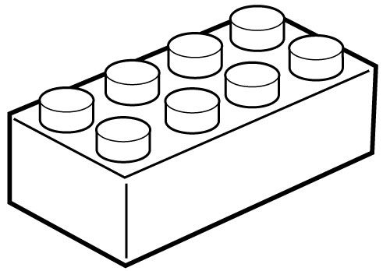
Autonomous 1.0 : Envisioning Automation App Store
Workflow based solutions
App Store
Components
Community based development
Promote Re-use
Integrated solutions
Connectors

