Slide 1
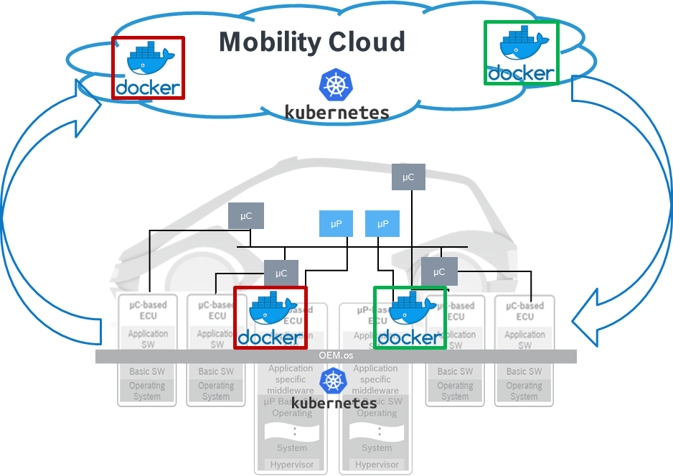

Case Study : Autonomous 1.0
Functional Complexity is constantly increasing
SW Defined Car
XaaS capturing significant turnover
Market growth is towards SW intensive systems
Virtual Platform
Physical World
code
plan
release
deploy
Development cycle times further reduced
build
test
monitor
operate
Frequent SW Updates required
Focus on
CICTCD Integration & Automation

Slide 2

Autonomous 1.0 : Problem Analysis
Fast & Automated
Expected
Plan
Design
Code
Integration
Validation
Release
Deploy
Operate
Monitor
Accurate & Complete
Backlog
Design
Code
Test
Processing Time/
Waiting time
30 days
1 day
10 days
2 days
1 day
2 days
Actual
Observations:
High Lead Time ~71 days.
Too many manual steps
Release cycles are not in sync
Late Feedback - High rework
40%
100%
Integration
System Testing
Release
5 days
1 day
5 days
3 days
10 days
1 day
* Example of one product

Slide 3
Autonomous 1.0 : 3C Model
Collaboration
Co-Creation
Competency
Multi-function team (Dev, Test, Integration, Quality)
Cutting across Divisions (CC, PS, TT, BSH, AE)
Joined hands with similar initiatives - Win-Win approach
Helped engineer domain agnostic cutting edge solutions
Enabled Proof of Scaling
Voluntary contribution helped in X-skilling & controlled spends
Talent development in Intelligent Automation
Education programs in association with HR team.
Motivated driven by hands-on contribution.

Slide 4




Autonomous 1.0 : CANVAS
 | 2019 |  |  | 2020 |  |  |  | 2021
 | Q2 | Q3 | Q4 | Q1 | Q2 | Q3 | Q4 | Q1 | Q2 | Q3 | Q4
Collaboration with Other Initiatives
Light House Projects |  |  | 2 Product lines |  |  |  |  | 2 Product lines
Solution Landscape
Vision
Live Data Dashboard
TOP’99
#FFF project
RB-CoC - IA
TOP’98
Implement Solutions
Implement Solutions
Nomination & Screening
Maturity Evaluation
Measure
Maturity Evaluation
Measure
Automation & AI Solutions – Automating CI, CT, CD
Criteria’s
Collection & Evaluation of solutions
Solution Repository
Hosting it on TOP’98
Assessing the Gaps – Integrating, Harmonizing solutions
Alignment with GBs & Steering members
Tool
Strategic Vision
How?
Maturity Model
Pilot
As of Today
Working On
Achieved

Slide 5
Autonomous 1.0 : Strategic Vision’2025
FOUNDATION
ROBOTIC
INTEGRATED ANALYTICS
AUTONOMOUS
High human interaction & Low Degree of AI
Low human interaction & High degree of AI
Autonomous 1.0 : Maturity Model
Separated in three levels of the continuous lifecycle
Automation Maturity in Continuous lifecycle.
Continuous Integration
Questionnaire clustered in 5 categories :
Build (B)
Testing (T)
Culture (C)
Deployment (D)
Release (R)
Continuous Delivery
Continuous Deployment

Slide 6
Autonomous 1.0
AI augmented Defect Prediction
Defect Management
Defect Localization
Defect Prediction
Defect Prioritization
Defect Similarity
Defect Severity
SW Requirements
Bug/Log Reports
Source Code
Defect Descriptions
Configuration Files
Test Cases
ML Based Representation
Static & Semantic Feature Extraction
Code Knowledge Graph
Knowledge Graph
Statistical Technique
Localized Defect in Source Code
Predicted Defective Source Code
CICD Test Metric Features
Software Code Change Commits
File Level Source Code Features
Method Level Source Code Features
Test Prioritization

Slide 7


Autonomous 1.0
Integration via Virtual Nodes
Hardware
Unit under Test
Touch Arm 2
Skill API's End Point
Transform Text to Speech
Touch Interface
Touch Arm 1
WIN
CCB2
Skill Directives
Virtual Device
(Alexa or Google Home)
GTS
Frame grabber / Camera
HMI Console
MQTT Read
Frame grabber / Camera
Mobile
Virtual Devices
Discover Response
Output Validation
Speech to Text
Selenium/Robot Interface
Actual Cloud / Debug server

Slide 8
Autonomous 1.0 : Challenges
People Management
Leading a group of dotted line reports
Alignment of Priorities & Timelines
Constantly driving Interest & Motivation
Divisional Alignment
Scattered Vs. Centralised
Socialising the ‘Standardisation’
Delivery commitment & Management
Change Management
Handling ways of working (culture)
Deploying the change
Budget Control & Funding Sources
Stakeholder Management

Slide 9


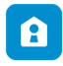

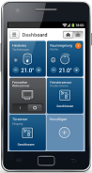

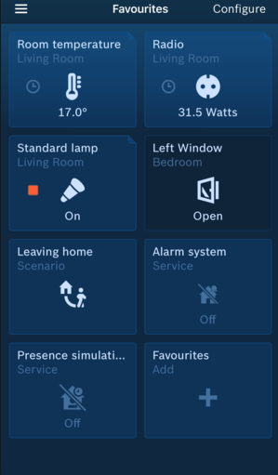













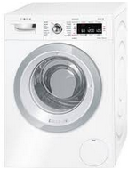






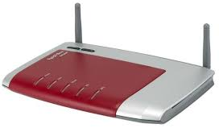










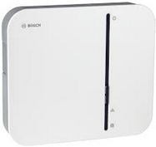


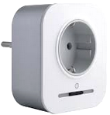



Autonomous 1.0 : Light House Project
USECASE 2
Delay in releasing Third party interfaces – Alexa, GH
USECASE 3
Support tickets increasing drastically.
USECASE 4
Delayed Feedback for SW Developer
USECASE 1
Long Release cycles
Home Appliance sector - CX Pipeline
Interfaces
Internet
Bosch CIAM
Service
Backend
USECASE 1
Lead time reduced to 28 days from 71 days in Phase 1
Efficiency enhancement using MQTT Simulation – 18%
Cloud Services
USECASE 2
Automation of Voice enabled devices implemented.
Reduced delay in feature release.
HOME API Gateway
Bosch Cloud-based Services
HOME Eco System
Smart Home
Camera Solutions
Wi-Fi Router
USECASE 3
Defect Prediction : Input data from Market Study, Crowd Data, Support Tickets.
Support
HOME SSD
HOME Log file Server
USECASE 4
Machine based analysis & Code reviews.
Developer’s effort saving : 24 PYO (4000 hrs – extrapolating to year)
Smart Home Controller
Push Notifications
System Devices
HOME Push Proxy
Enabled Fast Go-To Market : Huge Market demand

Slide 10
Autonomous 1.0 : Realized Benefits
Customers
Organization
Faster Go to Market
Improved Quality
Speeding up the entire value chain
Reducing waste time.
Built-in quality using Automatic Solutions.
Fast feedback loop established.
Enhanced Competency
Reduction in Cost
Maintenance Cost of ‘current’ redundant Solutions
Development Cost of ‘impending’ avoidable Solutions
Bringing cutting-edge technology
Enabled platform to collaborate & co-create own problem statements
Amalgamation of best practices across divisions.

Slide 11



Autonomous 2.0 : Envisioning Transformation
Tayloristic Approach -------- > Full Stack SW Team
(Split responsibilities) (E2E responsibility)
App Store
Indicates high maturity
A platform to consolidate all available and new Automation solutions.
Solutions to be used in silo mode or integrated using plug-ins.
Promoting Re-usability & Social coding.
Co-engineering on unique solutions
Central Maintenance of tools
Integrated product 1
Integrated product 2
Integrated product 3
Team1
Team1
Team1
Silo Solutions
Team2
Team2
Team2
Team3
Team3
Team3
Plug-in utilities
End to End responsibility (complete V in one team) for one feature by one team.

