Slide 1
STEEM PAY-OUT bOT
Shantanu
1509110095
VII – CS2

Slide 2
Contents
Introduction
Objective
Steem Blockchain
Artificial Intelligence
Dataset Collection
Neural Network Training and Prediction
References

Slide 3
Introduction
My three-month Industrial Internship Program work term was done for the project named “Steem Pay-out Bot” under the guidance of Mr. Pramesh Tyagi with the ShilazTech, New Delhi.
During my internship I worked as a python developer on Blockchain and Artificial Intelligence.

Slide 4
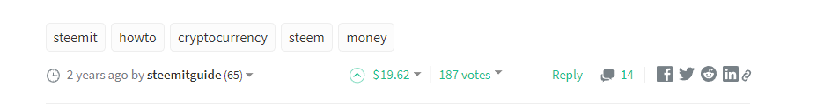
Objective
The idea behind the project is to gather information of posts on Steem blockchain and to design a Robot to predict potential upvote reward of the post using Steem Blockchain and Artificial Intelligence. The profitable posts will be upvoted before they land on trending section.

Slide 5
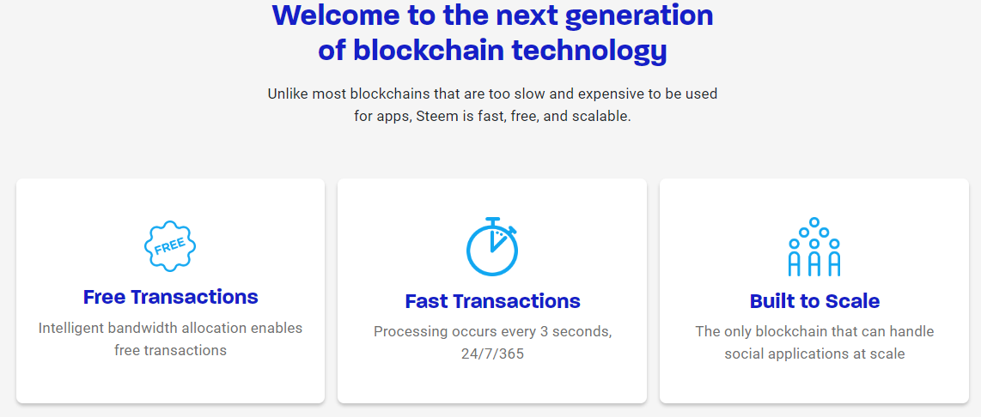
Steem Blockchain
Steem is a social blockchain that grows communities and makes immediate revenue streams possible for users by rewarding them for sharing content.

Slide 6
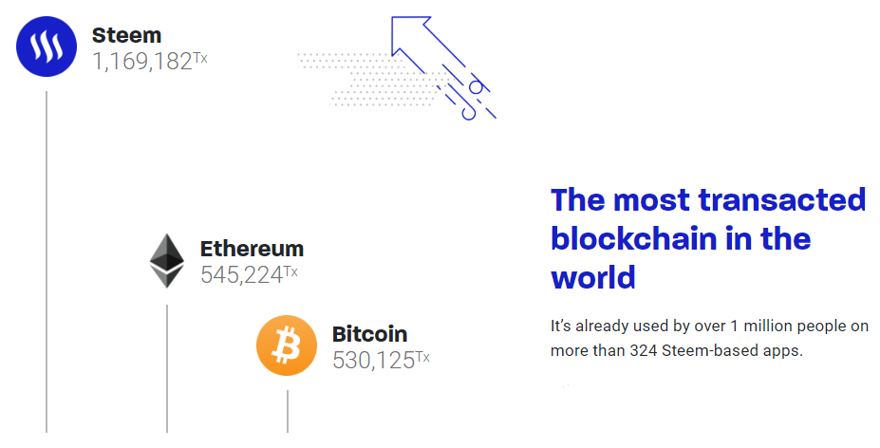
Based on Delegate Proof of Stake (DPoS), while Bitcoin is based on Proof of Work (PoW).
Steem takes 3 seconds to validate a transaction while Bitcoin takes about 10 minutes.

Slide 7
Initial token rate generation was 9.5% per year which decreases by 0.5% per year. This inflation will decrease until it reaches 0.95%. 75% of token generated compose the ”reward pool” which is distributed among content creators and curators.
15% are distributed to vested token holders and 10% to Witnesses.
Different currency:
STEEM
STEEM POWER
STEEM DOLLAR

Slide 8
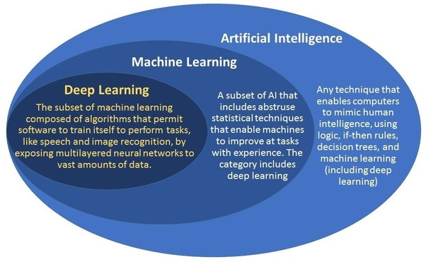
Artificial Intelligence

Slide 9
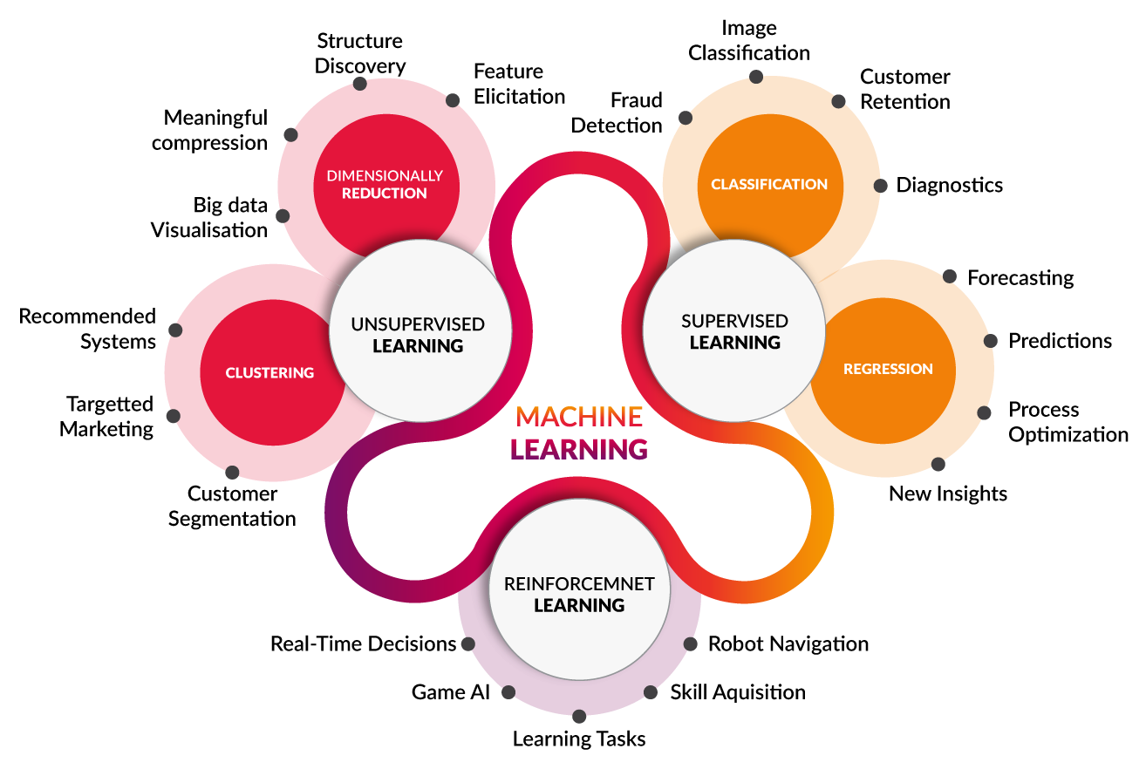

Slide 10
DataSet Collection
Dataset is collected by scrapping posts from the trending page.
Required features are collected from each post and store in a CSV file.
Tools used :
Steem : python library to interact with Steem blockchain.
csv : python library for storing data in .csv file
pandas : for data manipulation and interaction.
NumPy : fast and efficient operations on arrays
matplotlib : data visualization
keras : creating neural network models

Slide 11
List of features used
Tag Score | Replies | Followers | No of Posts
Author Reputation | Promotion | SBD author has | Liquid Steem
Steem Power | Reblogged | Vote Speed | Comment Speed
Pay-out Speed

Slide 12
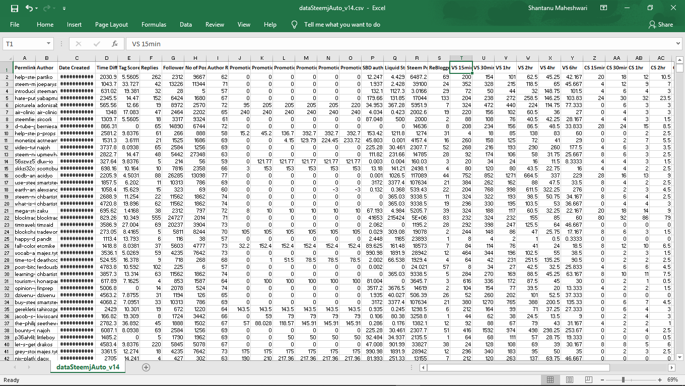

Slide 13
Training And Test Set
Training Set: Set of values on which the neural network gets trained
Test Set: Set of values used to check the accuracy of the trained neural network.
Training and Test Set are divided in the ratio of 80:20 of the total dataset

Slide 14
Training of ANN Regressor
Layers : Input and Output layer with 1 Hidden layers
Nodes : 13 nodes in Input; 7 nodes in Hidden and 1 nodes in Output Layer
Activation : ‘Rectified Linear Unit’ in Hidden Layer and ‘Linear’ in Output Layer
Optimizer : Adam Optimizer
Loss Function : Mean Square Error (mse)
No of Epochs : 500

Slide 15
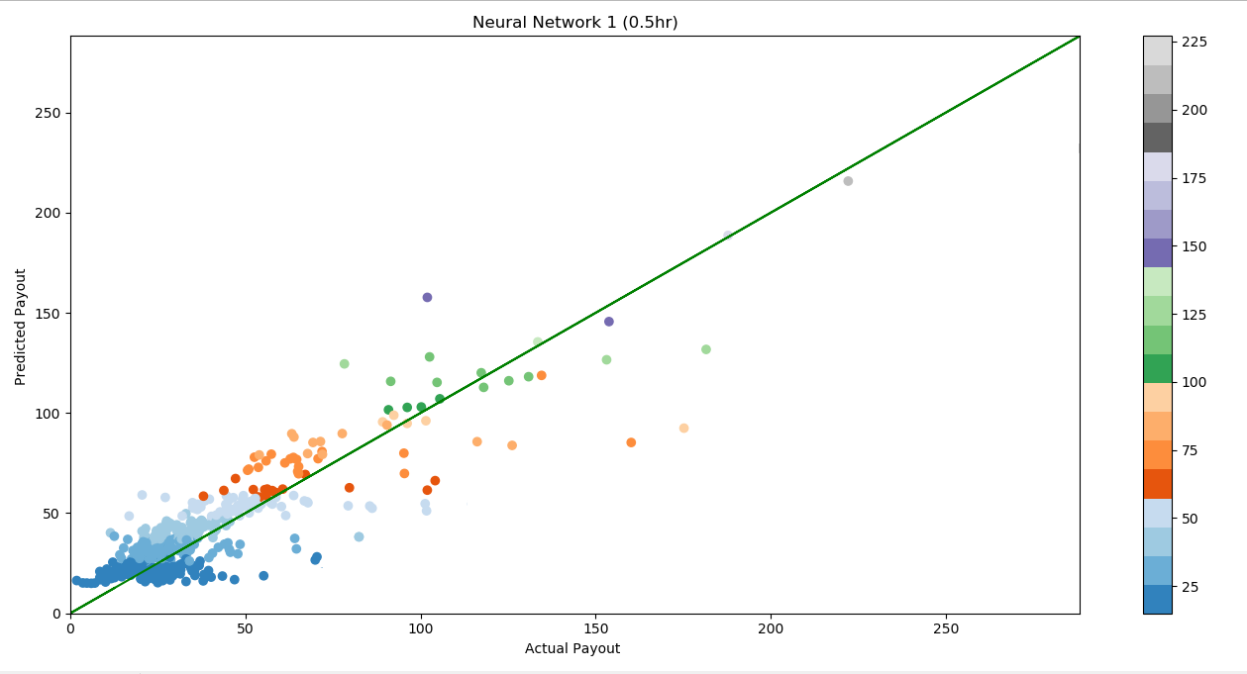

Slide 16
references
Steem White Paper (Research Paper)
Steem Blue Paper (Research Paper)
Stack overflow: https://stackoverflow.com

Slide 17
Thank You

