Slide 1
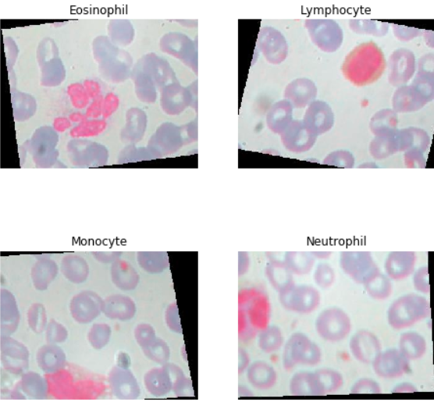
Leukocyte classification using inceptionReNetV2
Diwei Xiong, Shilong Yin
Cell type
Data set
preprocessing
Nerutrophil
About 12500 pictures
Image normalization
Eosinophil
Different morphology
Image resizing
Lymphocyte
240X320X3 RGB
Image augmentation
Monocyte
Train:test 8:2

Slide 2
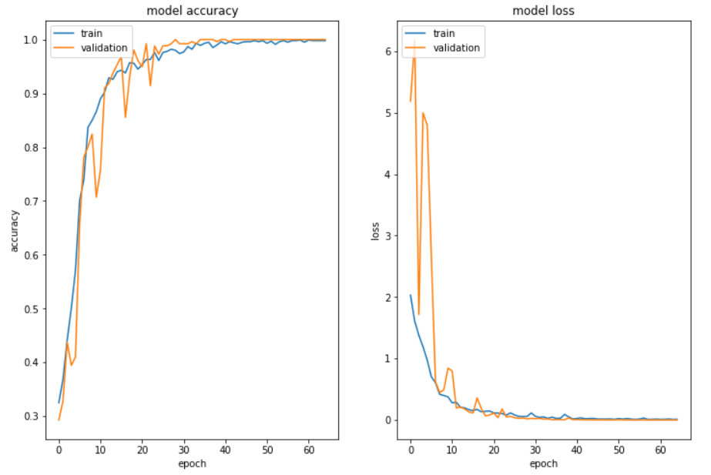
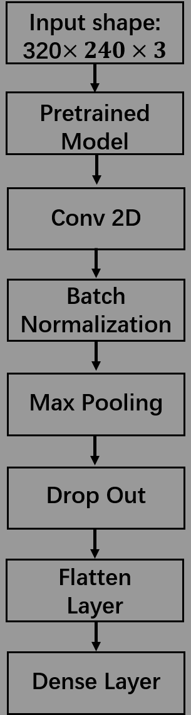
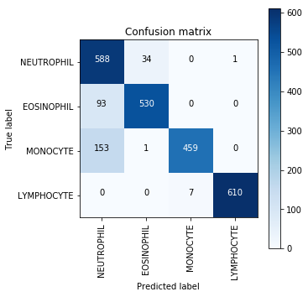
Model and result:
Model comparision
0.8841
our model
0.7832
Paul Mooney’s kernel
0.8376
Nh4cl’s kernel

