Slide 1

FactoryDocs Assistant: A Retrieval-Augmented Chatbot for Robot Error Diagnosis in Production
Concept Presentation
Team Members:
Divi Teja Dimmiti (Team Lead, RAG pipeline,test set)
Shilpa Golla (PDF extraction & LLM integration)
Vijay Boyapati (Evaluation & Streamlit demo)
Guided by:
Hamidreza Heidari, PhD

Slide 2
Introduction:
In a production line, every minute a machine stands still means lost output. Unplanned downtime costs the world’s 500 largest companies about $1.4 trillion per year, ~11% of revenue (Siemens, 2024). Collaborative robots like the Universal Robots UR5e load CNC machines and pick and place parts; when the robot stops with an error code, the connected machine and material flow stop too.
Key motivations:
The cause and fix are spread over several long manuals
Workers describe problems in their own words, which Ctrl+F cannot match
General AI chatbots can give confident but wrong answers

Slide 3
Real-World Problem: Robot Stops
Protective stop: the robot stops itself for safety and shows a code, e.g., C153 (position deviates from path) or C157 (collision detected by joint).
Common causes: wrong payload setting, collisions, external cables dragging, very high accelerations [8].
UR rule: a protective stop shall not be reset without a review of the fault’s root cause [8].
Step | Today | With FactoryDocs Assistant
Find meaning | Search the error code directory | Type the code, get the meaning
Find cause | Check several manuals, call a technician | Likely causes from all four manuals
Fix | Trial and error | Fix steps with source pages
Effect | Robot, CNC and material flow wait | Faster restart, root cause documented

Slide 4
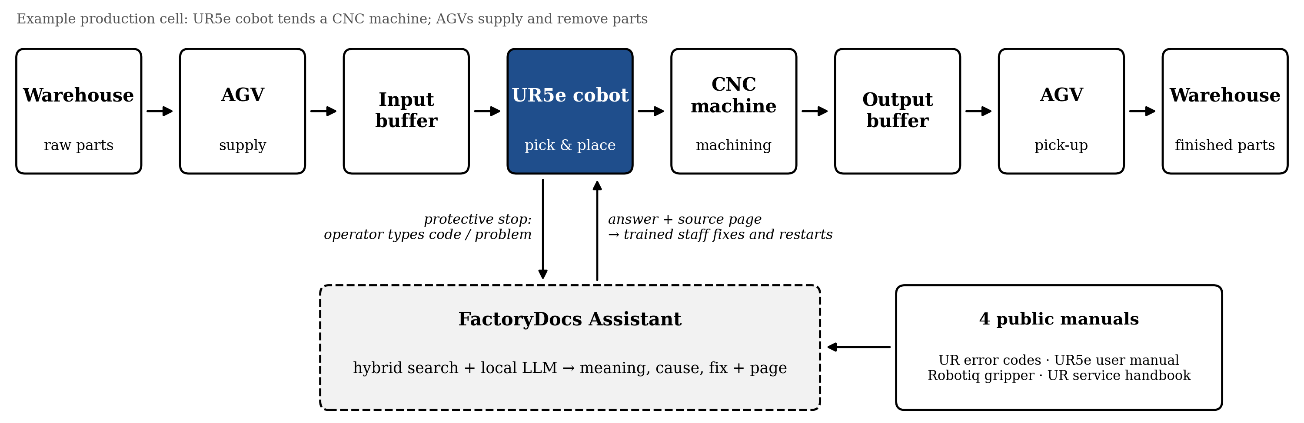
Use Case: Robot Cell in Production & Logistics:
Scenario | What happens at a robot stop
1. Manual search | Robot stops → operator searches 4 manuals with Ctrl+F → calls technician → fix
2. Plain chatbot | Robot stops → answer from memory, no source → cannot be verified
3. FactoryDocs Assistant | Robot stops → type code or problem → cause + fix with page → restart

Slide 5
Project Scope:
Aim:
Build and evaluate a local chatbot that diagnoses UR5e robot errors from the error code or a problem description, answering only from the robot and gripper manuals with source pages, and saying “I don’t know” otherwise.
Includes:
Text and table extraction from four public UR5e / gripper manuals
Keyword (BM25), meaning-based and hybrid search
Local LLM answers with page citations and refusal when unsure
60-question test set, evaluation and Streamlit chat demo
Out of Scope (Current Phase):
Live connection to a physical robot or factory systems (MES/ERP)
Images and drawings inside manuals; fine-tuning the language model

Slide 6
Objectives:
Build a reproducible RAG pipeline over four UR5e robot and gripper manuals.
Handle both exact error codes and problem descriptions in the worker’s own words.
Compare four approaches: plain LLM, BM25 RAG, dense RAG and hybrid RAG.
Deliver a Streamlit chat demo that shows the source page for every answer.

Slide 7
Input and Output:
 | Example input | Output
Error code | “C157A2” | Meaning of the error, likely causes, fix steps, source pages
Problem description | “The robot keeps dropping parts” | Likely causes (e.g., gripper or payload), checks and fixes, source pages
Not in the manuals | “What is the warranty period?” | “I don’t know” instead of guessing
Every answer comes only from the manuals and cites the page, so the worker can verify it.

Slide 8
Data: Four Public Manuals
Document | What it gives | Source
UR Error Codes Directory | Meaning and suggested fix for robot error codes | Universal Robots
UR5e User Manual | Robot settings, e.g., payload and safety | Universal Robots
Robotiq 2F-85 / 2F-140 Manual (for UR) | Gripper problems, e.g., dropped parts | Robotiq
UR e-Series Service Handbook | Repair and troubleshooting steps | Universal Robots
All four are public PDFs. They are not uploaded to GitHub (copyright); the repository shares download links only.

Slide 9
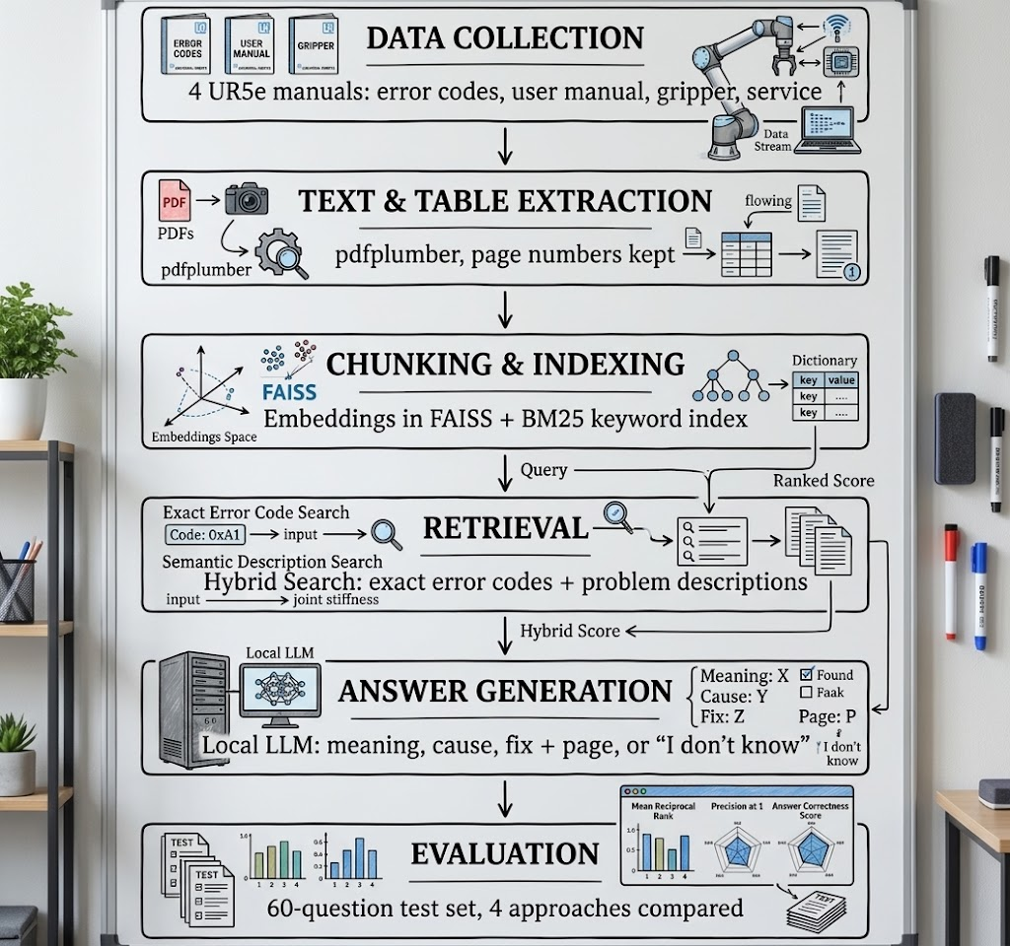
Project flow chart:

Slide 10
Working Methodology:
Step 1: Data Preparation
Download the four manuals; extract text and tables with page numbers.
Split into small chunks tagged with manual name and page.
Step 2: Retrieval
Baseline: keyword search (BM25). Then meaning-based search (sentence-transformers + FAISS).
Hybrid search combines both: exact codes like C157A2 and free-text problems.
Step 3: Answer Generation
Local LLM (Ollama) answers only from retrieved chunks and cites the pages.
If the answer is not in the chunks, it replies “I don’t know”.
Step 4: Evaluation and Comparison
60 questions in 5 types: error code, problem description, multi-document, procedure, unanswerable.
Scored by two members with a rubric, checked with RAGAS; four approaches compared.

Slide 11
Technology Stack:
Process | Tool / Framework | Purpose
PDF Extraction | pdfplumber (PyMuPDF backup) | Text and tables with page numbers
Embeddings | sentence-transformers | Turn text chunks into meaning vectors
Vector Search | FAISS | Meaning-based search
Keyword Search | rank-bm25 | Exact terms such as error codes
Language Model | Ollama (e.g., Llama 3 8B) | Local answers, no cloud needed
Evaluation | pandas, RAGAS | Metrics and faithfulness scores
Demo | Streamlit | Chat window showing source pages

Slide 12
What We Compare:
Approach | Description
1. Plain LLM | No retrieval; answers from the model’s memory (shows hallucination risk)
2. BM25 RAG | Keyword search baseline
3. Dense RAG | Meaning-based search with sentence embeddings
4. Hybrid RAG | BM25 + dense combined: exact error codes and problem descriptions
Why not Ctrl+F or ChatGPT? Ctrl+F needs the exact words in the manual; a plain chatbot answers from memory, without a source. We don’t build a new LLM, we make one reliable for the shop floor and prove it on the same test set.

Slide 13
Evaluation KPIs:
KPI | What it measures | Target
Retrieval hit rate@5 | Correct page is among the top 5 chunks | ≥ 80%
Answer accuracy | Answer judged correct (3-level rubric, 2 reviewers) | ≥ 75%, beats baselines
Refusal rate | “I don’t know” on unanswerable questions | ≥ 80%
Response time | Median seconds per answer on a laptop | ≤ 10 s
Test set: 60 team-written questions: error code · problem description · multi-document · procedure · unanswerable.
Targets are our goals; final values will come from the experiments.

Slide 14
Bill of Materials (BOM):
Component | Specifications | Quantity | Cost
Laptops | Team members’ own computers | 3 | Free (own)
GPU access (Colab Pro) | Cloud compute, optional | 3 months | €0–30
Manuals (data) | UR error codes, UR5e user manual, Robotiq gripper manual, UR service handbook | 4 | Free
Software | Python, Ollama, FAISS, Streamlit (open source) | - | Free
Repository | GitHub | 1 | Free
Total estimated cost: €0–30

Slide 15
Milestones:
 | (Oct) Week 43 | Week 44 | (Nov) Week 45 | Week 46 | Week 47 | Week 48 | (Dec) Week 49 | Week 50 | Week 51 | Week 52 | Week 53 | (Jan) Week 01 | Week 02
Proposal & literature review
PDF extraction + BM25 baseline
Embeddings, FAISS, plain-LLM baseline
Test set, hybrid search, comparison
Streamlit demo, video, run guide
Final report & presentation

Slide 16
Safety, Risks & Ethical Checklist:
Decision aid only: UR requires trained personnel to review every protective stop; the assistant supports, never replaces this
Every answer cites its source page; the bot says “I don’t know” when the answer is not found
Copyright respected: manuals are linked, never uploaded to GitHub
No personal data processed; the local model keeps documents on site
Technical risks: PDF tables extract badly (compare pdfplumber vs. PyMuPDF); slow local inference (smaller quantized model)

Slide 17
Expected Outcomes & Future Work:
Expected outcomes:
Working chatbot for UR5e error diagnosis with page citations
Comparison of four approaches on the same 60-question test set
Error analysis showing which question types fail, and why
Public GitHub repository, demo video and IEEE-format report
Future work:
Read the robot’s error log automatically instead of typing the code
Add more robots and machines; German-language questions; images in manuals

Slide 18
Bibliography
[1] P. Lewis et al., “Retrieval-Augmented Generation for Knowledge-Intensive NLP Tasks,” NeurIPS, 2020.
[2] Y. Gao et al., “Retrieval-Augmented Generation for Large Language Models: A Survey,” arXiv:2312.10997, 2023.
[3] S. Es et al., “RAGAS: Automated Evaluation of Retrieval Augmented Generation,” EACL (Demos), 2024.
[4] N. Reimers and I. Gurevych, “Sentence-BERT: Sentence Embeddings using Siamese BERT-Networks,” EMNLP, 2019.
[5] J. Johnson, M. Douze and H. Jégou, “Billion-scale similarity search with GPUs,” IEEE Trans. Big Data, vol. 7, no. 3, pp. 535–547, 2021.
[6] S. Robertson and H. Zaragoza, “The Probabilistic Relevance Framework: BM25 and Beyond,” Found. Trends Inf. Retr., 2009.
[7] Siemens AG, “The True Cost of Downtime 2024,” Siemens Digital Industries, 2024.
[8] Universal Robots, “Understanding Protective Stops,” support article, 2026.

Slide 19
Thank You!
GitHub Repository

