Slide 1

Team: 16 An Intuitive Projective Model with Probabilities with PSO+GA on Visegrad features with Multi domain Applicative Fraud Detections
Team members:
SAI SHILPA PADMANABULA (50327187)
SNEHASRI MANDA (50323664)
RAHUL GADDIPATI (50324311)
Youtube video Link: https://youtu.be/MrVW2XWWpcI

Slide 2


Agenda
Abstract
Introduction
Related works
Methodology
Algorithms
Implementation
Results
Conclusion
Future scope

Slide 3

Abstract
In finance, fraud detection is critical for trust and security. Traditional methods struggle with evolving fraud tactics.
This paper suggests a new way to improve fraud detection in finance by combining AI and metaheuristic techniques.
The proposed system uses AI algorithms like machine learning and deep learning to analyze large amounts of transaction data with high accuracy. The goal is to achieve over 90% accuracy in prediction and classification.
The AI model combines traditional machine learning with advanced techniques like Genetic Algorithms, Particle Swarm Optimization.
The model focuses on being transparent and understandable, by using techniques like LIME and SHAP to explain decisions, building user trust and comprehension.

Slide 4
Introduction
This introduction provides a comprehensive overview of the current state of fraud detection in finance, emphasizing recent research efforts and advancements in leveraging metaheuristic techniques.
Problem statement: Despite advancements, traditional fraud detection struggles to find the fraudulent cases in financial transactions. Visegrad Group listed companies face ineffective fraud detection due to multi-dimensional fraud and dataset imbalance.
Proposed Model: It utilizes metaheuristic techniques, combining Particle Swarm Optimization and Genetic Algorithms for optimized performance.
Objectives:
Improve Detection Accuracy: Improved fraud detection in Visegrad Group company transactions by combining AI with traditional and smart techniques like Genetic Algorithms, Particle Swarm Optimization, and Simulated Annealing.
Address Imbalanced Datasets: Develop an AI model to address imbalanced financial datasets, ensuring unbiased identification and classification of fraud instances.
Enhance Transparency and Interpretability: Incorporate techniques like LIME and SHAP to improve transparency and interpretability in the AI model's decision-making process.

Slide 5
Related Works
Comprehensive Analysis of AI applications in Trading, Risk Management and Financial Operations[4]: The findings offer insights into the AI and ML adoption in finance, highlighting trends, challenges, and regulatory concerns for professionals and policymakers to consider.
Research on Financial Fraud Detection Models Integrating Multiple Relational Graphs[10]: The study introduces Tri-RGCN-XGBoost, a model enhancing fraudulent user detection in digital finance by analyzing user association patterns while identifying key behavioral associations for fraud pattern mining.
Ensemble Model of the Financial Distress Prediction in Visegrad Group Countries[6]: Proposed ensemble model significantly outperforms traditional machine learning methods in credit card fraud detection, addressing issues such as data imbalance and achieving superior accuracy, precision, recall, and F1-score metrics.
Deep Learning Techniques in Financial Fraud Detection[31]: Proposed a hybrid method with a Dynamic Weighted Entropy measurement for improving the efficiency of the whole model learning.

Slide 6
Methodology
Data Acquisition and Preprocessing: In the initial phase, financial transaction data from Visegrad Group listed companies is gathered,and undergoes into preprocessing which handles missing values and encoding the categorical variables to prepare for fraud analysis.
Exploratory Data Analysis : In this phase, statistical summaries, histograms, box plots, and scatter plots are used to understand data patterns, followed by feature engineering to extract relevant features for fraud detection.
Handling Imbalanced datasets: Specialized techniques like SMOTE or ADASYN for oversampling minority class and adjusting model parameters to prioritize fraud detection are employed to address dataset imbalance in the AI model.
Model Development with Integrated AI Techniques: Preprocessed data is trained with various classification algorithms and metaheuristic techniques like Genetic Algorithms and Particle Swarm Optimization to achieve over 90% fraud detection accuracy, compared to traditional ML methods.

Slide 7
Contd…
Feature Selection and Engineering: Feature selection picks important variables for fraud detection, while engineering creates or modifies features to enhance classification.
Enhancing Transparency and Interpretability: Integrating LIME and SHAP techniques enhances transparency and interpretability of the AI model's decisions, fostering user trust and confidence through comparative analysis with existing methods.
Evaluation and Validation: Performance metrics, including accuracy, precision, recall, F1-score, and ROC-AUC, assess fraud detection effectiveness, validated via cross-validation for robustness and generalization.

Slide 8
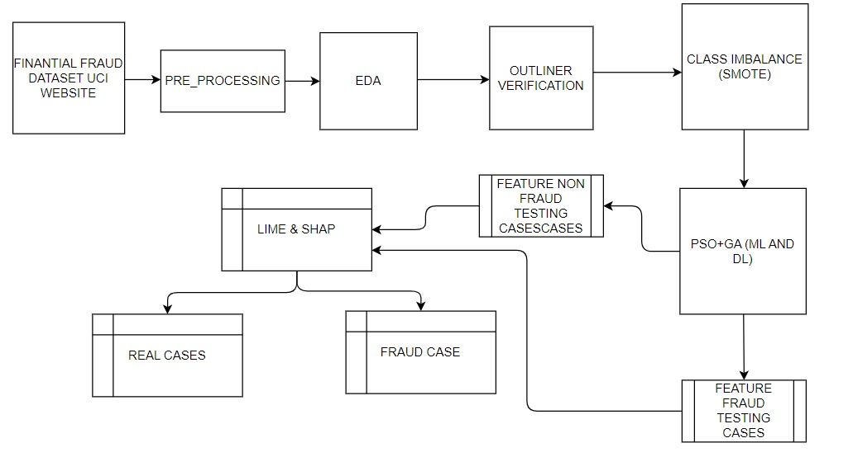
Block diagram
This indicates overall block diagram for financial fraud detection with VISEGRAD group dataset.

Slide 9

Algorithms
Algorithm 1 - GA + Ensemble:
Algorithm 2 - PSO + Ensemble:
Objective Function: Defines the goal using vector x and function f(x).
Population initialization: selecting solutions using a heuristic approach, each represented by a vector P={x₁, x₂, ..., xₙ}, where N is the number of solutions.
Fitness Evaluation: We check how good each solution is by plugging it into our objective function f(x).
We make our solutions better over time using a process called a Genetic Algorithm (GA).
Selection: Picks individuals based on fitness.
Crossover: Combines genetic material from selected individuals.
Mutation: Introduces random changes to offspring's genetic material.
Finally, we replace old solutions in our population with these new and improved ones.
we have a group of candidate solutions, called particles, moving around in a search space looking for the optimal solution to a given problem.
Update rules adjust particle position and velocity.
Velocity update formula involves personal best position and swarm's best position.
$v_{i}^{​\left(t+1\right)}=wv_{i}^{​\left(t\right)}+c_{1}​r_{1}​\left(x_{i}^{pbest}​−x_{i}^{​\left(t\right)}\right)+c_{2}​r_{2}​(x_{g}^{best}​−x_{i}^{​\left(t\right)})$ -- (1)
Position update moves particles based on updated velocity.
$x_{i}^{​\left(t+1\right)}=x_{i}^{​\left(t\right)}+v_{i}^{​\left(t+1\right)}$ -- (2)
Heuristic Guidance: Utilizes problem-specific knowledge to refine solution search.
Termination Criterion: Halt iterations based on conditions like maximum iterations or convergence.

Slide 10
Benefits of Combining GA and PSO:
By combining Genetic Algorithms (GA) and Particle Swarm Optimization (PSO), we get a hybrid algorithm that's great at finding optimal solutions in various tasks.
GA brings diversity to the population by exploring many possible solutions using selection, crossover, and mutation.
PSO focuses on exploiting promising areas efficiently by adjusting particles' positions based on local and global information.
Together, they strike a balance between exploring new solutions and exploiting known good ones, leading to better results.
Challenges of Combining GA and PSO:
Designing an effective way to combine GA and PSO is tricky because we need to balance their exploration and exploitation abilities.
Managing the complexity of the combined algorithm can be tough, especially for large problems or populations. Tuning the parameters of both GA and PSO requires a lot of experimentation and validation to find the right settings that give good results.
Overall, while combining GA and PSO is promising for optimization tasks, it's important to tackle these challenges to make the most of this hybrid approach.

Slide 11

Algorithms (contd..)
Algorithm3- Local Interpretable Model-agnostic Explanations (LIME):
LIME creates a simpler surrogate model around a complex model's prediction by sampling and perturbing similar examples around the prediction.
It trains a simple model (e.g., linear regression) on this new dataset to understand why the original model made the prediction.
Let x represent the instance to be explained, and f be the complex model's prediction function.LIME samples data points around x and perturbs them to create a dataset D′.
Explanation provided by LIME is the difference between the surrogate model's prediction and the original complex model's prediction.
f ^ ​(x) − f (x) -- (3)
Algorithm4 - SHapley Additive exPlanations (SHAP):
SHAP quantifies the contribution of each feature to a prediction by assigning “Shapley values” to each feature.
Shapley values are calculated based on the difference between the model's prediction for the current feature subset and the average prediction across all possible subsets.
Let ϕi​(x) represent the Shapley value of feature i for the instance x. The total prediction of the model for the instance x is given by f(x).
SHAP explanation for a prediction is the sum of Shapley values for all features, providing insights into individual feature influences on the model's output.
$f(x)=φ_{0}​+\sum_{i=1}^{N}{φ_{i}​(x)}​$ -- (4)

Slide 12
Implementation
Dataset Description: The proposed work leverages a comprehensive dataset encompassing listed companies from the Visegrad Group (Czech Republic, Hungary, Poland, Slovakia) across the period of Q1 2017 to Q1 2021 for quarterly analysis and yearly analysis spanning 2017 to 2020. The dataset incorporates 82 computed indicators and focuses on six distinct sectors: Transportation and warehousing, Wholesale trade, Manufacturing, Retail trade, Energy, and Construction.
Data Ingestion: Data Ingestion is the process of loading csv data.
Data Preprocessing: Data preprocessing is a crucial step in data analysis and machine learning, involving tasks like handling missing values, encoding categorical variables, and scaling features to prepare the data for analysis or modeling
Correlation Analysis: Correlation analysis is a statistical technique used to measure the strength and direction of the relationship between two or more variables. It's a fundamental tool in data analysis, particularly in exploring the associations between variables and identifying patterns or trends in the data.
Univariate Analysis: This process involves analyzing individual variables in isolation to understand their distribution, central tendency, variability, and shape
Bivariate Analysis: Bivariate analysis focuses on exploring the relationship between pairs of variables in the dataset.
Multivariate Analysis: Multivariate analysis extends the exploration beyond pairs of variables to include multiple variables simultaneously. The multivariate_analysis function generates a pair plot, which displays pairwise relationships between multiple variables in a grid format

Slide 13
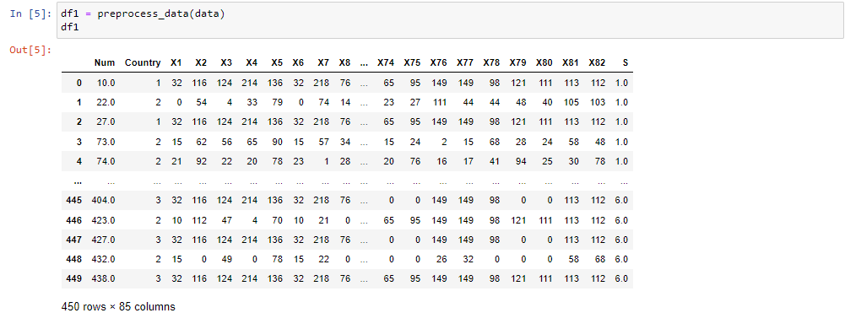
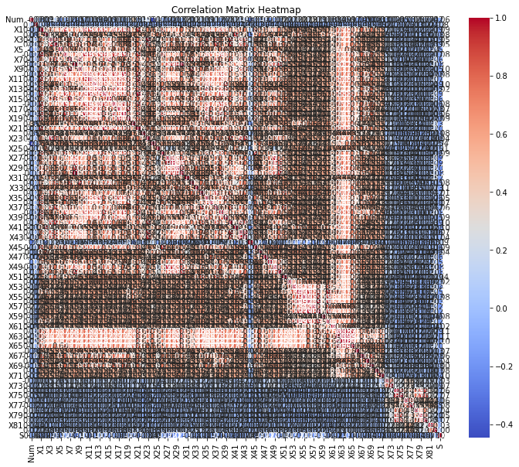
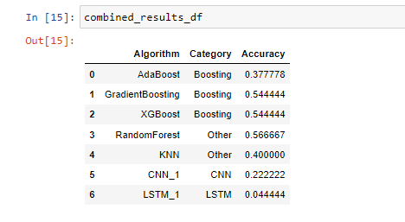
Representing the overall preprocessed dataset
Results
Representing the overall Heatmap model with correlation values for entire dataset.
Combined results of existing algorithms on the preprocessed dataset

Slide 14

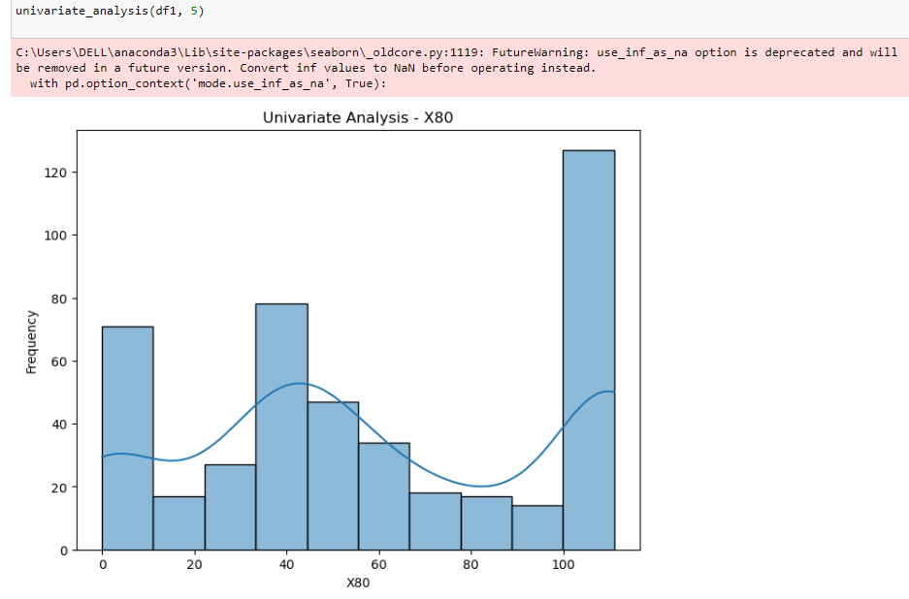
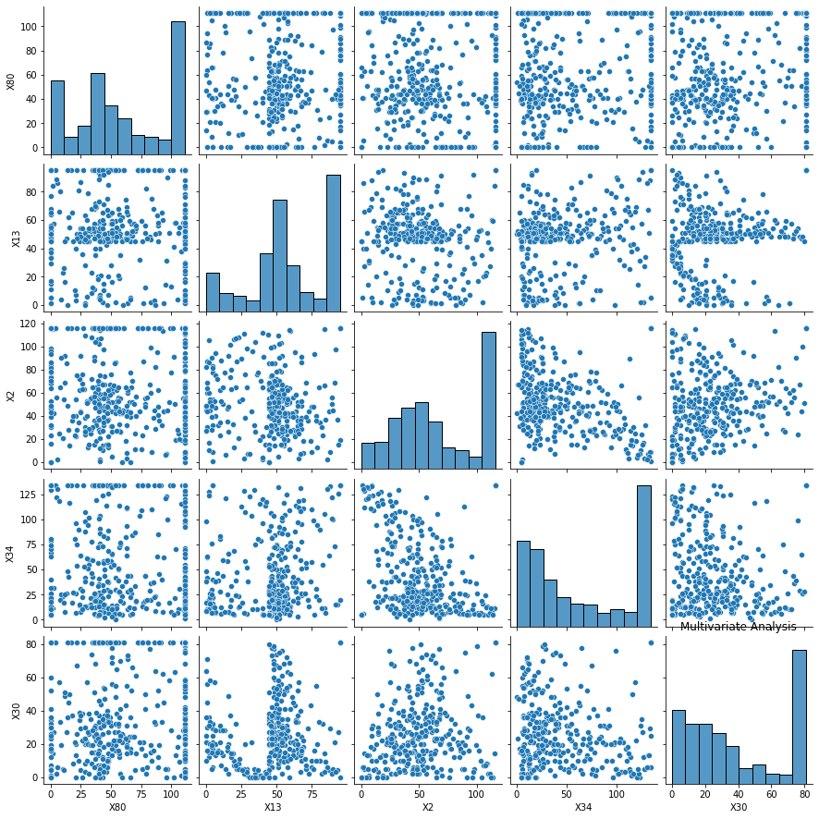


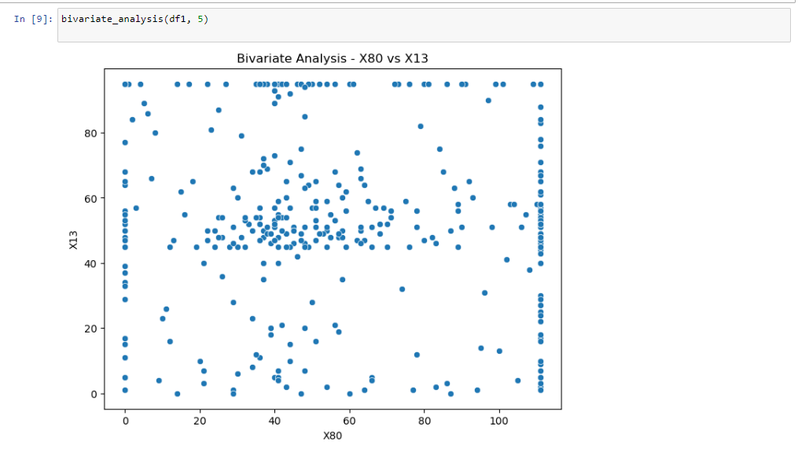

Results (contd..)
output of Univariate Analysis
output of Bivariate Analysis
Pair plot for 5 columns chosen for Multivariate analysis

Slide 15
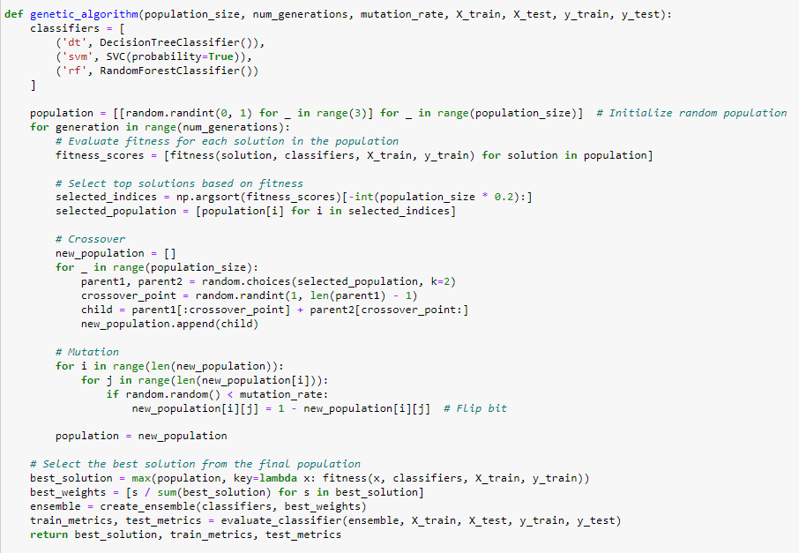
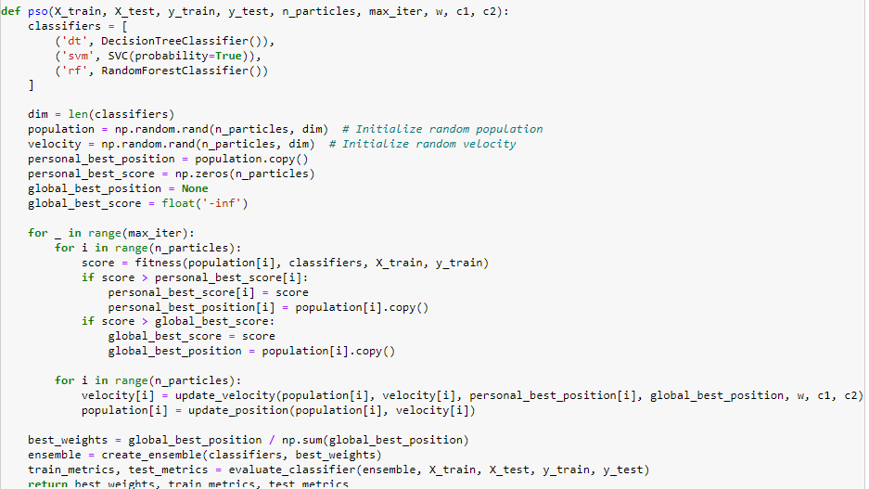
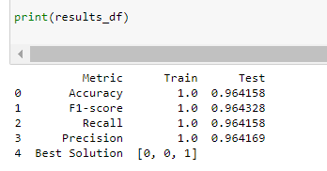
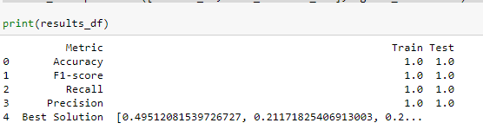
Results (contd..)
Representing the design of Genetic Algorithm
Representing the design of Particle Swarm Optimization
Captured results of Genetic Algorithm
Captured results of PSO

Slide 16
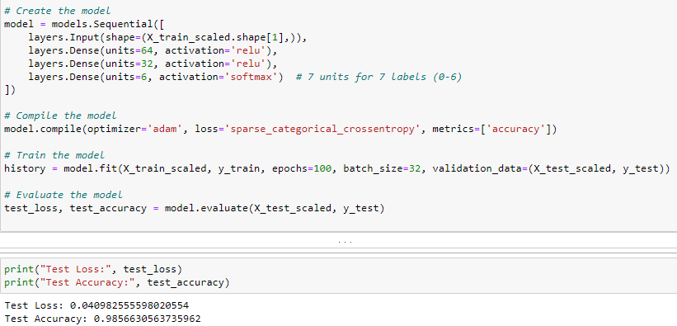
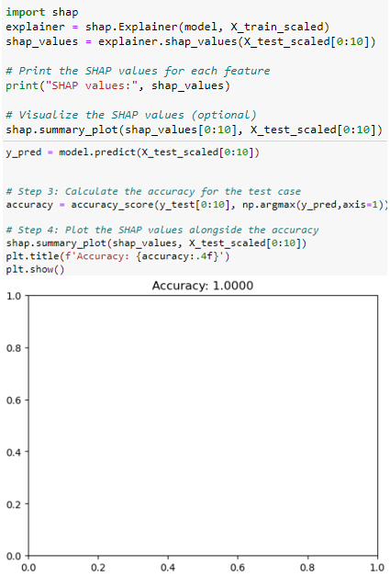
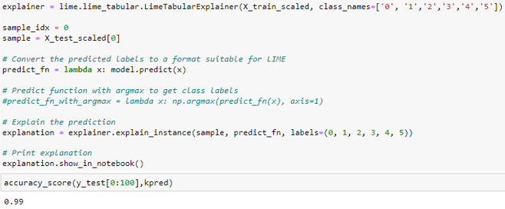
Results (contd..)
Representing the design of Interpolation Dense and its results
Representing the design of LIME and its results
Representing the design of SHap and its results

Slide 17
Results (contd..)
SNO | Existing Algorithm | Validation Accuracy
0 | AdaBoost | 0.377778
1 | Gradient Boosting | 0.555556
2 | XG-Boost | 0.555556
3 | Random Forest | 0.544444
4 | KNN | 0.400000
5 | CNN_1 | 0.377778
6 | LSTM_1 | 0.222222
7 | GA+ENSEMBLE | 0.978
8 | PSO+ENSEMBLE | 0.986
9 | LIME | 0.99
10 | SHap | 1.00
11 | Interpolation Dense | 0.947599
Traditional methods fall short due to the complex and diverse nature of fraud instances in the dataset.
The new models are much better at making accurate predictions compared to the existing methods.
In contrast, the proposed models demonstrate remarkable improvements in accuracy, with GA+ENSEMBLE and PSO+ENSEMBLE achieving validation accuracies of 97.8% and 98.6%, respectively.
Interpolation Dense, with a validation accuracy of 94.75%, also presents a notable enhancement over existing methods. LIME & Shap also achieved accuracies of 0.99 and 1.00 respectively.
Representing the overall comparison of the proposed validation accuracies of the design improvements from the existing algorithms.

Slide 18
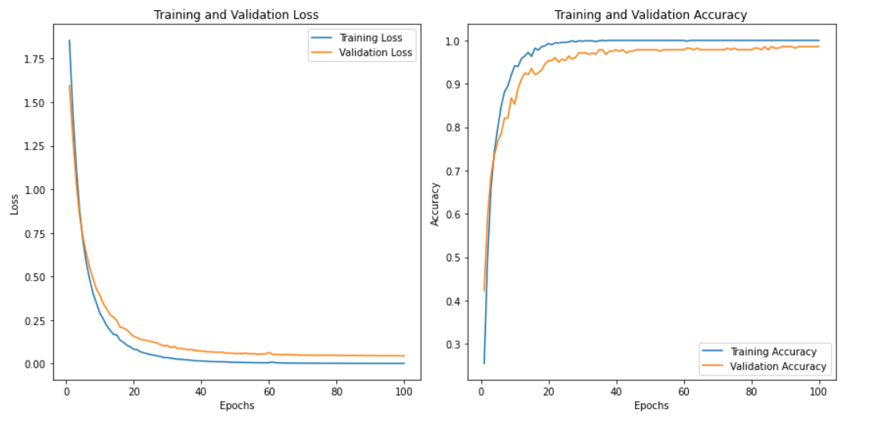
Results (contd..)
The proposed Interpolation Dense Model (IDM) demonstrates exceptional performance with a validation accuracy of 94.75% and a minimal validation loss of 0.1516.
The model exhibits a consistent improvement in accuracy over the training epochs, reaching a near-perfect accuracy by the end of the training period. Additionally, the validation loss steadily decreases throughout the training process, indicating effective convergence of the model.
Overall, IDM represents a well-designed model that achieves remarkable accuracy while avoiding overfitting.
Representing the overall IDM model performance Graph with interpolative model on PSO and GA model using Dense Layers.

Slide 19
Conclusion
The proposed approach integrates a Hybrid Probabilistic method combining Particle Swarm Optimization (PSO) and Genetic Algorithms (GA) to enhance fraud detection accuracy in financial transactions within the Visegrad Group.
Traditional methods fall short due to the complex and diverse nature of fraud instances in the dataset.
By leveraging PSO and GA, the approach optimizes the fraud detection model across multiple objectives. The initialization phase tailors PSO and GA parameters to dataset characteristics, setting the stage for iterative refinement of model parameters until convergence criteria are met.
Explainable AI (XAI) features, particularly the SHapley Additive exPlanations (SHAP) method, enhance model interpretability by providing insights into feature contributions to predictions.
Experimental results demonstrate significant improvements in validation accuracy compared to existing algorithms, with GA+ENSEMBLE and PSO+ENSEMBLE achieving accuracies of 97.8% and 98.6%, respectively.
Overall, the proposed approach offers a comprehensive framework for fraud detection, combining metaheuristic optimization techniques with XAI features to mitigate financial risks effectively within the Visegrad Group dataset.

Slide 20
Future Scope
We've used randomization to augment existing data, improving fraud detection with our models and achieving outstanding results.
Future plans involve combining generated random data with existing datasets to further boost fraud detection using our models.
Binary classification shows promise in accurately detecting all fraud cases generated by random processes, validating our models' effectiveness.
This approach paves the way for refining fraud detection methods and improving overall accuracy.
In future research, we aim to validate our models in real-world scenarios, explore technologies like blockchain and IoT, develop adaptive models for evolving fraud patterns, expand into new domains, enhance interpretability and transparency, collaborate with industry partners, and address ethical considerations.
These efforts will advance fraud detection solutions and contribute to a safer financial environment.

Slide 21
References
[4] M. El Hajj and J. Hammoud, “Unveiling the Influence of Artificial Intelligence and Machine Learning on Financial Markets: A Comprehensive Analysis of AI Applications in Trading, Risk Management, and Financial Operations,” Journal of Risk and Financial Management, vol. 16, no. 10, Oct. 2023, doi: 10.3390/jrfm16100434.
[10] J. Li and D. Yang, “Research on Financial Fraud Detection Models Integrating Multiple Relational Graphs,” Systems, vol. 11, no. 11, Nov. 2023, doi: 10.3390/systems11110539
M. Pavlicko, M. Durica, and J. Mazanec, “Ensemble model of the financial distress prediction in visegrad group countries,” Mathematics, vol. 9, no. 16, Aug. 2
[31] K. Gu, “Deep Learning Techniques in Financial Fraud Detection,” in ACM International Conference Proceeding Series, Association for Computing Machinery, Sep. 2022, pp. 282–286. doi: 10.1145/3558819.3565093.021, doi: 10.3390/math9161886.

Slide 22

Thankyou

