Slide 1
DATABASE SYSTEMS (CSCI-526-01B)
NAME: Sai shilpa Padmanabula, Rahul gaddipati
CWID: 50308848, 50324311
project : hospital MANAGEMENT SYSTEM
YOUTUBE LINK: https://youtu.be/ghvzvsQYQwM

Slide 2
Abstract
A Hospital Management System (HMS) is a platform designed to simplify the administration and management of a hospital or healthcare facility. Patient registration, appointment scheduling, medical record administration, inventory management, billing, and reporting are common features of the system. Doctors, nurses, administrative personnel, patients, and hospital administrators can all utilize the Hospital Management System. It aids in the reduction of manual workloads, the automation of administrative chores, the improvement of data accuracy, and the improvement of communication among healthcare practitioners.
The major goal of setting up a Hospital Management System is to improve patient care quality, increase operational efficiency, and assure regulatory compliance. It can also assist healthcare practitioners make more informed decisions, streamline workflows, and deliver better patient care.

Slide 3
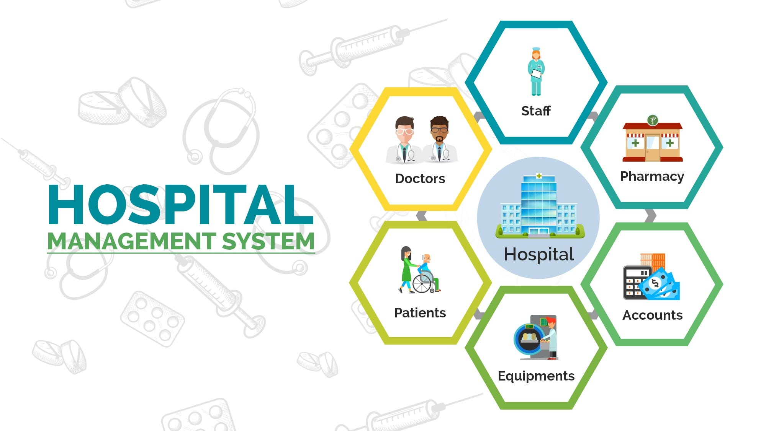
Introduction
The medical industry is facing several issues, including increased demand for healthcare services, the desire for greater patient care, and growing healthcare costs. Hospital Management Systems are designed to help solve some of these issues by reducing administrative operations, boosting communication among healthcare workers, and improving patient care.
The system aims to automate and streamline various hospital processes, making it easier for healthcare professionals to manage patient care and hospital operations.
HMS is designed to improve the efficiency of hospital operations, reduce administrative workload, minimize errors, and enhance the overall quality of patient care.
With the help of an HMS, hospitals can provide better healthcare services to their patients and optimize their resource utilization.

Slide 4
Operational Scenario’s
Create patient information, doctor information and also update the data when required
Patient needs to book an appointment to see a doctor . So, update the appointment information as per doctor’s availability.
The system should keep a detailed and secure electronic health record for each patient, including medical history, diagnosis, prescriptions, and lab test results.
The system should assist healthcare practitioners in managing drugs, medical supplies, and equipment inventories. It should also keep track of medicinal products expiration dates and notify workers when supplies are running short.
The system should create and manage bills, track payments, and handle insurance claims. It should also be able to connect to various payment channels and insurance companies
Remote consultations, virtual visits, and telemedicine services should be supported by the system. It should also allow for remote patient monitoring via wearables and other IoT devices

Slide 5
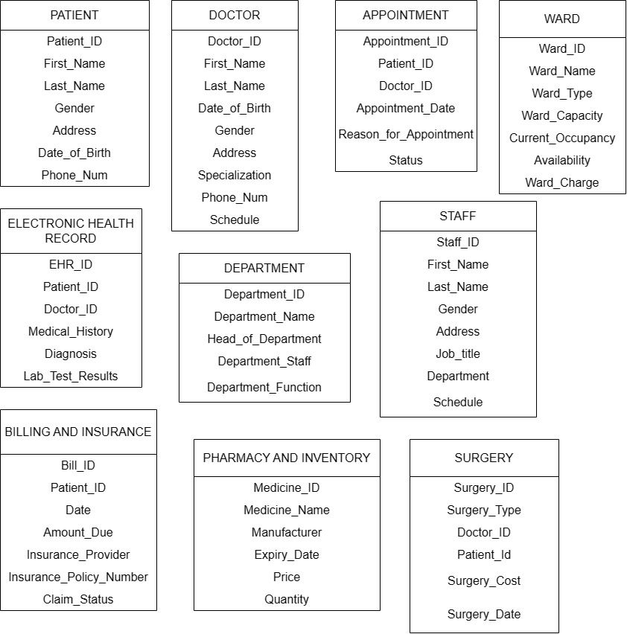
Entities & Attributes

Slide 6
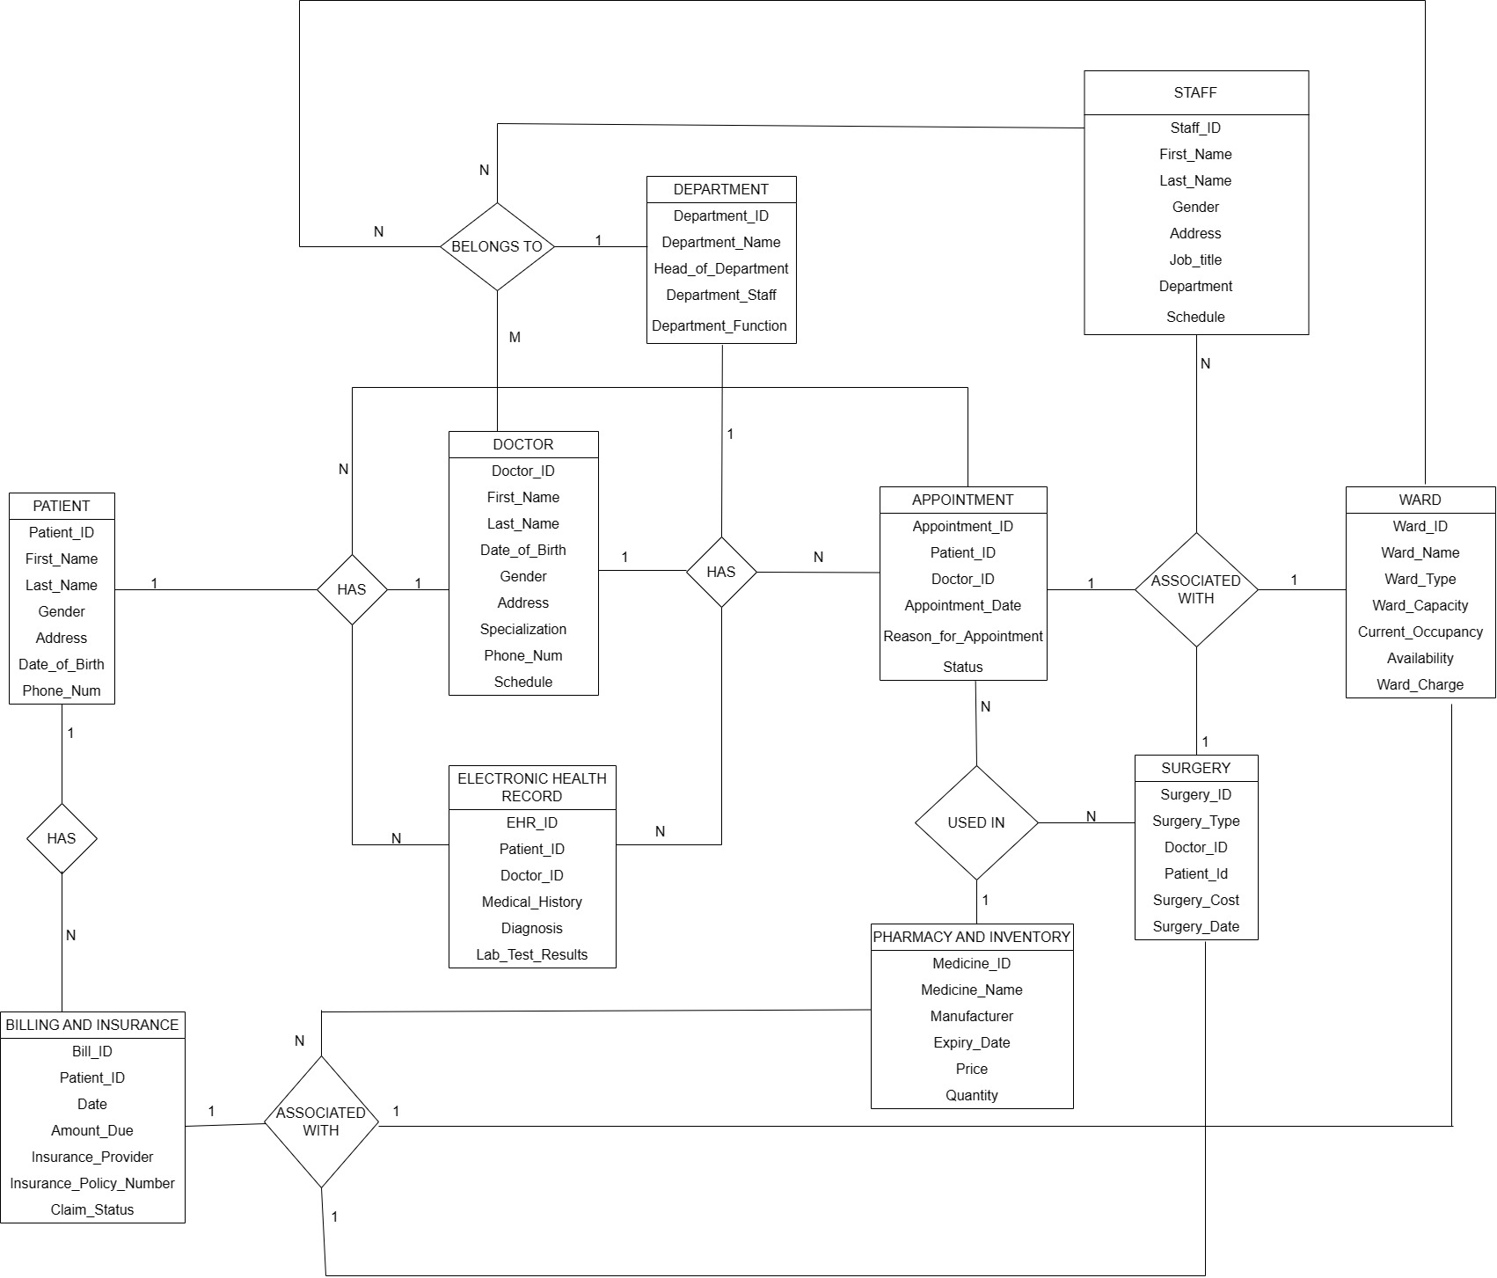
Entity Relationship Diagram

Slide 7
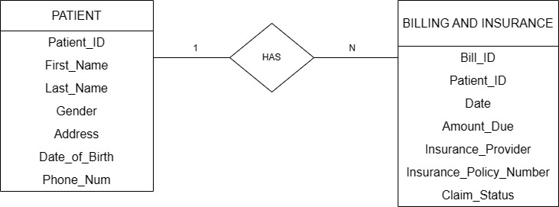
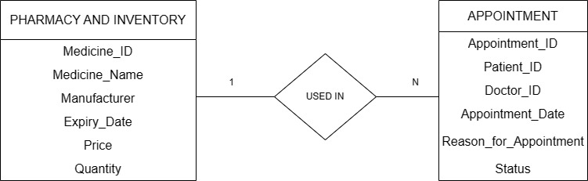
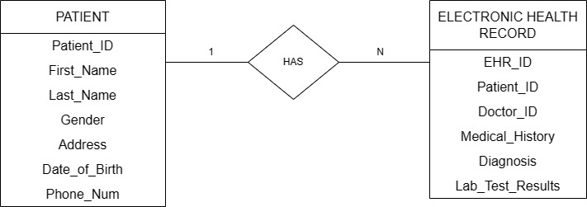
Entity Relationships One to Many Binary Relationships
One medicine from PHARMACY AND INVENTORY can be used in many APPOINTMENTS
One patient with Patient_ID may have one or more bills and insurances.
One patient may have different electronic health record based on different diseases.

Slide 8
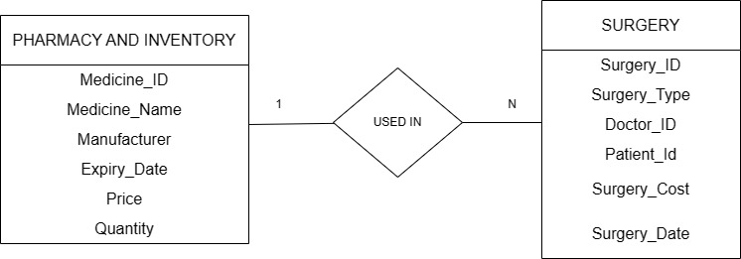
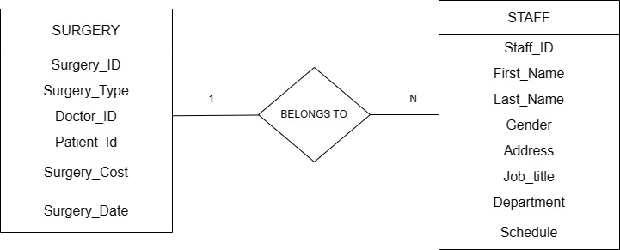
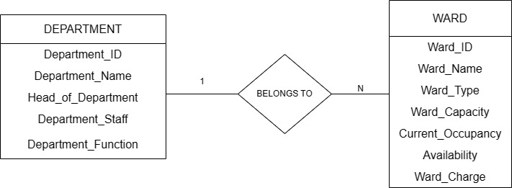
Contd…
One medicine can be used in many surgeries that are performed on many patients.
While performing one surgery on a patient many staff can be assisted.
One department may have different wards based on different diseases.

Slide 9
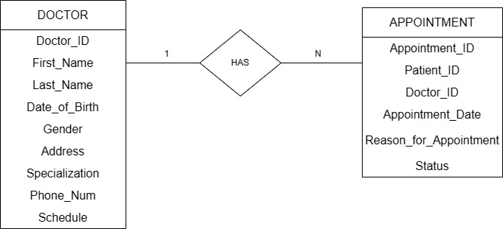
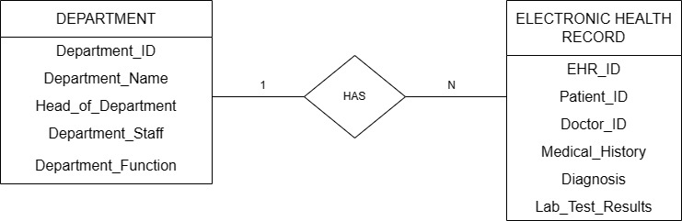
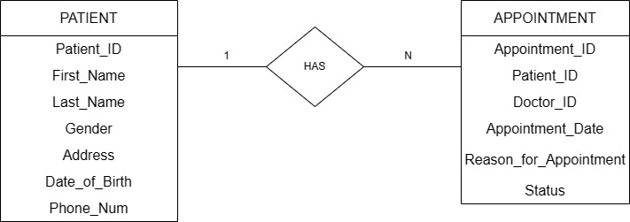
Contd…
One doctor may have many appointments with many patients.
One department may have different electronic health record based on different diseases.
One patient may have different appointments with different doctors based on the diseases he/she has.

Slide 10
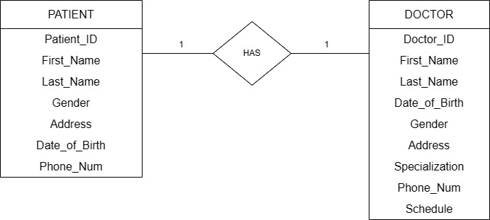
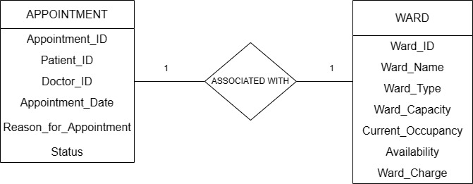
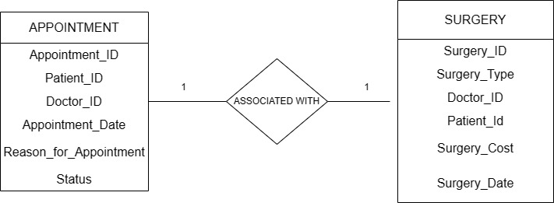
One-to-One binary Relationship
One patient may consult only one doctor at the same time.
One appointment may associate with one ward at the same time.
One appointment may associate with one surgery at the same time.

Slide 11
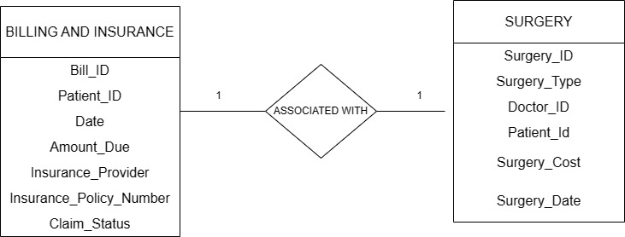
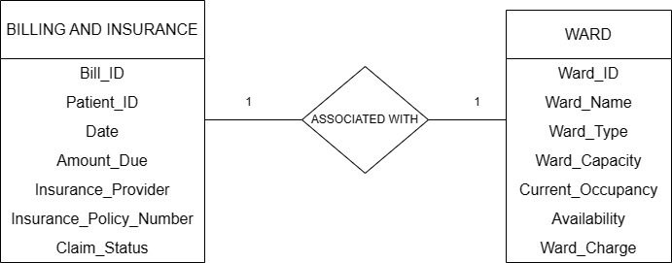
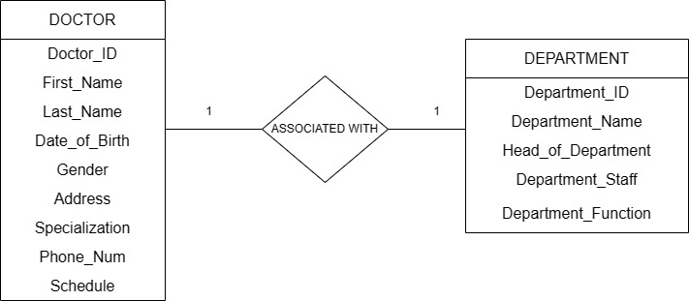
Contd…
One Billing and insurance may associate with one surgery at the same time.
One Billing and insurance may associate with one ward at the same time.
One Doctor is associated with one department at the same time.

Slide 12
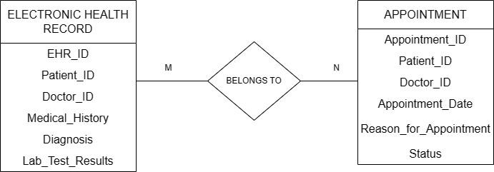
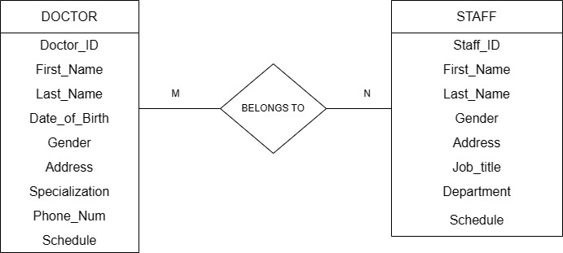
Many-to-Many Binary Relationships
Many Electronic health records may be associated with many appointments with the same time
Many Doctors may be associated with many staff at the same time.

Slide 13
Normalization Rules
Normalization is the process of organizing data in a database to reduce data redundancy and improve data integrity. It involves breaking down a large table into smaller, more manageable tables, which are then linked together through relationships. Normalization is an essential concept in database design as it helps to eliminate data redundancy and inconsistencies that may arise from data updates, deletions or insertions.
Generally, this normalization is divided into subcategories. They are:
1st normalization form (1NF)
2nd normalization form (2NF)
3rd normalization form (3NF)
These normalization rules are being applied to the entities to check whether these are satisfying all the normalization rules.

Slide 14
Contd…
PATIENT: {Patient_ID} {First_Name, Last_Name, Gender, Address, Date_of_Birth, Phone_Num}
DOCTOR: {Doctor_ID} { First_Name, Last_Name, Gender, Address, Specialization, Phone_Num, Date_of_Birth, Schedule}
APPOINTMENT: {Appointment_ID} {Patient_ID, Doctor_ID, Appointment_Date, Reason_for_Appointment, Status}
WARD: { Ward_ID } {Ward_Name, Ward_Type, Ward_Capacity, Availability, Current_Occupancy, Ward_Charge }
EHR: { EHR_ID } {Patient_ID, Doctor_ID, Medical_History, Diagnosis, Lab_Test_Results }
DEPARTMENT: { Department_ID } {Department_Name, Head_of_Departrment, Department_Staff, Department_Function }
STAFF: {Staff_ID} { First_Name, Last_Name, Department_Staff, Gender , Address , Job_Title ,Department, Schedule }

Slide 15
contd…
BILLING AND INSURANCE: { Bill_ID } { Patient_ID, Date, Amount_Due, Insurance_Provider, Insurance_Policy_Number, Claim_Status }
PHARMACY AND INVENTORY: { Medicine_ID } {Medicine_Name, Manufacturer, Expiry_Date, Price, Quantity }
SURGERY: { Surgery_ID } { Surgery_Type, Doctor_ID, Patient_ID, Surgery_Cost, Surgery_Date }
In the above relation all the attributes are atomic (indivisible). So, they satisfy the 1NF.
Here every non-prime attribute is completely dependent on the primary key. So, they satisfy the 2NF.
In the above relation there is no transitive dependency’s existing between non-prime attribute and primary key of relation, so it also satisfies 3NF.

Slide 16
SQL Queries
Syntax for table creation
The column parameters specify the names of the columns of the table.
The datatype parameter specifies the type of data the column can hold (e.g., varchar, integer, date, etc.).
CREATE TABLE table_name (
column1 datatype,
column2 datatype,
column3 datatype,
....
);
Syntax for record insertion
INSERT INTO table_name (column1, column2, column3, ...)
VALUES (value1, value2, value3, ...);
Syntax for view records
SELECT * FROM table_name;

Slide 17
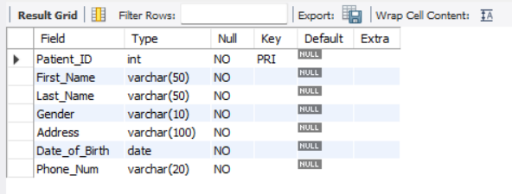
PATIENT:
create table patient ( Patient_ID INT NOT NULL,
First_Name VARCHAR(50) NOT NULL,
Last_Name VARCHAR(50) NOT NULL,
Gender VARCHAR(10) NOT NULL,
Address VARCHAR(100) NOT NULL,
Date_of_Birth DATE NOT NULL,
Phone_Num VARCHAR(20) NOT NULL,
PRIMARY KEY (Patient_ID)
);

Slide 18
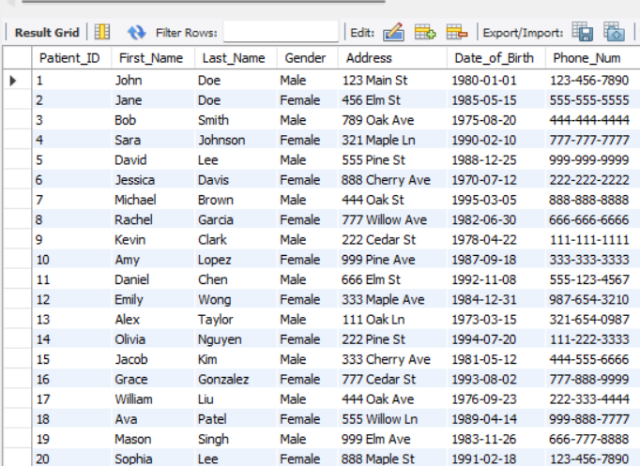
Patient(contd…) – insert records
INSERT INTO patient (Patient_ID, First_Name, Last_Name, Gender, Address, Date_of_Birth, Phone_Num) VALUES
(1, 'John', 'Doe', 'Male', '123 Main St', '1980-01-01', '123-456-7890'),
(2, 'Jane', 'Doe', 'Female', '456 Elm St', '1985-05-15', '555-555-5555'),
(3, 'Bob', 'Smith', 'Male', '789 Oak Ave', '1975-08-20', '444-444-4444'),
(4, 'Sara', 'Johnson', 'Female', '321 Maple Ln', '1990-02-10', '777-777-7777'),
(5, 'David', 'Lee', 'Male', '555 Pine St', '1988-12-25', '999-999-9999'),
(6, 'Jessica', 'Davis', 'Female', '888 Cherry Ave', '1970-07-12', '222-222-2222'),
(7, 'Michael', 'Brown', 'Male', '444 Oak St', '1995-03-05', '888-888-8888'),
(8, 'Rachel', 'Garcia', 'Female', '777 Willow Ave', '1982-06-30', '666-666-6666'),
(9, 'Kevin', 'Clark', 'Male', '222 Cedar St', '1978-04-22', '111-111-1111'),
(10, 'Amy', 'Lopez', 'Female', '999 Pine Ave', '1987-09-18', '333-333-3333'),
(11, 'Daniel', 'Chen', 'Male', '666 Elm St', '1992-11-08', '555-123-4567'),
(12, 'Emily', 'Wong', 'Female', '333 Maple Ave', '1984-12-31', '987-654-3210'),
(13, 'Alex', 'Taylor', 'Male', '111 Oak Ln', '1973-03-15', '321-654-0987'),
(14, 'Olivia', 'Nguyen', 'Female', '222 Pine St', '1994-07-20', '111-222-3333'),
(15, 'Jacob', 'Kim', 'Male', '333 Cherry Ave', '1981-05-12', '444-555-6666'),
(16, 'Grace', 'Gonzalez', 'Female', '777 Cedar St', '1993-08-02', '777-888-9999'),
(17, 'William', 'Liu', 'Male', '444 Oak Ave', '1976-09-23', '222-333-4444'),
(18, 'Ava', 'Patel', 'Female', '555 Willow Ln', '1989-04-14', '999-888-7777'),
(19, 'Mason', 'Singh', 'Male', '999 Elm Ave', '1983-11-26', '666-777-8888'),
(20, 'Sophia', 'Lee', 'Female', '888 Maple St', '1991-02-18', '123-456-7890');

Slide 19
Patient (contd…) – view records
Select * from patient;
In the way, we can create and insert records into the other tables involved in the project.

Slide 20
Future Scope
There are several potential future scopes for a hospital management system. Some possible ideas include:
In future a GUI based application can be developed that connects the hospitals with the Customers.
Incorporating artificial intelligence (AI) and machine learning (ML) algorithms to optimize patient care, such as predicting patient outcomes and recommending treatment plans.
Integration with wearable health devices and mobile apps, allowing patients to easily access and share their health data with healthcare providers.
Utilizing blockchain technology to securely store and share patient health records between healthcare providers, patients, and insurance companies.
Adding telemedicine functionality, allowing patients to remotely consult with healthcare providers and receive virtual care.
Developing a mobile app for patients to schedule appointments, view lab results, and communicate with healthcare providers.
Implementing a patient feedback system to improve the overall patient experience and quality of care.
Creating a patient portal for patients to access their health information and medical records, including test results and discharge instructions.
These are just a few potential ideas for future development of a hospital management system. The possibilities are endless, and the key is to continuously innovate and improve upon existing systems to provide the best possible care for patients.

Slide 21
Conclusion
In conclusion, the hospital management system is a comprehensive and efficient solution for managing various aspects of hospital operations, such as patient records, staff management, billing, pharmacy inventory, and surgical procedures.
By utilizing modern technology and database management techniques, this system offers several advantages such as improved accuracy, faster data processing, and better decision-making capabilities.
It also helps in reducing human errors, minimizing paperwork, and enhancing the overall efficiency of hospital operations.
Overall, the hospital management system can greatly benefit healthcare organizations by streamlining their operations and improving patient care.

