Slide 1



E-Waste Image Classification Using EfficientNetV2B0 (Transfer Learning)
Presented by-
SHILPA.S

Slide 2

Learning Objectives
Aim-
The primary objective of this project is to develop a highly accurate and dependable E-Waste Image Classification model using EfficientNetV2B0 and transfer learning. This model will automate the sorting of electronic waste, supporting sustainable recycling, environmental protection, and a circular economy.
🎓 Learning Objectives
📂 Data Prep: Clean and organize image data for modeling
📊 EDA: Analyze image quality, class balance, and visual traits
🤖 Transfer Learning: Use EfficientNetV2B0 to extract visual features
🧠 Modeling: Train & fine-tune EfficientNet for e-waste classification
🧪 Evaluation: Use accuracy, loss, confusion matrix, classification report
🌐 Deployment: Build a Gradio app to test model predictions interactively
GOAL
Source :
www.freepik.com/

Slide 3
Tools and Technology used
🧰 Software Requirements
Python 3.x
Jupyter Notebook / Google Colab
🛠️ Tools & Libraries:-
Python: For preprocessing, analysis, and visualization
TensorFlow & Keras: Built and fine-tuned EfficientNetV2B0 (optionally V2M)
Pillow (PIL): Image loading and resizing
Gradio: Interactive demo deployment
Matplotlib, NumPy: For data inspection and EDA
Regularization Tools: Dropout, L2, and data augmentation to reduce overfitting
📂 Dataset
Name: E-Waste Image Dataset
Source: https://www.kaggle.com/datasets/akshat103/e-waste-image-dataset

Slide 4
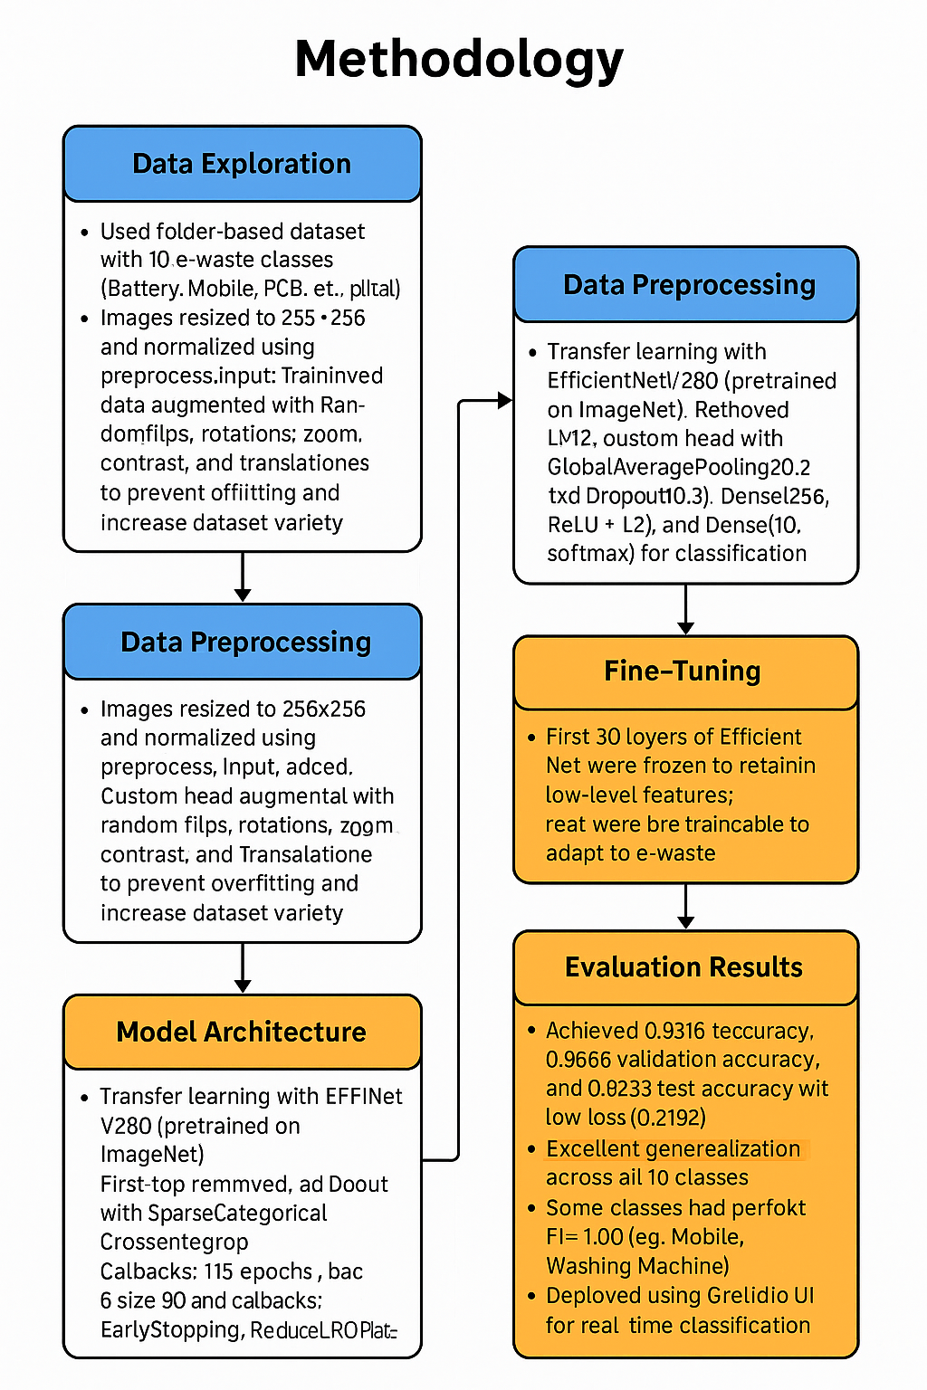
Methodology
🗂 Data Exploration: Used a folder-based dataset with 10 e-waste classes (Battery, Mobile, PCB, etc.), split equally into train (2400), validation (300), and test (300). Each class had balanced samples and visually distinguishable features.
🧹 Data Preprocessing: Images resized to 256×256 and normalized using preprocess_input. Training data was augmented with random flips, rotations, zoom, contrast, and translations to prevent overfitting and increase dataset variety.
🧠 Model Architecture: Transfer learning with EfficientNetV2B0 (pretrained on ImageNet). Removed the top, added a custom head with GlobalAveragePooling2D, two Dropout(0.3) layers, Dense(256, ReLU + L2), and Dense(10, softmax) for classification.
🔧 Fine-Tuning: First 30 layers of EfficientNet were frozen to retain low-level features; the rest were trainable to adapt to the e-waste dataset.

Slide 5
🏋 Model Training:
Optimizer: Adam with a learning rate of 0.0001
Loss Function: SparseCategoricalCrossentropy (ideal for integer-labeled multi-class problems)
Evaluation Metric: Accuracy
Callbacks Used:
EarlyStopping with patience=5 to halt training when no improvement in val_loss was detected.
ReduceLROnPlateau to reduce the learning rate if validation performance plateaued.
restore_best_weights=True ensured best model parameters were retained after training.
Training Configuration:
Trained for 15 epochs
Batch size: 80
🧪 Model Evaluation:
The model demonstrated strong and consistent performance:
Training Accuracy: 0.9916
Validation Accuracy: 0.9666
Test Accuracy: 0.9733
Test Loss: 0.7192
A detailed evaluation using the classification report and confusion matrix confirmed excellent performance across all classes.

Slide 6
Problem Statement:
E-waste (electronic waste) is rapidly becoming a serious environmental and health issue around the world. Proper sorting and categorization of e-waste is essential for efficient recycling and disposal, but manual classification is error-prone and labor-intensive. This project aims to build an automated e-waste classification system using artificial intelligence and machine learning. By training a deep learning model on images of different types of e-waste, we can identify and categorize them accurately.
Goal: Accurately recognize and classify e-waste types using computer vision.
Input: Images of electronic items (battery, mobile, PCB, microwave, etc.).
Output: Predicted category label from 10 classes.
Method: Transfer learning using pre-trained CNN models (e.g., EfficientNetV2B0).
Benefit: Supports faster, scalable e-waste recycling and smart city sustainability initiatives.

Slide 7
Solution:
1. Adopted EfficientNetV2B0 for Transfer Learning
Replaced older CNN or basic models with the EfficientNetV2B0 backbone.
Offers better performance with fewer parameters and improved accuracy.
Suitable for both small and large datasets due to compound scaling.
2. Enhanced Data Augmentation
Applied advanced augmentation techniques:
RandomFlip, RandomRotation, RandomZoom, RandomContrast, RandomTranslation.
Resulted in better generalization and reduced overfitting.
3. Fine-Tuned Feature Extraction
Froze first 30 layers of the EfficientNet model to retain low-level pretrained features.
Allowed higher layers and custom head to adapt to specific e-waste categories.
4. Improved Classification Head Design
Added a well-structured custom head:
GlobalAveragePooling2D
Dropout(0.3) for regularization
Dense(256, ReLU) with L2 regularization
Final Dense(10, softmax) for 10-class classification

Slide 8
Solution:
5. Advanced Training Strategies
Used Adam optimizer with learning rate = 0.0001.
Added:
EarlyStopping (to halt training if no improvement in val_loss)
ReduceLROnPlateau (to adjust learning rate dynamically)
6. Gradio-Based Model Deployment
Integrated a Gradio web interface for real-time image classification.
Simple UI for uploading images and showing predictions with confidence scores.
7. Scalability to Large and Small Datasets
The model design ensures:
Robust performance on small datasets (through transfer learning + augmentation)
Scalability for large datasets (EfficientNet handles high-resolution inputs efficiently)
8. Structured Evaluation and Visualization
Confusion matrix heatmap with Seaborn
Classification report showing precision, recall, F1-score

Slide 9
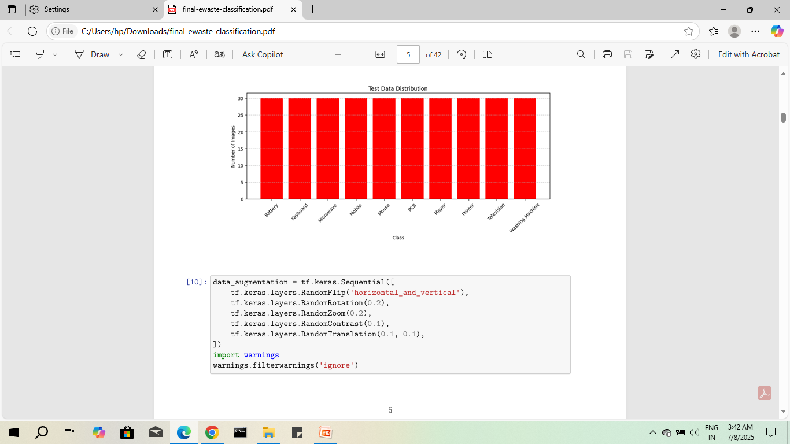
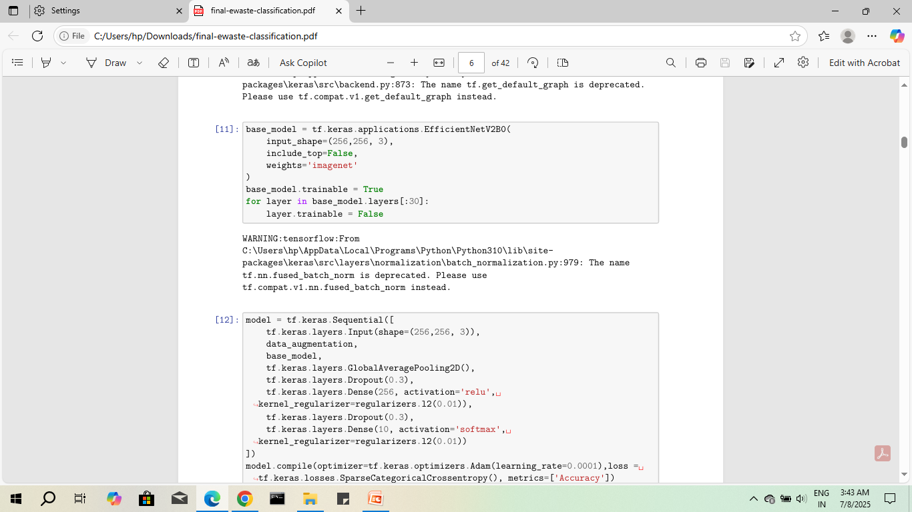
Screenshot of Output:

Slide 10
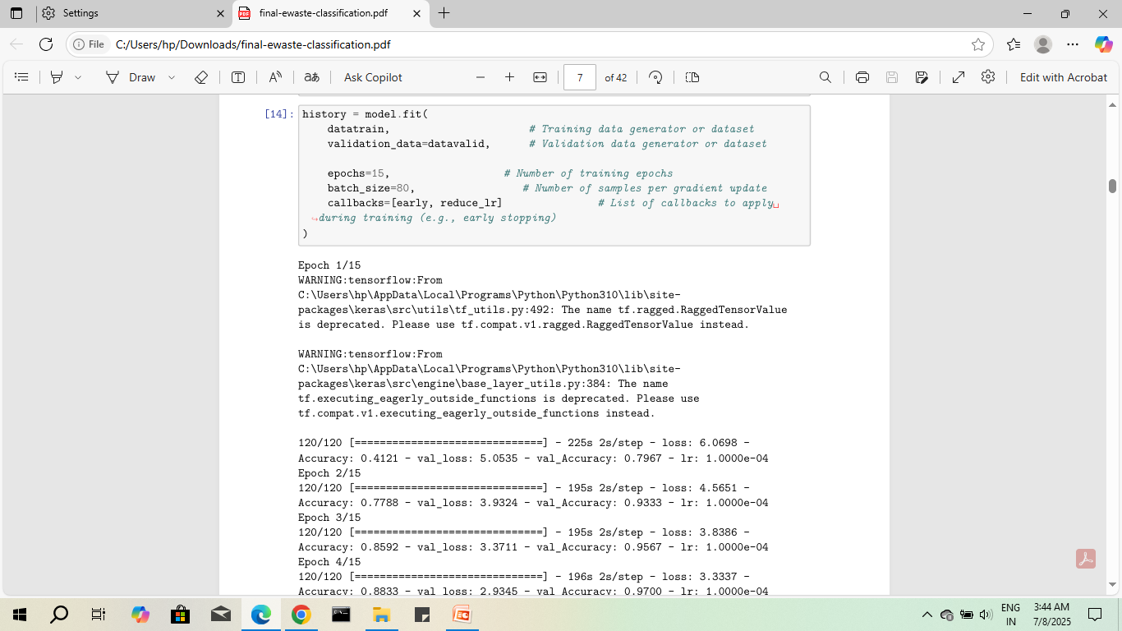

Slide 11
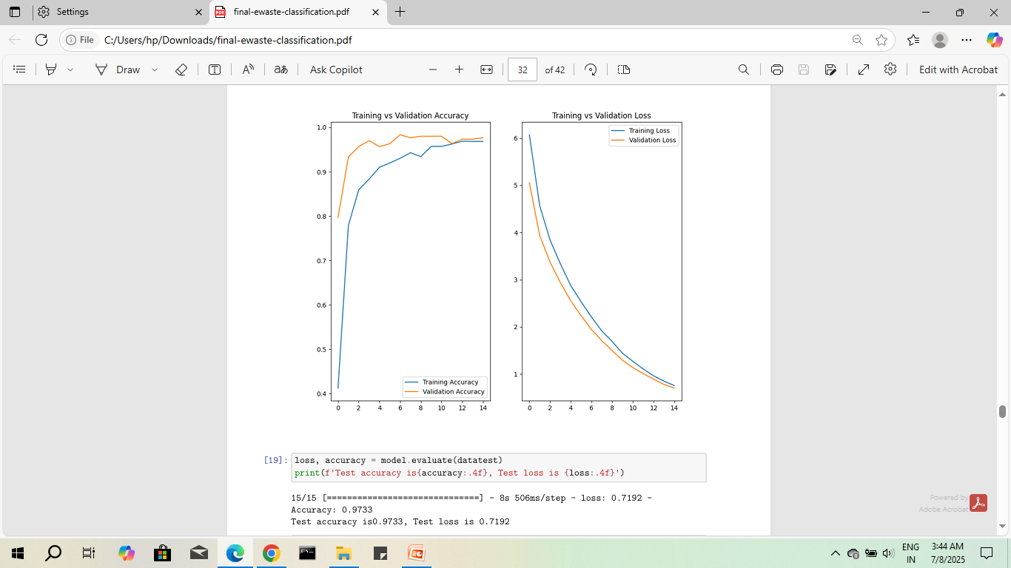

Slide 12
Conclusion:
This e-waste classification project successfully implemented an enhanced and scalable deep learning solution using EfficientNetV2B0 and transfer learning. The final model significantly improved upon earlier versions by incorporating robust data augmentation, fine-tuning strategies, and regularization techniques, leading to higher classification accuracy and better generalization.
The model demonstrated strong performance on both small balanced datasets and is architecturally capable of scaling to larger, more diverse datasets, owing to EfficientNet's compound scaling. The addition of a Gradio-based GUI further contributes to its practical usability, making it a valuable prototype for real-world e-waste sorting automation.
This study validates the power of transfer learning for domains with limited labeled data, while also pointing toward future improvements such as hyperparameter tuning, object detection for multi-item images, and deployment via lightweight inference models like TFLite or ONNX. The proposed system can meaningfully contribute to sustainable e-waste management practices and serve as a foundational step toward smarter waste-sorting infrastructures.

