Slide 1
Title: Sales and Financial Performance Dashboard
Subtitle: Cars Prices
Your Name: Shilpa Mahantesh Itnal
Date: 25-09-2025
Context/Logo: Elevate Labs Data Analyst Internship - Task 4

Slide 2
Introduction
In today’s business environment, organizations generate huge volumes of sales and financial data every day. To make sense of this data and turn it into actionable insights, dashboards play a crucial role.
A dashboard is a visual interface that consolidates key metrics, trends, and comparisons in a single interactive view . It enables business stakeholders to :
Track Key Performance Indicators (KPIs) such as Sales, Profit, and Growth.
Analyze trends over time (monthly, quarterly, yearly).
Compare performance across regions, products, and categories .
Make faster and more accurate data-driven decisions

Slide 3
Objective
The main objective of this task is to design and develop an interactive dashboard that provides meaningful insights to business stakeholders.
Goals:
Track Sales, Profit, and Growth KPIs
Provide time-series analysis for trend detection
Enable business decisions using interactive visualizations

Slide 4
Importance of Dashboards
Dashboards consolidate large datasets into simple, visual summaries.
Help stakeholders answer questions quickly:
“Which region is most profitable?”
“What is the sales trend over time?”
“Which products are underperforming?”
Improve decision-making speed and accuracy.
Tools Used Power BI
Microsoft’s data visualization tool .
Easy integration with Excel, SQL, and cloud services.
Features: DAX formulas, slicers, drill-through, interactive reports.

Slide 5
Dataset Source
Kaggle Sales & Financial dataset.
Data Attributes:
Sales data (Region, Product, Category, Quantity, Revenue).
Profit data (Cost, Margin, Net Profit).
Time attributes (Year, Month, Quarter).
Geographic attributes (Region, Country, State).
Reason for using: Rich dataset suitable for KPI measurement.

Slide 6
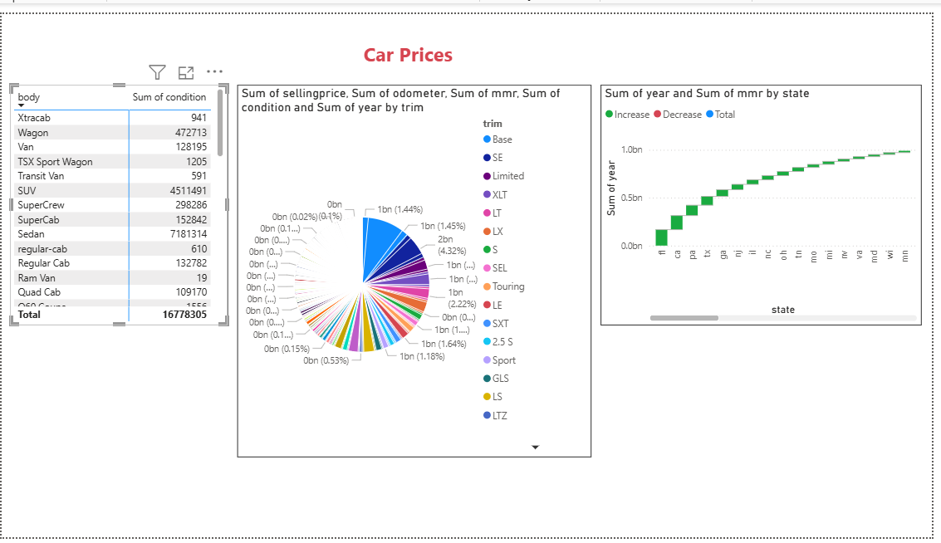
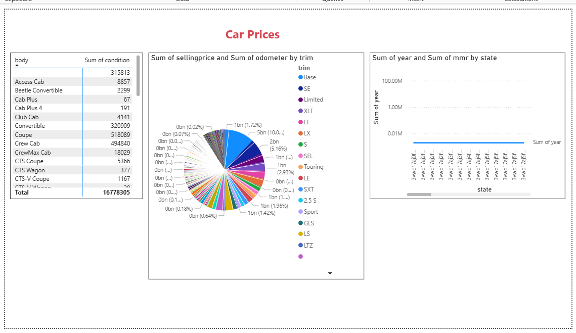
Pictures of Sales Analysis

Slide 7
Dashboard Design Approach
KPI Identification:
Total Sales, Total Profit, Year-over-Year Growth
Interactivity Features
Slicers (Year, Region, Product Category)
Drill-down functionality
Visualization Types
Line chart for time-series analysis
Bar chart for region/product comparison
Donut/Pie chart for category distribution
Cards for KPI totals
Design Consistency
Uniform color palette
Simple layout for readability

Slide 8
Conclusion
The dashboard project highlights the importance of converting raw sales and financial data into meaningful business insights. By using Power BI or Tableau, the data was transformed into an interactive dashboard that clearly displays key performance indicators such as sales, profit, and growth. The use of slicers, filters, and time-series charts made the dashboard highly interactive and easy to navigate, helping stakeholders explore the data from multiple perspectives. This not only improves decision-making but also identifies trends, profitable regions, and underperforming areas. Overall, the project enhanced my understanding of dashboard design principles, visualization techniques, and the role of data analytics in driving informed business strategies.

