Slide 1


DATA ANALYTICS FINAL PROJECT
Project Title:Instagram Analytics
Data Cleaning and Exploratory Data Analysis
Presented by Shilpa
Data Analytics course project
29,999
26
6
16
posts
working columns
key insights
chart figures
The notebook’s final figure has four panels, for 19 chart panels in total.
Notes:
Introduce the project. I analyzed 29,999 Instagram posts. The original CSV has 23 columns. I added three columns, so the final working dataset has 26. The notebook code contains 16 chart figures. Its last figure contains four small charts, so there are 19 chart panels altogether.
Project materials: user-provided Instagram_Analytics.csv, Instagram_Analytics_Project.ipynb, and Data Analytics Final Project Guidelines.

Slide 2

PROJECT AIM
Why analyze Instagram posts?
The question behind the project
A creator may ask: Which format gets more interactions? Which topics have higher engagement? How do reach and impressions change over time?
What this analysis can help us do
Use the post data to compare groups, spot patterns, and make better questions for future content tests.
A useful limit to remember
The dataset includes reach and impressions. It does not have a separate video-views column, so we should not call reach or impressions “views.”
Instagram Analytics
02
Notes:
Say: I want to understand what the dataset can tell us about Instagram post performance. The results can guide ideas, but they do not promise that a future post will perform the same way.
Project materials: user-provided Instagram_Analytics.csv, Instagram_Analytics_Project.ipynb, and Data Analytics Final Project Guidelines.

Slide 3

DATASET
What is in the dataset?
One row represents one Instagram post
The Kaggle CSV contains 29,999 posts and 23 original columns. The dates in the data run from November 2024 through November 2025.
Post and account details
Account type, follower count, media type, content category, traffic source, call to action, and posting date and time.
Performance details
Likes, comments, shares, saves, reach, impressions, engagement rate, followers gained, caption length, and hashtag count.
After preparation
I added total interactions, posting year, and posting month. The working dataset has 26 columns.
Instagram Analytics
03
Notes:
Say: This dataset combines information about the post, the account, and the results of each post. One row means one post.
Project materials: user-provided Instagram_Analytics.csv, Instagram_Analytics_Project.ipynb, and Data Analytics Final Project Guidelines.

Slide 4

PROJECT AIM
What each project step is for
Data Loading and cleaning
Import the Instagram dataset in to Python using Jupiter Notebook ,Check that the data is complete, consistent, and in a useful format.
New columns
Combine interaction counts and pull the year and month from the post date.
EDA and charts
Explore the data and make patterns easier to see.
Insights and suggestions
Explain what the results may mean and suggest what a creator could test next.
Instagram Analytics
04
Notes:
Say: We start with the raw rows and columns. Each step prepares the information so we can understand it and explain what we found.
Project materials: user-provided Instagram_Analytics.csv, Instagram_Analytics_Project.ipynb, and Data Analytics Final Project Guidelines.

Slide 5

WORKFLOW
Project workflow
1 Load and inspect
Bring the CSV into Python and check its size and contents.
2 Clean and prepare
Check data quality, convert dates, and create useful columns.
3 Explore the data
Use summaries and group comparisons to look for patterns.
4 Create visualizations
Show distributions, comparisons, relationships, and time patterns.
5 Share insights and next steps
Explain the findings, limits, and suggestions.
Instagram Analytics
05
Notes:
Say: This is the order I followed from loading the dataset through to the conclusion.
Project materials: user-provided Instagram_Analytics.csv, Instagram_Analytics_Project.ipynb, and Data Analytics Final Project Guidelines.

Slide 6

LOAD AND INSPECT
Step 1 Load the CSV into Python
What does loading mean?
Loading means opening the CSV file in Python so I can work with its rows and columns.
How I did it
I used the pandas library to read the CSV into a table called a DataFrame. A DataFrame is like a table with rows and named columns.
Why this step matters
Once the file is loaded, I can inspect, clean, summarize, and chart the data with Python.
Instagram Analytics
06
Notes:
Say: I loaded the Instagram CSV file into a pandas DataFrame. This made the data ready for checks and analysis.
Project materials: user-provided Instagram_Analytics.csv, Instagram_Analytics_Project.ipynb, and Data Analytics Final Project Guidelines.

Slide 7

LOAD AND INSPECT
Step 1 Inspect the dataset
What I checked
I looked at the number of rows and columns, sample records, column names and data types, missing values, and duplicate rows.
What the first check showed
The dataset had 29,999 rows and 23 columns. Every column had a value in every row. There were no duplicate rows.
Why inspect before cleaning?
The first check shows what the file contains and helps decide which cleaning checks are needed.
Instagram Analytics
07
Notes:
Say: Inspection is like checking the contents of a box before sorting it. I checked the size, a few example rows, each column’s type, blank values, and duplicates.
Project materials: user-provided Instagram_Analytics.csv, Instagram_Analytics_Project.ipynb, and Data Analytics Final Project Guidelines.

Slide 8
CLEANING
Step 2 Data cleaning checks
Missing values and duplicates
I checked for blank cells, repeated rows, and repeated post IDs. None were found.
Date and time formats
The date fields started as text. I changed them into date-time values so Python could read dates and times correctly.
Date consistency
I compared the date, hour, and weekday columns with the full post date and time. They all matched.
Why it matters
These checks help prevent errors when we group posts by date or compare them.
Instagram Analytics
08
Notes:
Say: I checked that the dataset had no blanks or duplicates. I converted the date fields from text into date and time format, then checked that the separate date fields agreed.
Project materials: user-provided Instagram_Analytics.csv, Instagram_Analytics_Project.ipynb, and Data Analytics Final Project Guidelines.

Slide 9
CLEANING
Step 2 Check values and categories
Numeric checks
I checked that counts were not negative, posting hours were between 0 and 23, engagement rates were between 0 and 1, and impressions were not below reach.
Call-to-action values
I checked that this column contained only 0 and 1. Here, 0 means no call to action and 1 means there is one.
Category checks
I checked labels such as brand or creator, image or reel, and the content and traffic-source categories. No unexpected labels appeared.
Instagram Analytics
09
Notes:
Say: These checks looked for values outside the expected range and labels that might have been typed inconsistently. All the checks passed.
Project materials: user-provided Instagram_Analytics.csv, Instagram_Analytics_Project.ipynb, and Data Analytics Final Project Guidelines.

Slide 10
CLEANING
Data cleaning summary
The checks passed
No missing values. No duplicate rows or post IDs. No date mismatches. No invalid numeric values or unexpected category labels.
What changed
I converted the date and time columns into date-time format.
What stayed
All 29,999 posts stayed in the dataset because none needed to be removed or corrected.
Instagram Analytics
10
Notes:
Say: I checked the main data-quality issues. The dataset passed these checks, so I kept all the rows and converted the date columns for analysis.
Project materials: user-provided Instagram_Analytics.csv, Instagram_Analytics_Project.ipynb, and Data Analytics Final Project Guidelines.

Slide 11
PREPROCESSING
Three columns I created
Total interactions
Likes + comments + shares + saves. This gives one combined count of four ways people interacted with a post.
Post year
The year taken from the post date. It can help group posts by year.
Post month
The month name taken from the post date. It can help compare posts by month.
Why create them?
These columns make it easier to compare overall interaction counts and explore time patterns.
Instagram Analytics
11
Notes:
Say: I created three helpful columns. Total interactions combines four counts. Post year and post month come from the full post date.
Project materials: user-provided Instagram_Analytics.csv, Instagram_Analytics_Project.ipynb, and Data Analytics Final Project Guidelines.

Slide 12
PREPROCESSING
Data preprocessing summary
Final working dataset
29,999 rows and 26 columns.
What I did
Checked missing values, duplicates, date consistency, numeric ranges, and category labels. Converted date fields. Added total interactions, year, and month.
Ready for analysis
The data is now in a format that is easier to group, compare, and chart.
Instagram Analytics
12
Notes:
Say: After cleaning and creating the three new columns, the dataset has 29,999 rows and 26 columns. This is the version I use in the analysis.
Project materials: user-provided Instagram_Analytics.csv, Instagram_Analytics_Project.ipynb, and Data Analytics Final Project Guidelines.

Slide 13
EDA
What is exploratory data analysis?
EDA means exploring the data before drawing conclusions
I look at the values, compare groups, and check patterns so I can understand what the dataset contains.
Simple examples
Which post type has more average interactions? Which content category has a higher engagement rate? Do reach and impressions move together?
Why do it?
EDA helps us notice useful patterns, differences, and questions that may need more testing.
Keep the result in context
A pattern in this dataset does not prove that one feature caused another.
Instagram Analytics
13
Notes:
Say: Exploratory data analysis means checking and studying the data to understand it better. For example, we can compare post types and see how engagement changes.
Project materials: user-provided Instagram_Analytics.csv, Instagram_Analytics_Project.ipynb, and Data Analytics Final Project Guidelines.

Slide 14
EDA
Review key performance measures
What is a key performance measure?
It is an important result we want to measure for each post.
People’s interactions
Likes, comments, shares, and saves show different ways people responded to a post.
Audience and exposure
Reach counts accounts reached. Impressions count times content was shown. Followers gained counts new followers.
Engagement rate
A rate that describes interaction compared with the audience size. In the notebook, 0.0421 is about 4.21%.
Instagram Analytics
14
Notes:
Say: I first reviewed the main measures of post performance. These help describe how people interacted with posts and how widely the posts were shown.
Project materials: user-provided Instagram_Analytics.csv, Instagram_Analytics_Project.ipynb, and Data Analytics Final Project Guidelines.

Slide 15
EDA METHODS
Three ways to explore data
Univariate means one variable
I study one column at a time. Example: how total interactions are spread across all posts.
Bivariate means two variables
I compare two things. Example: average interactions by media type, or caption length and total interactions.
Multivariate means three or more variables
I look at several things together. Example: account type, media type, and average interactions in one heatmap.
The charts that follow
Each chart asks a question and gives one view of the dataset.
Instagram Analytics
15
Notes:
Say: Univariate looks at one value. Bivariate compares two values. Multivariate studies three or more values at the same time.
Project materials: user-provided Instagram_Analytics.csv, Instagram_Analytics_Project.ipynb, and Data Analytics Final Project Guidelines.

Slide 16
VISUALIZATIONS
Step 4 Visualizations
Why make charts?
Charts help people see patterns that may be hard to notice in a long table of numbers. I used Matplotlib and Plotly in Python.
What these visuals cover
Distributions, group comparisons, relationships between measures, and changes over time.
How to read them
Check the title, labels, units, and legend. Then describe only what the chart supports.
Notebook count
16 chart figures, including one four-panel figure. That gives 19 individual chart panels.
Instagram Analytics
16
Notes:
Say: I used charts to make the analysis easier to understand. The deck includes all 16 chart figures saved in the notebook.
Project materials: user-provided Instagram_Analytics.csv, Instagram_Analytics_Project.ipynb, and Data Analytics Final Project Guidelines.

Slide 17
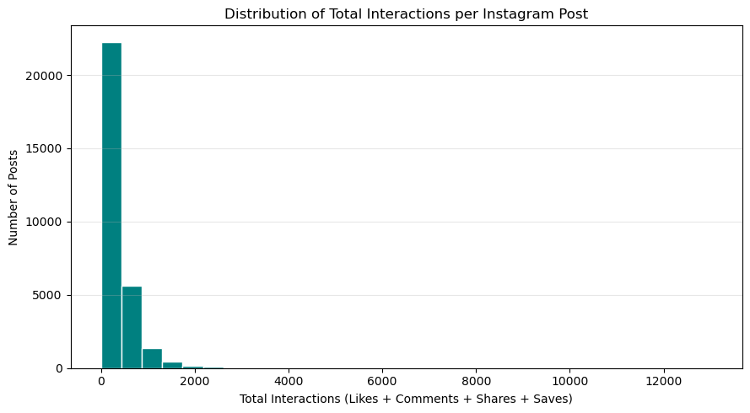
EDA AND VISUALS
Plot 1 of 16 – univariate Analysis- Distribution of total interactions
CHART TYPE: HISTOGRAM
WHAT THIS CHART SHOWS
A histogram groups posts into ranges of total interactions. The bars show how many posts fall in each range.
WHAT WE SEE
Most posts sit in the lower interaction ranges. A smaller number of posts have much higher totals.
SIMPLE TAKEAWAY
A few high-interaction posts create a long upper tail.
Instagram Analytics
17
Notes:
Say: This is univariate analysis. The histogram shows the spread of one measure, total interactions, across all posts.
Project materials: user-provided Instagram_Analytics.csv, Instagram_Analytics_Project.ipynb, and Data Analytics Final Project Guidelines.

Slide 18
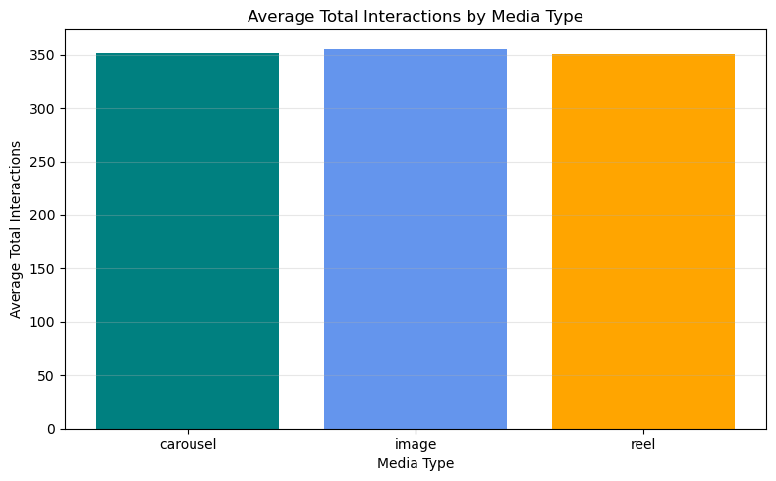
EDA AND VISUALS
Plot 2 of 16 –Bivariate Analysis- Average total interactions by media type
CHART TYPE: BAR CHART
WHAT THIS CHART SHOWS
This bar chart compares mean total interactions for carousel, image, and reel posts.
WHAT WE SEE
Image posts average 355.53 interactions. Carousels average 351.86 and reels 351.06.
SIMPLE TAKEAWAY
The averages are close. Image posts are slightly higher in this dataset.
Instagram Analytics
18
Notes:
Say: I used groupby to calculate one average for each media type. The differences are small and do not show that the format caused the result.
Project materials: user-provided Instagram_Analytics.csv, Instagram_Analytics_Project.ipynb, and Data Analytics Final Project Guidelines.

Slide 19
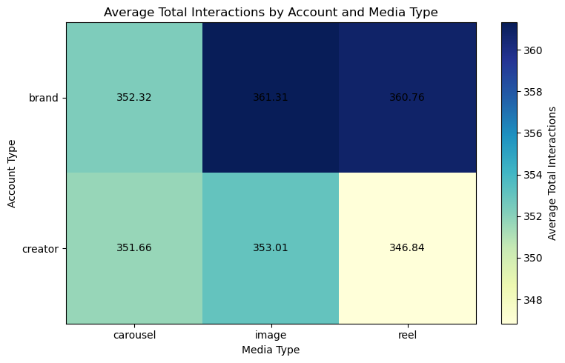
EDA AND VISUALS
Plot 3 of 16 –Multivariate Analysis- Account type ,media type & Average Total Interactions
CHART TYPE: HEATMAP (GROUPED AVERAGES)
WHAT THIS CHART SHOWS
This heatmap compares average interactions using account type, media type, and total interactions.
A pivot table was used to calculate the average interactions for each account type & media type
WHAT WE SEE
Brand image posts average 361.31. Creator reels average 346.84.
SIMPLE TAKEAWAY
The highest and lowest group averages differ by about 14 interactions.
Instagram Analytics
19
Notes:
Say: This is multivariate analysis. The pivot table lets us compare two group types together.
Project materials: user-provided Instagram_Analytics.csv, Instagram_Analytics_Project.ipynb, and Data Analytics Final Project Guidelines.

Slide 20
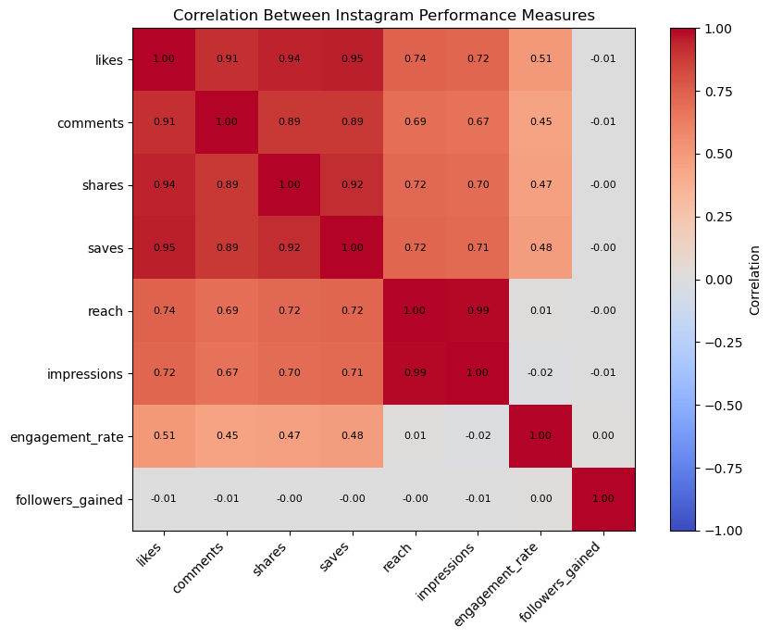
EDA AND VISUALS
Plot 4 of 16 - Correlation between performance measures
CHART TYPE: CORRELATION HEATMAP
WHAT THIS CHART SHOWS
A correlation heatmap shows how closely numeric measures move together. Values closer to 1 mean a stronger positive relationship.
WHAT WE SEE
Reach and impressions have a 0.99 correlation. Likes, comments, shares, and saves also have positive relationships.
SIMPLE TAKEAWAY
Reach and impressions move very closely together in these records. Correlation does not prove cause.
Instagram Analytics
20
Notes:
Say: The heatmap summarizes relationships between several measures at once. Followers gained has almost no linear relationship with the other measures here.
Project materials: user-provided Instagram_Analytics.csv, Instagram_Analytics_Project.ipynb, and Data Analytics Final Project Guidelines.

Slide 21
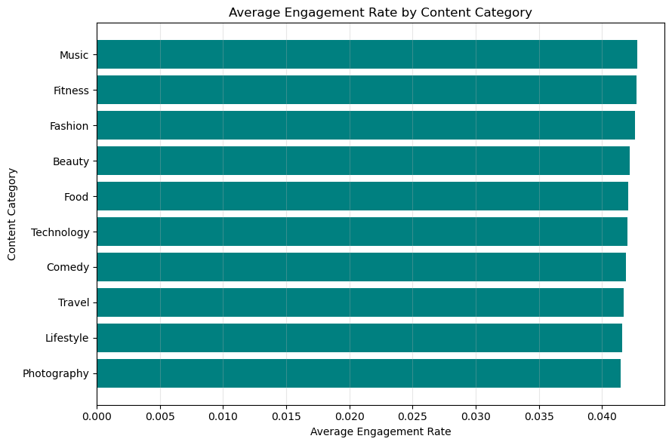
EDA AND VISUALS
Plot 5 of 16 - Engagement rate by content category
CHART TYPE: HORIZONTAL BAR CHART
WHAT THIS CHART SHOWS
This chart compares the average engagement rate across ten content categories.
WHAT WE SEE
Music is highest at about 4.28%. Photography is lowest at about 4.15%.
SIMPLE TAKEAWAY
The difference is small, about 0.13 percentage points.
Instagram Analytics
21
Notes:
Say: I grouped posts by category and compared average engagement rates. The categories are similar in this dataset.
Project materials: user-provided Instagram_Analytics.csv, Instagram_Analytics_Project.ipynb, and Data Analytics Final Project Guidelines.

Slide 22
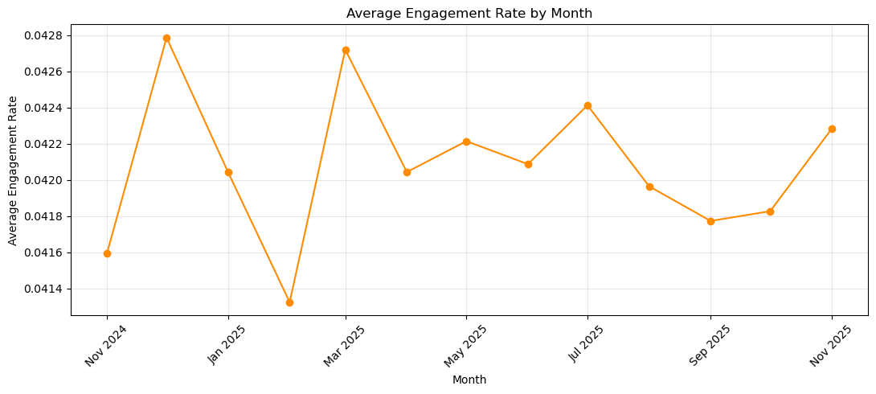
EDA AND VISUALS
Plot 6 of 16 - Average engagement rate by month
CHART TYPE: LINE CHART
WHAT THIS CHART SHOWS
The line chart shows the average engagement rate for each month.
WHAT WE SEE
Monthly averages stay in a narrow range, about 4.13% to 4.28%.
SIMPLE TAKEAWAY
The monthly engagement rate is fairly steady in this period.
Instagram Analytics
22
Notes:
Say: This line chart shows change over time. There are small month-to-month changes, but no large difference in the monthly averages.
Project materials: user-provided Instagram_Analytics.csv, Instagram_Analytics_Project.ipynb, and Data Analytics Final Project Guidelines.

Slide 23
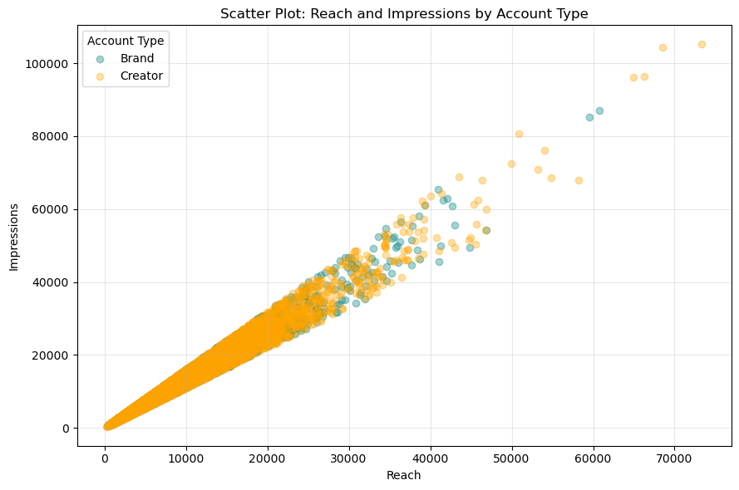
EDA AND VISUALS
Plot 7 of 16 - Reach and impressions by account type
CHART TYPE: SCATTER PLOT
WHAT THIS CHART SHOWS
Each dot is one post. The chart compares reach and impressions for brand and creator posts.
WHAT WE SEE
For both account types, higher reach generally appears with higher impressions. The two groups overlap.
SIMPLE TAKEAWAY
Reach and impressions rise together for both account types.
Instagram Analytics
23
Notes:
Say: This scatter plot compares two numeric measures. Each dot is one post, and the colors show account type.
Project materials: user-provided Instagram_Analytics.csv, Instagram_Analytics_Project.ipynb, and Data Analytics Final Project Guidelines.

Slide 24
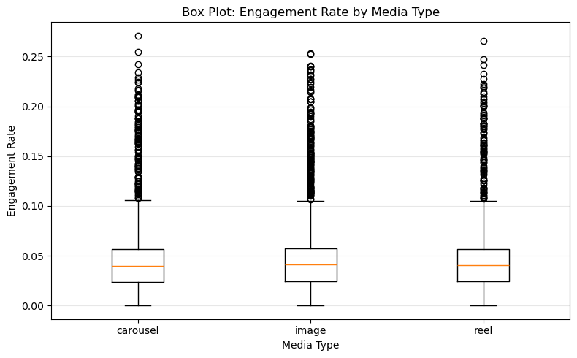
EDA AND VISUALS
Plot 8 of 16 - Engagement rate by media type
CHART TYPE: BOX PLOT
WHAT THIS CHART SHOWS
A box plot compares the middle value and spread of engagement rates for each media type.
WHAT WE SEE
The boxes and whiskers overlap, so the ranges look similar.
SIMPLE TAKEAWAY
The media types have broadly similar engagement-rate distributions.
Instagram Analytics
24
Notes:
Say: The box plot shows the middle half of the values, the median, and unusually high or low points.
Project materials: user-provided Instagram_Analytics.csv, Instagram_Analytics_Project.ipynb, and Data Analytics Final Project Guidelines.

Slide 25
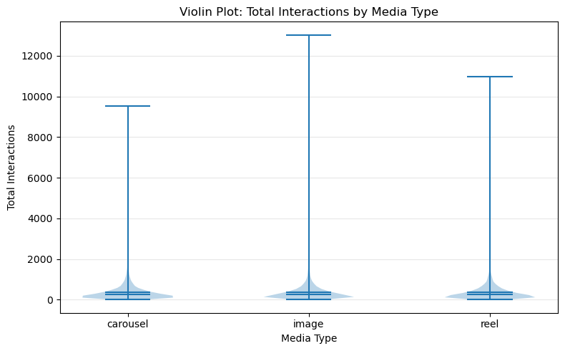
EDA AND VISUALS
Plot 9 of 16 - Total interactions by media type
CHART TYPE: VIOLIN PLOT
WHAT THIS CHART SHOWS
A violin plot shows where interaction counts are concentrated for each media type. Wider areas contain more posts.
WHAT WE SEE
The shapes are broadly similar, with many posts at lower counts and fewer at high counts.
SIMPLE TAKEAWAY
The distribution shapes are more alike than different.
Instagram Analytics
25
Notes:
Say: This chart adds the shape of the distribution to the comparison of media types.
Project materials: user-provided Instagram_Analytics.csv, Instagram_Analytics_Project.ipynb, and Data Analytics Final Project Guidelines.

Slide 26
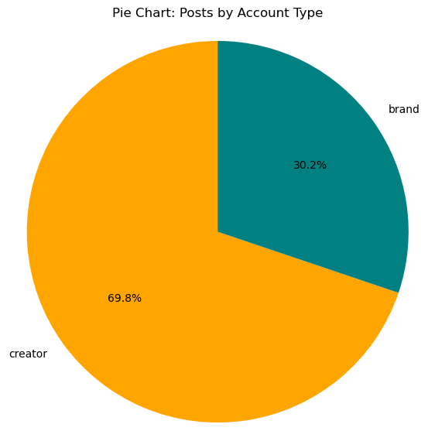
EDA AND VISUALS
Plot 10 of 16 - Posts by account type
CHART TYPE: PIE CHART
WHAT THIS CHART SHOWS
The pie chart shows the share of all posts from brands and creators.
WHAT WE SEE
Creators contributed 20,944 posts, about 69.8%. Brands contributed 9,055 posts, about 30.2%.
SIMPLE TAKEAWAY
Creator posts make up about seven in ten records.
Instagram Analytics
26
Notes:
Say: This chart describes which account types are represented in the dataset. It does not compare their post quality.
Project materials: user-provided Instagram_Analytics.csv, Instagram_Analytics_Project.ipynb, and Data Analytics Final Project Guidelines.

Slide 27
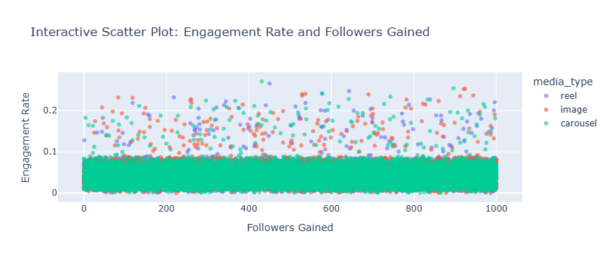
EDA AND VISUALS
Plot 11 of 16 - Engagement rate and followers gained
CHART TYPE: INTERACTIVE SCATTER PLOT
WHAT THIS CHART SHOWS
Each dot is a post. The colors show media type. Hovering in the notebook can reveal post details.
WHAT WE SEE
The points are spread across follower gains, with media types mixed together. No clear straight-line pattern stands out.
SIMPLE TAKEAWAY
Follower gain and engagement rate do not show a clear linear pattern here.
Instagram Analytics
27
Notes:
Say: This interactive chart lets me explore individual posts. The presentation image is a still view of the chart.
Project materials: user-provided Instagram_Analytics.csv, Instagram_Analytics_Project.ipynb, and Data Analytics Final Project Guidelines.

Slide 28
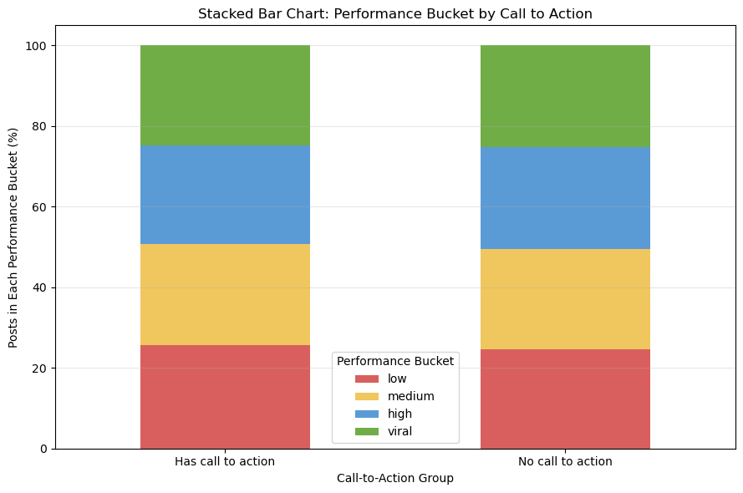
EDA AND VISUALS
Plot 12 of 16 - Performance group by call to action
CHART TYPE: STACKED BAR CHART
WHAT THIS CHART SHOWS
The stacked bars compare the percent of posts labeled low, medium, high, or viral for each call-to-action group.
WHAT WE SEE
The four groups are close to one quarter each. The percentages differ only slightly between CTA and no-CTA posts.
SIMPLE TAKEAWAY
The bucket mix looks similar for posts with and without a call to action.
Instagram Analytics
28
Notes:
Say: The chart shows group percentages, not proof that the call to action changed performance.
Project materials: user-provided Instagram_Analytics.csv, Instagram_Analytics_Project.ipynb, and Data Analytics Final Project Guidelines.

Slide 29
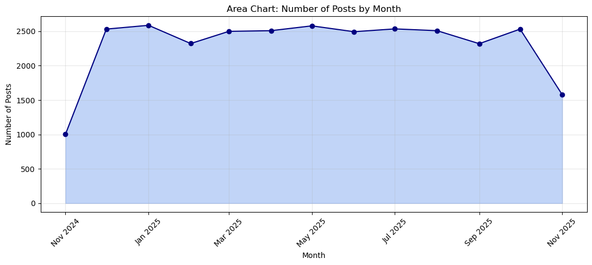
EDA AND VISUALS
Plot 13 of 16 - Number of posts by month
CHART TYPE: AREA CHART
WHAT THIS CHART SHOWS
The area chart counts how many posts appear in each month.
WHAT WE SEE
Most full months contain roughly 2,300 to 2,600 posts. The first and last months have fewer records.
SIMPLE TAKEAWAY
Monthly post counts are similar across most full months. The edge months may cover only part of a month.
Instagram Analytics
29
Notes:
Say: This chart shows posting volume over time. The ends of the dataset may be partial months, so their smaller totals need care.
Project materials: user-provided Instagram_Analytics.csv, Instagram_Analytics_Project.ipynb, and Data Analytics Final Project Guidelines.

Slide 30
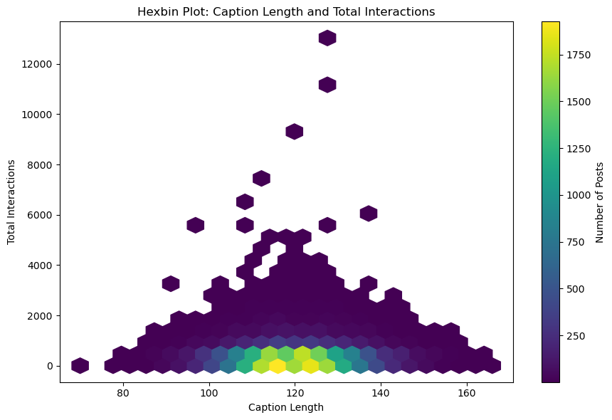
EDA AND VISUALS
Plot 14 of 16 - Caption length and total interactions
CHART TYPE: HEXBIN CHART
WHAT THIS CHART SHOWS
A hexbin chart groups posts with similar caption lengths and interaction totals. Darker or stronger color means more posts in that area.
WHAT WE SEE
Posts cluster in lower interaction ranges across a range of caption lengths. High totals are less common.
SIMPLE TAKEAWAY
The chart does not show a clear simple link between longer captions and more interactions.
Instagram Analytics
30
Notes:
Say: Each hexagon groups many posts, which helps when there are too many dots to show clearly.
Project materials: user-provided Instagram_Analytics.csv, Instagram_Analytics_Project.ipynb, and Data Analytics Final Project Guidelines.

Slide 31
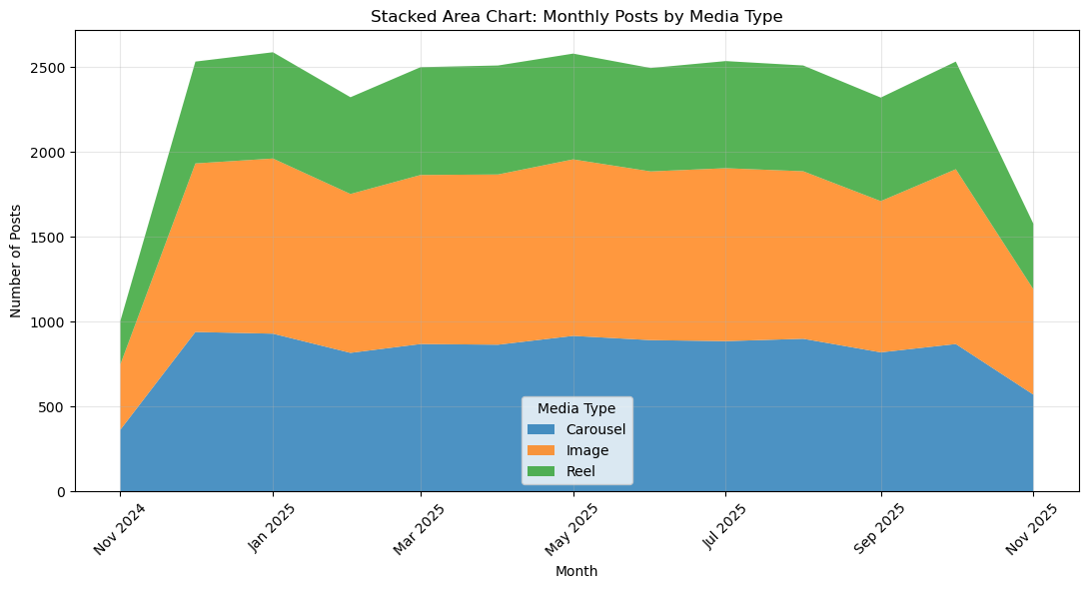
EDA AND VISUALS
Plot 15 of 16 - Monthly posts by media type
CHART TYPE: STACKED AREA CHART
WHAT THIS CHART SHOWS
The stacked area chart compares monthly post counts for carousel, image, and reel formats.
WHAT WE SEE
Image posts are the largest group each month, carousels are next, and reels are fewer.
SIMPLE TAKEAWAY
The mix of formats stays similar over time, with images most common.
Instagram Analytics
31
Notes:
Say: The total height shows all posts in a month, while each color shows one media type.
Project materials: user-provided Instagram_Analytics.csv, Instagram_Analytics_Project.ipynb, and Data Analytics Final Project Guidelines.

Slide 32
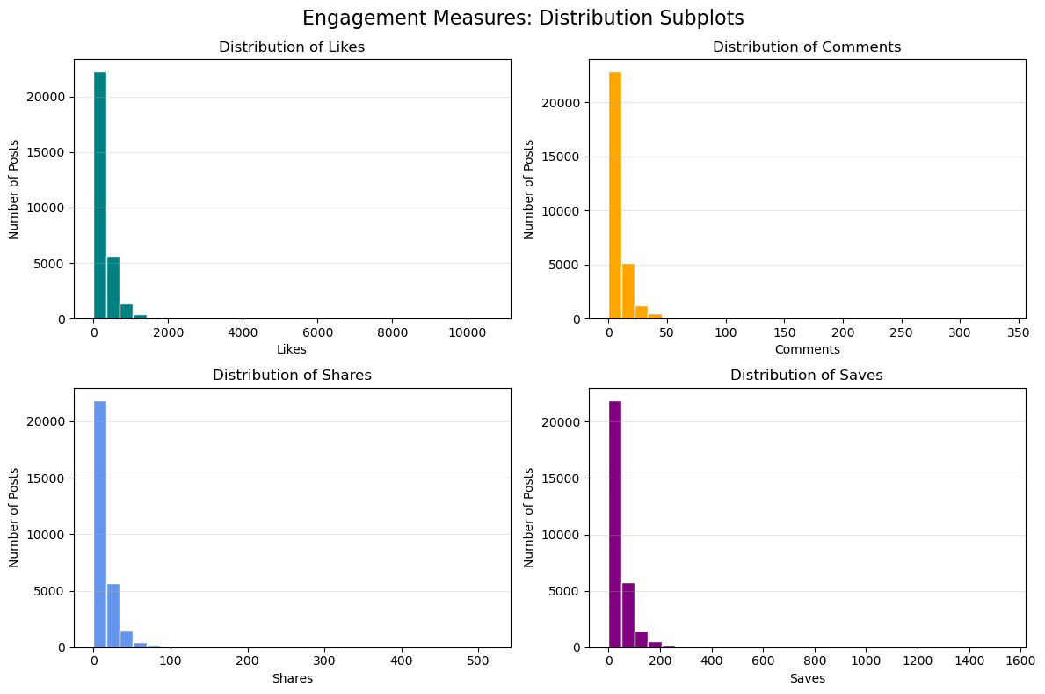
EDA AND VISUALS
Plot 16 of 16 - Distributions of likes, comments, shares, and saves
CHART TYPE: HISTOGRAMS (4 PANELS)
WHAT THIS CHART SHOWS
This single figure contains four histograms. Each panel shows how one interaction measure is distributed.
WHAT WE SEE
For all four measures, many posts have lower counts and fewer posts have very high counts.
SIMPLE TAKEAWAY
Likes, comments, shares, and saves all have uneven, right-skewed distributions.
Instagram Analytics
32
Notes:
Say: This final notebook figure has four panels, one each for likes, comments, shares, and saves. It is one figure but four charts.
Project materials: user-provided Instagram_Analytics.csv, Instagram_Analytics_Project.ipynb, and Data Analytics Final Project Guidelines.

Slide 33
INSIGHTS
Six key insights 1 to 3
1 Average interactions are close across formats
Image posts average 355.53 total interactions, carousels 351.86, and reels 351.06.
2 Category engagement rates are close
Music is highest at about 4.28%. Photography is lowest at about 4.15%.
3 Creators make up most posts
Creators account for 20,944 posts, about 69.8%. Brands account for 9,055, about 30.2%.
What this means
The dataset has a larger creator sample, so the overall patterns reflect more creator posts.
Instagram Analytics
33
Notes:
Say: These first three insights describe the small differences between formats and categories, and the mix of accounts in the dataset.
Project materials: user-provided Instagram_Analytics.csv, Instagram_Analytics_Project.ipynb, and Data Analytics Final Project Guidelines.

Slide 34
INSIGHTS
Six key insights 4 to 6
4 Account and media group averages are close
Brand image posts have the highest average, 361.31. Creator reels have the lowest, 346.84.
5 Call-to-action averages are very similar
Posts without a CTA average 353.68 interactions and 4.22% engagement. Posts with a CTA average 352.08 interactions and 4.19%.
6 Reach and impressions are strongly related
Their correlation is 0.99. Several interaction counts also move together. This is a relationship, not proof of cause.
Overall pattern
Most group differences in this analysis are small.
Instagram Analytics
34
Notes:
Say: The results show close averages for several comparisons. Reach and impressions are strongly related, but the analysis does not show that one caused the other.
Project materials: user-provided Instagram_Analytics.csv, Instagram_Analytics_Project.ipynb, and Data Analytics Final Project Guidelines.

Slide 35
RECOMMENDATIONS
Recommendations and next steps
Test posts in a fair comparison
Compare similar posts and change one thing at a time, such as format or CTA wording.
Try different call-to-action wording
The average results are close, so test clear CTA styles on similar posts before choosing one.
Look beyond averages
Check medians and the spread of results. A few very high posts can raise the average.
Explore more factors
In future work, compare posting time, traffic source, content category, audience size, and media type.
Instagram Analytics
35
Notes:
Say: My recommendation is to test ideas on comparable posts and use more than one measure. This dataset points to questions, not a guaranteed formula for success.
Project materials: user-provided Instagram_Analytics.csv, Instagram_Analytics_Project.ipynb, and Data Analytics Final Project Guidelines.

Slide 36
CONCLUSION
Conclusion What did this project help us learn?
The value of the analysis
Cleaning and organizing the CSV made it easier to compare posts and understand what the columns mean.
What we found
Media types, content categories, and CTA (call to action) groups had similar average results in this dataset. Reach and impressions moved very closely together.
How a creator can use it
Use these findings to plan small tests, learn from the results, and make content decisions based on evidence.
Final reminder
These results show what we found in our data. We need to test more posts to understand what really works.
Thankyou for listening to my presentation.
Instagram Analytics
36
Notes:
Say: This project turns a large table into clear comparisons and possible next steps. It helps us ask better questions and make evidence-based content decisions. The results describe this dataset only.
Project materials: user-provided Instagram_Analytics.csv, Instagram_Analytics_Project.ipynb, and Data Analytics Final Project Guidelines.

