Slide 1
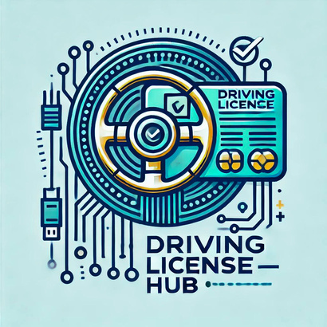
DRIVING LICENSE HUB
Group:76
Members: Manjusha Anand Jadhav
Shilpa Prakash Kale
https://github.com/Mjp777/DRIVING_LICENSE_HUB

Slide 2
/02
INTRODUCTION
“Driving License Hub” is a web application for maintaining details of a registered vehicle. Details include insurance, emission test and fine for violating traffic rules.
The current scenario is that when traffic police ask for insurance information, emission test results, etc., the owner of the vehicle is obligated to show all documents relating to the vehicle, but sometimes they are not kept on hand.
We will give a brief overview of our project below given that we are developing a web application for RTO. Allowing the less fortunate user to access this site for work-related RTO reasons will help to create a familiar environment.
For instance, under the previous method, before we could provide the RTO office with a user's vehicle number, the user would first need to register on our site and provide us with all the necessary and crucial information about the vehicle.

Slide 3
/03
OBJECTIVES :
The Driving License Hub project is designed with a clear set of objectives to apply easily for driving license process. The primary goal is to provide dealerships with a streamlined platform to efficiently register at the comfort and security of home environment getting the license process simpler and more sophisticated for users.
Key objectives include creating a user-friendly experience for users, offering real-time driving test information availability, ensuring secure user authentication for data protection, and enabling seamless communication between users and RTO officer.
The system focuses on maintaining accurate information, enhancing data accuracy and integrity, and adhering to legal requirements related to data privacy and security.
With modern technology and a future-ready approach, the project aims to create a reliable, transparent, and efficient platform that benefits all stakeholders in the applying for license process.

Slide 4
/04
FUNCTIONALITIES :
The “Driving License Hub " project provides a range of functionalities aimed at simplifying and enhancing getting the driving license process for users. Some of the key functionalities offered by the project include:
1.To manage vehicle details by the RTO. To maintain a vehicle's insurance information with an insurance provider
2. User Registration and Authentication: Users can create accounts and securely log in to the platform. Secure authentication mechanisms help protect user data and ensure that only authorized individuals can access the system.
3.Direct Messaging: The platform facilitates communication between users and RTO officer through direct messaging, enabling them to be updated regarding license process.
4.To send and receive notifications between system users regarding insurance renewal, expiration, emission tests, and past fines.

Slide 5
/05
5. Administrative Dashboard: To give vehicle owners a site where they can update their information
6. Data Integrity: The system ensures accurate and consistent vehicle information across the platform, reducing errors and misinformation.
7. Legal Compliance: The project adheres to relevant legal requirements and data protection regulations, ensuring user privacy and security.
8. User Support: The platform provides user support to address any technical issues, inquiries, or assistance needed during the buying or selling process.

Slide 6
/06
SOFTWARE REQUIREMENTS :
Software configuration for back-end Services:
- Java EE
- Spring Boot, JPA
- MySQL
- STS 3.9.18
Software configuration for front-end Services:
- ReactJS
- HTML, CSS, JS
- Bootstrap
VS Code

Slide 7
/07
HARDWARE REQUIREMENTS :
Back-end Server Configuration:
- Intel(R) Core(TM) i5-10210U CPU @ 1.60GHz 1.60 GHz
- 128 MB RAM
Front-end Client Configuration:
- Intel Pentium-III @ 650 MHz Processor
- 128 MB SDRAM
- 10 GB Hard Disk Drive
- 104 Keys Keyboard
- PS2 Mouse with pad

Slide 8
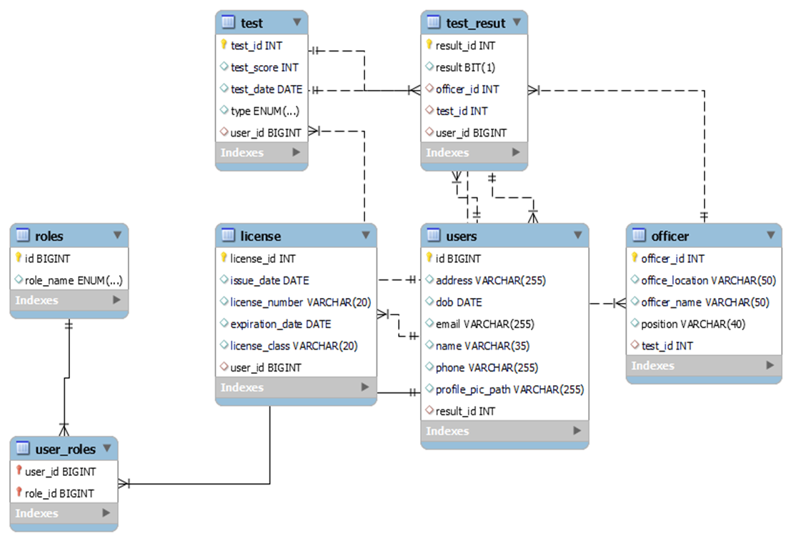
ER-DIAGRAM:
/08

Slide 9
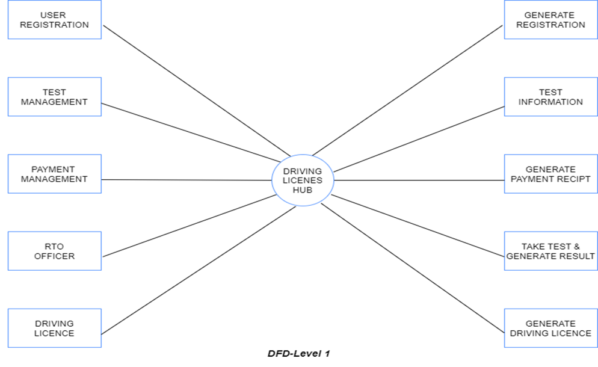
DFD-DIAGRAM:
/09

Slide 10
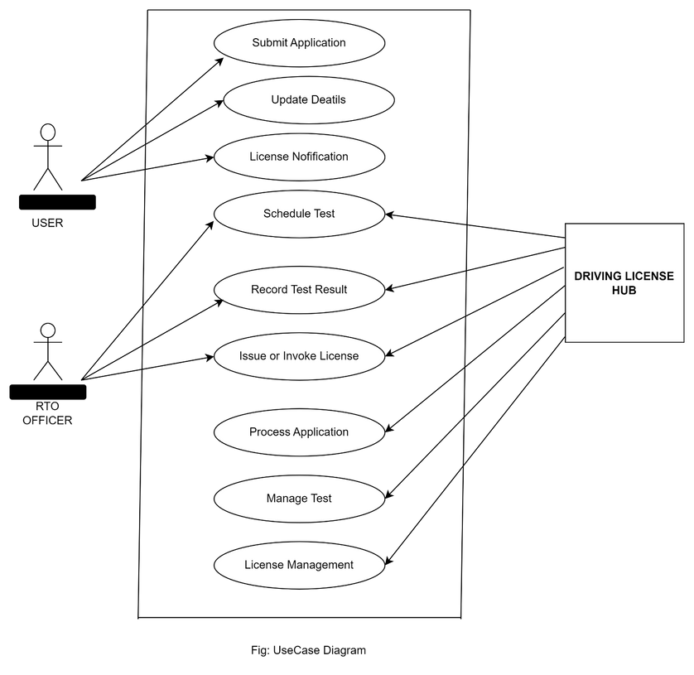
USE CASE-DIAGRAM:
/10

Slide 11
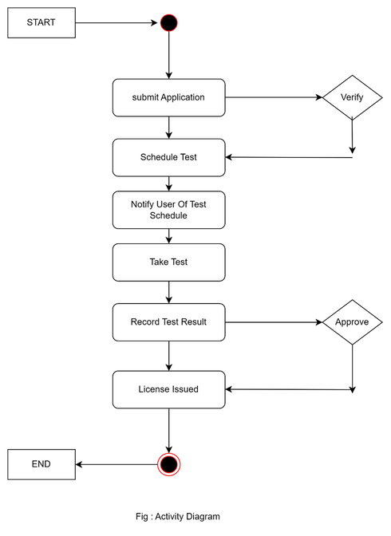
ACTIVITY-DIAGRAM:
/11

Slide 12
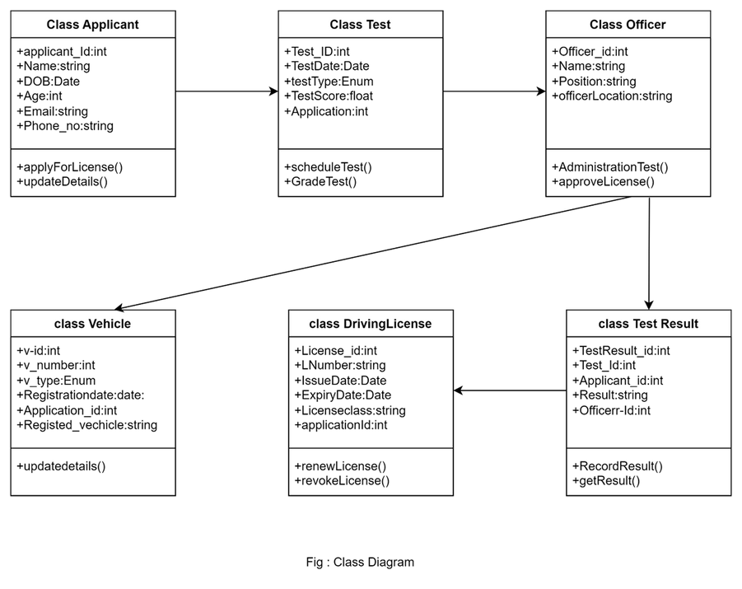
CLASS-DIAGRAM:
/12

Slide 13
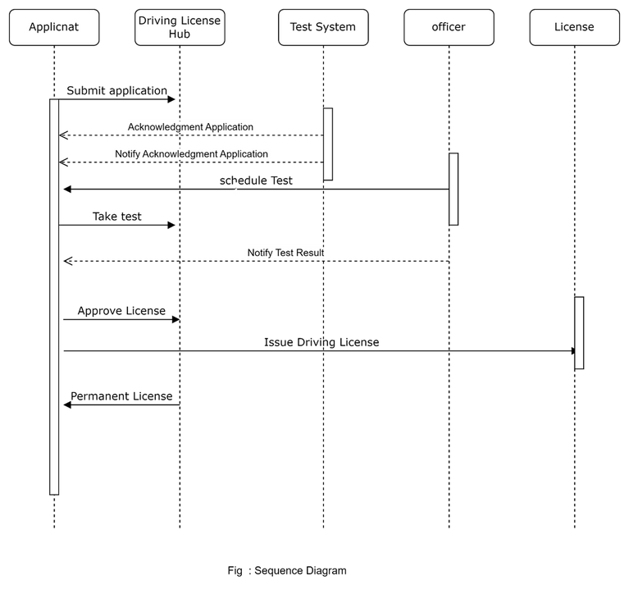
SEQUENCE-DIAGRAM:
/13

Slide 14
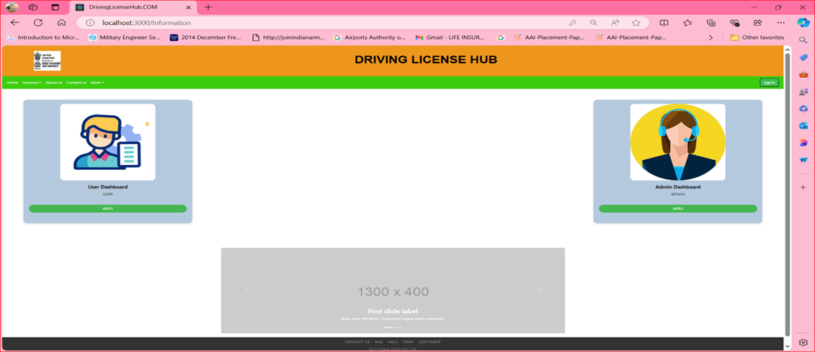
SCREENSHOTS:
/14
HOME PAGE

Slide 15
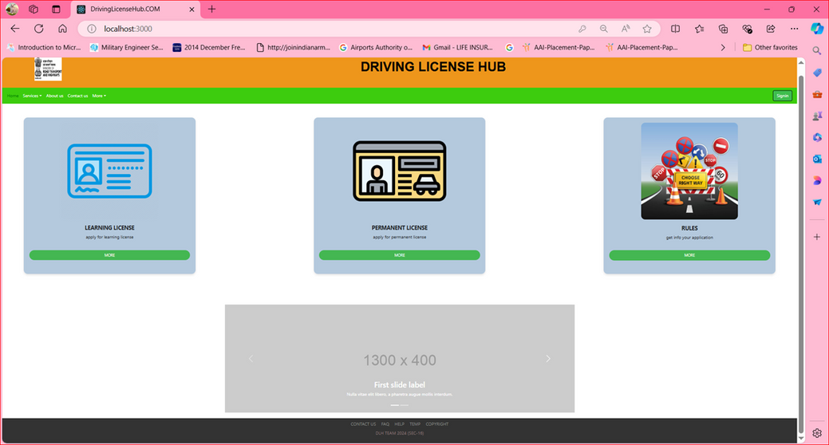
/15

Slide 16
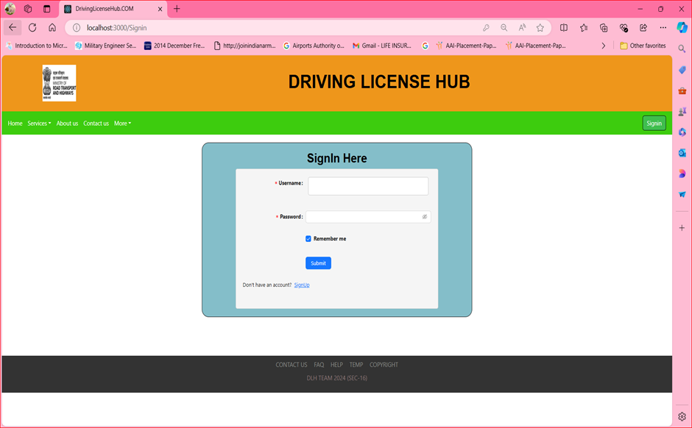
/16
LOGIN PAGE

Slide 17
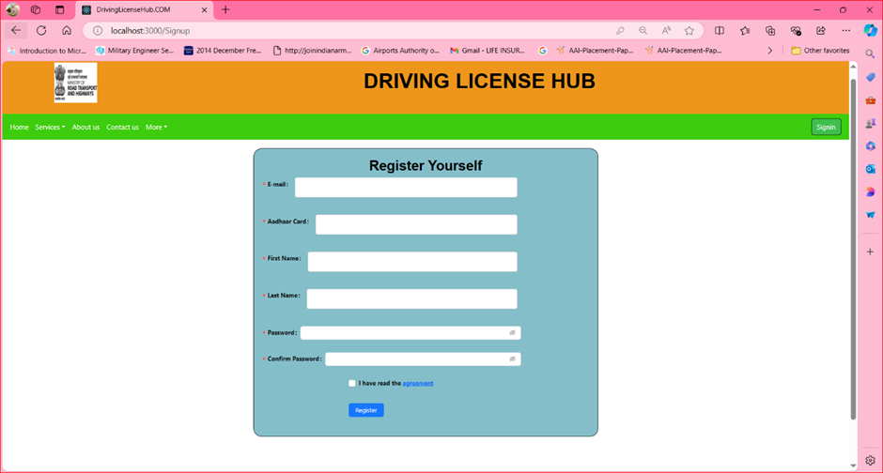
REGISTRATION PAGE
/17

Slide 18
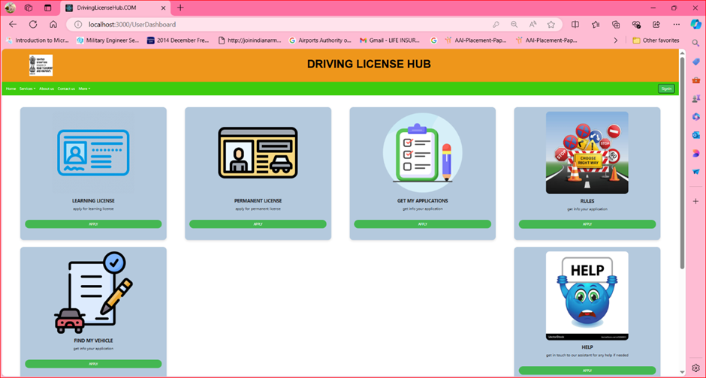
/18
USER DASHBOARD

Slide 19
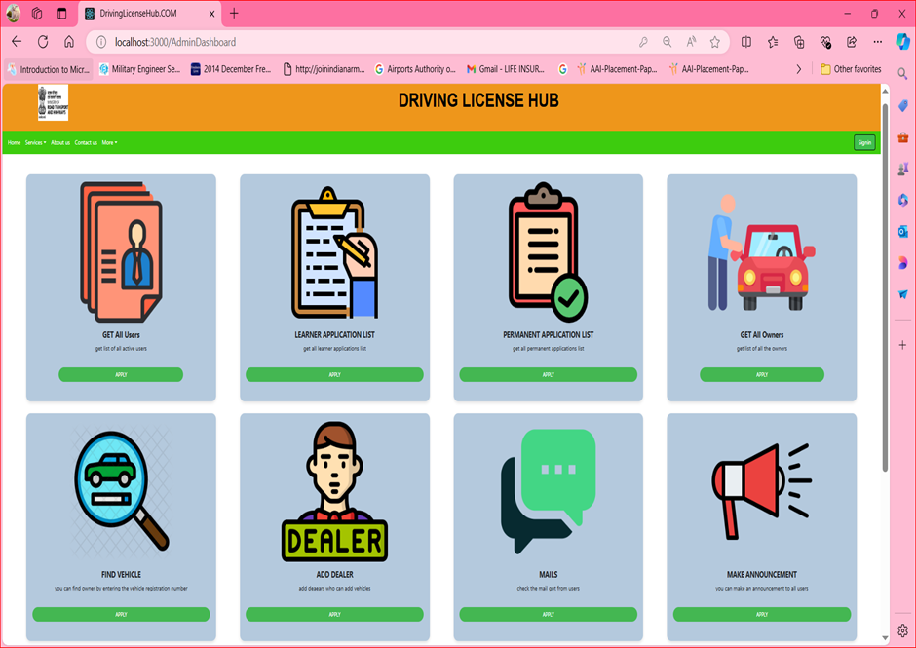
/19
ADMIN DASHBOARD

Slide 20
/20
FUTURE INNOVATIONS :
Future InnovationsFuture Innovations The future of driving license hubs may include AI-driven services, mobile applications, and virtual consultations. These innovations can further enhance accessibility and convenience for users in the licensing process.

Slide 21
/20
CONCLUSION :
Driving license hubs represent a promising solution to current licensing challenges. By focusing on technology, user experience, and community engagement, we can pave the way for a more efficient and accessible future in driving license services.

Slide 22
THANK YOU...
CDAC-MARCH2024

