Slide 1
M.S. Engineering College
DEPARTMENT OF COMPUTER SCIENCE & ENGINEERING
“SIGN LANGUAGE TRANSLATION”
Presented by
<PID>
<USN><Student Names>
Under the Guidance of
<Name of the Faculty> <Designation>
<Dept>

Slide 2
Agenda
Introduction
Literature Survey
Requirement Engineering
Project Planning and Scheduling
System Design
Applications & Conclusion
1/20

Slide 3
Introduction
Overview
Inability to speak is considered to be true disability. People with this disability use different modes to communicate with others, there are number of methods available for their communication one such common method of communication is sign language. Developing sign language application for deaf people can be very important, as they’ll be able to communicate easily with even those who don’t understand sign language. Our project aims at taking the basic step in bridging the communication gap between normal people, deaf and dumb people using sign language. The main focus of this work is to create a vision based system to identify sign language gestures from the video sequences. The reason for choosing a system based on vision relates to the fact that it provides a simpler and more intuitive way of communication between a human and a computer. In this report, 5 different gestures have been considered. We used the following approach for the classification of sign language gestures:­ Video sequences contain both the temporal as well as the spatial features. So we have used CNN models to train both the temporal as well as the spatial features. To train the model on the spatial features of the video sequences we have used CNN model which is a deep CNN(convolutional neural net). Trained CNN model was used to make predictions for individual frames to obtain a sequence of predictions or pool layer outputs for each video.
2/20

Slide 4
Objectives
To accomplish the communication gap between normal people, deaf and dumb people using sign language.
To minimize the training and testing time.
To build a vision based system to identify sign language gestures from the images sequences.
To design an automated sign language translation system.

Slide 5
Literature Survey
Sl. No. | Title | Author | Year | Contributions & Drawbacks
1 | Sign Language to Text and Vice Versa Recognition using Computer Vision in Marathi | Amitkumar Shinde, Ramesh Kagalkar | 2015 | The proposed system also includes efficient and robust hand segmentation and tracking algorithm to achieve better recognition rates. A large set of samples has been used to recognize 43 isolated words from the Standard Marathi sign language. In proposed system, we intend to recognize some very basic elements of sign language and to translate them to text and vice versa in Marathi language Draw Backs: Accuracy is less than 80%.
2 | Indian Sign Language Translator Using Gesture Recognition Algorithm | Purva C. Badhe, Vaishali Kulkarni | 2015 | In this paper they have used Euclidean Distance method for pattern matching. Drawbacks: It Consumes more time and consumes more resources.
5/20

Slide 6
Literature Survey
Sl. No. | Title | Author | Year | Contributions & Drawbacks
3 | Hand gesture recognition using Neural Network | Rajesh Mapari, Govind Kharat | 2013 | we captured the hand gesture of a user and stored it on disk. Then we read those videos captured one by one, converted them to binary images and created 3D Euclidian Space of binary values. We have used supervised feed-forward neural net based training and back propagation algorithm for classifying hand gestures into ten categories: hand pointing up, pointing down, pointing left, pointing right and pointing front and number of fingers user was showing Draw Backs: Accuracy is less than 89%.
4 | Real-time 2D hands detection and tracking for sign language recognition | S. Wu and H. Nagahashi | 2013 | This paper proposes a new training method for Haar-like features based AdaBoost classifier with insufficient data, and a hand detector integrating Haar-like features, skin-color and motion cue together. Also we present a novel hand tracking technique. Drawbacks: It Consumes more time and consumes more resources.
5/20

Slide 7
Literature Survey
Sl. No. | Title | Author | Year | Contributions & Drawbacks
5 | Embedded Sign Language Interpreter System for Deaf and Dumb People | Geethu G Nath, Anu V S, | 2017 | The system consists of two main parts. The first part is hand sign recognition and the second one is speech recognition. This ensures a bi directional communication avoiding the assistance of an interpreter. Draw Backs: High Implementation cost
6 | Indian Sign Language Numeral Recognition Using Region of Interest Convolutional Neural Network | Sajanraj T D, Beena M V | 2018 | In this we are introducing a deep learning approach which can classify the sign using the convolutional neural network. In the first phase we make a classifier model using the numeral signs using the Keras implementation of convolutional neural network using python. In phase two another real-time system which used skin segmentation to find the Region of Interest in the frame which shows the bounding box. The segmented region is feed to the classifier model to predict the sign. Drawbacks: It Consumes more time and consumes more resources.
5/20

Slide 8
Literature Survey
Sl. No. | Title | Author | Year | Contributions & Drawbacks
7 | American Sign Language Recognition using Deep Learning and Computer Vision | Kshitij Bantupalli, Ying Xie | 2018 | The focus of this work is to create a vision based application which offers sign language translation to text thus aiding communication between signers and non-signers. The proposed model takes video sequences and extracts temporal and spatial features from them. We then use Inception, a CNN (Convolutional Neural Network) for recognizing spatial features. We then use a RNN (Recurrent Neural Network) to train on temporal features. The dataset used is the American Sign Language Dataset. Draw Backs: The model also performed poorly when there was variation in clothing. Maybe using a ROI to isolate hand gestures from the images would help accuracy, but for the context of this paper, a consistent full-sleeved shirt was used in all the gesture recordings.
8 | Sign Language Recognition System Using Deep Neural Network, | Surejya Suresh, Mithun Haridas.T.P, Supriya M.H | 2019 | The main focus of this work is to create a vision based system, a Convolutional Neural Network (CNN) model, to identify six different sign languages from the images captured. The two CNN models developed have different type of optimizers, the Stochastic Gradient Descent (SGD) and Adam. Drawbacks: It Consumes more time and consumes more resources.
5/20

Slide 9
Literature Survey
Sl. No. | Title | Author | Year | Contributions & Drawbacks
9 | Object detection with deep learning: A review | Z.-Q. Zhao, P. Zheng, S.-t. Xu, and X. Wu | 2019 | It is used to detect the any non moveable object. Draw Backs: Accuracy is less than 89%
10 | Training region-based object detectors with online hard example mining | A. Shrivastava, A. Gupta, and R. Girshick, | 2016 | The main focus of this work is to built region based object detector using Hierarchal clustering and It is simple and efficient detection of object . Drawbacks: Accuracy is less than 80%.
5/20

Slide 10
Literature Survey
Sl. No. | Title | Author | Year | Contributions & Drawbacks
11 | Deep residual learning for image recognition | K. He, X. Zhang, S. Ren, and J. Sun, | 2016 | We provide comprehensive empirical evidence showing that these residual networks are easier to optimize, and can gain accuracy from considerably increased depth. Draw Backs: Accuracy is less than 79%
12 | Histograms of oriented gradients for human detection | N. Dalal and B. Triggs, | 2005 | we show experimentally that grids of histograms of oriented gradient (HOG) descriptors significantly outperform existing feature sets for human detection. We study the influence of each stage of the computation on performance Drawbacks: Accuracy is less than 80%.
5/20

Slide 11
Literature Survey
Sl. No. | Title | Author | Year | Contributions & Drawbacks
13 | Deep residual learning for image recognition | K. He, X. Zhang, S. Ren, and J. Sun, | 2016 | We provide comprehensive empirical evidence showing that these residual networks are easier to optimize, and can gain accuracy from considerably increased depth. Draw Backs: Accuracy is less than 79%
14 | Rich feature hierarchies for accurate object detection and semantic segmentation | R. Girshick, J. Donahue, T. Darrell, and J. Malik, | 2014 | we propose a simple and scalable detection algorithm that improves mean average precision (mAP) by more than 30% relative to the previous best result on VOC 2012 -- achieving a mAP of 53.3%. Our approach combines two key insights: (1) one can apply high-capacity convolutional neural networks (CNNs) to bottom-up region proposals in order to localize and segment objects and (2) when labeled training data is scarce, supervised pre-training for an auxiliary task, followed by domain-specific fine-tuning, yields a significant performance boost. Drawbacks: It consumes more time and resources.
5/20

Slide 12
Literature Survey
Sl. No. | Title | Author | Year | Contributions & Drawbacks
15 | Rapid object detection using a boosted cascade of simple features | P. Viola and M. Jones, | 2017 | The first is the introduction of a new image representation called the "integral image" which allows the features used by our detector to be computed very quickly. The second is a learning algorithm, based on AdaBoost, which selects a small number of critical visual features from a larger set and yields extremely efficient classifiers. The third contribution is a method for combining increasingly more complex classifiers in a "cascade" which allows background regions of the image to be quickly discarded while spending more computation on promising object-like regions.. Draw Backs: Accuracy is less than 89%
5/20

Slide 13
Drawbacks of Existing System
Existing System:
  Roel Verschaeren proposes a CNN model that recognizes a set of 50 different signs in the Flemish Sign Language with an error of 2.5%, using the Microsoft Kinect. Unfortunately, this work is limited in the sense that it considers only a single person in a fixed environment. In an American Language recognition system is presented with a vocabulary of 30 words. They constructed appearance-based representations and a hand tracking system to be classified with a hidden Markov model (HMM). An error rate of 10.91% is achieved on the RWTH-BOSTON-50 database. The approach in uses the Microsoft Kinect to extract appearance-based hand features and track the position in 2D and 3D.
Disadvantages of Existing System:
  Accuracy is less
  Implementation cost is high and more complexity.
6/20

Slide 14
Problem Statement
“Inability to speak is considered to be true disability. People with this disability use different modes to communicate with others, there are number of methods available for their communication one such common method of communication is sign language. Developing sign language application for deaf people can be very important, as they’ll be able to communicate easily with even those who don’t understand sign language.”
Input: Live capture of hand sign images
Output: Translated text and corresponding voice
3/20

Slide 15
Proposed System
We proposed convolutional neural networks can be used to accurately recognize different signs of a sign language, with users and surroundings not included in the training set. This generalization capacity of CNNs in spatiotemporal data can contribute to the broader research field on automatic sign language recognition.
Advantages:
Design an automatic sign language recognition with low cost and less complexity.
To develop an system which helpful for deaf and dumb people.
7/20

Slide 16
Requirement Engineering
Software and Hardware tools used
HARDWARE REQUIREMENTS:
System : Intel I3.
Hard Disk : 120 GB.
Monitor : 15’’ LED
Input Devices : Keyboard, Mouse
Ram : 4 GB
SOFTWARE REQUIREMENTS:
Operating system : Windows 7 64-bit.
Coding Language : PYTHON 3.6
Tools : Anaconda

Slide 17
Conceptual/Analysis Modelling
Object Oriented Models: Use case diagrams, Sequence diagrams, Activity diagrams, State chart diagrams, Class diagrams
Structured Development Models: Context diagrams, Data Flow Diagrams, ER diagrams

Slide 18
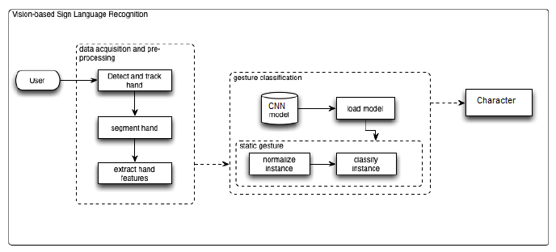
System Design- System Architecture
The system is currently developed by us. When user will open this application they have to show their hands on camera. System will detect hand and track the hand and extract the features from the captured image. Then system loads the pre-trained model and classify the character. The system will display the recognized character on the screen dynamically.
<number>/20

Slide 19
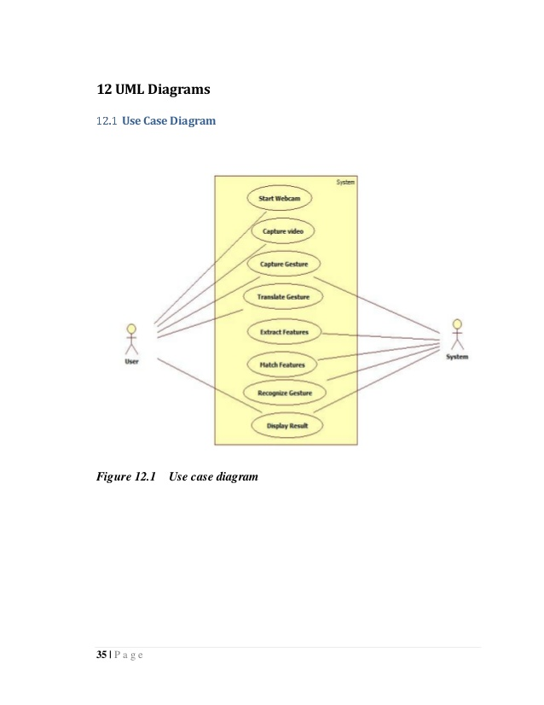
Use Case Diagram

Slide 20
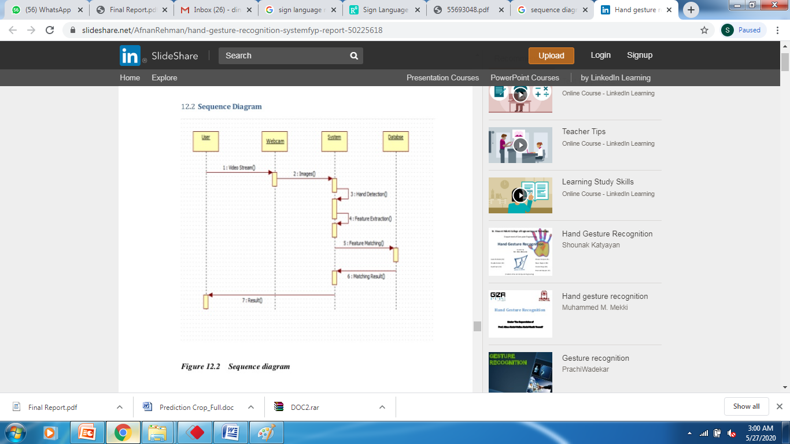
Sequence diagrams

Slide 21
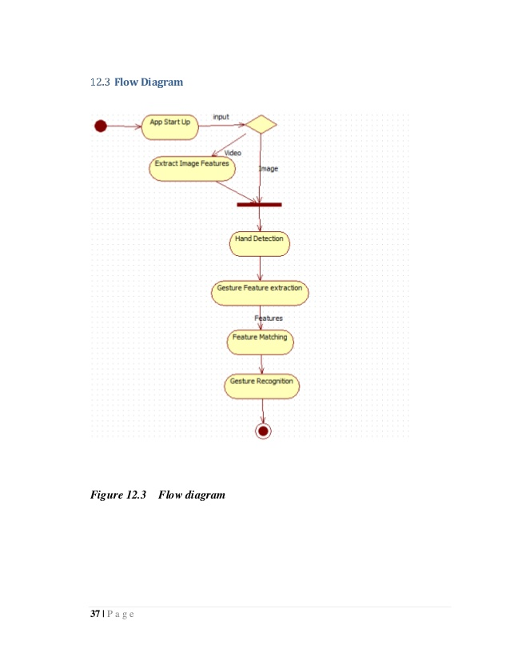
Activity diagrams

Slide 22
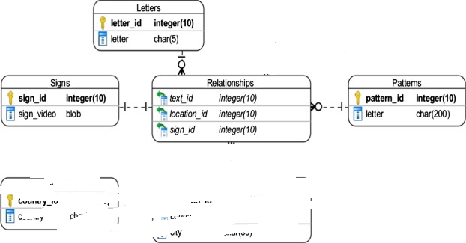
Class diagrams

Slide 23
Data Flow Diagrams Level-0
0.1
Sign Language Prediction Using CNN
Hand signs
Character Recognize
Level: 0 describes the overall process of the project. We are using Hand signs as input. System will use CNN algorithm to recognize the characters from the user input.

Slide 24
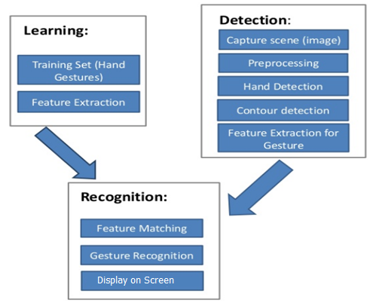
Data Flow Diagrams Level-1
Level: 1 describes the detail steps of sign language translation. We are using Hand signs as input. System will use CNN algorithm to recognize the characters from the user input.

Slide 25
Context Diagram
Sign language Translator
User
Train
Detected Text

Slide 26
Software Requirements Specification
Functionality Requirements
1. Create a Desktop application using Tkinter.
2. User should create the dataset for each characters.
3. System will train the characters by using the user images.
4. System will captures the hand symbols through the camera.
5. System will recognize the character from the sign.
6. Application should accurately recognize the characters from sign and automatically.

Slide 27
Software Requirements Specification
Non-Functionality Requirements
The program must be self-contained so that it can easily be moved from one Computer to another. It is assumed that network connection will be available on the computer on which the program resides.
Capacity, scalability and availability.
The system shall achieve 100 per cent availability at all times.
The system shall be scalable to support additional clients and volunteers.
Maintainability.
  The system should be optimized for supportability, or ease of maintenance as far as possible. This may be achieved through the use documentation of coding standards, naming conventions, class libraries and abstraction.
Randomness, verifiability and load balancing.
  The system should be optimized for supportability, or ease of maintenance as far as possible. This may be achieved through the use documentation of coding standards, naming conventions, class libraries and abstraction. It should have randomness to check the nodes and should be load balanced.

Slide 28
Component Design /
Module Decomposition
The system developed by us includes following modules as follows:
1. Data Set Creation
2. Preprocessing
3. Training Model
4. Recognition
<number>/20

Slide 29
Interface Design
We are designing the front-end using Python tkinter library.
<number>/20

Slide 30
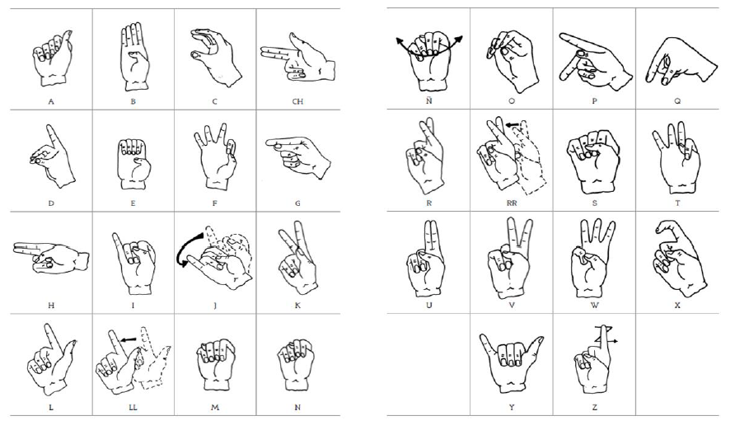
Data Structure Design
<number>/20

Slide 31
Algorithm Design
Convolutional Neural Network (CNN) CNNs are feature extraction models in deep learning that recently have proven to be to be very successful at image recognition. As of now, the models are in use by various industry leaders like Google, Facebook and Amazon. And recently, researchers at Google applied CNNs on video data. CNNs are inspired by the visual cortex of the human brain. The artificial neurons in a CNN will connect to a local region of the visual field, called a receptive field. This is accomplished by performing discrete convolutions on the image with filter values as trainable weights. Multiple filters are applied for each channel, and together with the activation functions of the neurons, they form feature maps. This is followed by a pooling scheme, where only the interesting information of the feature maps are pooled together.
For the pooling method, we use max-pooling: only the maximum value in a local neighborhood of the feature map remains. To accommodate video data, the max-pooling is performed in three dimensions. However, using 2D convolutions resulted in a better validation accuracy than 3D convolutions. The architecture of the model consists of two CNNs, one for extracting hand features and one for extracting upper body features. Each CNN is three layers deep. A classical ANN with one hidden layer provides classification after concatenating the outcomes of both CNNs. Also, local contrast normalization (LCN) is applied in the first two layers and all artificial neurons are rectified linear units (ReLUs ).
<number>/20

Slide 32
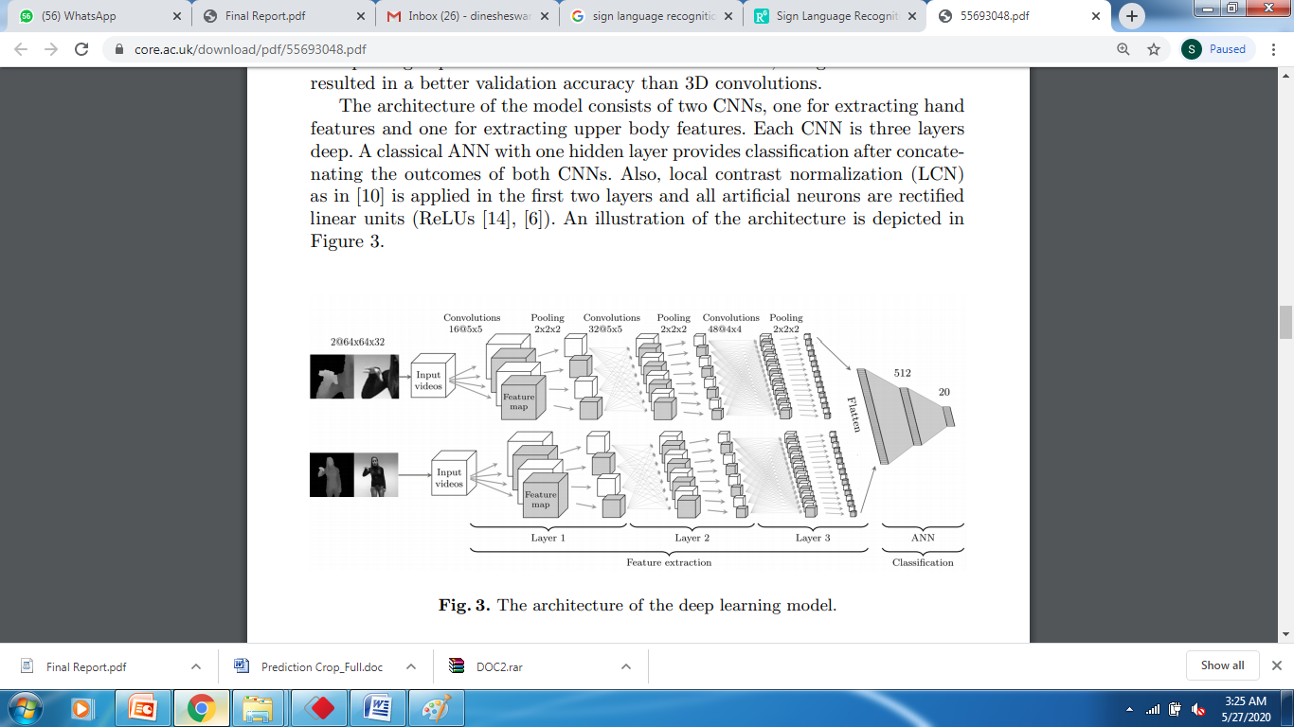
Algorithm Design
<number>/20

Slide 33
Test cases
Test Case# | UTC01
Test Name | User input format
Test Description | To test user input as image
Input | Hand image
Expected Output | It should read and detect the hand region
Actual Output | Detected the hand region
Test Result | Success

Slide 34
Test cases
Test Case# | UTC02
Test Name | User input format
Test Description | To test user input as image
Input | null
Expected Output | Show the error
Actual Output | Shown error
Test Result | Success

Slide 35
Test cases
Test Case# | UTC03
Test Name | Recognize sign
Test Description | To test whether Recognizing sign or not?
Input | Hand sign
Expected Output | It Should Recognize
Actual Output | Recognized and generated the output on screen
Test Result | Success

Slide 36
Test cases
Test Case# | UTC04
Test Name | Test case for importing valid python libraries
Test Description | To test whether an algorithm to implement congestion nodes works without sklearn and opencv, keras,librosa,playaudios models
Input | Import all valid libraries sklearn, flask and keras libraries
Expected Output | An error should be thrown specifying “error importing libraries sklearn, flask and keras libraries”
Actual Output | An error is thrown
Test Result | Success

Slide 37
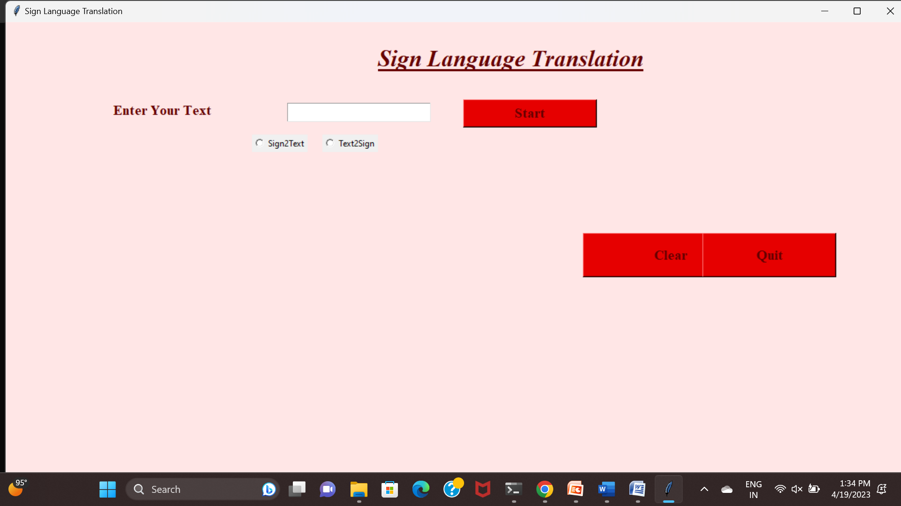
Results

Slide 38
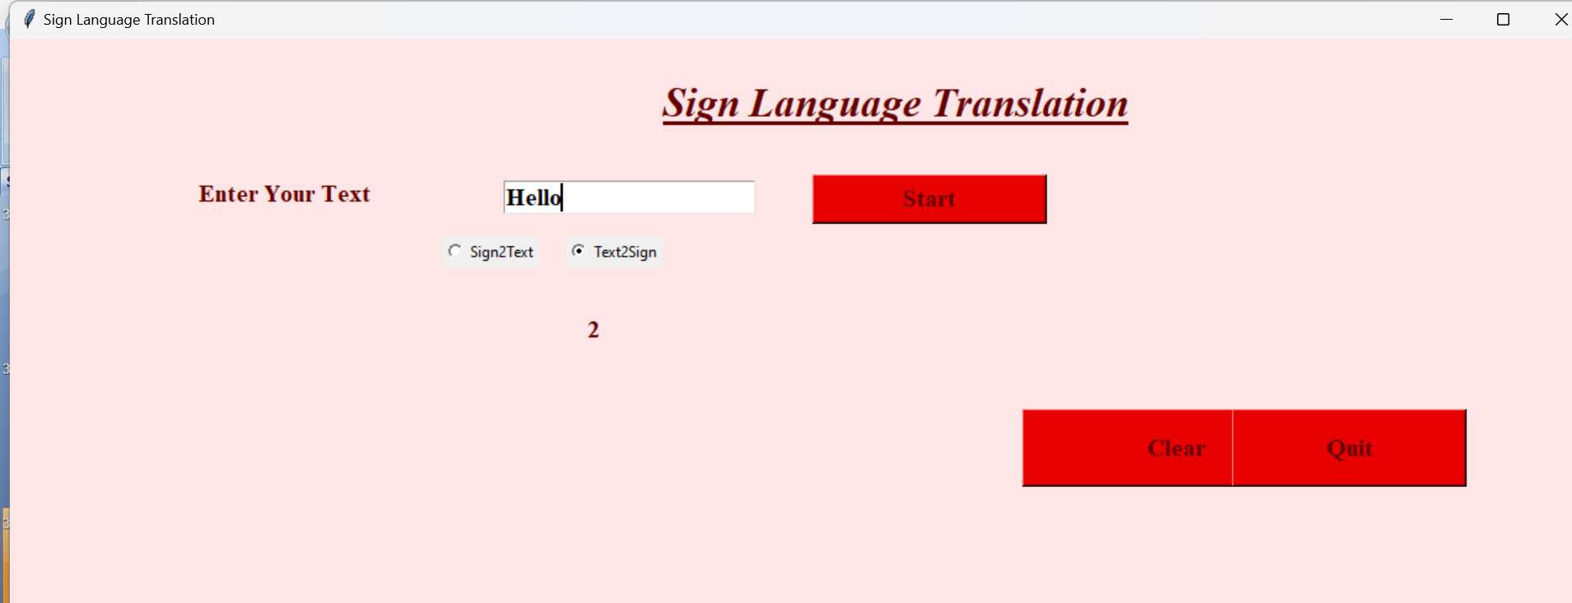
Results

Slide 39
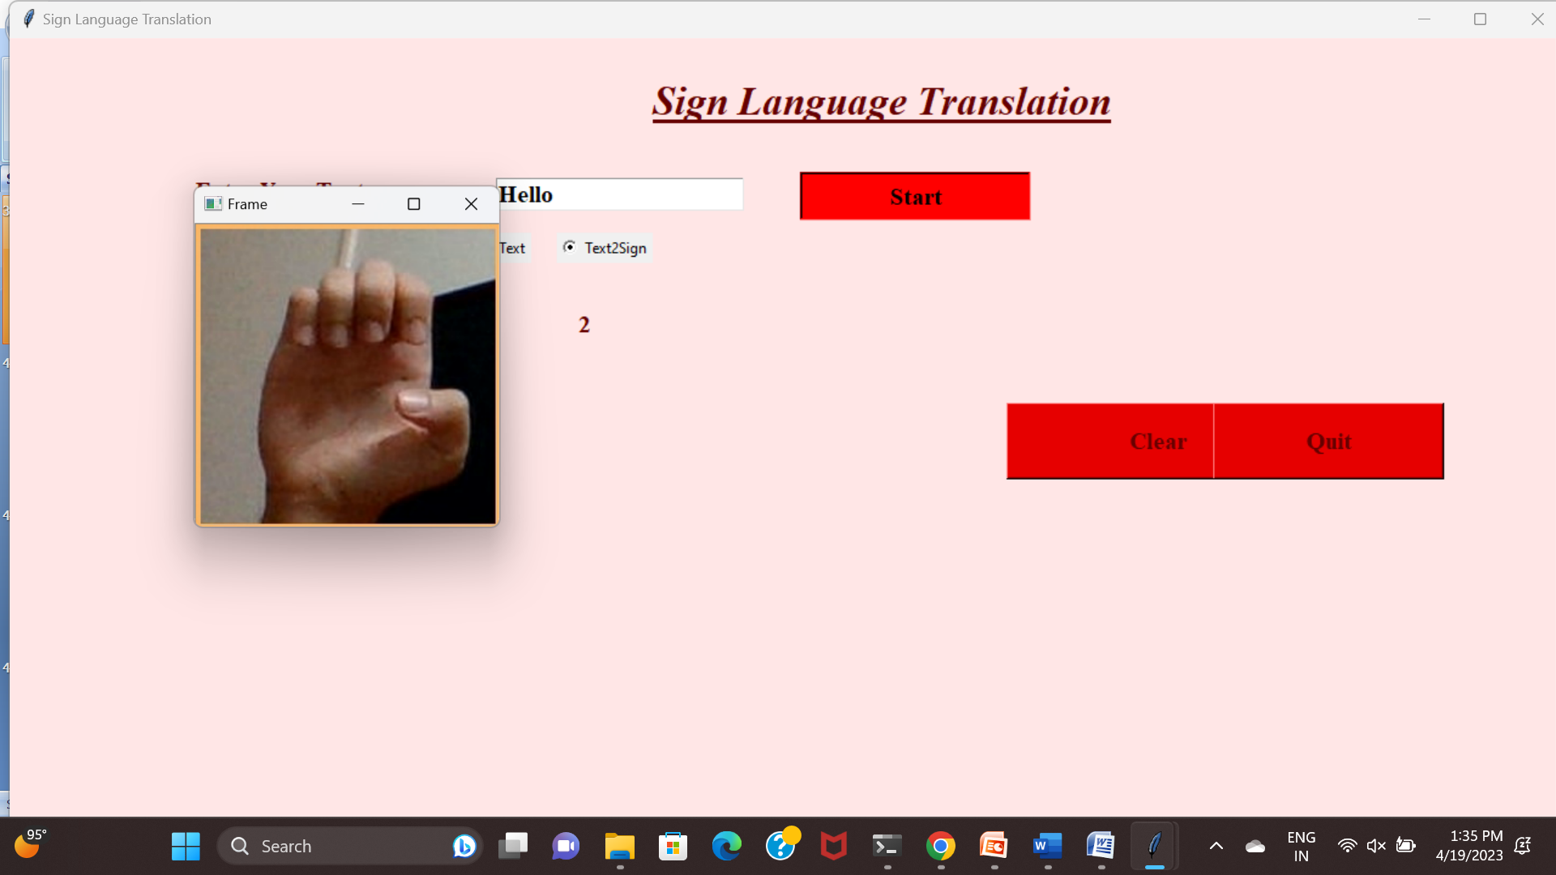
Results-Video Played

Slide 40
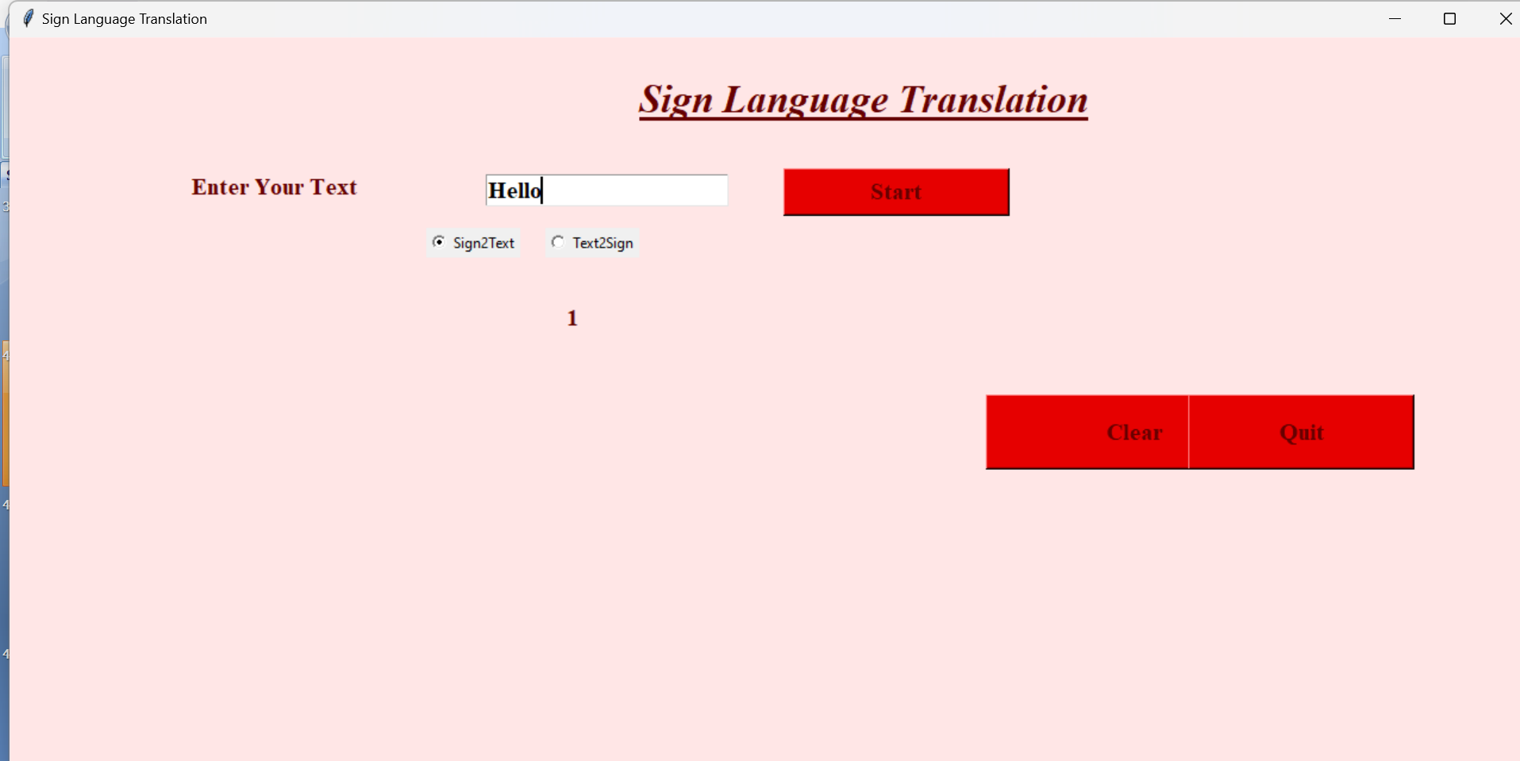
Results

Slide 41
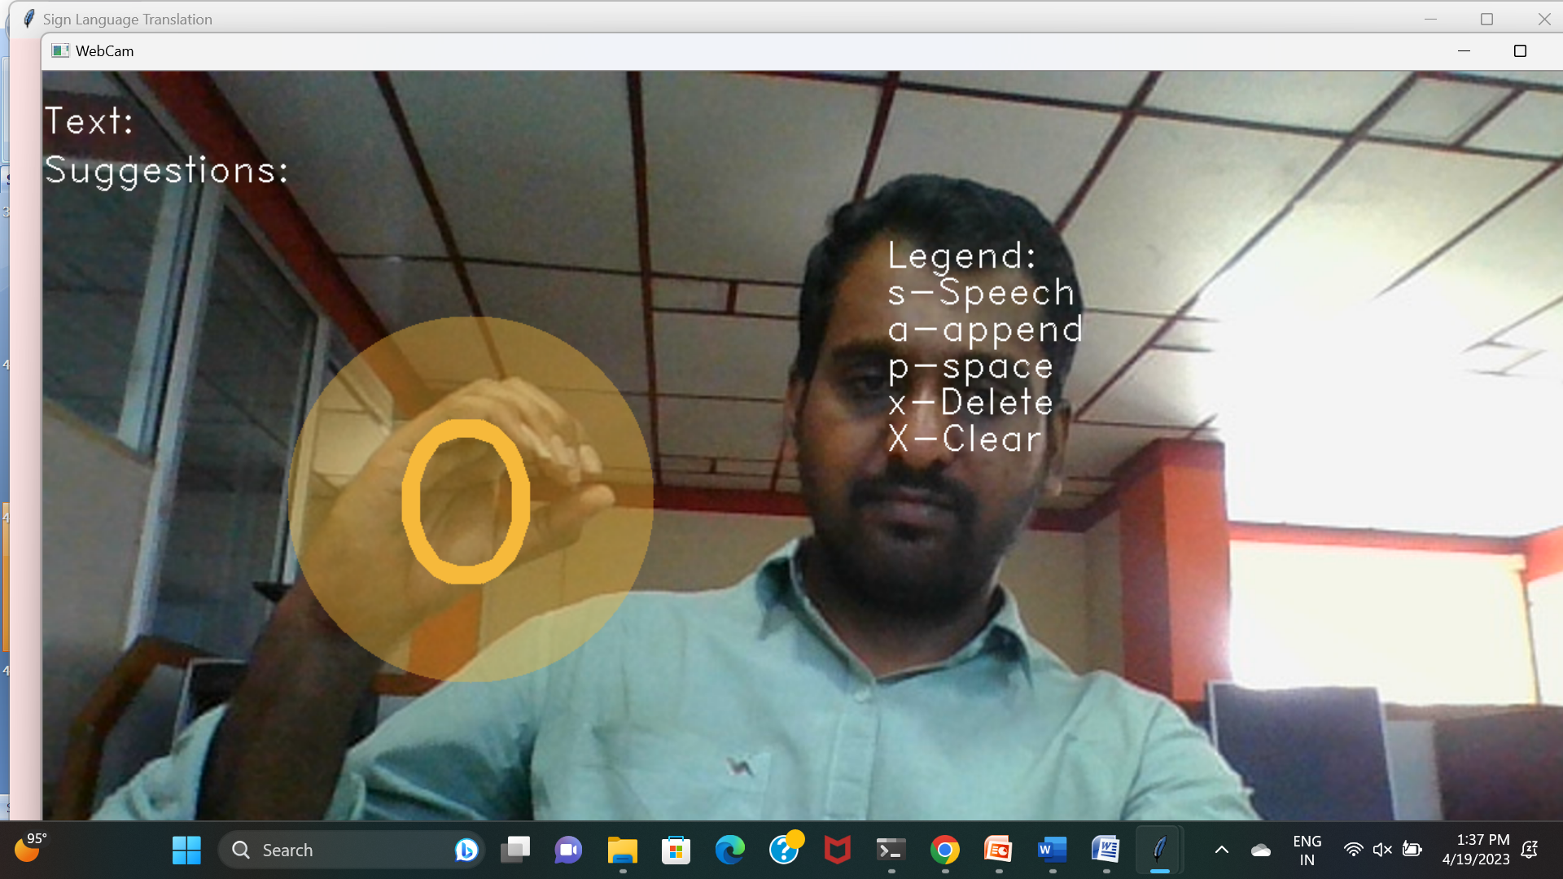
Results

Slide 42
Applications
We can use this to learn sign language.
It is suitable for E-learning
News channels
<number>/20

Slide 43
Conclusion
In this project, Hand gestures are a powerful way for human communication, with lots of potential applications in the area of human computer interaction. Vision ­based hand gesture recognition techniques have many proven advantages compared with traditional devices. However, hand gesture recognition is a difficult problem and the current work is only a small contribution towards achieving the results needed in the field of sign language gesture recognition. This report presented a vision ­based system able to interpret isolated hand gestures from the American Sign Language(ASA). Videos are difficult to classify because they contain both the temporal as well as the spatial features. We have used CNN model to classify on the spatial and temporal features. We obtained an accuracy of 95.217 %.
<number>/20

Slide 44
References
[1] Ronchetti, Franco, Facundo Quiroga, César Armando Estrebou, and Laura Cristina Lanzarini. "Handshape recognition for argentinian sign language using probsom." Journal of Computer Science & Technology 16 (2016).
[2] Singha, Joyeeta, and Karen Das. "Automatic Indian Sign Language Recognition for Continuous Video Sequence." ADBU Journal of Engineering Technology 2, no. 1 (2015).
[3] Tripathi, Kumud, and Neha Baranwal GC Nandi. "Continuous Indian Sign Language Gesture Recognition and Sentence Formation." Procedia Computer Science 54 (2015): 523­531.
[4] Nandy, Anup, Jay Shankar Prasad, Soumik Mondal, Pavan Chakraborty, and Gora Chand Nandi. "Recognition of isolated indian sign language gesture in real time." Information Processing and Management (2010): 102­107.
[5] Bengio, Yoshua, Patrice Simard, and Paolo Frasconi. "Learning long­term dependencies with gradient descent is difficult." IEEE transactions on neural networks 5, no. 2 (1994): 157­166. [6] Hochreiter, Sepp, and Jürgen Schmidhuber. "Long short­term memory." Neural computation 9, no. 8 (1997): 1735­1780.
[7] Ronchetti, Franco, Facundo Quiroga, César Armando Estrebou, Laura Cristina Lanzarini, and Alejandro Rosete. "LSA64: An Argentinian Sign Language Dataset." In XXII Congreso Argentino de Ciencias de la Computación (CACIC 2016). 2016.
[8] Kingma, Diederik, and Jimmy Ba. "Adam: A method for stochastic optimization." arXiv preprint arXiv:1412.6980 (2014).
[9] Rumelhart, David E., Geoffrey E. Hinton, and Ronald J. Williams. "Learning representations by back­propagating errors." Cognitive modeling 5, no. 3 (1988):
[10] Hahnloser, Richard HR, Rahul Sarpeshkar, Misha A. Mahowald, Rodney J. Douglas, and H. Sebastian Seung. "Digital selection and analogue amplification coexist in a cortex­inspired silicon circuit." Nature 405, no. 6789 (2000): 947­951.12 Bottou, Léon. "Large­scale machine learning with stochastic gradient descent." In Proceedings of COMPSTAT'2010, pp. 177­186. Physica­Verlag HD, 2010.
[11] Copyright © William Vicars, Sign Language resources at LifePrint.com, http://lifeprint.com/asl101/topics/wallpaper1.htm
[12] https://medium.com/technologymadeeasy/the­best­explanation­of­co nvolutional­neural­networks­on­the­internet­fbb8b1ad5df8
[13] https://www.quora.com/What­is­an­intuitive­explanation­of­Convol utional­Neural­Networks
[14] Abadi, Martín, Ashish Agarwal, Paul Barham, Eugene Brevdo, Zhifeng Chen, Craig Citro, Greg S. Corrado et al. "Tensorflow: Large­scale machine learning on heterogeneous distributed systems." arXiv preprint arXiv:1603.04467 (2016).
[15] Cooper, Helen, Brian Holt, and Richard Bowden. "Sign language recognition." In Visual Analysis of Humans, pp. 539­562. Springer London, 2011.
21

