Slide 1

Airline Ticketing System
Industry: Transportation/Aviation Industry

Slide 2
Overview of Cloud Computing
Cloud computing is the on-demand delivery of compute power, database, storage, applications, and other IT resources via the internet with pay-as-you-go pricing. These resources run on server computers that are located in large data centers
The cloud service provider owns the computers that you are using. These resources can be used together like building blocks to build solutions that help meet business goals and satisfy technology requirements.
There are three cloud service models: IaaS, PaaS, and SaaS
There are three cloud deployment models: cloud, hybrid, and on-premises or private cloud.
The cloud service providers offer significant advantages over traditional IT infrastructure in terms of cost-effectiveness, scalability, maintenance and support, and security.

Slide 3
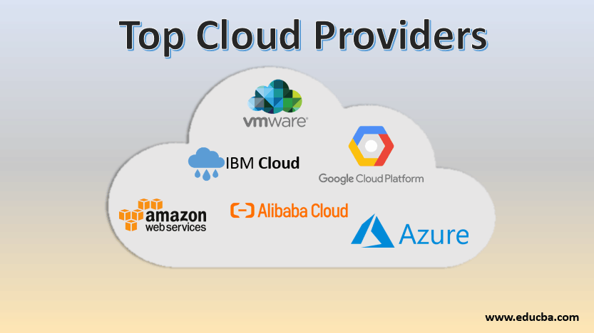
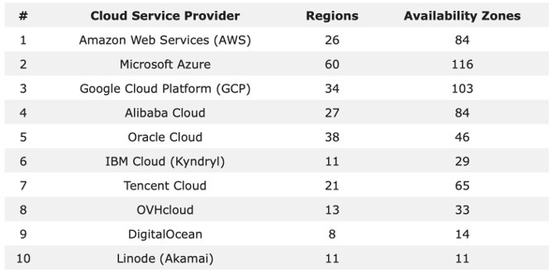
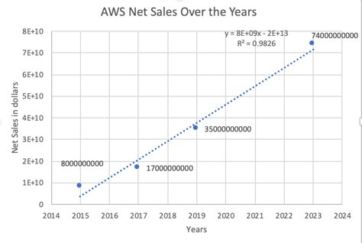
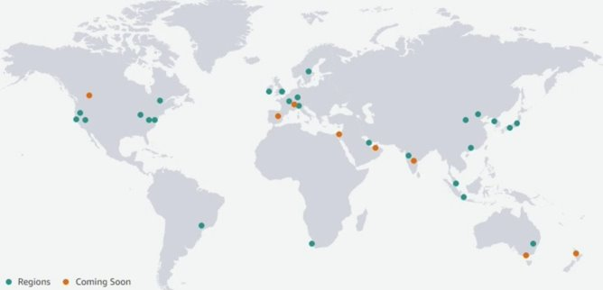
Why did we choose AWS as our cloud service provider?
-Over 200 services offered in a variety of categories such as Databases, Networking, Storage, Machine Learning, Analytics, etc. ​
-Go Global in minutes
​
-Everything is a click away!​
-Massive economies of scale for customers' benefit​

Slide 4
Airline Ticketing System overview
Business objective:
Develop an airline ticketing system which adheres to the 6 pillars of well-architected framework.
Challenges:
Limited seats per flight
Handling users concurrently requesting for the same seat
Payment failure scenarios
Handling booking cancellations and refunds
Functional requirements:
Search for a flight
Secure login for customers
Book tickets
Payment through third party payment gateway
View flight information
Notification system – flight status and itinerary
Non-functional requirements:
Highly available flight search system
Highly available booking system capable of serializing requests from concurrent users
Data management and archival
Low latency system to handle bookings from around the world

Slide 5
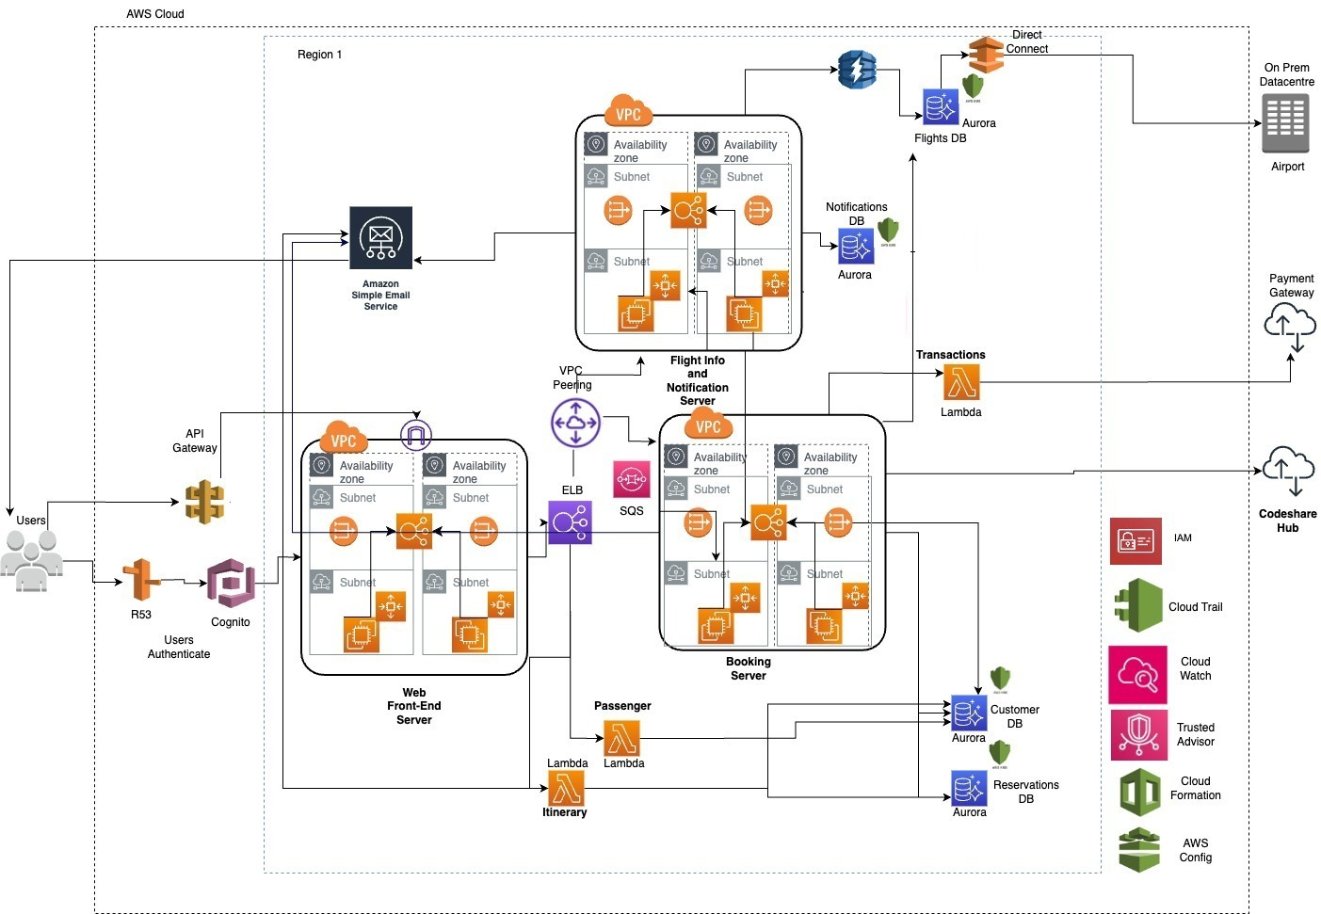
Airline Ticketing System Full Architecture Diagram

Slide 6
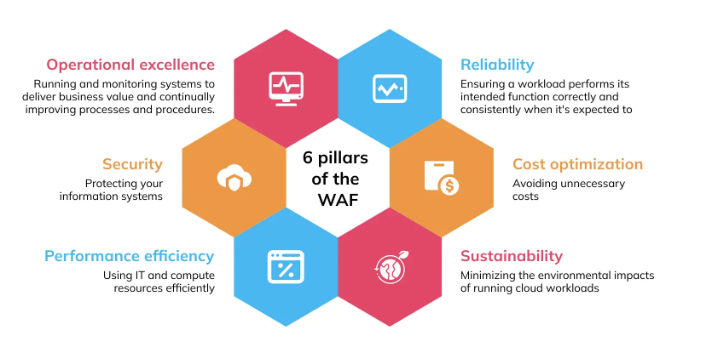
Well-Architected Framework Overview

Slide 7



Pillar 1: Operational Excellence
It refers to the ability to run and monitor systems to deliver business value, and to continually improve processes and procedures.
Perform operations as code
Make frequent, small, reversible changes
Anticipate failure
Refine operations procedures frequently
Learn from all operational failures
AWS Cloud Formation
AWS Cloud watch
AWS Cloud trail

Slide 8

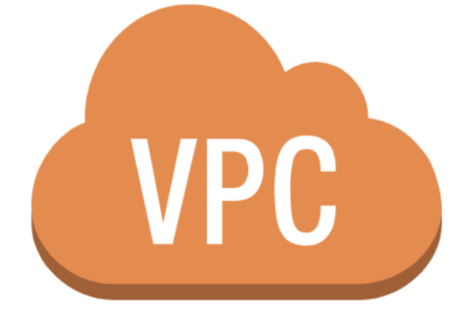

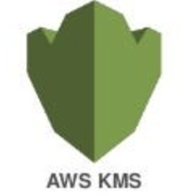
Pillar 2: Security
It refers to the ability to protect information, systems, and assets while delivering business value through risk assessments and mitigation strategies.
Implement a strong identity foundation
Enable traceability
Apply security at all layers
Keep people away from data
AWS IAM
AWS Cloud Trail
Amazon VPC
Automate security best practices
Protect data in transit and at rest
AWS Config
AWS KMS

Slide 9

Pillar 3: Reliability
It refers to the ability of a system to recover from infrastructure or service disruptions, to dynamically acquire computing resources to meet demand, and to mitigate disruptions such as misconfigurations or transient network issues.
Automatically recover from failure
Stop guessing capacity
Scale horizontally to increase aggregate workload availability
Test recovery procedures
Manage change in automation
Amazon EC2 Auto Scaling
Amazon CloudWatch
AWS CloudFormation

Slide 10

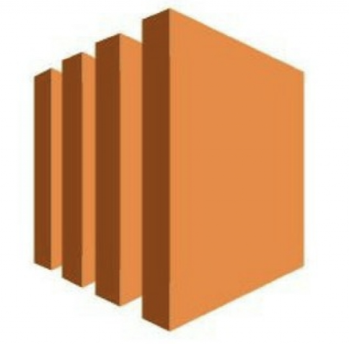


Pillar 4: Performance Efficiency
It refers to the ability to use computing resources efficiently and to maintain that efficiency as demand changes and technologies evolve.
Go global in minutes
Consider mechanical sympathy
Use serverless architectures
Amazon EC2
AWS Route 53
AWS Lambda
AWS VPC

Slide 11
Pillar 5: Cost Optimization
It refers to a set of best practices and guidelines for designing and operating reliable, secure, efficient, and cost-effective systems in the AWS cloud.
Stop spending money on undifferentiated heavy lifting
Adopt a consumption model
Measure overall efficiency
Amazon CloudWatch
AWS Lambda

Slide 12



Pillar 6: Sustainability
It refers to the ability of an architecture to meet the needs of the organization, its stakeholders, and the environment in a long-term, efficient, and scalable manner. Sustainability involves designing architectures that are not only cost-effective and reliable but also environmentally friendly, socially responsible, and adaptable to changing business needs.
Understand your impact
Maximize utilization
Use managed services
AWS Trusted Advisor
Amazon EC2 Auto Scaling
Amazon Aurora
Anticipate and adopt new, more efficient hardware and software offerings
Reduce the downstream impact of your cloud workloads
Amazon EC2
Amazon Elastic Load Balancing

Slide 13

Thank You!

