Slide 1

Analysis of Docker Storage Backends
CmpE 284- Storage and Network Virtualization
Class Project Presentation
Team Name: StoragePros
Team Members:
Larkins Carvalho
Nielet Dmello
Shilpa Murali
Vikram Arsid

Slide 2
Outline
Extremely short intro to Docker
Short intro to copy-on-write
History of Docker storage drivers
AUFS, BTRFS, Device Mapper, Overlayfs, VFS
Our Approach to Performance Analysis
Performance Analysis results
Conclusions

Slide 3
Copy on Write
Sharing and Copying
Copy of data is made only when the data is modified or written
Copy of data is accessible only to the process that created it
Optimizes both image disk space usage and the performance of container start times

Slide 4
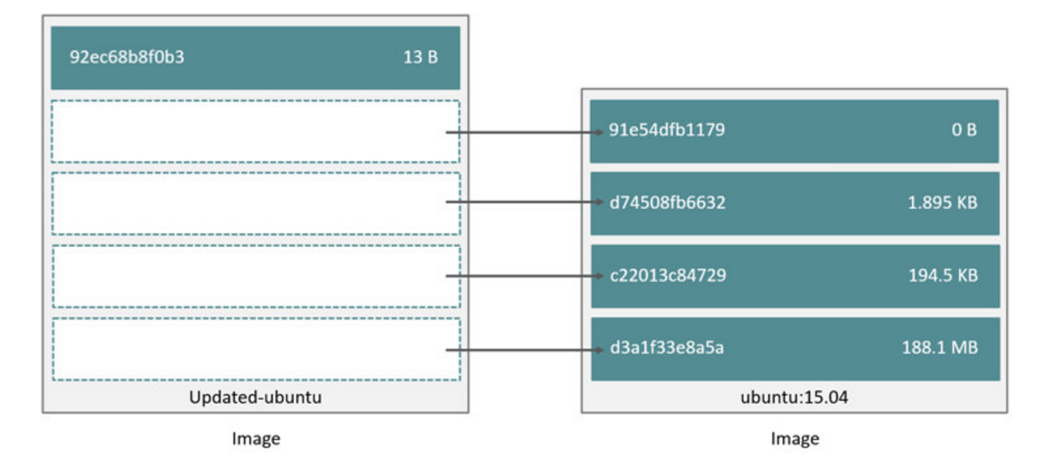
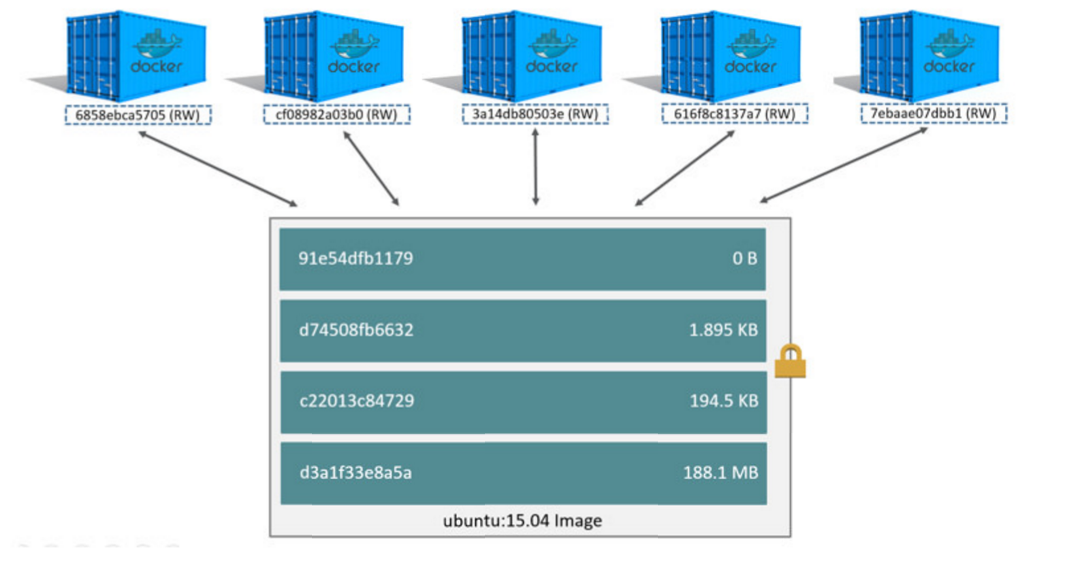
Advantages of CoW
Sharing promotes smaller images
Copying makes containers efficient

Slide 5
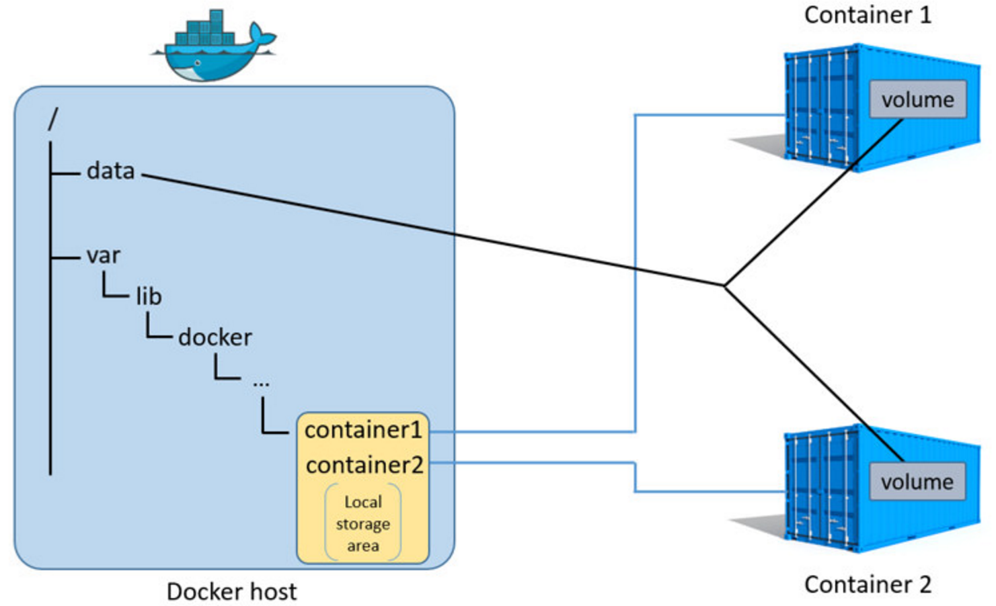
Data volumes and the storage driver
Reads and writes to data volumes bypass the storage driver
The data volume resides outside of the local storage area on the Docker
Data stored in shared data volumes persists on the Docker host even if container is deleted

