Slide 1
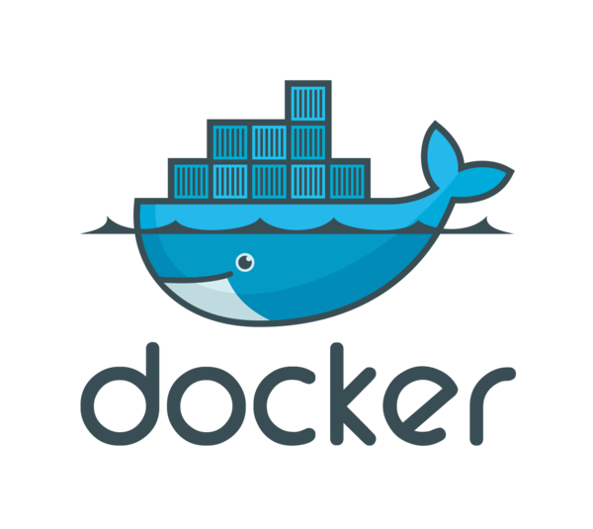
Analysis of Docker Storage Backends
CmpE 284- Storage and Network Virtualization
Class Project Presentation
Team Name: StoragePros
Team Members:
Larkins Carvalho
Nielet Dmello
Shilpa Murali
Vikram Arsid

Slide 2
Outline
Extremely short intro to Docker
Short intro to copy-on-write
History of Docker storage drivers
AUFS, BTRFS, Device Mapper, Overlayfs, VFS
Our Approach to Performance Analysis
Performance Analysis results
Conclusions

Slide 3
Docker Storage drivers
A storage driver is responsible for enabling and managing both the image layers and the writeable container layer.
Two key technologies behind Docker image and container management are:
Stackable image layers
Copy-on-write (CoW).
Docker images are a series of read-only layers that are stacked on top of each other to form a single unified view.
The first image in the stack is called a base image and all the other layers are stacked on top of this layer.

Slide 4
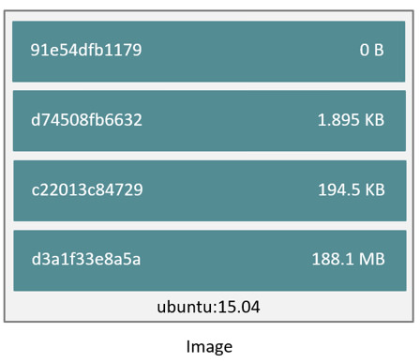
Image

Slide 5
Stackable image layers
The ubuntu image contains four stacked image layers.
When you make a change inside a container by, for example, adding a new file to the Ubuntu 15.04 image, you add a new layer on top of the underlying image stack.
This change creates a new image layer containing the newly added file. Each image layer has its own universal unique identifier (UUID) and each successive image layer builds on top of the image layer below it.
Containers (in the storage context) are a combination of a Docker image with a thin writable layer added to the top known as the container layer.

Slide 6
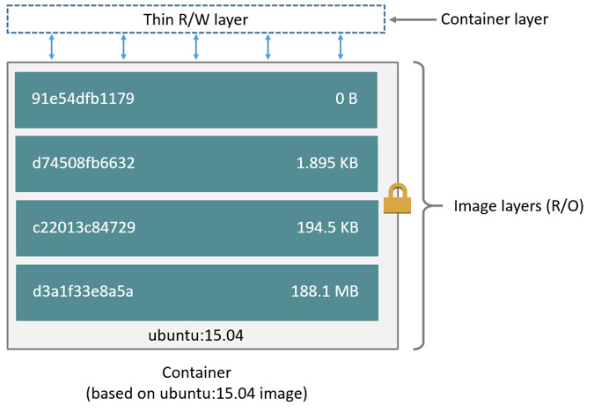
Container
Notes:
Stop:Nielet

Slide 7
Copy on Write
fork() and exec()
Sharing and Copying
Copy of data is made only when the data is modified or written
Copy of data is accessible only to the process that created it
Docker uses a copy-on-write technology with both images and containers
Optimizes both image disk space usage
Improves performance of container start times

Slide 8
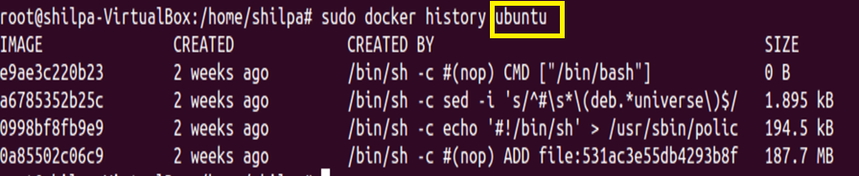
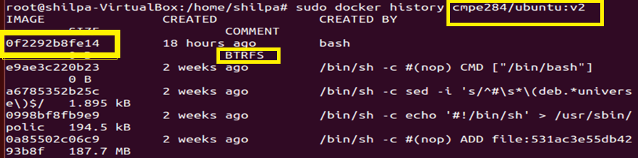
Advantages of CoW
Sharing promotes smaller images

Slide 9
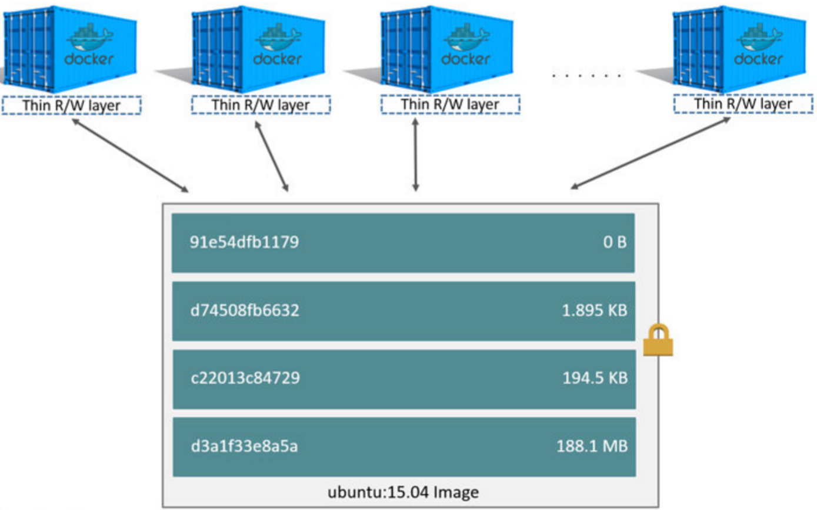
Copying makes containers efficient
Search through the layers for the file to update
Perform a “copy-up” operation on the first copy of the file that is found
Modify the copy of the file in container’s thin writable layer
The operation only occurs the first time any particular file is modified
Subsequent modifications on the file’s existing copy

Slide 10
Selecting a Storage Driver
Docker has pluggable storage driver architecture. This gives the flexibility to plug in the storage driver best for your environment.
Each Docker storage driver is based on a Linux filesystem or volume manager.
Once you decide which driver is best, you set this driver on the Docker daemon at start time. As a result, the Docker daemon can only run one storage driver, and all containers created by that daemon instance use the same storage driver.

Slide 11
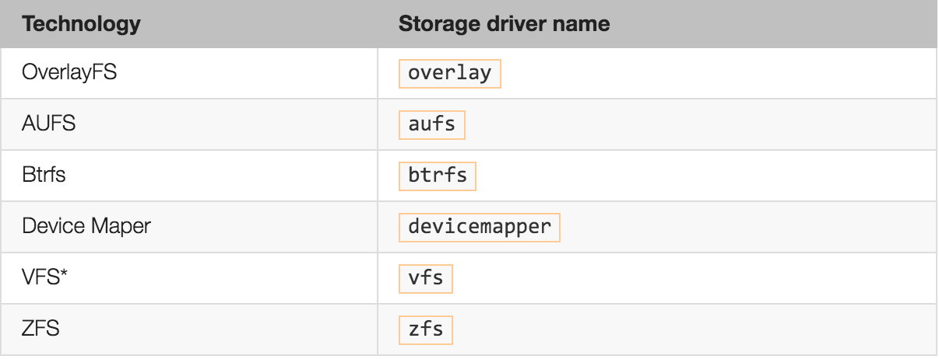
Supported Storage drivers

Slide 12
AUFS
First storage driver in use with Docker.
It is a unification file system - It takes multiple directories on a single Linux host, stacks them on top of each other, and provides a single unified view.
Docker leverages AUFS CoW technology to enable image sharing and minimize the use of disk space. AUFS works at the file level.
Combination of multiple branches in a specific order
Each branch is just a normal directory
We generally have:
At least one read-only branch (at the bottom)
Exactly one read-write branch (at the top)

Slide 13
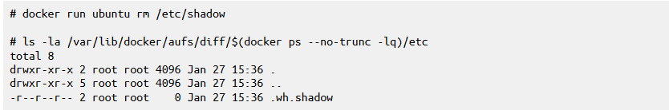
When opening a file
With O_RDONLY - read-only access:
Look it up in each branch, starting from the top.
Open the first one we find.
With O_WRONLY or O_RDWR - write access:
Look it up in the top branch; if it's found here, open it
Otherwise, look it up in the other branches; if we find it, copy it to the read-write (top) branch, then open the copy
That "copy-up" operation can take a while if the file is big!
To delete a file, “whiteout” file is created

Slide 14
In Practice
The AUFS mountpoint for a container is
/var/lib/docker/aufs/mnt/$CONTAINER_ID/
It is only mounted when the container is running
The AUFS branches (read-only and read-write) are in
/var/lib/docker/aufs/diff/$CONTAINER_OR_IMAGE_ID/
All writes go to /var/lib/docker

Slide 15
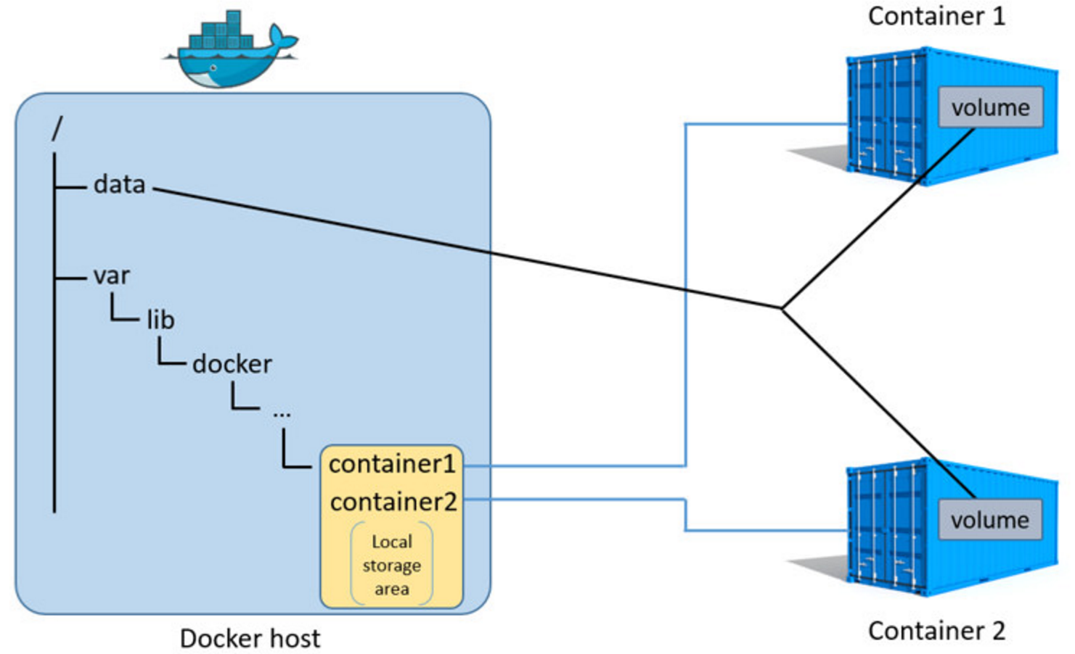
Data volumes and the storage driver
Reads and writes to data volumes bypass the storage driver
The data volume resides outside of the local storage area on the Docker
Data stored in shared data volumes persists on the Docker host even if container is deleted

Slide 16
Performance Analysis
AUFS mount() is fast, so creation of containers is quick
Read/write access has native speeds
But initial open() is expensive in two scenarios:
when writing large sized files
with many layers + many directories in PATH
When starting the same container 1000x, the data is loaded only once from disk, and cached only once in memory (but dentries will be duplicated)
By this approach aufs makes efficient usage of storage and memory

Slide 17
Good choice for PaaS where container density is important. This is because AUFS efficiently shares images between multiple running containers, enabling fast container start times and minimal use of disk space.
The underlying mechanics of how AUFS shares files between image layers and containers uses the systems page cache very efficiently.
The AUFS storage driver can introduce significant latencies into container write performance. This is because the first time a container writes to any file, the file has be located and copied into the containers top writable layer. These latencies increase and are compounded when these files exist below many image layers and the files themselves are large.

Slide 18
DeviceMapper
Benefits:
RAID
Encrypted devices
Snapshots(COW)
Thin provisioning

Slide 19
Why DeviceMapper
Device mapper is kernel based framework.
RedHat collaborated with docker to come up with this backend. As a result, docker engine was re-engineered to make the storage backends pluggable. So, device mapper became the second storage driver docker supported.

Slide 20
The device mapper backend
Uses the device-mapper thin provisioning module (dm-thinp) to implement layers.
Device-mapper is the kernel part of the LVM2 logical volumes system, so this is is a block-level copy-on-write system.
The thin provisioning module takes two block devices (the data and the metadata devices) and creates a“pool” of space that can be used to create other block devices from.
Such block devices are “thinly provisioned” meaning they start out empty, and the parts that are unused are not allocated. Additionally it is possible to take a copy-on-write snapshot of a device, producing a new device.

Slide 21
OverLayFS
Modern Union file system similar to AUFS. In comparison to AUFS, OverLayFS has simpler design and potentially faster.
OverlayFS takes two directories on a single Linux host, layers one on top of the other, and provides a single unified view.
The OverlayFS terminology is “lowerdir” for the bottom layer and “upperdir” for the top layer. The unified view is exposed through its own directory called “merged”.

Slide 22
Container Read with overlay
The file does not exist in the container layer. If a container opens a file for read access and the file does not already exist in the container (“upperdir”) it is read from the image (“lowerdir”). This should incur very little performance overhead.
The file only exists in the container layer. If a container opens a file for read access and the file exists in the container (“upperdir”) and not in the image (“lowerdir”), it is read directly from the container.
The file exists in the container layer and the image layer. If a container opens a file for read access and the file exists in the image layer and the container layer, the file’s version in the container layer is read. This is because files in the container layer (“upperdir”) obscure files with the same name in the image layer (“lowerdir”).

Slide 23
OverLayFS and Docker Performance
Page Caching. OverlayFS supports page cache sharing. This means multiple containers accessing the same file can share a single page cache entry (or entries). This makes the overlay driver efficient with memory and a good option for PaaS and other high density use cases.
copy_up. As with AUFS, OverlayFS has to perform copy-up operations any time a container writes to a file for the first time.The OverlayFS copy_up operation should be faster than the same operation with AUFS
Inode limits. Use of the overlay storage driver can cause excessive inode consumption.

Slide 24
BTRFS
Btrfs is a next generation copy-on-write filesystem
Leverages many Btrfs features for image and container management
Thin provisioning
Copy-on-Write
Snapshotting
Pooling
Potential long-term replacement for the device mapper storage driver
Notes:
B-tree is a self-balancing tree data structure that keeps data sorted and allows searches, sequential access, insertions, and deletions in logarithmic time.
B-tree is optimized for systems that read and write large blocks of data
B-trees do not need re-balancing as frequently as other self-balancing search trees
TP operates by allocating disk storage space in a flexible manner among multiple users, based on the minimum space required by each user at any given time.

Slide 25
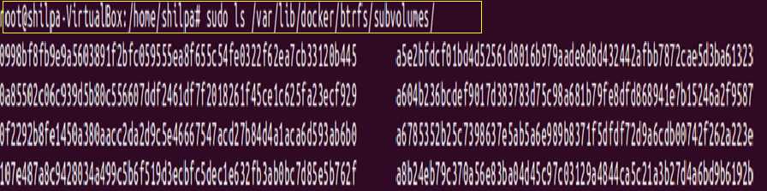
BTRFS Sub Volumes
Btrfs subvolumes and snapshots for managing the on-disk components of image and container layers.
Subvolumes are natively CoW and have space allocated to them on-demand from an underlying storage pool.
Do not have a fixed size
Notes:
B-tree is a self-balancing tree data structure that keeps data sorted and allows searches, sequential access, insertions, and deletions inlogarithmic time.
B-tree is optimized for systems that read and write large blocks of data
B-trees do not need re-balancing as frequently as other self-balancing search trees
The BTRFS mountpoint for a container or an image is subvolumes

Slide 26
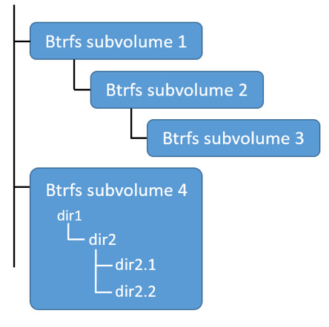
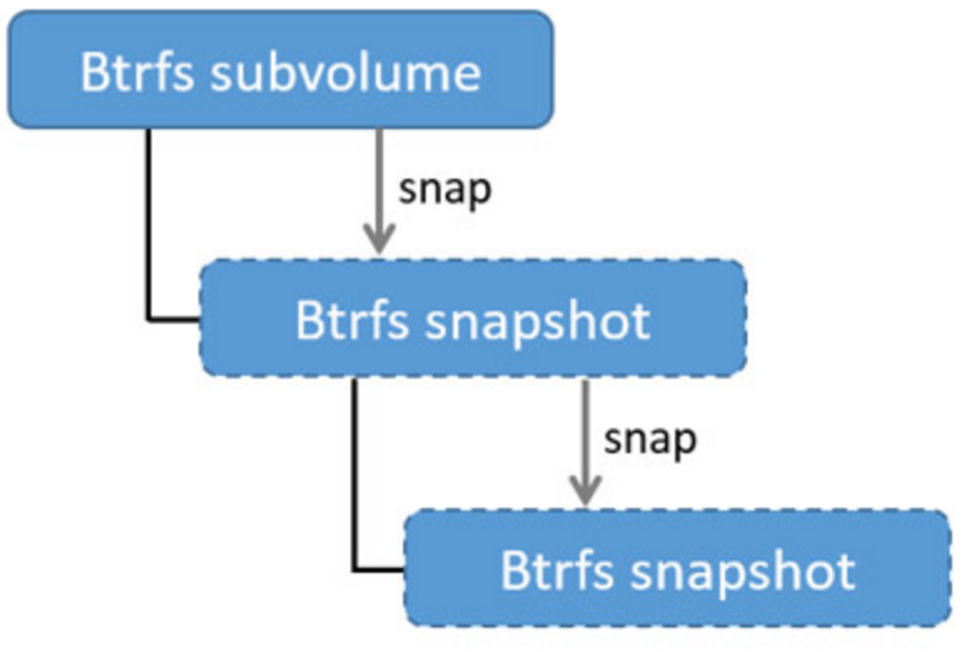
Sub Volumes
The unit of allocation is referred to as a chunk ~1GB in size.
Snapshots
It is a copy of a subvolume, without the parent or child subvolumes
No copies of files, but shares the data and metadata of the original subvolume
Notes:
Internal directory structure similar to the wider Unix filesystem.
Snapshots are a point-in-time read-write copy of an entire subvolume.
They exist directly below the subvolume they were created from.
The technology required to create snaphot is built directly into the Btrfs filesystem thanks to its native copy-on-write design

Slide 27
BTRFS and Docker Performance
Page caching: Btrfs does not support page cache sharing. This means that n containers accessing the same file require n copies to be cached.
Small writes: Containers performing lots of small writes can lead to poor use of Btrfs chunks. This can ultimately lead to out-of-space conditions on your Docker host and stop it working.
Sequential writes: Btrfs writes data to disk via journaling technique. This can impact sequential writes, where performance can be up to half.
Fragmentation: Fragmentation is a natural byproduct of copy-on-write filesystems like Btrfs. This results in poor performance.

Slide 41
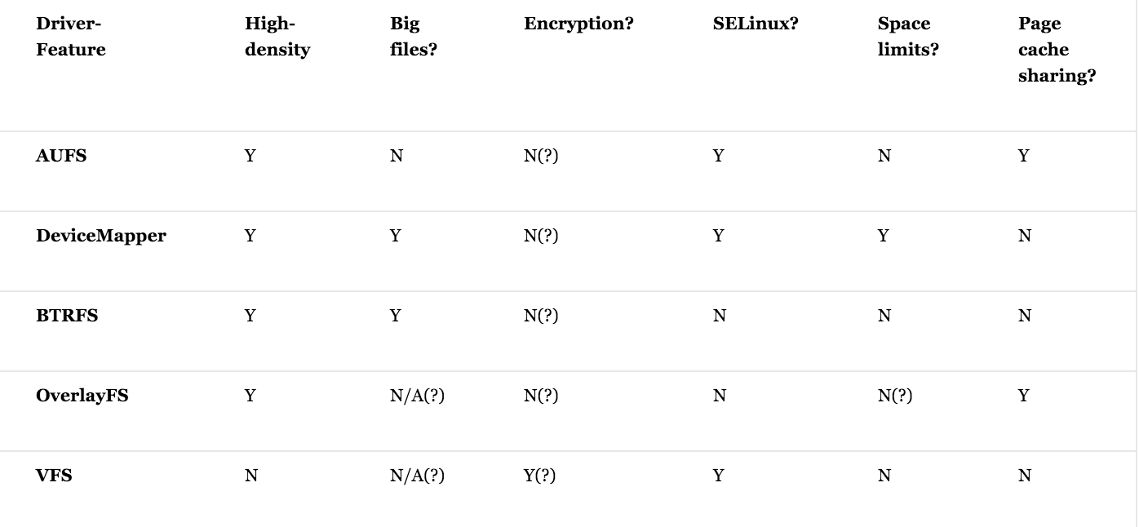
Comparison

Slide 42
References
https://docs.docker.com/engine/userguide/storagedriver/imagesandcontainers/
https://docs.docker.com/engine/userguide/storagedriver/btrfs-driver/
https://docs.docker.com/engine/userguide/storagedriver/aufs-driver/
https://docs.docker.com/engine/userguide/storagedriver/device-mapper-driver/
https://docs.docker.com/engine/userguide/storagedriver/overlayfs-driver/
http://www.thegeekstuff.com/2011/05/iozone-examples/

Slide 43
THANK YOU

