Slide 1
GoSafe
Enabling smart safe routing options for users.
And creating a community driven for Safety.

Slide 2
Solving Safe Commute
We propose a Safety Index, which denotes the safety of any place by analysing various demographic features and user feedbacks. And then further use this to suggest the safest route for users.
We divide the suggested route into different points and for each point we calculate features. And further we club all the calculated features in a route and then our Model predicts the safest route or safest place near you.

Slide 3
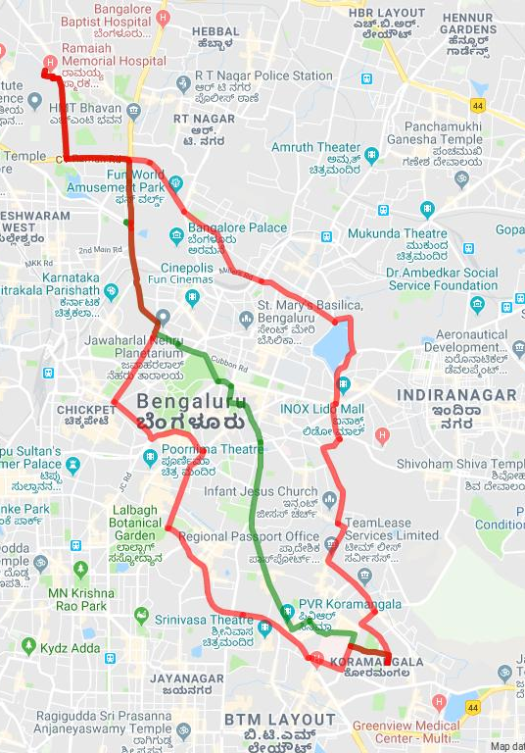
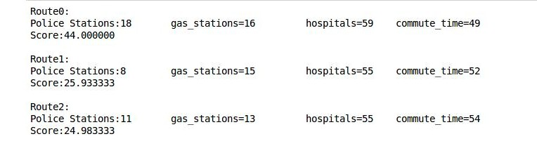
Scores and Best Route

Slide 4
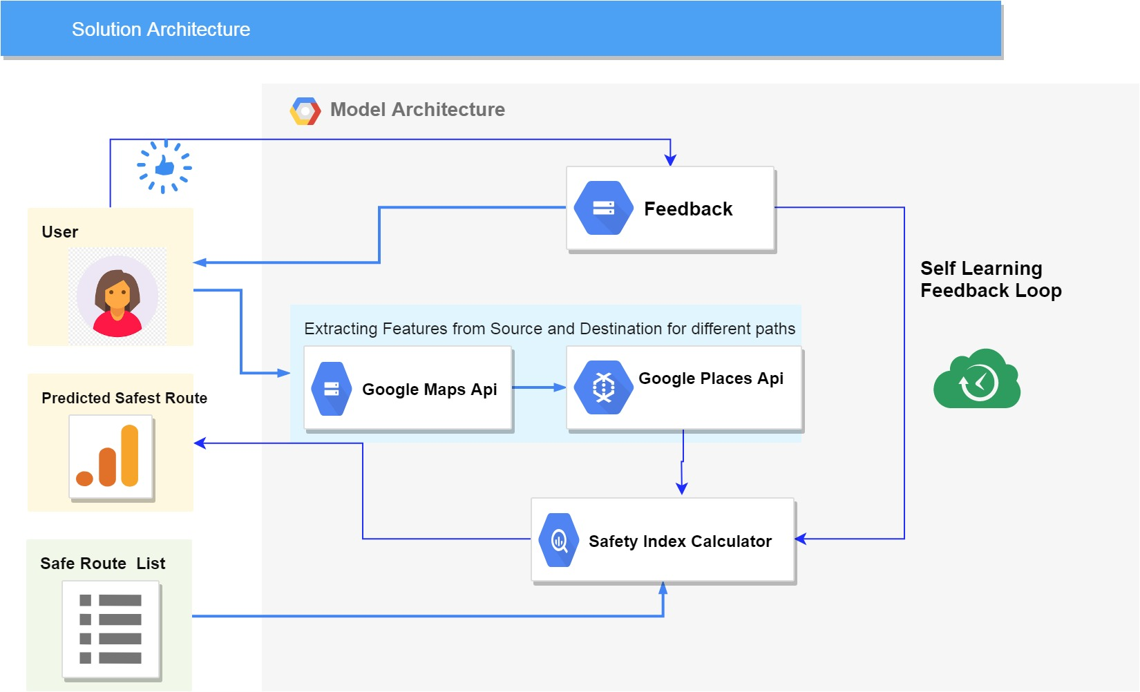

Slide 5
Safety Index Features :
Number of Police Stations and distance from the proposed route .
Number of Hospitals , Petrol Pumps, Restaurants etc
Reviews of places nearby constituting the route.
Number of accidents on the routes.
Previously marked safety routes. Etc
People density using Social Handles.(Facebook , Twitter , Instagram)

Slide 6
Business Model
Users
Safety Index
Commute Services
Government Authorities

Slide 7
Go to Market Plan :
We plan to create a community of users where users can share their experience and knowledge of their surroundings.
Users can mark safe zones and also get similar safe zone recommendations.
As we start to create more user data our model will learn from the feedbacks provided and further we can monetize this data
Collaborate with different NGO’s and government bodies to create an impact .

Slide 8
Financial Projection :
We intend to have the product free for users.
Revenue would be through ads, after we hit a userbase of 10000
3. Financial projection for year 2 = (number of user trips * 200 working days * Rs. 10)
4. The ads will be non-intrusive, and will be displayed at the end of the trip

