Slide 1




Slide 2
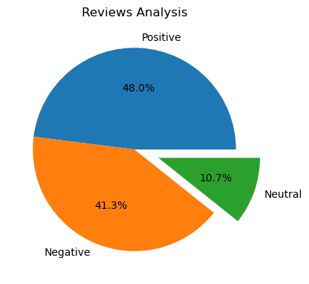
Customer satisfaction based on reviews
Sentiment Distribution: The chart illustrates the sentiment distribution with wedges representing positive, negative, and neutral sentiments.
Positive Sentiment: The wedge positioned at the top right signifies positive sentiment, accounting for 48.0% of the overall sentiment.
Negative Sentiment: The wedge on the top left represents negative sentiment, comprising 41.3% of the total sentiment.
Neutral Sentiment: The bottom wedge on the right side denotes neutral sentiment, making up 10.7% of the sentiment distribution.

Slide 3

Listing the common words via Lemmatization

