Slide 1

QRT BOT
Department of CSE
Jyothi Engineering College
Thrissur
April 16 , 2021

Slide 2
Group Members :
Joshua Joseph (JEC17CS059)
Josin George (JEC17CS060)
Sangeetha C P (JEC17CS086)
Shilpa Sivadas ( JEC17CS093)
MENTOR : Mr Unnikrishnan P (Assistant Professor)
Project Repository Link: https://github.com/ShilpaSivadas24/Group21_FinalProject

Slide 3
Project Abstract
PProject Abstractroject Abstract
Due to COVID-19 pandemic, many people have become paranoid about whether they have contracted the virus or not and are deprived of social contact. To solve both of these issues we introduce QRT BOT, a chatbot that provides two major functions, recognizing symptoms of COVID-19 for users as well as providing a means for social interaction for people in quarantine.

Slide 4
Project Objective
Raise awareness among people regarding Covid 19
Help people fight against this deadly disease
Determine if a user has a high chance of being COVID-19 positive
Predict user's mental and emotional state.

Slide 5
Literature Survey
Medbot: Conversational artificial intelligence powered chatbot for delivering tele-health after covid-19- To Provides information about the possible symptoms and applicable preventive measures
Sentiment analysis: Capturing favorability using natural language processing- Manually defined sentiment lexicon with different classifiers are used
Chatbot for Disease Prediction and Treatment Recommendation using Machine Learning-Identifies the symptoms of the user and thereby predicts the disease and recommends treatment
Compassion Driven Conversational Chatbot Aimed for better Mental Health-Designed by generative based learning instead of rule based

Slide 6
Software Requirement Specification
Functional Requirements:
Admin interface: The user interface module where the user needs to login.
Data Pre-processing and Feature extraction: User replies are taken as input from the chat.
Request analysis/Return response: The user is informed with preventive measures and other counter measures. Jokes and comics are displayed to cheer up the mental state.

Slide 7
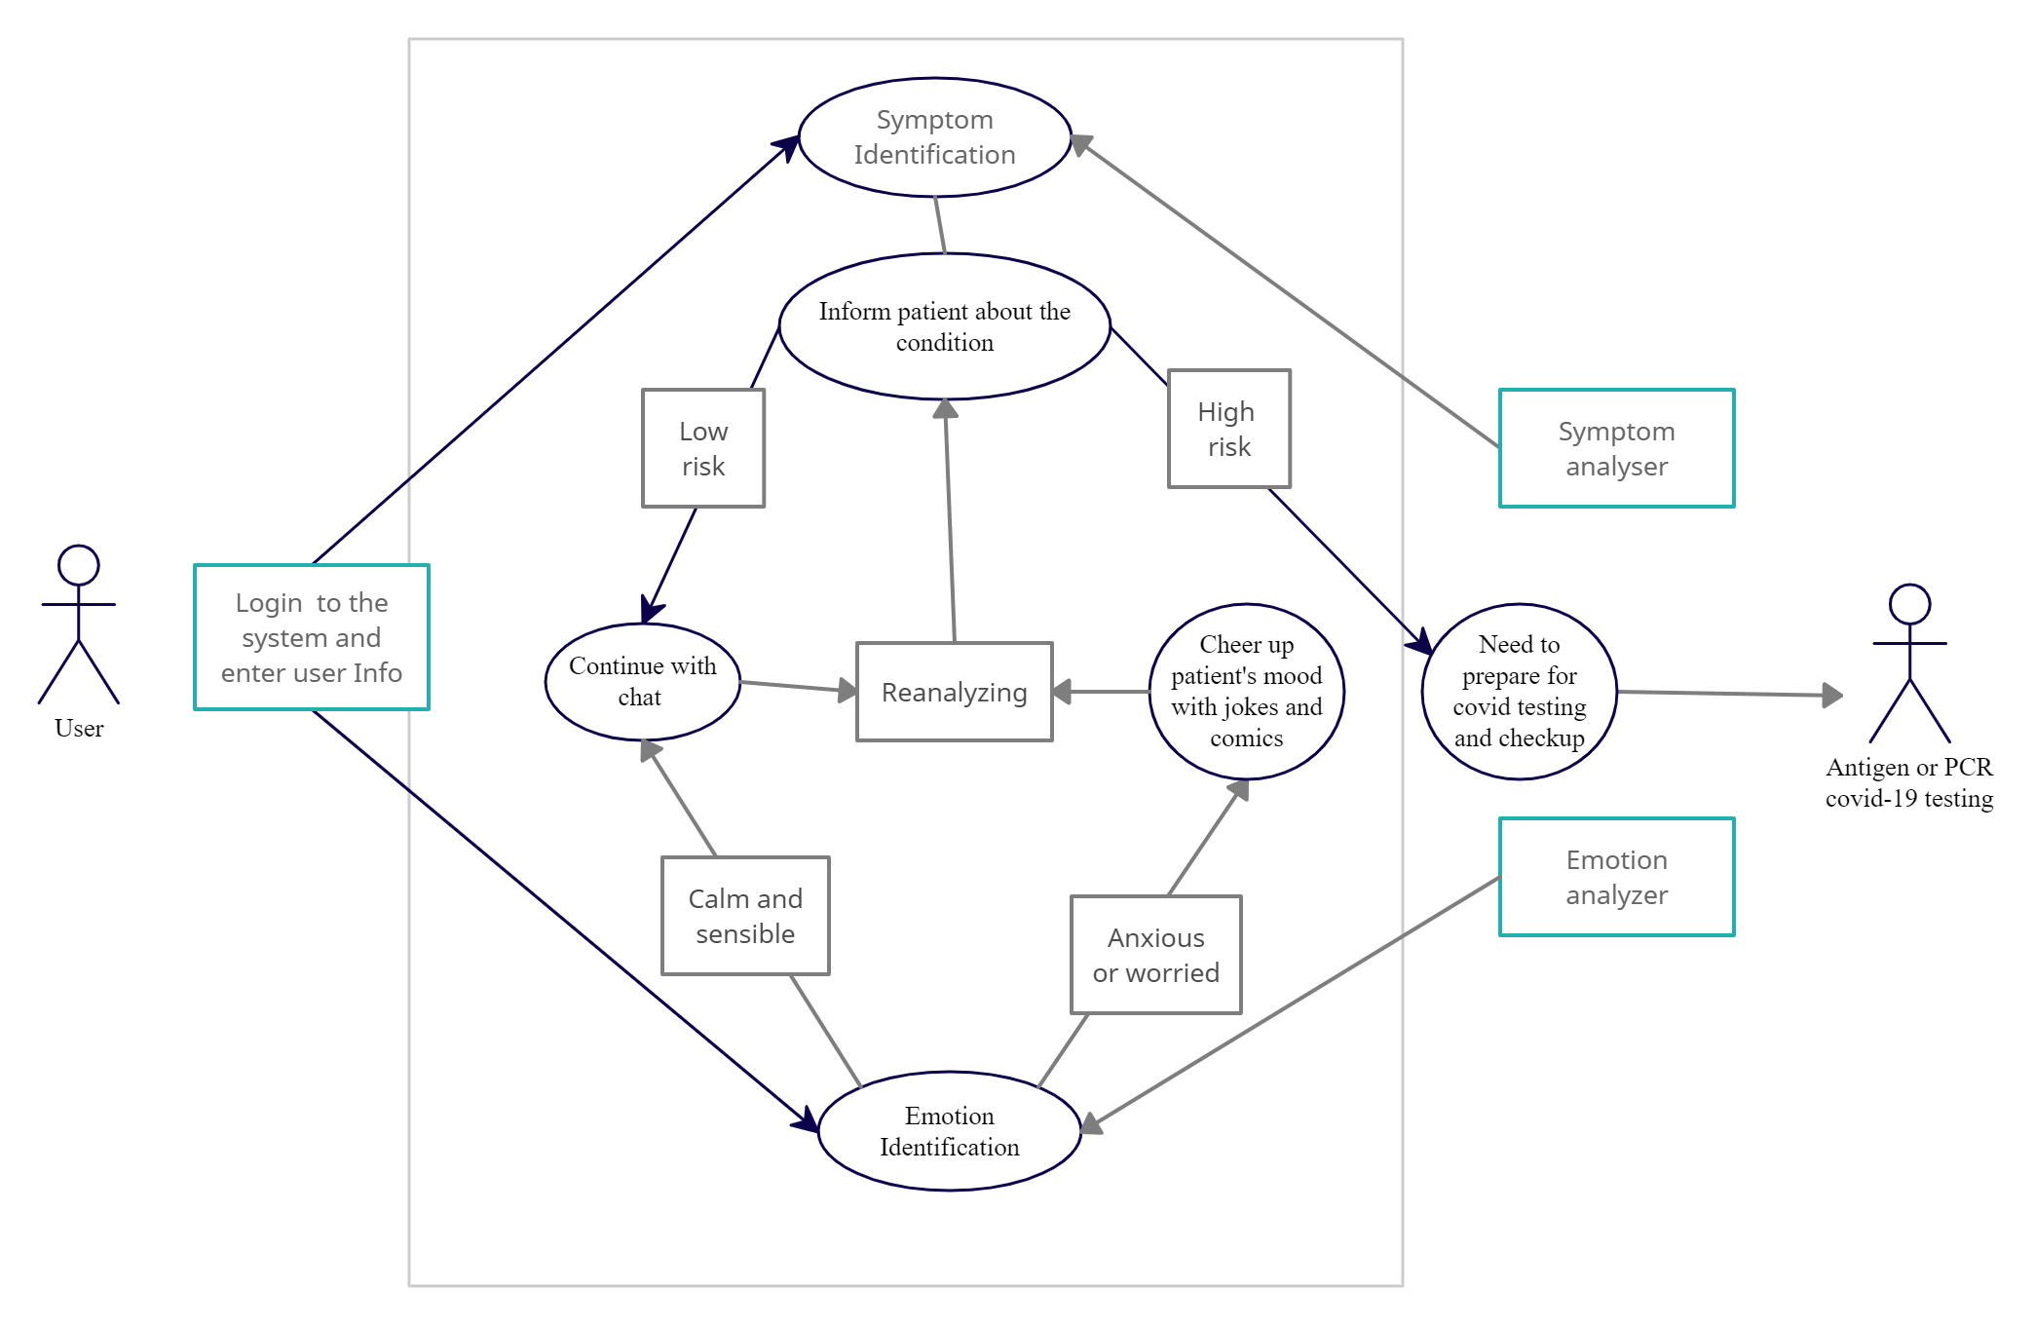
Use Case Diagram

Slide 8
User Interface
Kivy- open source python library
Cross platform
Create object for each page in the app
Makes use of screen manager
Each screen formatted based on kivy grid layout

Slide 9
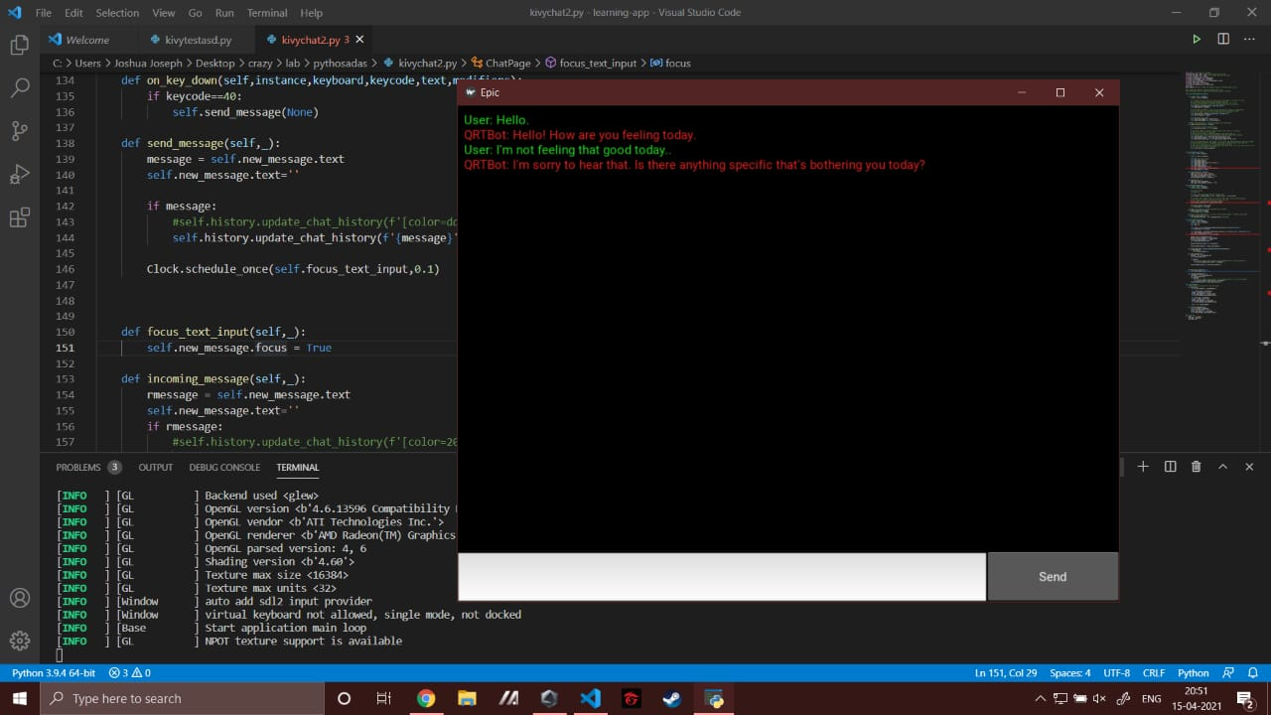
Output

Slide 10
Emotion Analysis
Data Set: It contains 40,000 tweets
Data Pre-processing:
Removal of regular expressions
Removal of lemmas (Lexicon Normalization)
Removal of stop-words
Training Model: SVM is used to train the model

Slide 11
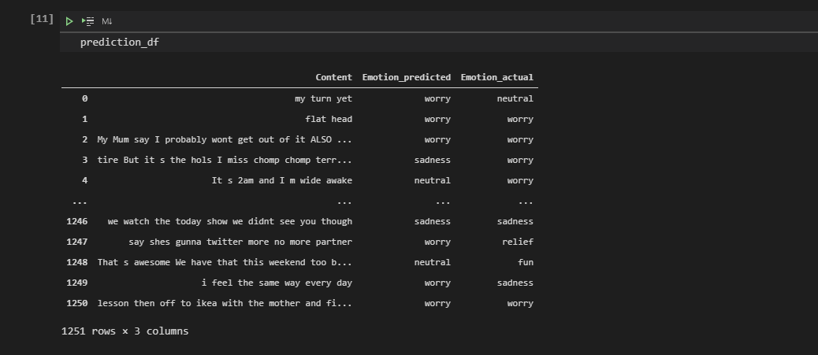
Output

Slide 12
Symptom Prediction using Decision Tree Classifier
Decision Tree algorithm - uses a tree like structure and their possible combinations to solve a particular problem.
The attribute selection measure that CART (Categorical and Regression Trees) uses here is the Gini index.
Gini index -measures the degree or probability of a particular variable being wrongly classified when it is randomly chosen.

Slide 13
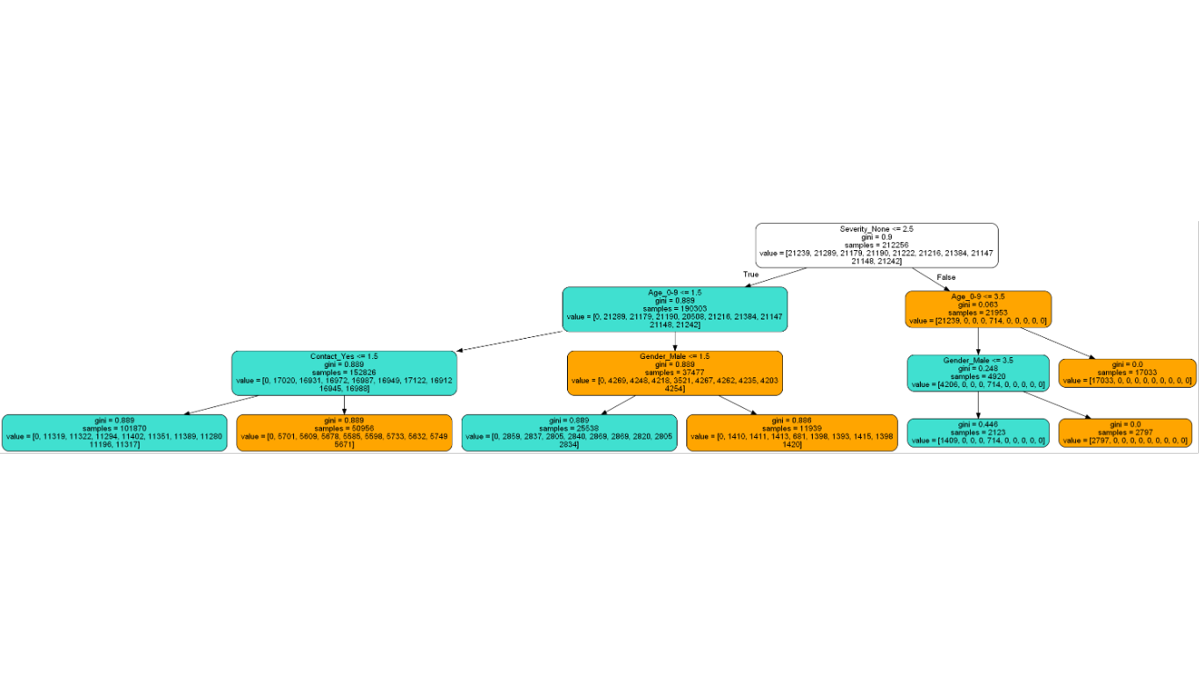
Output

Slide 14
Pending Work
Perform actions - based on user’s detected emotion
Integration of Emotion Analysis and Covid Symptom Prediction

Slide 15
Conclusion
A simple chatbot that effectively allow users to check if they belong to COVID-19 high risk category
Provide emotional support during quarantine.
Non-intrusive and user friendly application that anyone can use.
Will greatly help in the fight against COVID-19.

Slide 16
References
Mathew, Rohit Binu, et al. "Chatbot for Disease Prediction and Treatment Recommendation using Machine Learning" , 2019 3rd International Conference on Trends in Electronics and Informatics (ICOEI). IEEE, 2019o
Khadikar, Sunath and Sharma, Pawan and Paygude, Priyankatinal, “Compassion Driven Conversational Chatbot Aimed for better Mental Health”, Zeichen Journal Volume 6, Issue 9, 2020
Bharti, Urmil and Bajaj, Deepali and Batra, Hunar and Lalit, Shreya and Lalit, Shweta and Gangwani, Aayushi, “Medbot: Conversational artificial intelligence powered chatbot for delivering tele-health after covid-19”,2020 5th International Conference on Communication and Electronics Systems (ICCES)
Nasukawa, Tetsuya, and Jeonghee Yi, "Sentiment analysis: Capturing favorability using natural language processing", Proceedings of the 2nd international conference on Knowledge capture.

Slide 17
Thank You !!

