Slide 1


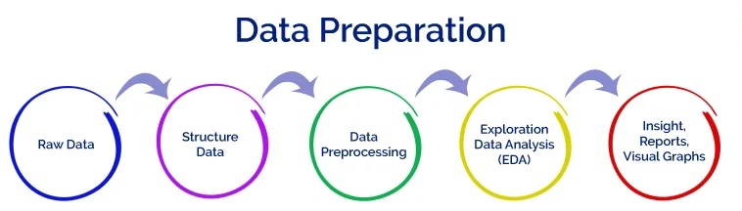
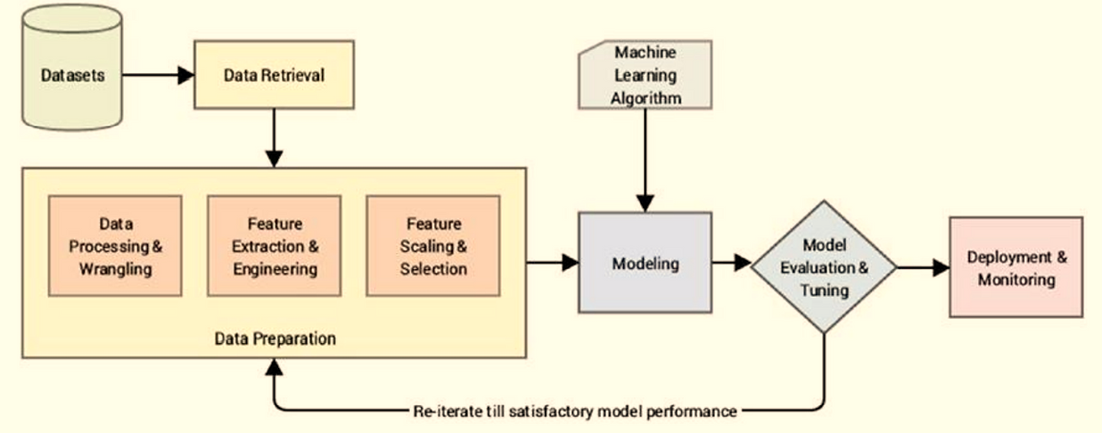
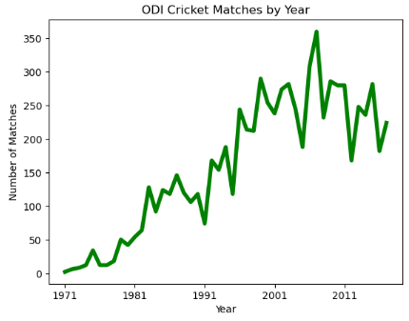
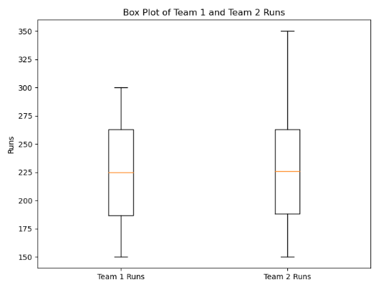
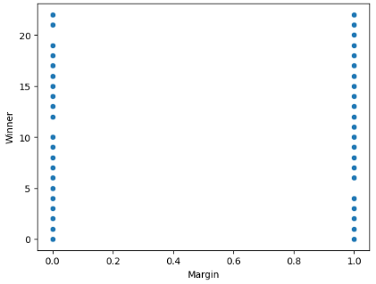
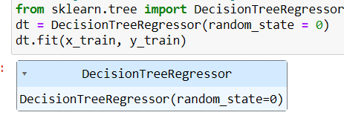
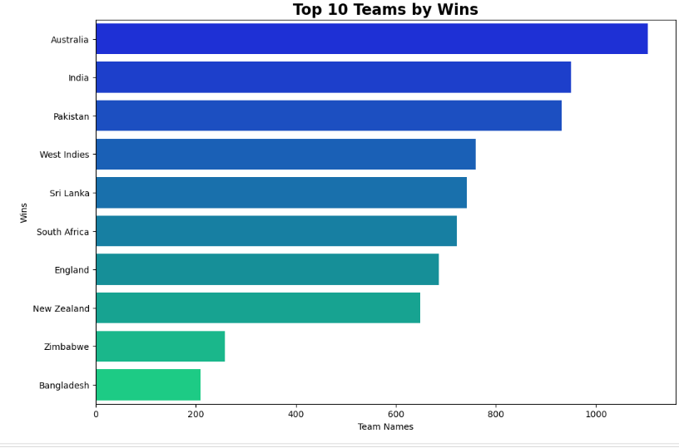
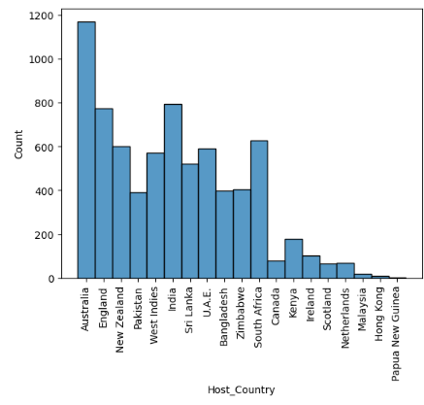
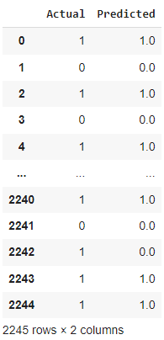
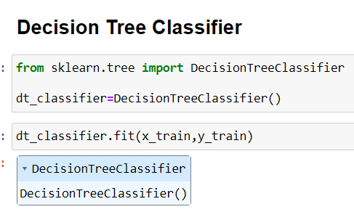
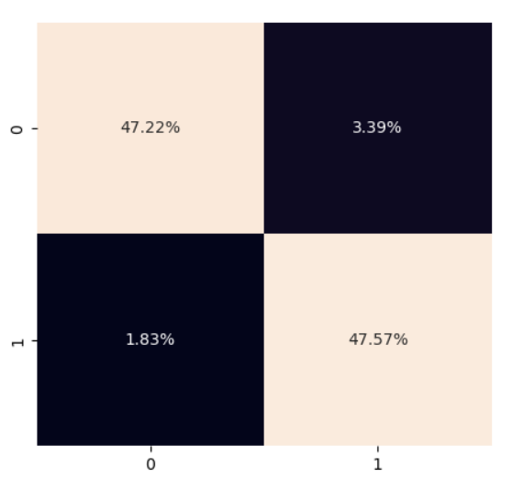
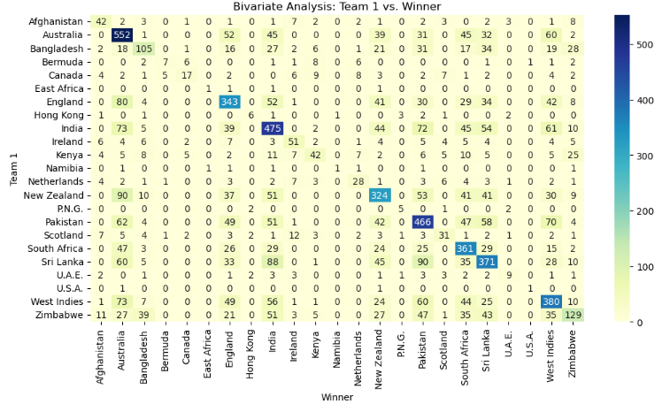
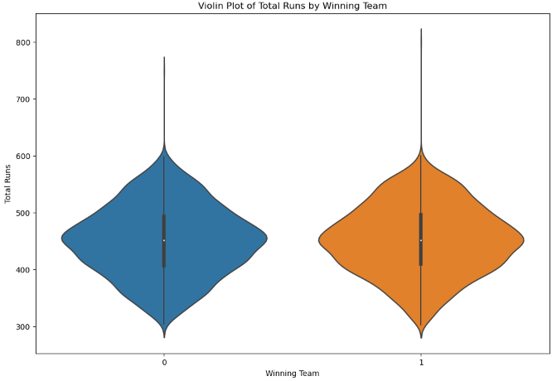
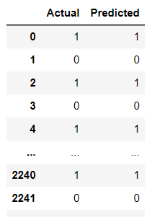
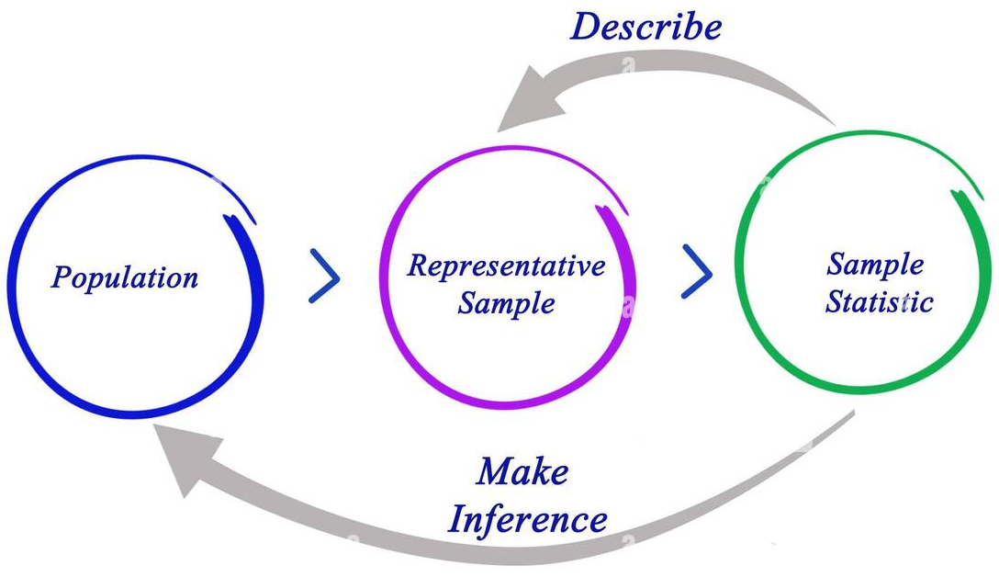
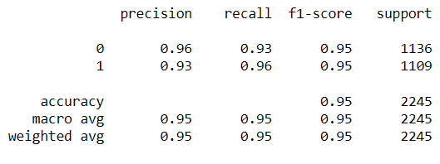
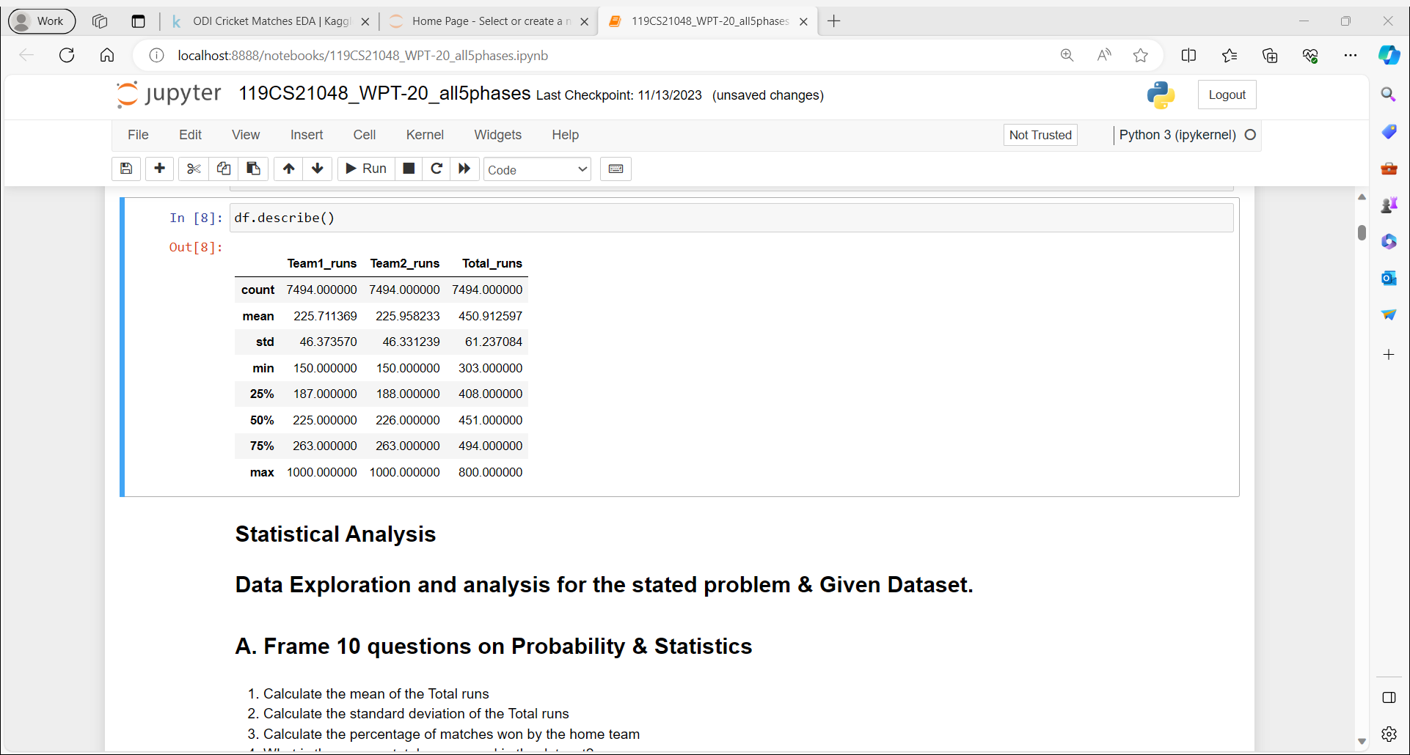
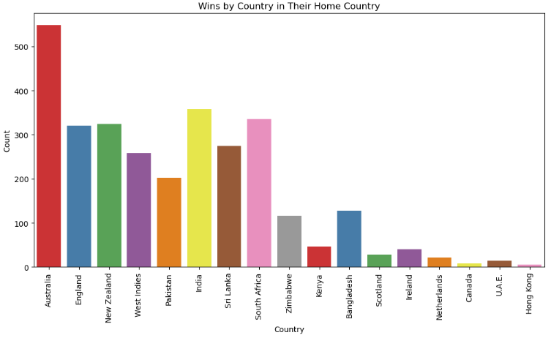
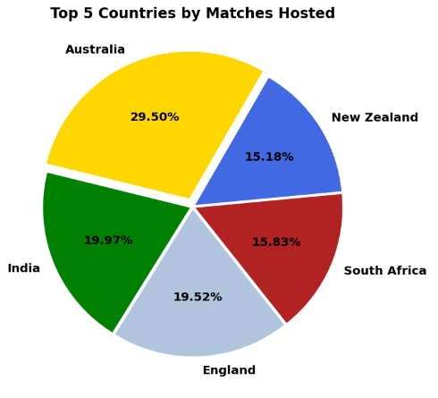
Classification and Prediction of Cricket ODI Winning Teams
_{SHILPA.G (119CS21048)}
_{Under the Guidance of:}
External Guide: Fathima Afroz Internal Guide: Parameshwarappa.K.H _{& Ashok Hullur}
Technical Head, iPEC Solutions Pvt.Ltd Faculties, Govt WPT, Bangalore
Phase-I
Phase-III
Machine Learning Model Building Process
Problem Statement & Objectives
Exploratory Data Analysis
The Cricket ODI dataset provides information of participating teams, match winners, venues, innings, and runs scored, the project's primary goal is to predict mtch outcome. The project aims to employ regression modeling to predict which team, among two participants, will emerge as the winner. By discovering patterns and relationships, the analysis seeks to reveal key factors impacting match results and enhance the understanding of team performance .Through EDA, statistical analysis, and regression modeling, the project aims to provide valuable insights into the world of ODI cricket.
Objective
1. Data collection 6. Exploratory data analysis
2. Data Exploration 7. Machine Learning Modelling
3. Data Preprocessing 8. Model Evaluation
4. Feature Engineering 9. Results Interpretation
5. Statistical Analysis 10. Documentation
Line Plot Box Plot Scatter Plot
Phase-IV
Regression Results & Diagrams
About Dataset
Bar plot
Decision Tree
Scores of linear regression model
CV: 0.0122
R2_score (train): 0.01866460
R2_score (test): 0.02469530
RMSE: 0.49375
Scores of logistic regression model
CV: 0.5422839461124166
R2_score (train): 0.01866
R2_score (test): -0.81228
RMSE: 0.673057710
Scores of lasso regression model
CV: -0.0009
R2_score (train): 0.018
R2_score (test): 0.001
RMSE: 0.499707
Dataset Description, Number of rows & columns
The ODI Cricket Matches dataset is a comprehensive collection of data on One Day International (ODI) cricket matches played from 1971 to 2017. It includes information on every ODI match played during this period, including match details, team scores, player statistics, and match outcomes.
Scorecard: Match identifier for the One-Day International match
Team 1: Name of the first team
Team 2: Name of the second team
Margin: Margin of victory in the match
Ground: Location where the match was played
Match Date: Date on which the match was played
Winner: Winning team name
Host Country: Which country hosted the match
Venue Team1: Home or Away for team 1
Venue Team2: Home or Away for team 2
Innings Team1: Batting order for team 1 (First or Second)
Innings Team2: Batting order for team 2 (First or Second)
Team1 runs: Runs scored by team 1
Team2 runs: Runs scored by team 2
Total runs: Combined total of team 1 and team 2 runs
Hist Plot
Training score: 1.0
Testing score: 0.7719
accuracy: 93.15
CV: 0.7528862390268223
R2_score (train): 1.0
R2_score (test): 0.7719
RMSE: 0.23877937557596016
Summarization
Based on the scores , the algorithm that suits the best is Decision Tree
regression. It has the highest R2_score (both train and test) and the lowest RMSE.
Phase-V
Confusion Matrix
Classification Results & Diagrams
Number of rows & columns
Number of rows : 7494
Number of columns : 16
DecisionTree Classifier
Summarization :
Based on the provided precision, recall, and f1-score results, Decision Tree Classifier is the best classifier among the three. It has a perfect accuracy of 98%, which means that it correctly classified all of the data points.
Heat map
Violin Plot
Phase-II
Training score: 1.0
Testing score: 0.94788
accuracy: 98.436
Classification Report:
Statistical Analysis
Conclusion
The mean of the Total runs : 450.91259674406194
The standard deviation of the Total runs : 61.23708420474303
Average total runs scored in the dataset: 450.91259674406194
Correlation between Margin and Total Runs scored: 0.6628505159694387
The highest number of runs scored by a teams : 1000
The average number of runs scored by Team 1 in their first innings across all seasons : 226.025
Bar Plot
We can use both regression and classification model for the Cricket dataset both provides best accuracy. Decision Tree Regression and Decision Tree Classifier are the best algorithms for Cricket ODI dataset.
We have got best accuracy in classification model Decision Tree Classifier .
We can predict unseen data, in this work I predicted the “WinnerTeam” based on various parameters and found the results are better in classifier compared to other models.
Pie Plot
Hypothesis Testing
1. Does the choice of Ground significantly impact the probability of Team 1 winning?
The null hypothesis is that the choice of ground has no impact on the probability of Team 1 winning.
Chi-square: 33029.37112931123
P-value for chi-square test: 0.0
Since the p-value is less than alpha, we reject the null hypothesis and conclude that there is no significant correlation between the Ground and Winning Team.
What Knowledge You Gain
By developing this project I learnt various aspects of Artificial Intelligence, right from data collection, understanding ,preprocessing , how various features contribute towards victory, by performing EDA and different machine learning algorithms. My Sincere thanks to Internal and External Guide .

