Slide 1
Project P217: Classification of the leathal outcome after a myocardial infraction/heart attack
Group 6
Dr. Renu Maan, Ms. Chaaya Patole, Ms Shilpa R. , Ms. Vaishnavi Rajendra Pawar, Miss. Ruksaar Fatima, Mr. Deepak Pramod Chaudhari

Slide 2
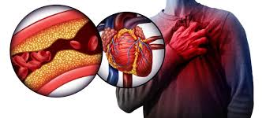
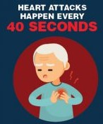
Introduction
Myocardial infraction(MI):
commonly know as heart attack is a condition where the heart muscles begin to die because of the restricted blood supply from the arteries.
MI can lead to a permanent heart damage of death if the blood supply is not restored immediately.
Most common Risk factors:
Age, gender, family history, smoking, high blood pressure, high cholesterol, Diabetes, obesity.
People with south Asian ethnicity comes under high risk category
https://www.cdc.gov/mmwr/volumes/68/wr/mm6805a2.htm

Slide 3
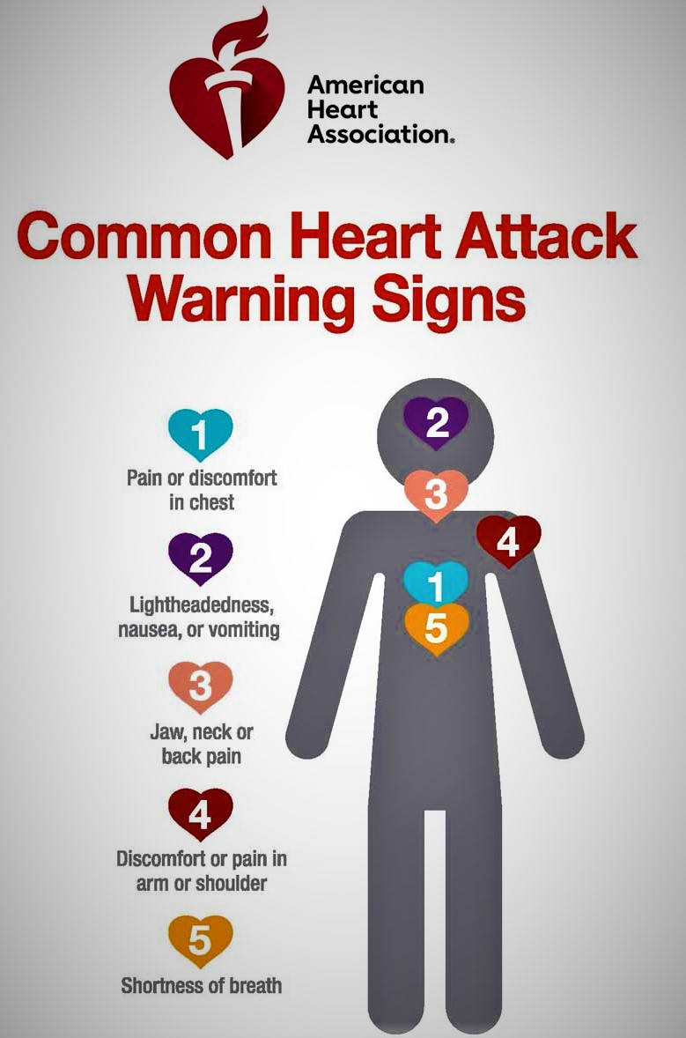
Introduction
After Myocardial infraction……
20% patients die due to sudden cardiac death within a year, with half of them within 30 days.
For those who survive a life long lifestyle change is needed,
quit smoking,
reduce alcohol,
adopt a heart healthy diet
maintain healthy weight
Take prescribed medicines
Reduce stress
Keep blood pressure under control

Slide 4
Problem statement
The course of the disease in patients with MI is different. MI can occur without complications or with complications that do not worsen the long-term prognosis. At the same time, about half of patients in the acute and subacute periods have complications that lead to worsening of the disease and even death. Even an experienced specialist can not always foresee the development of these complications. In this regard, predicting complications of myocardial infarction in order to timely carry out the necessary preventive measures is an important task.
Our objective here is to classify the lethal outcome (cause) by using the given dataset.
About Dataset:
Publically available dataset at the UC Irvine machine learning repository https://archive.ics.uci.edu/dataset/579/myocardial+infarction+complications
The dataset consists of 124 features that include a patients medical history, reports of the various tests carried out at the time of hospital admission, treatment given and the complications that developed due to myocardial infraction.

Slide 5
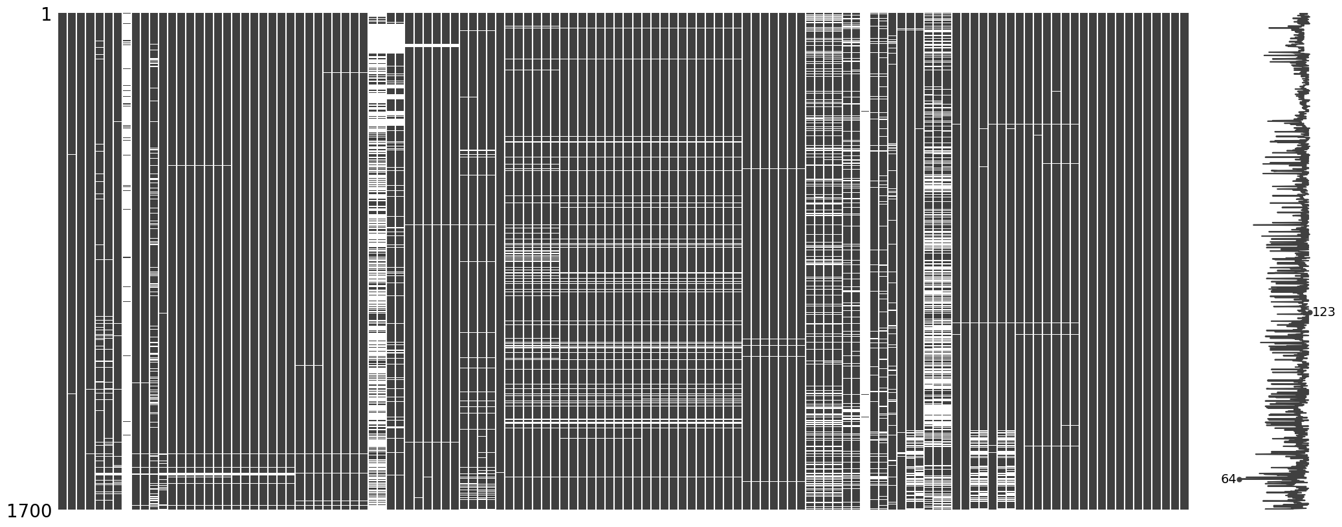
EDA : step1
Dealing with missing values
four columns with more than 1000 values missing out of 1700

Slide 6
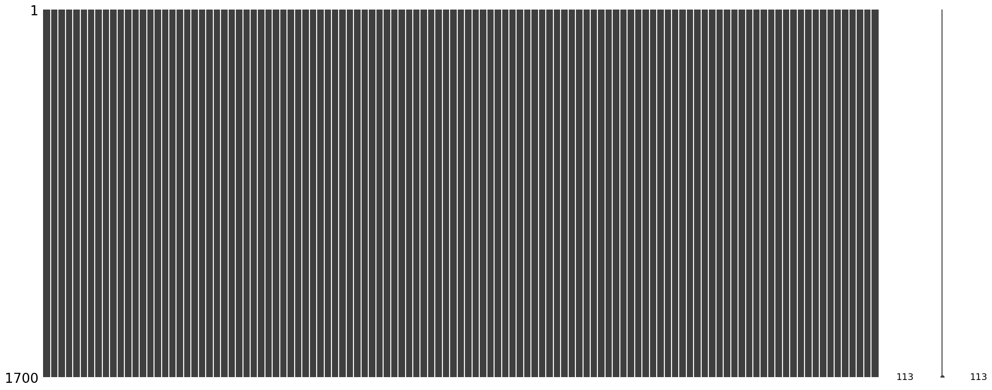
EDA : step1
Drop one of the columns with more no. of missing values if shows collinearity with other column using heatmap
Drop the columns with missing values more than 30%
Replace the missing values with most frequent on the basis of category
Dealing with missing values

Slide 7
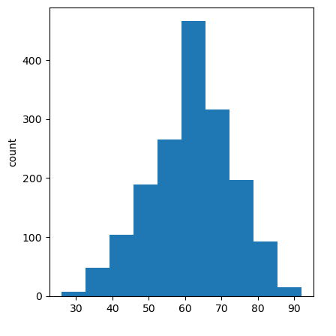
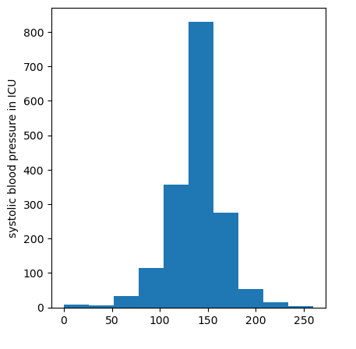
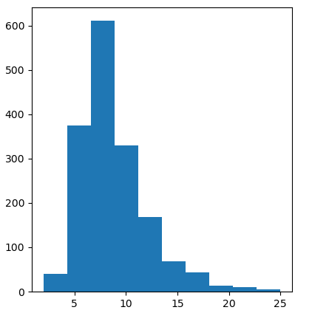
EDA: data visualization
Age
Systolic blood pressure
Wbc count
The column wbc_count wan log transformed to reduce skewness

Slide 8
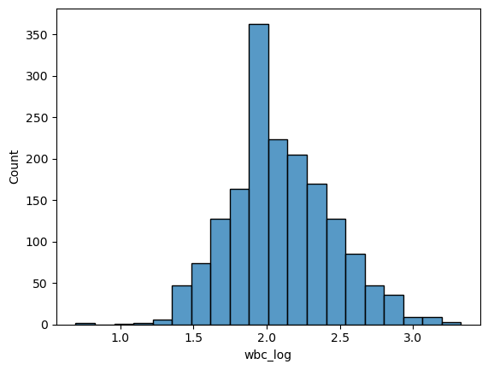
EDA: data visualization
The column wbc_count wan log transformed to reduce skewness

Slide 9
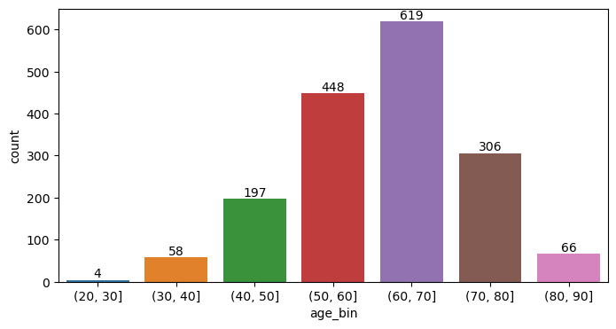
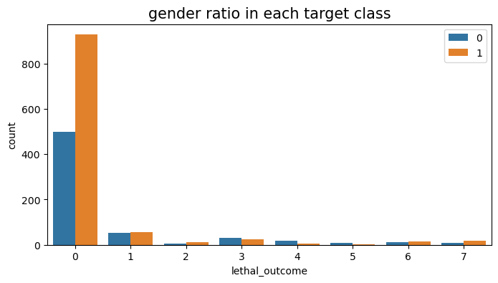
EDA: data visualization
About 1000 out of 1700 patients are in the age group (50-70)
Gender bias was visible only for class 0 of the target variable

Slide 10
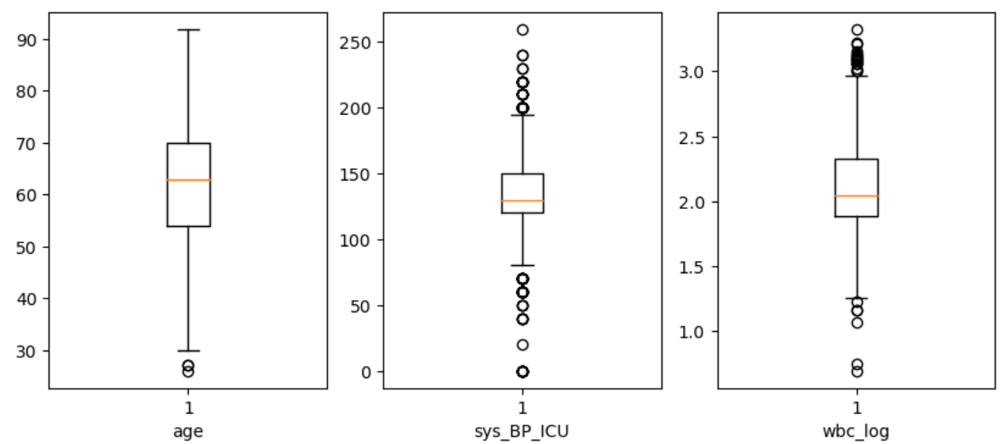
EDA: handling outliers

Slide 11
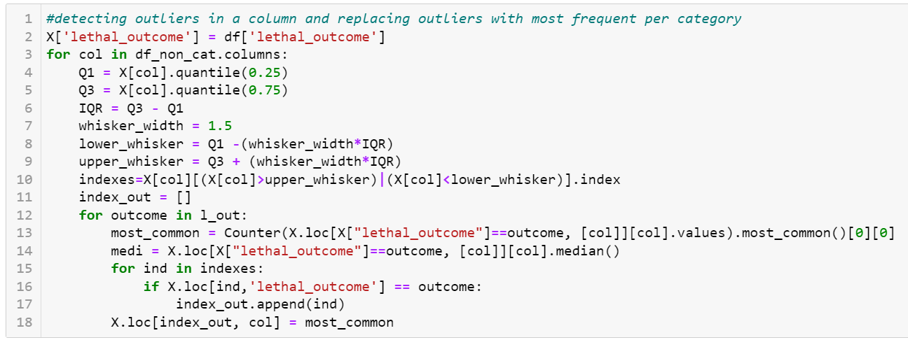
EDA: removing outliers
Outlier detection and replacement with most frequent for non categorical fetaures

Slide 12
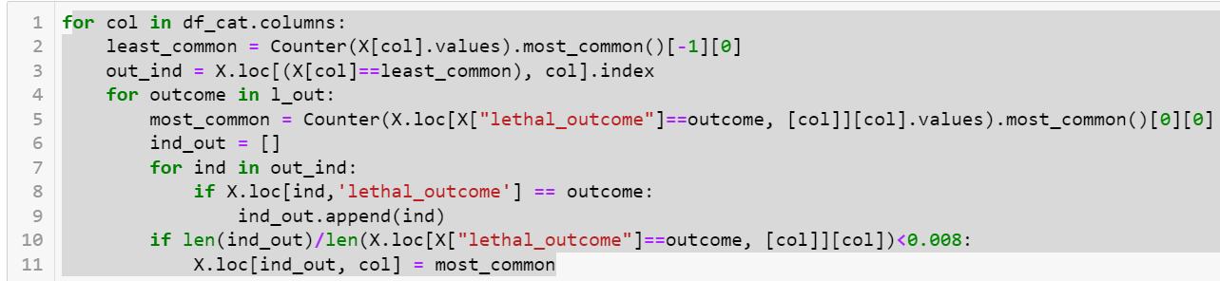
EDA: removing outliers
Outlier detection and replacement with most frequent for categorical fetaures

Slide 13
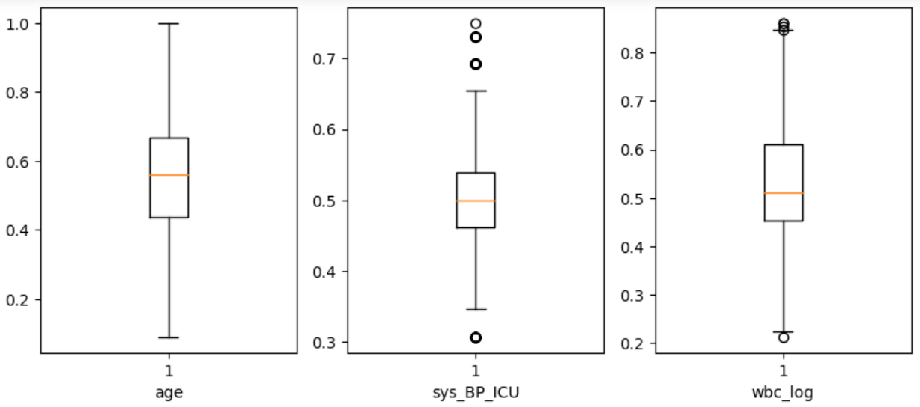
EDA: removing outliers

Slide 14
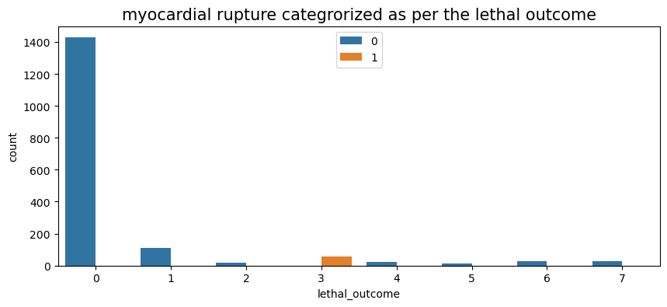
EDA: data visualization
Women with myocardial rupture as complication of MI were all classified in class 3 only. This is why class 3 showed 100% accuracy with all classification algorithms

Slide 15
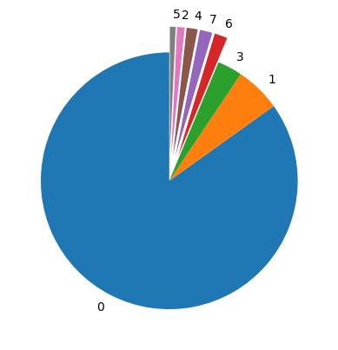
EDA: Data visualization
Class = 0, n = 1429 (84.059%)
Class = 1, n = 110 (6.471%)
Class = 2, n = 18 (1.059%)
Class = 3, n = 54 (3.176%)
Class = 4, n = 23 (1.353%)
Class = 5, n = 12 (0.706%)
Class = 6, n = 27 (1.588%)
Class = 7, n = 27 (1.588%)
An imbalanced multi class target variable
Target variable distribution

Slide 16
Data normalization
Split the data frame into two, categorical and non categorical
Use MinMax standardization on the data frame with non categorical columns
Join the normalized data frame with non-categorical columns with the data frame with categorical columns

Slide 17
Feature selection
Use chi square from sklearn.feature_selection for selecting catagorical features that show association with the target variable
Using SelectKBest and f_class if from sklearn.feature_selection select features with high score from the non-categorical features
X = Data[selected features from the last two steps]
Y=Lethal outcome
Dropped features that show collinearity by plotting a heat map for X

Slide 18
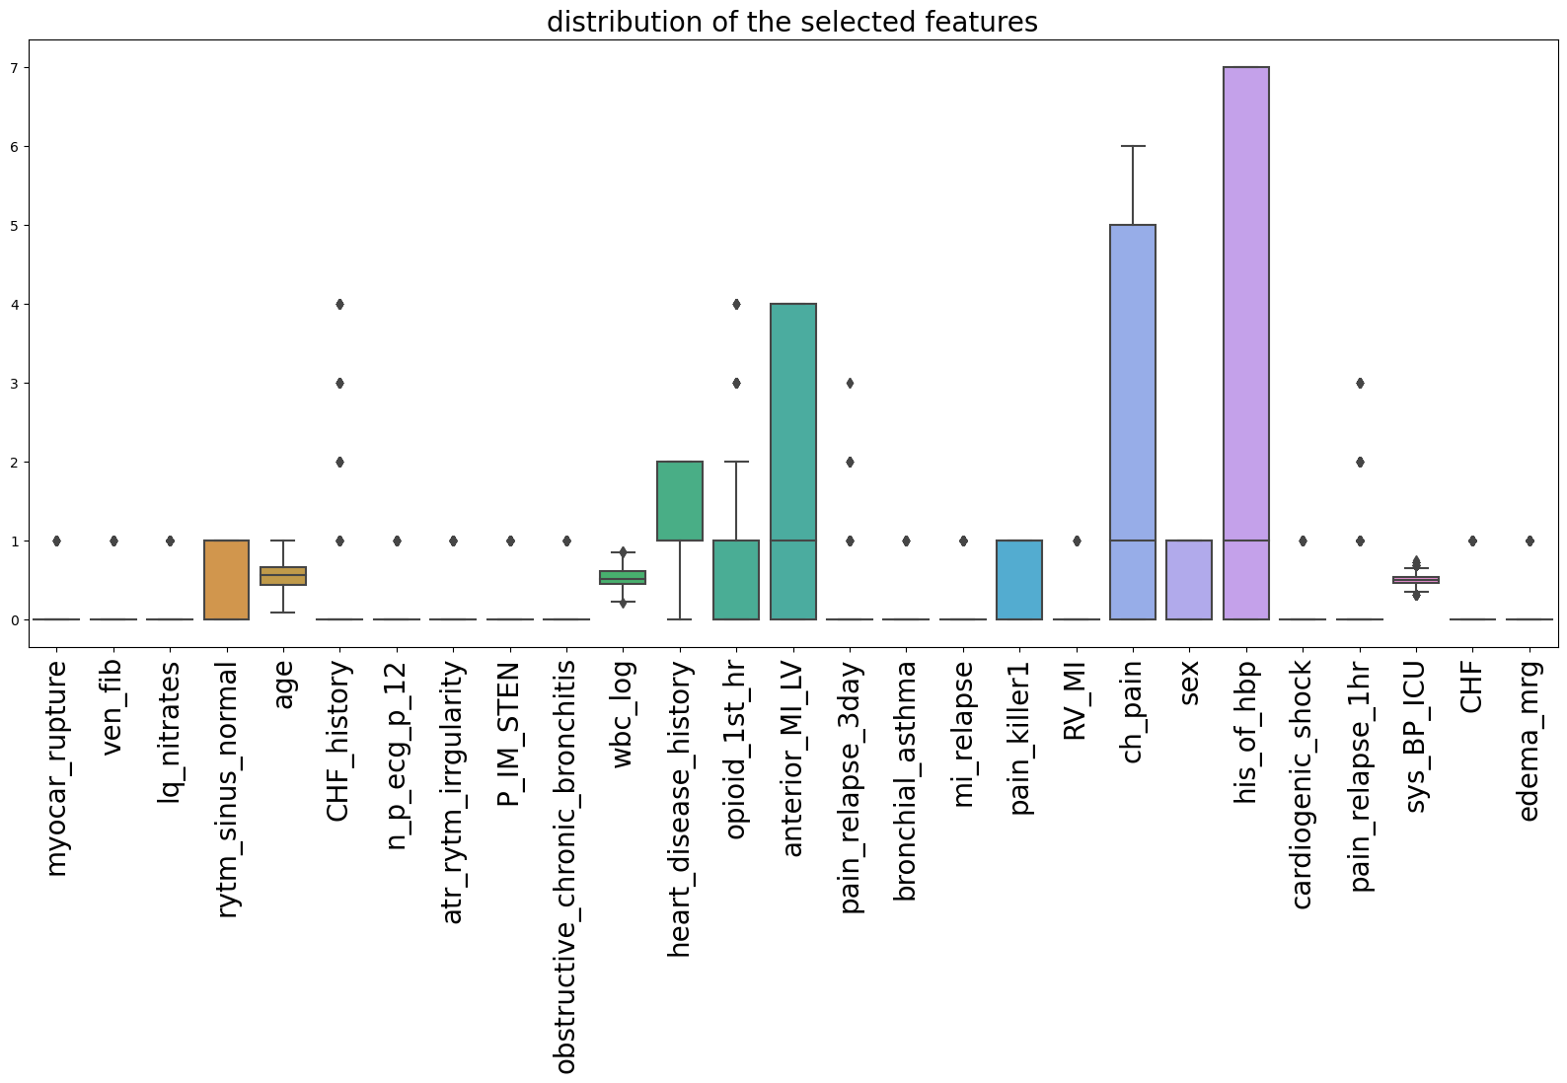
Feature engineering
We engineered feature named edema_mrg by merging edema and edema_ICU
List of selected features (25):
myocar_rupture, sys_BP_ICU, age, cardiogenic_shock, ch_pain, wbc_count, opioid_1st_hr, anterior_MI_LV, CHF_history, heart_disease_history, lq_nitrates, pain_killer1, rytm_sinus_normal, mi_relapse,n_p_ecg_p_12, sex, RV_MI, pain_relapse_3day, obstructive_chronic_bronchitis, his_of_hbp, pain_relapse_1hr, ven_fib, atr_rytm_irregularity, bronchial_asthma, CHF, edema, edema_ICU

Slide 19
Model building
Split the data into training and test dataset
x_train1, x_test, y_train1, y_test = train_test_split(selected, Y, test_size=0.20,stratify=Y, random_state=42)
Oversample the training set using smote()
x_train, y_train = oversample.fit_resample(x_train1, y_train1)
Use x_train and y_train to trai the model

Slide 20
Model building
List of models used:
wights = {0:0.95, 1:0.85, 2:0.94, 3:0.31, 4:0.77, 5:1.43, 6:0.62, 7:0.62}
Model_lr = LogisticRegression(solver='lbfgs', random_state = 42)
model_svm = SVC(kernel='linear',gamma='auto', decision_function_shape='ovr',
random_state=42,class_weight = weights)
3. model_knn = KNeighborsClassifier(n_neighbors=2, weights = 'distance', metric='manhattan')
4. model_rf = RandomForestClassifier(n_estimators=250,random_state=42)
5. model_rf_wt = RandomForestClassifier(n_estimators=250, max_samples = 14, class_weight = weights,
max_features = None, random_state=42)
model_xg = XGBClassifier(objective='multi:softmax',n_estimators=50, random_state = 42)
model_bagg_lr = BaggingClassifier(base_estimator= model_lr, max_samples = 800,
n_estimators=100, random_state = 42)
8. model_bagg_svm = BaggingClassifier(base_estimator= model_svm, max_samples = 800,
n_estimators=100, random_state = 42)
9. model_bagg_wt_rf = BaggingClassifier(base_estimator= model_rf_wt, max_samples = 850,
n_estimators=50, random_state = 42)
10. model_bagg_xg = BaggingClassifier(base_estimator= XGBClassifier(objective='multi:softmax',random_state = 42),
max_samples = 650,n_estimators=50, random_state = 42)

Slide 21
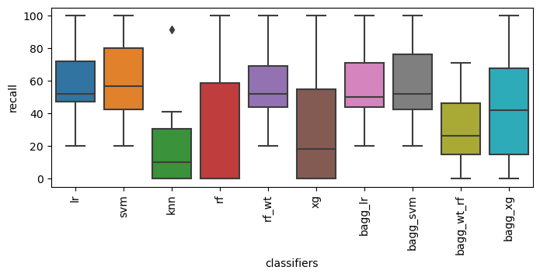
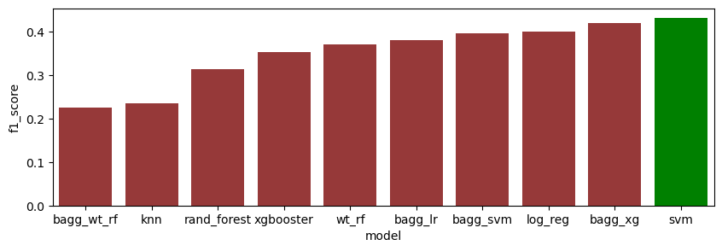
Model evaluation

Slide 22
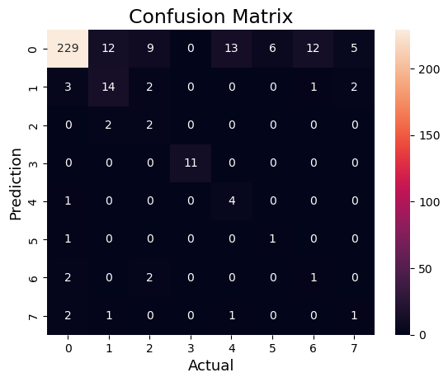
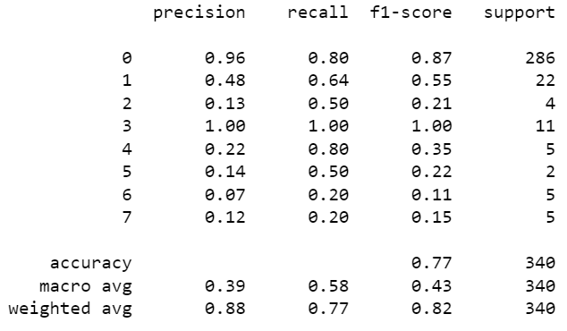
Model evaluation:svm

Slide 23
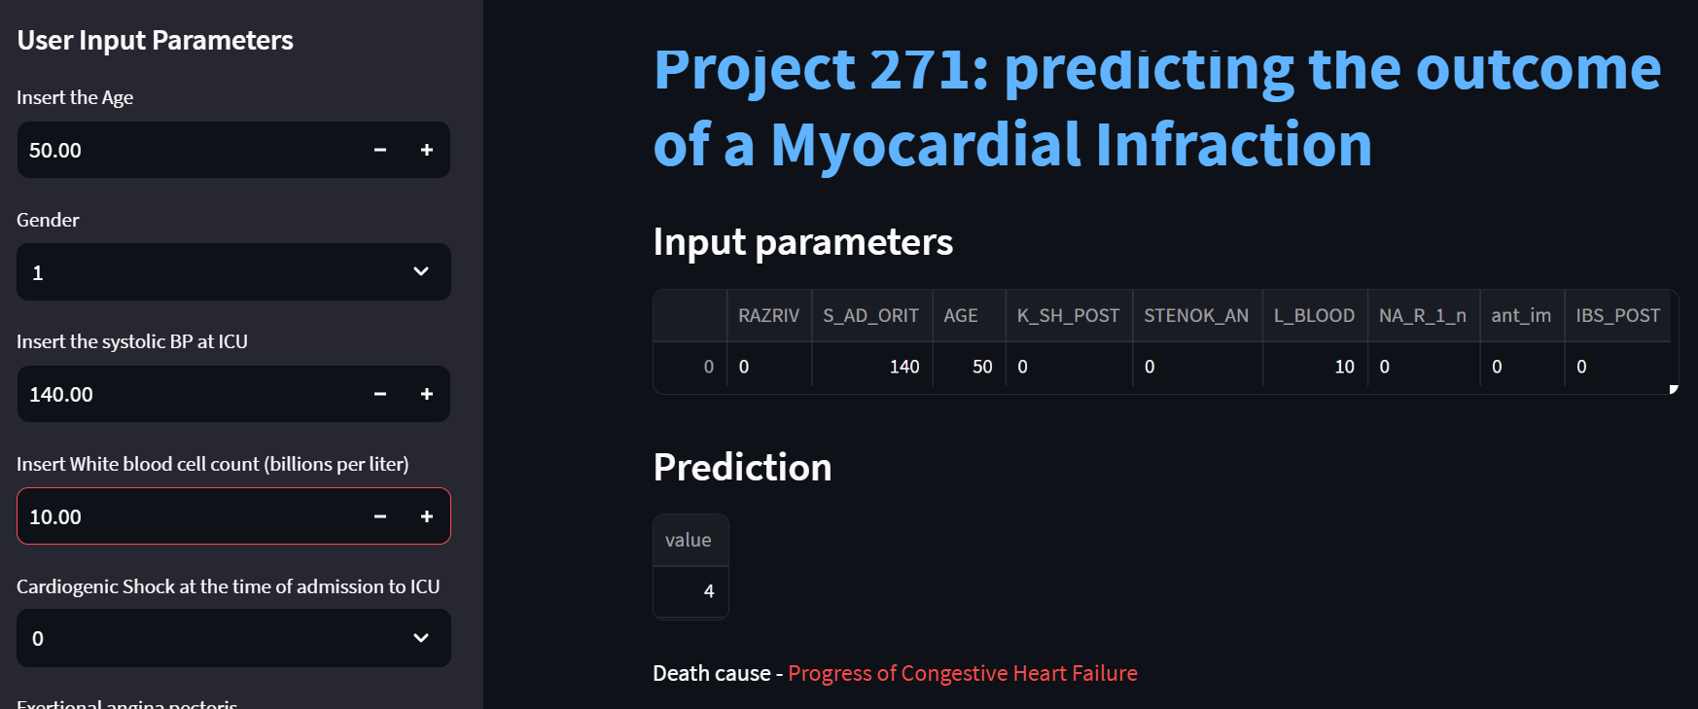
Model deployment
Age:50, Gender : 1(male), sys_BP: 140, wbc count:10, cardiogenic schock:0

Slide 24
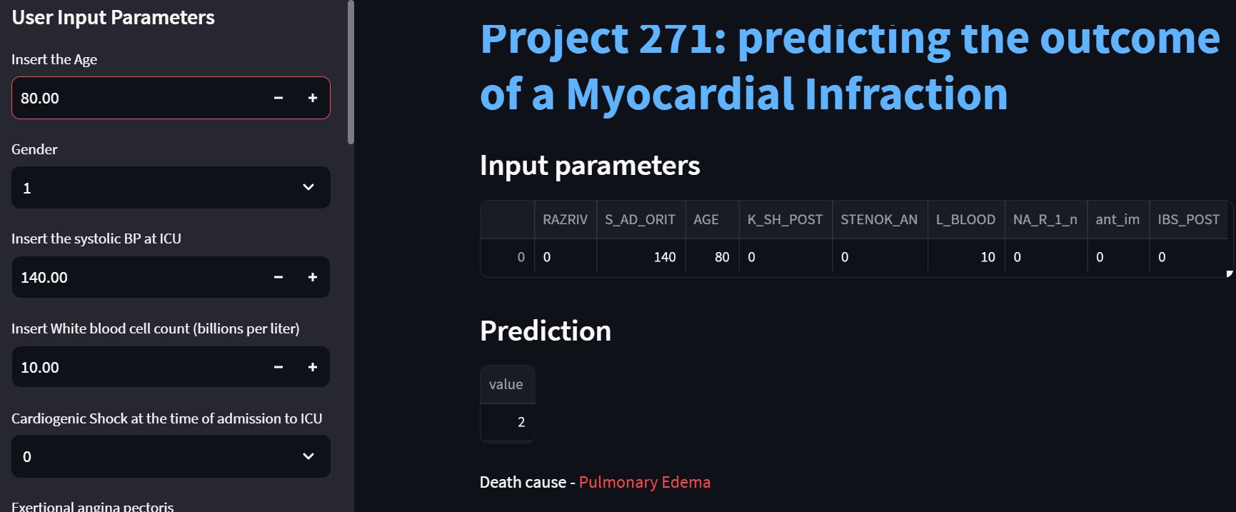
Model deployment
Age:80, Gender : 1(male), sys_BP: 120, wbc count:8, cardiogenic schock:0

Slide 25
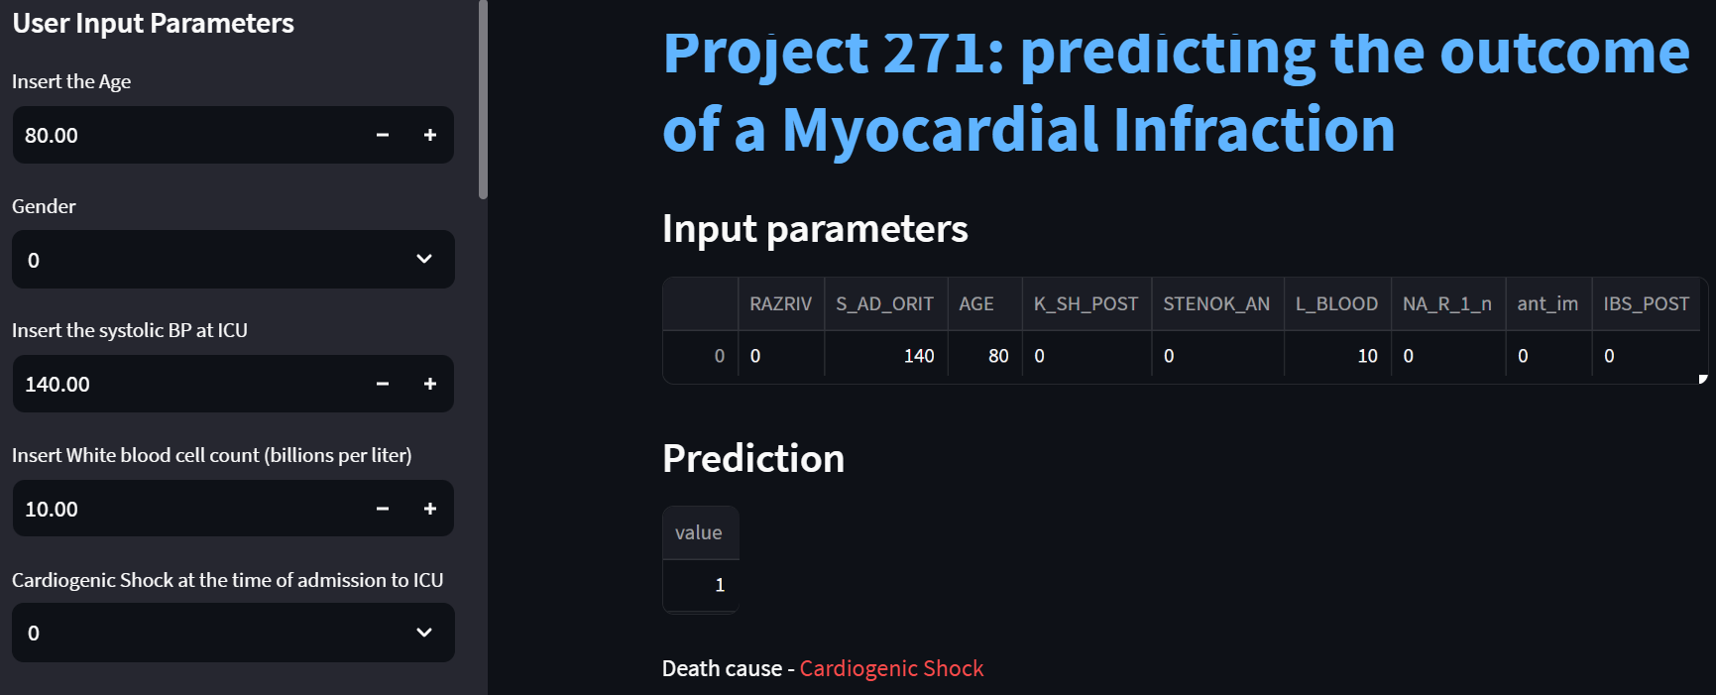
Model deployment
Age:80, Gender : 0(Female), sys_BP: 120, wbc count:10, cardiogenic schock:0

Slide 26
Thank you!

