Slide 1
EXPLORATORY DATA ANALYTICS
Module 2
Data Transformation & Wrangling
Merging · Joins · Pivoting · Missing Values · Binning
Mrs. Shilpashree S | Mrs. Vinutha K
Assistant Professors, Dept. of CS & E | 23CSE422

Slide 2




Data Transformation
Data transformation is a set of techniques used to convert data from one format or structure to another, ensuring compatibility and enhancing interoperability.
01
Data Deduplication
06
Data Derivation
Identify and remove duplicate data.
Create rules to generate additional information from the source data.
02
Key Restructuring
07
Data Aggregation
Transform keys with built-in meanings into generic keys.
Searching, extracting, summarize and preserve important information for reporting systems.
03
Data Cleansing
08
Data Integration
Remove outdated, inaccurate, or incomplete information without changing its meaning.
Convert and merge different data types into a common structure or schema.
04
Data Validation
09
Data Filtering
Formulate rules or algorithms to validate data against known issues.
Identify and extract relevant information for specific users.
08
Format Revisioning
10
Data Joining
Convert data from one format to another.
Establish relationships between two or more tables.

Slide 3
Merging Database-Style DataFrames

Slide 4
pd.concat() — Vertical Concatenation (axis=0)
Stacking rows from two DataFrames that share the same columns
df1 (Batch A)
Result — pd.concat([df1,df2], ignore_index=True)
Python
Name
Marks
Grade
Name
Marks
Grade
df1 = pd.DataFrame({'Name':['Alice','Bob','Carol'],
'Marks':[82,91,74],
‘Grade':['B','A','C']})
df2 = pd.DataFrame({'Name':['David','Eva'],
'Marks':[88,65],
‘Grade':['A','C']})
# Stack vertically — more rows, same columns
result = pd.concat([df1, df2], axis=0, ignore_index=True)
0
Alice
82
B
0
Alice
82
B
1
Bob
91
A
1
Bob
91
A
2
Carol
74
C
2
Carol
74
C
3
David
88
A
→
4
Eva
65
C
df2 (Batch B)
axis=0
Name
Marks
Grade
0
David
88
A
1
Eva
65
C
⚠️ Without ignore_index=True the index repeats as 0,1,2,0,1 — causes bugs in .loc[] filtering later.
🌐 Use case: combining monthly CSV files, merging exam batches.
EDA | Module 2 | 23CSE422

Slide 5
pd.concat() — Horizontal Concatenation (axis=1)
Placing DataFrames side-by-side when they share the same rows
df_SE (SE marks)
Result — columns placed side-by-side
Python
Name
SE_Marks
Name
SE_Marks
Name
ML_Marks
# Horizontal concat — axis=1
result = pd.concat([df_SE, df_ML], axis=1)
# Better: drop the duplicate 'Name' column
result = pd.concat([df_SE,
df_ML[['ML_Marks']]], axis=1)
# Output:
# Name SE_Marks ML_Marks
# 0 Alice 82 88
# 1 Bob 91 75
# 2 Carol 74 90
0
Alice
82
0
Alice
82
Alice
88
1
Bob
91
1
Bob
91
Bob
75
2
Carol
74
2
Carol
74
Carol
90
⚠ Duplicate 'Name' column — drop it:
→
Name
SE_Marks
ML_Marks
df_ML (ML marks)
axis=1
0
Alice
82
88
Name
ML_Marks
0
Alice
88
1
Bob
91
75
1
Bob
75
2
Carol
74
90
2
Carol
90
🌐 Use case: student performance across subjects; product attributes from multiple tables.
⚠️ axis=1 works only when row indices align perfectly — both DFs must have the same index values in the same order.
EDA | Module 2 | 23CSE422

Slide 6
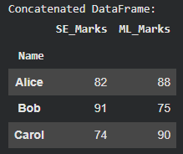
pd.concat() — Horizontal Concatenation (axis=1)
Name can be made as index instead of default index.
df_SE (SE marks)
Result — columns placed side-by-side
Python
Name
SE_Marks
Name
SE_Marks
Name
ML_Marks
df_SE = df_SE.set_index('Name')
df_ML = df_ML.set_index('Name')
result = pd.concat([df_SE, df_ML], axis=1)
print("Concatenated DataFrame:")
display(result)
#Output:
0
Alice
82
0
Alice
82
Alice
88
1
Bob
91
1
Bob
91
Bob
75
2
Carol
74
2
Carol
74
Carol
90
⚠ Duplicate 'Name' column — drop it:
→
Name
SE_Marks
ML_Marks
df_ML (ML marks)
axis=1
0
Alice
82
88
Name
ML_Marks
0
Alice
88
1
Bob
91
75
1
Bob
75
2
Carol
74
90
2
Carol
90
🌐 Use case: student performance across subjects; product attributes from multiple tables.
⚠️ axis=1 works only when row indices align perfectly — both DFs must have the same index values in the same order.
EDA | Module 2 | 23CSE422

Slide 7

Concatenating along with an axis
pd.concat() Function
pd.concat() is used to concatenate pandas DataFrames along a particular axis (rows or columns).
Syntax:
pd.concat([df1, df2], axis=0, ignore_index=False)
axis=0 (default): Concatenates vertically (row-wise).
axis=1: Concatenates horizontally (column-wise).
ignore_index=True: Resets the index to a new integer sequence, avoiding duplication of indices.
When to Use pd.concat()?
When you need to combine data from multiple sources with similar structure.
When you want to combine data along rows or columns.
When handling large datasets across multiple files or regions, concatenation helps combine data for further analysis.

Slide 8
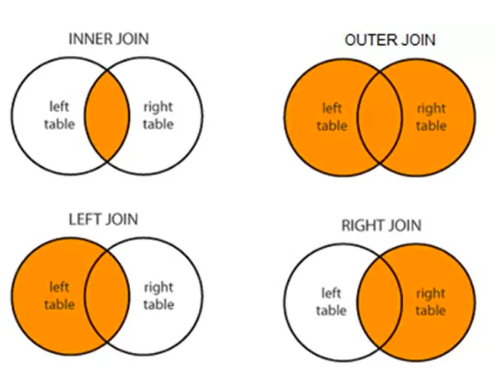
Using df.merge
Syntax:
pandas.merge(
left,
right,
how='inner',
on=’column_name’,
left_on=None,
right_on=None,
left_index=False, right_index=False,
)
left, right → DataFrames to be combined
on → common column(s) used as key
how → type of join ('inner', 'left', 'right', 'outer')
When keys are different
left_on → column(s) in left DataFrame used as key
right_on → column(s) in right DataFrame used as key
When index is used as key
left_index → use index of left DataFrame as key (True/False)
right_index → use index of right DataFrame as key (True/False)

Slide 9
df.merge() — INNER JOIN
Returns only rows whose key exists in BOTH DataFrames ≡ SQL INNER JOIN
dfSE (input)
dfML (input)
Result (only matched rows)
StudentID
SE_Score
StudentID
ML_Score
StudentID
SE_Score
ML_Score
S001
82
S001
78
∩
→
S001
82
78
S002
91
S002
85
INNER
S002
91
85
S003
74
S004
90
S004
88
90
S004
88
S005
66
S003 (SE only) → DROPPED
S005 (ML only) → DROPPED
Python
# INNER JOIN — keeps only rows present in BOTH DataFrames
result = dfSE.merge(dfML, how='inner', on='StudentID')
# SQL equivalent:
# SELECT * FROM dfSE INNER JOIN dfML
# ON dfSE.StudentID = dfML.StudentID
# S003 (SE only) → DROPPED | S005 (ML only) → DROPPED
# INNER produces the FEWEST rows of all 4 join types
📌 INNER = strictest join. Any row missing from either side is excluded. Row count: INNER ≤ LEFT/RIGHT ≤ OUTER.
🌐 Use case: customers who made both online AND in-store purchases.
EDA | Module 2 | 23CSE422

Slide 10
df.merge() — LEFT JOIN
All rows from left DataFrame kept; NaN where right has no match ≡ SQL LEFT OUTER JOIN
dfSE (input — PRIMARY)
dfML (input)
Result (all 4 SE rows; S003 gets NaN)
StudentID
SE_Score
StudentID
ML_Score
StudentID
SE_Score
ML_Score
S001
82
S001
78
ALL
→
S001
82
78
S002
91
S002
85
LEFT
S002
91
85
S003
74
S004
90
S003
74
NaN
S004
88
S005
66
S004
88
90
S003: ML_Score = NaN (row kept)
S005 (ML only) → EXCLUDED
Python
# LEFT JOIN — all left rows kept; NaN where no right match
result = dfSE.merge(dfML, how='left', on='StudentID')
# S003 has no ML record → ML_Score = NaN (row KEPT)
# S005 is ML-only → completely excluded
# Find students with missing ML score:
no_ml = result[result['ML_Score'].isna()]
print(no_ml) # shows S003
📌 LEFT is the most common join — left table is primary, right data supplements it. Missing right data → NaN, not deletion.
🌐 Use case: all registered students + marks for those who appeared (absent students get NaN).
EDA | Module 2 | 23CSE422

Slide 11
df.merge() — RIGHT JOIN & OUTER JOIN
Completing all four join types
RIGHT JOIN
OUTER JOIN (Full Outer)
All ML students; NaN where SE has no match
ALL students from both; NaN where no match on either side
StudentID
SE_Score
ML_Score
StudentID
SE_Score
ML_Score
S001
82
78
S001
82
78
S002
91
85
S002
91
85
S004
88
90
S003
74
NaN
S005
NaN
66
S004
88
90
S005
NaN
66
Python
result = dfSE.merge(dfML,
how='right', on='StudentID')
# S003 (SE-only) → excluded
# S005 (ML-only) → kept; SE_Score=NaN
Python
result = dfSE.merge(dfML,
how='outer', on='StudentID')
# S003: ML_Score = NaN
# S005: SE_Score = NaN
# Most rows, most NaN of all joins
→ ALL right (dfML)
ALL from both
📌 Row count: INNER ≤ LEFT ≤ OUTER and INNER ≤ RIGHT ≤ OUTER. OUTER = most rows, most NaN.
EDA | Module 2 | 23CSE422

Slide 12
Merging on Index — left_on & right_index
When the join key lives in the DataFrame index, not a column
left1 (key is a column)
right1 (key IS the index)
INNER (default) left_on='key', right_index=True
key
value
index
group_val
key
value
group_val
0
apple
0
apple
33.4
0
apple
0
33.4
1
ball
1
ball
5.0
1
apple
2
33.4
2
apple
2
2
apple
3
33.4
3
apple
3
3
ball
1
5.0
4
ball
4
4
ball
4
5.0
5
cat
5
OUTER — 'cat' has no match
key
value
group_val
Python
# Join: left column <-> right index
inner = pd.merge(left1, right1,
left_on='key',
right_index=True) # INNER (default)
outer = pd.merge(left1, right1,
left_on='key',
right_index=True,
how='outer')
# 'cat' row: group_val=NaN
0
apple
0
33.4
left1 = pd.DataFrame(
{'key': ['apple','ball','apple','apple','ball','cat'],
'value': range(6)})
right1 = pd.DataFrame(
{'group_val': [33.4, 5]},
index=['apple', 'ball'])
# <-- key is the INDEX
1
apple
2
33.4
2
apple
3
33.4
3
ball
1
5.0
4
ball
4
5.0
5
cat
5
NaN
🌐 Use case: lookup tables where the index is the key (country code → population).
📌 left_index=True uses left DF's index; right_index=True uses right DF's index. Combine with left_on/right_on as needed.
EDA | Module 2 | 23CSE422

Slide 13
Reshaping — stack() : Wide → Long Format
Rotating column labels into the row index
dframe1 (WIDE — 3 rows × 5 columns)
stacked (LONG — MultiIndex Series)
Bergen
Oslo
Trondheim
Stavanger
Kristiansand
Level 0
Level 1
Value
Rainfall
0
1
2
3
4
Rainfall
Bergen
0
→
Oslo
1
Humidity
5
6
7
8
9
Wind
10
11
12
13
14
stack()
Trondheim
2
Humidity
Bergen
5
Oslo
6
Trondheim
7
Wind
Bergen
10
Oslo
11
…
…
…
Python
# stack(): columns → MultiIndex rows
stacked = dframe1.stack()
print(type(stacked)) # <class 'pandas.core.series.Series'>
print(stacked) # MultiIndex (15 entries)
# Reverse: unstack() restores original DataFrame exactly
dframe1_restored = stacked.unstack()
import numpy as np, pandas as pd
data = np.arange(15).reshape((3, 5))
index = ['Rainfall', 'Humidity', 'Wind']
cols = ['Bergen','Oslo','Trondheim','Stavanger','Kristiansand']
dframe1 = pd.DataFrame(data, index=index, columns=cols)
📌 stack() compresses 15 separate column values into a single Series with 2-level MultiIndex (row label + column name).
🌐 Long format is required for seaborn groupby plots and pandas .groupby() aggregations.
EDA | Module 2 | 23CSE422

Slide 14
Reshaping — unstack() : Long → Wide + Handling NaN
NaN appears for index combinations that don't exist in the source data
Two Series → concat → MultiIndex
Python
series1 = pd.Series([0,111,222,333],
index=['zeros','ones','twos','threes'])
series2 = pd.Series([444,555,666],
index=['fours','fives','sixes'])
frame2 = pd.concat([series1, series2],
keys=['Number1','Number2'])
frame2 (long/stacked form)
frame2.unstack() → NaN for missing combos
Key1
Key2
Value
fives
fours
ones
sixes
threes
twos
zeros
Number1
zeros
0
Number1
NaN
NaN
111
NaN
333
222
0
Number1
ones
111
Number2
555
444
NaN
666
NaN
NaN
NaN
Number1
twos
222
→
Number1
threes
333
Python
unstack()
# unstack: innermost index level → columns
wide = frame2.unstack()
# NaN fills missing (outer, inner) combinations
# Re-stack to restore long format
long_again = wide.stack(dropna=False)
Number2
fours
444
Number2
fives
555
Number2
sixes
666
📌 NaN appears wherever a combination like (Number1,fours) never existed in the original data — expected and correct.
EDA | Module 2 | 23CSE422

Slide 15
Data Cleaning — Detecting & Removing Duplicates
duplicated() · drop_duplicates() · keep parameter
frame3 (original — with duplicates)
duplicated()
drop_duplicates() keep='first'
keep='last'
col1
col2
Row
isDuplicate
col1
col2
col1
col2
0
Looping
10
0
False
0
Looping
10
1
Looping
10
1
Looping
10
1
True ✗
2
Looping
22
2
Looping
22
2
Looping
22
2
False
3
Functions
23
4
Functions
23
3
Functions
23
3
False
4
Functions
23
4
True ✗
5
Functions
24
6
Functions
24
5
Functions
24
5
False
Python
frame3 = pd.DataFrame({
'col1': ['Looping']*3 + ['Functions']*4,
'col2': [10, 10, 22, 23, 23, 24, 24]})
# Step 1: Detect — True means 'repeat of a previous row'
frame3.duplicated() # rows 1, 4, 6 → True
# Step 2: Remove — keeps first occurrence by default
frame3.drop_duplicates()
# Keep LAST occurrence instead of first
frame3.drop_duplicates(keep='last')
# Check only specific column for duplicates
frame3.drop_duplicates(subset=['col2'])
# After drop, always clean the index
clean = frame3.drop_duplicates().reset_index(drop=True)
6
Functions
24
6
True ✗
🌐 Use case: deduplicating transaction logs, removing repeated API responses.
⚠️ Always .reset_index(drop=True) after dropping duplicates — otherwise index has gaps (0,2,3,5)
that confuse later .iloc[] operations.
EDA | Module 2 | 23CSE422

Slide 16
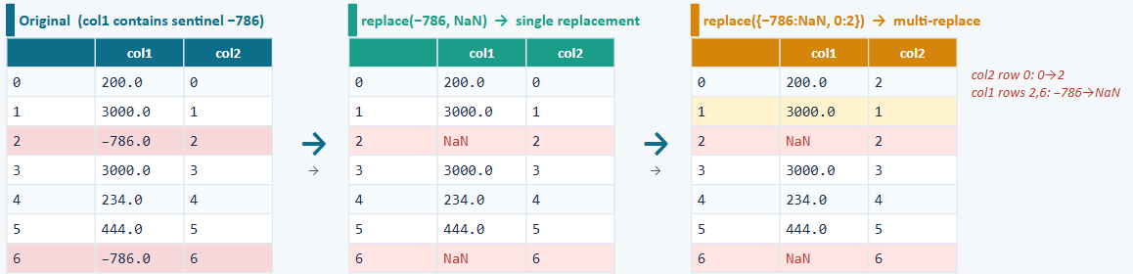
Replacing Values — replace()
Fixing sentinel values, typos, and standardising entries
Python
import pandas as pd, numpy as np
df = pd.DataFrame({
'col1': [200., 3000., -786., 3000., 234., 444., -786.],
'col2': range(7)})
# Single value replacement
df.replace(to_replace=-786, value=np.nan)
# Multiple values — list form (positional 1-to-1 mapping)
df.replace(to_replace=[-786, 0], value=[np.nan, 2])
# Multiple values — dict form (preferred, explicit)
df.replace({-786: np.nan, 0: 2})
# Column-specific replacement
df['col1'].replace(-786, np.nan, inplace=True)
🌐 Use case: survey datasets where −1=refused, 99=unknown, 9999=not applicable.
⚠️ replace() returns a NEW DataFrame by default — assign back: df=df.replace(...) or use inplace=True. Does not modify original.
EDA | Module 2 | 23CSE422

Slide 17
Missing Data — isnull() / notnull() Detection
Locating NaN values and measuring their extent
dfx (fruit sales — NaN in store4 & store5)
dfx.isnull()
s1
s2
s3
s4
s5
s1
s2
s3
s4
s5
apple
15
16
17
20.0
NaN
apple
F
F
F
F
T
banana
18
19
20
NaN
NaN
banana
F
F
F
T
T
kiwi
21
22
23
NaN
NaN
kiwi
F
F
F
T
T
grapes
24
25
26
NaN
NaN
grapes
F
F
F
T
T
mango
27
28
29
NaN
NaN
mango
F
F
F
T
T
waterml
15
16
17
18.0
NaN
waterml
F
F
F
F
T
oranges
NaN
NaN
NaN
NaN
NaN
oranges
T
T
T
T
T
Python
# Count NaN per column
dfx.isnull().sum()
# s1=1 s2=1 s3=1 s4=6 s5=7
# Total NaN in entire DataFrame
dfx.isnull().sum().sum() # → 16
# Count valid (non-NaN) values per column
dfx.count()
# s1=6 s2=6 s3=6 s4=2 s5=0
# Find rows that contain ANY NaN
dfx[dfx.isnull().any(axis=1)]
# Find rows where ALL values are NaN
dfx[dfx.isnull().all(axis=1)] # → oranges
🌐 Use case: data quality audit — identify columns too sparse to be useful before ML pipeline.
⚠️ store5 (s5) has 0 valid values — entirely NaN. Drop it with dropna(axis=1,how='all'), do not fill it.
EDA | Module 2 | 23CSE422

Slide 18
Missing Data — dropna() Variants
Before vs After for every parameter combination
Original dfx
dropna(how='all') → only 'oranges' removed
dropna(axis=1,how='all') → s5 column removed
s1
s2
s3
s4
s5
s1
s2
s3
s4
s5
s1
s2
s3
s4
apple
15
16
17
20
NaN
apple
15
16
17
20
NaN
apple
15
16
17
20
s5 dropped (all-NaN column)
banana
18
19
20
NaN
NaN
banana
18
19
20
NaN
NaN
banana
18
19
20
NaN
kiwi
21
22
23
NaN
NaN
kiwi
21
22
23
NaN
NaN
kiwi
21
22
23
NaN
grapes
24
25
26
NaN
NaN
grapes
24
25
26
NaN
NaN
grapes
24
25
26
NaN
mango
27
28
29
NaN
NaN
mango
27
28
29
NaN
NaN
mango
27
28
29
NaN
waterml
15
16
17
18
NaN
waterml
15
16
17
18
NaN
waterml
15
16
17
18
oranges
NaN
NaN
NaN
NaN
NaN
oranges
NaN
NaN
NaN
NaN
Python
# 1. Drop ANY row with ≥1 NaN → empty (all rows have NaN)
dfx.dropna()
# 2. Drop rows where EVERY value is NaN → removes 'oranges'
dfx.dropna(how='all')
# 3. Drop COLUMNS where all values are NaN → removes 's5'
dfx.dropna(axis=1, how='all')
# 4. Drop cols with < 5 valid values → also removes 's4'
dfx.dropna(axis=1, thresh=5)
# 5. Keep only rows with ≥4 valid values
dfx.dropna(thresh=4)
💡 thresh=N keeps rows/cols with at least N non-NaN values — the most practical parameter for real datasets.
🌐 Use case: drop sensors/columns with >60% missing before ML feature selection.
EDA | Module 2 | 23CSE422

Slide 19
Missing Data — fillna() : Constant & Statistical Filling
Replace NaN with a fixed value or column statistics — and see the impact on the mean
store4 (original)
fillna(0) → NaN → 0.0
fillna(mean) → NaN → 19.0
Mean impact — compare strategies
Index
store4
Index
store4
Index
store4
Column
Raw mean
fill=0
fill=mean
apple
20.0
apple
20.0
apple
20.0
store4
19.0
5.43
19.0
banana
NaN
banana
0.0
banana
19.0
store5
NaN
0.0
NaN
kiwi
NaN
→
kiwi
0.0
→
kiwi
19.0
fill=0 drags mean from
19.0 down to 5.43 !
fill=mean preserves it.
grapes
NaN
→
grapes
0.0
→
grapes
19.0
mango
NaN
mango
0.0
mango
19.0
waterml
18.0
waterml
18.0
waterml
18.0
oranges
NaN
oranges
0.0
oranges
19.0
Python
# Fill per-column with different values
fill_vals = {'store4': dfx.store4.mean(), 'store5': 0}
dfx.fillna(value=fill_vals)
# Compare means before and after
print("Before:", dfx.mean())
print("After 0:", dfx.fillna(0).mean())
print("After mean:", dfx.fillna(dfx.mean()).mean())
ser2 = dfx.store4 # apple=20.0, rest NaN, watermelon=18.0
# Fill with constant — fast but distorts statistics
dfx.fillna(0)
# Fill with column mean (only 2 valid: 20+18=38, mean=19)
dfx.fillna(dfx.mean())
⚠️ fillna(0) artificially pulls the mean toward zero. fillna(df.mean()) preserves the column's statistical distribution — prefer this for numeric columns.
🌐 Use case: imputing missing temperature readings, filling product ratings before a recommendation model.
EDA | Module 2 | 23CSE422

Slide 20
Missing Data — ffill · bfill · interpolate()
Smart filling strategies for sequential and time-series data
Original
ffill
bfill
interpolate()
Index
Val
Index
Val
Index
Val
Index
Val
apple
20.0
apple
20.0
apple
20.0
apple
20.0
banana
NaN
banana
20.0
banana
18.0
banana
19.6
kiwi
NaN
→
kiwi
20.0
→
kiwi
18.0
→
kiwi
19.2
grapes
NaN
→
grapes
20.0
→
grapes
18.0
→
grapes
18.8
mango
NaN
mango
20.0
mango
18.0
mango
18.4
waterml
18.0
waterml
18.0
waterml
18.0
waterml
18.0
oranges
NaN
oranges
18.0
oranges
NaN
oranges
NaN
How each method works
Key detail
Method
Logic
ffill
Carries last valid value forward
20→fills banana/kiwi/grapes/mango; 18→fills oranges
bfill
Fills with next valid value backward
18←fills mango/grapes/kiwi/banana; oranges stays NaN
interpolate
Calculates intermediate values linearly
(18−20)/5 steps = −0.4/step → 19.6, 19.2, 18.8, 18.4
Python
ser2 = dfx.store4
ser2.fillna(method='ffill') # forward fill
ser2.fillna(method='bfill') # backward fill
ser2.interpolate() # linear (default)
⚠️ oranges stays NaN after bfill and interpolate — no future anchor value exists. Handle separately.
🌐 Use case: stock prices (ffill), IoT sensor gaps (interpolate), survey blanks (bfill).
EDA | Module 2 | 23CSE422

Slide 21
Discretization — pd.cut() : Custom Bin Edges
Converting continuous values into labelled category intervals
Input: height (continuous)
Python
Idx
Height
height = [120,122,125,127,121,123,137,131,161,145,141,132]
bins = [118, 125, 135, 160, 200] # 4 intervals
# Default: right-closed (a, b] — 125 goes to (118,125]
category = pd.cut(height, bins)
# Add readable labels
bin_names = ['Short','Average','Good','Taller']
category = pd.cut(height, bins, labels=bin_names)
pd.value_counts(category)
# Left-closed [a,b) — use right=False
pd.cut(height, [118,126,136,161,200], right=False)
# Auto equal-width bins (pass integer)
pd.cut(np.random.rand(40), 5, precision=2)
0
120
1
122
118
125
135
160
200
2
125
Short
Average
Good
Taller
Output: category column
Value counts
3
127
4
121
Idx
Height
Category
Category
Count
5
123
0
120
Short
Short
5
6
137
1
122
Short
Average
3
7
131
2
125
Short
3
127
Average
Good
3
8
161
Taller
1
9
145
4
121
Short
10
141
5
123
Short
11
132
6
137
Good
7
131
Average
8
161
Taller
9
145
Good
10
141
Good
🌐 Use case: grade bands (90-100=S), BMI categories, age groups, risk tiers.
11
132
Average
📌 (118,125] means 118 is excluded, 125 is included (right-closed). Use right=False to flip to [118,125).
EDA | Module 2 | 23CSE422

Slide 22
pd.qcut() vs pd.cut() + Outlier Detection
Equal-frequency binning and filtering extreme values
pd.qcut() — Quantile-based
Outlier Detection — np.abs() threshold
Edges auto-computed → equal record count per bin
Flag rows where |TotalPrice| exceeds a threshold
Bin
Range
Count
Idx
UnitPrice
Qty
TotalPrice
Q1
(−0.001, 0.261]
500
0
12.50
100
1,250
Q2
(0.261, 0.520]
500
1
45.00
150
6,750
Q3
(0.520, 0.770]
500
2
8.00
50
400
Q4
(0.770, 0.999]
500
3
1200.00
6000
7,200,000
Python
# Custom quantile edges
cat4 = pd.qcut(rnd, [0, 0.3, 0.5, 0.7, 1.0])
4
3.50
200
700
rnd = np.random.rand(2000)
# 4 equal-frequency bins (quartiles)
cat3 = pd.qcut(rnd, 4)
pd.value_counts(cat3) # each ~500
Python
df['TotalPrice'] = df['UnitPrice']*df['Quantity']
total = df['TotalPrice']
# Threshold method
outliers = total[np.abs(total) > 3_000_000]
# IQR method (statistically grounded)
Q1, Q3 = total.quantile(0.25), total.quantile(0.75)
IQR = Q3 - Q1
df[(total < Q1-1.5*IQR)|(total > Q3+1.5*IQR)]
cut()
qcut()
Edges
User-defined
Auto (quantiles)
Bin width
Equal/User Defined
Varies
Records/bin
Varies
~Equal
📌 qcut() = equal record counts per bin. cut() = equal-width ranges. IQR method is statistically grounded — same rule as box plots.
EDA | Module 2 | 23CSE422

Slide 23
get_dummies() — One-Hot Encoding Categorical Variables
ML models need numbers, not text — convert each category to a binary 0/1 column
Original DataFrame
get_dummies(prefix='gender') → 3 binary columns
drop_first=True → 2 columns (avoids dummy trap)
gender
votes
g_female
g_male
g_unknown
g_male
g_unknown
g_female dropped:
if g_male=0 AND g_unknown=0
→ must be female (redundant)
0
female
6
0
1
0
0
0
0
0
1
female
7
1
1
0
0
1
0
0
2
male
8
→
2
0
1
0
→
2
1
0
3
unknown
9
→
3
0
0
1
→
3
0
1
4
male
10
4
0
1
0
4
1
0
5
female
11
5
1
0
0
5
0
0
Python
df = pd.DataFrame({'gender':['female','female','male','unknown','male','female'],
'votes': range(6,12)})
# Basic encoding
dummies = pd.get_dummies(df['gender'])
# With prefix — essential when encoding multiple columns
dummies = pd.get_dummies(df['gender'], prefix='gender')
# With prefix — essential when encoding multiple columns
dummies = pd.get_dummies(df['gender'], prefix='gender')
# Avoid the dummy trap — drop one column per categorical feature
dummies = pd.get_dummies(df['gender'], prefix='gender', drop_first=True)
# Attach back to original DataFrame
df_enc = pd.concat([df.drop('gender', axis=1), dummies], axis=1)
⚠️ THE DUMMY TRAP: k categories need only k−1 dummy columns. The k-th is always predictable from the rest → causes multicollinearity in regression models.
🌐 Use case: one-hot encoding for logistic regression, SVM, neural networks — same as sklearn's OneHotEncoder.
EDA | Module 2 | 23CSE422

Slide 24
Renaming Indexes — map() and rename()
Transforming row and column labels programmatically
dframe1 (original)
Python
Bergen
Oslo
Trondheim
Stavanger
Kristiansand
# map() — uniform transform on all index labels
dframe1.index = dframe1.index.map(str.upper)
# Rainfall→RAINFALL, Humidity→HUMIDITY, Wind→WIND
# map() with lambda
dframe1.index = dframe1.index.map(lambda x: x[:3])
# Rainfall→Rai, Humidity→Hum
# rename() — transforms index AND columns simultaneously
dframe1.rename(index=str.title, columns=str.upper)
# rename() with specific dict mapping (selective)
dframe1.rename(index={'Rainfall': 'Precipitation'},
columns={'Bergen': 'BER', 'Oslo': 'OSL'})
# When to use:
# map() → uniform transform (every label through same function)
# rename() → mixed/selective (index and columns independently)
Rainfall
0
1
2
3
4
Humidity
5
6
7
8
9
Wind
10
11
12
13
14
After index.map(str.upper)
Bergen
Oslo
Trondheim
Stavanger
Kristiansand
RAINFALL
0
1
2
3
4
HUMIDITY
5
6
7
8
9
WIND
10
11
12
13
14
After rename(index=str.title, columns=str.upper)
BERGEN
OSLO
TRONDHEIM
STAVANGER
KRISTIANSAND
Rainfall
0
1
2
3
4
Humidity
5
6
7
8
9
🌐 Use case: standardising column names (lowercase, strip spaces) before merging two DataFrames.
Wind
10
11
12
13
14
📌 map() modifies index in-place (reassign needed). rename() returns new DF — assign back or use inplace=True.
EDA | Module 2 | 23CSE422

Slide 25
Permutation & Random Sampling
Shuffling rows and selecting subsets — essential for ML train/test splits
Permutation — shuffle ALL rows
Sampling — select a subset
Original
WITHOUT replacement (no repeats)
After permutation
Idx
A
B
Idx
A
B
Python
0
0
1
→
1
8
9
perm = np.random.permutation(len(df))
df.take(perm[:3]) # 3 unique rows
# Modern: df.sample(n=3, random_state=42)
# 80/20 train-test split
train = df.sample(frac=0.8, random_state=42)
test = df.drop(train.index)
1
8
9
→
3
24
25
2
16
17
0
0
1
3
24
25
2
16
17
Python
dat = np.arange(80).reshape(10, 8)
df = pd.DataFrame(dat)
# Permute all row indices randomly
sampler = np.random.permutation(10)
shuffled = df.take(sampler)
# Modern: df.sample(frac=1,random_state=42)
# .reset_index(drop=True)
WITH replacement (repeats allowed)
Python
sack = np.array([4, 8, -2, 7, 5])
sampler = np.random.randint(0,len(sack),size=10)
draw = sack.take(sampler)
# [7,7,4,5,4,4,8,-2,8,5] — repeats occur
# Modern: pd.Series(sack).sample(n=10,replace=True)
80% train: df.sample(frac=0.8, random_state=42)
💡 Always set random_state=42 for reproducibility — same split every run. Essential for ML experiments.
EDA | Module 2 | 23CSE422

Slide 26
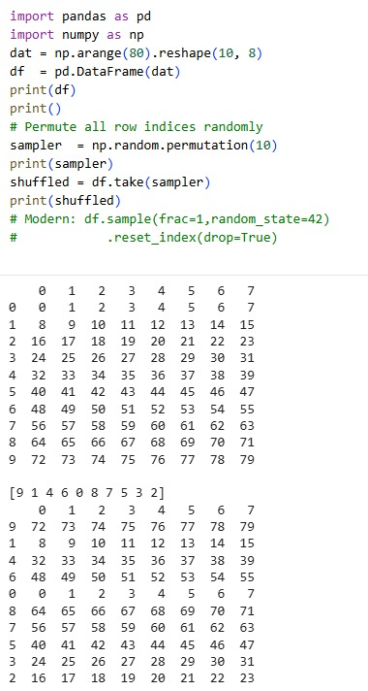
Permutation & Random Sampling

Slide 27
Test Your Understanding
Q1. Apply pd.merge() on the following two DataFrames and show the result of all four types of joins:
df1 = pd.DataFrame({'EmpID':[101,102,103], 'Name':['Alice','Bob','Charlie']})
df2 = pd.DataFrame({'EmpID':[102,103,104],a'Dept':['HR','IT','Finance']})
Write the code for each join type and interpret the resulting DataFrames.

Slide 28
Solution
import pandas as pd
df1 = pd.DataFrame({'EmpID': [101, 102, 103],
'Name': ['Alice', 'Bob', 'Charlie']})
df2 = pd.DataFrame({'EmpID': [102, 103, 104],
'Dept': ['HR', 'IT', 'Finance']})
print('--- df1 ---')
print(df1)
print('--- df2 ---')
print(df2)
inner = pd.merge(df1, df2, on='EmpID', how='inner')
print('\n=== INNER JOIN ===')
print(inner)
left = pd.merge(df1, df2, on='EmpID', how='left')
print('\n=== LEFT JOIN ===')
print(left)
right = pd.merge(df1, df2, on='EmpID', how='right')
print('\n=== RIGHT JOIN ===')
print(right)
outer = pd.merge(df1, df2, on='EmpID', how='outer')
print('\n=== OUTER JOIN ===')
print(outer)

Slide 29
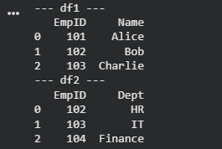
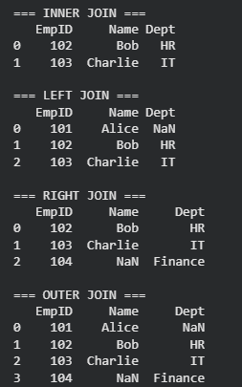
Output

Slide 30
Test Your Understanding
Q2. Apply the following transformation code on the given dataset and interpret the output at each step.
import pandas as pd
import numpy as np
df = pd.DataFrame({'A':[1,2,np.nan,4,5],'B':[np.nan,2,3,np.nan,5],'C':[1,2,3,4,5]}) print(df.isnull().sum())
df_filled = df.fillna(df.mean())
print(df_filled)
df_dropped = df.dropna()
print(df_dropped)

Slide 31
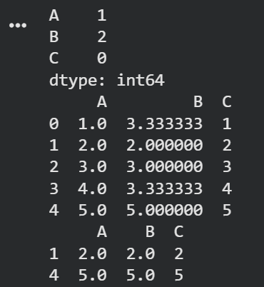
Output

Slide 32
Test Your Understanding
Q3. Analyse the following code snippet and Interpret the output at each step:
import pandas as pd
df = pd.DataFrame({'Mumbai':[200,250],'Delhi':[300,350]}, index=['2023-01','2023-02']) print('Original DataFrame:');
print(df)
print('After stack():');
stacked = df.stack();
print(stacked)
print('After unstack():');
print(stacked.unstack())

Slide 33
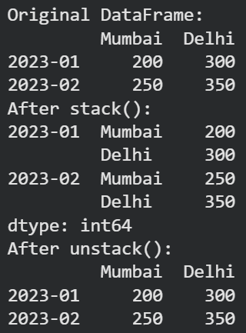
Output

Slide 34
Test Your Understanding
Q4. Interpret the output:
df = pd.DataFrame({'A':[1,2,3],'B':[4,5,6]}, index=['x','y','z'])
print(df)
df = df.rename(columns={'A':'Score','B':'Rank'}, index={'x':'Row1','y':'Row2','z':'Row3'})
print("After renaming:")
print(df)

Slide 35
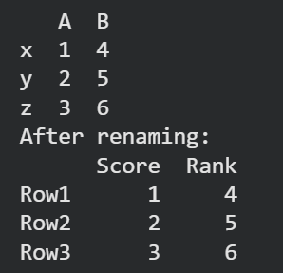
Output

Slide 36
Test Your Understanding
Q5.The following two Data Frames are given:
df1 = pd.DataFrame({'A':[1,2],'B':[3,4]})
df2 = pd.DataFrame({'A':[5,6],'B':[7,8]})
print(df1)
print(df2)
Write Python code to:
Perform vertical concatenation
Perform horizontal concatenation

Slide 37
Test Your Understanding
# === Output 1: Vertical concatenation (axis=0) ===
output1 = pd.concat([df1, df2]) # axis=0 is default
# OR: pd.concat([df1, df2], axis=0)
print('\n=== Output 1: pd.concat axis=0 (vertical) ===')
print(output1)
# Reset index to get sequential 0,1,2,3
output1_reset = pd.concat([df1, df2], ignore_index=True)
print('\n=== Output 1 with ignore_index=True ===')
print(output1_reset)
# === Output 2: Horizontal concatenation (axis=1) ===
output2 = pd.concat([df1, df2], axis=1) # axis=1 = side-by-side
print('\n=== Output 2: pd.concat axis=1 (horizontal) ===')
print(output2)

Slide 38
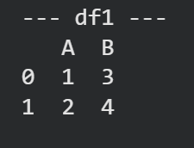
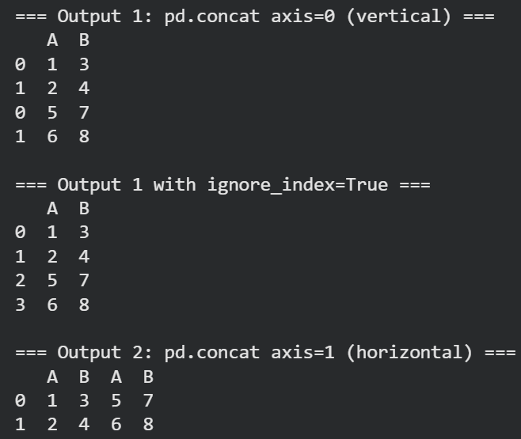
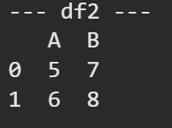
Output

Slide 39
Test Your Understanding
Q6. Write Python code to perform the following tasks for the given dataframe
Columns: Bergen, Oslo
Rows: Rainfall, Humidity, Wind
i) Convert index to uppercase
ii) Truncate index to contain only first three characters

Slide 40
Solution
import pandas as pd
import numpy as np
# Create the DataFrame
df = pd.DataFrame({
'Bergen': [45, 82, 23],
'Oslo': [38, 75, 19]
}, index=['Rainfall', 'Humidity', 'Wind'])
print('Original DataFrame:')
print(df)
# Using index.map()
df.index = df.index.map(str.upper)
print('After converting index to uppercase:')
print(df)
# Using index.map() with a lambda function
df.index = df.index.map(lambda x: x[:3])
print('After truncating index to first 3 characters:')
print(df)

Slide 41
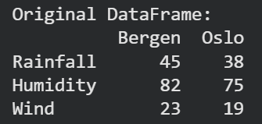
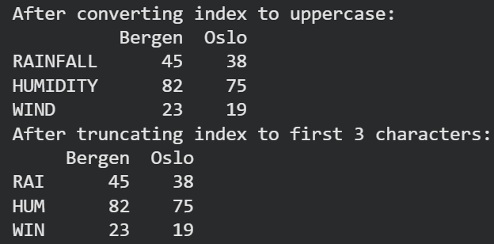
Output

Slide 42
Test Your Understanding
Q7. Write Python code and output to: Create a DataFrame, display summary statistics, display rows and columns, calculate TotalPrice = UnitPrice × Quantity, detect outliers where TotalPrice > 3,000,000, and filter rows where TotalPrice > 6,741,112.

Slide 43
Solution
import pandas as pd
import numpy as np
# Create the sales transactions dataset
data = {
'Transaction_ID': [1, 2, 3, 4, 5, 6, 7, 8, 9, 10],
'Quantity': [10, 5, 2, 8, 12, 15, 20, 3, 9, 7],
'UnitPrice': [150000, 750000, 400000, 550000, 70000,
100000, 65000, 1200000, 450000, 950000],
'Customer_ID': [101, 102, 103, 104, 105, 106, 107, 108, 109, 110],
'Date': ['2025-01-01','2025-01-02','2025-01-03','2025-01-04',
'2025-01-05','2025-01-06','2025-01-07','2025-01-08',
'2025-01-09','2025-01-10']
}
df = pd.DataFrame(data)
print('DataFrame created successfully!')
print(df.head())

Slide 44
Solution
# Summary statistics — mean, std, min, max, quartiles
print('\nSummary Statistics:')
print(df.describe())
# Display shape
rows, cols = df.shape
print(f'\nNumber of rows: {rows}')
print(f'Number of columns: {cols}')
print(f'Shape: {df.shape}')
# Info — column names, dtypes, non-null counts
print('\nDataFrame Info:')
df.info()
# Add new derived column TotalPrice
df['TotalPrice'] = df['UnitPrice'] * df['Quantity']
print('\nDataFrame with TotalPrice column:')
print(df[['Transaction_ID', 'Quantity', 'UnitPrice', 'TotalPrice']])

Slide 45
Solution
# Detect outliers — transactions exceeding 3 million
TotalTransaction = df['TotalPrice']
outliers = TotalTransaction[np.abs(TotalTransaction) > 3000000]
print('\nOutliers (TotalPrice > 3,000,000):')
print(outliers)
print(f'\nNumber of outlier transactions: {len(outliers)}')

Slide 46
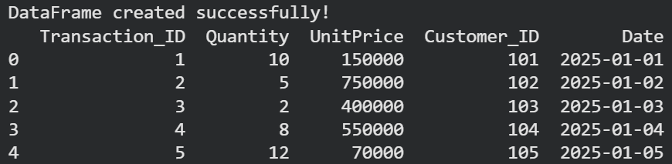
Output

Slide 47
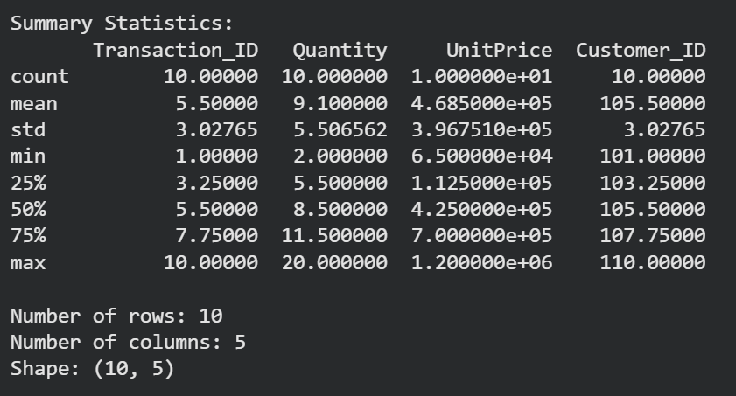
Output

Slide 48
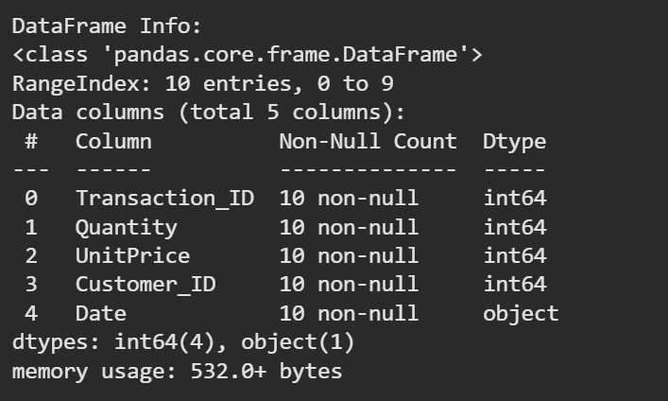
Output

Slide 49
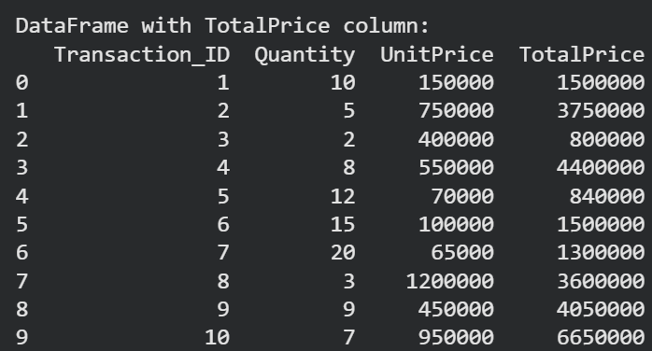
Output

Slide 50
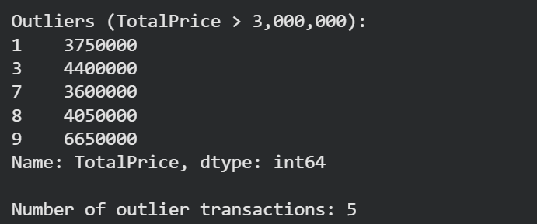
Output

Slide 51
Module 2 — Quick Reference Cheatsheet
Operation | Key Function / Syntax | Critical Note
Vertical concat | pd.concat([df1,df2], axis=0, ignore_index=True) | ignore_index resets to 0,1,2,... avoids duplicate indices
Horizontal concat | pd.concat([df1,df2], axis=1) | Row indices must align; drop duplicate columns afterward
Inner join | df1.merge(df2, how='inner', on='key') | Only matching rows — fewest rows, no NaN from join
Left join | df1.merge(df2, how='left', on='key') | All left rows kept; NaN where right has no match
Right join | df1.merge(df2, how='right', on='key') | All right rows kept; NaN where left has no match
Outer join | df1.merge(df2, how='outer', on='key') | All rows from both; most rows, most NaN
Merge on index | pd.merge(l, r, left_on='col', right_index=True) | right_index=True uses the right DF's index as join key
Wide → Long | df.stack() | Columns → MultiIndex rows; result is a Series
Long → Wide | series.unstack() | Index rows → columns; NaN for missing combinations
Detect duplicates | df.duplicated() | True = repeat of an earlier row
Remove duplicates | df.drop_duplicates(keep='first') | keep='last' or subset=['col'] for column-specific check
Replace values | df.replace({-786: np.nan}) | Returns new DF — assign back or use inplace=True

Slide 52
Module 2 — Quick Reference Cheatsheet
Operation | Key Function / Syntax | Critical Note
Detect NaN | df.isnull().sum() | Per column; .sum().sum() for total NaN count
Drop NaN | df.dropna(how='all', thresh=N, axis=1) | how='all' = only all-NaN rows; thresh=N = flexible cutoff
Fill NaN constant | df.fillna(0) or df.fillna(df.mean()) | mean fill preserves column distribution; 0 distorts mean
Fill NaN sequence | df.fillna(method='ffill') or 'bfill' | ffill = carry forward; bfill = carry backward
Interpolate NaN | df.interpolate(method='linear') | Estimates between two known anchor points
Custom bins | pd.cut(data, bins, labels=[...]) | right=False for left-closed [a,b) intervals
Equal-freq bins | pd.qcut(data, 4) | Quartiles; each bin gets ~equal record count
Outlier detection | df[np.abs(col) > threshold] | IQR: flag below Q1−1.5×IQR or above Q3+1.5×IQR
Dummy encoding | pd.get_dummies(df['col'], prefix='p', drop_first=True) | drop_first=True avoids dummy trap / multicollinearity
Shuffle rows | df.sample(frac=1, random_state=42).reset_index(drop=True) | Train/test: df.sample(frac=0.8, random_state=42)

