Slide 1
BILLING MANAGEMENT SYSTEM

Slide 2
Submitted by:-
Shilpi Kumari(191220043)
Akshit Chand(191220008)

Slide 3
INTRODUCTION:
The computer has brought revolution in every sphere of life,whether it is business, education, hospital etc. The project “Billing system” is an application to automate the process of ordering and billing of a Departmental store,Malls,Shopkeepers, Hospitals and Schools.This web based application is designed considering the chain of above stakeholders which is located in various cities. This application also administrates its users and customers.
The project is based on python programming.

Slide 4
QUESTIONS REQUIRED TO UNDERSTAND THE NEED OF THE CUSTOMER:-
•
For what department (for eg. grocery, cosmetics, vegetable shop etc.) they require the software?
•
•
Do they need a permanent unchangeable software or they want a software in which any changes can be
applied at any time?
What is the kind and type of software in their view they require for billing management?
What things they want in the software?
How should the interface look like?

Slide 5

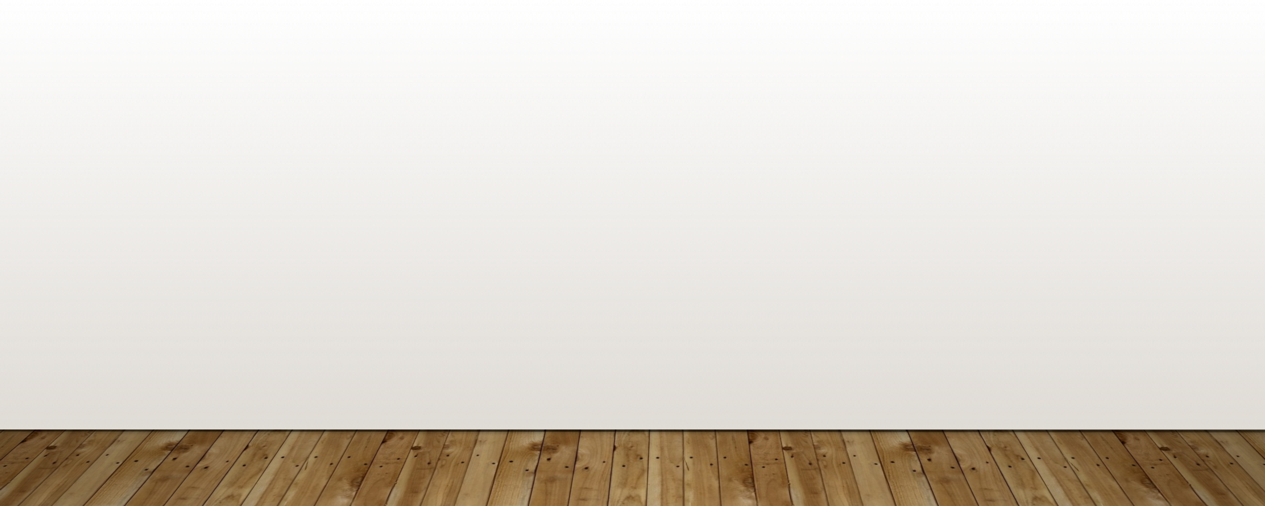
The task sets for Requirements gathering action for a project:
Make a list of stakeholders for the project and interview each of them to determine overall needs.
Build a preliminary list of functions and features based on stakeholder input.
Schedule a series of facilitated application specification meetings and conduct meetings.
Produce informal user scenarios as part of each meeting andrefine user scenarios based on stakeholder feedback.
Build a revised list of stakeholder requirements.
Use quality function deployment techniques to prioritize requirements.
Package requirements so that they can be delivered incrementally.
Note constraints and restrictions that will be placed on the system.
Discuss methods for validating the system.

Slide 6
OBJECTIVES:
This project will serve the following objectives:-
Add and maintain records of available products.
Add and maintain customer details.
Add and maintain description of new products.
Add and maintain new entered category of products.
Provides economic/financial reports to the owner monthly or weekly and yearly.
Provides a convenient solution of billing pattern.
Make an easy to use environment for users and customers.

Slide 7
CHARACTERISTICS OF THE PROPOSED SYSTEM:-
Easiness in modification of data: The proposed system provides management of huge data effectively and efficiently for efficient results, storing the details of the customers, employees etc. in such a way that the database can be modified.
User friendly: The proposed system is user friendly because the retrieval and storing of data is fast and data is maintained efficiently.Moreover the graphical user interface is provided in the proposed system, which provides user to deal with the system very easily.
Reports are easily generated: Reports can be easily generated in a proposed system. So any type of reports can be generated in a proposed system, which helps the managers in a decisions-making activity.
Sharing the data is possible: Data can be shared in proposed system.This means that two or more persons can use the same data in existing system provided that they have right to access that data. Also the two or more departments in an organisation can easily interact with each other without the actual movement of data.
No or very few paperwork: The proposed system either does not require paper work or very few paper works is required. All the data is feted into the computer immediately and various bills and reports can be generated through computers. Since all the data is kept in a database no data of the organisation can be destroyed. Moreover work becomes very easy because there is no need to keep data on papers

Slide 8
HARDWARE AND SOFTWARE REQUIREMENTS
Software Requirements:
Front End
Language used: Python
Back end
Supporting Software: SQL Server 2005. This is used to storing data in the form of tables. It is easy to use.
OPERATING SYSTEM:
Platform: Windows XP . Our system requires window operating system, which is easily available.
Hardware Requirements:
Intel based processor-run computer system, which have keyboard and mouse as input devices. This has been decided for its case of availability and up-gradation.
The various registers maintained at the different department have enough information recording, which will help in digitizing the available data.

Slide 9
PLANNING THE DESIGN OF THE SOFTWARE:-
step 1:-
In the Billing Management System we have the following entities :-
Identify all the entities.
Identify the relationship between entities and
Add meaningful attributes to our entities such as user , user log, customer, billing , billing information, attached file ,currency history , charges.
Our design of Billing Management System consists of 8 entities; the specified entities will be our database tables in the design and implementation of Billing Management database schema.

Slide 10
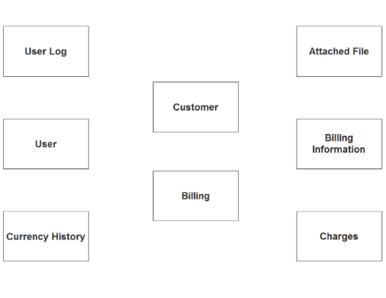

Slide 11
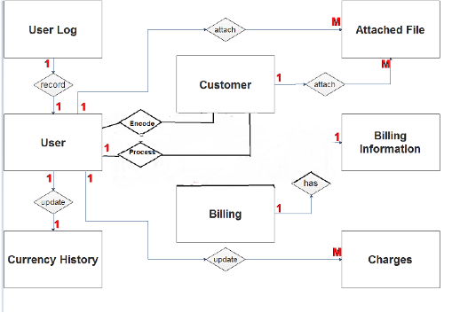
STEP 2:-
After we have specified our entities, it is time now to connect or establish a relationship among the entities:-
The user encodes the customer information (1 to many relationship).
The user process the billing information (1 to many relationship).
The user logs the login history (1 to 1 relationship).
The user updates the currency history (1 to 1 relationship).
The user updates the charges information (1 to M relationship).
The user can attach file in the billing information (1 to many relationship).
The customer has multiple billing information (1 to many relationship).
The customer can attach files to the billing information (1 to many relationship).

Slide 12
FUTURE SCOPE
This project will help the store keeper,School,Malls in fast billing
This project enable stakeholders to maintain a great database
Project will enable to see report regarding product and category.
Easy to maintain in future prospect.

Slide 13
RISKS INVOLVED IN THE SYSTEM:-
Tight Schedules
Often, project managers face the pressure of having to deliver the project earlier than anticipated. This can happen due to many different reasons – lack of resources, poor planning, or even technical glitches.
Budget Changes
Budget changes are a common occurrence, especially in software development projects. A common reason why this happens is ‘scope creep’. Scope creep is when you start off your project with a set of clear, well-defined requirements, but as you approach the finish line, so many requirements are added or deleted that all you’re left with is one big mess.
Technical Difficulties
Data security, information privacy, large-scale system implementation, software integration, and compliance are some areas where you are likely to run into unpredictable problems.
Poor Management
This may be a no-brainer but is unfortunately overlooked in many projects. While many may blame budget overshoots and time constraints as the reasons, the underlying reason is always poor management.

Slide 14


CODE SNIPPETS
Declaration of all the important modules which are important for the execution of the code
#The Tk class is instantiated without arguments. This creates a toplevel widget of Tk which usually is the main
window of an application. Each instance has its own associated Tcl interpreter
from tkinter import*
#The OS module in Python provides functions for interacting with the operating system. OS comes under Python’s standard utility modules.
import math,random,os
#The datetime module is used to get the date and time
import datetime
#messagebox to indicate or give a warning or to give a successful completion of the task from tkinter import messagebox
#making a class for the bill app which will contains all the things to be displayed in the billing software

Slide 15
Declaring all the classes and objects of the code
1.The BillApp class
class Bill_App:
def __init (self,root):
self.root=root self.root.geometry("1350x700+0+0") self.root.title("Billing Software")

Slide 16
Contents of the bill app class:
The variables area
Cosmetcs frame
Grocery frame 4.Cold drinks frame 5.Bill Area
6.Button frame
#===================Bill Area===============
F5=LabelFrame(self.root,bd=10,relief=GROOVE)
F5.place(x=1010,y=180,width=350,height=380)
bill_title=Label(F5,text="Bill Area",font="arial 15 bold",bd=7,relief=GROOVE).pack(fill
scrol_y=Scrollbar(F5,orient=VERTICAL) self.txtarea=Text(F5,yscrollcommand=scrol_y.set) scrol_y.pack(side=RIGHT,fill=Y) scrol_y.config(command=self.txtarea.yview) self.txtarea.pack(fill=BOTH,expand=1)

Slide 17
The customers details frame
It is used to get the customer’s informatiom

Slide 18
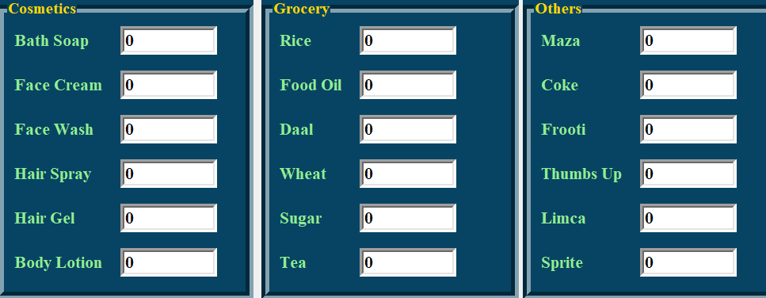
The products frame:
It contains the name of products and the quantity purchased.

Slide 19
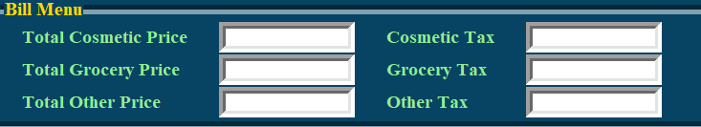
The Bill Menu Frame:
It contains the total price including the taxes

Slide 20
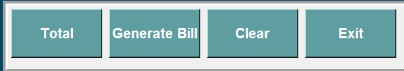
The Button Frame
The button frame is to perform all the tasks required for billing

Slide 21
Function to generate total bill:
#function to generate total bill
def total(self): self.c_s_p=self.soap.get()*40 self.c_fc_p=self.face_cream.get()*120 self.c_fw_p=self.face_wash.get()*60 self.c_hs_p=self.spray.get()*180 self.c_hg_p=self.gell.get()*140 self.c_bl_p=self.lotion.get()*180 self.total_cosmetic_price=float(
self.c_s_p+ self.c_fc_p+ self.c_fw_p+ self.c_hs_p+ self.c_hg_p+ self.c_bl_p
)
Same code structure is for grocery and cold drinks area

Slide 22
Function for the billing area:
#function to show the billing area
def welcome_bill(self):
x = datetime.datetime.now()
self.txtarea.delete('1.0',END) self.txtarea.insert(END,"\tWelcome to THE SHOP") self.txtarea.insert(END,f"\n{x}")
self.txtarea.insert(END,f"\n Bill Number : {self.bill_no.get()}") self.txtarea.insert(END,f"\n Customer Name : {self.c_name.get()}") self.txtarea.insert(END,f"\n Phone Number : {self.c_phon.get()}") self.txtarea.insert(END,f"\n=====================================")
self.txtarea.insert(END,f"\n Products\t\t QTY\t\tPrice")
self.txtarea.insert(END,f"\n=====================================")

Slide 23
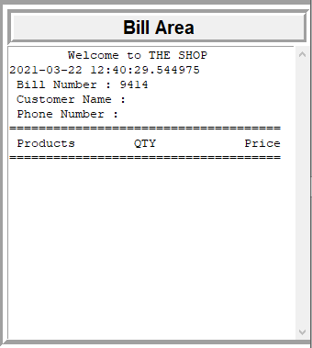
The billing area:
It displays total billing information .The customer name , bill number , Phone number ,products , quantity and price all gets displayed here.

Slide 24
Function to save the bill
The save bill function is used to save the bill .When the user click on the generate bill button
then a messagebox appears asking for the confirmation to save the bill.
def save_bill(self):
op=messagebox.askyesno("Save Bill","Do u want to save the bill?")
if op>0:
self.bill_data=self.txtarea.get('1.0',END) f1=open("bills/"+str(self.bill_no.get())+".txt","w") f1.write(self.bill_data)
f1.close()
messagebox.showinfo("Saved",f"Bill No. : {self.bill_no.get()} saved
else:
return
successfully")

Slide 25
The find bill function:
Through the search button the user can search any bill. If the input bill number in the search area is valid then the bill
get displayed in the billing area
def find_bill(self):
present="no"
for i in os.listdir("bills/"):
if i.split('.')[0]==self.search_bill.get(): f1=open(f"bills/{i}","r") self.txtarea.delete('1.0',END)
for d in f1:
self.txtarea.insert(END,d)
f1.close()
present="yes" if present=="no":
messagebox.showerror("Error","Invalid Bill No.")

Slide 26
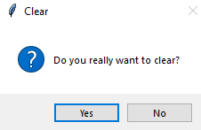
Function to clear the data
The clear data function is to exit the interface as there should be proper way to exit the software. In this software when user clicks on clear button it ask for the to clear to ensure all the processes related to the bill are completed and the user do not clear the data by any mistake
def clear_data(self):
op=messagebox.askyesno("Clear","Do you really want to clear?")

Slide 27
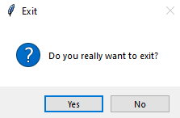
Function to exit the software
The exit app function is to exit the interface as there should be proper way to exit the software. In this software when user clicks on exit button it ask for the confirmation of exiting to ensure all the processes related to the bill are completed and the user do not exit the app by any mistake
#function to exit billing software
def Exit_app(self):
op=messagebox.askyesno("Exit","Do you really want to exit?") if op>0:
self.root.destroy()

Slide 28
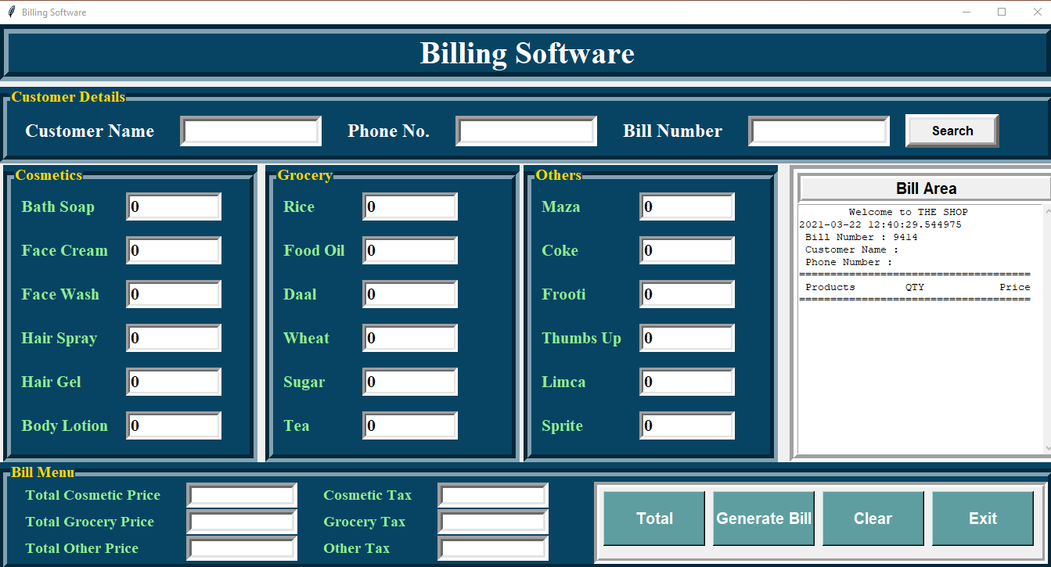
Complete Billing Software

Slide 29
Total tasks performed:
Akshit Chand(191220008)
-GUI interface, documentation ,PPT
Shilpi Kumari(191220043)
-GUI , documentation ,PPT
Link for the code:
https://drive.google.com/drive/folders/1XZv4T0DDXvizPrU1R63LUcYnZB06lHDU?usp=sharing

Slide 30
CONCLUSION
This was our project of about “Billing System”.Development of this System takes a lot of efforts from us. We think this system gave a lot of satisfaction to all of us. Though every task is never said to be perfect in this development field even more improvement may be possible in this system.We learned so many things and gained a lot of knowledge about development field.We hope this will prove fruitful to us.

Slide 31
THANK YOU

