Slide 1
DATA STRUCTURE PROJECT IMAGE PROCESSING
SUBMITTED BY:
SHILPI KUMARI(191220043)
INDALA TEJASHWINI(191220024)

Slide 2

WRITING AN IMAGE IN PGM FORMAT
PGM stands for Portable Gray Map. Saving a 2D array in C as images in PNG, JPG or other formats would need a lot of effort to encode the data in the specified format before writing to a file.

Slide 3
How to write PGM files? The File format is as follows: 1. Magic Number “P2” 2. Whitespace (blanks, TABs, CRs, LFs). 3. A width, formatted as ASCII characters in decimal. 4. Whitespace. 5. A height, again in ASCII decimal. 6. Whitespace. 7. The maximum gray value, again in ASCII decimal. 8. Whitespace. 9. width X height gray values, each in ASCII decimal, between 0 and the specified maximum value, separated by whitespace, in raster format, from top to bottom

Slide 4

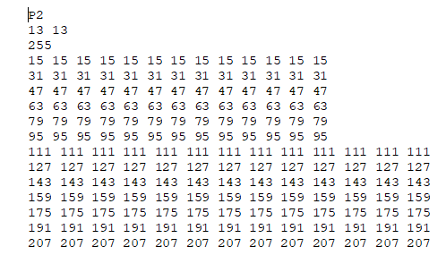
The Image will look like this:
IN TEXT FILE AND THE ORIGINAL PGM IMAGE.

Slide 5
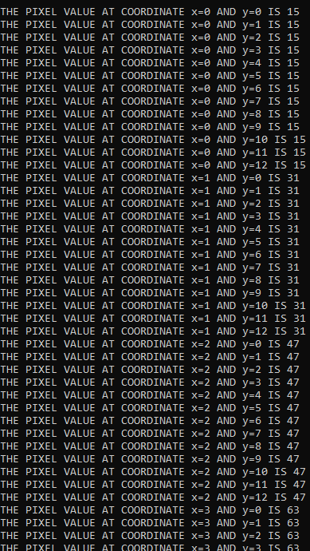
GETTING INFORMATION ABOUT THE IMAGE
KNOWING THE PIXEL VALUE AT ANY LOCATION REPRESENTED BY X AND Y COORDINATE IN TWO DIMENSIONAL COORDINATE SYSTEM.

Slide 6


C program to invert (making negative) an image content in PGM format
INPUT
P2 is the type of image that is grey image
4 4 is the image dimension
255 is the maximum grey level
Since, the image data are stored in matrix format and each row indicates the image row and the value indicates the grey level of corresponding pixel. The maximum value (255) is used for white and minimum value (0) is used for black.
OUTPUT
P2
4 4
255
255 0 255 0
0 255 0 255
100 200 150 100
50 150 200 0
P2
4 4
255
0 255 0 255
255 0 255 0
155 55 105 155
205 105 55 255

Slide 7
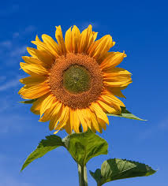
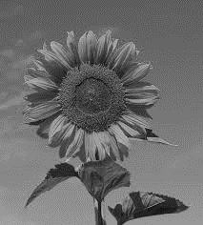
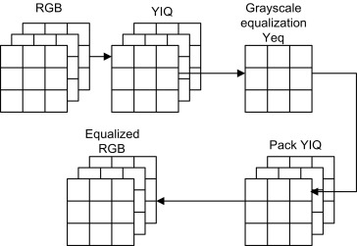
RGB TO GRAY CONVERSION
PROGRAM OUTPUT
For equalizing the RGB image, we first transform RGB values to YIQ values since Y channel contains most of the signal energy, about 93%. Then Y channel is equalized just like the grayscale to enhance the luminance. We leave the I and Q channels as they are, since these contain color information only and we do not equalize them. Next, we can repack the equalized Y channel back to the YIQ format. Finally, the YIQ values are transformed back to the RGB values for display.
A grayscale (or graylevel) image is simply one in which the only colors are shades of gray. The reason for differentiating such images from any other sort of color image is that less information needs to be provided for each pixel. In fact a `gray' color is one in which the red, green and blue components all have equal intensity in RGB space, and so it is only necessary to specify a single intensity value for each pixel, as opposed to the three intensities needed to specify each pixel in a full color image.

Slide 8
RGB TO GRAY CONVERSION
unsigned char pixel[3];
for (int y = 0; y < height; ++y)
{
for (int x = 0; x < width; ++x)
{
fread(pixel, 3, 1, fIn);
unsigned char gray = pixel[0] * 0.3 + pixel[1] * 0.58+ pixel[2] * 0.11;
memset(pixel, gray, sizeof(pixel));
fwrite(&pixel, 3, 1, fOut);
}
fread(pixel, padding, 1, fIn);
fwrite(pixel, padding, 1, fOut);
}

Slide 9
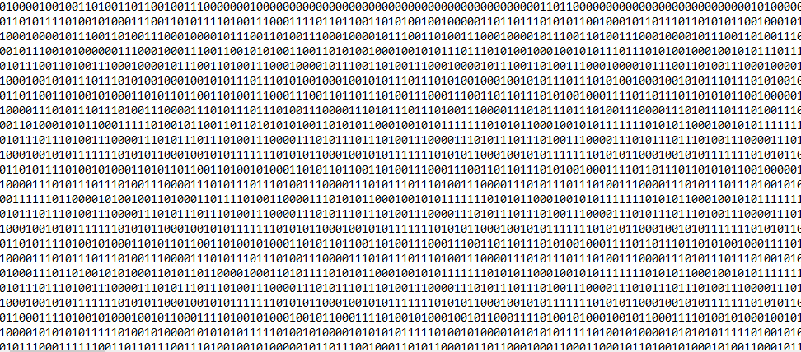
.
RGB TO BINARY DATA
Binary images are images whose pixel have only two possible intensity values. They are normally displayed as black and white. Numerically, the two values are often 0 for black, and either 1 or 255 for white.
PROGRAM OUTPUT

Slide 10
RGB TO BINARY DATA
while((c=fgetc(ptr_bmp_in)) != EOF)
{
for(int i=0;i<=7;i++)
{
if(c&(1<<(7-i)))
{
fputc('1',ptr_text_out);
}
else
{
fputc('0',ptr_text_out);
}
}
}

Slide 11
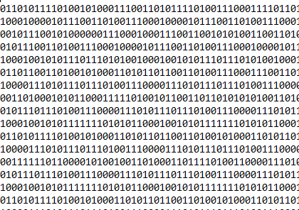
CONVERTING BINARY DATA TO RGB IMAGE
PROGRAM OUTPUT
A binary image is one that consists of pixels that can have one of exactly two colors, usually black and white. Binary images are also called bi-level or two-level. This means that each pixel is stored as a single bit—i.e., a 0 or 1. The names black-and-white, B&W, monochrome or monochromatic are often used for this concept, but may also designate any images that have only one sample per pixel, such as grayscale images.

Slide 12
CONVERTING BINARY DATA TO RGB IMAGE
while((c=fgetc(ptr_txt_in)) != EOF)
{
buf[j++] = c;
if(j==8)
{
fputc(bytefromtext(buf),ptr_bmp_out);
j=0;
}
}

Slide 13
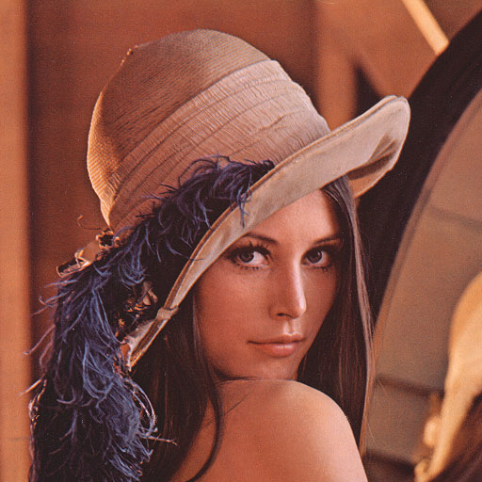
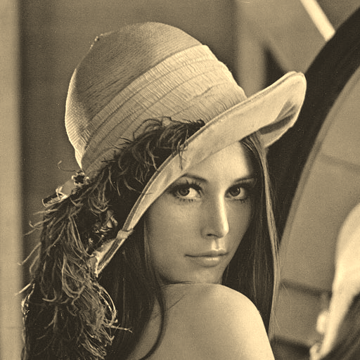
CONVERTING COLOR IMAGE TO SEPIA FILTER
Sepia filter is one of the most popular tools for editing images. The word “sepia” refers to the name of the rich brown pigment that was widely used by photographers back in the early days of photography. Sepia effect gives your images a warm brownish tone. Sepia filter improves the general look and feel of your image

Slide 14
CONVERTING COLOR IMAGE TO SEPIA FILTER
CONVERSION FORMULA FROM RGB TO SEPIA
r = (buffer[i][0]*0.393) + (buffer[i][1]*0.769) + (buffer[i][2]*0.189);
g = (buffer[i][0]*0.349) + (buffer[i][1]*0.686) + (buffer[i][2]*0.168);
b = (buffer[i][0]*0.272) + (buffer[i][1]*0.534) + (buffer[i][2]*0.131);

Slide 15

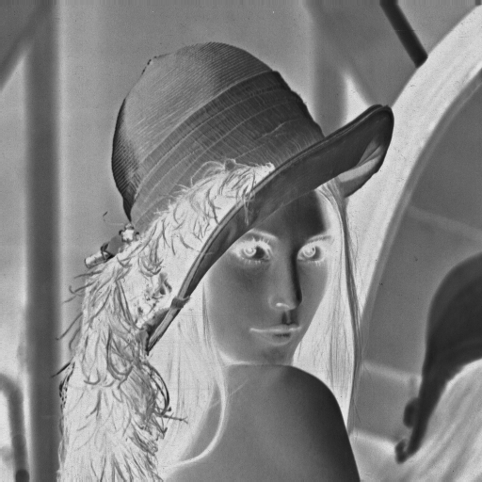
MAKING NEGATIVE OF IMAGE
INPUT IMAGE
OUTPUT IMAGE

Slide 16
MAKING NEGATIVE OF IMAGE
CONVERSION FORMULA TO MAKE NEGATIVE OF IMAGE
for(i = 0; i < height; i++){
for(j = 0; j < width; j++){
newimageData[i*width + j] = 255 - imageData[i*width + j]; }

Slide 17
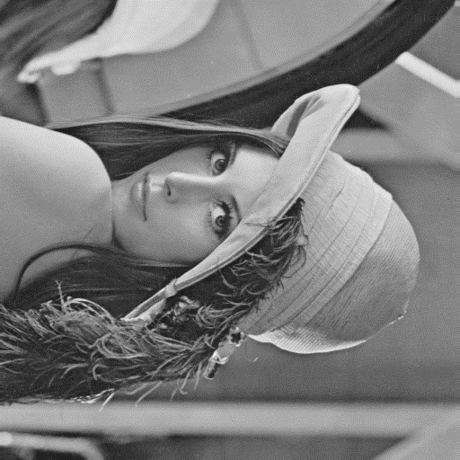
ROTATION OF IMAGE
LEFT ROTATION(90˚rotation)
Image rotation is a common image processing routine with applications in matching, alignment, and other image-based algorithms. The input to an image rotation routine is an image, the rotation angle θ, and a point about which rotation is done.
The coordinates of a point (x₁, y₁) when rotated by an angle θ around (x₀, y₀) become (x₂, y₂), as shown by the following equation:
x2=cos(θ)*(x1−x0)+sin(θ)*(y1−y0)
y2=−sin(θ)*(x1−x0)+cos(θ)*(y1−y0)
The coordinates of a point (x, y) when rotated by an angle θ around (x₀, y₀) become (x′, y′), as shown by the following equations:
x′=cosθ(x−x0)+sinθ(y−y0),
y′=−sinθ(x−x0)+cosθ(y−y0).

Slide 18
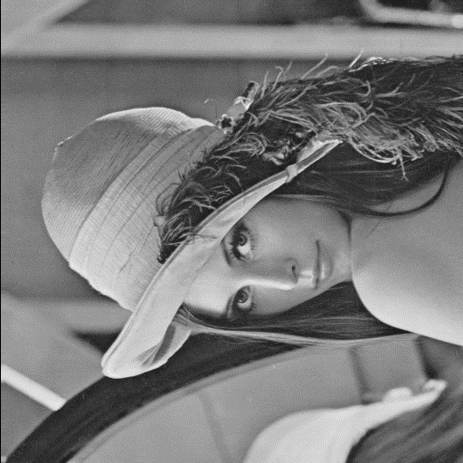
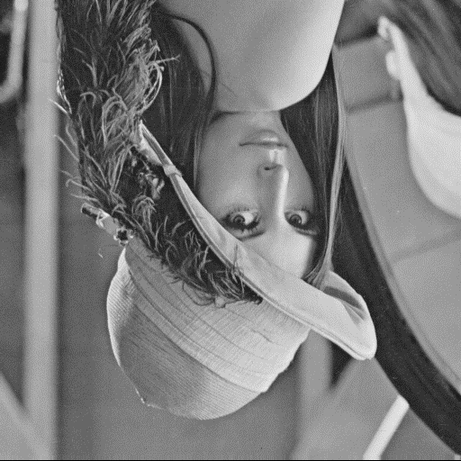
RIGHT ROTATION(-90˚rotation)
180˚ ROTATION

Slide 19
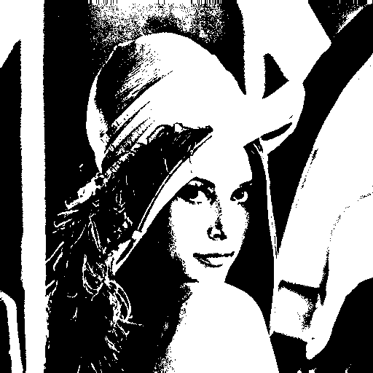
CONVERTING GRAYSCALE TO BINARY IMAGE

Slide 20
CONVERTING GRAYSCALE TO BINARY IMAGE
#define THRESHOLD 128 #define WHITE 255
#define BLACK 0
for(i=0;i<size;i++) //store 0(black) and 255(white) values to buffer {
buffer[i] = (buffer[i] > THRESHOLD) ? WHITE : BLACK;
}
for(i=0;i<size;i++) //store 0(black) and 255(white) values to buffer
 | {
 | buffer[i] = (buffer[i] > THRESHOLD) ? WHITE : BLACK;
 | }

Slide 21

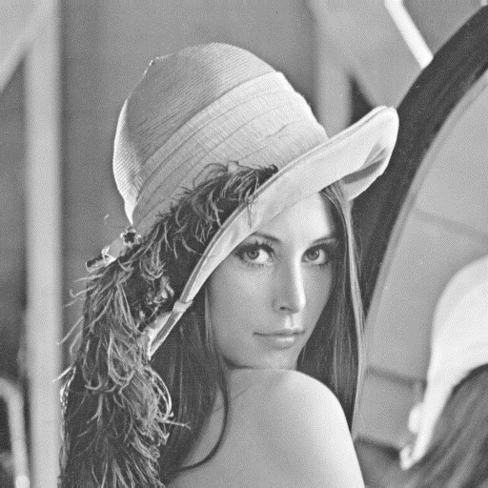
BRIGHTENING THE IMAGE
IMAGE HAS BEEN BRIGHTENED WITH BRIGHTNESS FACTOR 25.
PROGRAM OUTPUT

Slide 22
BRIGHTENING THE IMAGE
#define MAX_COLOR 255
#define BRIGHTNESS_FACTOR 25
for(i=0;i<size;i++) //increasing pixel values to get image bright {
temp = buffer[i] + BRIGHTNESS_FACTOR;
buffer[i] = (temp > MAX_COLOR) ? MAX_COLOR : temp;
}

Slide 23
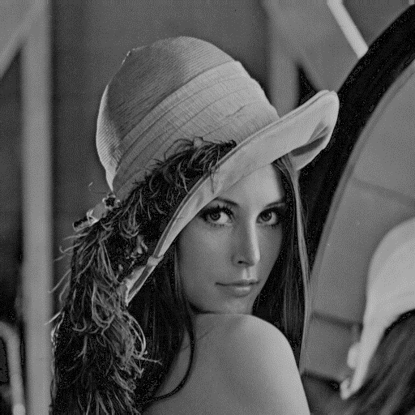
DARKENING THE IMAGE
PROGRAM OUTPUT

Slide 24
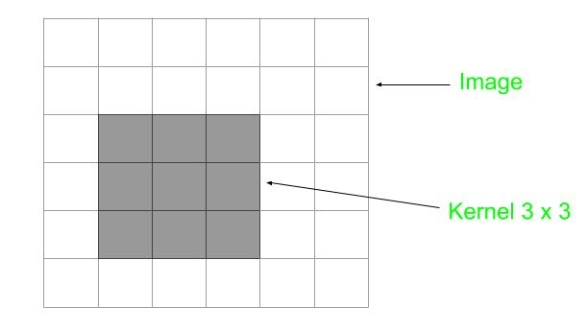
BLURRING THE IMAGE
What is Image Blurring?
What is convolution in 2D? Image is denoted as matrix inside computer. An image contains a lot of features like edge, contrast etc. In image processing features have to be extracted from the image for further study of image. Convolution is a fundamental operation on images in which a mathematical operation is applied to each pixel to get the desired result. For this purpose, another matrix called as kernel is used which is smaller in size of image. This is also called filter. This filter is applied on each pixel of the image and new value obtained is the value of that pixel. The image obtained is called filtered image. In kernel each cell contain some value, that kernel is kept above the pixel and corresponding values are multiplied and then summed up this value obtained is new the value of pixel.

Slide 25
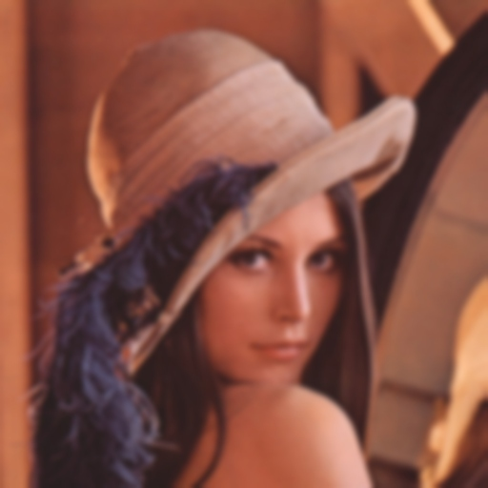
What is Blurring? If a blurred image is observed carefully then a common thing to notice is that image is smooth meaning edges are not observed. A filter used for blurring is also called low pass filter, because it allows low frequency to enter and stop high frequency. Here frequency means the change of pixel value. Around edge pixel value changes rapidly as blur image is smooth so high frequency should be filtered out. For blur purpose a filter with every call having value 1 is used because to blur image a pixel value should be close to neighbor value.
PROGRAM OUTPUT

Slide 26
BLURRING THE IMAGE
for(x=1;x<height-1;x++) {
for(y=1;y<width-1;y++)
{
float sum0= 0.0;
float sum1= 0.0;
float sum2= 0.0;
for(i=-1;i<=1;++i)
{
for(j=-1;j<=1;++j)
{
// matrix multiplication with kernel with every color plane
sum0=sum0+(float)kernel[i+1][j+1]*buffer[(x+i)*width+(y+j)][0];
sum1=sum1+(float)kernel[i+1][j+1]*buffer[(x+i)*width+(y+j)][1];
sum2=sum2+(float)kernel[i+1][j+1]*buffer[(x+i)*width+(y+j)][2];
}
}

Slide 27

CROPPING THE IMAGE
Cropping is the removal of unwanted outer areas from a photographic or illustrated image. The process usually consists of the removal of some of the peripheral areas of an image to remove extraneous trash from the picture, to improve its framing, to change the aspect ratio, or to accentuate or isolate the subject matter from its background. Depending on the application, this can be performed on a physical photograph, artwork, or film footage, or it can be achieved digitally by using image editing softwareThe process of cropping is common to the photographic, film processing, broadcasting, graphic design, and printing businesses.
In the program input is the height and width of the image to crop and the output is the cropped image.
CROPPED IMAGE

Slide 28
int temp, y1, y2, x1, x2, wide, high; CROPPING IMAGE
printf("Please Enter x1 y1 x2 y2");
scanf("%i %i %i %i", &x1, &y1, &x2, &y2);
if(y1> y2)
{ temp = y1;
y1 = y2;
y2 = temp; }
if(x1> x2)
{ temp = x1;
x1 = x2;
x2 = temp; }
wide = x2-x1+1;
high = y2-y1+1;
fprintf(outstream, "%2s\n%i %i\n%i\n", header->filetype, wide, high,header->maxgray);
pixel image[header->height][header->width];
pixel *pix = malloc((wide*high) *sizeof(char));
int a = 0;
for(int b= 0; b<header->height; ++b)
{ for(int c=0; c<header->width; ++c)
{ image[b][c] = header->p[a]; ++a; } } I
nt k = 0;
for(int i = 0; i< high; ++i)
{ for(int j = 0; j<wide; ++j)
{ pix[k]=image[i][j]; }

Slide 29
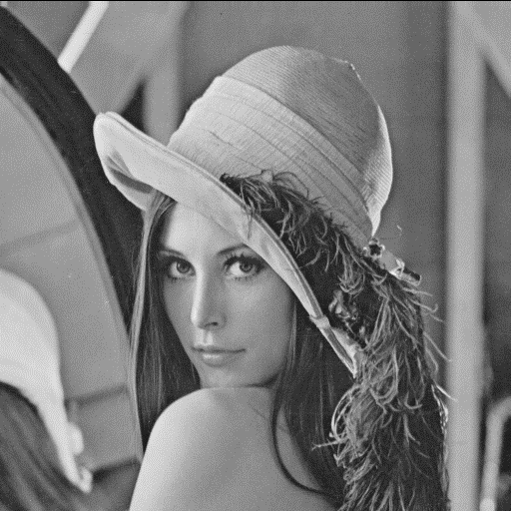
CREATING A COPY OF IMAGE

Slide 30
CREATING A COPY OF IMAGE
 | READ THE DATA FROM EXISTING FILE
 | int width = *(int*)&header[18]; // read the width from the image header int height = *(int*)&header[22]; // read the height from the image header
 | int bitDepth = *(int*)&header[28]; // read the bitDepth from the image header
 | WRITING THE DATA TO A NEW FILE
 | fwrite(header, sizeof(unsigned char), 54, fo); // write the image header to output file
 | unsigned char buf[height * width]; // to store the image data
 | fread(buf, sizeof(unsigned char), (height * width), streamIn);
 | if(bitDepth <= 8)
 | fwrite(colorTable, sizeof(unsigned char), 1024, fo);
 | fwrite(buf, sizeof(unsigned char), (height * width), fo);

Slide 31
THE END
THANK YOU

