Slide 1
Promising Results and Future Directions for Automated Sentiment Analysis of Amazon Product Reviews
Presented by: Shilpi

Slide 2
Introduction and Problem Statement
The machine learning analysis evaluates Amazon product review sentiment.
The insights increase product quality, customer happiness, and corporate profitability.
Manually assessing customer feedback is inefficient and time-consuming.
Amazon's online consumers make the market size huge.
Notes:
Our analysis's goal is to use machine learning to assess the sentiment of Amazon product reviews. We want to provide insights that raise the caliber of our products, the level of client pleasure, and the profitability of our company. The cumbersome, inefficient, and time-consuming procedure of reviewing customer evaluations has been recognized as the issue. The scale of the potential market is immense given the massive number of online customers on Amazon.

Slide 3
Data Collection and Preprocessing
Data was downloaded three CSV files of Amazon customer reviews from Kaggle (https://www.kaggle.com/datasets/datafiniti/consumer-reviews-of-amazon-products ), preserving just the required fields for sentiment analysis: "reviews.text" and "reviews.rating."
The preprocessing included deleting NaN numbers, converting reviews to lowercase, removing stop words, and stemming words.
Notes:
We collected data from Kaggle website(https://www.kaggle.com/datasets/datafiniti/consumer-reviews-of-amazon-products) with three CSV files of Amazon consumer reviews, retaining only the relevant columns for sentiment analysis - 'reviews.text' and 'reviews.rating'. The preprocessing involved removing NaN values, converting reviews to lowercase, removing stop words, and stemming words.

Slide 4
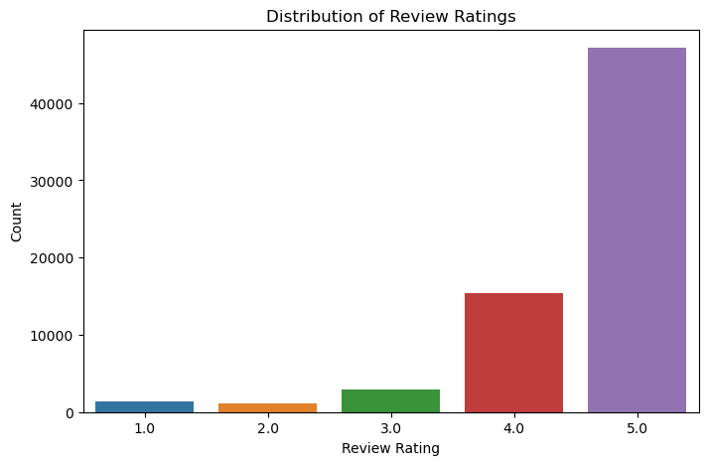
Exploratory Data Analysis
Exploratory data analysis showed review rating dispersion.
Understanding this distribution helps determine customer happiness.
Seaborn visualized review rating distribution.
Notes:
The examination of the data through exploratory analysis unveiled the pattern of distribution pertaining to the ratings provided in the reviews. Understanding this distribution is of utmost importance as it offers valuable insights into the overall levels of customer satisfaction. Seaborn was employed as a tool for the visualization of the distribution of review ratings.

Slide 5
Feature Engineering and Selection
Training and testing sets were created using our data.
We employed TF-IDF vectorization to numerically represent our text data.
To optimize our machine learning models, we standardized the TF-IDF properties.
Notes:
The data was divided into separate sets for training and testing purposes. In order to transform our textual data into a numerical representation, we employed the TF-IDF vectorization method, which effectively captures the significance of individual words. In addition, we applied a standardization technique to the TF-IDF features in order to maximize the performance of our machine learning models.

Slide 6
Model Training - Linear Regression
Linear Regression, was original model, was trained and validated using Mean Squared Error and R-squared metrics.
The Linear Regression model lets us examine the review text-review rating relationship.
With the following performance measures, this model was inaccurate:
Linear regression MSE: 8.068420579966495e+25
R-squared: -1.2206417600618311e+26
Notes:
Mean Squared Error and R-squared were used to train and evaluate the first linear regression model. We can understand the relationship between the review text and the review scores thanks to the linear regression model. The findings below nevertheless show that the model's performance was not satisfactory:Error in the Mean Square of a Linear Regression: 8.068420579966495e+25R-squared for a linear regression is -1.2206417600618311e+26.These numbers imply that the model underperformed in capturing the underlying patterns in the data, since the predictions are distant from the actual review scores. We may need to investigate other models, such as LightGBM, and contrast their outcomes with those of the Linear Regression model in order to attain superior performance.

Slide 7
Model Training - LGBMRegressor
We trained a LGBMRegressor model for regression.
Like the Linear Regression model, it was tested using Mean Squared Error and R-squared metrics to choose the best model.
The results are as shown below:
LightGBM Mean Squared Error: 0.4082236619560984
LightGBM R-squared: 0.3824133926951945
Notes:
The LGBMRegressor (LightGBM) model was employed in our study, as it is a resilient machine learning algorithm that is well-suited for both classification and regression tasks. In a manner akin to the Linear Regression model, we evaluated its efficacy by employing the Mean Squared Error and R-squared metrics. This facilitated a comparative examination, enabling us to ascertain the model that exhibited the highest level of optimality.

Slide 8
Results Analysis and Monetary Value
LightGBM has lower MSE than Linear Regression.
LightGBM models with lower MSEs make more accurate predictions.
The LightGBM model's R-squared score of 0.3824133926951945 is closer to 1.0 than the Linear Regression model's (-1.2206417600618311e+26).
A higher R-squared value suggests a better model fit.
In this measure, the LightGBM model fits the data better.
Notes:
LightGBM demonstrates a reduced Mean Squared Error (MSE) in comparison to Linear Regression, thereby signifying its superior accuracy in making predictions.
Models that exhibit lower mean squared errors (MSEs) tend to yield more precise and accurate predictions.
The R-squared score of the LightGBM model (0.3824) exhibits a higher proximity to 1.0 in comparison to the R-squared score of the Linear Regression model (-1.2206e+26).A larger R-squared value indicates a stronger alignment between the model and the observed data.
The LightGBM model demonstrates superior fit to the data compared to Linear Regression, as evidenced by the R-squared measure.

Slide 9
Application and Implications
LightGBM model enables automated sentiment categorization of reviews, aiding businesses to quickly identify positive, neutral, and negative sentiments.
LightGBM can identify areas of improvement, guiding resource allocation for better customer satisfaction and product development.
LightGBM can optimizes customer service by analyzing sentiments towards service quality.
LightGBM can enhances brand reputation management by promptly addressing negative sentiments.
LightGBM can offers valuable competitive intelligence for strategic decision-making.
It can also drives effective marketing and advertising strategies by leveraging sentiment insights.
It can fosters customer loyalty through personalized offerings based on customer preferences.
Notes:
The LightGBM model facilitates the automated categorization of sentiments in reviews, thereby assisting businesses in promptly discerning positive, neutral, and negative sentiments.
This statement highlights the importance of identifying areas for improvement in order to effectively allocate resources for the purpose of enhancing customer satisfaction and product development.
This study aims to enhance customer service effectiveness through the examination of sentiments pertaining to service quality.
The prompt addressing of negative sentiments contributes to the enhancement of brand reputation management. Provides significant competitive intelligence to inform strategic decision-making.
The utilization of sentiment insights is employed to enhance the efficacy of marketing and advertising strategies. This strategy aims to cultivate customer loyalty by providing tailored offerings that are aligned with individual customer preferences.

Slide 10
Conclusion and Future Work
We've shown how automated sentiment analysis of Amazon product reviews can be done using machine learning.
The findings are encouraging and have the potential to reduce expenses and boost productivity.
Future research may examine other machine learning algorithms, use more intricate feature engineering, and go beyond Amazon reviews.
Notes:
In this work, we demonstrated how sentiment analysis in Amazon product evaluations can be automated using machine learning. The results show potential and provide chances for cost savings and increased effectiveness. Alternative machine learning models, sophisticated feature engineering methods, and expanding the study to include review sources other than Amazon are also potential directions for future research.

