Slide 1

PROJECT TITLE: Healthcare Analytics for Doctor Visits_TIRTC
STUDENT NAME: Shilpi Bhakat

Slide 2

PROBLEM STATEMENT
Healthcare organizations generate large amounts of doctor-visit data, but it is often difficult to analyse effectively. This project aims to use Healthcare Analytics to identify patterns in patient visits, common health conditions, appointment trends, and doctor workload, helping improve healthcare planning and decision-making.

Slide 3
PROJECT DESCRIPTION
This project focuses on analysing doctor visit data to identify patterns and trends in healthcare services. It examines information such as patient visits, common health conditions, appointment trends, patient demographics, and doctor workload. Data analytics and visualization techniques are used to convert the collected data into meaningful insights. These insights can help healthcare organizations improve resource planning, understand patient needs, and support better decision-making.

Slide 4

WHO ARE THE END USERS?
Doctors – to understand patient visit patterns and workload.
Hospital Administrators – for resource planning and management.
Healthcare Managers – to monitor trends and improve services.
Data Analysts – to analyze healthcare data and generate insights.

Slide 5

TECHNOLOGY USED
Python: Used for data analysis and programming.
Pandas and NumPy: Used to clean, organise, and analyse the dataset.
Matplotlib and Seaborn: Used to create charts and visualisations.
Google Colab and GitHub: Used to run the notebook and share the project.

Slide 6
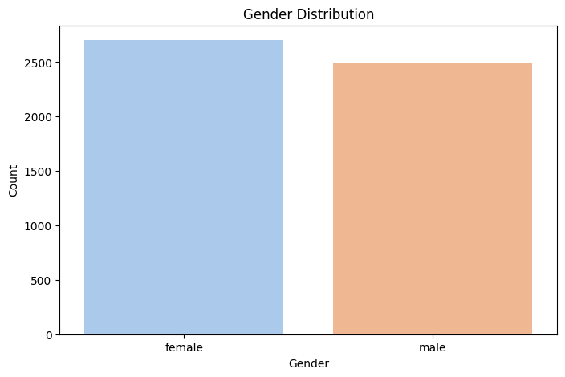
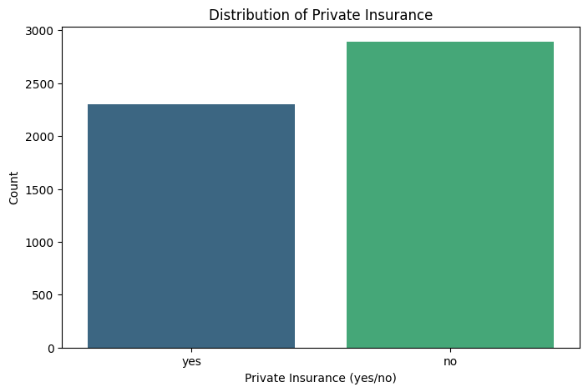
RESULTS
Demo Link - https://github.com/Shilpi29-byte/Healthcare-Analytics-for-Doctor-Visits.git

Slide 7
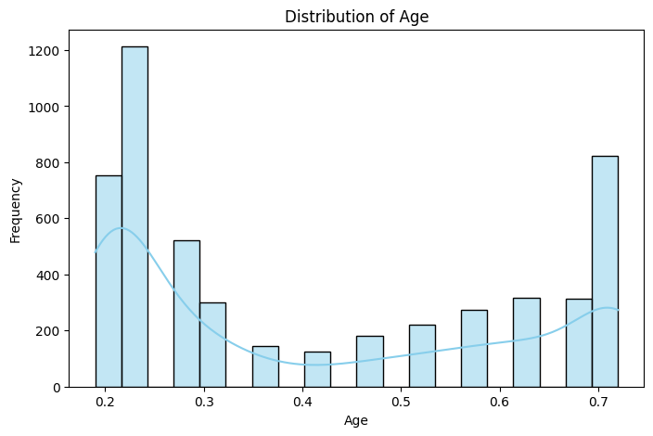
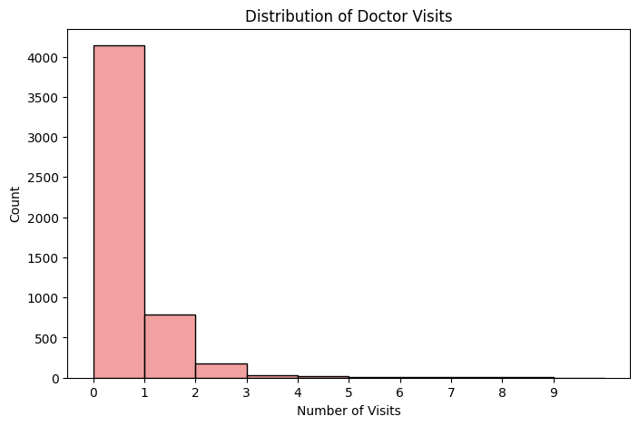
RESULTS
Demo Link - https://github.com/Shilpi29-byte/Healthcare-Analytics-for-Doctor-Visits.git

Slide 8


RESULTS
Demo Link - https://github.com/Shilpi29-byte/Healthcare-Analytics-for-Doctor-Visits.git

Slide 9
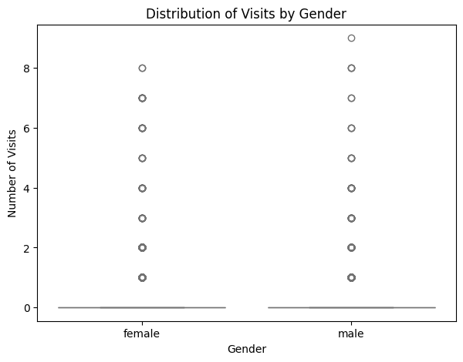
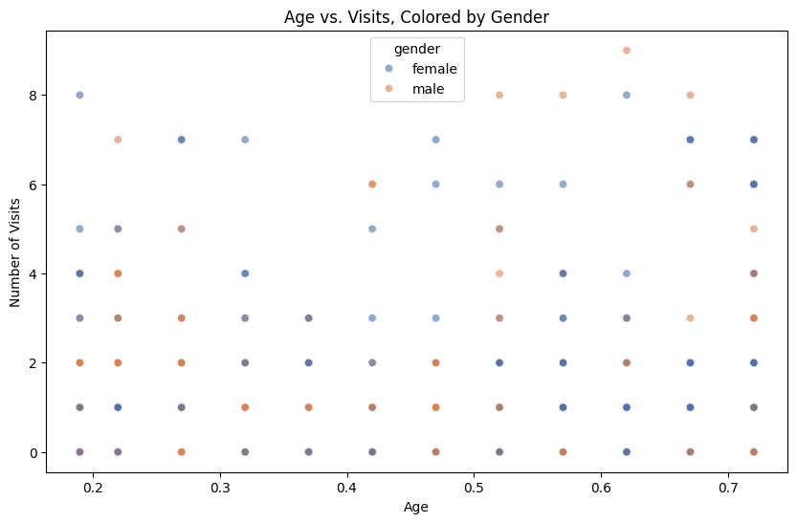
RESULTS
Demo Link - https://github.com/Shilpi29-byte/Healthcare-Analytics-for-Doctor-Visits.git

Slide 10
Thank you
.
.

