Slide 1
IBM University Engagement Project Submission
“Exploring the Power of Agentic AI with IBM Granite and IBM Bob”

Slide 2

Project Tile – Interview Trainer Agent
Domain of Project – Career Development
Student Name | Recent Passport Photo | Email ID | Mobile number [WhatsApp]
Shilpi Bhakat |  | sbjan292005@gmail.com | 9907396815

Slide 3
Problem Statement -
Problem Statement : Interview Trainer Agent
The Challenge
Job seekers often struggle with effective and personalized interview preparation. Generic questions may not match their skills, experience, or target job role, while relevant technical, behavioural, and HR interview resources are scattered across different sources.
The Objective
Build an AI-powered Interview Trainer Agent that provides personalized preparation based on the user's profile, resume, and job role.
Personalized Questions – Generate questions based on profile and target role.
RAG-Based Retrieval – Retrieve relevant questions, industry expectations, and HR guidelines.
Resume & Job Analysis – Provide targeted interview preparation.
Model Answers & Feedback – Suggest answers and improvement tips.
Skill Assessment – Evaluate technical knowledge and communication skills.

Slide 4
Proposed Solution -
The proposed solution is an AI-powered Interview Trainer Agent that uses IBM Granite and RAG to provide personalized and interactive interview preparation.
Personalized Questions – Generates technical, HR, and behavioural questions based on the user’s profile and target job role.
Resume & Job Analysis – Uses the user’s resume, skills, and experience to create targeted preparation.
RAG-Based Retrieval – Retrieves relevant interview questions, industry expectations, and HR guidelines.
Answer Evaluation – Analyses user responses and provides scores, model answers, and improvement suggestions.
Performance Tracking – Displays strengths, weaknesses, scores, and overall interview progress through a dashboard.
Mock Interview Practice – Conducts interactive mock interviews and gives real-time feedback to improve confidence and communication skills.

Slide 5
Technology Used -
IBM Bob platform -For designing and orchestrating multi-agent workflows visually
IBM Granite Model – Natural language understanding, reasoning, and personalization
IBM Cloud – Secure and scalable deployment
RAG – Retrieves relevant interview information for accurate responses
IBM watsonx.ai – Model deployment, embeddings, and AI governance
Vector Database (FAISS/Chroma) – Stores and retrieves interview-related data for RAG

Slide 6
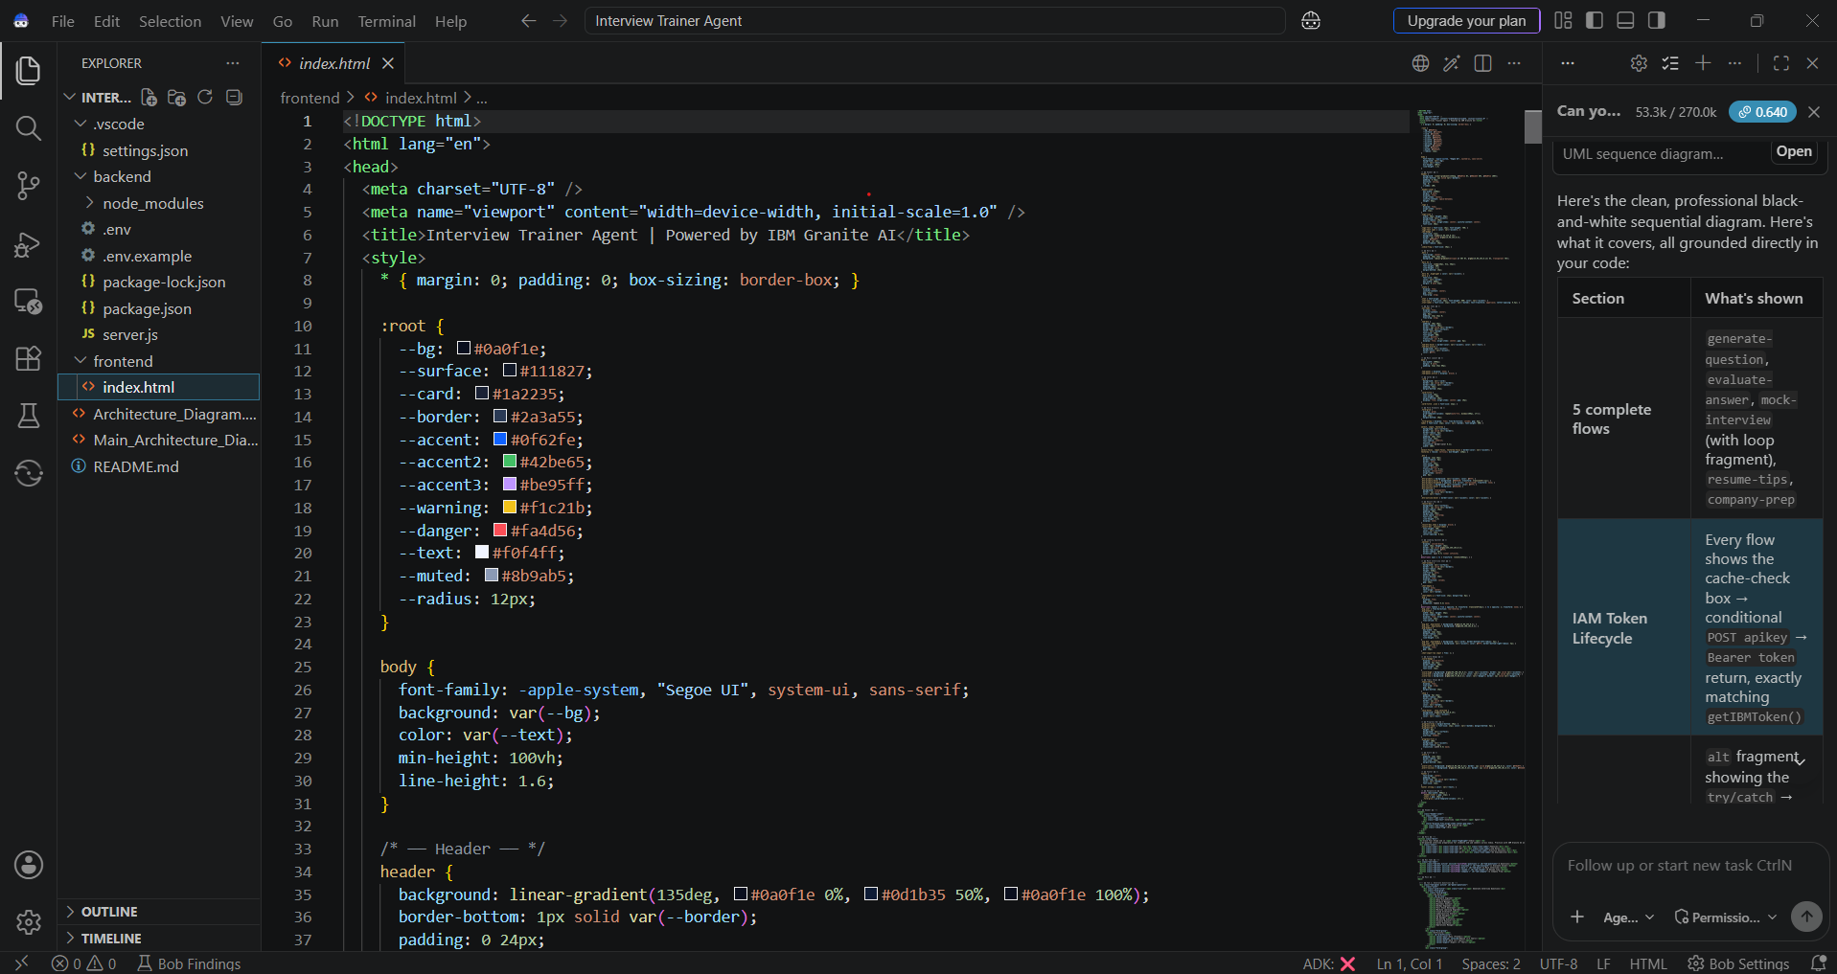
Required Files created using IBM bob -

Slide 7
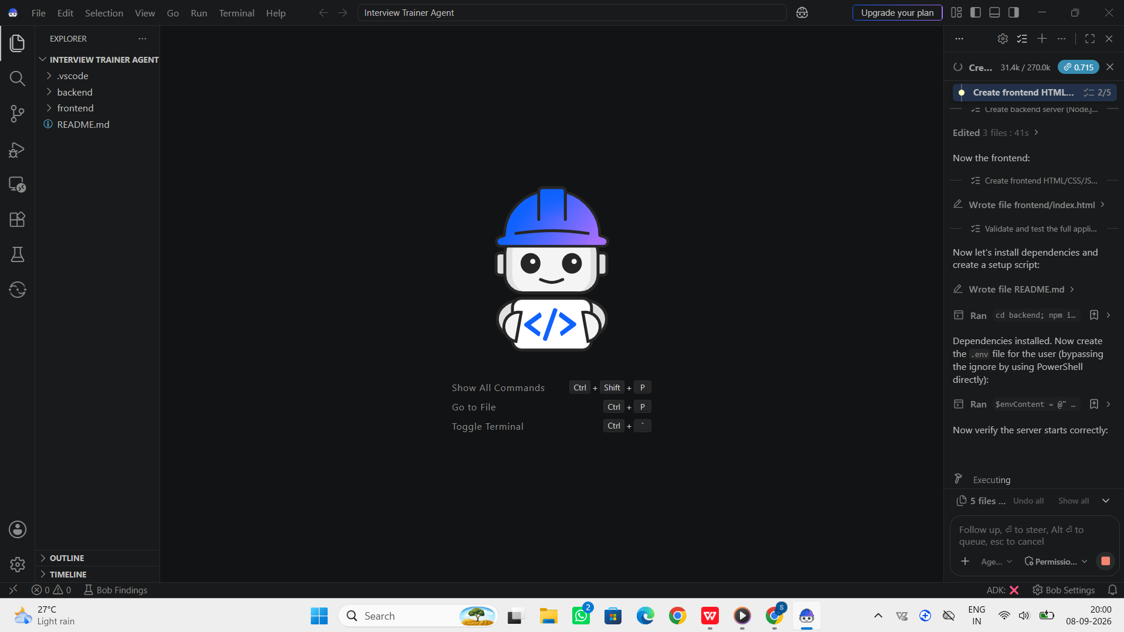
IBM Bob Screenshots-

Slide 8
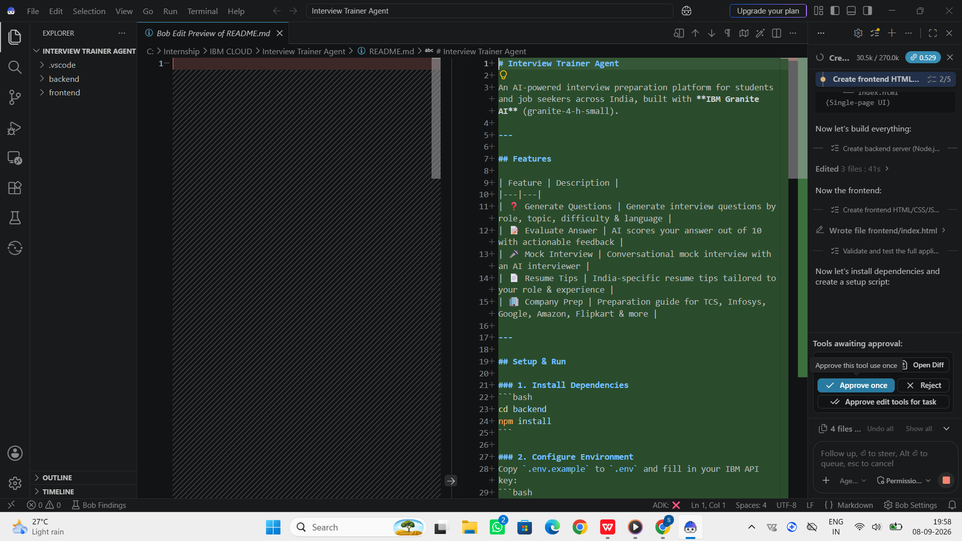

Slide 9
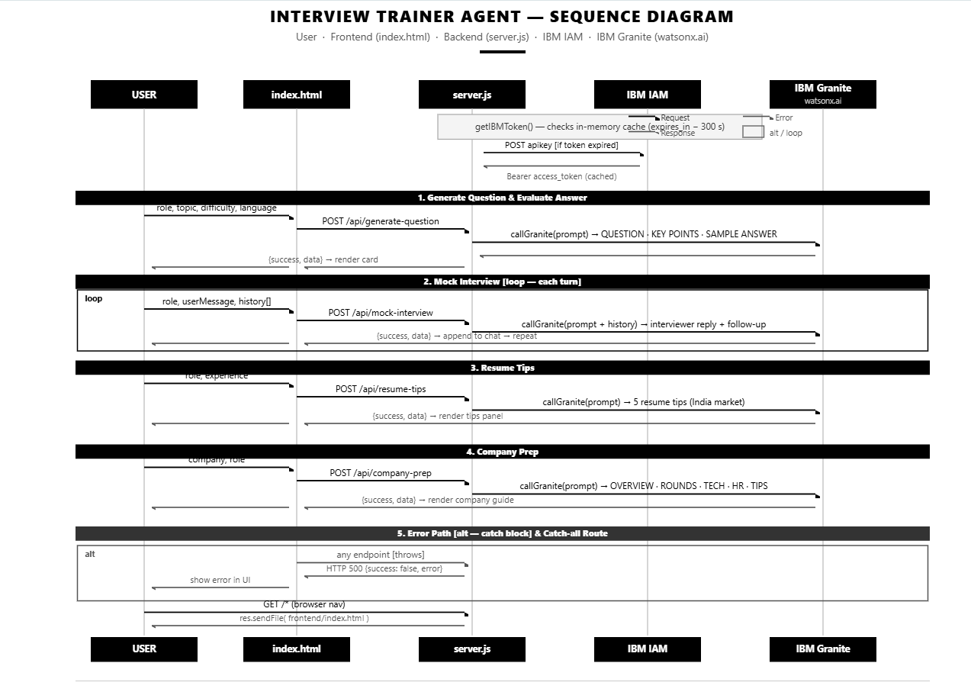
Architecture blueprint for IBM bob -

Slide 10

Role of Agentic AI in the solution -
Role of Agentic AI in Interview Trainer Agent
Agentic AI makes the Interview Trainer Agent intelligent and adaptive by using IBM watsonx Orchestrate and IBM Granite to coordinate specialized agents.
Question Generation – Creates role-specific interview questions.
Resume Analysis – Uses skills and experience for personalized preparation.
Answer Evaluation – Analyses responses and performance.
Feedback – Provides improvement suggestions.
Adaptive Practice – Adjusts questions based on user responses.
Overall, it works as a smart virtual interview coach that provides personalized and interactive preparation.

Slide 11
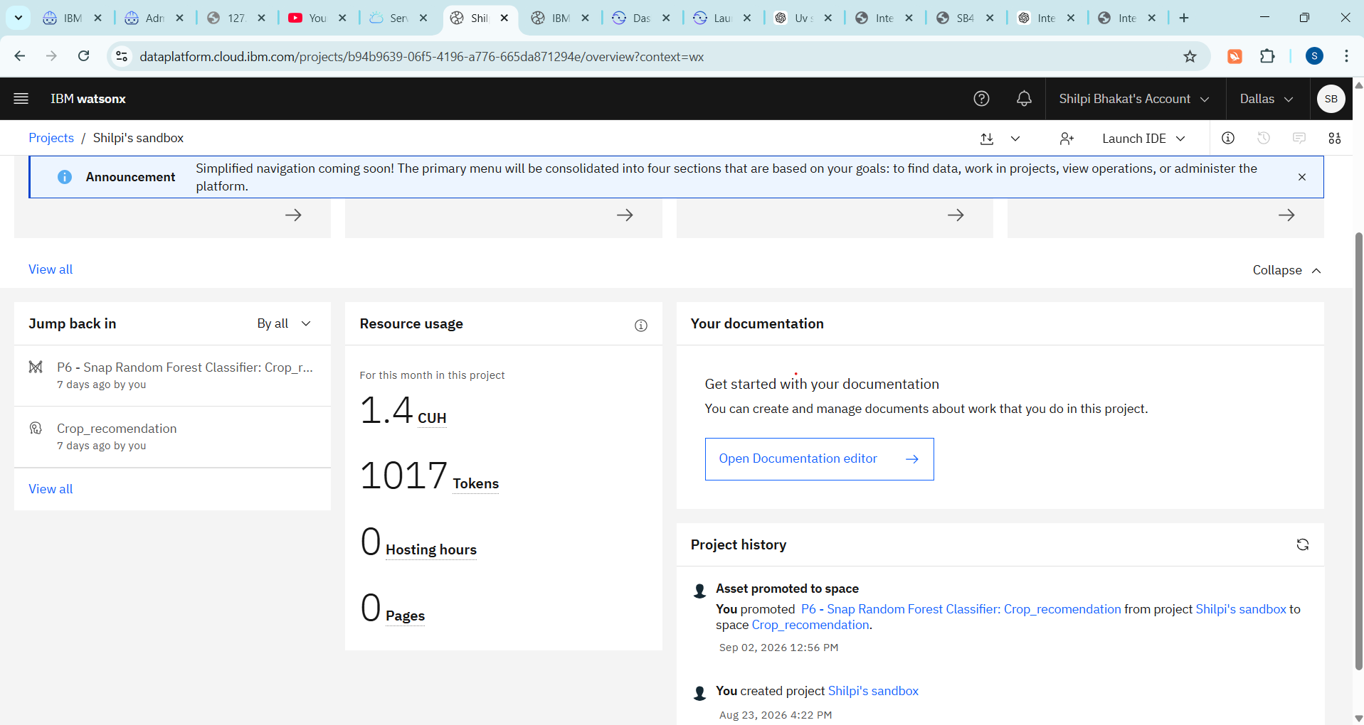
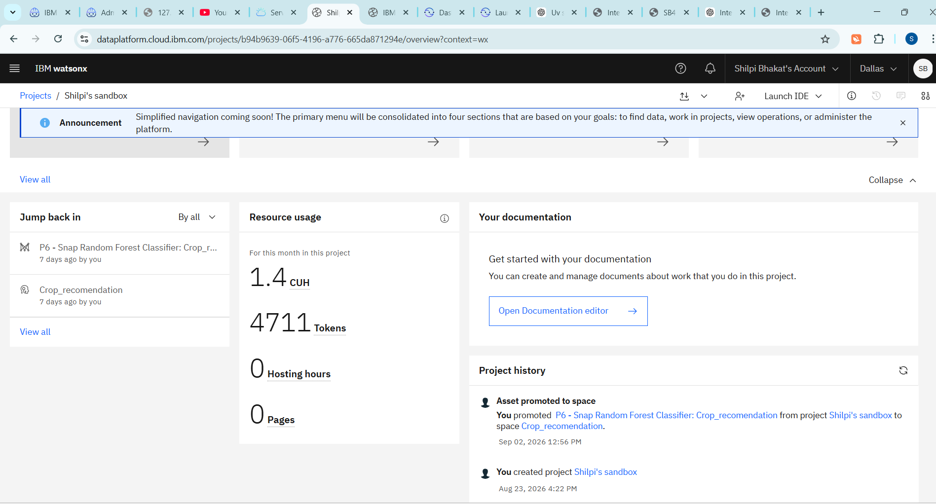
Token Usage -
3694 token are used
Before Prompt
After the Prompt
·
·
·

Slide 12
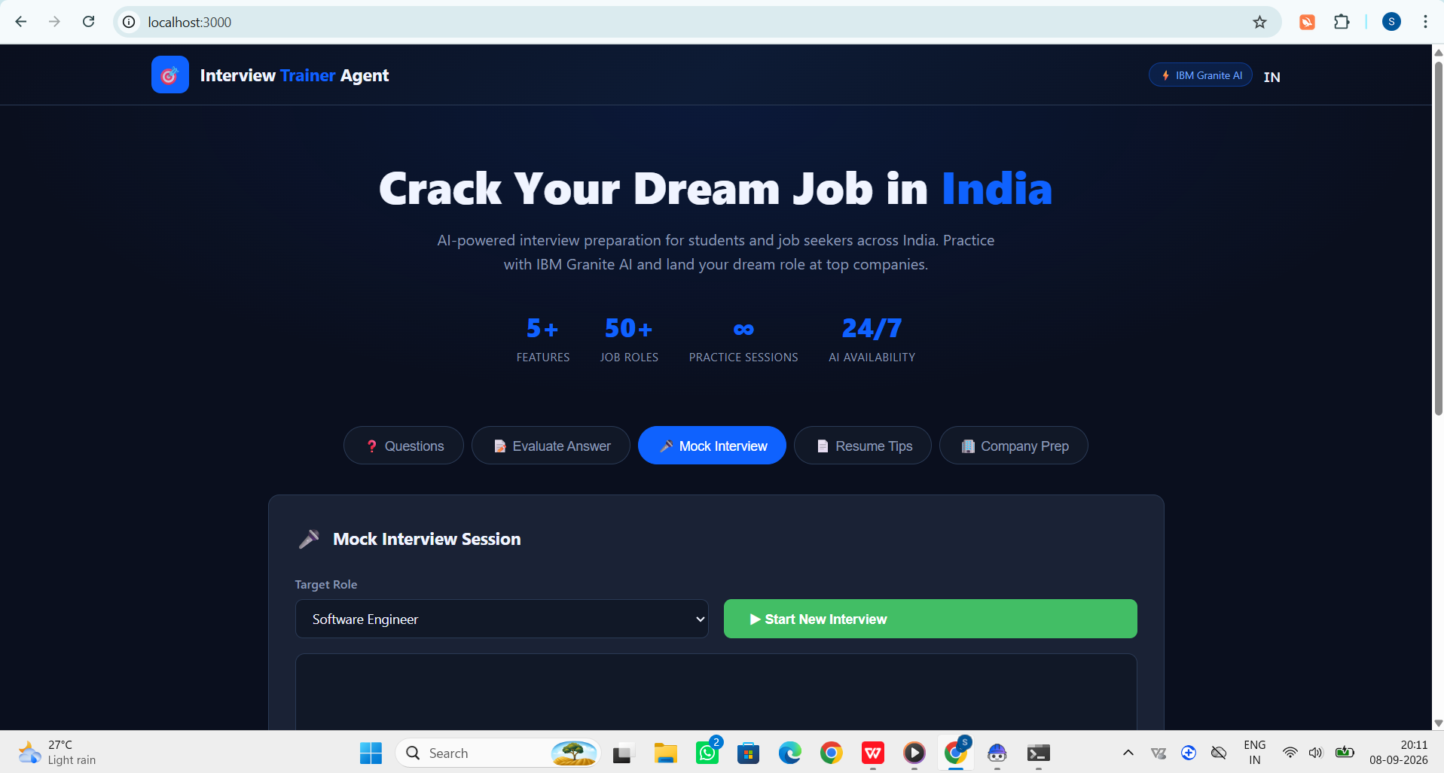
Project Output Screenshot -
·
·
·

Slide 13
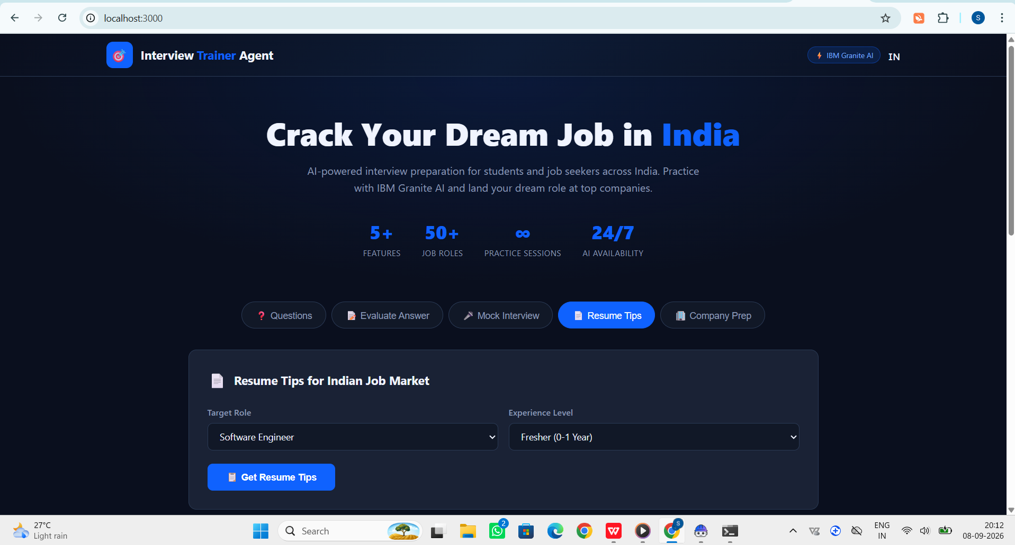
Project Output Screenshot -
·
·
·

Slide 14
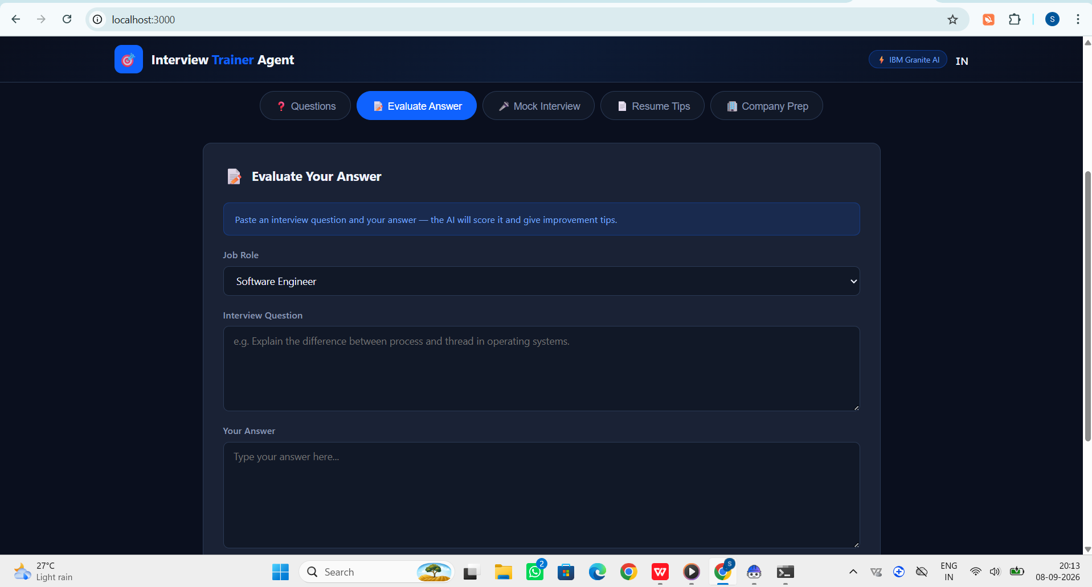
Project Output Screenshot -
·
·
·

Slide 15
Novelty and Uniqueness -
The proposed Interview Trainer Agent stands out by combining Agentic AI, RAG, and personalization into one intelligent interview preparation system.
Multi-Agent Intelligence – Specialized agents collaborate for question generation, evaluation, and feedback.
RAG-Based Accuracy – Retrieves relevant interview information before generating responses.
Personalized Preparation – Tailors questions based on resume, skills, experience, and job role.
Adaptive Feedback – Adjusts preparation based on the user’s performance.
Mock Interview Practice – Provides an interactive and realistic interview experience.
IBM-Based Solution – Uses IBM Granite and watsonx Orchestrate for intelligent and scalable AI workflows.
This makes the solution a smart, adaptive, and personalized virtual interview coach rather than a basic chatbot.

Slide 16
Git Hub Link -
https://github.com/Shilpi29-byte/Interview-Trainer-Agent.git
·
·
·

Slide 17
Future Scope -
AI Voice Interview & Multilingual Support – The system can be enhanced with voice-based interviews and multiple languages, allowing users to practice naturally and improving accessibility.
Advanced Performance Analytics – Future versions can provide detailed performance analysis, tracking response quality, interview scores, strengths, and areas for improvement.
Real-Time Mock Interviews – The agent can conduct dynamic mock interviews, adapting questions based on the user's answers and performance.
Job Portal Integration – Integration with job portals can provide role-specific interview preparation based on current job requirements and vacancies.
.
·
·
·

Slide 18
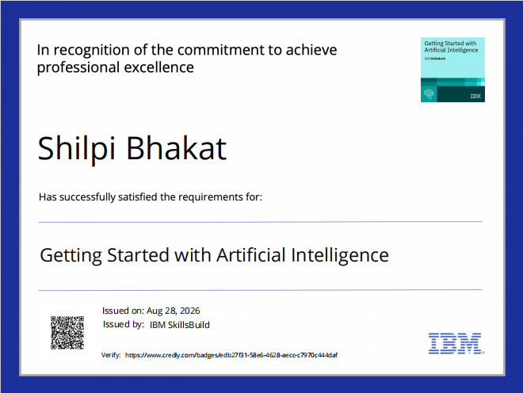
Certificates Earned -

Slide 19
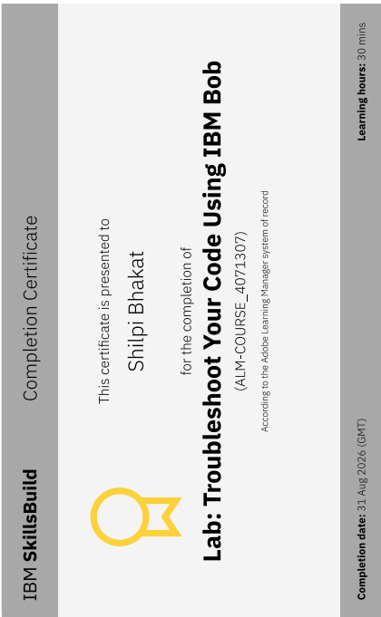
Certificates Earned -

Slide 20


