Slide 1

Project Title - Seasonal Agriculture Performance Analysis
Student Name - Shilpi Bhakat
University Name - Brainware University
AICTE STU ID - STU6a68bbd4a8fcc1785248724

Slide 2

Problem Statement
Agricultural activities are influenced by seasonal variations in environmental conditions, farming practices, resource availability and market conditions. As a result, agricultural performance may differ from one season to another.
However, raw agricultural data does not clearly explain how agricultural performance changes across seasons or what patterns can be observed in different seasonal conditions.
The problem is to analyse the given agricultural dataset and investigate seasonal differences in agricultural performance by identifying meaningful patterns, trends, relationships and variations within the available data.

Slide 3
Project Description
Seasonal Agriculture Performance Analysis is a Data Analytics project that examines agricultural performance across different seasons, regions, farming conditions, resource usage, and economic factors. The project focuses on cleaning and analysing the dataset to identify important seasonal patterns, trends, relationships, and variations. Exploratory data analysis, statistical techniques, and visualizations are used to understand differences in crop performance, resource utilization, disease risk, and profitability. The findings provide data-driven insights and recommendations that can support better seasonal agricultural planning and decision-making.

Slide 4

Who are the end users?
Farmers – To understand seasonal trends and improve farming decisions.
Agricultural Planners – To support seasonal agricultural planning.
Government & Agriculture Departments – To identify regional and seasonal patterns.
Agricultural Researchers – To study relationships between environmental conditions and crop performance.
Agribusinesses – To understand production and economic trends.

Slide 5

Technology Used
Python
Google Colab
Pandas & NumPy – Data Processing
Matplotlib & Seaborn – Data Visualization

Slide 6
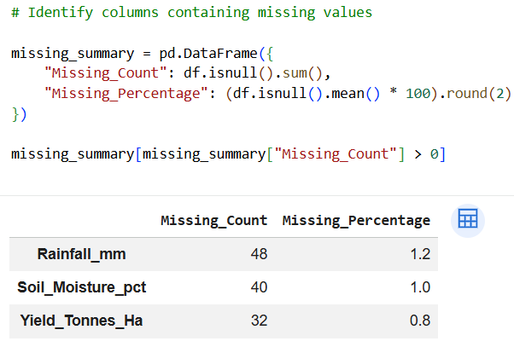
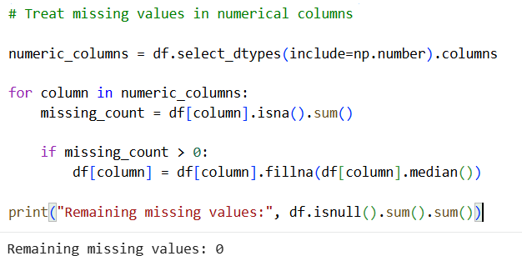
Results
Observation: Missing values were found in Rainfall, Soil Moisture, and Yield columns, with missing percentages ranging from 0.8% to 1.2%.
Observation: Missing values in numerical columns were replaced with their respective median values, resulting in 0 remaining missing values
in the dataset.

Slide 7
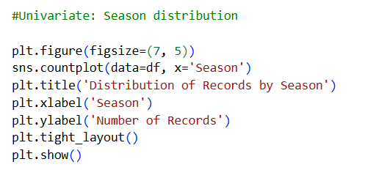
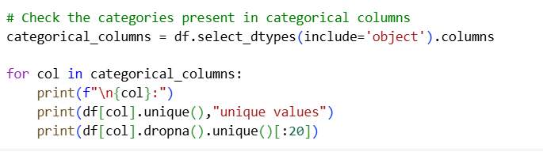
Results
Observation: Categorical columns were reviewed to identify their unique values and understand the different categories present in the dataset.
Observation: The visualization shows the distribution of agricultural records across the different seasons, helping compare their representation in the dataset.

Slide 8
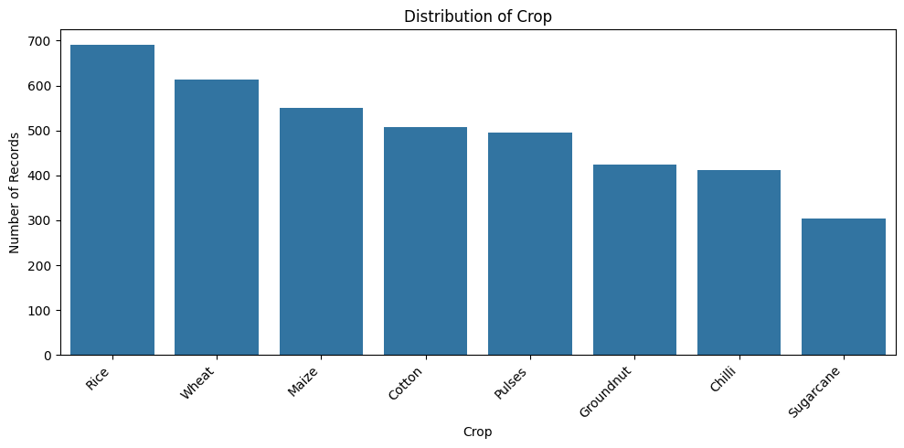
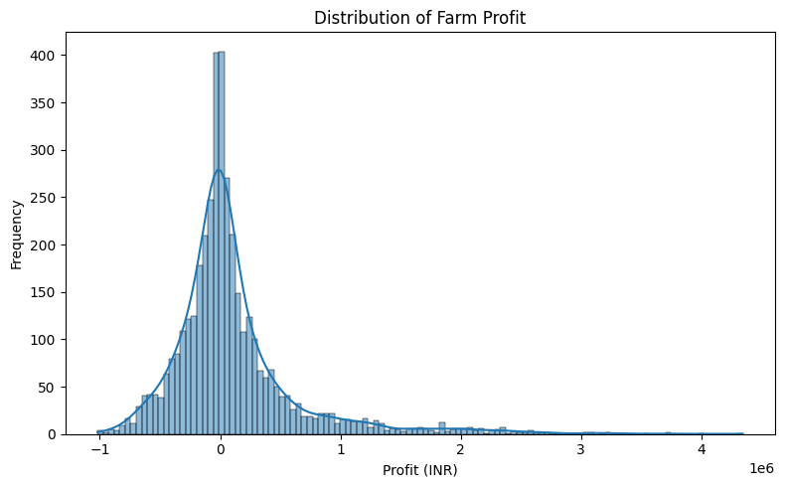
Results
Observation: The crop distribution varies across categories, with some crops having higher representation than others in the dataset.
Observation: Profit distribution is highly uneven, with most farms recording low or negative profits, while a small number achieve significantly higher profits.

Slide 9
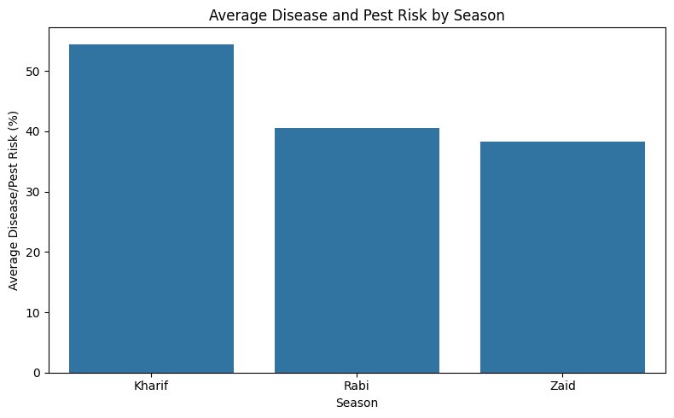
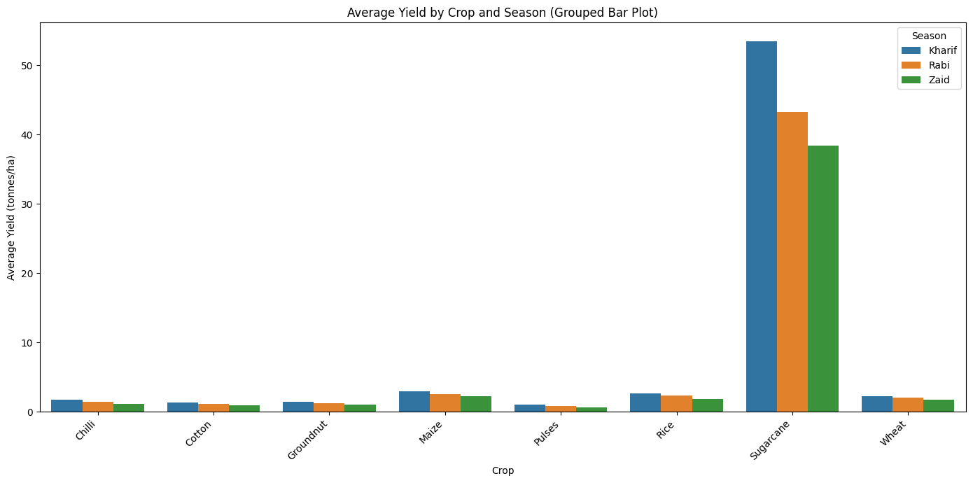
Results
Observation: Kharif has the highest disease and pest risk, followed by Rabi, while Zaid has the lowest risk.
Observation: Sugarcane has the highest yield, while Kharif generally shows higher yields and Zaid the lowest.

Slide 10
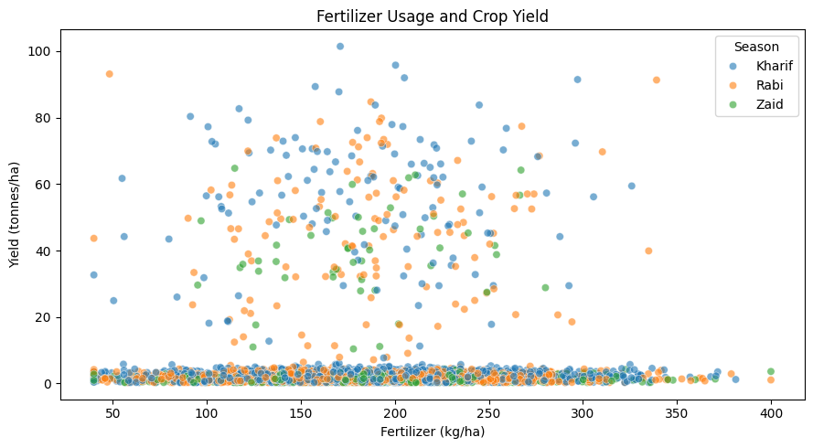
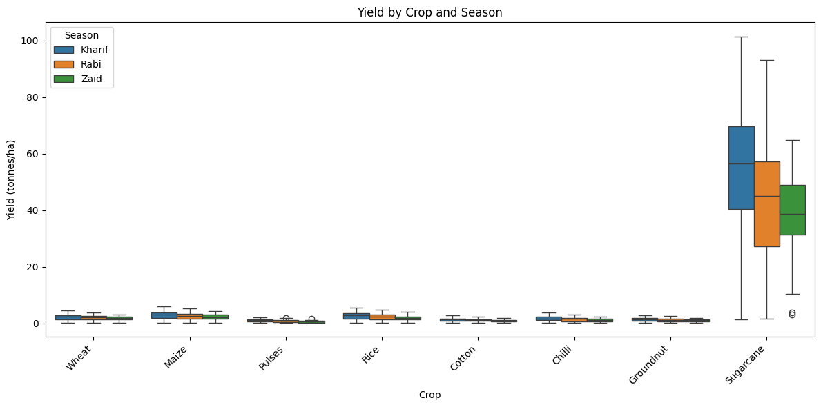
Results
Observation: No clear relationship is observed between fertilizer usage and crop yield.
Observation: Sugarcane has the highest yield, while Groundnut and Pulses have the lowest. Kharif generally outperforms Rabi and Zaid, with moderate seasonal variation in Chilli and Cotton.

Slide 11
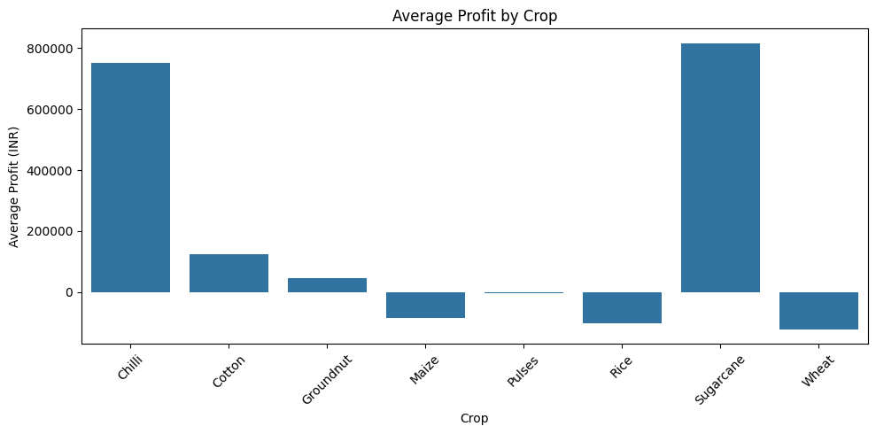
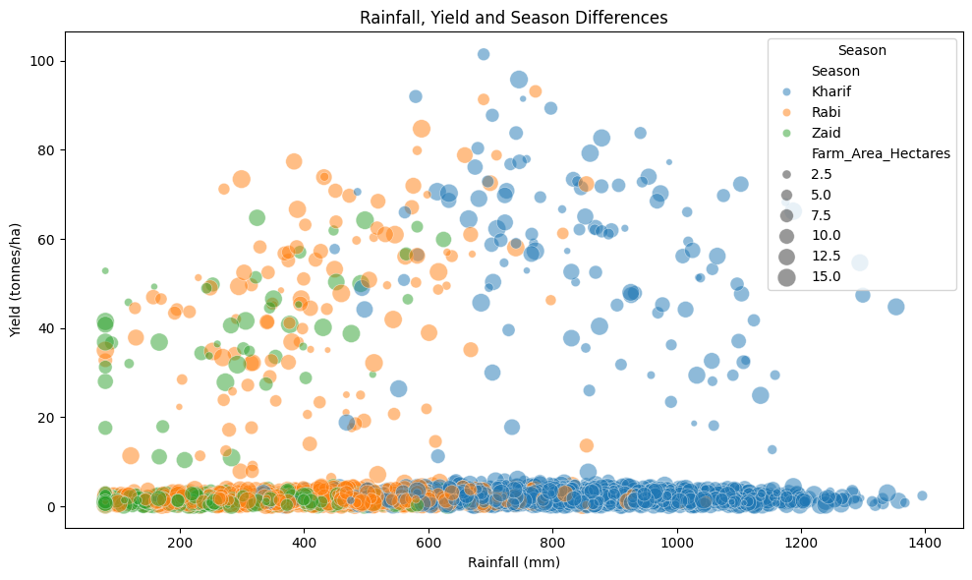
Results
Observation: Chilli, Sugarcane, and Cotton generate the highest profits, while Pulses have the lowest, with Wheat, Rice, and Maize showing moderate profits.
Observation: Kharif records the highest yields, Rabi shows moderate performance, and Zaid records the lowest yields, with no consistent impact of farm area on yield.

Slide 12
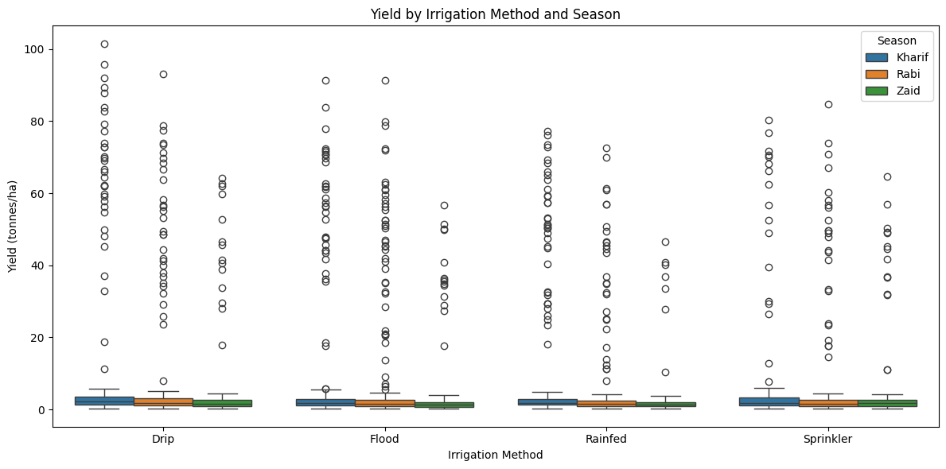
Results
Observation: Sprinkler and Drip irrigation show the highest yields, while Rainfed has the lowest. Kharif performs best across all irrigation methods.

Slide 13
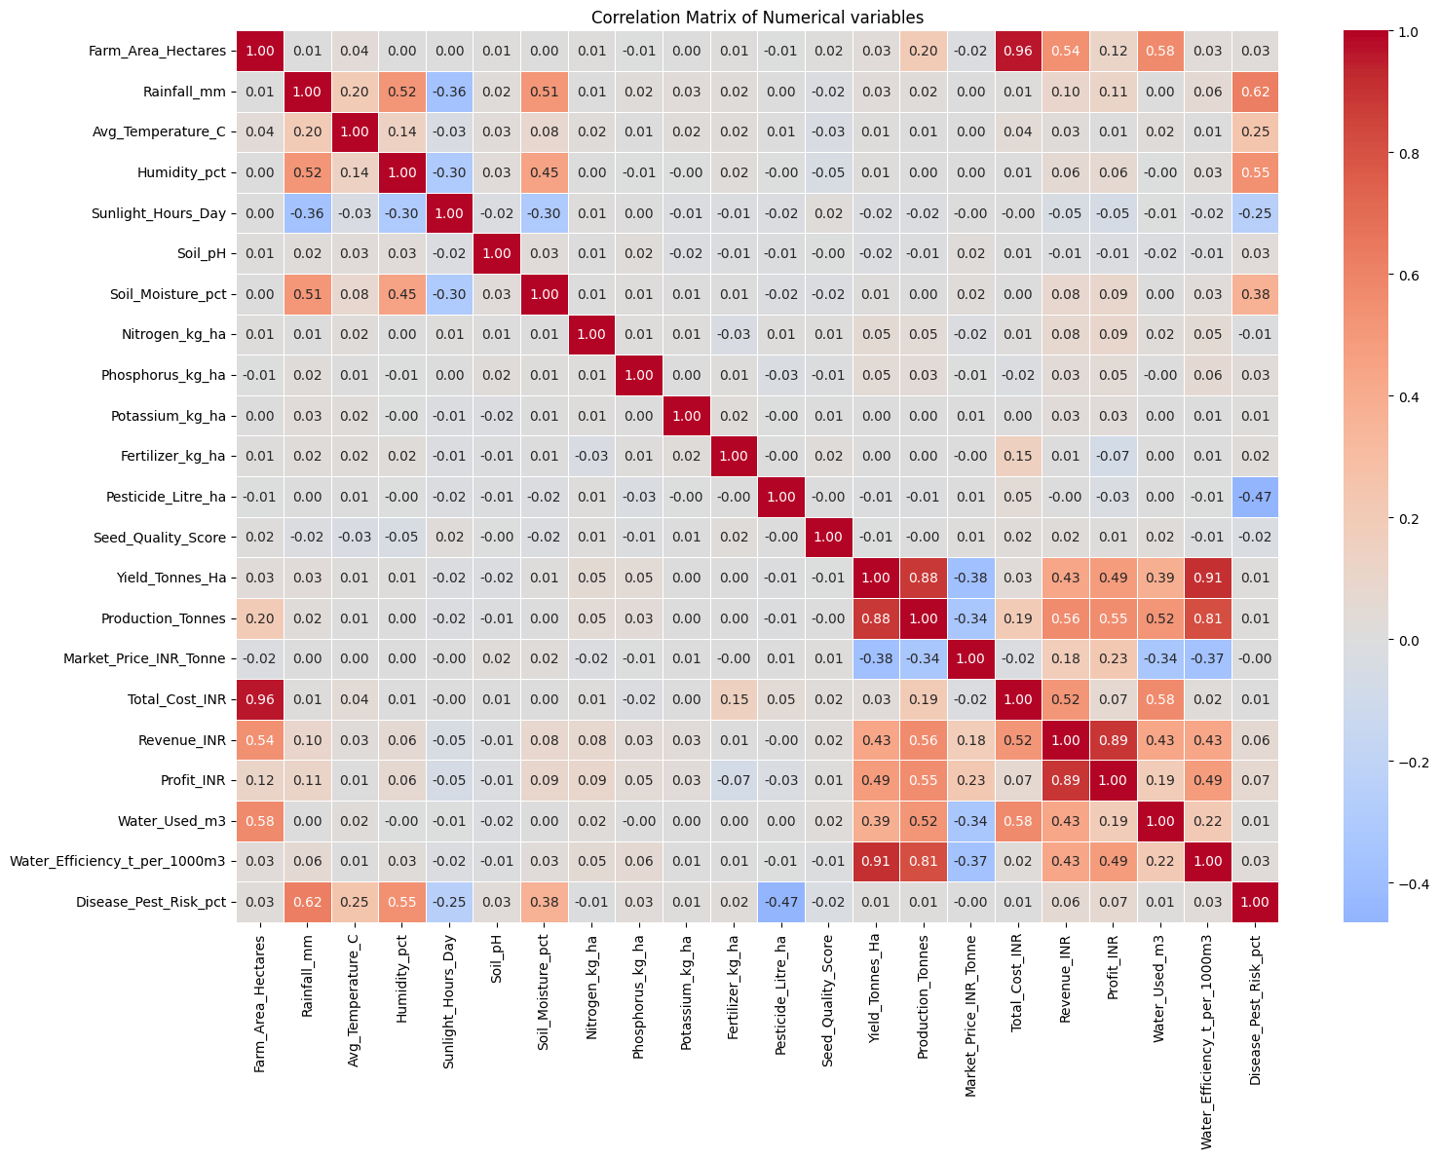
Results
Observation: Farm Area has the strongest positive correlation with Production, while environmental variables show moderate relationships. Yield and Profit have weak correlations with most variables.

Slide 14
Future Scope
Predictive Analysis: Develop models for crop yield and profitability.
Environmental Analysis: Analyse weather and environmental factors in greater detail.
Real-Time Data: Integrate real-time agricultural data for improved insights.
Interactive Dashboard: Build dashboards for better visualization and decision-making.
Machine Learning: Apply ML techniques for seasonal farming recommendations.
Crop Recommendation: Develop systems to suggest suitable crops based on seasonal conditions.
Risk Analysis: Identify and predict potential crop and disease-related risks.

Slide 15
GitHub Link-
https://github.com/Shilpi29-byte/Seasonal_Agriculture_Performance_Analysis.git

Slide 16
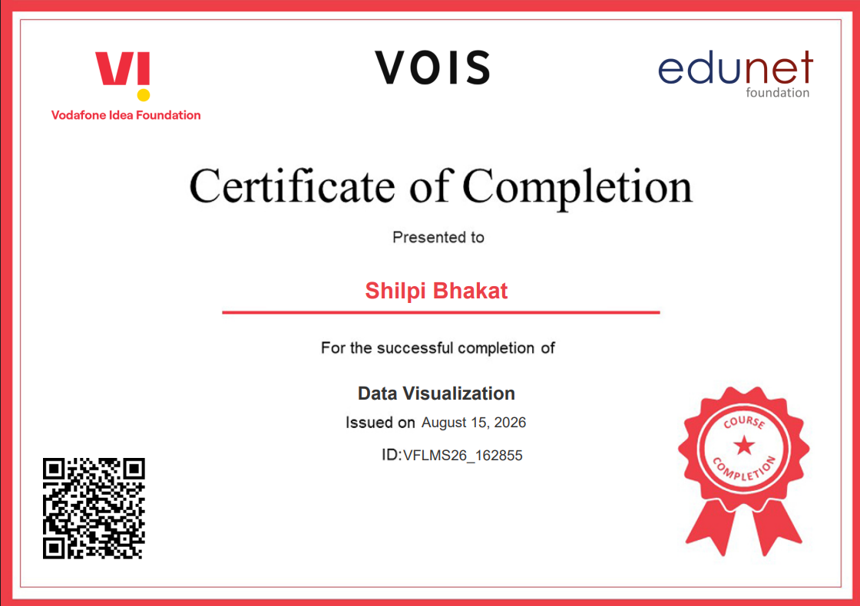
VOIS Course completion certificate - Course name- Data Visualization

Slide 17
Thank you
.
.

