Slide 1

G2M Case Study
By Shilpi Pandita

Slide 2
BACKGROUND
XYZ, a private equity firm in the US, is considering investing in the Cab industry due to its significant growth in recent years and the presence of multiple key players.
This report aims to provide actionable insights to assist XYZ in identifying the most suitable company for investment.
The analysis is divided into four parts:
1. Data understanding,
2. forecasting profitability and ride volume for each cab type,
3. Identifying the most profitable cab company,
4. Providing investment recommendations.

Slide 3

INPUT DATA BREAKDOWN
Assumptions:
Treatment of Outliers: In the Price Charged feature, outliers are observed; however, due to the unavailability of trip duration details, we have not treated them as outliers in this analysis.
2. Profit Calculation: The calculation of ride profits is based on the assumption that all other factors remain constant, and only the Price Charged and Cost of Trip features are considered to determine the profitability of each ride.
3. Users Feature: In the city dataset, the Users feature represents the number of cab users in the city. It is important to note that these users can include customers of other cab companies, including Yellow Cab and Pink Cab.

Slide 4
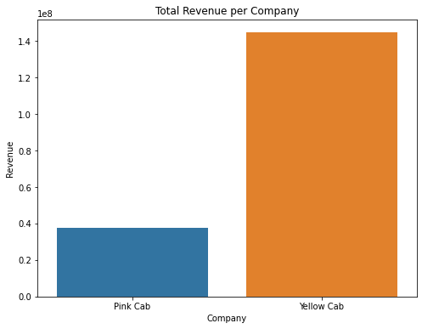
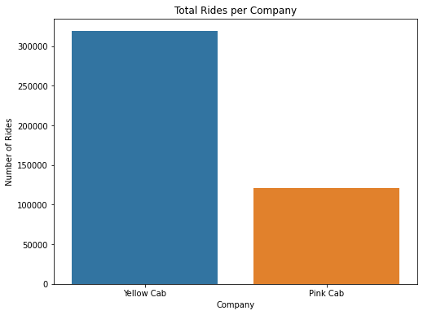
Profit Analysis
1. The comparison of the two bar graphs demonstrates that Yellow Cab outperforms Pink Cab both in terms of total revenue and total rides.
2. This indicates that Yellow Cab has achieved greater financial success and serves a larger customer base in the transportation industry.

Slide 5
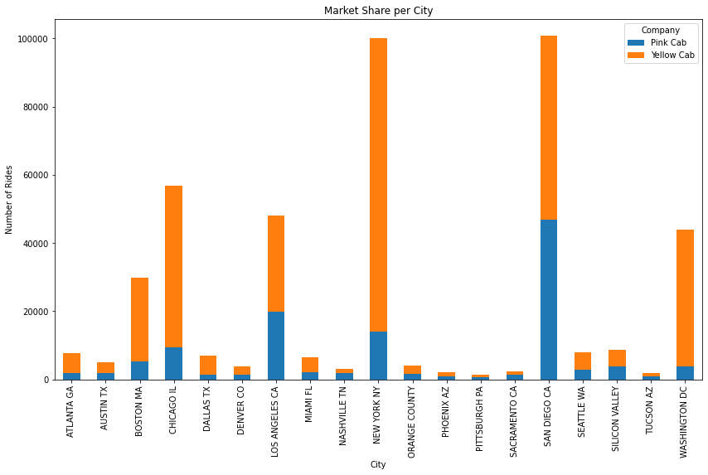
City Wise Cab users retained by the companies
1. The bar graph is showcasing the number of rides achieved by Pink Cab and Yellow Cab in various cities in the United States highlights the substantial difference in ride volumes between the two companies.
2. The data suggests that Yellow Cab has established a more extensive customer base and market presence, while Pink Cab may need to refine its strategies to gain a stronger foothold in the highly competitive cab market.

Slide 6
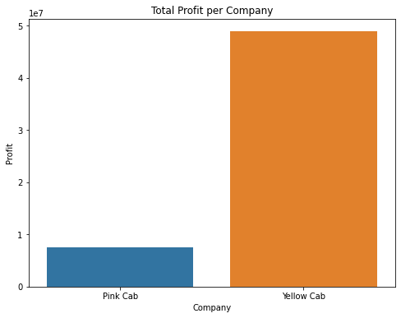
Total Profit per Company
1. The bar graph is depicting the total profit statistics for Pink Cab and Yellow Cab highlights the disparity in financial performance between the two companies.
2. The data suggests that Yellow Cab has consistently achieved higher profitability, while Pink Cab may need to address operational aspects to enhance its profitability.

Slide 7
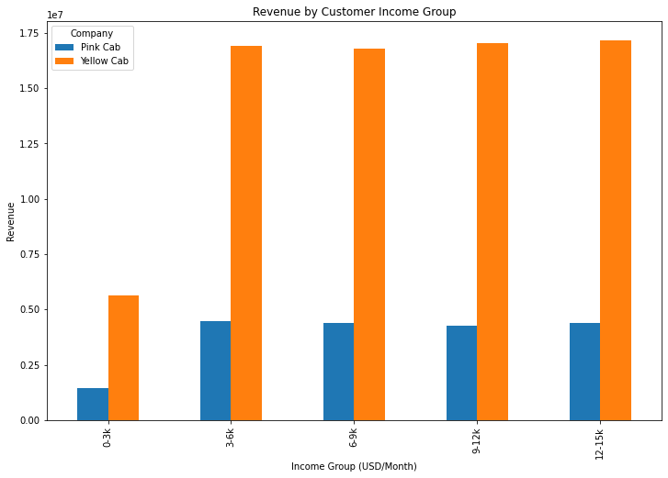
Revenue by Customer Income Group
1. The bar graph is comparing the revenue generated by Pink Cab and Yellow Cab across different income groups indicates a notable disparity in revenue, with Yellow Cab outperforming Pink Cab.
2. The data suggests that Yellow Cab has established a stronger revenue base among diverse income segments, potentially due to various factors such as pricing strategies or service appeal.
3. Pink Cab may need to reassess its market positioning and revenue generation strategies to enhance its performance across different income groups.

Slide 8
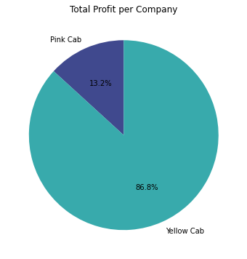
Total Profit per Company
1. The pie chart is portraying the total profit distribution between Pink Cab and Yellow Cab demonstrates a significant disparity, with Yellow Cab capturing a substantial majority of the total profit.
2. This indicates Yellow Cab's strong financial performance and potential competitive advantages.

Slide 9
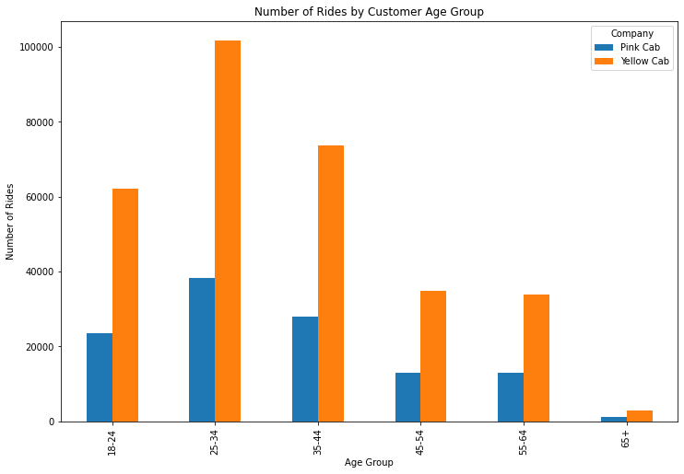
Number of Rides by Customer Age Group
1. The bar graph is comparing the number of rides by customer age group for Pink Cab and Yellow Cab reveals distinct patterns in ride volumes across different age segments.
2. The data suggests that each company may have a varying level of success in attracting specific age groups, potentially due to differing marketing approaches, service offerings, or customer targeting strategies.

Slide 10
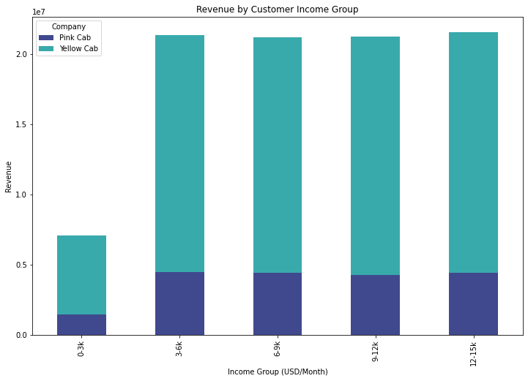
Revenue by Customer Income Group
1. The bar graph comparing revenue distribution by customer income group for Pink Cab and Yellow Cab highlights distinct patterns in revenue generation across different income segments.
2. The data suggests that each company may have varying success in appealing to specific income groups, potentially due to different pricing strategies, service offerings, or customer targeting approaches.

Slide 11
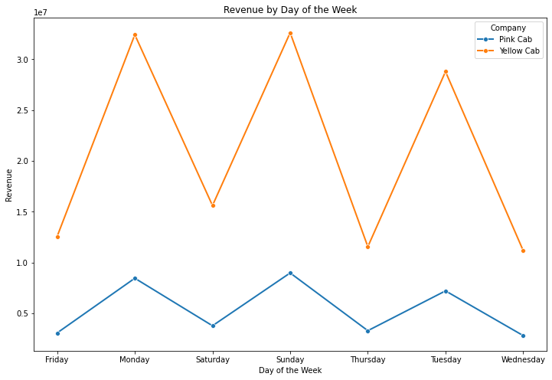
Revenue by Day of the Week
1. The bar graph comparing revenue distribution by the day of the week for Pink Cab and Yellow Cab highlights distinct patterns in revenue generation throughout the weekdays.
2. The data suggests that each company may have varying success in revenue generation on specific days, potentially due to factors such as demand variations, operational strategies, or marketing initiatives.
3. While there is a spike in revenue on days such as Monday, Sunday and Tuesday where Yellow Cab is leading in revenue generated.

Slide 12
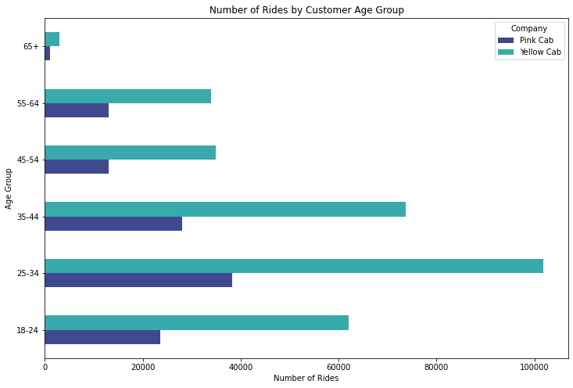
Number of Rides by Customer Age Group
1. The bar graph comparing the number of rides by customer age group for Pink Cab and Yellow Cab highlights Yellow Cab's dominance in terms of ride volumes across all age groups.
2. This suggests that Yellow Cab has successfully captured a larger customer base and met the transportation needs of customers from diverse age segments. Pink Cab may need to reassess its market positioning and strategies to enhance its competitiveness.

Slide 13
Recommendations
Higher Revenue: Yellow Cab consistently generates higher revenue compared to Pink Cab, indicating a stronger financial performance and potential for higher returns on investment.
Greater Ride Volume: Yellow Cab attracts more customers and experiences higher ride volumes than Pink Cab, reflecting a larger market share and increased revenue-generating opportunities.
Market Dominance: Yellow Cab surpasses Pink Cab in terms of market presence and customer demand, positioning it as a dominant player in the industry. This market dominance suggests a higher likelihood of sustained growth and profitability.
Competitive Advantage: Yellow Cab's superior performance in revenue and ride volume demonstrates a competitive advantage over Pink Cab, indicating its ability to attract and retain customers in a highly competitive market.
Strong Brand Recognition: Yellow Cab enjoys a well-established brand reputation and customer loyalty, contributing to its continued success and potential for long-term profitability.
Potential for Expansion: The data suggests that Yellow Cab has a higher growth potential compared to Pink Cab, making it an attractive investment option for capitalizing on the expanding Cab industry.
Keeping these points in mind, the Yellow Cab company is most suitable for investment.

Slide 14
Thank You.

