Slide 1


Classification of Electrocardiosignal Based on Deep Learning
9th Lab
Professor : P.X Li
Mentor : J.X You
Member : S.L Li/Y.L Liao/Z.Y Lu/H.Q Huang/B.L Pan/Z.X Wu
∈ Y.C Project

Slide 2

01
Topic Analysis
CONTENTS
02
Ideas
03
Key Technology
04
Experiment & Result

Slide 3

Topic Analysis
01

Slide 4
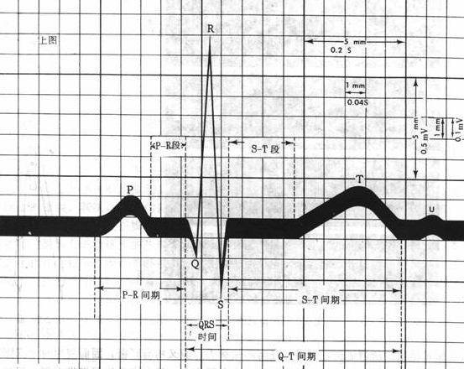

Topic
Analysis
Ideas
Key Technology
Experiment & Result
Nomenclature of the waveforms and wavebands of the electrocardiogram

Slide 5
选题分析
方法与思路
关键技术
实验与结果
Topic
Analysis
Ideas
Key Technology
Experiment & Result
Steps of ECG analysis
1. Analysis of heart rate and heart rate
2. Analyze RR interval, PR interval and QRS complex time limit to observe the presence or absence of conduction block.
3. Analysis of presence or absence of indoor block and WPW syndrome
4. Analysis of ST segment elevation or depression
5. Analysis of pathological Q waves
6. Analysis of P waves
7. Analysis of left and right ventricular hypertrophy
8. Analysis of T waves
9. Analyze the ECG axis
10. Analyze other issues
11. Analysis of arrhythmia
ECG:Electrocardiogrand

Slide 6
选题分析
方法与思路
关键技术
实验与结果
Topic
Analysis
Ideas
Key Technology
Experiment & Result
Steps of ECG analysis
1. Analysis of heart rate and heart rate
2. Analyze RR interval, PR interval and QRS complex time limit to observe the presence or absence of conduction block.
3. Analysis of presence or absence of indoor block and WPW syndrome
4. Analysis of ST segment elevation or depression
5. Analysis of pathological Q waves
6. Analysis of P waves
7. Analysis of left and right ventricular hypertrophy
8. Analysis of T waves
9. Analyze the ECG axis
10. Analyze other issues
11. Analysis of arrhythmia
Deep Learning!

Slide 7
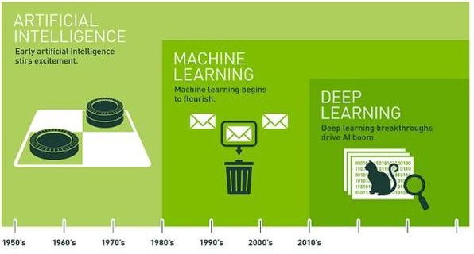
选题分析
方法与思路
关键技术
实验与结果
Topic
Analysis
Ideas
Key Technology
Experiment & Result
What’s Deep Learning?

Slide 8
选题分析
方法与思路
关键技术
实验与结果
Topic
Analysis
Ideas
Key Technology
Experiment & Result
Steps of ECG analysis（Deep Learning）
1.Train ANNs(Artificial Neural Networks) by using large amounts of data
2.Input data for prediction

Slide 9

Ideas
02

Slide 10
Topic Analysis Ideas Key Technology Experiment & Result
Deep
Learning
Data
ANNs
Application

Slide 11
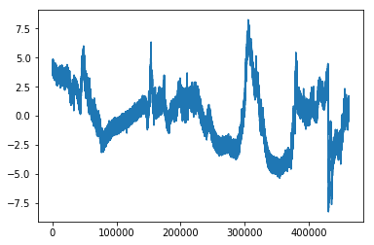
Topic Analysis Ideas Key Technology Experiment & Result
选题分析 方法与思路 关键技术 实验与结果
Problems
1. There is a lot of noise in the original ECG signal；
2.Both normal and abnormal heart beats are in the sample.

Slide 12
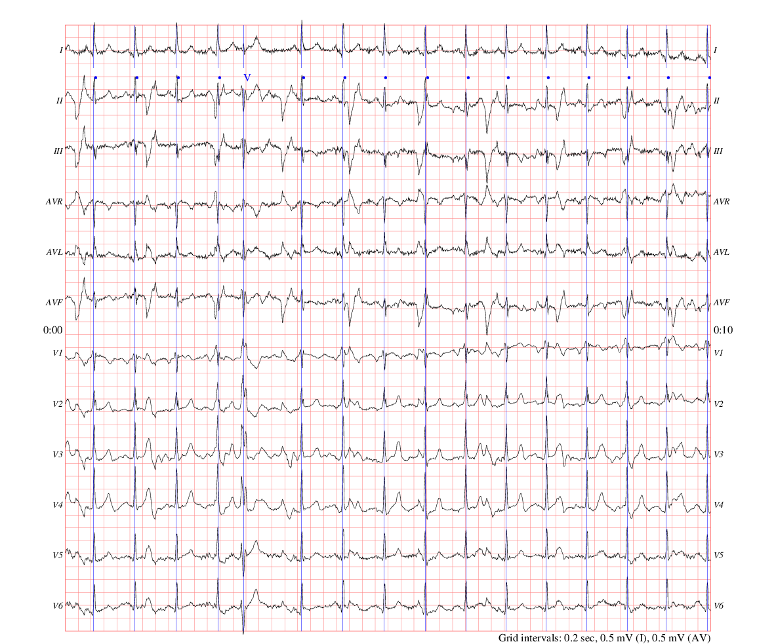
Topic Analysis Ideas Key Technology Experiment & Result
选题分析 方法与思路 关键技术 实验与结果
Structure of the data

Slide 13
Key Technology
03

Slide 14
Topic Analysis Ideas Key Technology Experiment & Result
选题分析 方法与思路 关键技术 实验与结果
8
Data Processing:
Wavelet transform, Median filter, Heart beat segmetation
Deep Learning:
CNN, RNN, LSTM, Batch Normalization

Slide 15
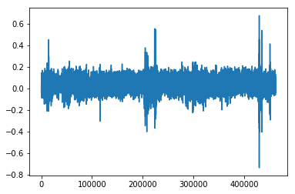
Topic Analysis Ideas Key Technology Experiment & Result
选题分析 方法与思路 关键技术 实验与结果
8
Median Filtering
Before filtering
After filtering

Slide 16
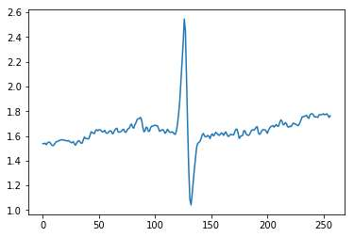
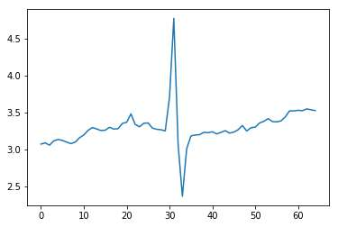
Topic Analysis Ideas Key Technology Experiment & Result
选题分析 方法与思路 关键技术 实验与结果
8
Wavelet transform
Before transforming
After transforming

Slide 17
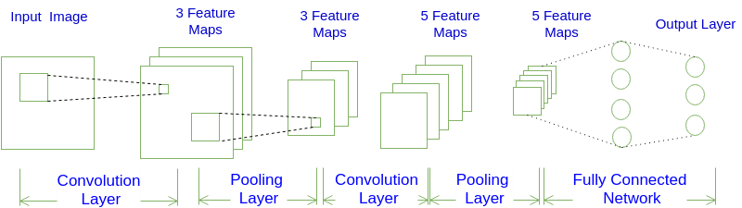
Topic Analysis Ideas Key Technology Experiment & Result
选题分析 方法与思路 关键技术 实验与结果
8
CNN-Convolutional Neural Network

Slide 18
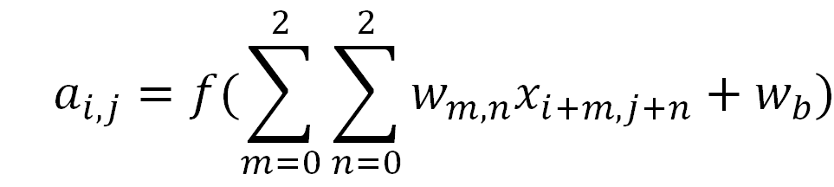
Topic Analysis Ideas Key Technology Experiment & Result
选题分析 方法与思路 关键技术 实验与结果
8
CNN-Convolutional Neural Network
Convolutinal layer

Slide 19
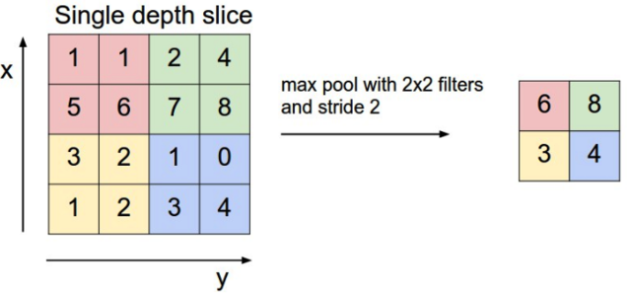
Topic Analysis Ideas Key Technology Experiment & Result
选题分析 方法与思路 关键技术 实验与结果
8
CNN-Convolutional Neural Network
Pooling layer(max pooling)

Slide 20
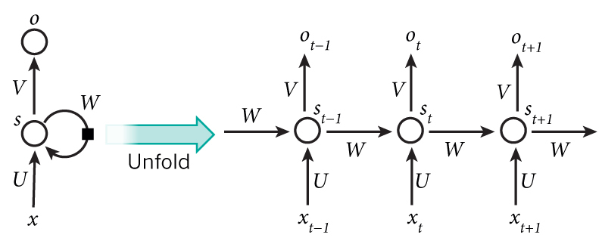
Topic Analysis Ideas Key Technology Experiment & Result
选题分析 方法与思路 关键技术 实验与结果
8
RNN-Recurrent Neural Network

Slide 21
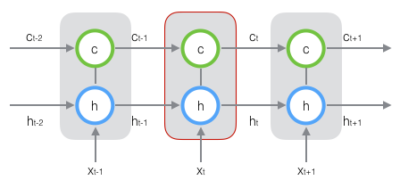
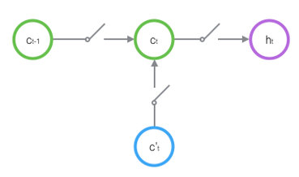
Topic Analysis Ideas Key Technology Experiment & Result
选题分析 方法与思路 关键技术 实验与结果
8
LSTM- Long Short Term Memory Network

Slide 22
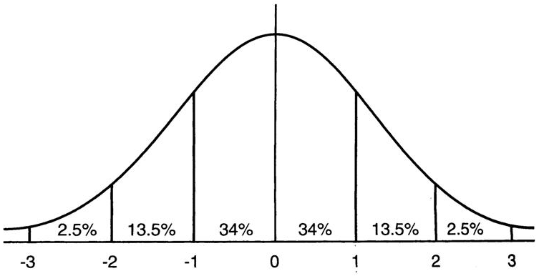
Topic Analysis Ideas Key Technology Experiment & Result
选题分析 方法与思路 关键技术 实验与结果
8
Batch Normalization
Data normalization, so that the mean of the data is close to 0, the variance is close to 1
A standard normal distribution with a mean of 0 variance of 1.

Slide 23
Experiment & Result
04

Slide 24
Topic Analysis Ideas Key Technology Experiment & Result
选题分析 方法与思路 关键技术 实验与结果
Experiment environment:
Programmed by: Python
Toolbox: wfdb, pywt, numpy, scipy
Deep learning framework: Keras with Tensorflow as backend
Computer configuration:
Intel®Core™i7-6700HQ CPU@2.6GHz 2.59GHz
RAM: 8GB
64bits
GPU:NVIDIA® GEFORCE® GTX

Slide 25
Topic Analysis Ideas Key Technology Experiment & Result
选题分析 方法与思路 关键技术 实验与结果
N:Normal
V:Ventricular premature beat
A:Atrial premature beat
R:Right bundle branch block
Diseases | Numbers
N | 150361
V | 20009
A | 1943
R | 3173
4 classes

Slide 26
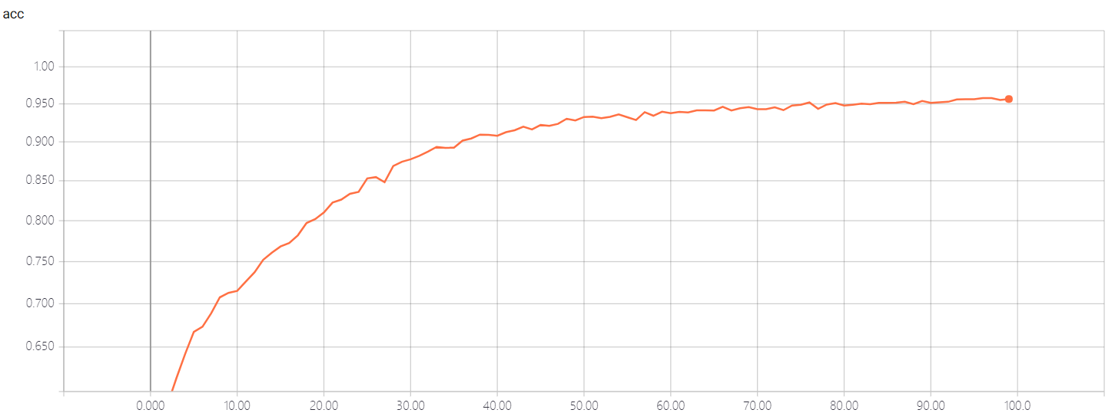
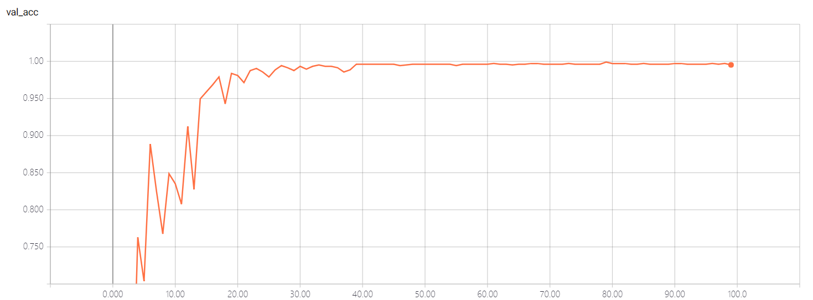
Topic Analysis Ideas Key Technology Experiment & Result
选题分析 方法与思路 关键技术 实验与结果
Result:
Training accuracy | Train loss | Validation accuracy | Validation loss
0.9952 | 0.0134 | 0.9949 | 0.0144
Accuracy curves:
Train accuracy curve
Validation accuracy curve

Slide 27
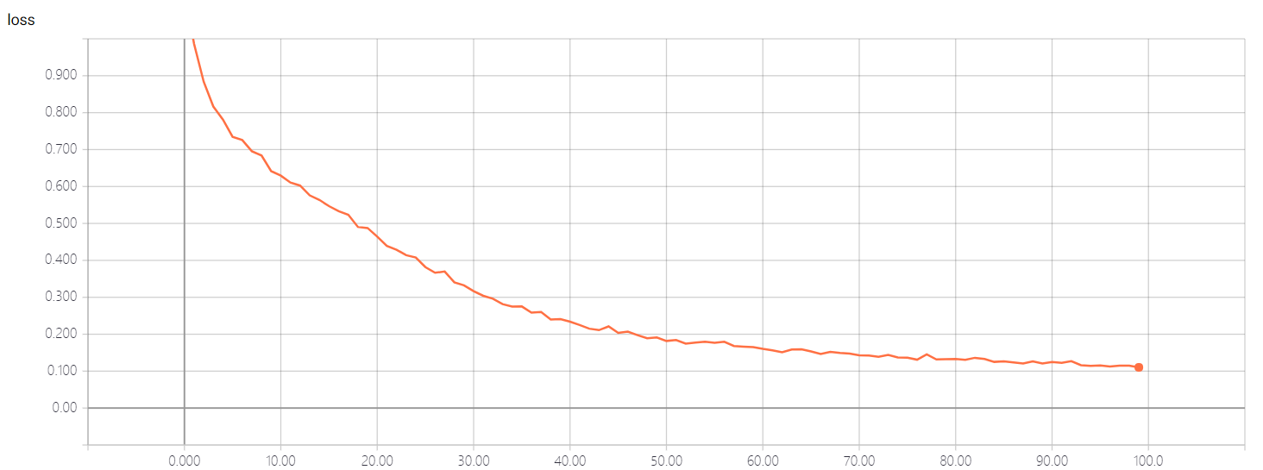
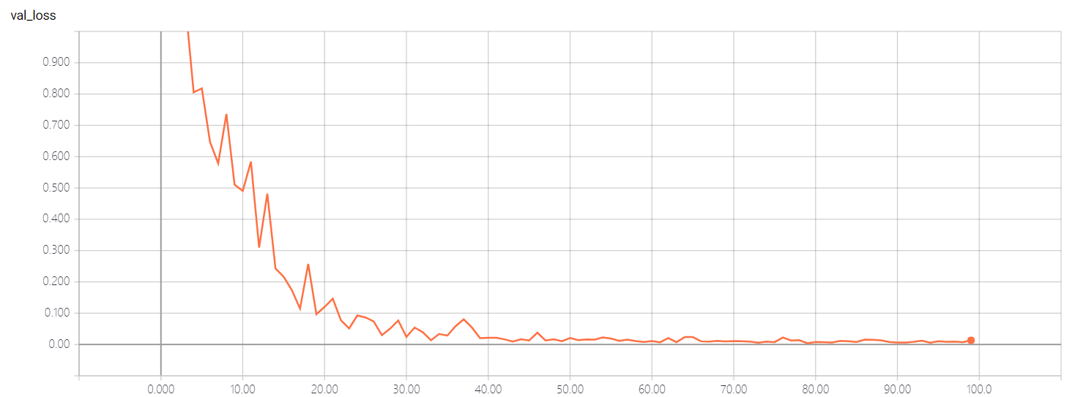
Topic Analysis Ideas Key Technology Experiment & Result
选题分析 方法与思路 关键技术 实验与结果
Result:
Loss curves:
Train loss curve
Validation loss curve

Slide 28

鸣谢：
英才计划 组委会
中山大学 数学学院
黎培兴 教授
游君霞 老师 庄轩权 老师
旧数学楼 炒菜大叔
廖雪峰
光子工作室

