Slide 1
GIT
(http://git-scm.com/book)
이 동호
오픈솔루션팀
2017. 05. 25

Slide 2
GIT?
Project
- A Set of Files
●
●
●
Version
commit
Changes
Version
commit
Changes
Changes
Version
commit

Slide 3
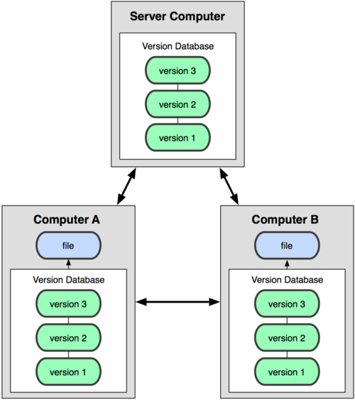
Collaboration
Project
- Developers
Remote
Repository
Local
Repository
Local
Repository

Slide 4

The Three States
Repository
Branch (master)
commit
commit
commit
•••
Branch
commit
commit
•••
•••

Slide 5
First-Time Git Setup
Your Identity
$ git config --global user.name "John Doe"
$ git config --global user.email johndoe@example.com
Checking Your Settings
$ git config -–global --list
user.name=Scott Chacon
user.emailc=schacon@gmail.com
…
$ git config -–global user.name
Scott Chacon
Git for Windows
$ git config --global core.editor
"'/c/Program Files (x86)/Notepad++/notepad++.exe' -multiInst
-notabbar -nosession -noPlugin“
$ git config --global core.autocrlf true
$ git config –-global fetch.prune true

Slide 6
Getting a Git Repository
Initializing a Repository in an Existing Directory
$ git init
This creates a new subdirectory named .git that contains all of your necessary repository files
Cloning an Existing Repository
git clone [url].
$ git clone git://github.com/schacon/grit.git
That creates a directory named grit, initializes a .git directory inside it, pulls down all the data for that repository
$ git clone git://github.com/schacon/grit.git mygrit
That command does the same thing as the previous one, but the target directory is called mygrit.

Slide 7
Recording Changes to the Repository
Checking the Status of Your Files
$ git status
# On branch master
nothing to commit (working directory clean)
$ vim README
$ git status
# On branch master
# Untracked files:
# (use "git add <file>..." to include in what will be committed)
#
# README
nothing added to commit but untracked files present (use "git add" to track)
Tracking New Files
$ git add README
$ git status
# On branch master
# Changes to be committed:
# (use "git reset HEAD <file>..." to unstage)
#
# new file: README
#

Slide 8
Staging Modified Files
$ git status
# On branch master
# Changes to be committed:
# (use "git reset HEAD <file>..." to unstage)
#
# new file: README
#
# Changes not staged for commit:
# (use "git add <file>..." to update what will be committed)
#
# modified: benchmarks.rb
#
$ git status -s
A README
M benchmarks.rb
$ git add benchmarks.rb
$ git status
# On branch master
# Changes to be committed:
# (use "git reset HEAD <file>..." to unstage)
#
# new file: README
# modified: benchmarks.rb
#
$ git status -s
A README
M benchmarks.rb

Slide 9
$ vim benchmarks.rb
$ git status
# On branch master
# Changes to be committed:
# (use "git reset HEAD <file>..." to unstage)
#
# new file: README
# modified: benchmarks.rb
#
# Changes not staged for commit:
# (use "git add <file>..." to update what will be committed)
#
# modified: benchmarks.rb
#
$ git add benchmarks.rb
$ git status
# On branch master
# Changes to be committed:
# (use "git reset HEAD <file>..." to unstage)
#
# new file: README
# modified: benchmarks.rb
#

Slide 10
Ignoring Files
.gitignore
$ cat .gitignore
*.[oa]
*~
. Blank lines or lines starting with # are ignored.
. Standard glob patterns work.
. You can end patterns with a forward slash (/) to specify a directory.
. You can negate a pattern by starting it with an exclamation point (!).
# a comment - this is ignored
# no .a files
*.a
# but do track lib.a, even though you're ignoring .a files above
!lib.a
# only ignore the root TODO file, not subdir/TODO
/TODO
# ignore all files in the build/ directory
build/
# ignore doc/notes.txt, but not doc/server/arch.txt
doc/*.txt
# ignore all .txt files in the doc/ directory
doc/**/*.txt

Slide 11
Viewing Your Staged and Unstaged Changes
git diff
$ git status
# On branch master
# Changes to be committed:
# (use "git reset HEAD <file>..." to unstage)
#
# new file: README
#
# Changes not staged for commit:
# (use "git add <file>..." to update what will be committed)
#
# modified: benchmarks.rb
#
$ git diff
diff --git a/benchmarks.rb b/benchmarks.rb
index 3cb747f..da65585 100644
--- a/benchmarks.rb
+++ b/benchmarks.rb
@@ -36,6 +36,10 @@ def main
@commit.parents[0].parents[0].parents[0]
end
+ run_code(x, 'commits 1') do
+ git.commits.size
+ end
+
run_code(x, 'commits 2') do
log = git.commits('master', 15)
log.size

Slide 12
$ git diff --staged
diff --git a/README b/README
new file mode 100644
index 0000000..03902a1
--- /dev/null
+++ b/README2
@@ -0,0 +1,5 @@
+grit
+ by Tom Preston-Werner, Chris Wanstrath
+ http://github.com/mojombo/grit
+
+Grit is a Ruby library for extracting information from a Git repository
Committing Your Changes
$ git commit
# Please enter the commit message for your changes. Lines starting
# with '#' will be ignored, and an empty message aborts the commit.
# On branch master
# Changes to be committed:
# (use "git reset HEAD <file>..." to unstage)
#
# new file: README
# modified: benchmarks.rb
~
~
~
".git/COMMIT_EDITMSG" 10L, 283C
or
$ git commit -m "Story 182: Fix benchmarks for speed"
[master]: created 463dc4f: "Fix benchmarks for speed"
2 files changed, 3 insertions(+), 0 deletions(-)
create mode 100644 README

Slide 13
Skipping the Staging Area
$ git status
# On branch master
#
# Changes not staged for commit:
#
# modified: benchmarks.rb
#
$ git commit -a -m 'added new benchmarks'
[master 83e38c7] added new benchmarks
1 files changed, 5 insertions(+), 0 deletions(-)
Removing Files
$ git rm circumspect
rm 'grit.gemspec'
$ git status
# On branch master
#
# Changes to be committed:
# (use "git reset HEAD <file>..." to unstage)
#
# deleted: grit.gemspec
#
The next time you commit, the file will be gone and no longer tracked.

Slide 14
Moving Files
$ git mv README.txt README
$ git status
# On branch master
# Your branch is ahead of 'origin/master' by 1 commit.
#
# Changes to be committed:
# (use "git reset HEAD <file>..." to unstage)
#
# renamed: README.txt -> README
#

Slide 15
Viewing the Commit History
$ git log
commit ca82a6dff817ec66f44342007202690a93763949
Author: Scott Chacon <schacon@gee-mail.com>
Date: Mon Mar 17 21:52:11 2008 -0700
changed the version number
commit 085bb3bcb608e1e8451d4b2432f8ecbe6306e7e7
Author: Scott Chacon <schacon@gee-mail.com>
Date: Sat Mar 15 16:40:33 2008 -0700
removed unnecessary test code
commit a11bef06a3f659402fe7563abf99ad00de2209e6
Author: Scott Chacon <schacon@gee-mail.com>
Date: Sat Mar 15 10:31:28 2008 -0700
first commit

Slide 16
Rollback to an old commit
$ git checkout <commit>
Unmodifying a Modified File
$ git status
# On branch master
# Changes to be committed:
# (use "git reset HEAD <file>..." to unstage)
#
# modified: README.txt
#
# Changes not staged for commit:
# (use "git add <file>..." to update what will be committed)
# (use "git checkout -- <file>..." to discard changes in working directory)
#
# modified: benchmarks.rb
#
$ git checkout -- benchmarks.rb
$ git status
# On branch master
# Changes to be committed:
# (use "git reset HEAD <file>..." to unstage)
#
# modified: README.txt
#

Slide 17
Tagging
Listing Your Tags
$ git tag
v0.1
v1.3
Annotated Tags
$ git tag -a v1.4 -m 'my version 1.4'
$ git tag
v0.1
v1.3
v1.4
$ git show v1.4
tag v1.4
Tagger: Scott Chacon <schacon@gee-mail.com>
Date: Mon Feb 9 14:45:11 2009 -0800
my version 1.4
commit 15027957951b64cf874c3557a0f3547bd83b3ff6
Merge: 4a447f7... a6b4c97...
Author: Scott Chacon <schacon@gee-mail.com>
Date: Sun Feb 8 19:02:46 2009 -0800
Merge branch 'experiment'

Slide 18
Lightweight Tags
$ git tag v1.4-lw
$ git tag
v0.1
v1.3
v1.4
v1.4-lw
$ git show v1.4-lw
commit 15027957951b64cf874c3557a0f3547bd83b3ff6
Merge: 4a447f7... a6b4c97...
Author: Scott Chacon <schacon@gee-mail.com>
Date: Sun Feb 8 19:02:46 2009 -0800
Merge branch 'experiment'
Tagging Later
$ git log --pretty=oneline
15027957951b64cf874c3557a0f3547bd83b3ff6 Merge branch 'experiment'
a6b4c97498bd301d84096da251c98a07c7723e65 beginning write support
0d52aaab4479697da7686c15f77a3d64d9165190 one more thing
6d52a271eda8725415634dd79daabbc4d9b6008e Merge branch 'experiment'
0b7434d86859cc7b8c3d5e1dddfed66ff742fcbc added a commit function
4682c3261057305bdd616e23b64b0857d832627b added a todo file
166ae0c4d3f420721acbb115cc33848dfcc2121a started write support
9fceb02d0ae598e95dc970b74767f19372d61af8 updated rakefile
$ git tag -a v1.2 -m 'version 1.2' 9fceb02

Slide 19
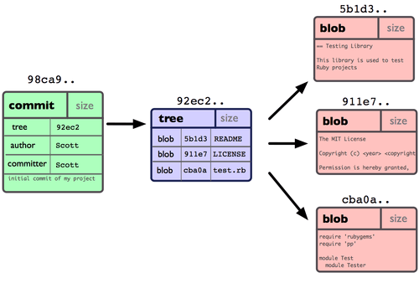
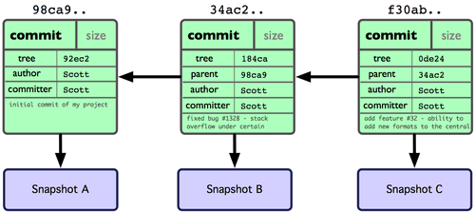
What a Branch Is

Slide 20
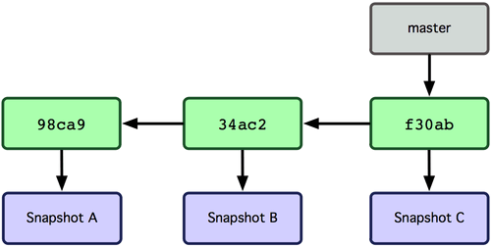
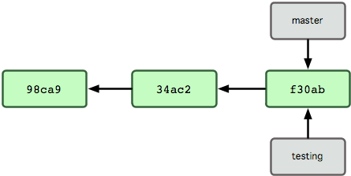
$ git branch testing

Slide 21
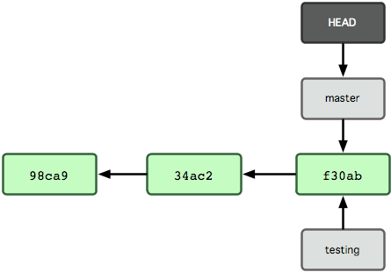
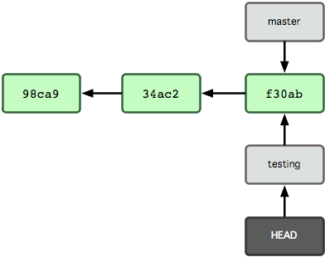
$ git branch
* master
Testing
$ git checkout testing
$ git branch
master
* testing

Slide 22
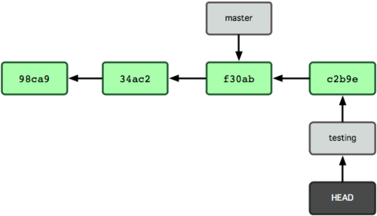
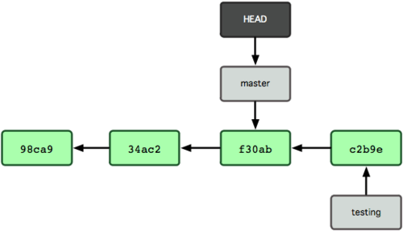
$ vim test.rb
$ git commit -a -m 'made a change'
$ git checkout master

Slide 23
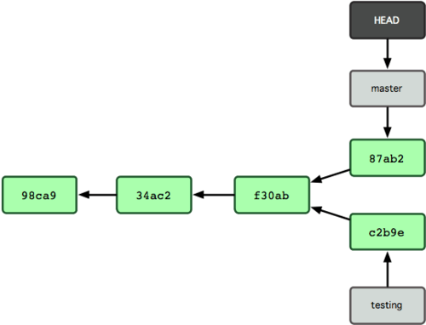
$ vim test.rb
$ git commit -a -m 'made other changes'

Slide 24
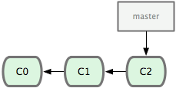
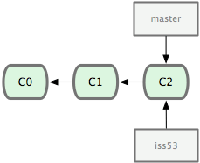
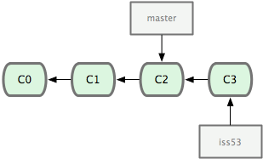
$ git checkout -b iss53
Switched to a new branch "iss53"
$ vim index.html
$ git commit -a -m 'iss53 comment #1'

Slide 25
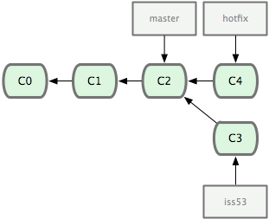
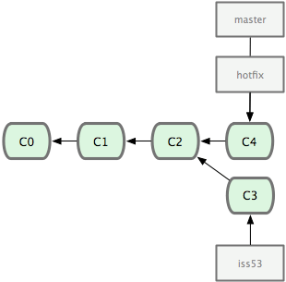
$ git checkout master
Switched to branch "master"
$ git checkout -b hotfix
Switched to a new branch "hotfix"
$ vim index.html
$ git commit -a -m 'hotfix comment #1'
$ git checkout master
$ git merge hotfix
Updating f42c576..3a0874c
Fast forward
README | 1 -
1 files changed, 0 insertions(+), 1 deletions(-)
$ git branch -d hotfix
Deleted branch hotfix (3a0874c).

Slide 26
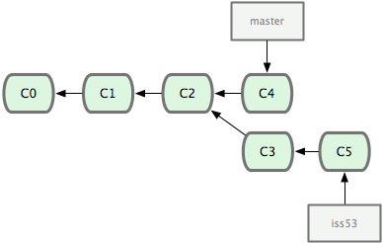
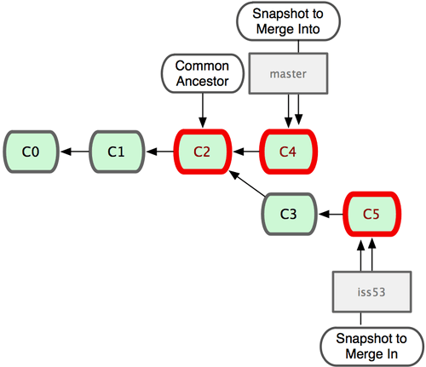
$ git checkout iss53
Switched to branch "iss53"
$ vim index.html
$ git commit -a -m 'iss53 comment #2'
$ git checkout master
$ git merge iss53
Merge made by recursive.
README | 1 +
1 files changed, 1 insertions(+), 0 deletions(-)

Slide 27
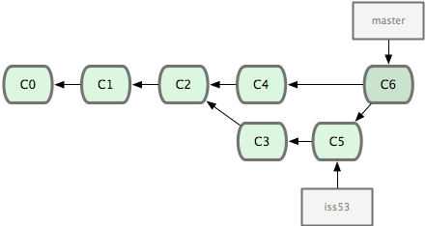
Three-way merge

Slide 28
$ git log
commit af5be61a5b854932da10111ab3fc1b54a994f92f
Merge: e5031c6 10e7e8a
Author: Dongho Lee <dhlee@icube.co.kr>
Date: Thu Jan 9 10:12:06 2014 +0900
Merge branch 'iss53'
commit 10e7e8a827e5220af72ddc2d5d7a4d6cf3fdb679
Author: Dongho Lee <dhlee@icube.co.kr>
Date: Thu Jan 9 10:11:32 2014 +0900
iss53 comment #2
commit e5031c62dd10f5fb044eb7a76629f4d9f2067a61
Author: Dongho Lee <dhlee@icube.co.kr>
Date: Thu Jan 9 10:01:58 2014 +0900
hotfix comment #1
commit 168dadbb1166f979a225431f8a45fc9bd7c19030
Author: Dongho Lee <dhlee@icube.co.kr>
Date: Thu Jan 9 09:58:37 2014 +0900
iss53 comment #1
commit d0f127c0869e3df0aa3defd17a2c3574c739b996
Author: Dongho Lee <dhlee@icube.co.kr>
Date: Fri Jan 3 10:14:48 2014 +0900
. Initial commit

Slide 29
$ git log --graph
* commit af5be61a5b854932da10111ab3fc1b54a994f92f
|\ Merge: e5031c6 10e7e8a
| | Author: Dongho Lee <dhlee@icube.co.kr>
| | Date: Thu Jan 9 10:12:06 2014 +0900
| |
| | Merge branch 'iss53'
| |
| * commit 10e7e8a827e5220af72ddc2d5d7a4d6cf3fdb679
| | Author: Dongho Lee <dhlee@icube.co.kr>
| | Date: Thu Jan 9 10:11:32 2014 +0900
| |
| | iss53 comment #2
| |
| * commit 168dadbb1166f979a225431f8a45fc9bd7c19030
| | Author: Dongho Lee <dhlee@icube.co.kr>
| | Date: Thu Jan 9 09:58:37 2014 +0900
| |
| | iss53 comment #1
| |
* | commit e5031c62dd10f5fb044eb7a76629f4d9f2067a61
|/ Author: Dongho Lee <dhlee@icube.co.kr>
| Date: Thu Jan 9 10:01:58 2014 +0900
|
| hotfix comment #1
|
* commit d0f127c0869e3df0aa3defd17a2c3574c739b996
Author: Dongho Lee <dhlee@icube.co.kr>
Date: Fri Jan 3 10:14:48 2014 +0900
. Initial commit

Slide 30
Basic Merge Conflicts
$ git merge iss53
Auto-merging index.html
CONFLICT (content): Merge conflict in index.html
Automatic merge failed; fix conflicts and then commit the result.
$ git status
index.html: needs merge
# On branch master
# Changes not staged for commit:
# (use "git add <file>..." to update what will be committed)
# (use "git checkout -- <file>..." to discard changes in working directory)
#
# unmerged: index.html
#
Conflicted file
<<<<<<< HEAD:index.html
<div id="footer">contact : email.support@github.com</div>
=======
<div id="footer">
please contact us at support@github.com
</div>
>>>>>>> iss53:index.html

Slide 31
$ git mergetool
merge tool candidates: kdiff3 tkdiff xxdiff meld gvimdiff opendiff emerge vimdiff
Merging the files: index.html
Normal merge conflict for 'index.html':
{local}: modified
{remote}: modified
Hit return to start merge resolution tool (opendiff):
$ git status
# On branch master
# Changes to be committed:
# (use "git reset HEAD <file>..." to unstage)
#
# modified: index.html
#
$ git commit
Merge branch 'iss53'
Conflicts:
index.html
#
# It looks like you may be committing a MERGE.
# If this is not correct, please remove the file
# .git/MERGE_HEAD
# and try again.
#

Slide 32
Cherry-picking
$ git cherry-pick 168dadbb1166f979a225431f8a45fc9bd7c19030
[master 8f2ce27] iss53 comment #1
1 file changed, 1 insertion(+)
Squashed Commit
$ git merge --squash iss53
Squash commit -- not updating HEAD
Automatic merge went well; stopped before committing as requested
$ git commit
Squashed commit of the following:
commit 10e7e8a827e5220af72ddc2d5d7a4d6cf3fdb679
Author: Dongho Lee <dhlee@icube.co.kr>
Date: Thu Jan 9 10:11:32 2014 +0900
iss53 comment #2
commit 168dadbb1166f979a225431f8a45fc9bd7c19030
Author: Dongho Lee <dhlee@icube.co.kr>
Date: Thu Jan 9 09:58:37 2014 +0900
iss53 comment #1
# Please enter the commit message for your changes. Lines starting
# with '#' will be ignored, and an empty message aborts the commit.

Slide 33
Resetting
$ git log
commit bedb2adc4f46787de041bc51bb9b940ddce71128
Author: Dongho Lee <dhlee@icube.co.kr>
Date: Thu Jan 9 10:58:34 2014 +0900
master comment #1
commit d0f127c0869e3df0aa3defd17a2c3574c739b996
Author: Dongho Lee <dhlee@icube.co.kr>
Date: Fri Jan 3 10:14:48 2014 +0900
. Initial commit
$ git reset d0f127c0869e3df0aa3defd17a2c3574c739b996
Unstaged changes after reset:
M ScaryBugsMac/ScaryBugDoc.h
M ScaryBugsMac/ScaryBugDoc.m 1 file changed, 1 insertion(+)
$ git log
commit d0f127c0869e3df0aa3defd17a2c3574c739b996
Author: Dongho Lee <dhlee@icube.co.kr>
Date: Fri Jan 3 10:14:48 2014 +0900
. Initial commit

Slide 34
Reverting
$ git log
commit 46cf06a42d64428b578f79c9b17c7cbb1a39c9f7
Author: Dongho Lee <dhlee@icube.co.kr>
Date: Thu Jan 9 11:08:24 2014 +0900
master comment #1
commit d0f127c0869e3df0aa3defd17a2c3574c739b996
Author: Dongho Lee <dhlee@icube.co.kr>
Date: Fri Jan 3 10:14:48 2014 +0900
. Initial commit
$ git revert 46cf06a42d64428b578f79c9b17c7cbb1a39c9f7
$ git log
commit 29fe527a9dfae3e1a30e315f0514500f94108bf5
Author: Dongho Lee <dhlee@icube.co.kr>
Date: Thu Jan 9 11:13:17 2014 +0900
Revert "master comment #1"
This reverts commit 46cf06a42d64428b578f79c9b17c7cbb1a39c9f7.
commit 46cf06a42d64428b578f79c9b17c7cbb1a39c9f7
Author: Dongho Lee <dhlee@icube.co.kr>
Date: Thu Jan 9 11:08:24 2014 +0900
master comment #1

Slide 35
Git on the Server
The Protocols
: Local Protocol
This is often used if everyone on your team has access to a shared filesystem such as an NFS mount
: The SSH Protocol
SSH is the only network-based protocol that you can easily read from and write to. The other two network protocols (HTTP and Git) are generally read-only.
: The Git Protocol
provides a service similar to the SSH protocol, but with absolutely no authentication.
: The HTTP/S Protocol
The beauty of the HTTP or HTTPS protocol is the simplicity of setting it up. It’s possible to make Git push over HTTP as well, although that technique isn’t as widely used and requires you to set up complex WebDAV requirements.

Slide 36
Getting Git on a Server
In order to initially set up any Git server, you have to export an existing repository into a new bare repository — a repository that doesn’t contain a working directory.
$ git clone --bare my_project my_project.git
Cloning into bare repository 'my_project.git'...
done.
Checking connectivity... done
Putting the Bare Repository on a Server
$ scp -r my_project.git user@git.example.com:/opt/git
At this point, other users who have SSH access to the same server which has read-access to the /opt/git directory can clone your repository by running
$ git clone user@git.example.com:/opt/git/my_project.git
Alternatively, on the server 'git.example.com', you can set up an empty repository by running git init with the --bare option, which initializes the repository without a working directory
$ git init --bare /opt/git/my_project.git
Then, a member can push the first version of their project into that repository by adding it as a remote and pushing up a branch.
# on the member's computer
$ git remote add origin user@git.example.com:/opt/git/my_project.git
$ git push origin master

Slide 37
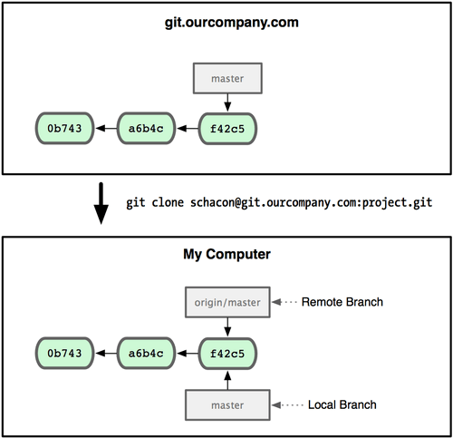
Remote Branches
Remote branches are local branches that you can't move.
They're moved automatically.
They take the form (remote)/(branch). e.g.) origin/master

Slide 38
$ git remote
origin
$ git remote -v
origin schacon@git.ourcompany.com:project.git (fetch)
origin schacon@git.ourcompany.com:project.git (push)
$ git branch
* master
$ git branch -r
origin/HEAD -> origin/master
origin/master
$ git branch -a
* master
remotes/origin/HEAD -> origin/master
remotes/origin/master

Slide 39
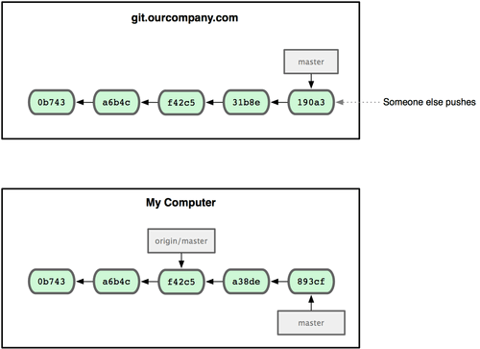
Pushing
Local Branch
$ git push origin master (or git push origin master:master)
Counting objects: 7, done.
Delta compression using up to 2 threads.
Compressing objects: 100% (4/4), done.
Writing objects: 100% (4/4), 351 bytes | 0 bytes/s, done.
Total 4 (delta 3), reused 0 (delta 0)
To leepaul@localhost:~leepaul/demo/ScaryBugsMac.git
d0f127c..17478f6 master -> master

Slide 40
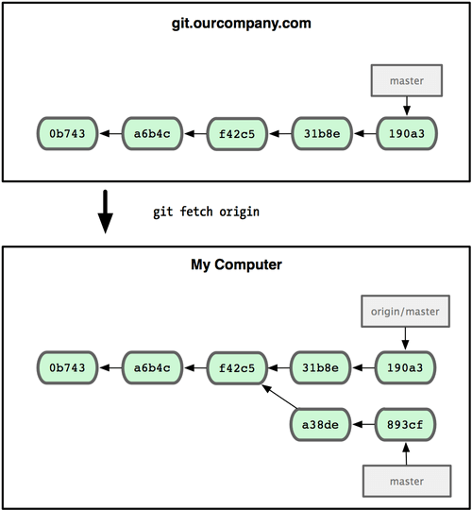
Fetching
$ git fetch origin
remote: Counting objects: 7, done.
remote: Compressing objects: 100% (4/4), done.
remote: Total 4 (delta 3), reused 0 (delta 0)
Unpacking objects: 100% (4/4), done.
From localhost:~leepaul/demo/ScaryBugsMac
d0f127c..17478f6 master -> origin/master
Not automatically merged.
You can do 'git merge‘ into
current branch
$ git merge origin/master
'git pull' fetches and
automatically merges into the
current branch.
Remote Branch
$ git pull origin master

Slide 41
Pushing & Fetching Another Branch
$ git push origin serverfix
Counting objects: 20, done.
Compressing objects: 100% (14/14), done.
Writing objects: 100% (15/15), 1.74 KiB, done.
Total 15 (delta 5), reused 0 (delta 0)
To git@github.com:schacon/simplegit.git
* [new branch] serverfix -> serverfix
$ git fetch origin
remote: Counting objects: 20, done.
remote: Compressing objects: 100% (14/14), done.
remote: Total 15 (delta 5), reused 0 (delta 0)
Unpacking objects: 100% (15/15), done.
From git@github.com:schacon/simplegit
* [new branch] serverfix -> origin/serverfix
$ git checkout -b serverfix origin/serverfix
Branch serverfix set up to track remote branch refs/remotes/origin/serverfix.
Switched to a new branch "serverfix"
$ git pull (or git pull origin)
No need to specify the remote branch name
to merge into the current branch
(Refer to the Tracking Branches below)
Tracking Branches
: Tracking branches are local branches that have a direct relationship to a remote branch.
: When you clone a repository, it generally automatically creates a master branch that tracks origin/master.
: Checking out a local branch from a remote branch automatically creates what is called a tracking branch.

Slide 42
$ git remote show origin
Password:
* remote origin
Fetch URL: leepaul@localhost:demo/ScaryBugsMac.git
Push URL: leepaul@localhost:demo/ScaryBugsMac.git
HEAD branch: master
Remote branches:
master tracked
serverfix tracked
Local branches configured for 'git pull':
master merges with remote master
serverfix merges with remote serverfix
Local refs configured for 'git push':
master pushes to master (up to date)
serverfix pushes to serverfix (up to date)
Deleting Remote Branches
$ git push origin :serverfix
To git@github.com:schacon/simplegit.git
- [deleted] serverfix
# on another computer
$ git fetch origin -p (or --prune)

Slide 43
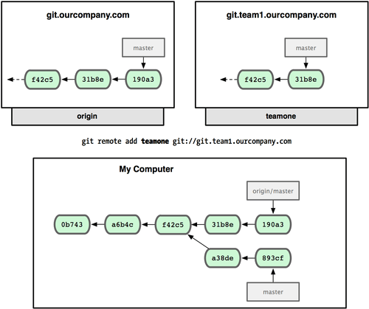
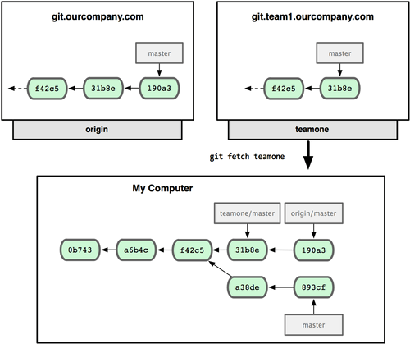
Adding another server as a remote

Slide 44
Tips
Changing Your Last Commit
$ git commit --amend
Stashing
$ git status
# On branch master
# Changes to be committed:
# (use "git reset HEAD <file>..." to unstage)
#
# modified: index.html
#
# Changes not staged for commit:
# (use "git add <file>..." to update what will be committed)
#
# modified: lib/simplegit.rb
#
$ git stash
Saved working directory and index state \
"WIP on master: 049d078 added the index file"
HEAD is now at 049d078 added the index file
(To restore them type "git stash apply")

Slide 45
$ git status
# On branch master
nothing to commit (working directory clean)
$ git stash list
stash@{0}: WIP on master: 049d078 added the index file
stash@{1}: WIP on master: c264051... Revert "added file_size"
stash@{2}: WIP on master: 21d80a5... added number to log
$ git stash apply
# On branch master
# Changes not staged for commit:
# (use "git add <file>..." to update what will be committed)
#
# modified: index.html
# modified: lib/simplegit.rb
#
Or
$ git stash apply --index
# On branch master
# Changes to be committed:
# (use "git reset HEAD <file>..." to unstage)
#
# modified: index.html
#
# Changes not staged for commit:
# (use "git add <file>..." to update what will be committed)
#
# modified: lib/simplegit.rb
#

Slide 46
$ git stash list
stash@{0}: WIP on master: 049d078 added the index file
stash@{1}: WIP on master: c264051... Revert "added file_size"
stash@{2}: WIP on master: 21d80a5... added number to log
$ git stash drop stash@{0}
Dropped stash@{0} (364e91f3f268f0900bc3ee613f9f733e82aaed43)
Or
$ git stash pop

