Slide 1

Melanoma Classification Using Machine Learning
Exploring PCA, SVM, ANN, and AlexNet
Presented By : Shimaa Aboudeif
University of Calgary| 2023

Slide 2
1
Introduction
Melanoma is a type of skin cancer that originates from the pigment-producing cells called melanocytes.
Asymmetry
Border irregularity
Color changes
Diameter: often about 6 mm
Evolving

Slide 3
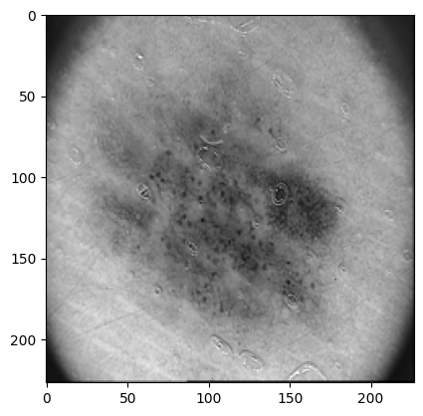
3
Dataset Overview
Source:
Dermoscopic images obtained at the Dermatology Service of Hospital Pedro Hispano (Matosinhos, Portugal).
Captured under the same conditions through the Tuebinger Mole Analyzer system.
Magnification: 20x.
Image Characteristics:
8-bit RGB color images.
Resolution: 768x560 pixels.

Slide 4
6
Dataset Composition
Total Images:
The dataset comprises a total of 200 dermoscopic images of melanocytic lesions
Class Distribution:
Common Nevi: 80 images.
Atypical Nevi: 80 images.
Melanomas: 40 images.

Slide 5
6
Dataset Features
Clinical and histological diagnosis provided.
Assessment of several dermoscopic criteria:
Colors.
Pigment network.
Dots/globules.
Streaks.
Regression areas.
Blue-whitish veil.

Slide 6
5
Machine Learning Models
1
PCA with SVM
2
Alexnet
3
Artificial Neural Networks

Slide 7
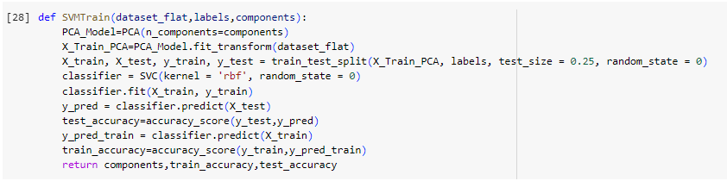
4
PCA and SVM
Train/Test = 75/25
At 10 PCA Components, with SVM of rbf kernel:
Training accuracy achieved: 0.79
Testing accuracy achieved: 0.82

Slide 8
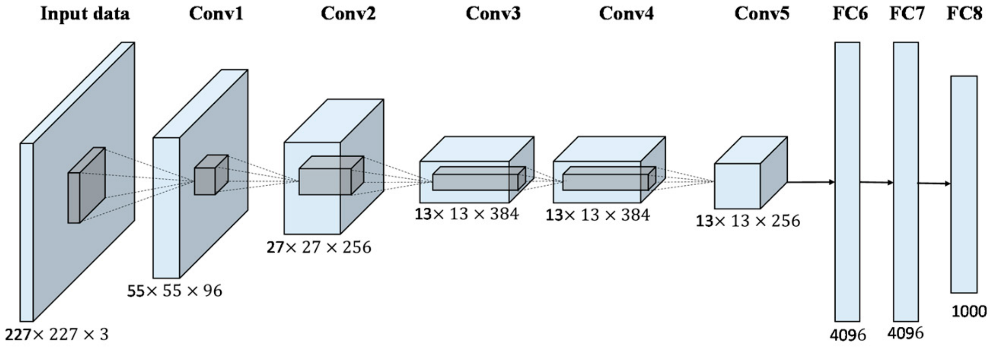
4
AlexNet
Train/Test/Validate = 80/10/10
Data resized to 227 x 227
At 10 PCA Components, with SVM of rbf kernel:
Training accuracy: 0.66
Validation accuracy: 0.55
Testing accuracy: 0.6

Slide 9
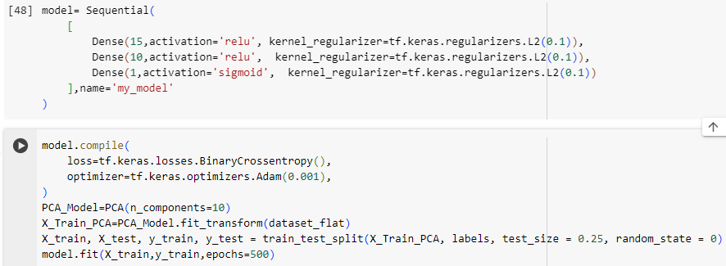
4
ANN and SVM
Train/Test = 75/25
At 10 PCA Components, with 3 layers:
Training accuracy achieved: 0.83
Testing accuracy achieved: 0.76

Slide 10
8
Conclusion
PCA with SVM has performed the best in classification

Slide 11
THANK YOU

