Slide 1
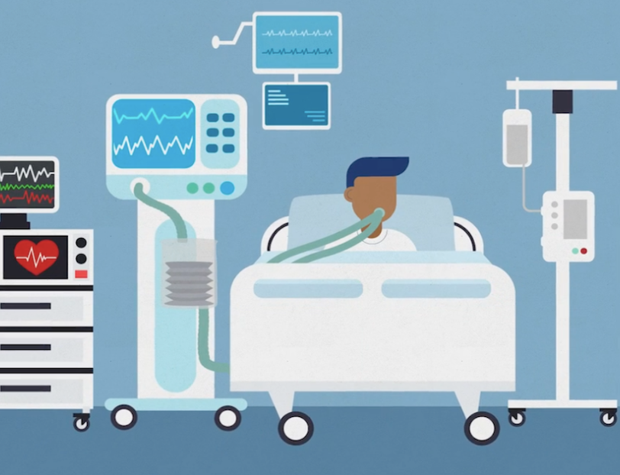
Predictive Modeling and Analysis of ICU Admissions
Using Machine Learning Techniques to Forecast Patient Admissions and Improve Healthcare Outcomes
Presented by: Shimaa Hamadelnel
Date: 7/24/2024

Slide 2
Objective
Analyze ICU admissions data to identify trends.
Predict future ICU admissions.
Provide actionable insights for healthcare improvement.

Slide 3
Data Collection
Dataset from Kaggle: COVID-19 ICU Admissions
Includes patient demographics, admission hours, and age percentile.
Key variables: Age, Gender, Medical History, Window, ICU Admission.

Slide 4

Key observations
Clusters of Correlation: Features related to blood gas measurements (e.g., P02, PCO2) and oxygen saturation levels show strong correlations within their groups. This suggests that these features provide similar information and may be redundant.
Unique Features: Some features have minimal correlation with others, indicating they provide unique information. These features might be important for creating a more effective predictive model.

Slide 5

Observations
Patient Visit Identifier: There are 385 unique patients, each listed in 5 separate rows.
Age Above 65: About 47% of patients are over 65 years old, with some variability in this figure.
Disease Groupings: Disease Grouping 5 is the most common, with different groupings appearing at varying frequencies.
Health Conditions: 21% of patients have hypertension, and 16% are immunocompromised.
Laboratory Metrics: Albumin levels are generally consistent across patients.
Blood Gas and Chemistry Metrics: These measurements show moderate variability, with some issues in consistency.
Blood Cell Counts: Blood cell counts show little variation among patients.
Gas Exchange Metrics: Measurements of oxygen and carbon dioxide levels are stable.
Lactate Levels: There is considerable variation in lactate levels among patients.

Slide 6
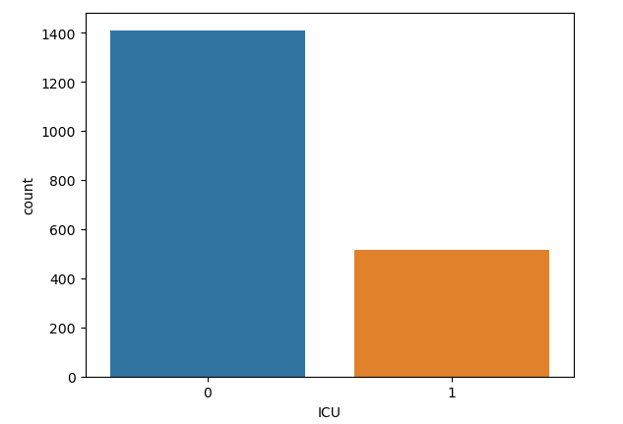
The bar plot shows that a significantly higher number of COVID-19 patients did not require ICU admission (represented by '0’) compared to those who did (represented by '1’).

Slide 7
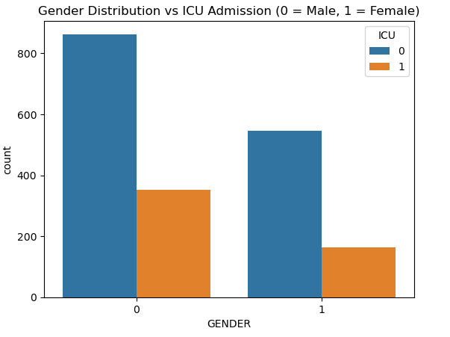
The bar plot shows that more male patients were recorded compared to females, with a higher number of non-ICU admissions for both genders.
The gap between ICU admissions and non-admissions is larger for males, suggesting gender-specific differences in the impact of COVID-19 and aiding in targeted medical resource planning.

Slide 8
Summary Insights
Total Admissions:
Non-ICU: 1410, ICU: 515.
Admission Reasons:
Respiratory failure, sepsis, postoperative complications.
Demographic Distribution:
Nearly half over 65, balanced gender distribution.
Disease and Health Conditions:
Notable prevalence of certain conditions.

Slide 9
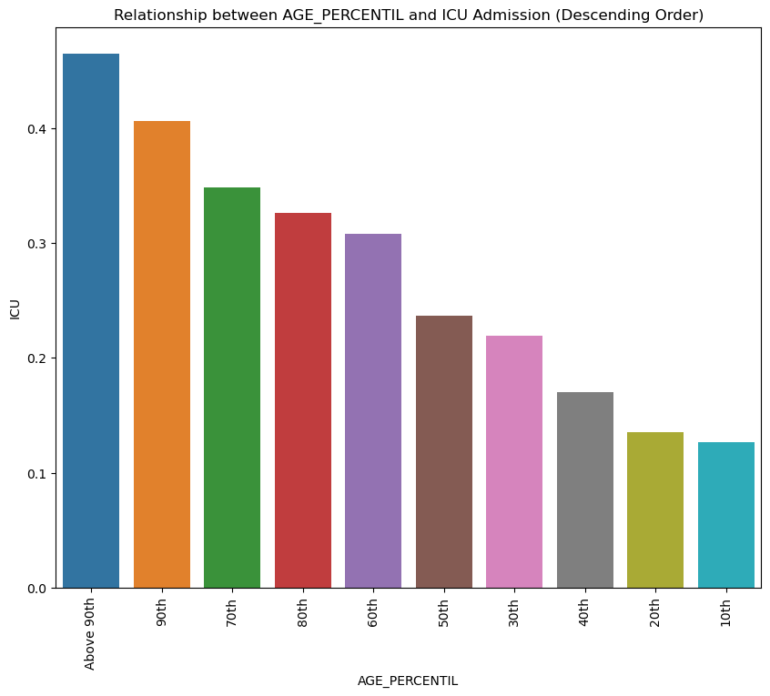

Slide 10
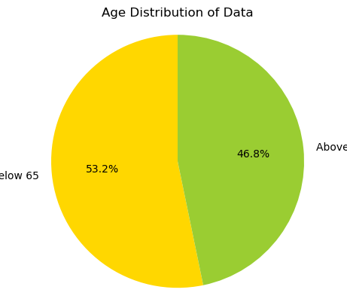
Age Distribution
Patients below age 65: 1025
Patients above age 65: 900

Slide 11

Machine Learning Insights
Trend Analysis :
  Patterns in ICU admissions based on demographics.
Key Factors:
  Random Forest model high accuracy (93%).
  Reliable prediction of ICU admissions.

Slide 12

Conclusion
Random Forest Model:
  Best performance with 93% accuracy.
  Handles many features well, less prone to overfitting.
  Provides feature importances for interpretability.
By implementing this predictive model, the hospital can improve patient outcomes, optimize the use of critical care resources, and enhance overall operational efficiency. These benefits align with the hospital's mission to provide high-quality care and save lives, especially during the ongoing COVID-19 pandemic.

Slide 13

Thank you!

