Slide 1

EduHub

Slide 2

Presented By :
Manar Ahmed Ahmed Hashad
Maryam Ahmed Ahmed Hashad
Nada Mohamed Rashid Saad
Shimaa Samir Ahmed Ebrahim
Shrouk Mostafa Mohamed Hassan
Under the supervision of :
- Dr. Hossam ALDin Ebrahim

Slide 3

OUTLINE :
The proposed idea.
Objectives of the project.
Benefits of the projects.
similar works.
Project feasibility.
Stakeholders.
Software and hardware requirements.
Use case Diagram
Activity Diagrams
Entity Relationship diagram
Sequence Diagrams
INTERFACES
Database
Timeline (Gantt Chart).
References

Slide 4
The proposed idea :
1
versatile exchange platform that eases students’ financial challenges while fostering a spirit of collaboration and resource sharing.
2
Encouraging sustainability by extending the lifecycle of educational resources, cutting costs, and minimizing environmental waste.

Slide 5






Objectives:
Saving Money
Saving time
Easy Browse For Products
To facilitate Shopping
Education Hub
Student Support

Slide 6






Benefits:
Quick search for the product
Better Prices
Shopping from anywhere
More Variety
No Crowds
Convenience

Slide 7


Similar Works:
Feature\System
Chegg
Facebook Student Groups
Book Exchange Websites
EduHub
Book Exchange
Study Tool Sharing
Limited
AI Chatbot Support
Student Community
Organized Categories
Limited
Field Based Classification
Student Focused Platform
Easy Resource Discovery
Limited
Free Access

Slide 8

Project Feasibility

Slide 9
Economic Feasibility:
Development and Operational Costs:
The EduHub platform mainly depends on software development, hosting services, and maintenance.
Development Costs:
Costs include website design, database setup, and chatbot integration, software tools, testing, the estimated development cost is approximately 2000–3000 EGP .
Hosting and Domain Costs:
Estimated annual cost for hosting and domain is approximately 1500–2500 EGP depending on the service provider.
Total Estimated Cost:
The prototype development and deployment of EduHub is estimated to cost approximately 3500–6500 EGP.

Slide 10
Technical Feasibility:
The platform can be easily scaled using cloud infrastructure to support more users and institutions. Cloud-based services allow flexible storage, performance optimization, and system reliability.
EduHub can be developed using common web technologies and frameworks, which makes implementation practical and achievable. The required tools, programming languages, and hosting services are widely available and cost-effective.
Additionally, the chatbot integration can be implemented using existing AI APIs, making the system technically feasible without requiring complex infrastructure.

Slide 11

Scheduling Feasibility:
The project can be developed within 6 months.

Slide 12



Stakeholders:
Students
Developers
Community

Slide 13

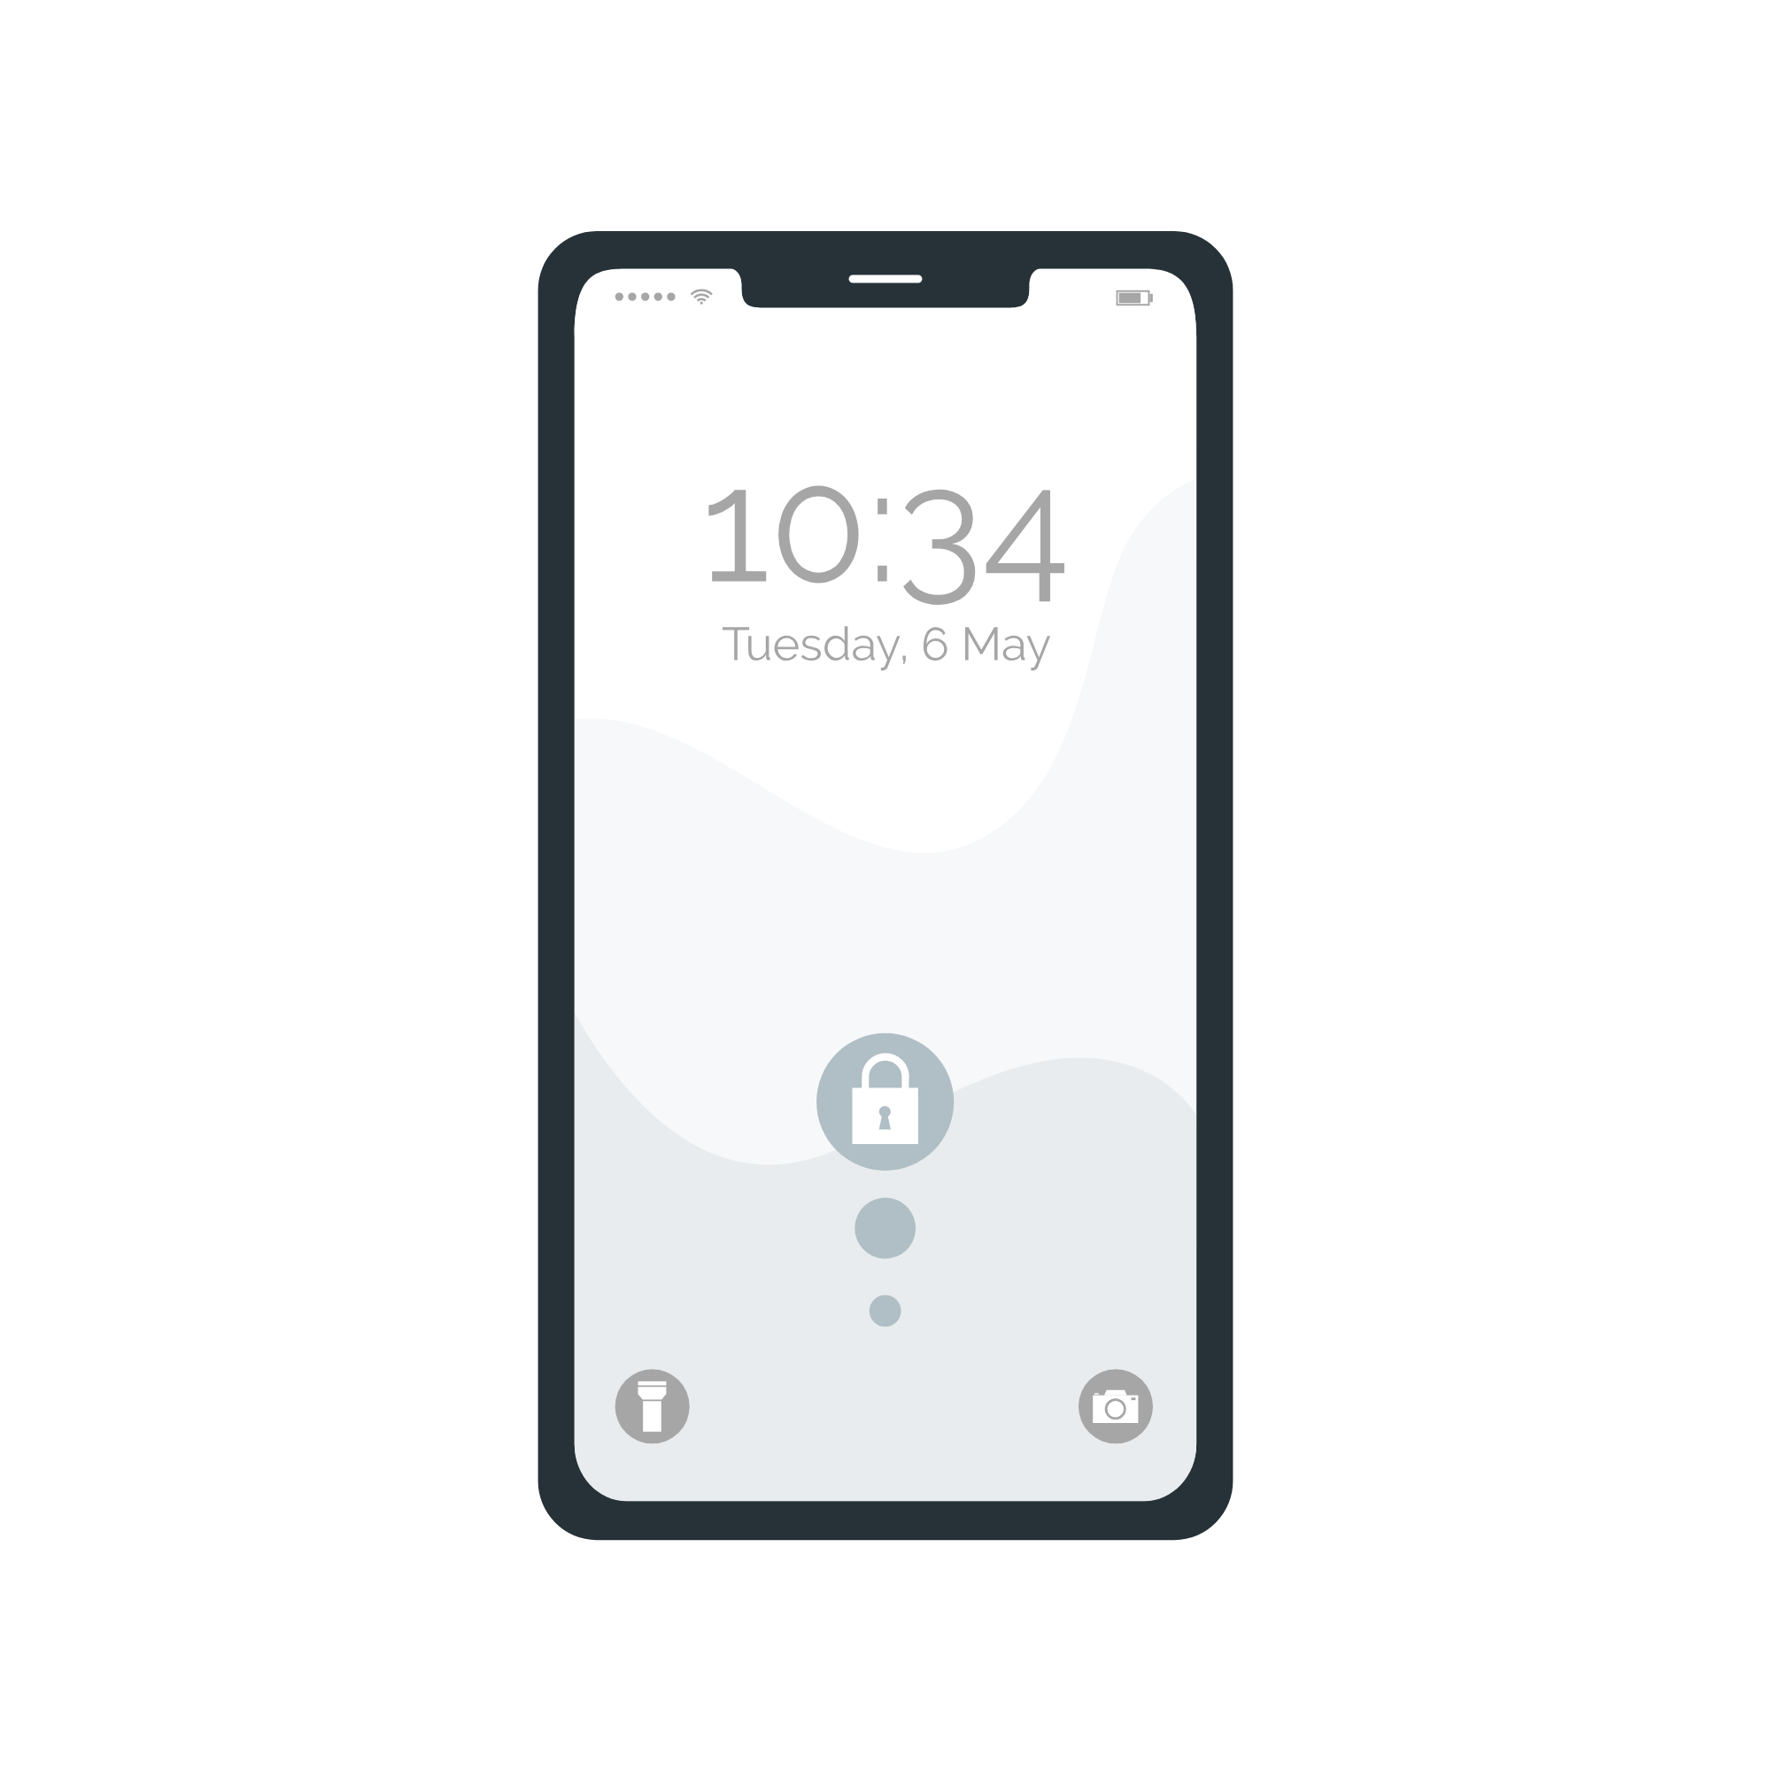

Hardware Requirement:
PC
Phone
Internet

Slide 14




Software Requirement:
HTML, CSS, Java Script
Python
MYSQL Database
AI

Slide 15
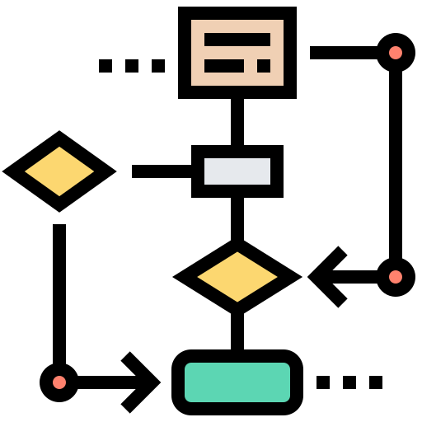
Diagrams

Slide 16
Diagarms:
ER
1
Use Case
2
Sequence
3

Slide 17

ER Diagram

Slide 18
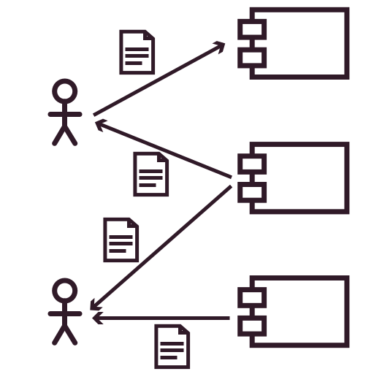
Use Case Diagram

Slide 19

Sequence Diagram

Slide 20
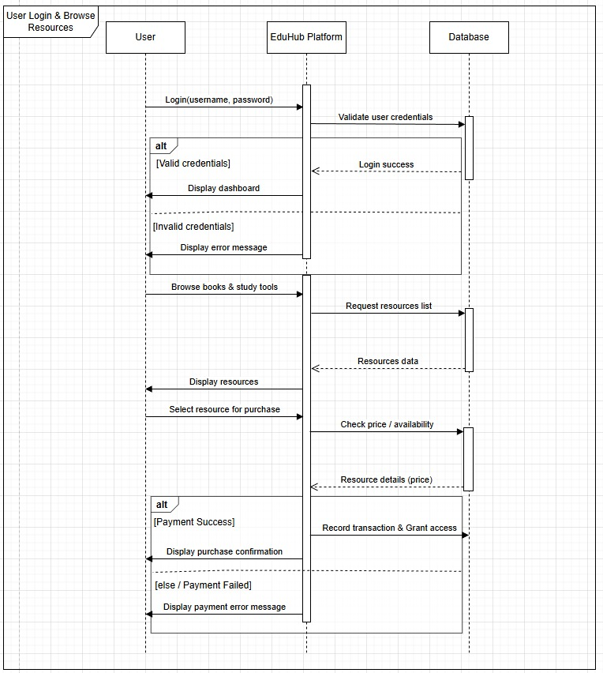
1- User Login & Browse Resources

Slide 21
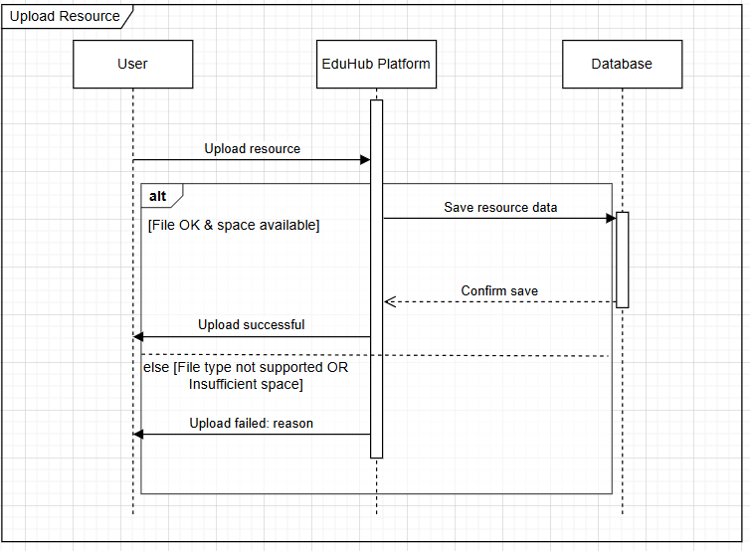
2- Upload Resource

Slide 22
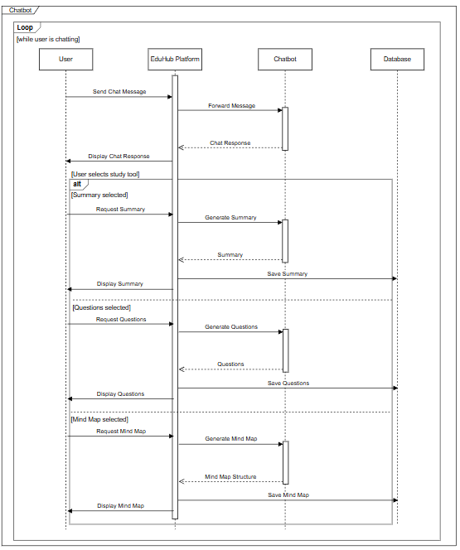
3- Chatbot

Slide 23
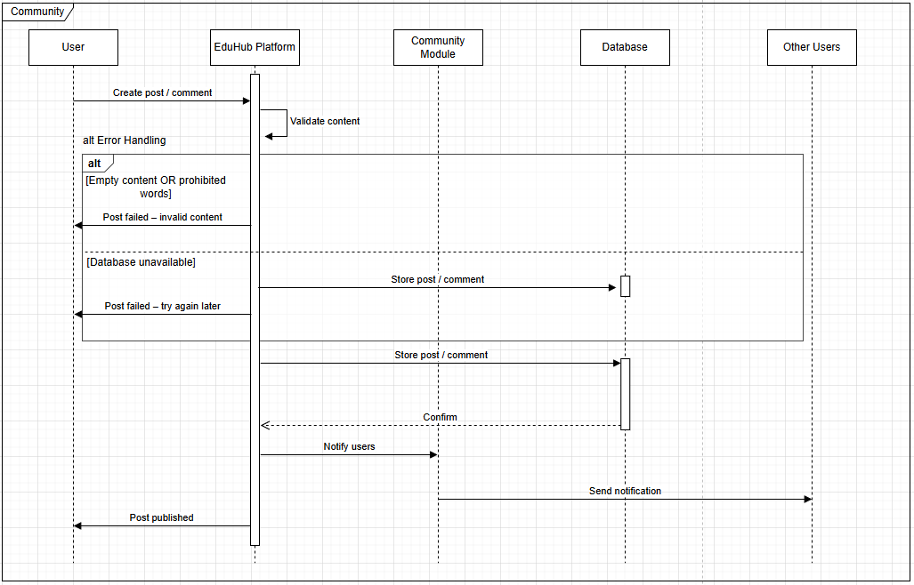
4- Community

Slide 24

User Interface

Slide 25
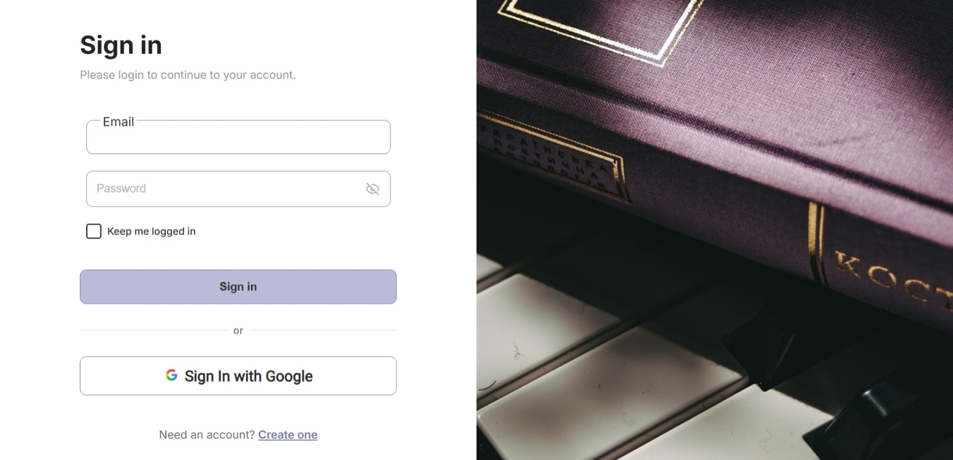

Slide 26
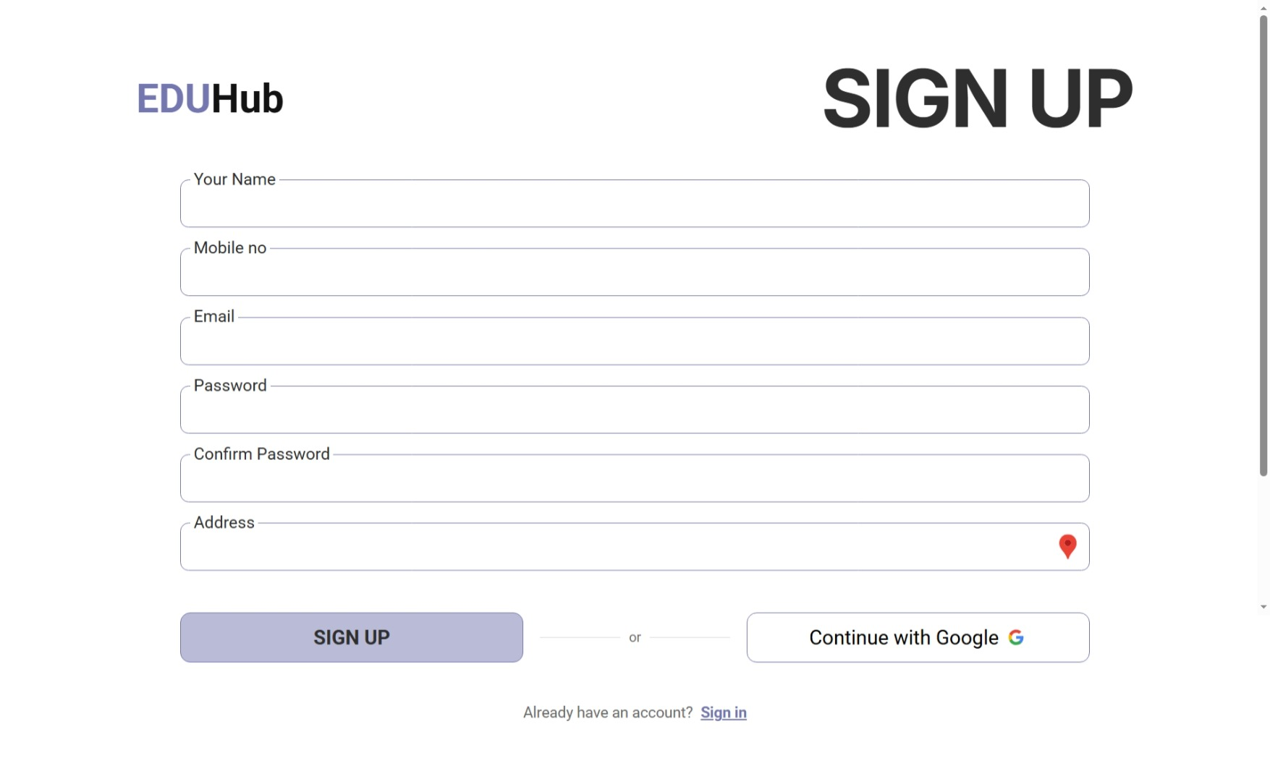

Slide 27
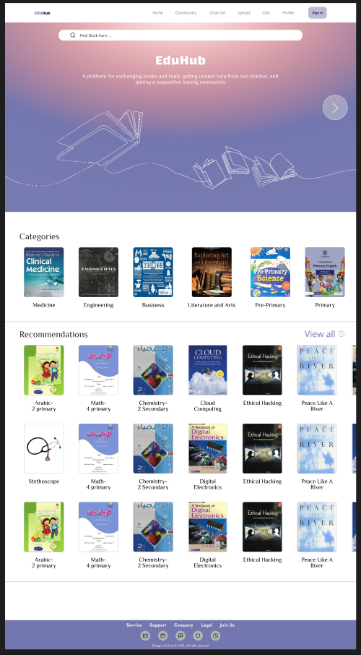

Slide 28
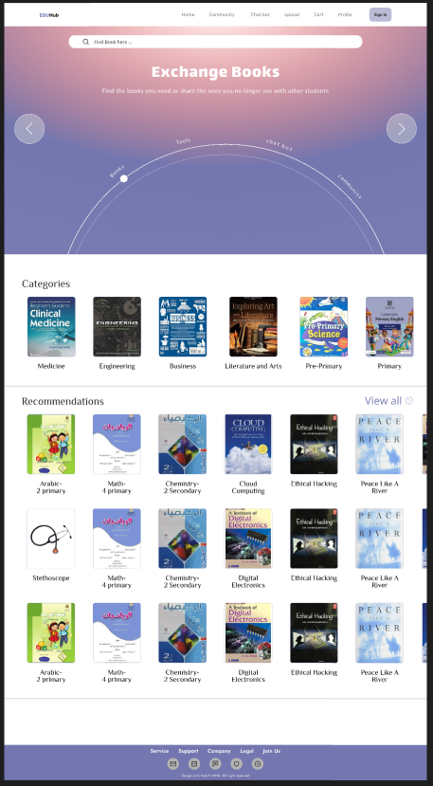

Slide 29
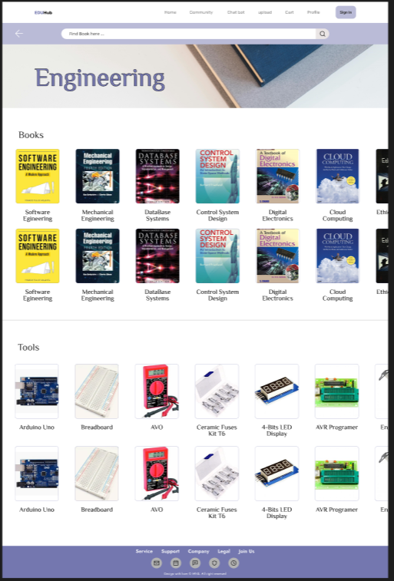

Slide 30
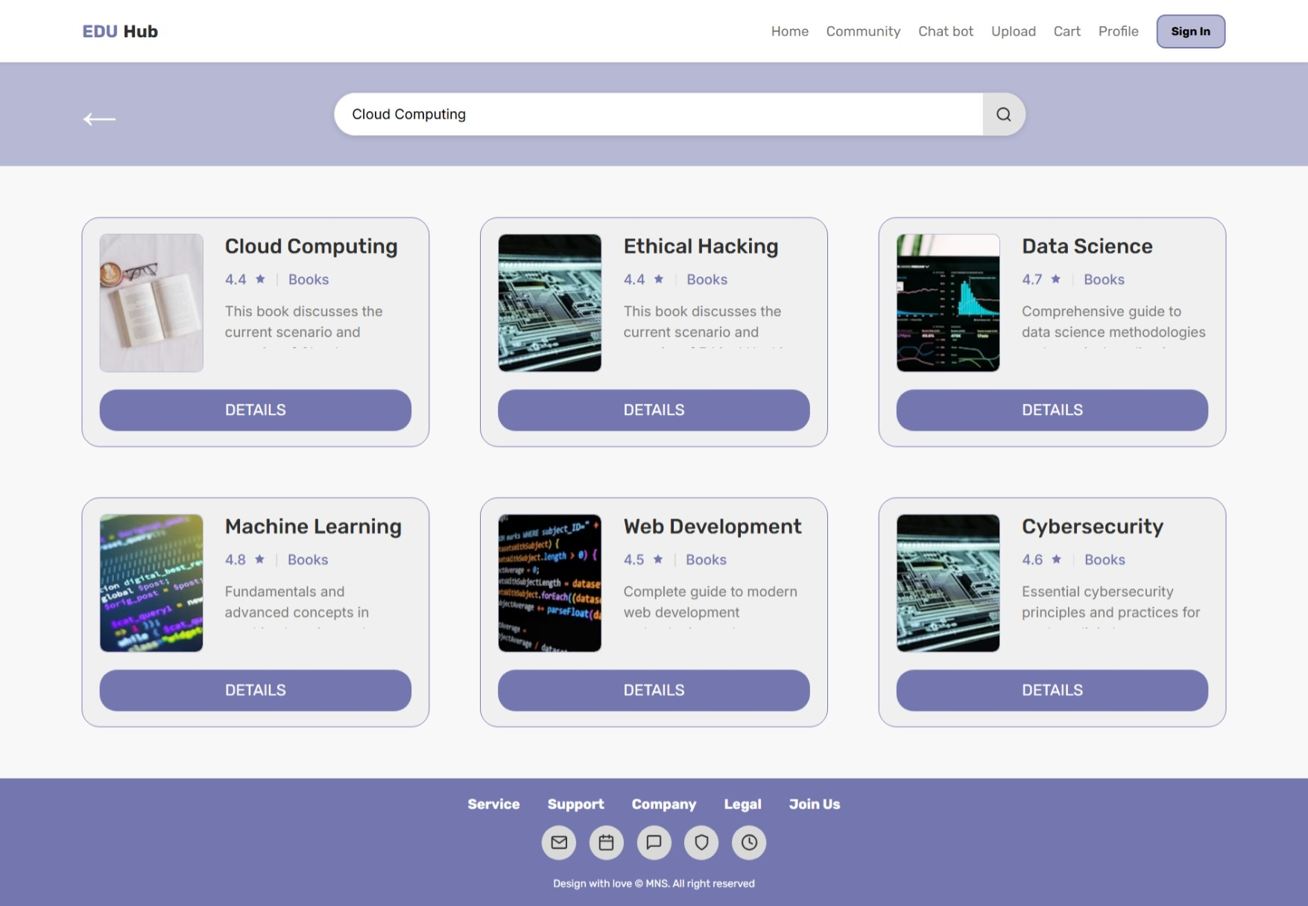

Slide 31
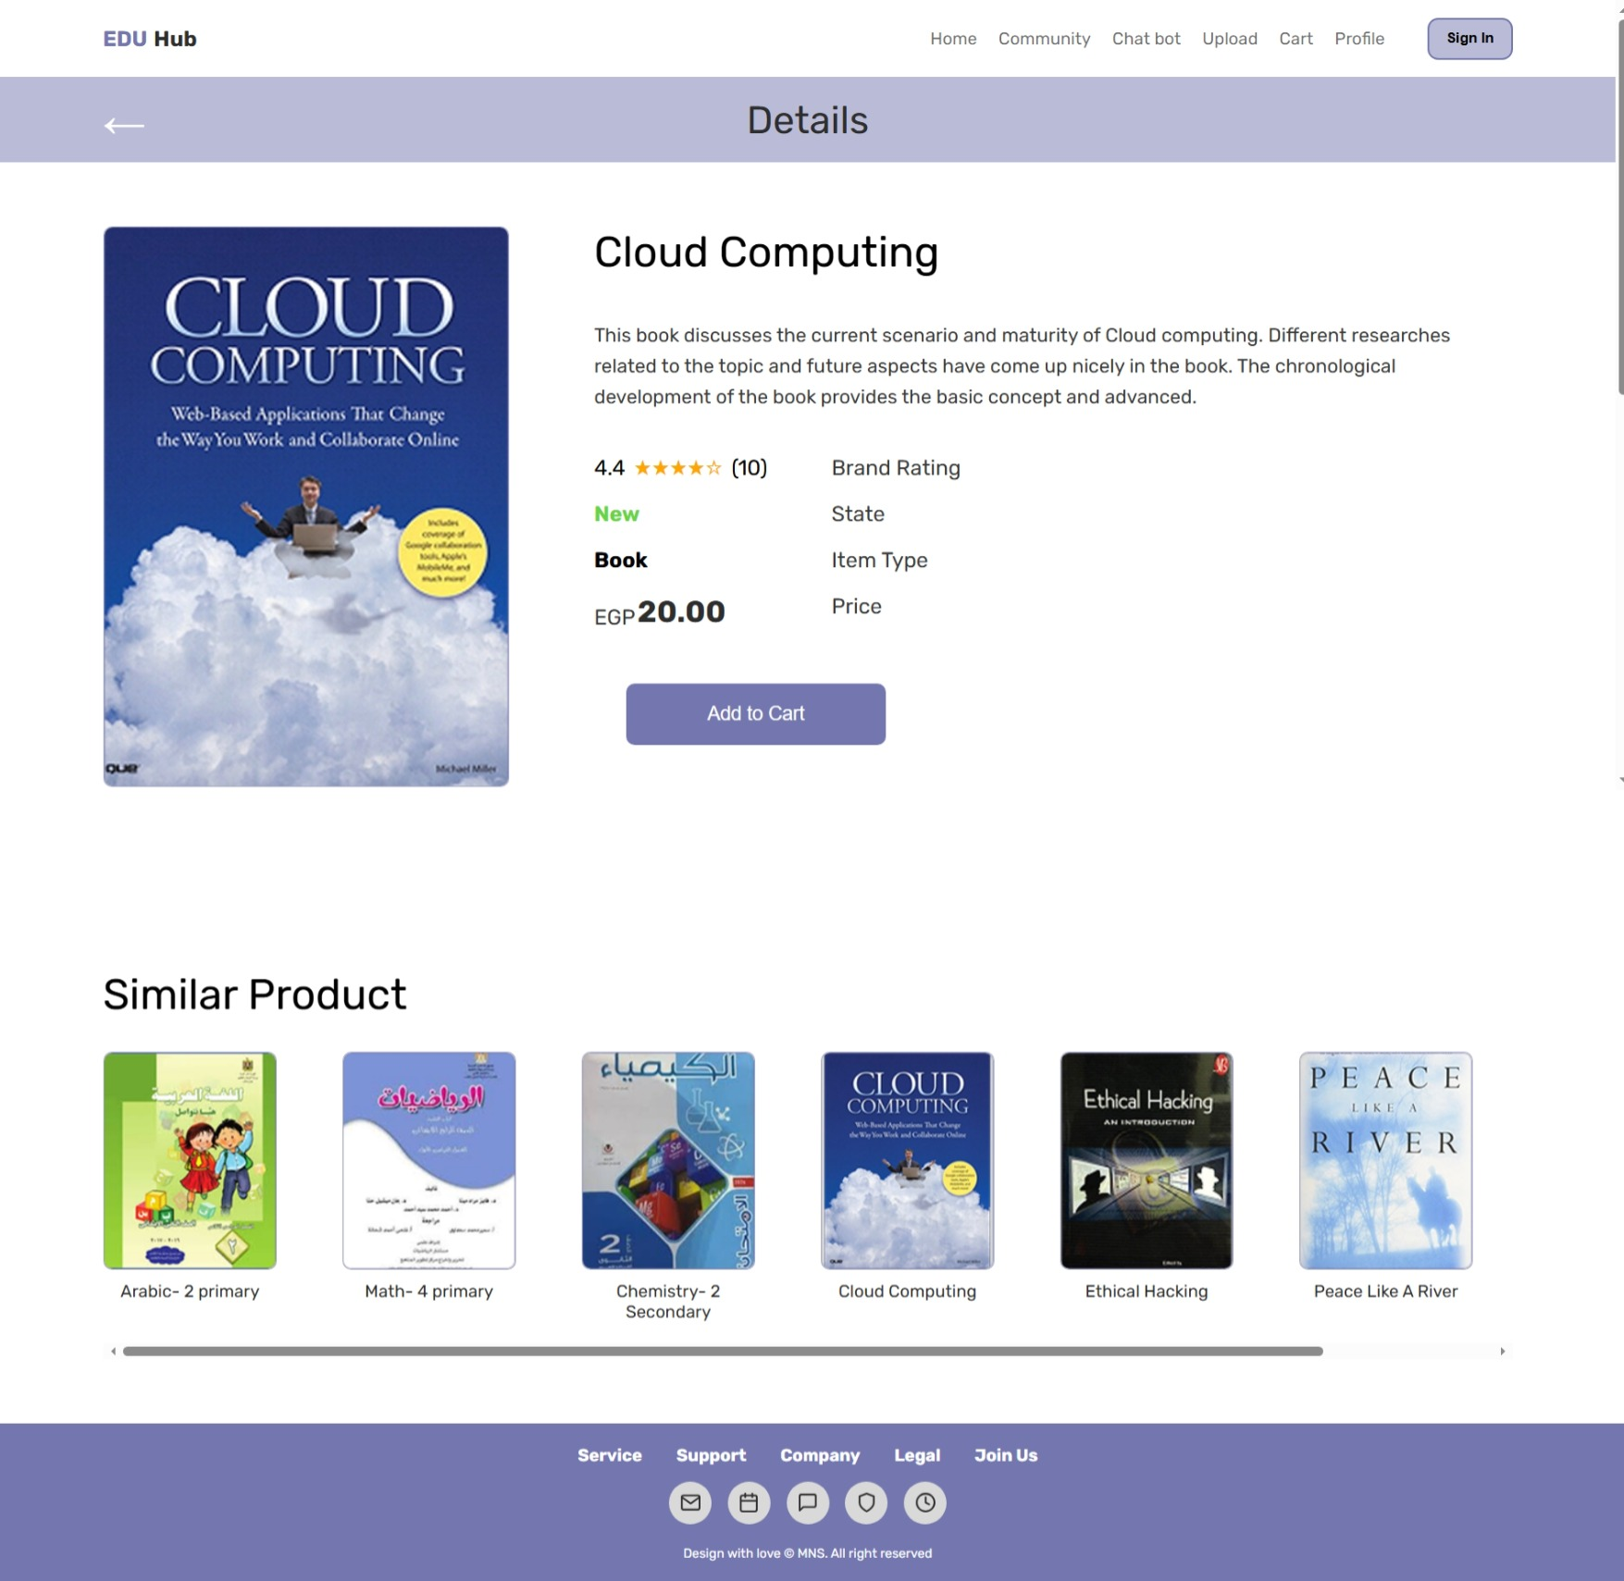

Slide 32
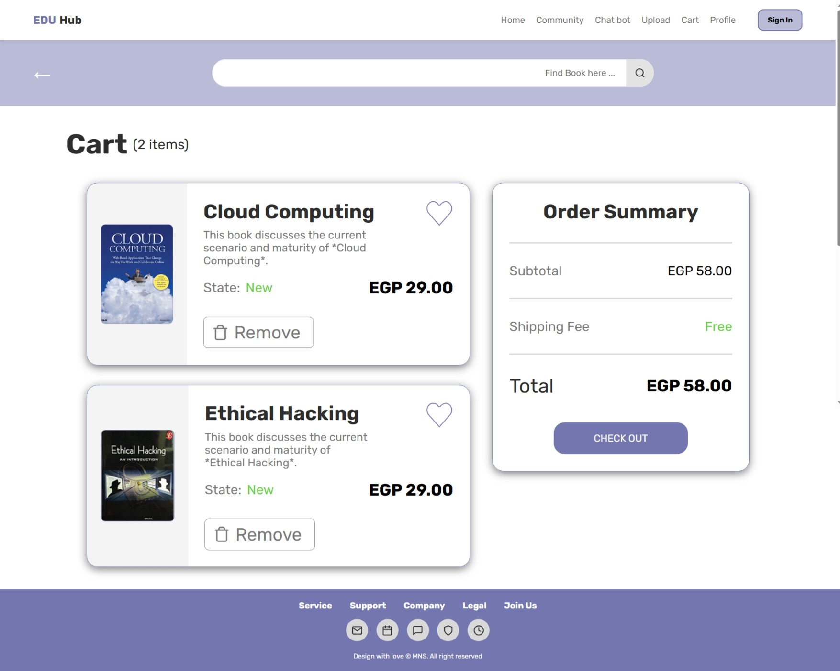

Slide 33
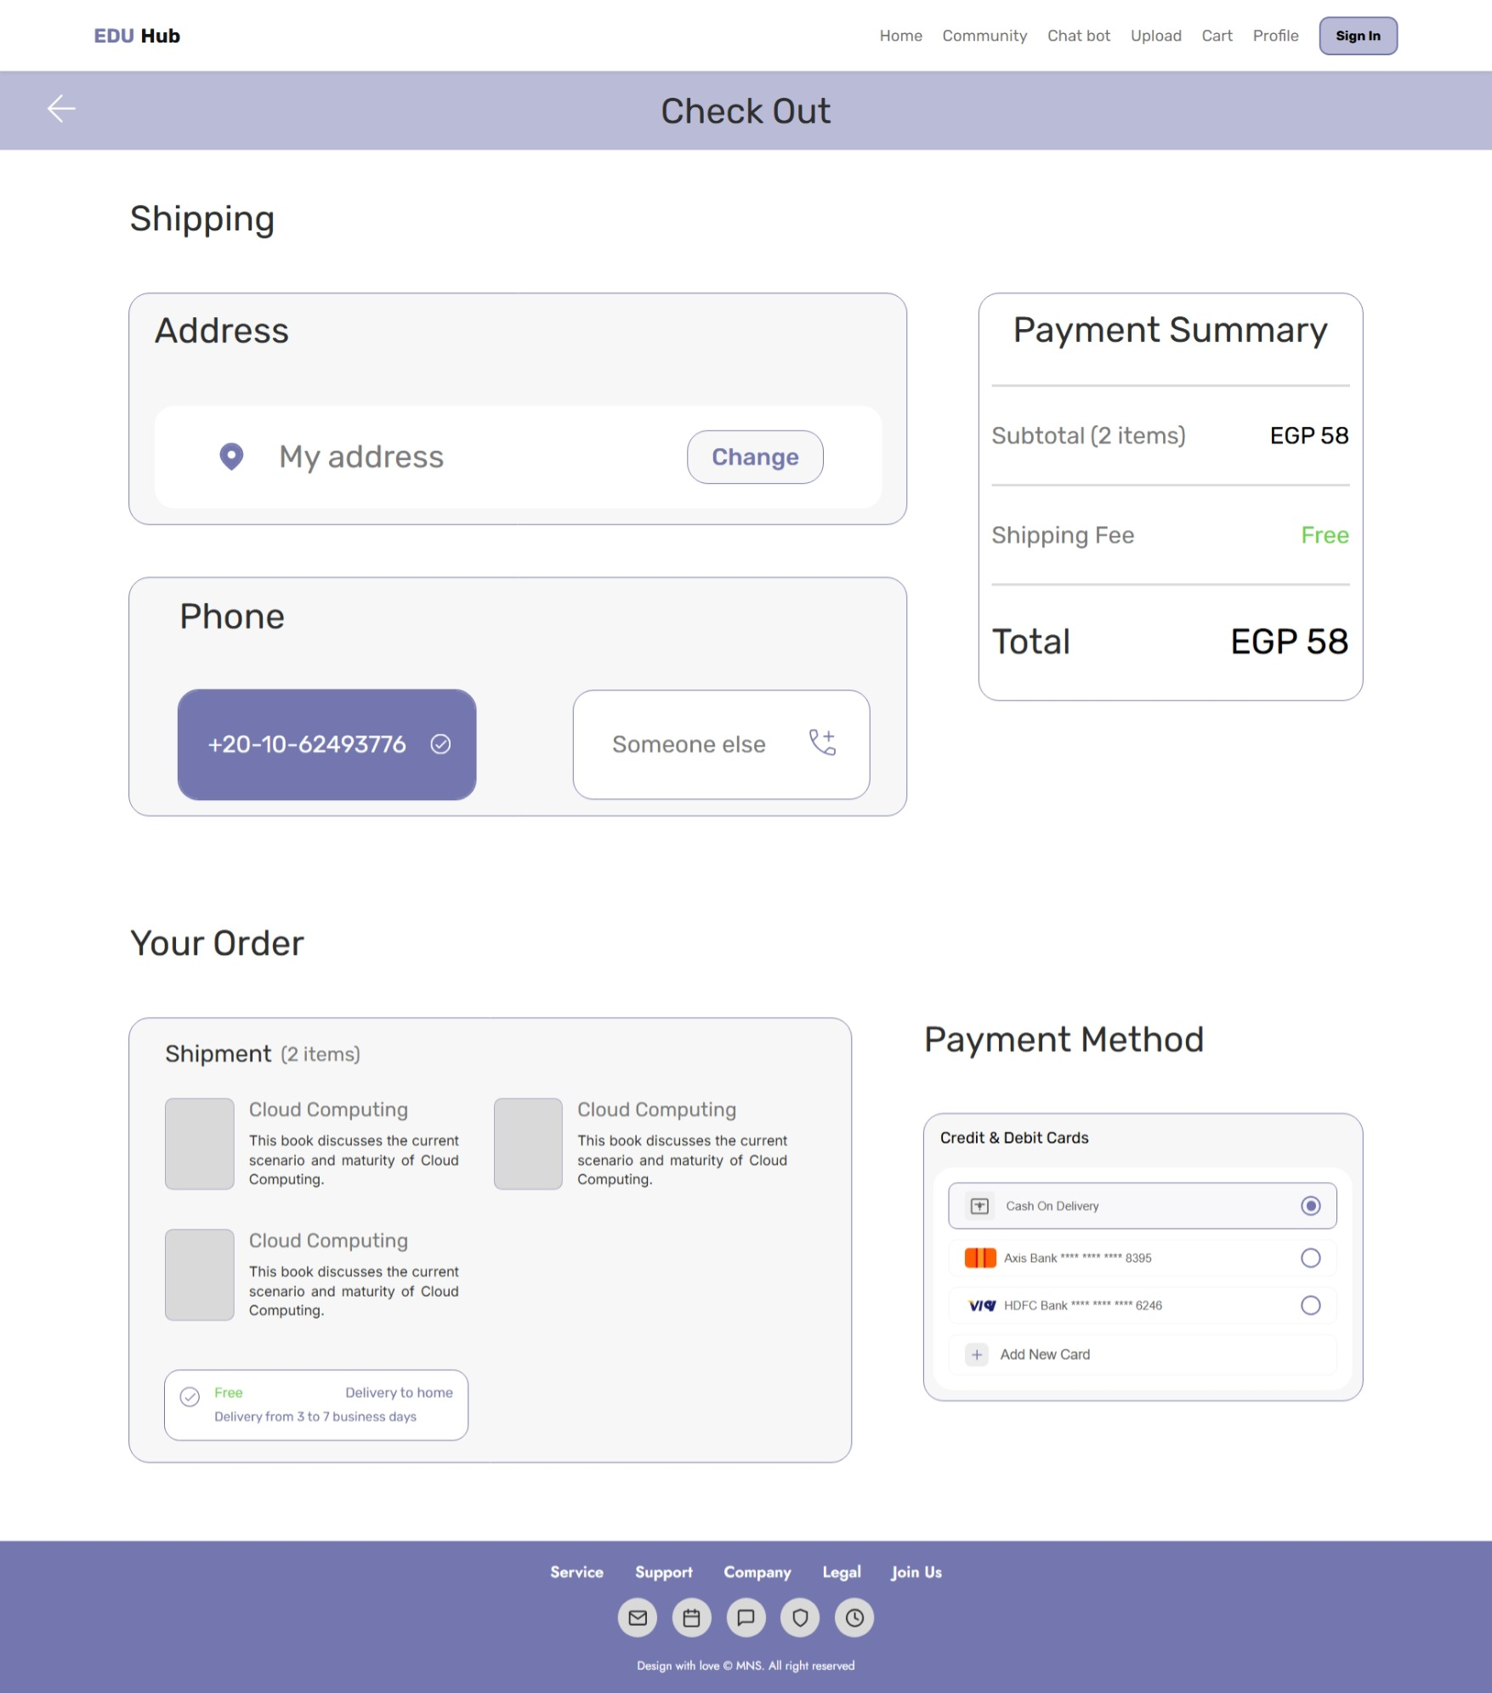

Slide 34
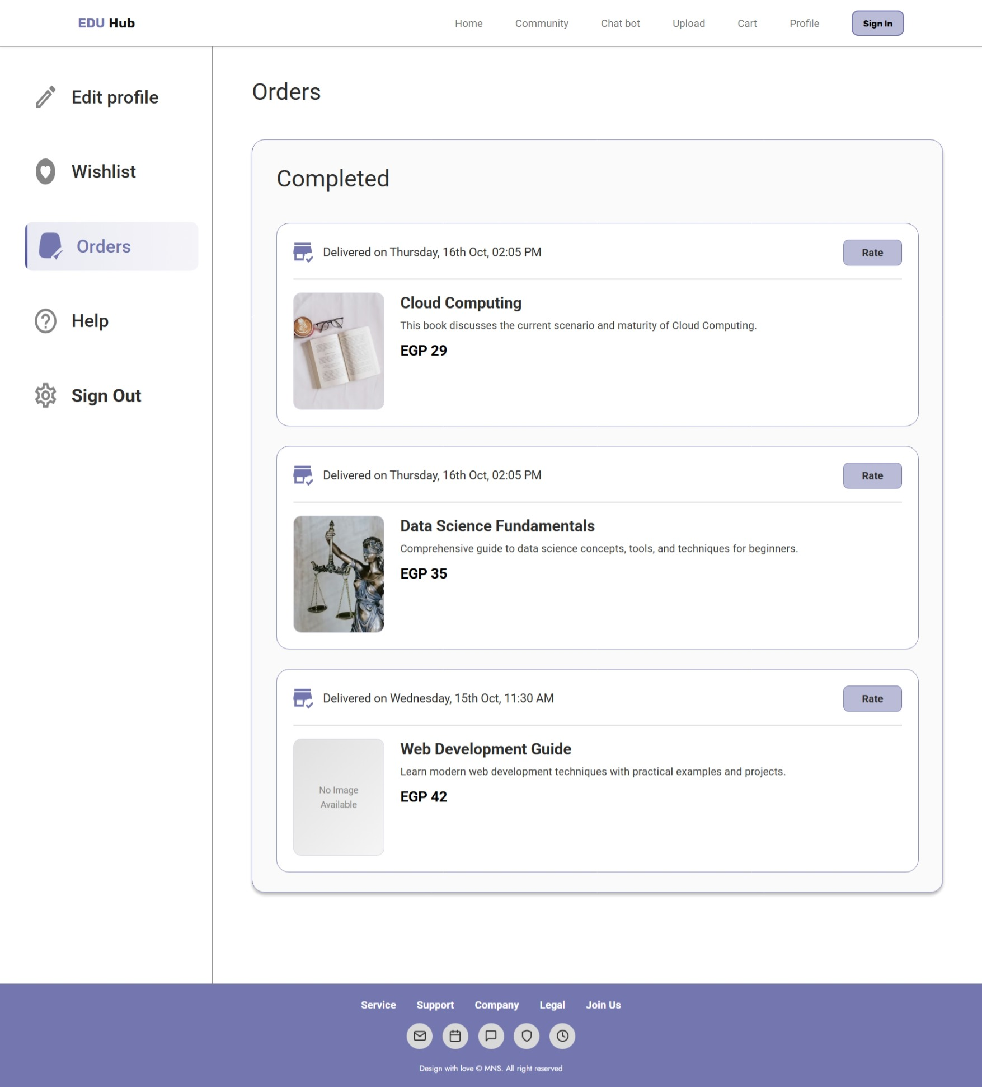

Slide 35
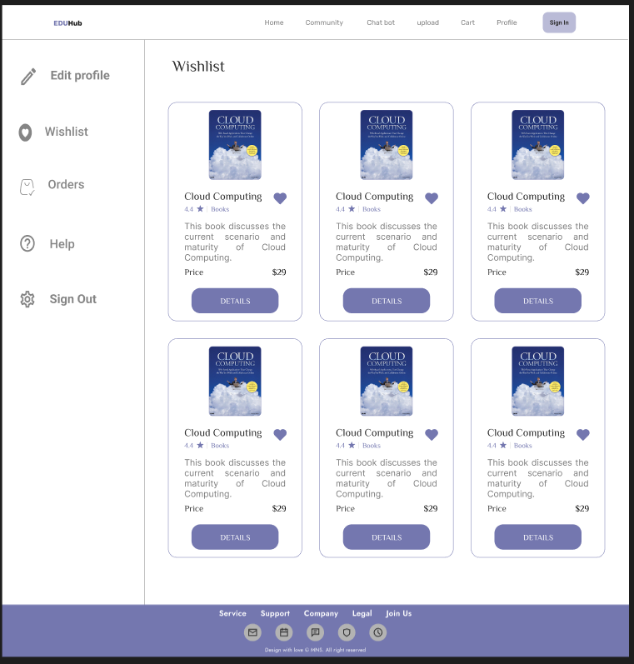

Slide 36
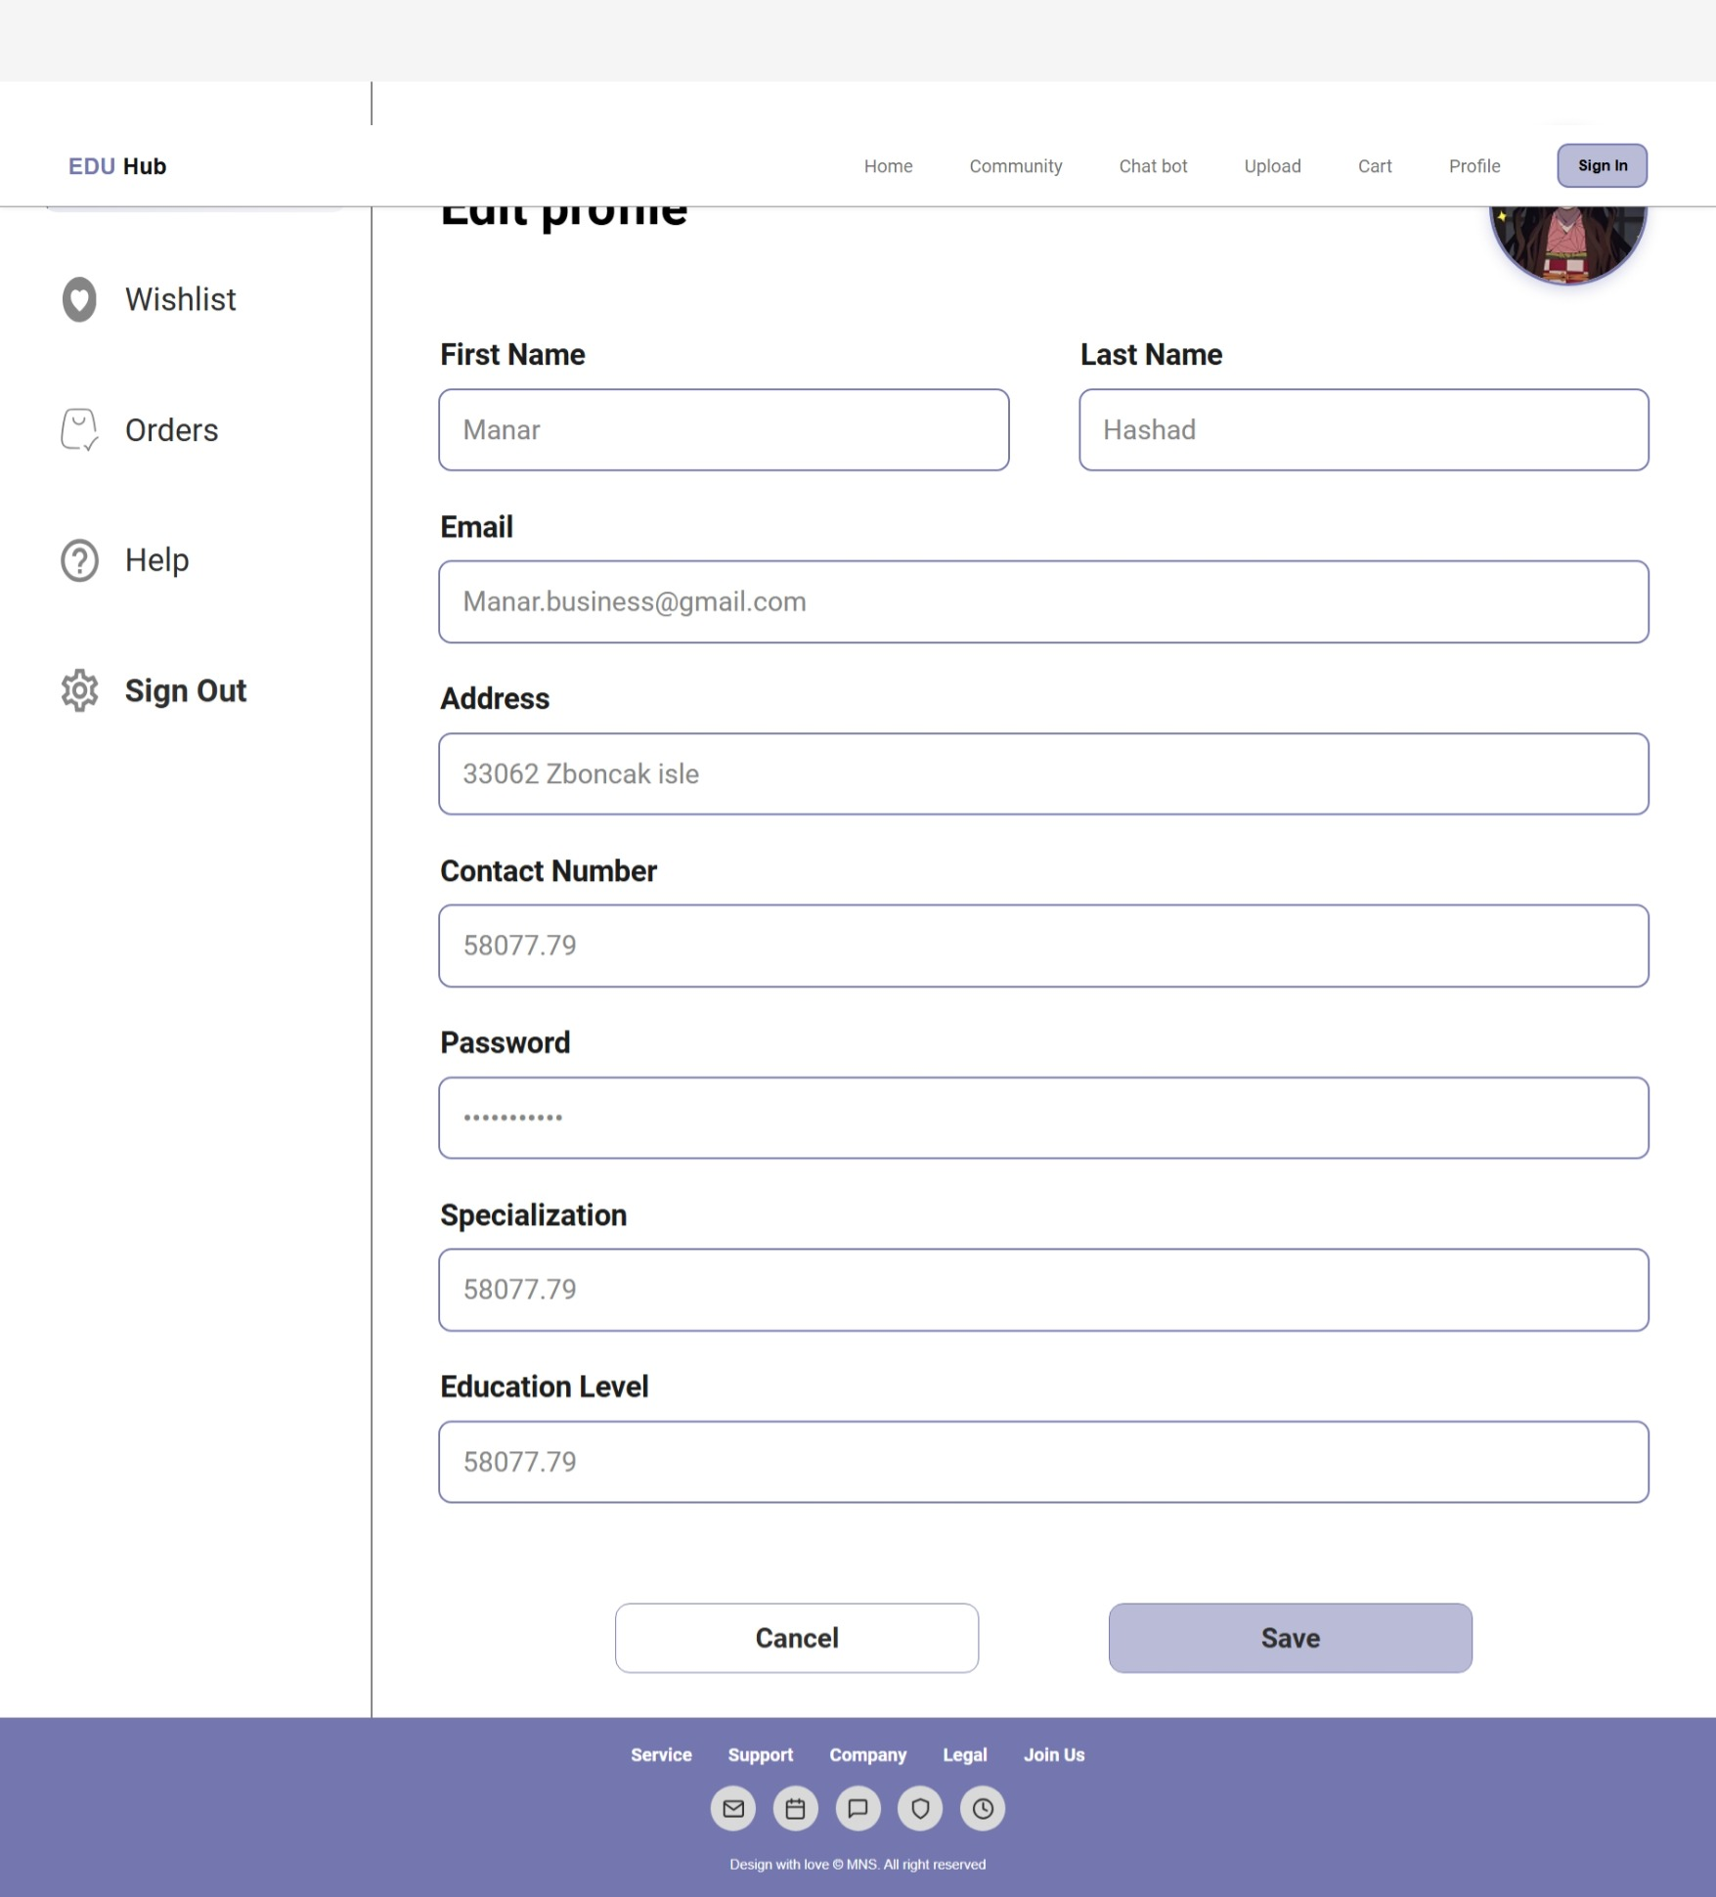

Slide 37
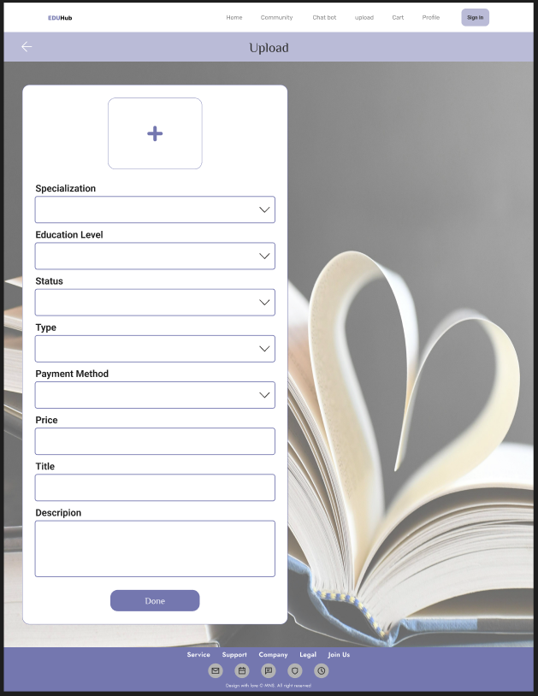

Slide 38
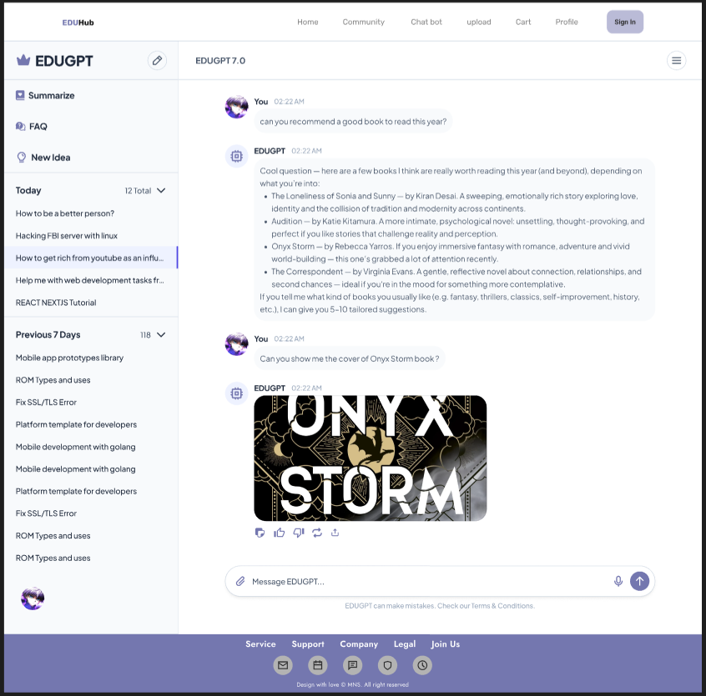

Slide 39

Thank You

