Slide 1

EduHub

Slide 2

Presented By :
Manar Ahmed Ahmed Hashad
Maryam Ahmed Ahmed Hashad
Nada Mohamed Rashid Saad
Shimaa Samir Ahmed Ebrahim
Shorouk Mostafa Mohamed Hassan

Slide 3

OUTLINE :
The proposed idea.
Defining the Challenge
similar works.
Stakeholders.
Software and hardware requirements
UX Research & Design
Survey Insights
Empathy map
Persona
Design Identity
INTERFACES
Code Implementation
Project Demo

Slide 4
The proposed idea :
1
versatile exchange platform that eases students’ financial challenges while fostering a spirit of collaboration and resource sharing.
2
Encouraging sustainability by extending the lifecycle of educational resources, cutting costs, and minimizing environmental waste.

Slide 5
Defining the Challenge:
Problem Statement
1
Pain Point
2
5Ws and H
3
Goal Statement
4

Slide 6

Problem Statement

Slide 7
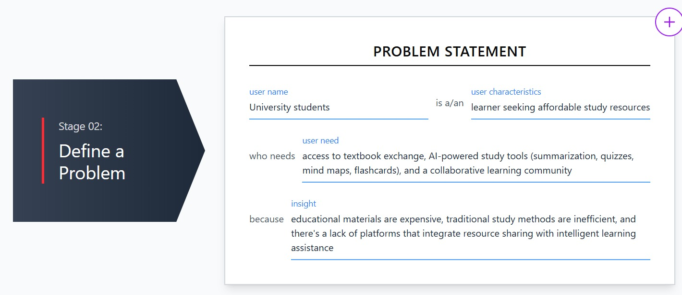

Slide 8

Pain Point

Slide 9
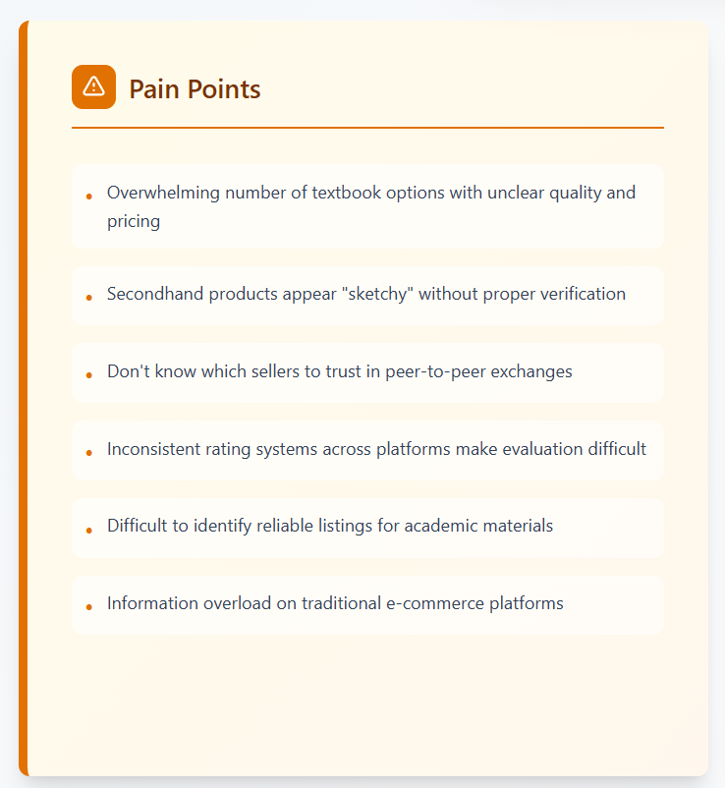

Slide 10

5Ws and H

Slide 11
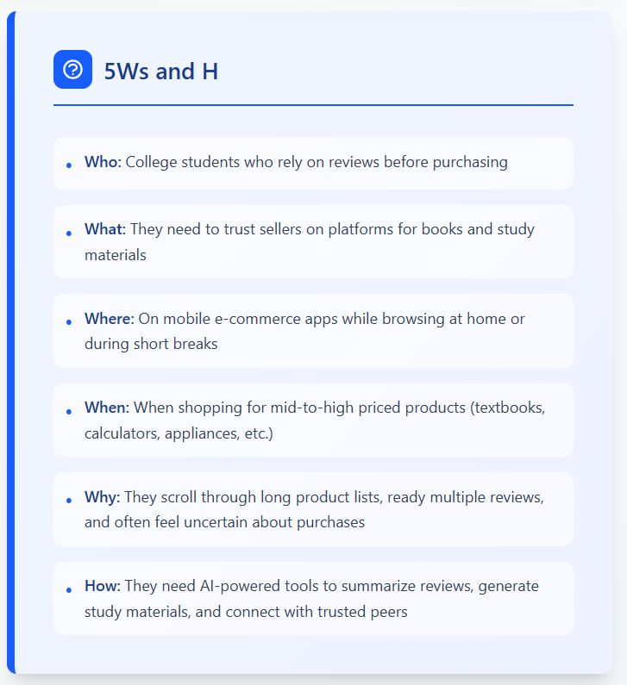

Slide 12

Goal Statement

Slide 13
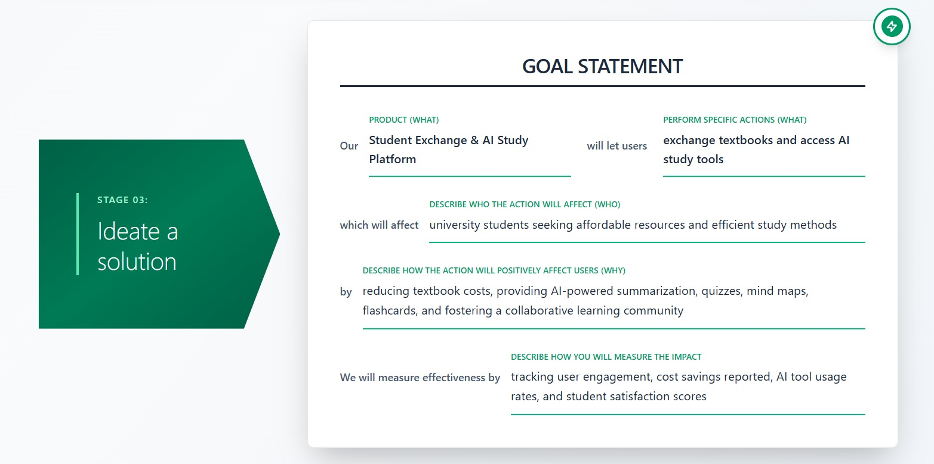

Slide 14


Similar Works:
Feature\System
Chegg
Facebook Student Groups
Book Exchange Websites
EduHub
Book Exchange
Study Tool Sharing
Limited
AI Chatbot Support
Student Community
Organized Categories
Limited
Field Based Classification
Student Focused Platform
Easy Resource Discovery
Limited
Free Access

Slide 15



Stakeholders:
Students
Developers
Community

Slide 16

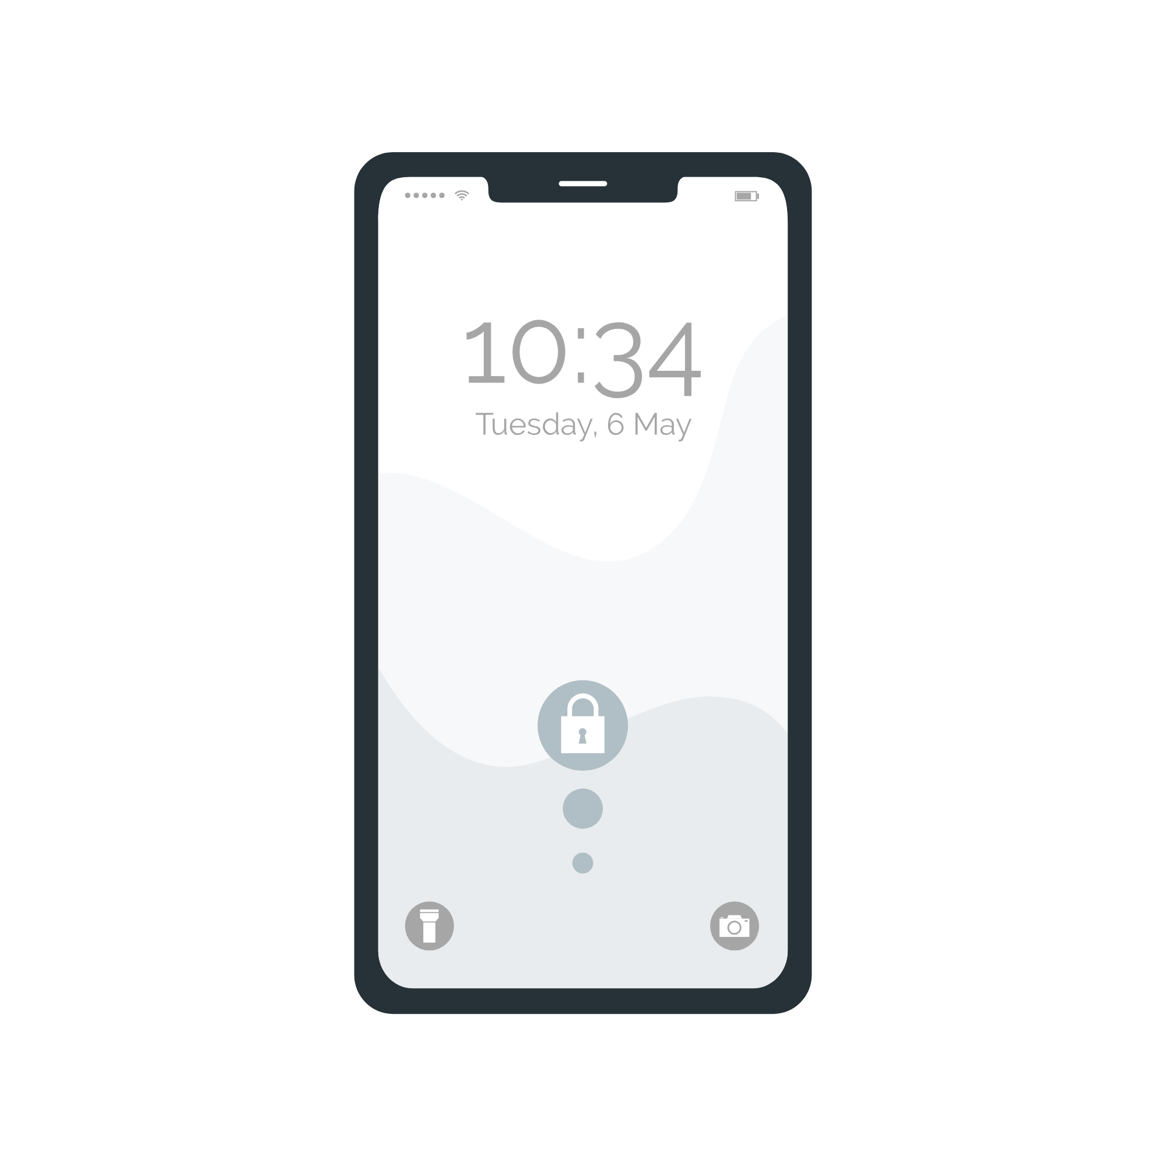

Hardware Requirement:
PC
Phone
Internet

Slide 17




Software Requirement:
HTML, CSS, Java Script, React Native
Python
MYSQL Database
AI

Slide 18

UX Research & Design

Slide 19
UX Research :
Survey Insights
1
Empathy map
2
Persona
3
Design Identity
4

Slide 20

Survey Insights

Slide 21
Demographics: Majority of respondents are university students (ages 18–23),
largely from Engineering and Medical backgrounds.
Key Statistics:
Resource Waste: Many students currently leave unused tools and books "without use" or simply store them.
Top Needs: AI-powered "Book Summaries" and "Exam Predictors" were ranked as high-priority features.
Exchange Preference: Students highly favor a "Mixed System" (Points + Cash) for transactions.

Slide 22
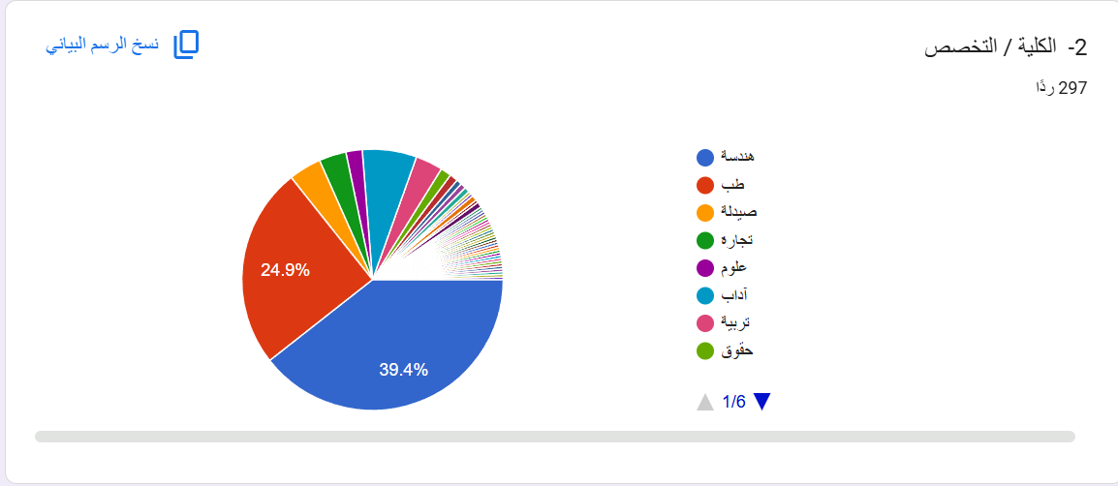

Slide 23
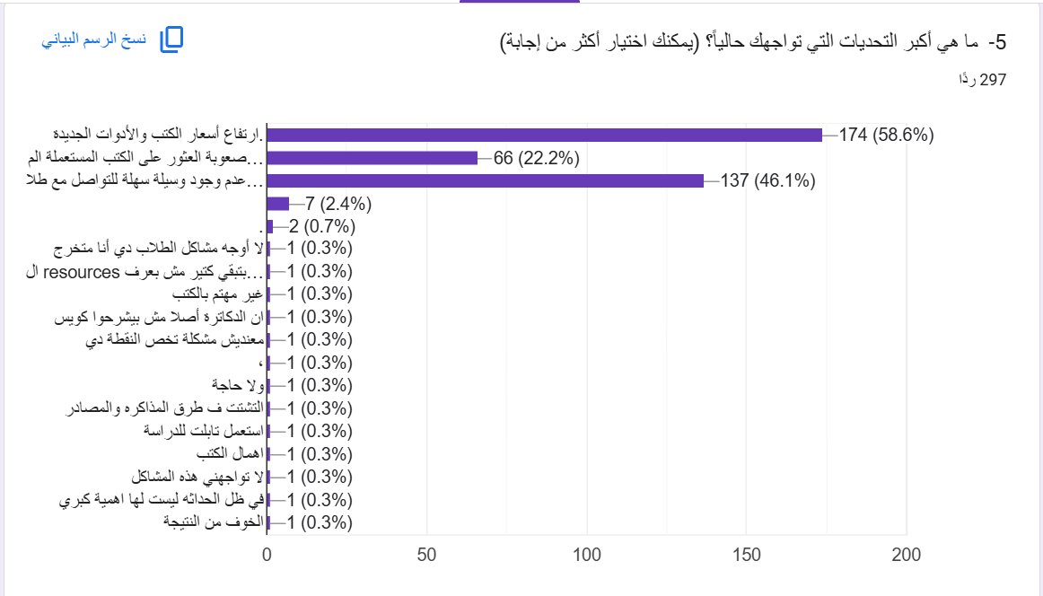

Slide 24
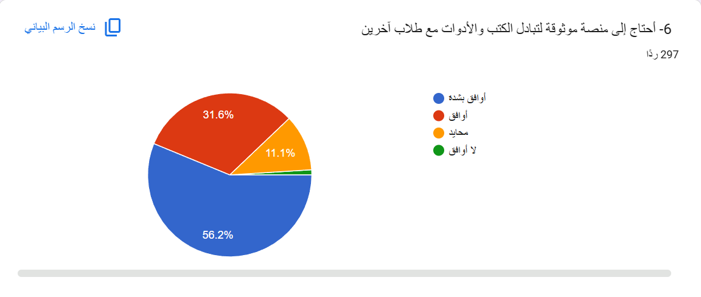

Slide 25

Empathy map

Slide 26
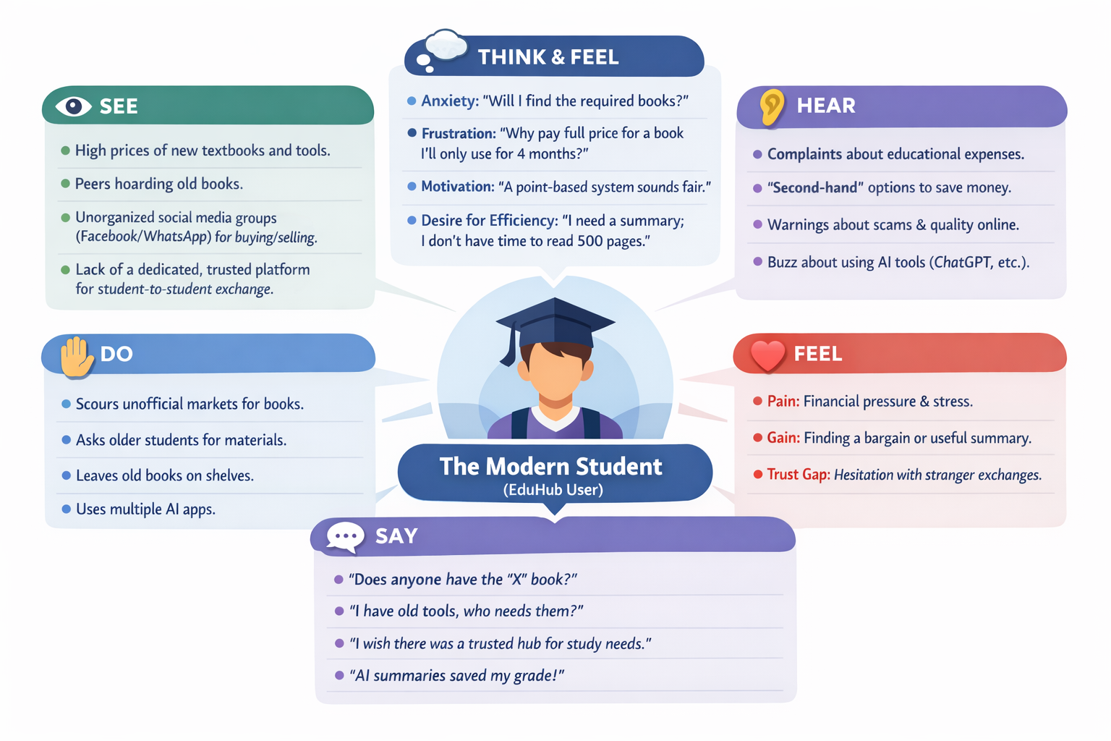

Slide 27

Persona

Slide 28
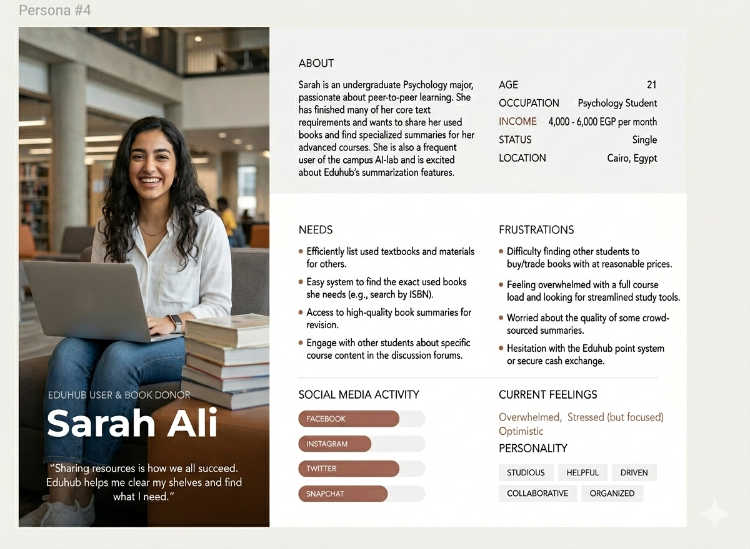

Slide 29

Design Identity

Slide 30
1. Color Palette
We selected a modern and user-friendly color palette that aligns with the educational purpose of the platform while maintaining a clean and soft visual experience.
Primary Color: Soft Indigo (#7477AF) – Represents creativity, focus, and a calm learning environment. It is used in key elements like buttons, highlights, and the footer.
Secondary Colors: Light Grey tones (#7A7A7A, #D9D9D9) – Used for text, placeholders, and subtle UI elements to maintain visual balance.
Background: White and very light grey (#f5f5f5) – Ensures high readability and a clean, modern interface.

Slide 31
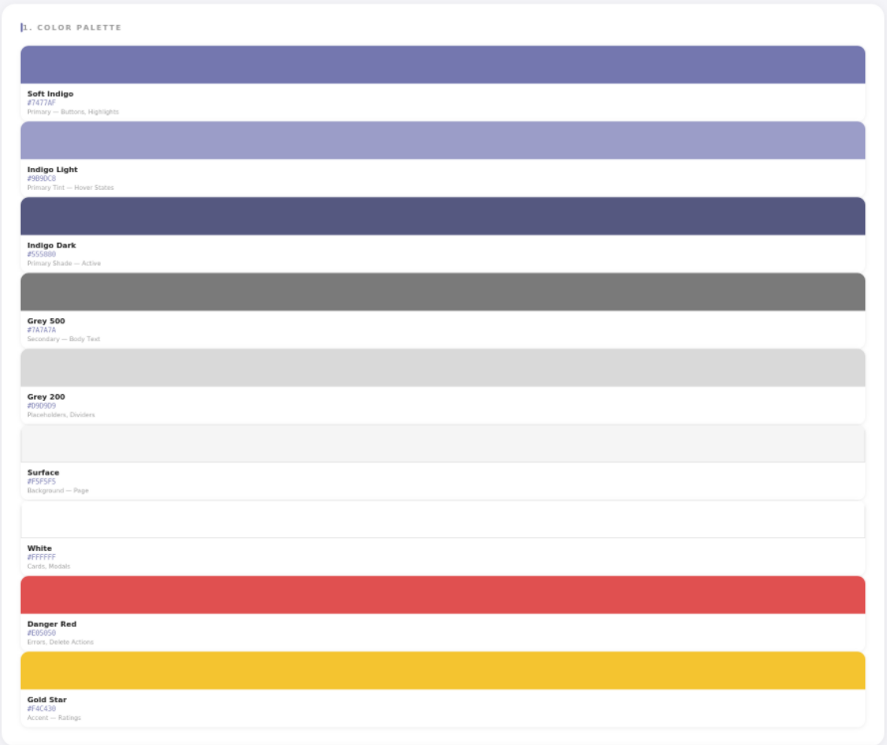

Slide 32
2. Typography
Our typography is designed to ensure clarity and readability, especially for students who spend long periods interacting with the platform.
Font Families: We used modern sans-serif fonts such as Roboto, Inter, Rubik, and Jost.
Inter & Rubik: Used for headings and branding to create a strong and modern identity.
Roboto: Used for body text to ensure readability.
Jost: Used in smaller elements like the footer.
Style: Bold weights are used for headings, while regular and medium weights are used for body text to create a clear visual hierarchy.

Slide 33
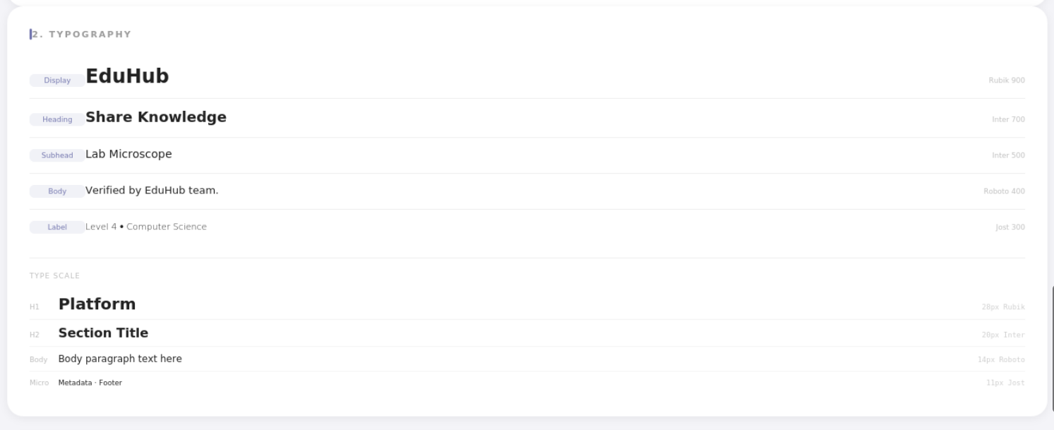

Slide 34
3. Buttons & Interactive elements
The UI elements follow a consistent and modern design language that enhances usability and user interaction.
Style: Rounded corners (border-radius) are used across buttons and containers to create a friendly and approachable interface.
Call to Actions (CTAs): Buttons such as “Sign In” use the primary color (#7477AF) with subtle transparency and borders to make them noticeable without being overwhelming.
Hover Effects: Smooth transitions, slight scaling (transform: scale), and color changes are applied to provide interactive feedback.
Shadows: Soft shadows are used in elements like the navbar and search box to create depth and a slightly elevated (floating) effect.

Slide 35
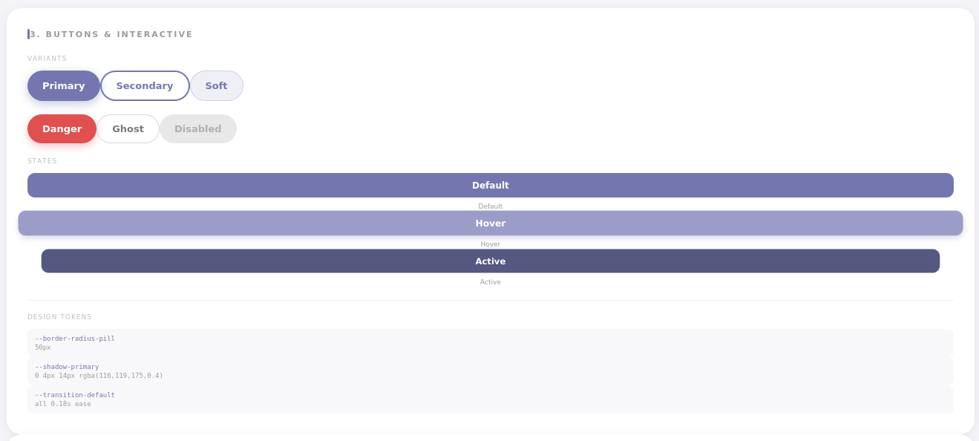

Slide 36
4. Icons & Imagery
Visual elements are designed to be clean, simple, and supportive of the content without causing distraction
Icon Style: Outline (linear) icons are used consistently across the interface (e.g., navbar, search bar, footer), giving a minimalist and modern appearance.
Image :
Placeholder boxes are used in grids to represent books and tools in a structured layout.
The hero section includes decorative background images to enhance visual appeal without affecting usability.
Layout: Content such as recommendations and categories is displayed using a clean grid system to ensure organization and easy navigation.

Slide 37
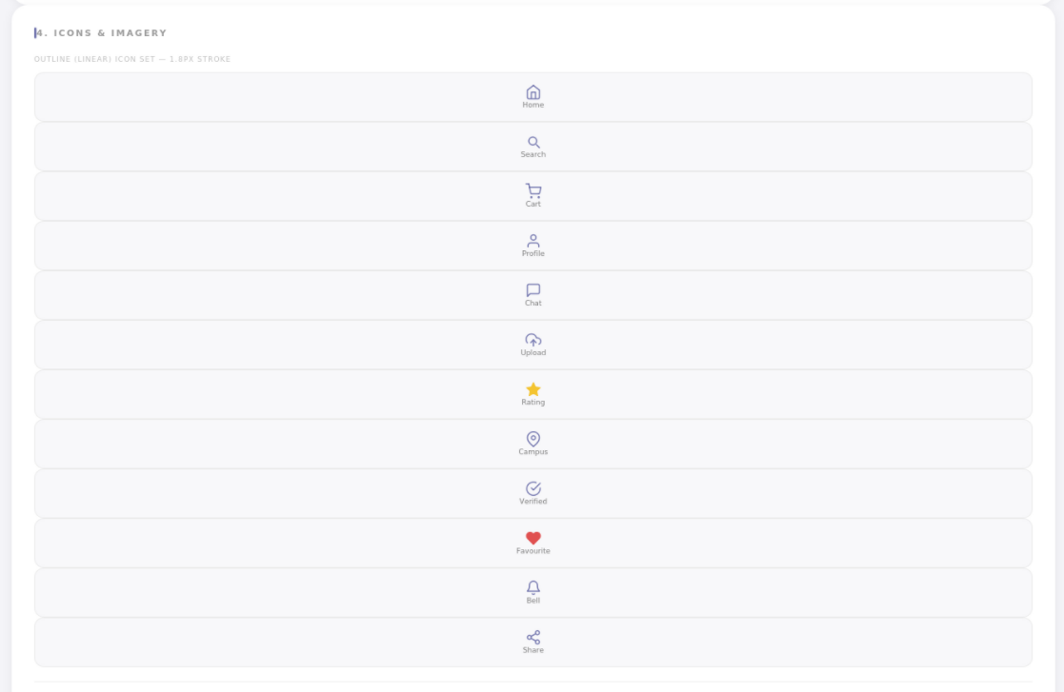

Slide 38
4. Wireframes (Figma)
Before moving to the high-fidelity design, we created low-fidelity wireframes using Figma to define the user flow and overall layout structure of the platform.
Navigation Logic: Focused on a top navigation bar that provides easy access to main sections such as Home, Community, Chatbot, Upload, Cart, and Profile, ensuring clear and direct navigation.
Structure: A card-based and grid layout was designed to display books and tools in an organized and visually consistent way (as seen in categories and recommendations sections).
UX Goal: Reduce the number of steps needed for users to find books or tools, while maintaining a simple and intuitive browsing experience.
Additional Focus: Included a hero section with a search bar to allow users to quickly search for books directly from the homepage.

Slide 39
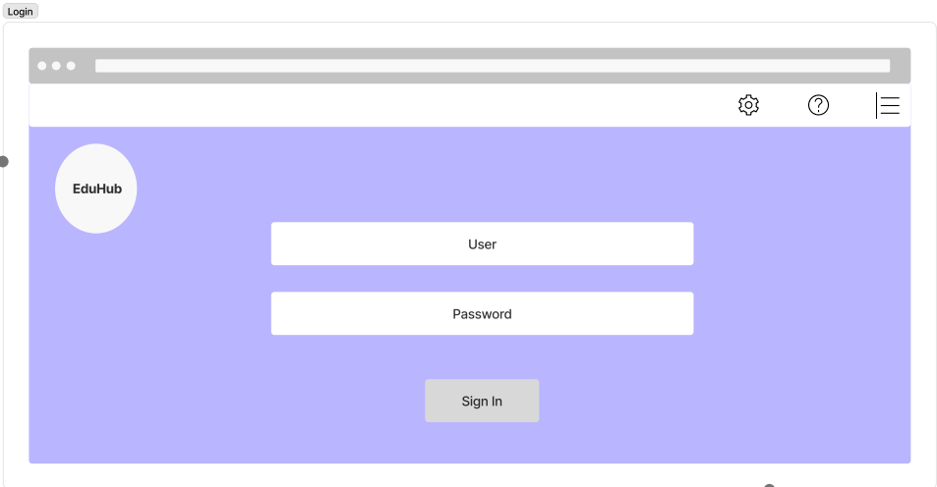
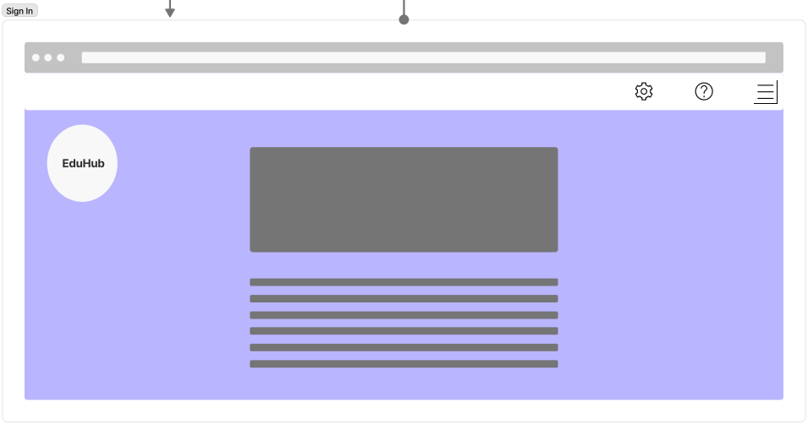

Slide 40
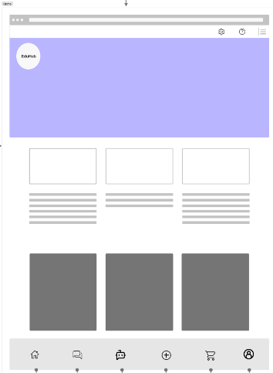
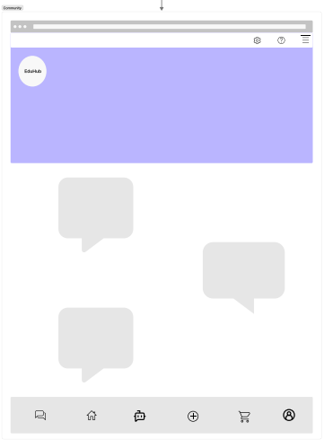

Slide 41
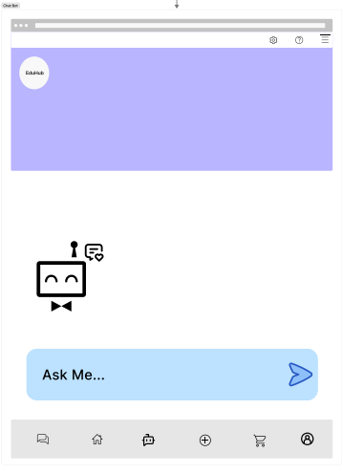
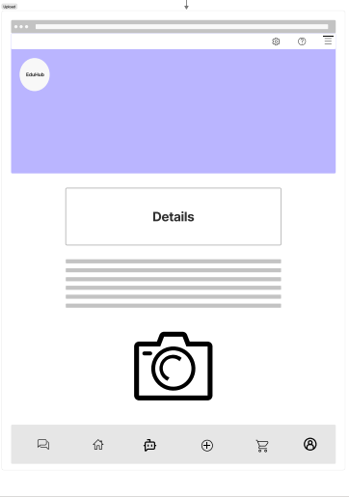

Slide 42
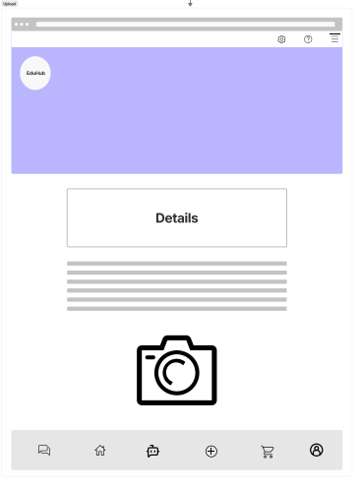
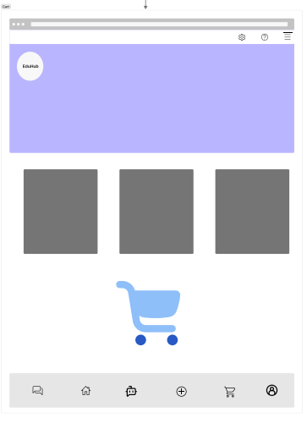

Slide 43

User Interface

Slide 44
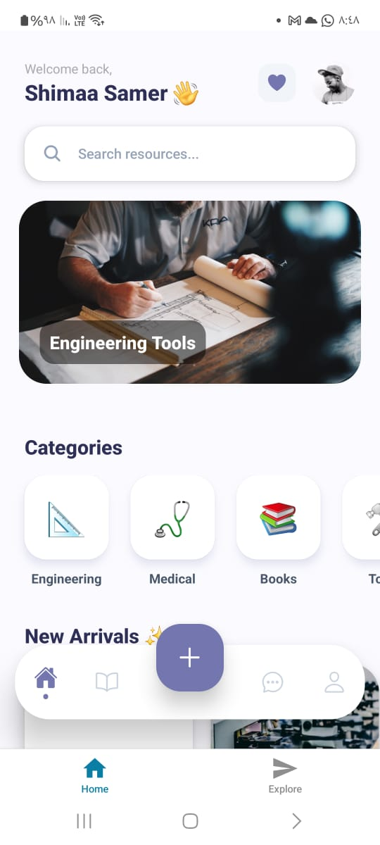
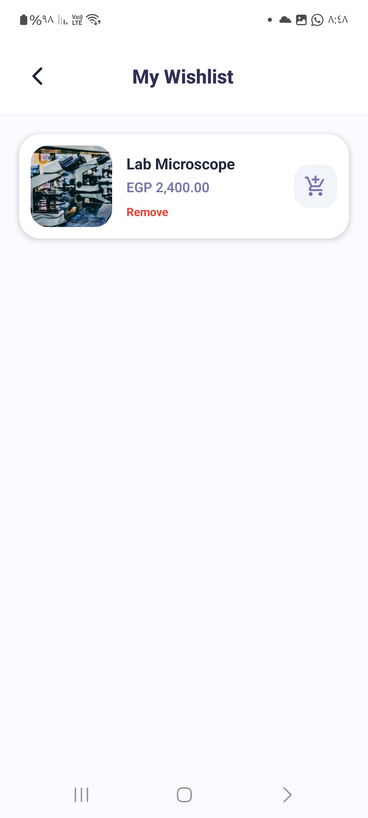

Slide 45
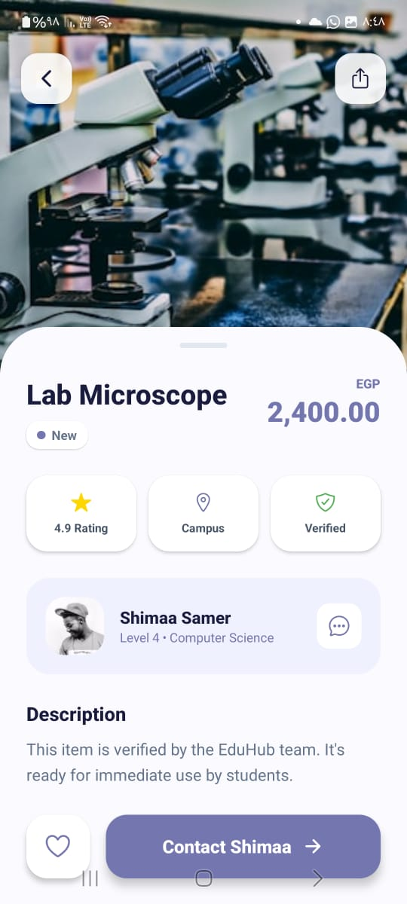
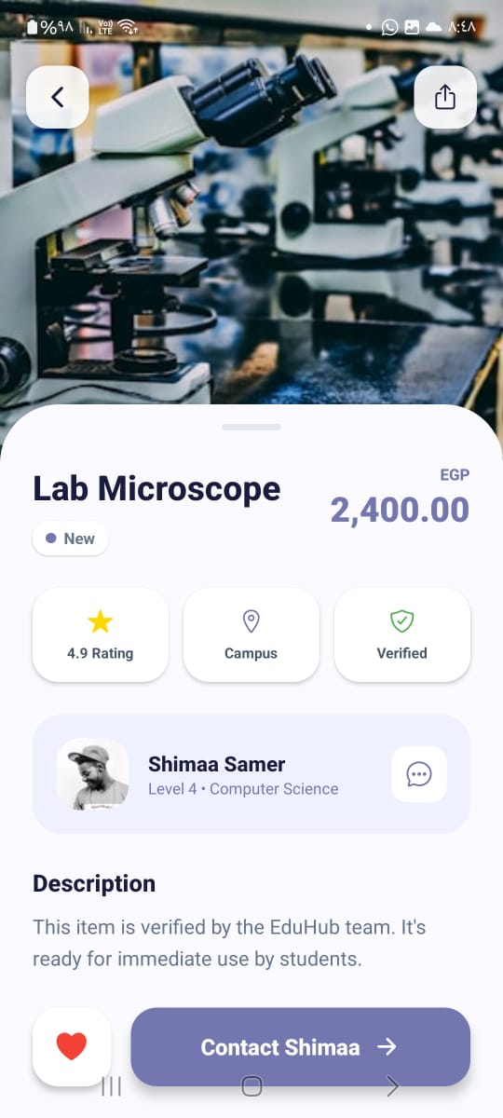

Slide 46
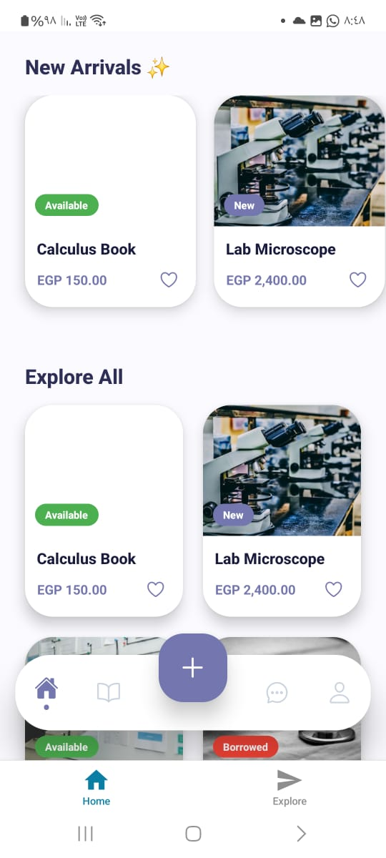
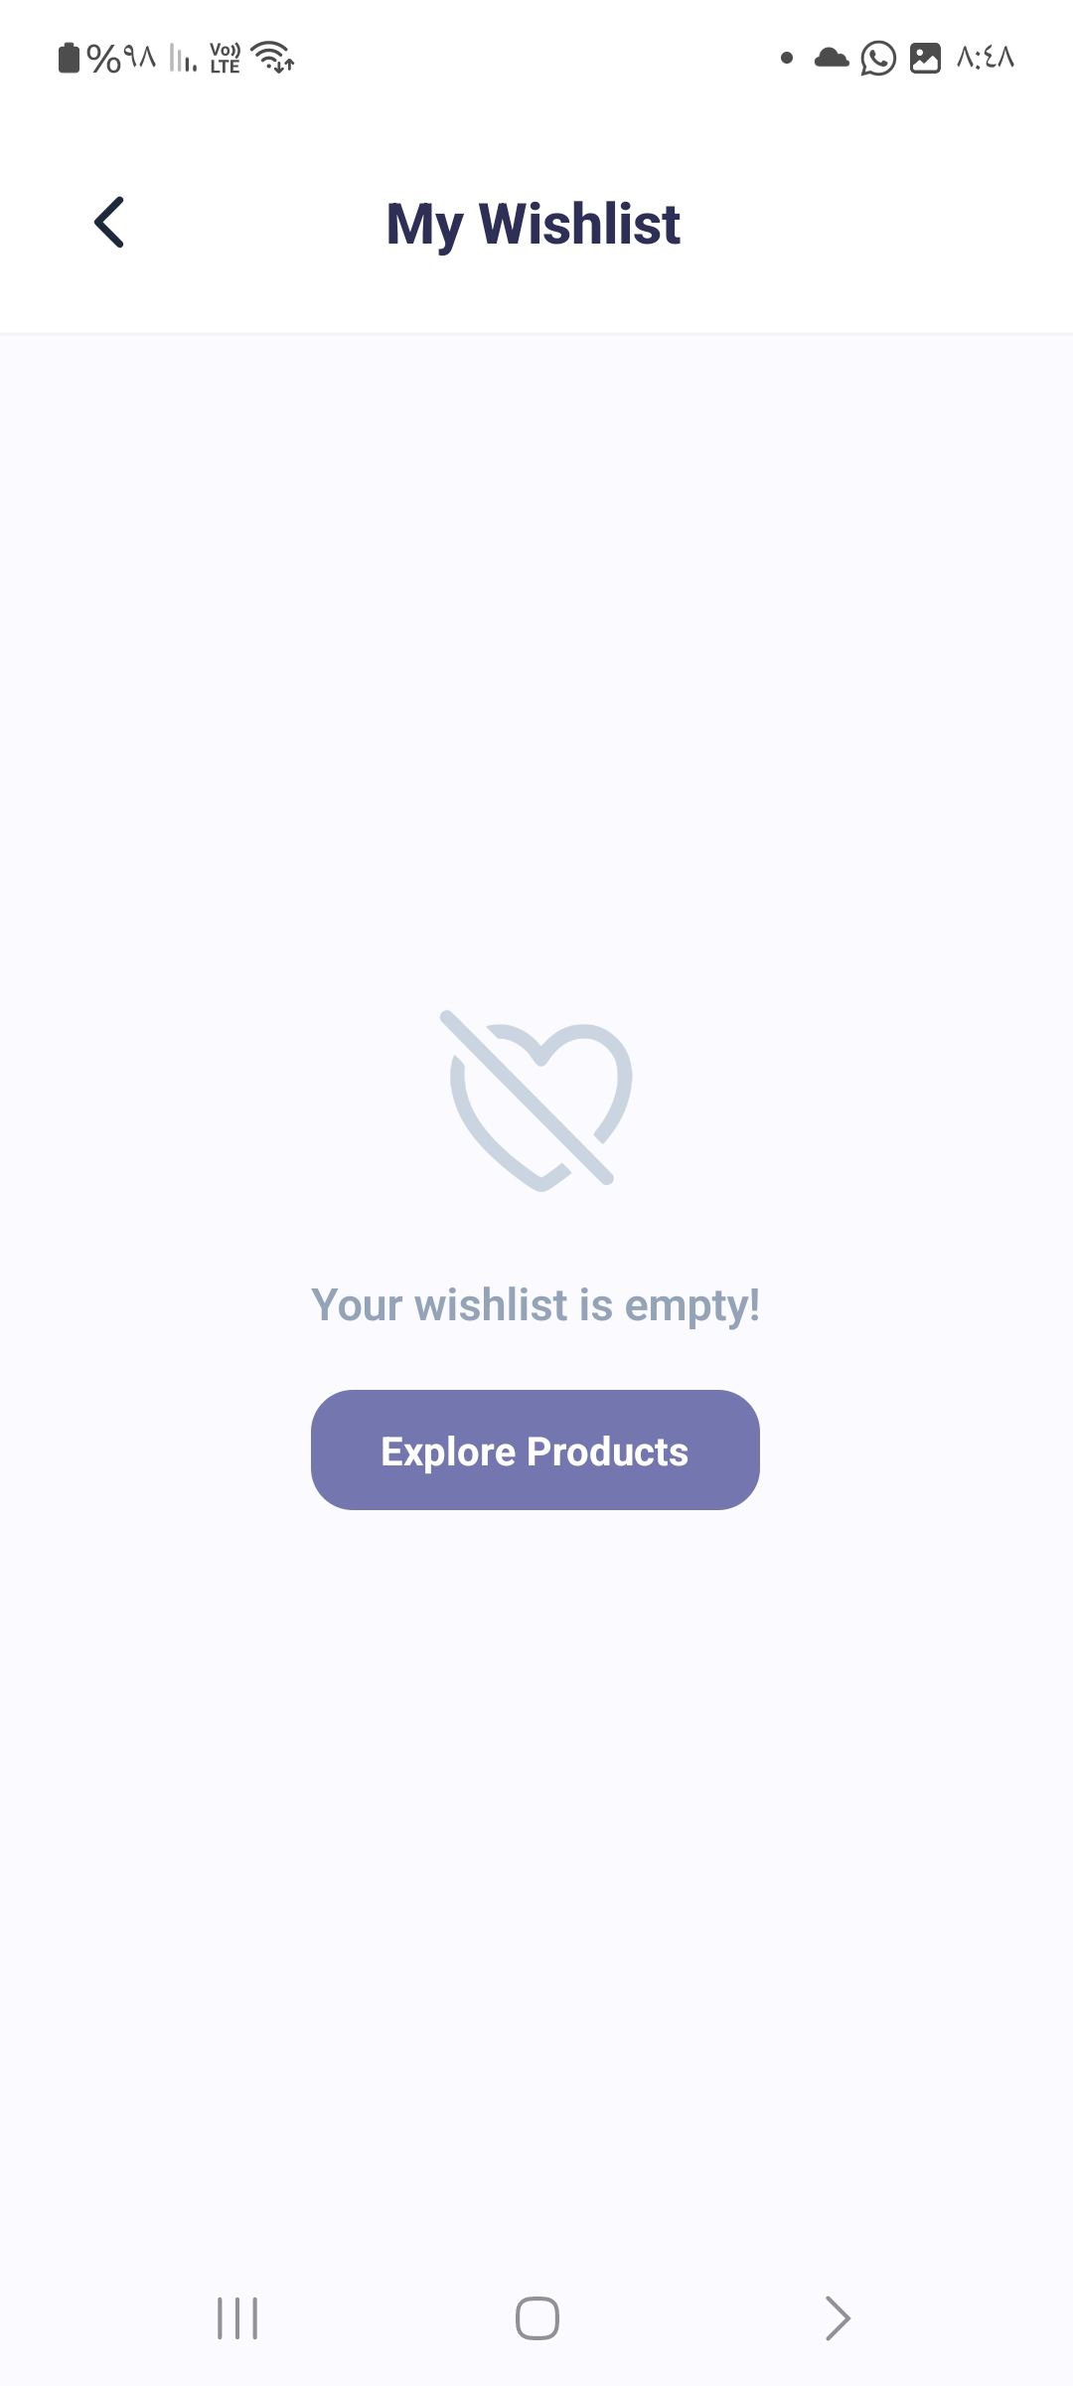

Slide 47
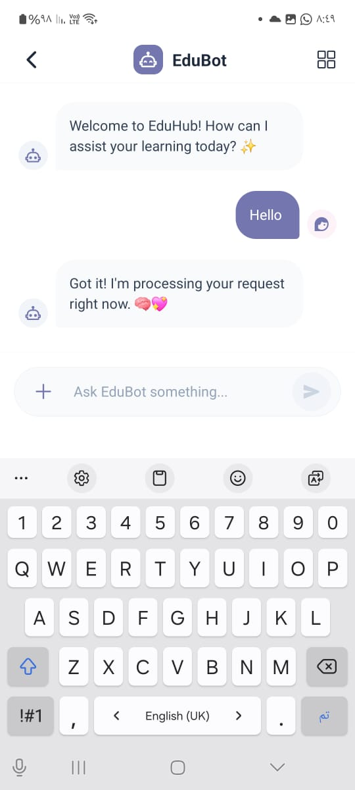
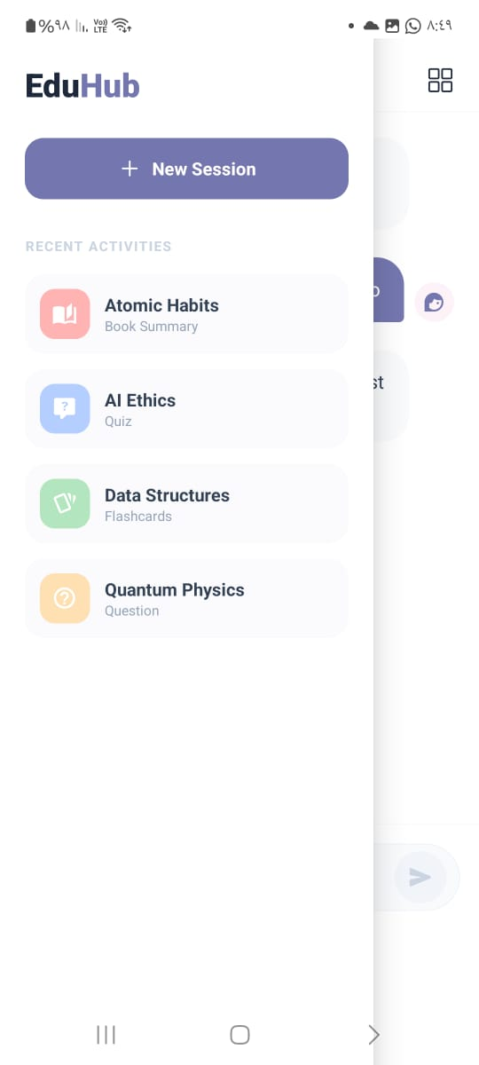
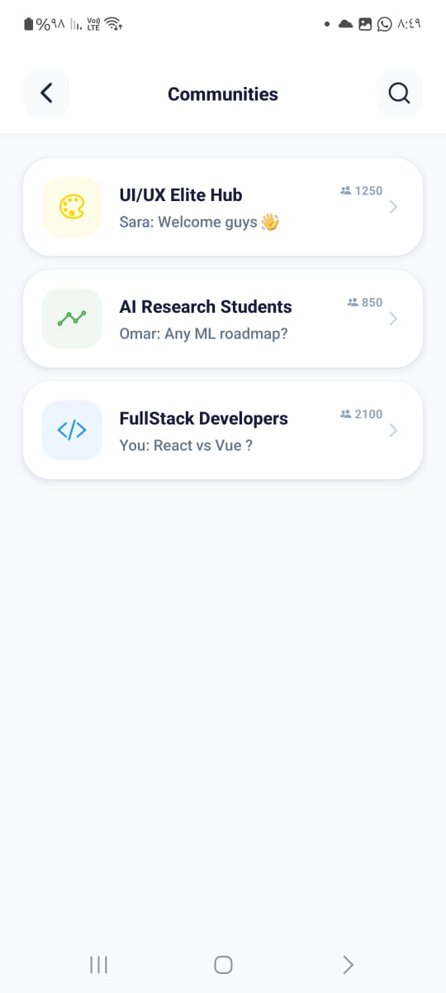

Slide 48

Code Implementation

Slide 49
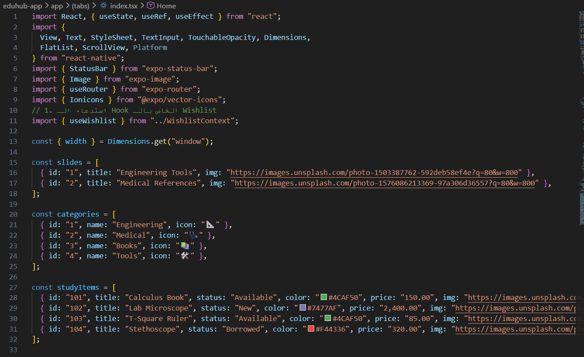

Slide 50
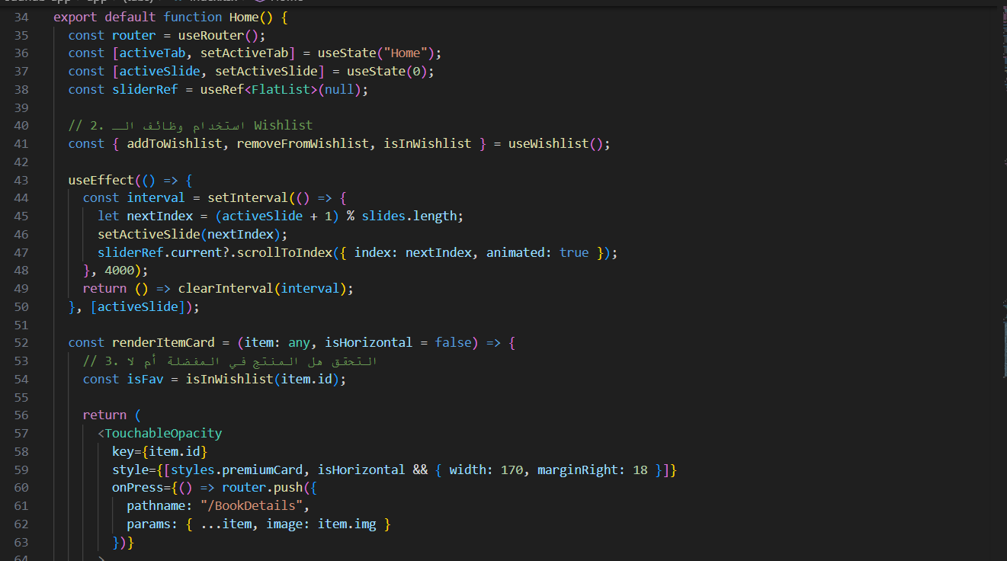

Slide 51
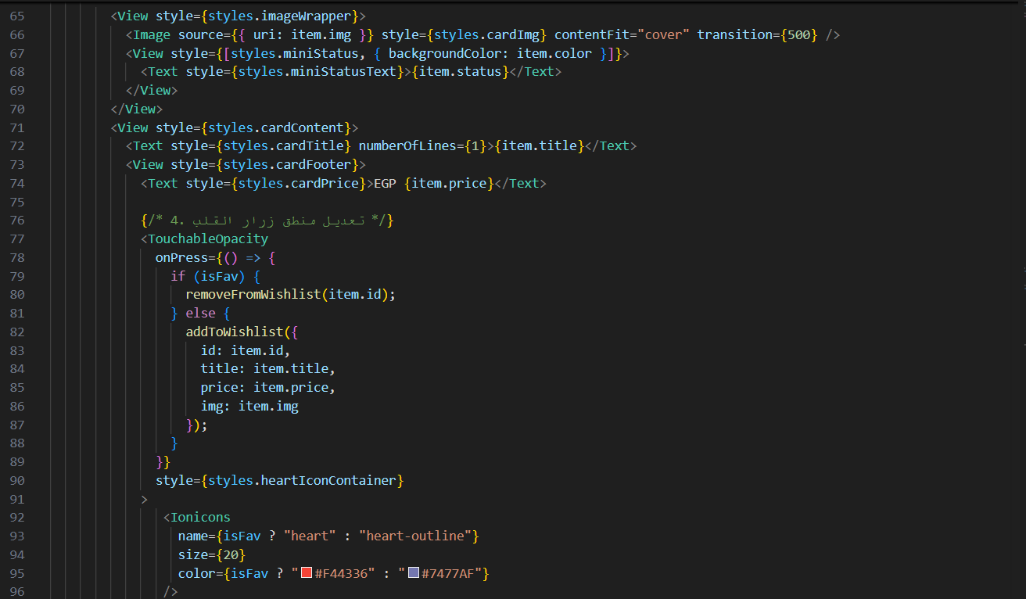

Slide 52
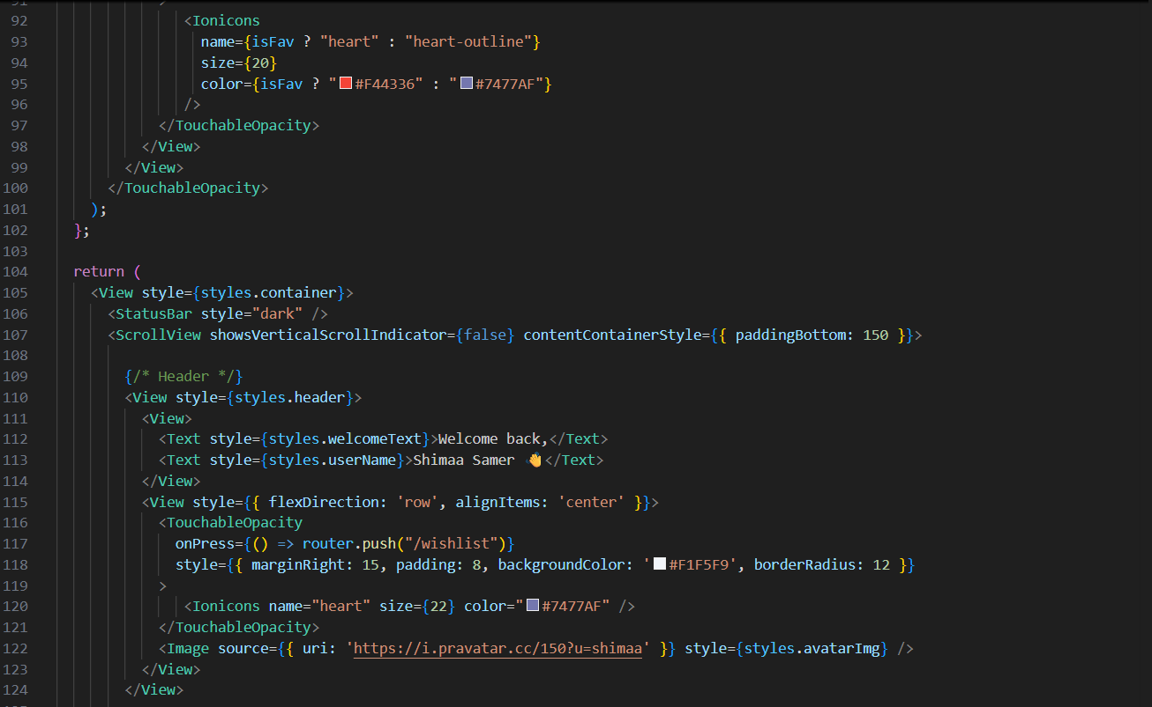

Slide 53
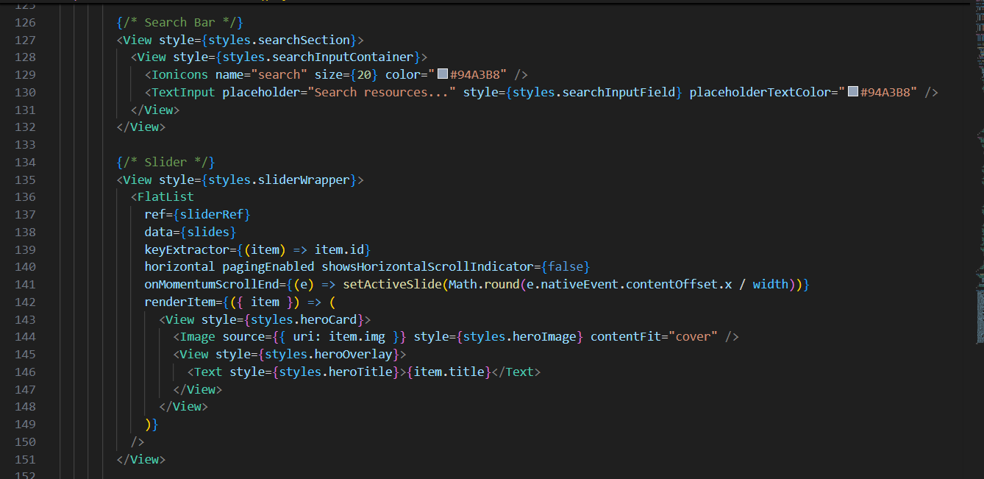

Slide 54
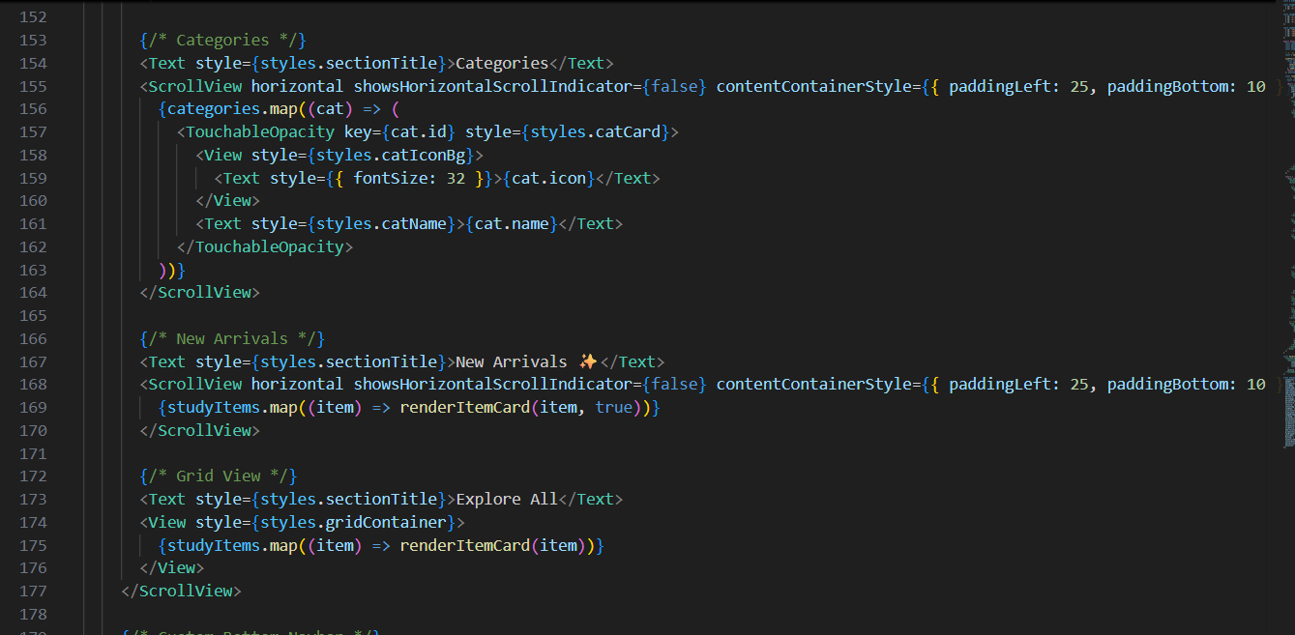

Slide 55
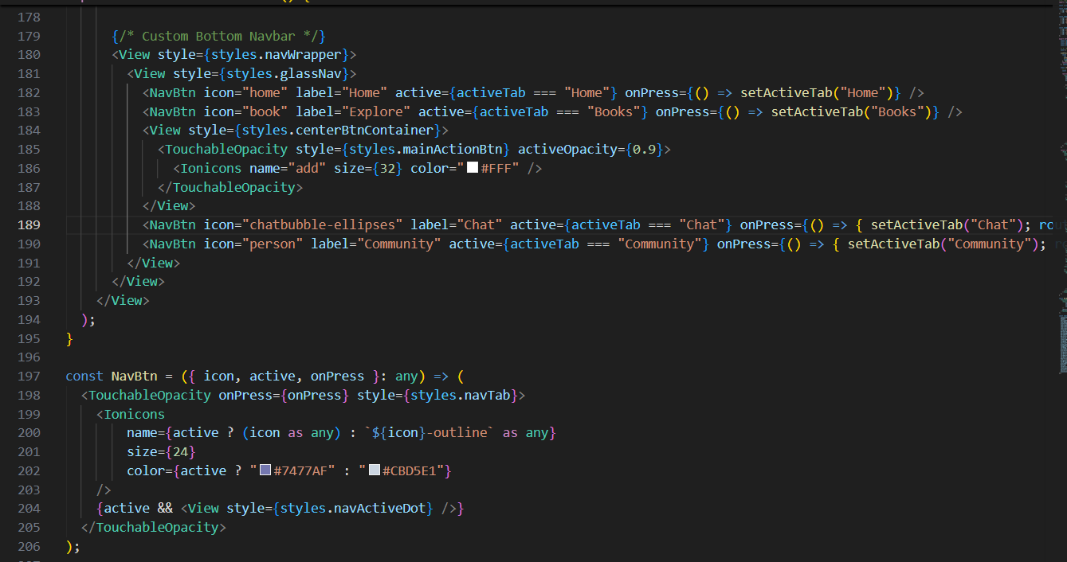

Slide 56
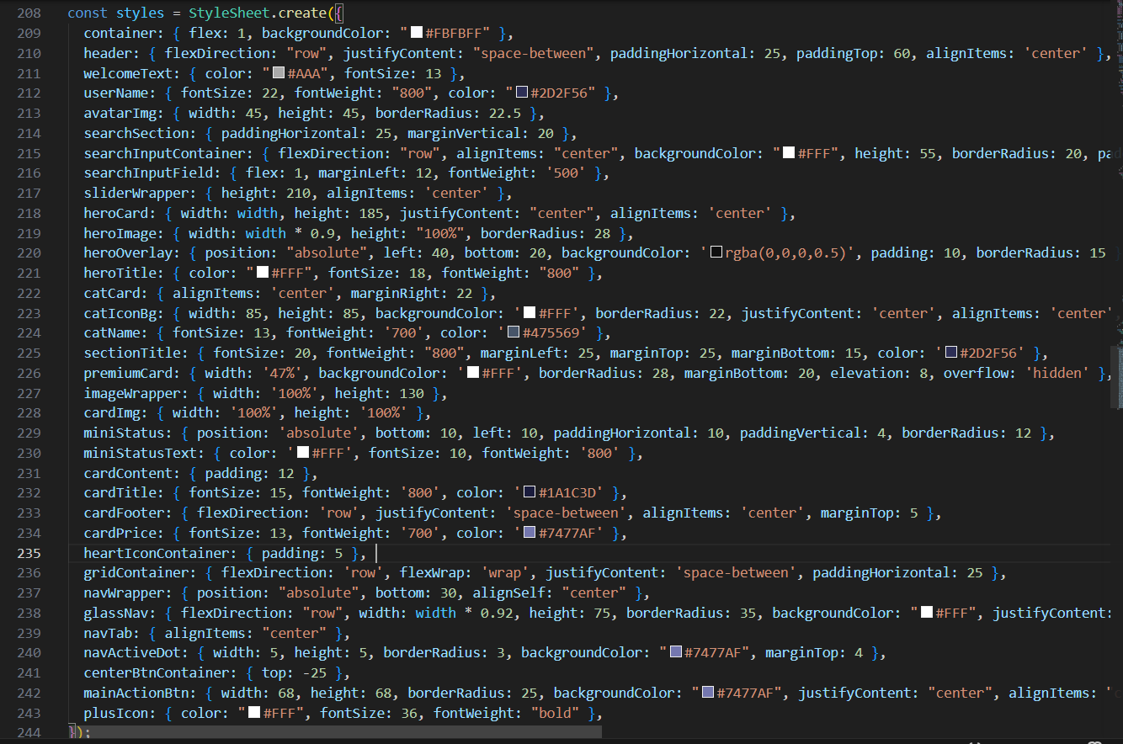

Slide 57

Project Demo

Slide 58
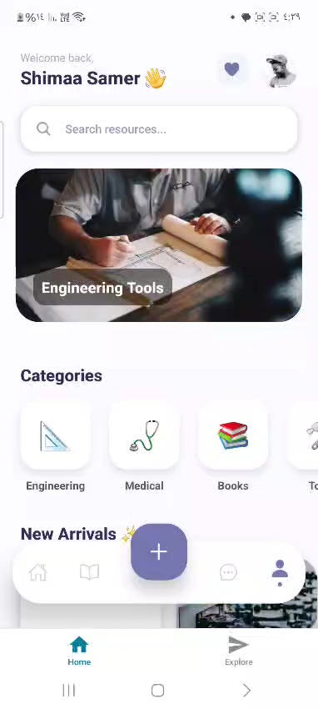
Project Demo:

Slide 59

Thank You

