Slide 1
Final Project - Pet Adoption
By Shimeng Cao, Jiarong Li, and Evan Okin

Slide 2
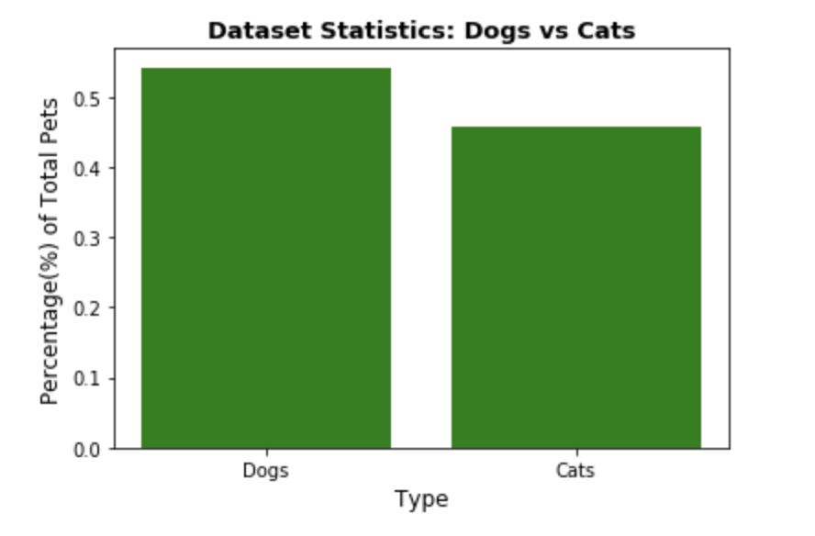
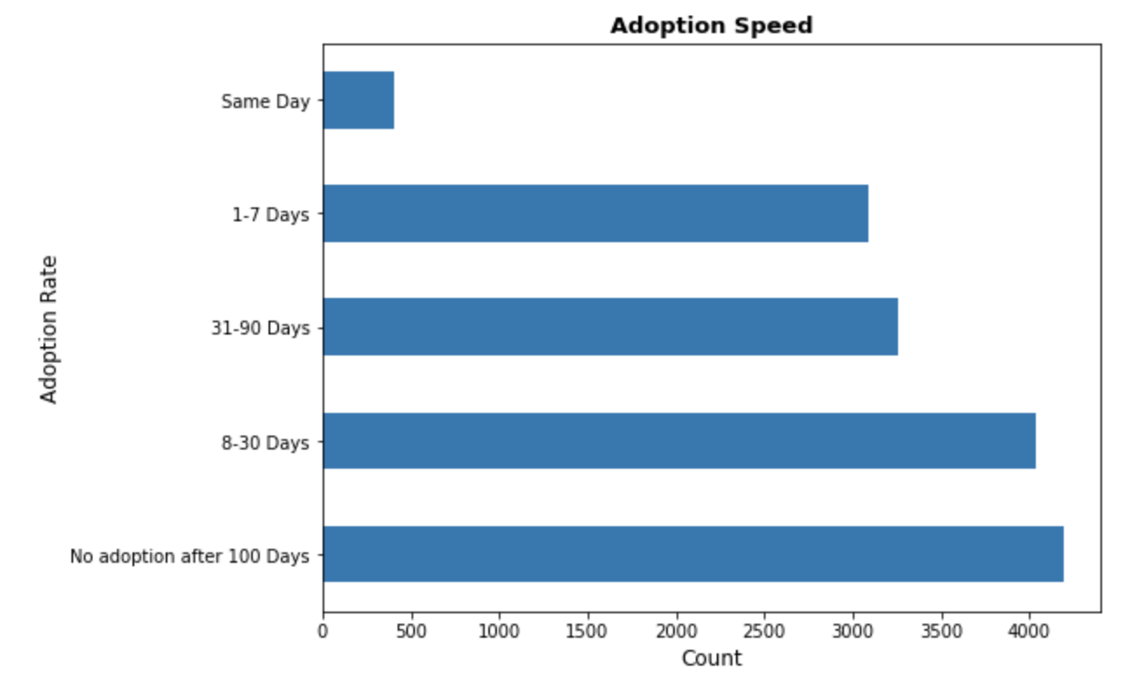
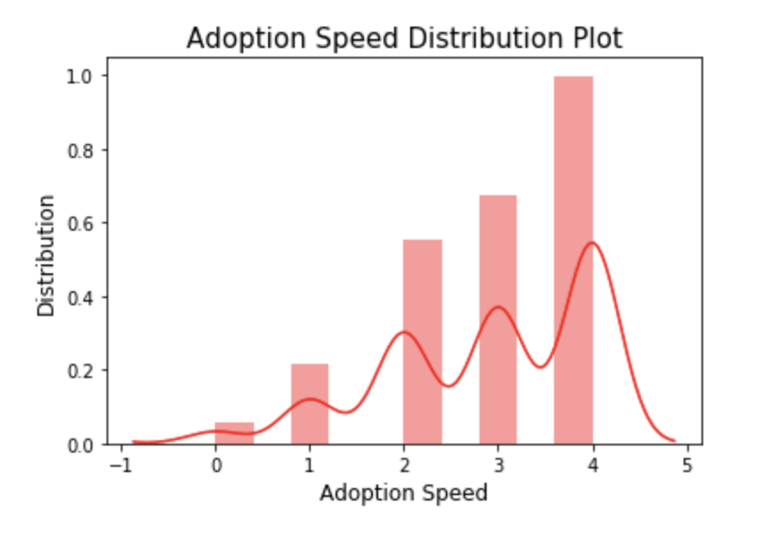
Data Exploration and Cleaning
The sad truth is that many pets don't get adopted quickly (or, they don't get adopted at all.
Nearly 28% of all pets in our dataset were not adopted after 100 days.
We filtered on pets who possess are vaccinated, are dewormed, are sterilized, are either healthy or have only a minor injury, have no adoption fee, and age of less than 1 year. Surprisingly, 40% of our sliced dataset were still not adopted

Slide 3
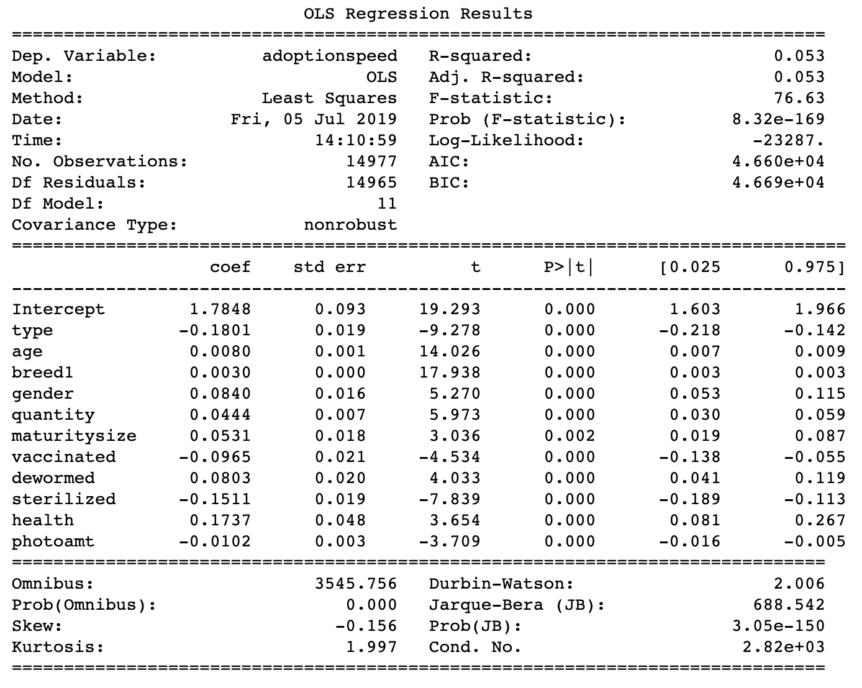
2. Regression Analysis
This reg_total model takes multiple independent variables which were tested to be statistically significant in impacting the dependent variable 'adoptionspeed'.
This model explains 5.3% of the total variable in the independent variables, which is still a small amount.
Based on the coefficient of each independent variable, dogs tend to be more likely to be adopted than cats, younger pets tend to be more likely to be adopted than older pets, and higher code primary breeds tend to be more likely to be adopted than lower code primary breeds.

Slide 4
3. ML for the Regression Problem (pet adoption speed)
5.36%
12.51%
15.37%
R-Sqaured of the regression model using 5-fold cross validation
R-Sqaured of the KNN model using 5-fold cross validation
R-Sqaured of the Random Forest model using 5-fold cross validation
Y = adoptionspeed
X = type + age + breed1 + gender + quantity + maturitysize + vaccinated + dewormed + sterilized + health + photoamt
k= 68
n_estimators=200
max_depth = 9
max_features = 5

Slide 5
4. ML for the Classification Problem (adopted vs. not adopted)
72%
74.33%
75.65%
Accuracy of the regression model using 5-fold cross validation
Accuracy of the KNN model using 5-fold cross validation
Accuracy of the Random Forest model using 5-fold cross validation
Y = adoption_indicator
X = type + age + breed1 + gender + quantity + maturitysize + vaccinated + dewormed + sterilized + health + photoamt
K = 65
n_estimators=200
max_depth = 11
max_features = 4

