Slide 1
Relativity of Wage to Financial Situations
Charlie Vang

Slide 2
Topic
My goal for this project was to look at the variables that can affect financial situations in the economy of some states in the U.S.
Situations refer to the unemployment rate, consumption, and amount of SNAP benefit holders there are.

Slide 3
Variables and Data
Variables
Unemployment Rate
Average Wage(Private Sector)
Snap Benefits Holders
Personal Consumption Expenditure
BA+ Degree Holders
These data were pulled from https://fred.stlouisfed.org based on the states of
CA
FL
OR
OH
TX
NY

Slide 4
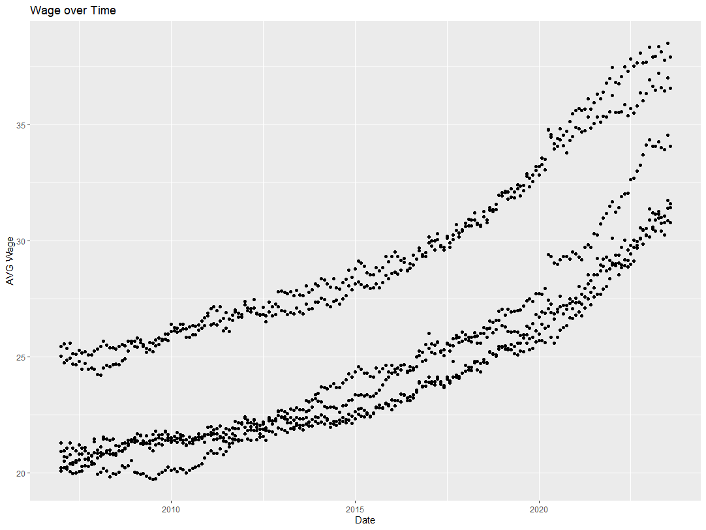
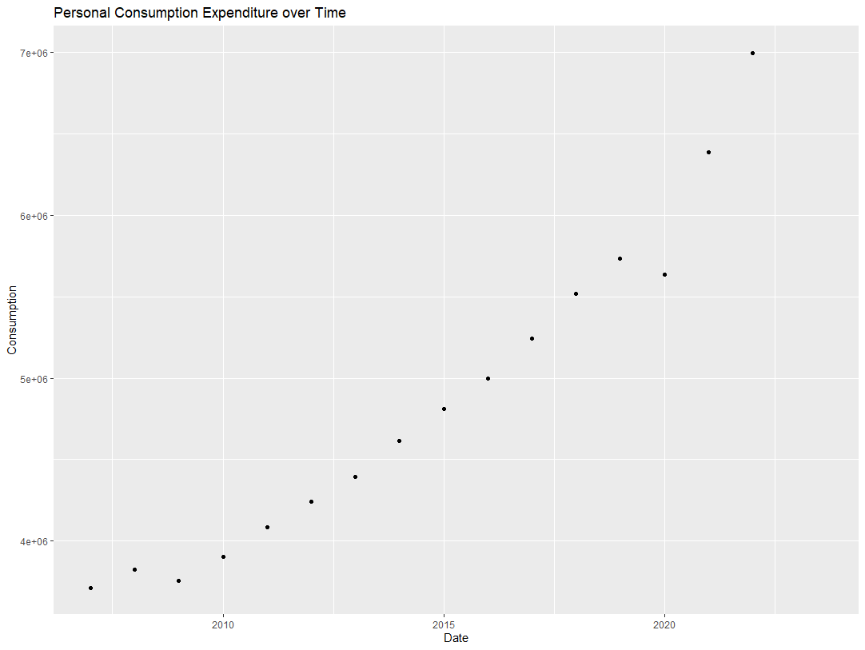
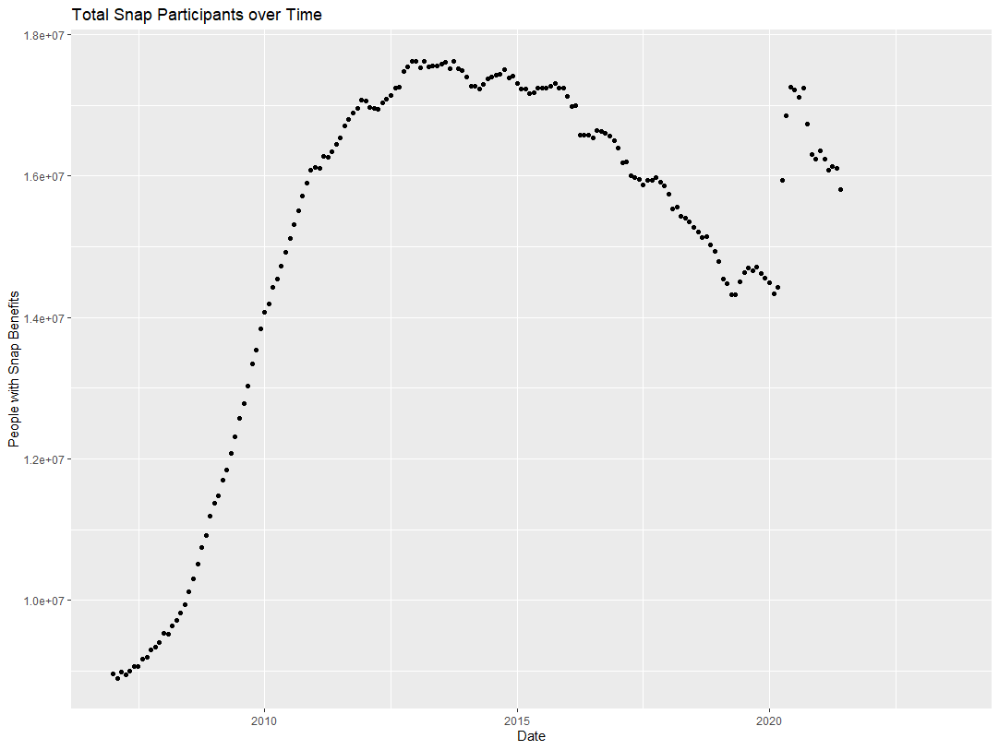
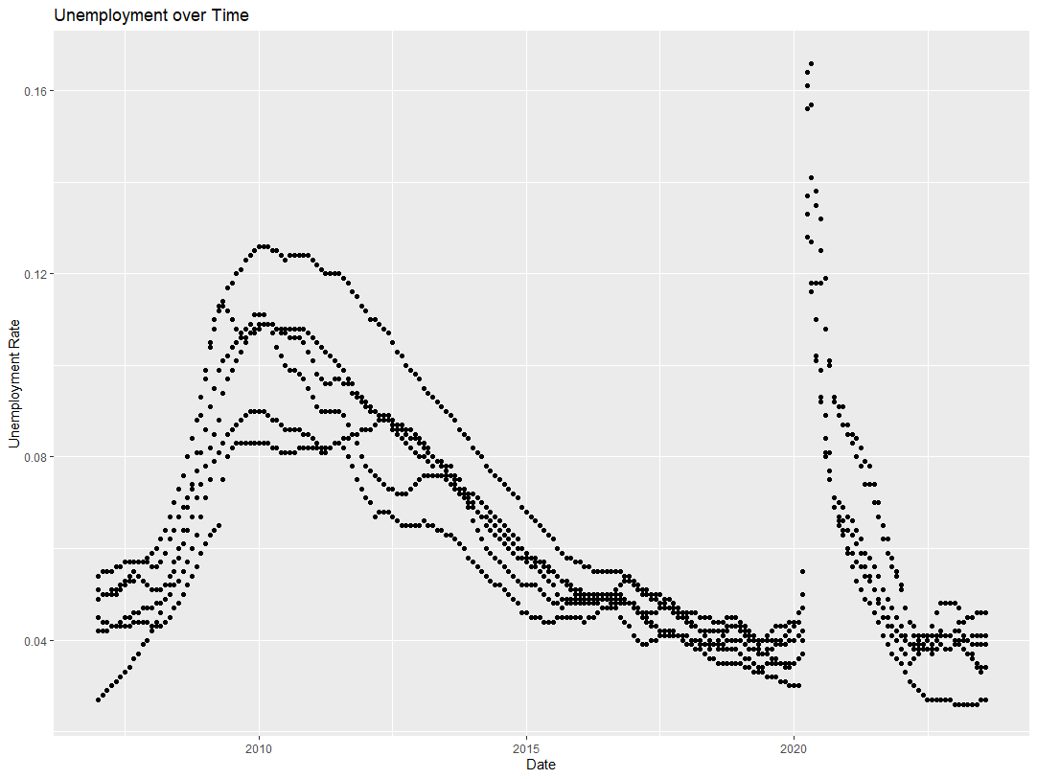
Over Time Scatterplots

Slide 5
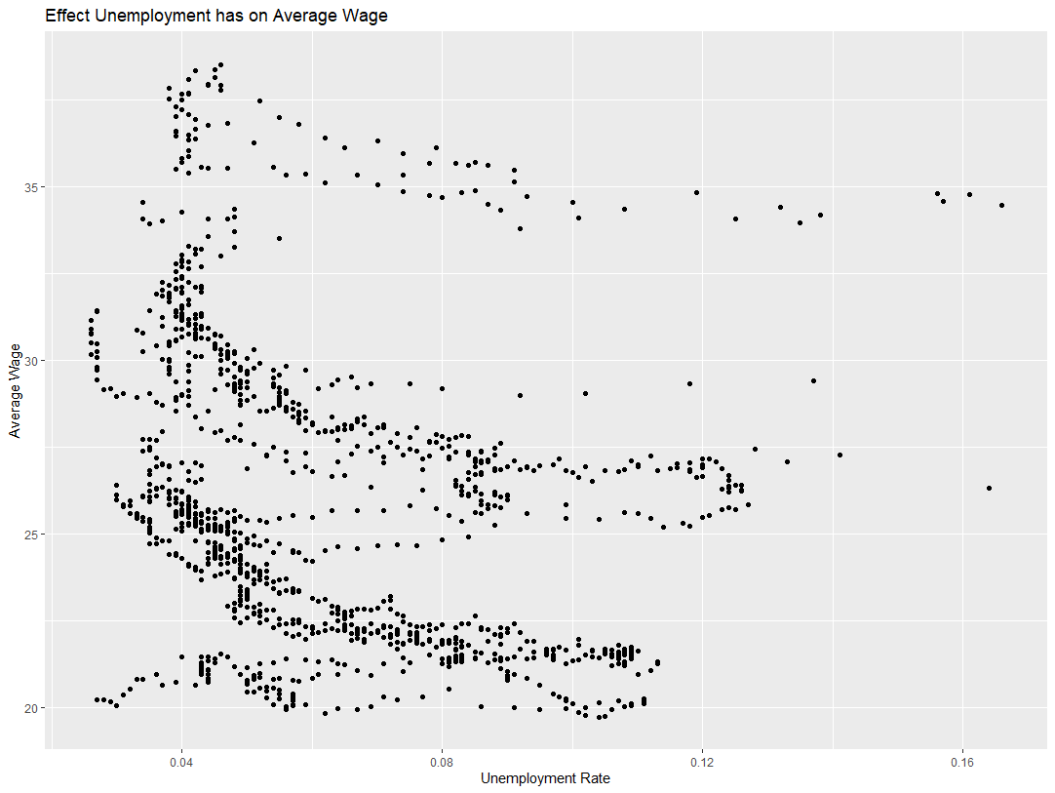
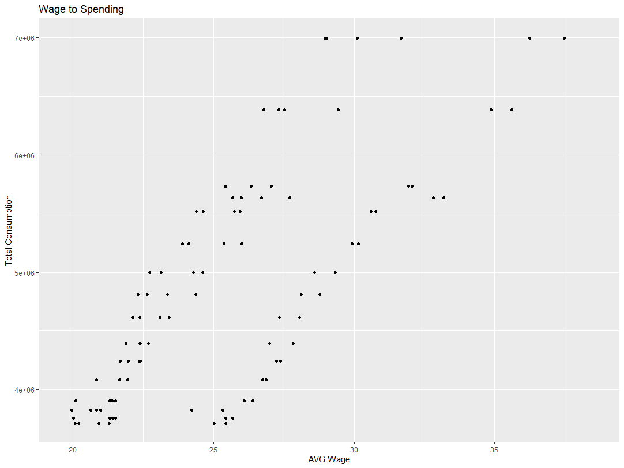
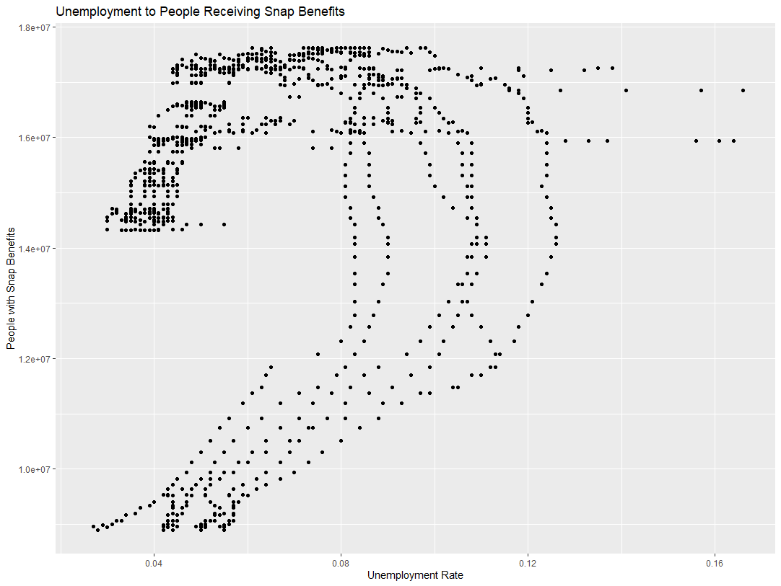

Slide 6
Descriptive Statistics
 | Unemployment Rate | AVG Wage | Snap total | BA+ Degree
Mean | 0.063 | 25.99 | 15143963 | 0.307
Median | 0.055 | 25.50 | 16099713 | 0.301
St. Dev. | 0.025 | 4.33 | 2596195 | 0.027
Max. | 0.016 | 38.51 | 17630011 | 0.35
Min. | 0.02 | 19.73 | 8900983 | 0.27

Slide 7
Regressions/Interpretations
Reg1 <- lm(test$`AVG Wage`~test$`Unemployment Rate`+ test$Percent_BA, data = test)
AVG_Wage=-12.92 + 31.26(Unemployment Rate) + 1.19(Percent_BA) R=0.64 R^2= 0.63
Reg2 <- lm(test$Total_PCE~test$`AVG Wage`+test$`Snap Total`, data = test)
Total_PCE=6.949e+04 + 1.321e+05(AVG Wage) + 8.969e-02(Snap Total) R=0.54 R^2=0.53
Reg3 <- lm(test$`Snap Total`~test$`AVG Wage`+test$`Unemployment Rate`, data = test)
Snap_Total=8254643 + 223047(AVG Wage) + 19558094(Unemployment Rate) R=0.11 R^2=0.11
Reg4 <- lm(test$Total_PCE~test$`Unemployment Rate`+test$`AVG Wage`, data = test)
Total_PCE=1639618 -13389243(Unemployment Rate) + 159425(AVG Wage) R=0.64 R^2= 0.63

Slide 8
Possible Additional Variables
Average Housing Cost
Homeless Percentage
Unemployment Benefit Holders

