Slide 1



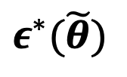



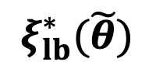






$$M_{\tilde{θ}}^{svt}$$
$$\tilde{θ_{1}}$$
$$5.1$$
Low
$$10$$
$$ξ_{lb}^{∗}(\tilde{θ})$$
$$ε^{∗}(\tilde{θ})$$
$$ε_{c}$$
$$19$$
$$1.2$$
Mid
$$1.5$$
$$1.8$$
$$0.85$$
High
$$0.9$$
$$1.0$$

