Slide 1

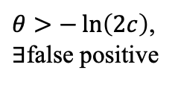

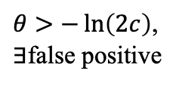



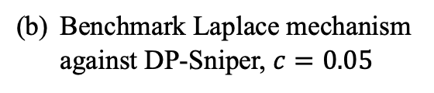



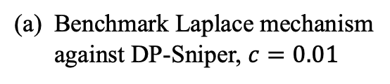
Benchmark Laplace mechanism against DP-Sniper, $c=0.01$
Benchmark Laplace mechanism against DP-Sniper, $c=0.05$
$$ξ^{∗}(θ)$$
$$ξ^{∗}(θ)$$
$$ε_{c}$$
$$ε_{c}$$
$$ε^{∗}(θ)$$
$$ε^{∗}(θ)$$
$θ>−\ln\left(2c\right)$,
$∃$false positive
$θ>−\ln\left(2c\right)$,
$∃$false positive
$$θ$$
$$θ$$

