Slide 1





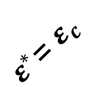


$$ε^{∗}$$
$ε^{∗}$=${ ε}_{c}$
M is not $ε_{c}$-DP
False
Positive
M is $ε_{c}$-DP
True Negative
True Positive
$$ξ^{∗}$$
Infeasible region
False
Negative
$$0$$
$$ε_{c}$$
Negative
$$ξ^{∗}$$
Positive

