Slide 1



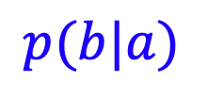






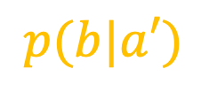



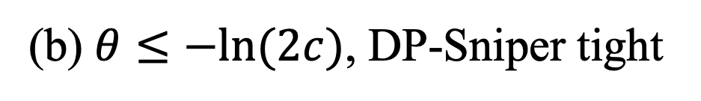


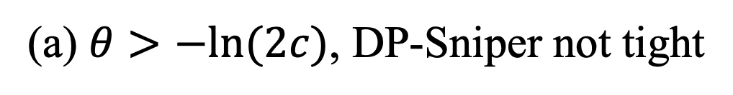


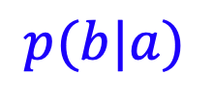

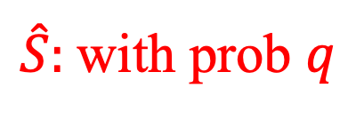





$r\left(b\right)$=$\frac{p(b|a)}{p(b|a^{′})}$
$r\left(b\right)$=$\frac{p(b|a)}{p(b|a^{′})}$
$$t^{∗}$$
$$t^{∗}$$
$$\hat{S}$$
$\hat{S}:$with prob $q$
$$S^{∗}$$
$$S^{∗}$$
$$p(b|a)$$
$$p(b|a′)$$
$$p(b|a)$$
$$p(b|a′)$$
$$c$$
$c$/$q$
$$b$$
$$b$$
$$−∞$$
$$0$$
$$μ\text{=}Δ$$
$$∞$$
$$−∞$$
$$0$$
$μ$=$Δ$
$$∞$$
(a) $θ>−ln(2c)$, DP-Sniper not tight
(b) $θ≤−ln(2c)$, DP-Sniper tight

