Slide 1












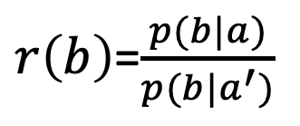






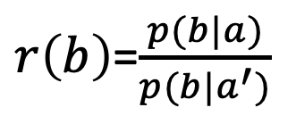











$r\left(b\right)$=$\frac{p(b|a)}{p(b|a^{′})}$
$r\left(b\right)$=$\frac{p(b|a)}{p(b|a^{′})}$
$$∞$$
$$∞$$
$$t^{∗}$$
$$t^{∗}$$
$\hat{S}:$prob $1$
prob $q$
$\hat{S}:$prob $1$
prob $q$
$$0$$
$$0$$
$$S^{∗}$$
$$S^{′}$$
$$S^{∗}$$
$$S^{′}$$
$$p(b|a)$$
$$p(b|a′)$$
$$p(b|a)$$
$$p(b|a′)$$
$${−θ}_{2}$$
$c$/$q$
$${−θ}_{2}$$
$c$/$q$
$$b$$
$$b$$
$$∆/\tilde{θ_{1}}$$
$$0$$
$$μ\text{=}Δ$$
$$∆/\tilde{θ_{1}}$$
$$0$$
$$μ\text{=}Δ$$
(a) $\tilde{θ_{1}}>1$
(b) $\tilde{θ_{1}}≤1$

