Slide 1
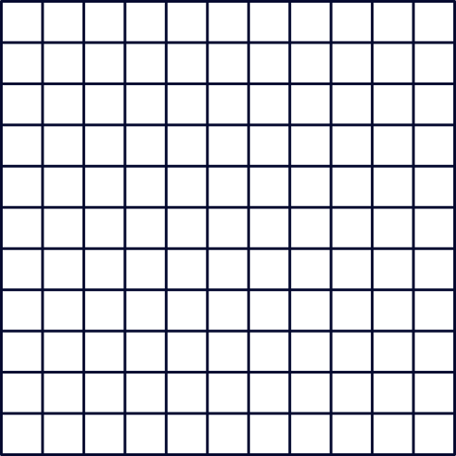
Module 6 - Input/Output Systems
BSIT - 2G
LOOK Scheduling
Algorithm

Slide 2
LOOK Scheduling Algorithm
LOOK Scheduling Algorithm is an enhanced version of the SCAN Disk Scheduling Algorithm. It does cause the head to move to the ends when there are no requests to be serviced.

Slide 3
LOOK Scheduling Algorithm
This approach minimizes unnecessary travel by only scanning for requests that are in the current path of movement.

Slide 4
LOOK Scheduling Algorithm
LOOK aims to improve efficiency and reduce average seek times while maintaining fairness among requests by ensuring all are eventually serviced.

Slide 5
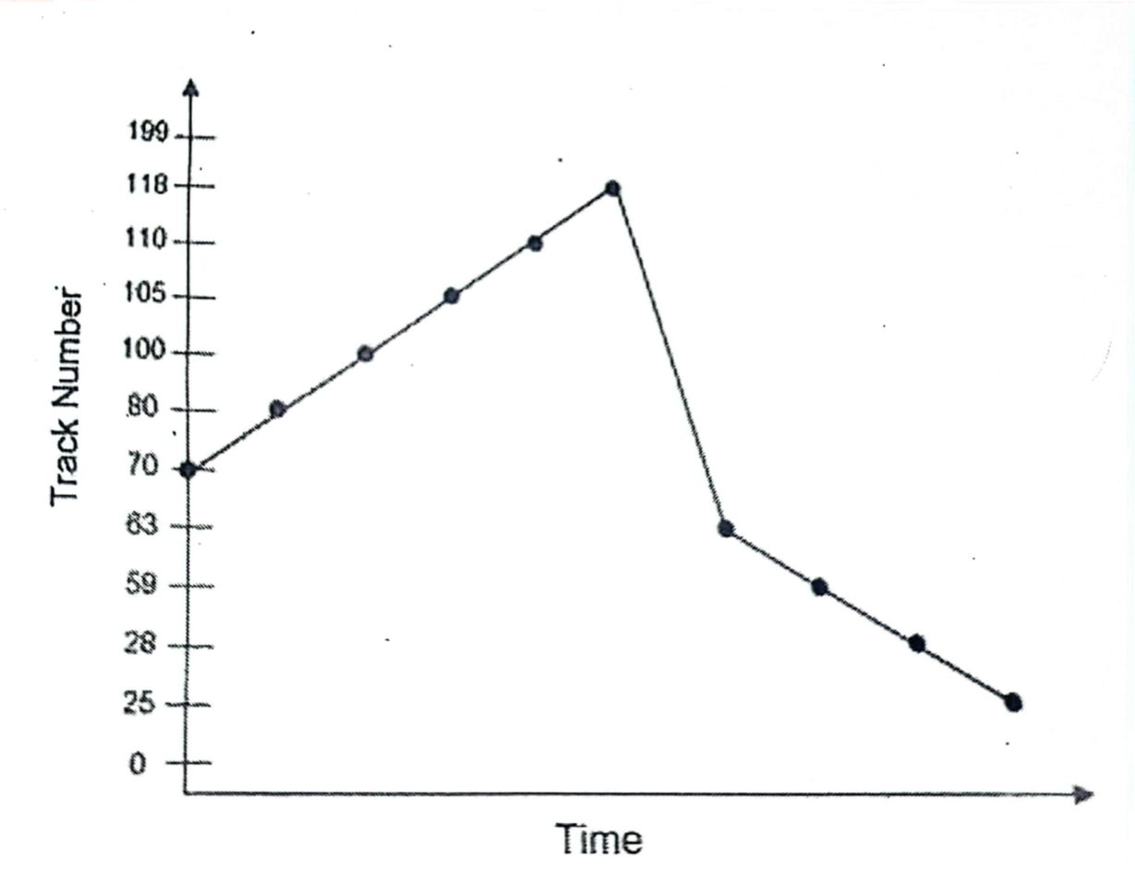
The LOOK Disk Scheduling Algorithm

Slide 6
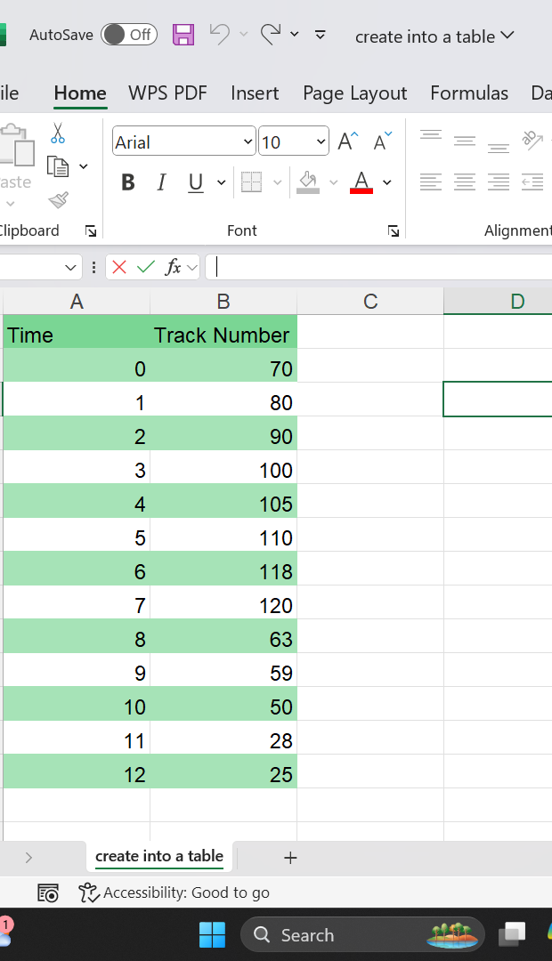
The LOOK Disk Scheduling Algorithm

Slide 7
The total number of head movements is
= (80-70) + (100 - 80) + (105 - 100) + (110 - 105) + (118 - 110) + (118 - 63) + (63 - 59) + (59 - 28) + (28 - 25)
= 10 + 20 + 5 + 5 + 8 + 55 + 44 + 31 + 3
= 141 tracks

Slide 8
Advantages of LOOK Scheduling Algorithm
LOOK minimizes the time the disk arm spends moving by only scanning requests in the direction it is currently moving, reducing unnecessary travel.
By servicing requests before reversing direction, it decreases the wait time for processes and improves overall response times.
It ensures that all requests are eventually serviced, as it does not ignore requests that are further away, promoting fairness among processes.

Slide 9
Advantages of LOOK Scheduling Algorithm
It can adapt to changing workloads, as it adjusts its scan based on incoming requests, making it suitable for varying usage patterns.
LOOK reduces the chances of starvation compared to more static scheduling methods since it periodically revisits areas of the disk regardless of request timing.

Slide 10
Disadvantages of LOOK Scheduling Algorithm
The management of request direction and pending requests introduces some overhead, which can be a concern in systems with limited processing resources.
Since LOOK adapts to incoming requests, the time for any individual request can vary significantly, making it harder to predict response times.

Slide 11
Disadvantages of LOOK Scheduling Algorithm
Reduces starvation compared to some methods, there is still a risk that some requests, especially those at the ends of the disk, may be delayed longer than desired if new requests frequently arrive.
Requires more complex logic to determine the direction of movement and manage pending requests.

Slide 12
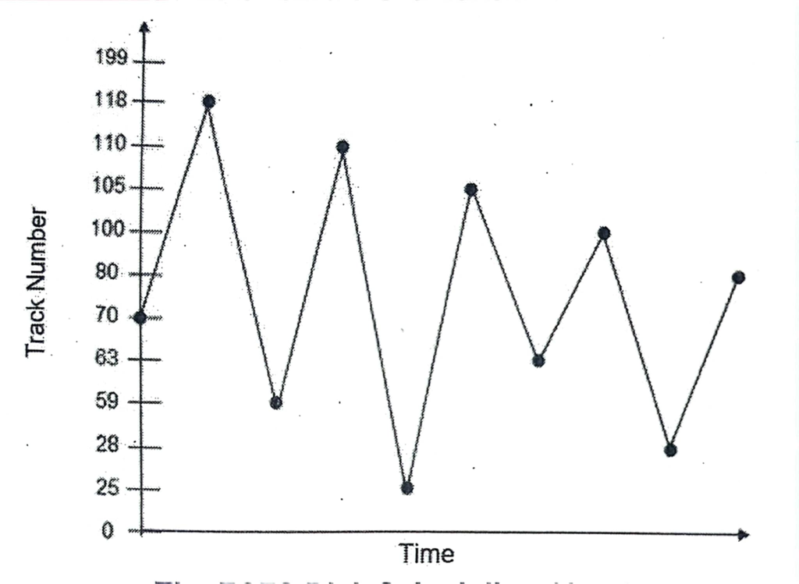
COMPARISON
LOOK Scheduling Algorithm
FCFS Scheduling Algorithm

Slide 13
The total number of head movements for LOOK Disk Scheduling Algorithm
= (80 - 70) + (100 - 80) + (105 - 100) + (110 - 105) + (118 - 110) + (118 - 63) + (63 - 59) + (59 - 28) + (28 - 25)
= 10 + 20 + 5 + 5 + 8 + 55 + 44 + 31 + 3
= 141 tracks
The total number of head movements for FCFS Disk Scheduling Algorithm
= (118 - 70) + (118 - 59) + (110 - 59) + (110 - 25) + (105 - 25) + (105 - 63) + (100 - 63) + (100 - 28) + (80 - 28)
= 48 + 59 + 51 + 85 + 80 + 42 + 37 + 72 + 52
= 526 tracks

Slide 14
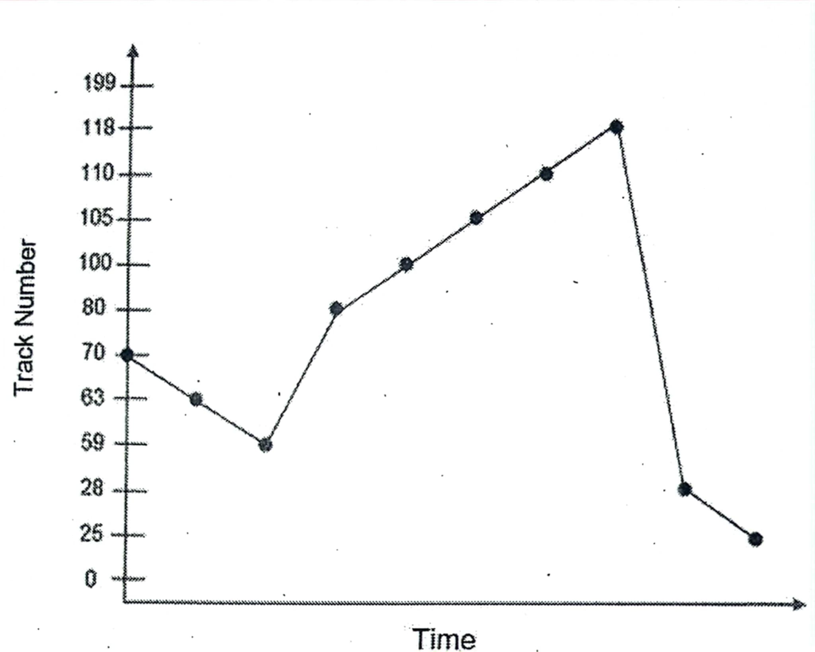
COMPARISON
SSTF Scheduling Algorithm
LOOK Scheduling Algorithm

Slide 15
The total number of head movements for LOOK Disk Scheduling Algorithm
= (80 - 70) + (100 - 80) + (105 - 100) + (110 - 105) + (118 - 110) + (118 - 63) + (63 - 59) + (59 - 28) + (28 - 25)
= 10 + 20 + 5 + 5 + 8 + 55 + 44 + 31 + 3
= 141 tracks
The total number of head movements for SSTF Disk Scheduling Algorithm
= (70 - 63) + (63 - 59) + (80 - 59) + (100 - 80) + (105 - 100) + (110 - 105) + (116 - 110) + (118 - 28) + (28 - 25)
= 7 + 4 + 21 + 20 + 5 + 5 + 8 + 90 + 3
= 163 tracks

Slide 16
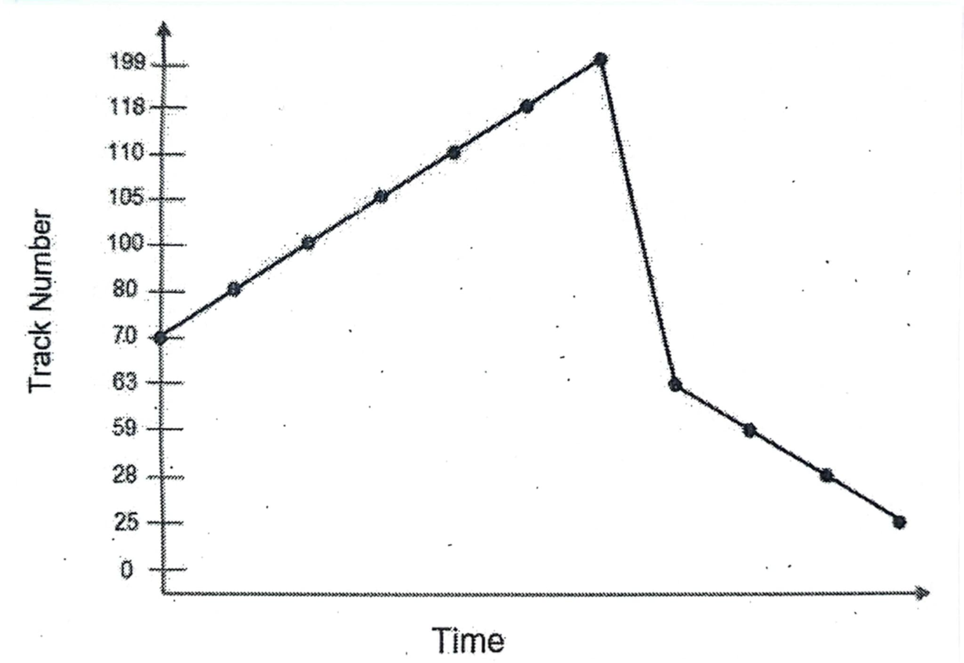
COMPARISON
Scan Disk Scheduling Algorithm
LOOK Scheduling Algorithm

Slide 17
The total number of head movements for LOOK Disk Scheduling Algorithm
= (80 - 70) + (100 - 80) + (105 - 100) + (110 - 105) + (118 - 110) + (118 - 63) + (63 - 59) + (59 - 28) + (28 - 25)
= 10 + 20 + 5 + 5 + 8 + 55 + 44 + 31 + 3
= 141 tracks
The total number of head movements for Scan Disk Scheduling Algorithm
= (80 - 70) + (100 - 80) + (105 - 100) + (110 - 105) + (118 - 110) + (199 - 118) + (199 - 63) + (63 - 59) + (69 - 28) + (28 - 25)
= 10 + 20 + 5 + 5 + 8 + 81 + 136 + 4 + 31 + 3
= 303 tracks

Slide 18
The total number of head movements for LOOK Disk Scheduling Algorithm
= (80 - 70) + (100 - 80) + (105 - 100) + (110 - 105) + (118 - 110) + (118 - 63) + (63 - 59) + (59 - 28) + (28 - 25)
= 10 + 20 + 5 + 5 + 8 + 55 + 44 + 31 + 3
= 141 tracks
The total number of head movements for C-Scan Disk Scheduling Algorithm
= (80 - 70) + (100 - 80) + (105 - 100) + (110 - 105) + (118 - 110) + (199 - 118) + (199 - 0) + (25 - 0) + (28 - 25) + (59 - 28) + (63 - 59)
= 10 + 20 + 5 + 5 + 8 + 81 + 199 + 25 + 3 + 31 + 4
= 391 tracks

Slide 19
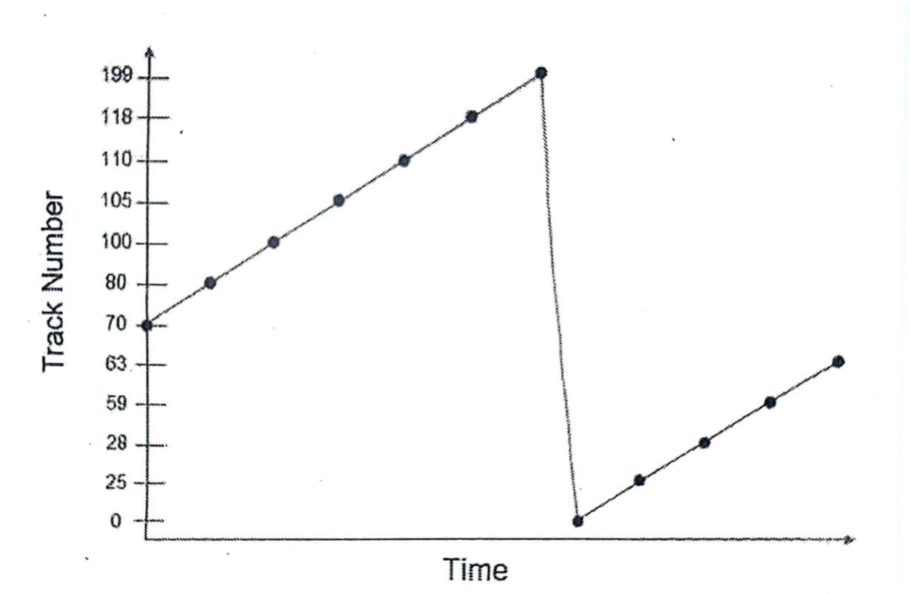
COMPARISON
LOOK Scheduling Algorithm
C-Scan Scheduling Algorithm

Slide 20
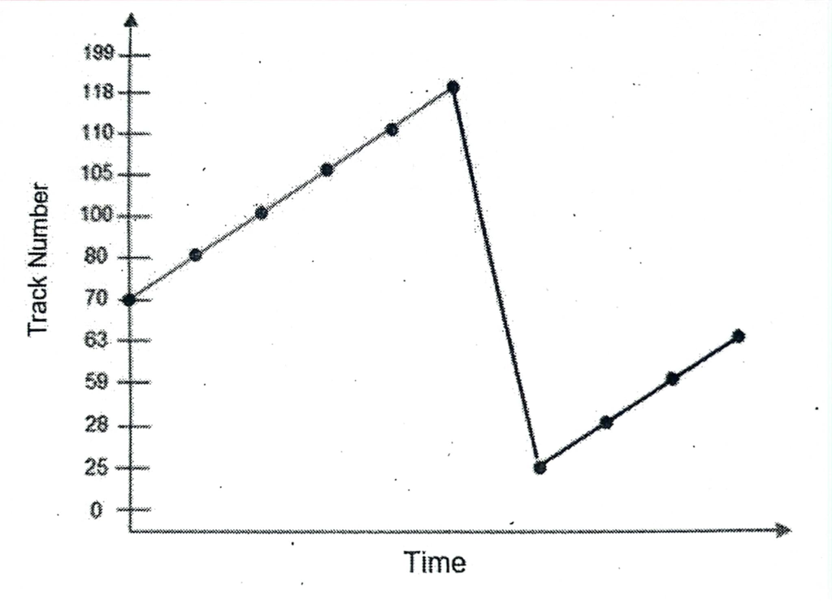
COMPARISON
C-LOOK Scheduling Algorithm
LOOK Scheduling Algorithm

Slide 21
The total number of head movements for LOOK Disk Scheduling Algorithm
= (80 - 70) + (100 - 80) + (105 - 100) + (110 - 105) + (118 - 110) + (118 - 63) + (63 - 59) + (59 - 28) + (28 - 25)
= 10 + 20 + 5 + 5 + 8 + 55 + 44 + 31 + 3
= 141 tracks
The total number of head movements for C-LOOK Disk Scheduling Algorithm
= (80 - 70) + (100 - 80) + (105 - 100) + (110 - 105) + (118 - 110) + (118 - 25) + (28 - 25) + (59 - 28) + (63 - 28)
= 10 + 20 + 5 + 5 + 8 + 93 + 3 + 31 + 35
= 210 tracks

Slide 22
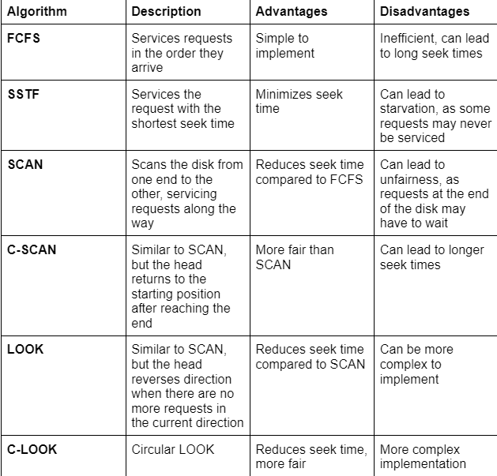
Comparison of
LOOK Scheduling
Algorithm to other Algorithms

Slide 23
Module 6 - Input/Output Systems
BSIT - 2G
THANK YOU!
Sevilla, Angelica
Silvestrece, Shan
Suarez, Lyken
Suyom, Christian

