Slide 1
１
２
２
１
２
second
Key
Key
second
１
２
１
true
Key
second
Key
second

Slide 2
second
Key
Key
second
１
２
１
true
Key
second
Key
second
second
Key
Key
second
１
２
２
true
Key
second
Key
second
second
Key
Key
second
１
3
1
true
Key
second
Key
second

Slide 3
CLEAR
FAILED
RADY!?
GO!!
W
JUMP
00:00
TIME
SCORE

Slide 4
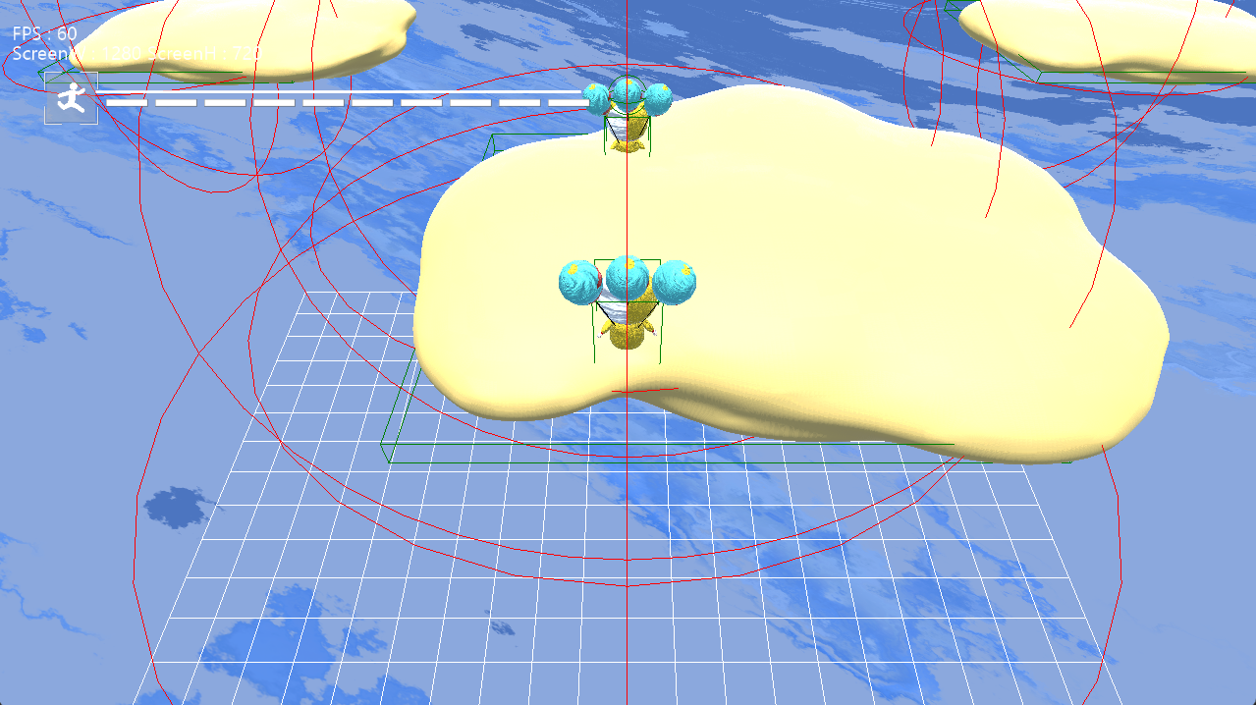

SCORE
TIME
100
00:00
RADY!?
GO!!
W
A
JUMP

