Slide 1
FastLink
Haocheng, Kewei, Zaolin, Chuhan

Slide 2
Introduction
FastLink is a scalable entity resolution methodology designed for merging large-scale datasets.
Advantages
Addresses challenges such as missing data, measurement errors, and uncertainty in the merging process
Provide more flexibility by using auxiliary information (e.g., name frequency, migration rates)
Utilize a probabilistic match score for more accurate linking, even with incomplete or imprecise data
Scalable and capable of handling millions of records, making it efficient in terms of speed and accuracy
Limitations
Less effective with long strings (e.g., full names, long addresses) due to variations and typographical errors without advanced string-matching algorithms

Slide 3
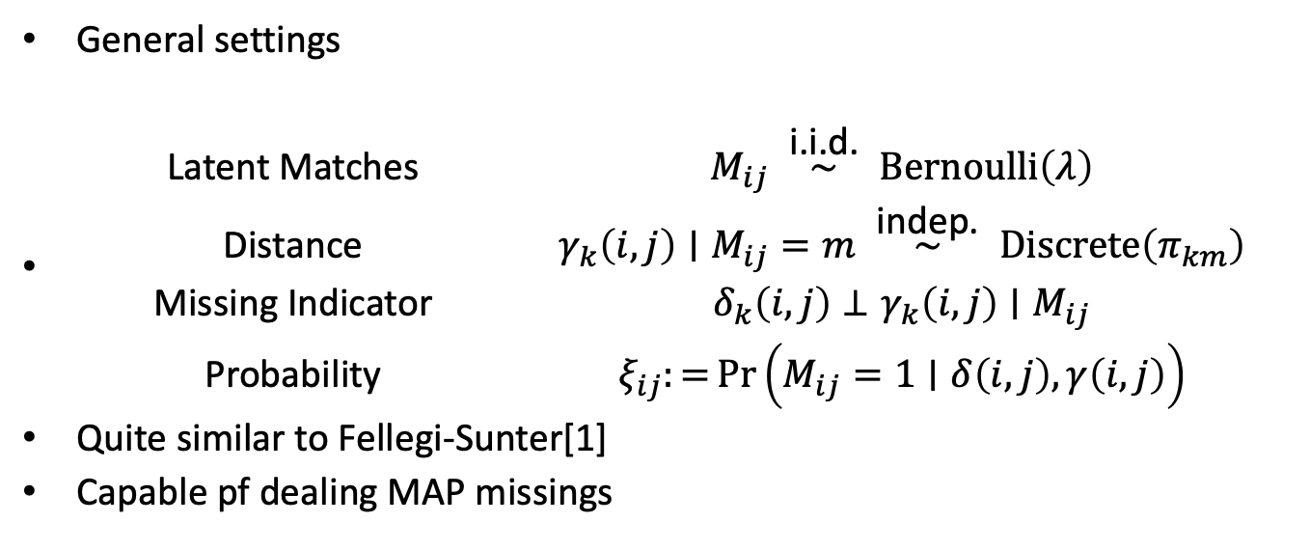
Methodology
General settings
$\begin{matrix} & \text{Latent} \text{Matches} & & M_{ij}\overset{ \text{i}\text{.}\text{i}\text{.}\text{d}\text{. }}{∼}Bernoulli\left(λ\right) \\ & \text{Distance} & & γ_{k}\left(i,j\right)∣M_{ij}=m\overset{ \text{indep}\text{. }}{∼}Discrete\left(π_{km}\right) \\ & \text{Missing} \text{Indicator} & & δ_{k}\left(i,j\right)⊥γ_{k}\left(i,j\right)∣M_{ij} \\ & \text{Probability} & & ξ_{ij}:=Pr\left(M_{ij}=1∣δ\left(i,j\right),γ\left(i,j\right)\right)\end{matrix}$
Quite similar to Fellegi-Sunter[1]
Capable pf dealing MAP missings

Slide 4
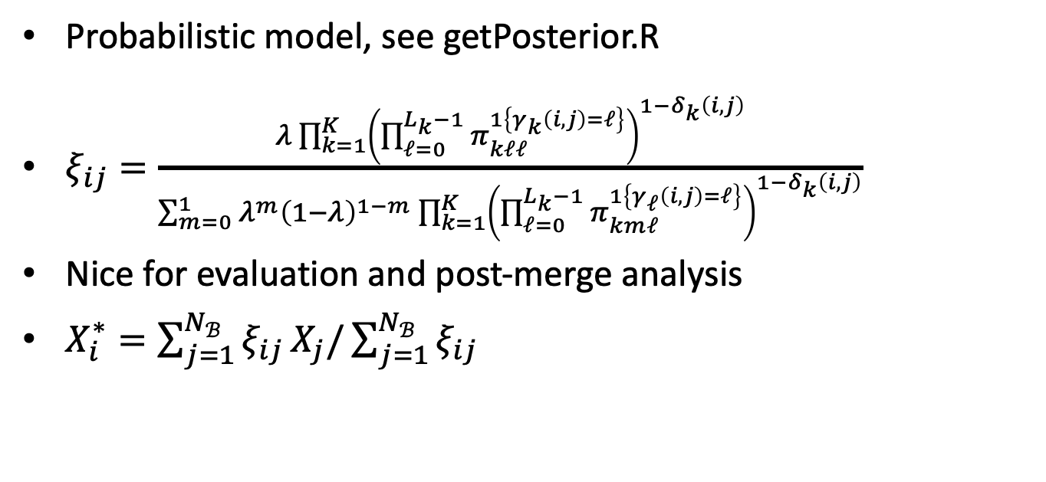
Methodology
Probabilistic model, see getPosterior.R
$\begin{matrix}ξ_{ij}=\frac{λ\prod_{k=1}^{K}{{\left(\prod_{ℓ=0}^{L_{k}−1}{π_{kℓℓ}^{1\left\{γ_{k}\left(i,j\right)=ℓ\right\}}}\right)}^{1−δ_{k}\left(i,j\right)}}}{\sum_{m=0}^{1}{λ^{m}}{\left(1−λ\right)}^{1−m}\prod_{k=1}^{K}{{\left(\prod_{ℓ=0}^{L_{k}−1}{π_{kmℓ}^{1\left\{γ_{ℓ}\left(i,j\right)=ℓ\right\}}}\right)}^{1−δ_{k}\left(i,j\right)}}}\end{matrix}$
Nice for evaluation and post-merge analysis
$X_{i}^{∗}=\sum_{j=1}^{N_{ℬ}}{ξ_{ij}}X_{j}/\sum_{j=1}^{N_{ℬ}}{ξ_{ij}}$

Slide 5
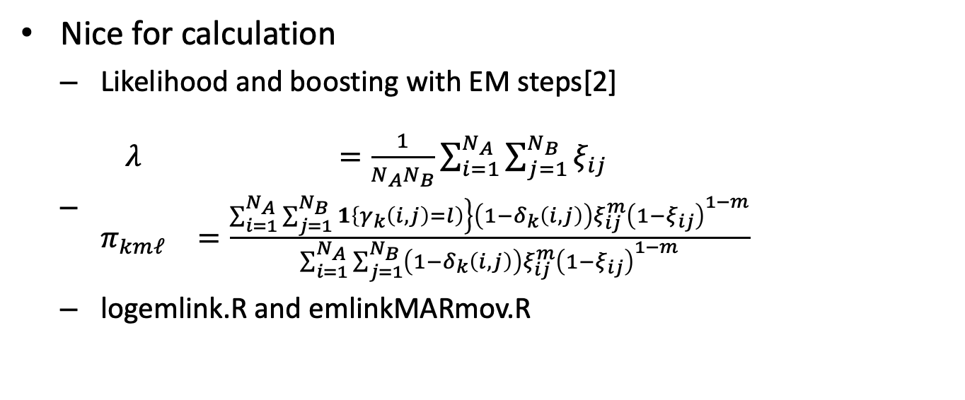
Methodology
Nice for calculation
Likelihood and boosting with EM steps[2]
$\begin{matrix}λ & =\frac{1}{N_{A}N_{B}}\sum_{i=1}^{N_{A}}{\sum_{j=1}^{N_{B}}{ξ_{ij}}} \\ π_{kmℓ} & =\frac{\left.\sum_{i=1}^{N_{A}}{\sum_{j=1}^{N_{B}}{1}}\left\{γ_{k}\left(i,j\right)=l\right)\right\}\left(1−δ_{k}\left(i,j\right)\right)ξ_{ij}^{m}{\left(1−ξ_{ij}\right)}^{1−m}}{\sum_{i=1}^{N_{A}}{\sum_{j=1}^{N_{B}}{\left(1−δ_{k}\left(i,j\right)\right)}}ξ_{ij}^{m}{\left(1−ξ_{ij}\right)}^{1−m}}\end{matrix}$
logemlink.R and emlinkMARmov.R

Slide 6
Package Implement
The required package for FastLink is called “fastLink”:
install.packages("fastLink")
Install the most recent version of “fastLink” package (version 0.6):
library(devtools) install_github("kosukeimai/fastLink",dependencies=TRUE)
Load the package in R:
## Load the package and data library(fastLink)
Tutorial Link: https://github.com/kosukeimai/fastLink

Slide 7
Package Implement
Run the entire algorithm:
matches.out <- fastLink( dfA = dfA, dfB = dfB, varnames = c("given_name", "surname", "address_1", "suburb"), stringdist.match = c("given_name", "surname"), partial.match = c("given_name", "surname"), return.all = TRUE )
The merged dataset can be accessed using the getMatches() function:
matched_dfs <- getMatches( dfA = dfA, dfB = dfB, fl.out = matches.out, threshold.match = 0.85 )

Slide 8
Package Implement
Preprocessing Matches via Blocking: The blockData() function can block two datasets using one or more variables and various blocking techniques.
Using Auxiliary Information to Inform fastLink: The algorithm could also incorporate auxiliary information on migration behavior to inform the matching of datasets over time.
Aggregating Multiple Matches Together: The algorithm can also aggregate multiple matches into a single summary using the aggregateEM() function.
Random Sampling with fastLink: The algorithm allows us to run the matching algorithm on a randomly selected smaller subset of data to be matched and then apply those estimates to the full sample of data.
Finding Duplicates within a Dataset via fastLink: The algorithm uses the probabilistic match algorithm to identify duplicated entries.

Slide 9
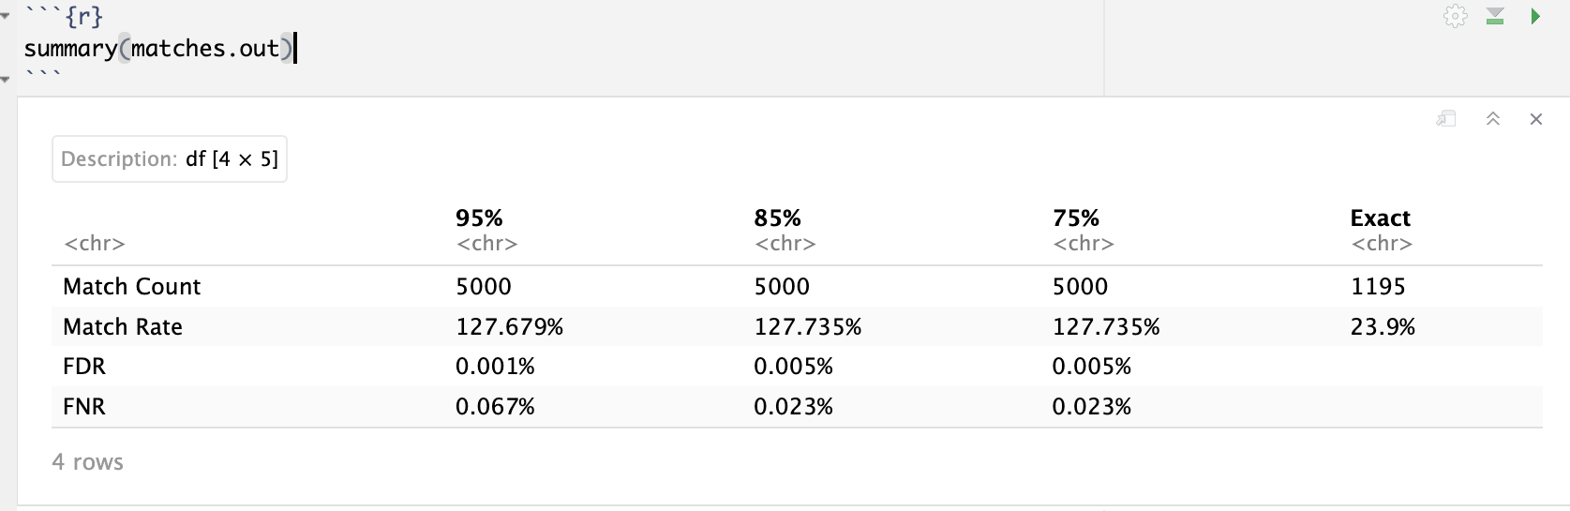
Dataset
Two sets of datasets explored
Products on Amazon & Google
fictious dataset from Freely Extensible Biomedical Record Linkage
Empirical evidence of reduced effectiveness with long strings (e.g., product descriptions)
only 75 matches for Amazon (>1000 rows) & Google (>3000 rows) product datasets
Avoid overly broad matching criteria / using too many variables
Inflate match rate (even over 100%), underestimate False Discovery Rate (FDR) and False Non-match Rate (FNR)

Slide 10
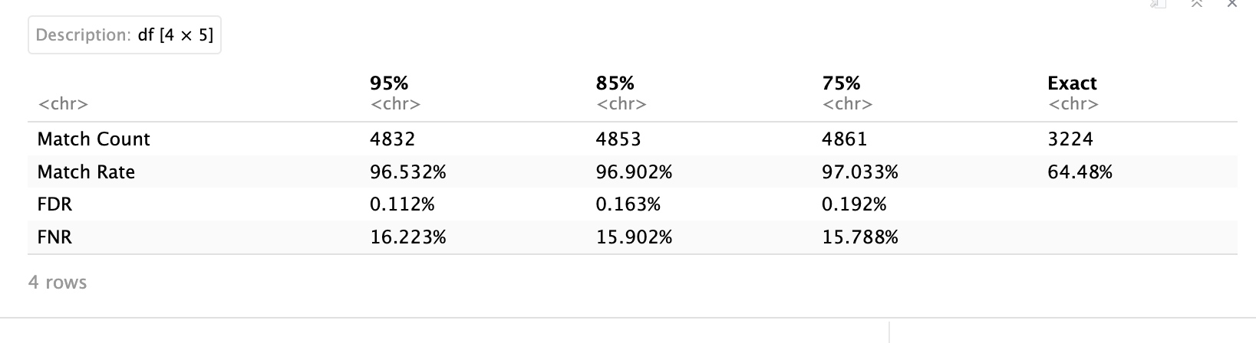
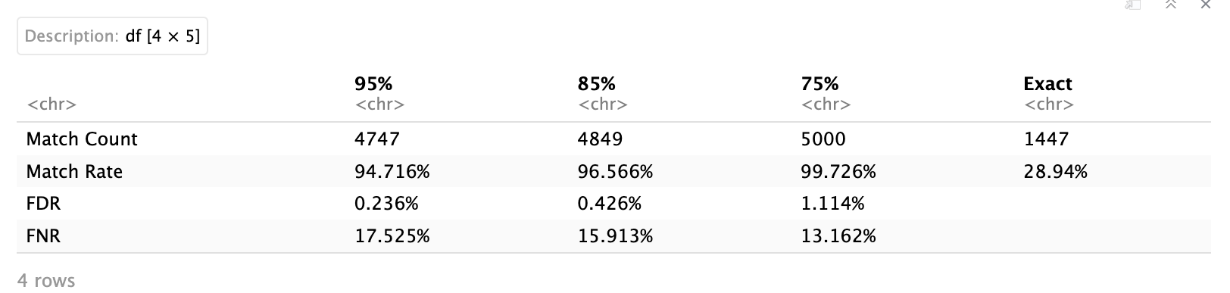
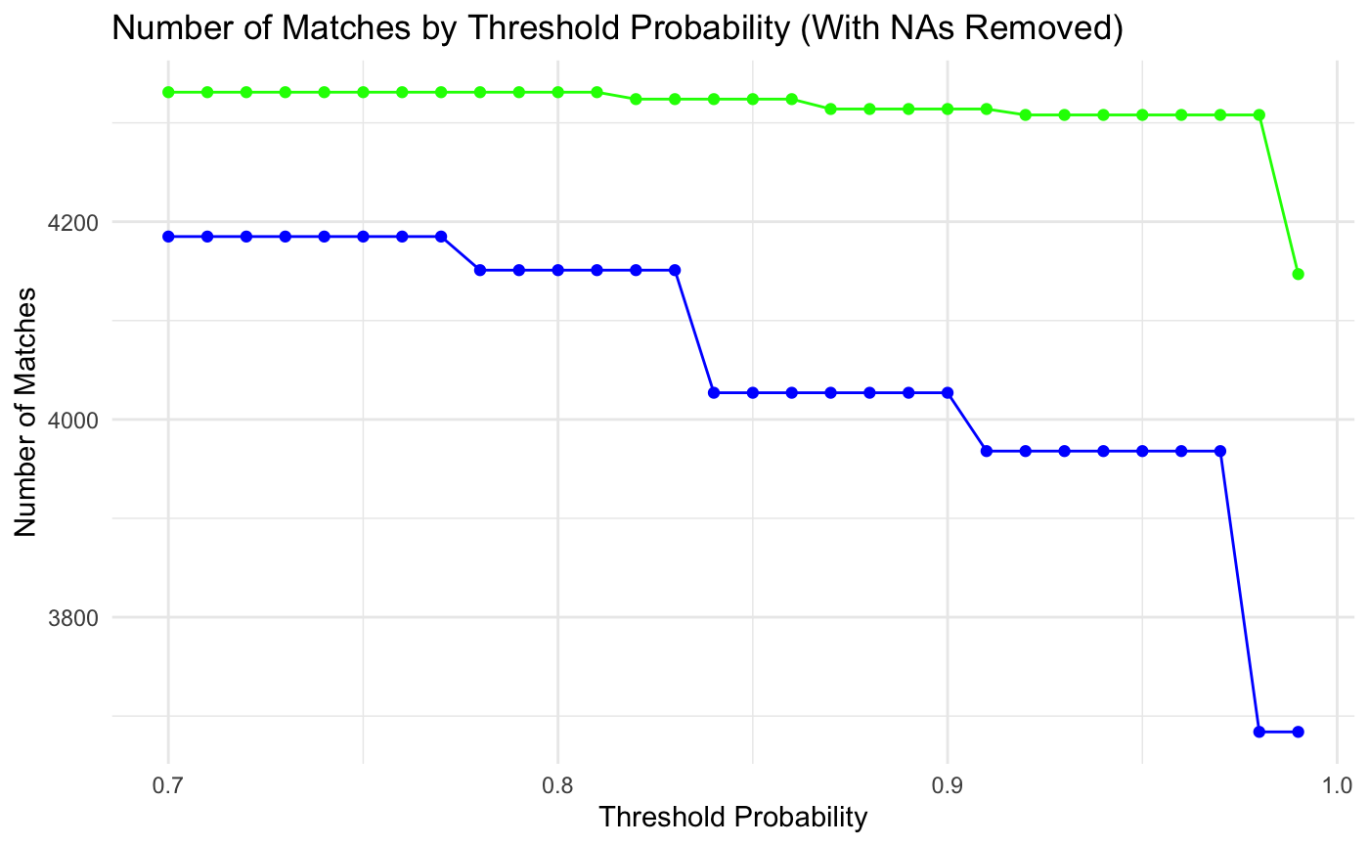
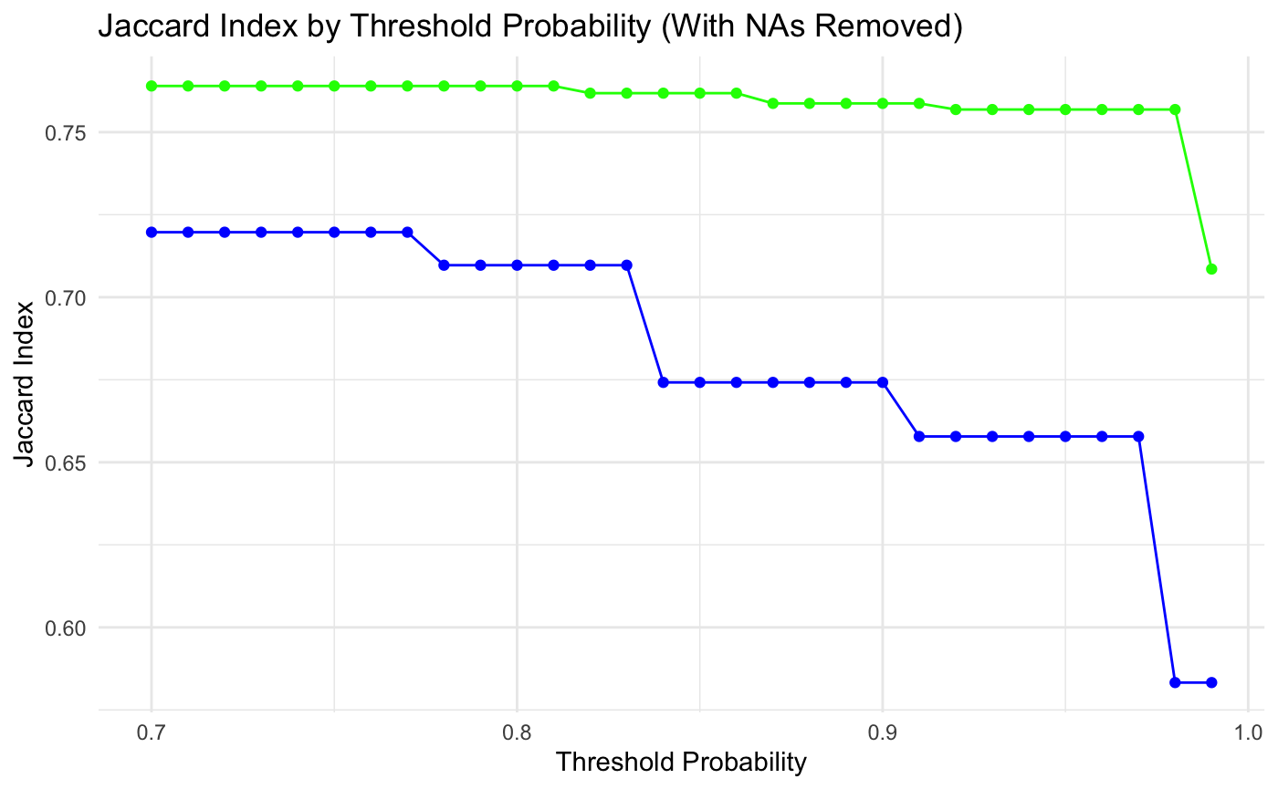
Dataset
choose more informative variable could reduce the use of matching variables
name + soc_sec_id vs name + address + suburb
number of matches & jaccard index vs threshold probabilities
jaccard index = intersection size / union size

Slide 11
References
[1] I. P. Fellegi and A. B. Sunter, “A theory for record linkage,” Journal of the American Statistical Association, vol. 64, no. 328, pp. 1183–1210, 1969.
[2] W. E. Winkler, Using the EM algorithm for weight computation in the fellegi-sunter model of record linkage. US Bureau of the Census Washington, DC, 2000.

