Slide 1
Cruise Ship Datawarehouse
Submitted By:
Shimona Dubey
Mehrunnissa Pathan

Slide 2
Problem Statement
The main goal of Cruise Ship Data warehouse is to find an optimal solution to analyze large amount of data using Data warehousing Techniques.

Slide 3
Overview
This project is associated to maintain Ship details, Staff details, Customer details, Ticket details and Transaction details which are going to be analyzed.
Using this data warehousing technique we can get estimation of :
Number of customers travelled
Number of tickets sold
Number of tickets cancelled.

Slide 4
Why Data Warehousing?
A data warehouse is a collection of integrated, time-variant, subject-oriented,non-volatile databases designed to supply the information required for decision-making.

Slide 5
Fact Table
This table consists of :
Primary key : Fact_key
Foreign key from dimensions.
Metrics: No. of customers
No. of Tickets sold
No. of Cancelled tickets

Slide 6
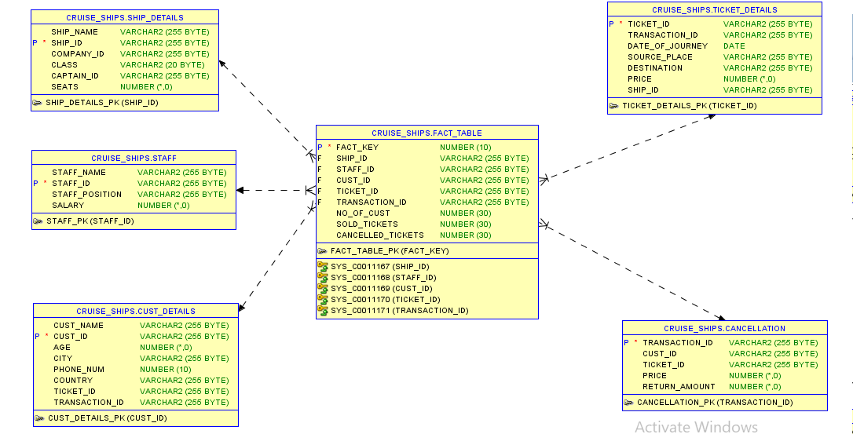

Slide 7
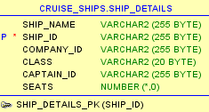
Dimension Table
Ship_Details
This table contains:
  Ship_Name
  Ship_id
  Company_id
  Class
  Captain_id
  Seats

Slide 8
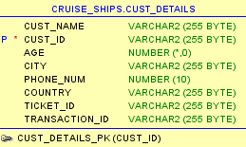
Cust_Details
This table contains:
  Cust_Name
  Cust_id
  Age
  City
  Phone_num
  Country
  Ticket_id
  Transaction_id

Slide 9
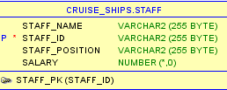
Staff
This table contains:
  Staff_Id
  Staff_Name
  Position
  Salary

Slide 10
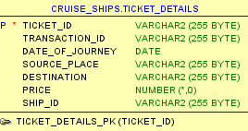
Ticket_Details
This table contains:
  Ticket_id
  Transaction_id
  Date_Of_Journey
  Source_Place
  Destination
  Price
  Ship_id

Slide 11
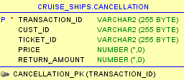
Cancellation Table
This table contains:
  Transaction_id
  Cust_id
  Ticket_id
  Price
  Return_amount

Slide 12
Advantages
It allows users to access critical data from the number of sources in a single place. Therefore, it saves user's time of retrieving data from multiple sources.
Details of customers can be easily analyzed whenever required.
Data warehouse stores a large amount of historical data. This helps users to analyze different time periods and trends to make future predictions.

Slide 13
Disadvantages
The data warehouse may seem easy, but actually, it is too complex for the average users.
Despite best efforts at project management, data warehousing project scope will always increase.
Sometime warehouse users will develop different business rules.

Slide 14
Future Scope
As the size of the databases grows, the estimates of what constitutes a very large database continue to grow. It is complex to build and run data warehouse systems which are always increasing in size.
Multimedia data cannot be easily manipulated but text data can be.

Slide 15


