Slide 1
CSE 442 Microprocessors and microcontrollers Project: Simulation of IoT based fire alert system
Presented To:
Dr. Md. Nawab Yousuf Ali
Professor
Department of
Computer Science and Engineering

Slide 2
Group members
Name | Id
Md. Moniruzzaman Shanto | 2018-1-60-075
Farzana Akhi | 2016-2-60-142
Shimanto Krishna Chakroborty | 2017-2-68-001

Slide 3
Introduction
Fire Alarm System detects the fire to give an alarm automatically or manually. Fire alarm device is an integrated electronic device consisting of several devices sensitive to different fire outputs, control devices, auxiliary networks, and others.

Slide 4
Objectives
Our objective is to implement a system which will detect fire using fire sensors and the system will automatically display fire detection alert on the LCD monitor. Moreover, the system will also turn on necessary devices to alert the whole area. User can monitor this system by using his smart phone or computer. The system will show current state wither fire is detected or not and user will be notified if fire is detected in the house.

Slide 5
Requirements
Microcontroller
Arduino
Fire sensor or Flame sensor
Temperature sensor
Small Breadboard
Connecting Wire
Liquid Crystal Display (LCD)
Buzzer
fire sprinkler
Specker
Siren
Home gateway

Slide 6
Implementation
we have used cisco packet tracer to create whole network and implemented the IoT based fire alert system. We have created three networks for this system.
Home network
IoT server network
Mobile access network

Slide 7
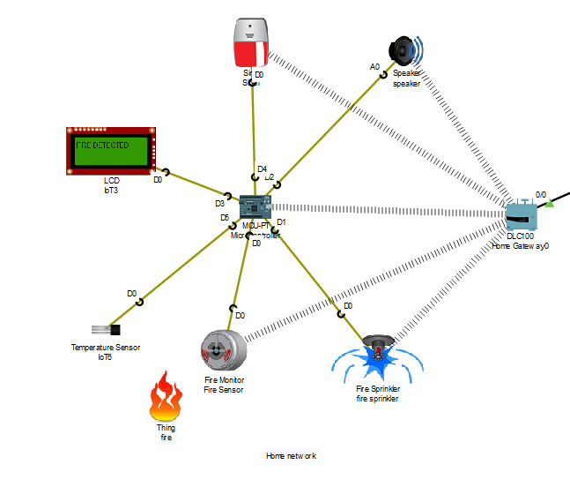
Home network
In the home network Microcontroller will control all the devices like fire sensor, fire sprinkler, Specker, Siren and the LCD display. When the fire sensor Detects fire in the house the Microcontroller will automatically turn on fire sprinkler, Specker, Siren and in the LCD display Fire Detected message will be shown. Fire Detection information will be transfer wirelessly using home gateway device to the Remote IoT server Which will transfer the information to the user’s phone.

Slide 8
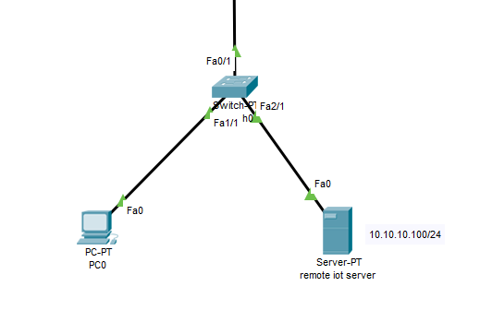
IoT server network
When the fire sensor detects fire, Fire Detection information will be transfer wirelessly using home gateway device to the Remote IoT server Which will transfer the information to the user’s phone. Admin of the IoT server also can see the information of the sensors and also can monitor the home network.

Slide 9
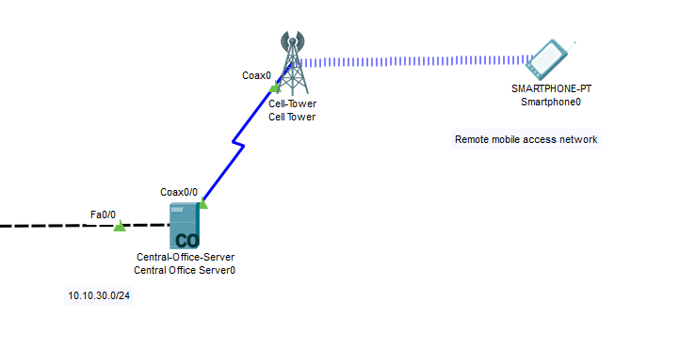
Mobile access network
User can see the information of the sensor and condition of the home network by just logging in to the IoT monitor option by using user’s smart phone. The IoT server will send the information of home network to the user’s network and user will be able to see the condition of the sensors and also can control the devices if necessary.

Slide 10
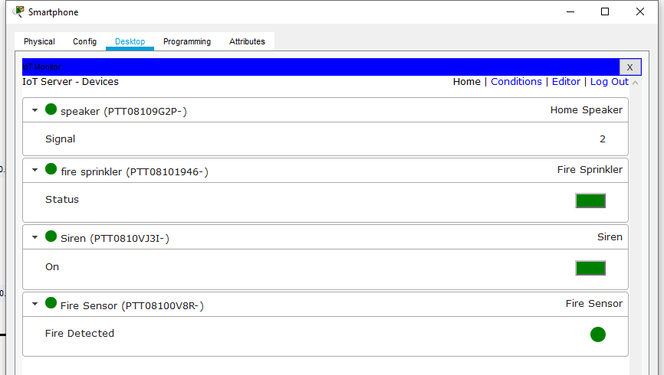
IoT monitoring option

Slide 11
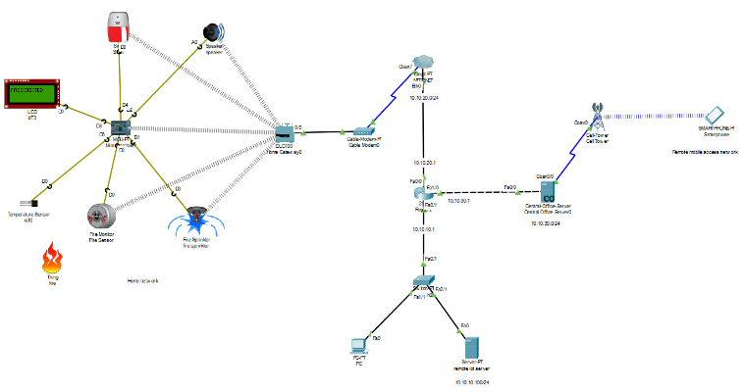
Design of the whole network

Slide 12
Thank You

