Slide 1






Pizza sales analysis
using sql

Slide 2



List of Datasets
Pizza_types
pizzas
orders
orderdetails

Slide 3



Introduction
Pizza is a dish that originates from Italy and is one of the favorite foods of many people in various parts of the world.
Let's start our analysis in the world of pizza!

Slide 4


Basic:
Retrieve the total number of orders placed.
Calculate the total revenue generated from pizza sales.
Identify the highest-priced pizza.
Identify the most common pizza size ordered.
List the top 5 most ordered pizza types along with their quantities.
Intermediate:
Join the necessary tables to find the total quantity of each pizza category ordered.
Determine the distribution of orders by hour of the day.
Join relevant tables to find the category-wise distribution of pizzas.
Group the orders by date and calculate the average number of pizzas ordered per day.
Determine the top 3 most ordered pizza types based on revenue.
Analysis

Slide 5
.
Advanced:
Calculate the percentage contribution of each pizza type to total revenue.
Analyze the cumulative revenue generated over time.
Determine the top 3 most ordered pizza types based on revenue for each pizza category.
Analysis

Slide 6

1
Retrieve the total number of orders placed.
select count(order_id) as total_orders from orders;

Slide 7


SELECT
ROUND(SUM(order_details.quantity * pizzas.price),
2) AS total_sales
FROM
order_details
JOIN
pizzas ON pizzas.pizza_id = order_details.pizza_id;
Calculate the total revenue generated from pizza sales.
2

Slide 8
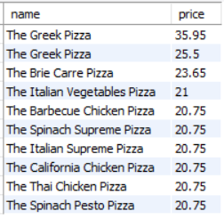
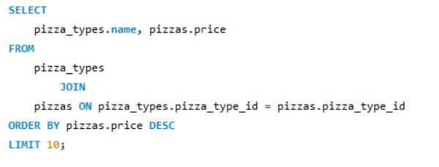
3
Identify the highest-priced pizza.

Slide 9
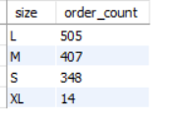
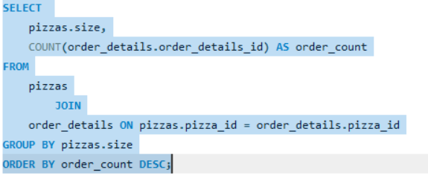
4
Identify the most common pizza size ordered.

Slide 10
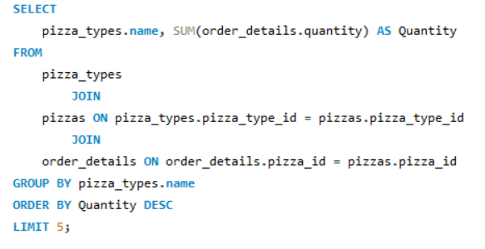
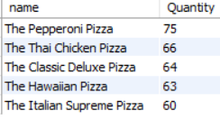
5
List the top 5 most ordered pizza types along with their quantities.

Slide 11
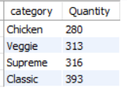
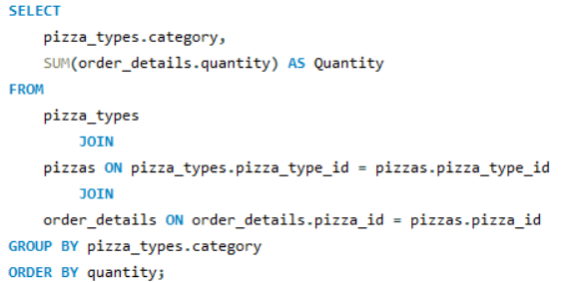
6
Join the necessary tables to find the total quantity of each pizza category ordered.

Slide 12
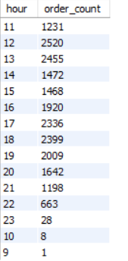
7
Determine the distribution of orders by hour of the day.
SELECT
HOUR(order_time) AS hour, COUNT(order_id) AS order_count
FROM
orders
GROUP BY HOUR(order_time);

Slide 13
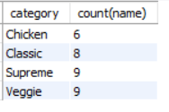
8
Join relevant tables to find the category-wise distribution of pizzas.
select category, count(name) from pizza_types
group by category;
02

Slide 14
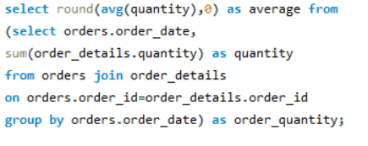

9
Group the orders by date and calculate the average number of pizzas ordered per day.

Slide 15
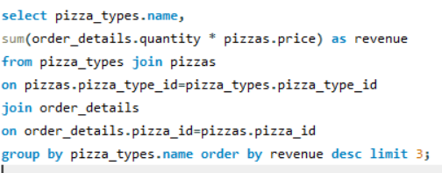
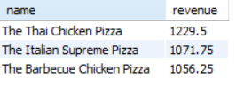
10
-- Determine the top 3 most ordered pizza types based on revenue.

Slide 16
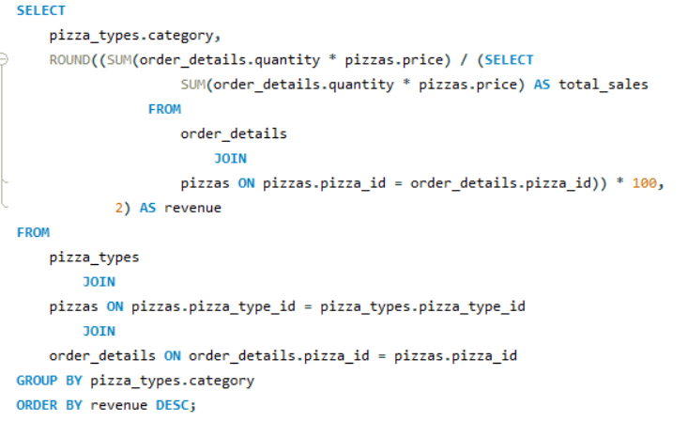
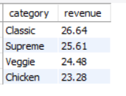
11
Calculate the percentage contribution of each pizza type to total revenue.

Slide 17
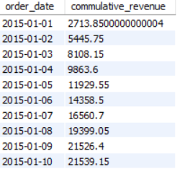
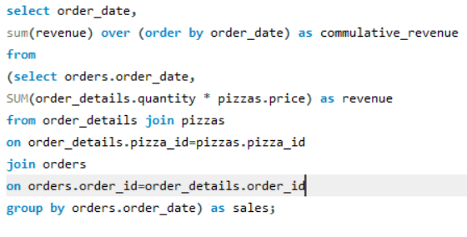
12
Analyze the cumulative revenue generated over time.

Slide 18
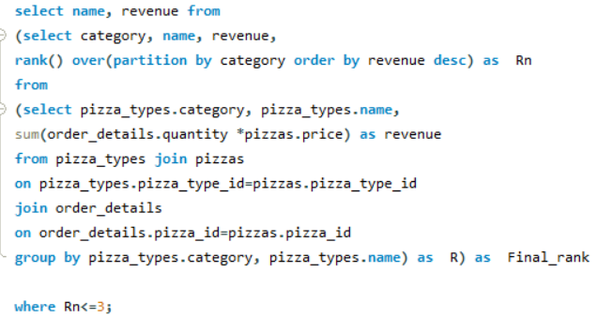
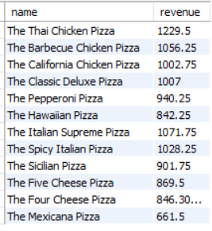
13
Determine the top 3 most ordered pizza types based on revenue for each pizza category.

Slide 19
Thank You
“Have fun making your own pizza and enjoy every bite”

