Slide 1
Seminar/Conference Paper Presentation
Technical Communication
[KAS 301]
By-
Dr. Virendra Kumar Yadav
Department of Applied Sciences & Humanities

Slide 2
Outlines for Presentation
About Seminar
Points for Conducting a Seminar/Conference
Designing a Presentation for a Seminar / Conference: Content, Focus, and Style

Slide 3
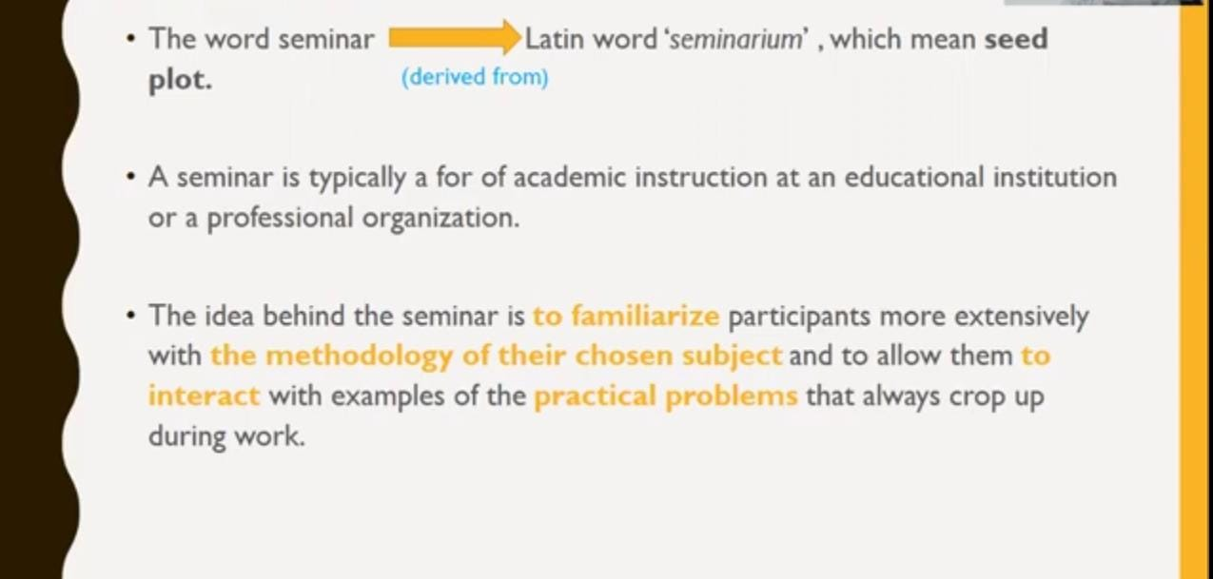
Seminar

Slide 4
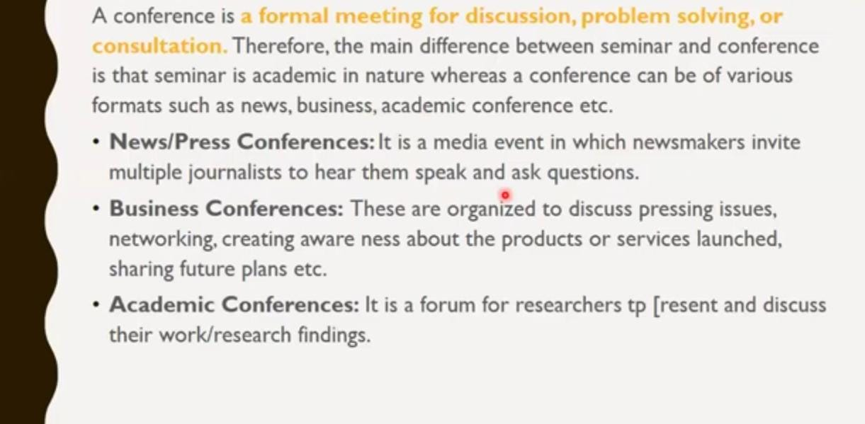
Conference

Slide 5
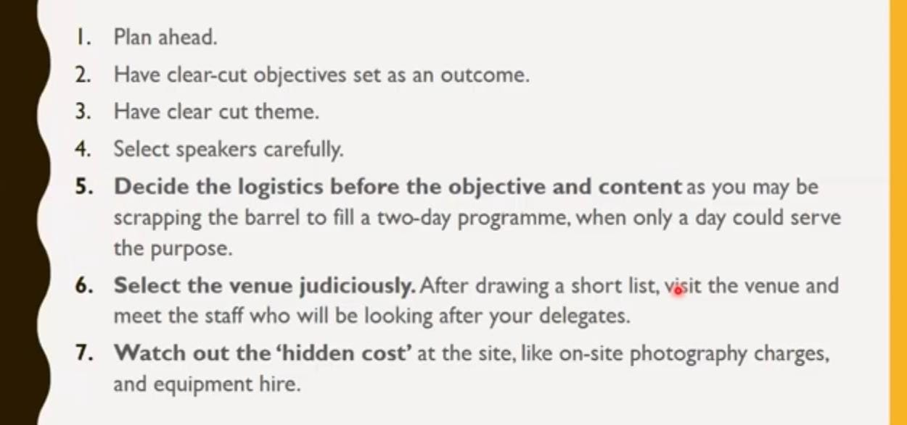
Points for Conducting a Seminar/Conferenc

Slide 6
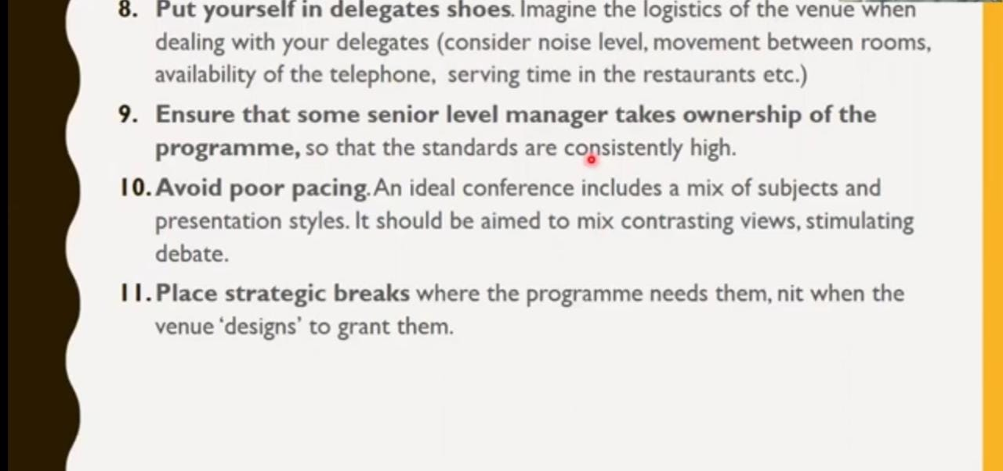
Important Findings

Slide 7
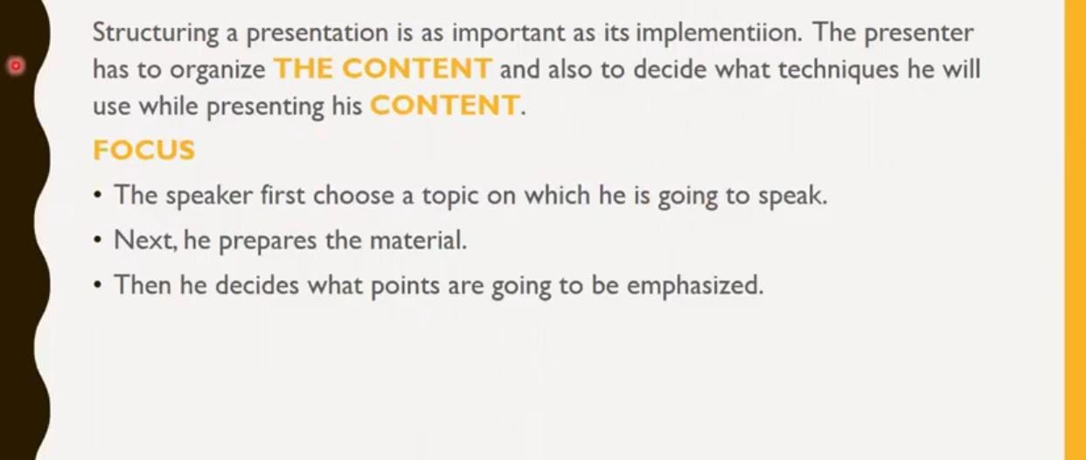
Designing a Presentation for a Seminar/Conference:
.

Slide 8
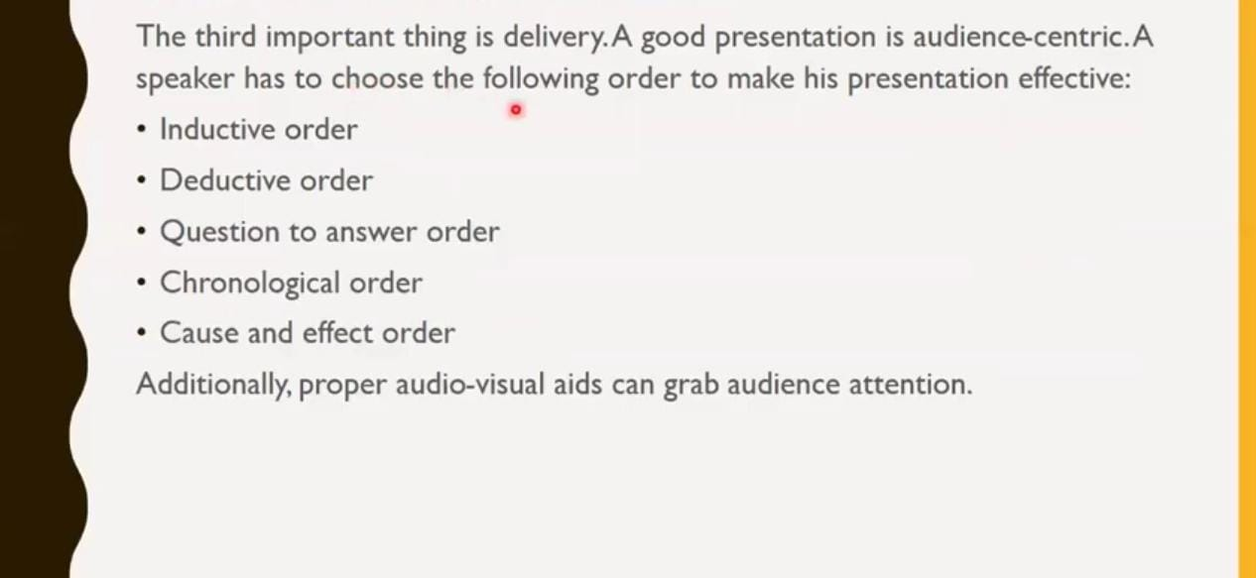
Thank You

