Slide 1
Behavioral Economic Factors and Covid-19

Slide 2
Behavioral Economic Factors and Covid-19
Our team wanted to tell the story of covid-19 and the effects of mask use, income and healthcare cost.
Questions:
What is the correlation between Covid-19 infections and deaths?
How strong is the relationship between COVID19 infections and deaths? (Behrouz)
Do states with higher healthcare costs per capita have higher covid-19 infections and/or mortality rates per capita?
Do states with the higher uninsured healthcare rates have higher covid-19 infections and/or mortality rates?
Do states with low mask usage have higher rates of covid19 infections?
Do higher mask use correlate to income levels?

Slide 3
Datasets
Census 2018 ACS-5
Total Population
Health Care Coverage by Sex by Age
Median Household Income
New York Times Mask Usage
Covid Tracking Project
Current State Data
Center for Medicaid and Medicare Services
Total All Payers Per Capita State Estimates by State of Residence 2014 - Personal Health Care (Millions of Dollars)

Slide 4
Covid-19 Infections and Deaths

Slide 5
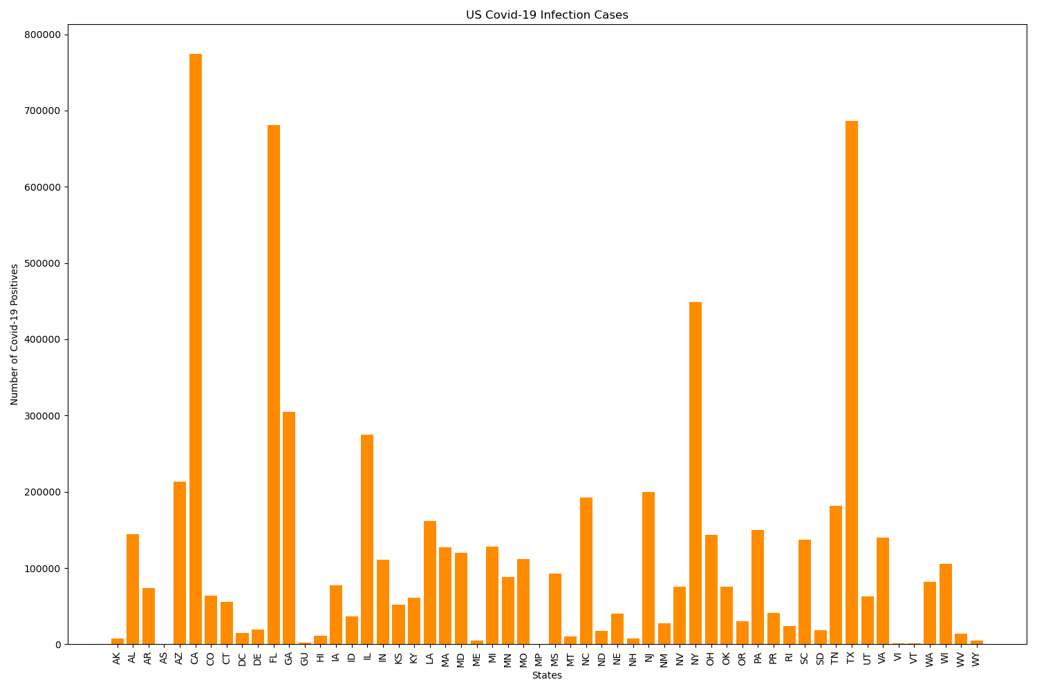
Covid-19 Infections and Deaths

Slide 6
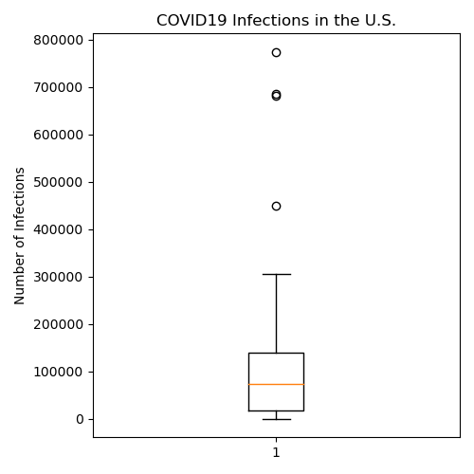
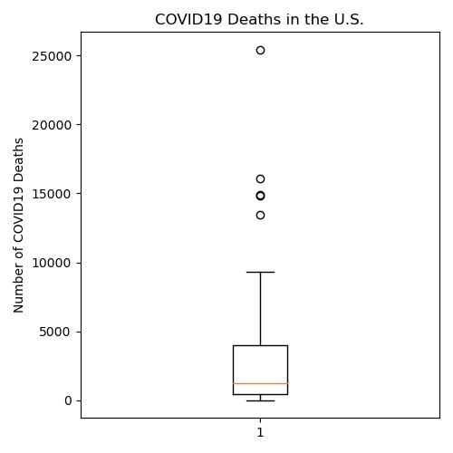
Covid-19 Infections and Deaths
State | Covid-19 Positives
CA | 769831
FL | 677660
NY | 448052
TX | 682241
States | Deaths
CA | 14812
FL | 13387
NJ | 16061
NY | 25423
TX | 14713

Slide 7
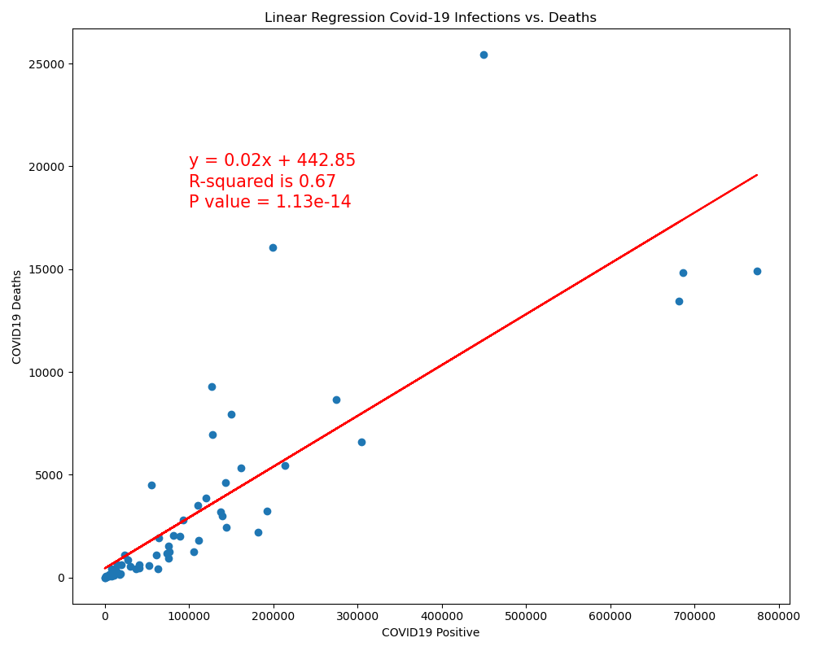
Covid-19 Infections and Deaths

Slide 8
Covid-19 and Healthcase Costs

Slide 9
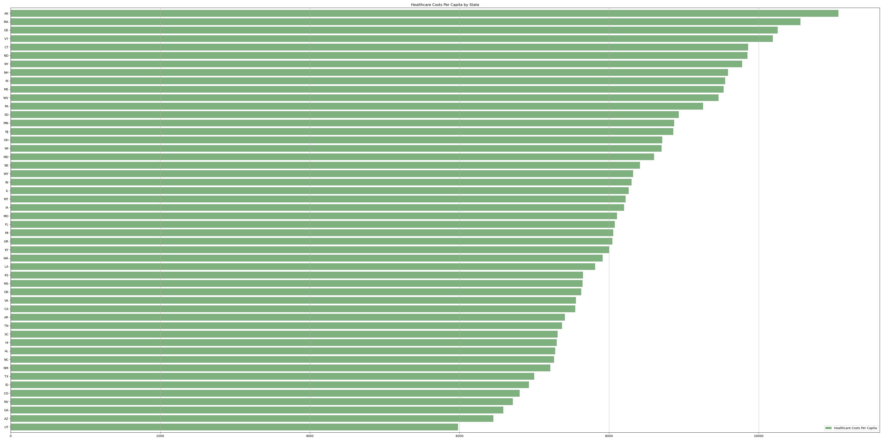
Healthcare Costs by State

Slide 10
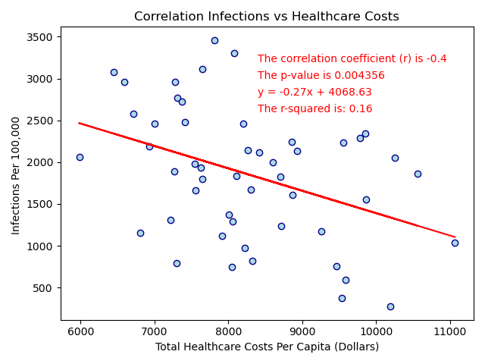
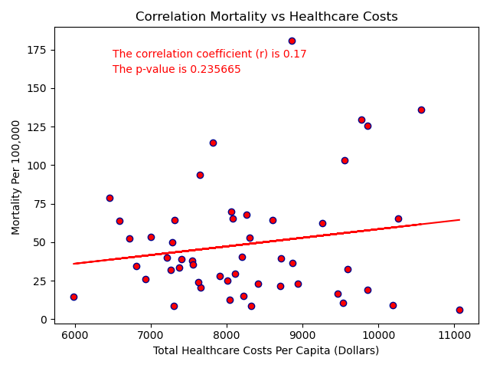
Covid-19 Healthcare Costs vs Infection and Mortality

Slide 11
Covid-19 Infection and Mortality Rates by Uninsured

Slide 12
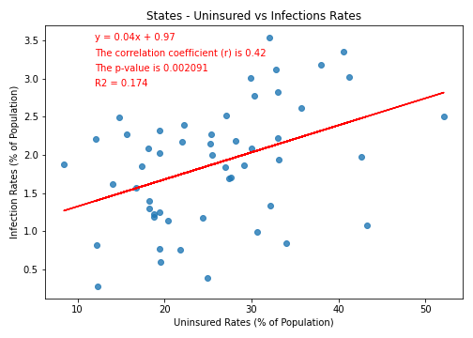
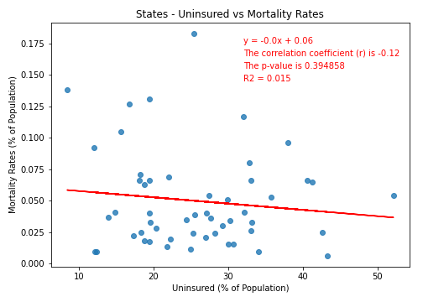
Covid-19 Infection and Mortality Rates by Uninsured
Notes:
Discuss Outliers

Slide 13
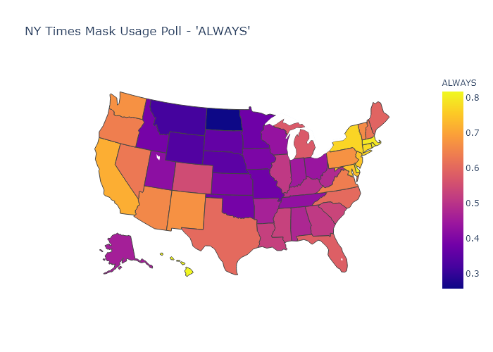
Covid-19 Mask Usage Response ‘Always’ by State
Notes:
Discuss Outliers

Slide 14
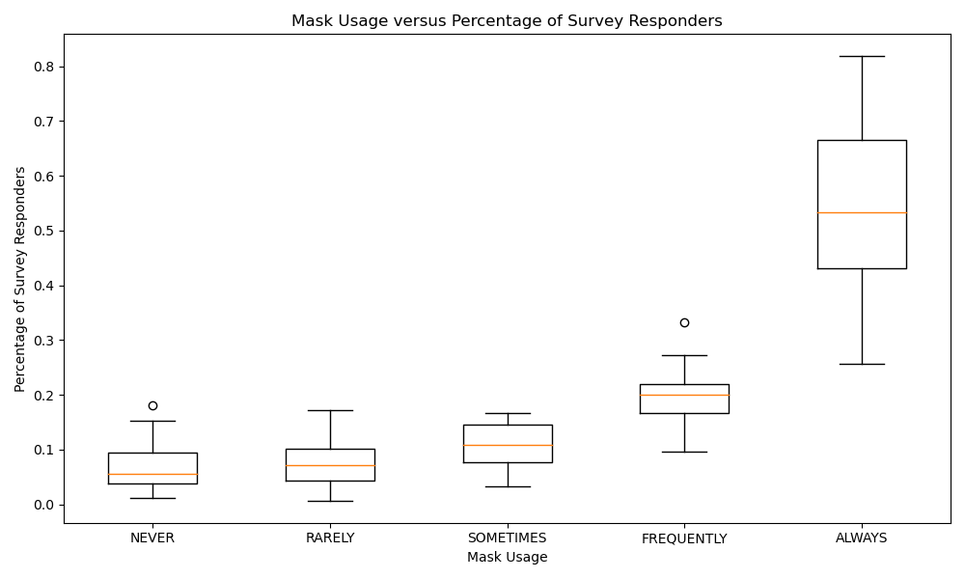
Covid-19 Mask Usage Vs Percentage of Survey Responders
Never: Outlier is North Dakota
Frequently: Outlier is Alaska
Notes:
Discuss Outliers

Slide 15
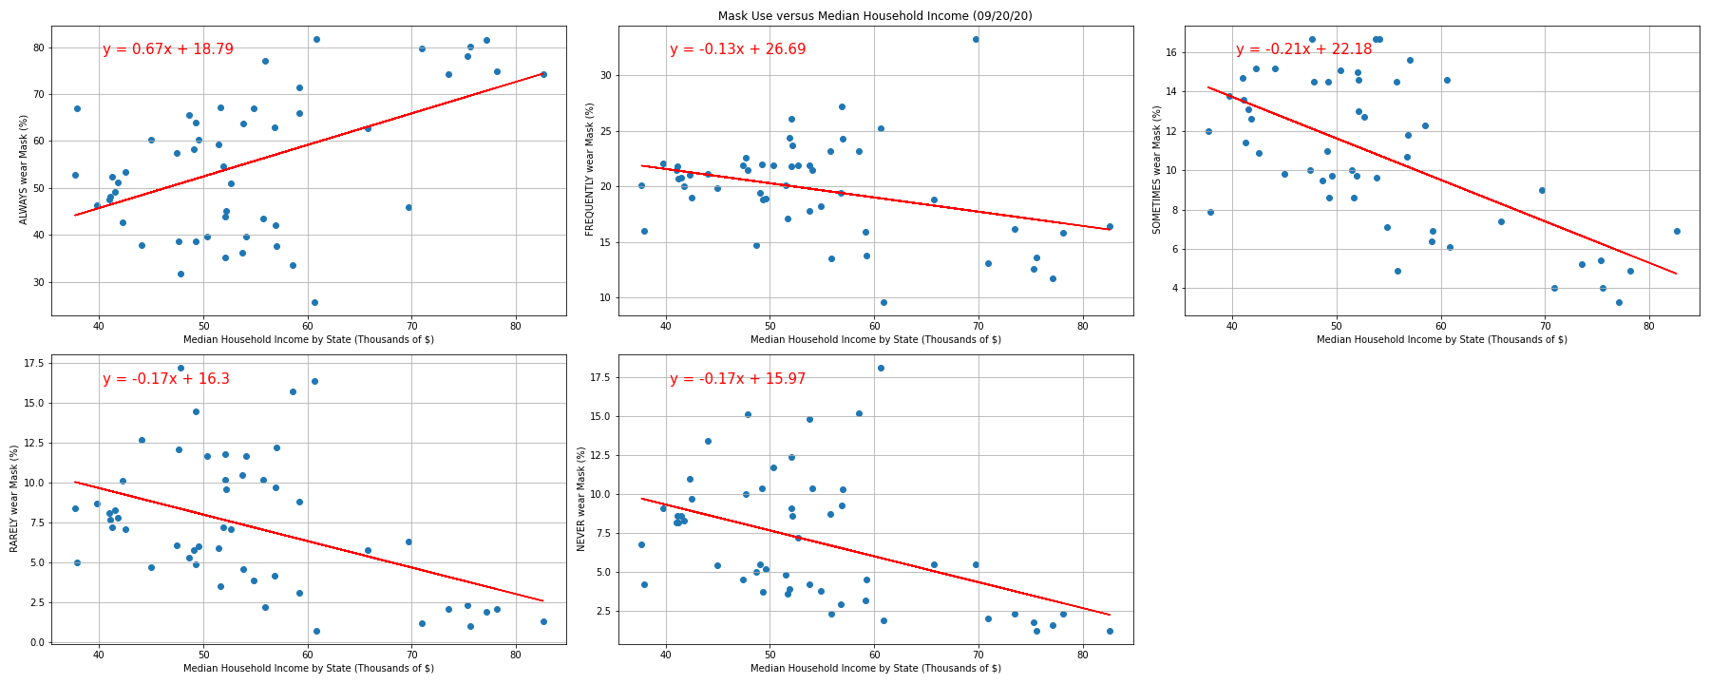
Covid-19 Mask Usage vs Median Household Income
ALWAYS
The correlation coefficient (r) is 0.5
The p-value is 0.000166
The r-squared is 0.25
FREQUENTLY
The correlation coefficient (r) is -0.33
The p-value is 0.016612
The r-squared is 0.11
SOMETIMES
The correlation coefficient (r) is -0.62
The p-value is 1e-06
The r-squared is 0.39
RARELY
The correlation coefficient (r) is -0.45
The p-value is 0.00099
The r-squared is 0.2
NEVER
The correlation coefficient (r) is -0.45
The p-value is 0.000934
The r-squared is 0.2
Notes:
Discuss Outliers

Slide 16
Covid-19 Mask Usage vs Median Household Income
ALWAYS
The correlation coefficient (r) is 0.5
The p-value is 0.000166
The r-squared is 0.25
FREQUENTLY
The correlation coefficient (r) is -0.33
The p-value is 0.016612
The r-squared is 0.11
SOMETIMES
The correlation coefficient (r) is -0.62
The p-value is 1e-06
The r-squared is 0.39
RARELY
The correlation coefficient (r) is -0.45
The p-value is 0.00099
The r-squared is 0.2
NEVER
The correlation coefficient (r) is -0.45
The p-value is 0.000934
The r-squared is 0.2
Notes:
Discuss Outliers

Slide 17
Limitations of Datasets
New York Times Mask Usage Data
Taken during a poll from July 2-14, 2020.
250,000 surveyed. No information on demographics for sample.
State percentages is a mean for county information
As stated, Total All Payers Per Capita State Estimates by State of Residence - Personal Health Care (Millions of Dollars)
2014 which is the last data set available
Did not District of Columbia which is included in other datasets.
Government Administration and Net Cost of Health Insurance and Government Public Health Activities not include in estimates
Census Data
All data for 2018 is listed as estimates.

